Slide 1

Problems of Modeling Phone Deletion in Conversational Speech for Speech Recognition
Brian Mak and Tom Ko
Hong Kong University of Science and Technology

Slide 2
Follow-up Work of Our Previous Paper
Tom Ko, Brian Mak, “Improving Speech Recognition by Explicit Modeling of Phone Deletions,” in ICASSP 2010.
We extend our investigation of modeling phone deletion in conversational speech.
We present some plausible explanations for why phone deletion modeling is more successful in read speech.

Slide 3
Motivations of Modeling Phone Deletion
Phone deletion rate is about 12% in conversational speech. [ Greenberg, “Speaking in shorthand — a syllable-centric perspective for understanding pronunciation variation,” ESCA Workshop 1998 ]
Phone deletions cannot be modeled well by triphone training. [ Jurafsky, “What kind of pronunciation variation is hard for triphones to model?” ICASSP 2001 ]

Slide 4
Explicit Modeling of Phone Deletions
Conceptually, we may explicitly model phone deletions by adding skip arcs.
ah
b
aw
t
Practically, it requires a unit bigger than a phone to implement the skip arcs. Since we want to capture the word-specific behavior of phone deletion, we choose to use the whole word models.

Slide 5
Problems in Creating Whole Word Models
assume a vocabulary size of W(~5k)and a set of N(~40) phones:
=> large number of context-dependent models: vs.
=> training data sparsity
W
3
N
3

Slide 6
Solutions
To decrease the number of model parameters by:
Bootstrapping
  construct the word models from triphone models.
Fragmentation
  cut the word units into several segments to limit the increase in the number of units during tri-unit expansion.

Slide 7
Bootstrapping from Triphone Models
Word | Phonetic Transcription | Context-dependent Triphone Units
ABOUT | ah b aw t | sil-ah+b ah-b+aw b-aw+t aw-t+sil
sil-ah+b
b-aw+t
aw-t+sil
ah-b+aw
ah ^ b ^ aw ^ t (ABOUT)

Slide 8
Fragmentation
Consider the model of word “CONSIDER”
k^ah^n^s^ih^d^er
k
ah
n
s
ih
d
er
n^s^ih^dr
k
ah
n
s
ih
dr
er
Segment: 1st 2nd 3rd (Sub Word Unit) 4th

Slide 9
Fragmentation
Word | Phonetic Transcription
ABOUT | ah b aw t
Assume the vocabulary size is 5k and #monophones is 40 :
Not fragmented
Fragmented
CI mono-unit :
ah^b^aw^t
ah b^aw t
CD tri-unit :
? - ah^b^aw^t + ?
? –ah+b^aw ah-b^aw+t b^aw-t+?
#model :
40 x 5k x 40= 8M
40 x 5k x 2 + 5k = 0.4M

Slide 10
Context-dependent Fragmented Word Models (CD-FWM)
Consider the model of word “CONSIDER”
k^ah^n^s^ih^d^er
n^s^ih^dr
k
ah
n
s
ih
dr
er
Segment: 1st 2nd 3rd (Sub Word Unit) 4th

Slide 11
Setup of the Read Speech Experiment
Training Set : WSJ0 + WSJ1 (46995 utterances), about 44 hours of read speech, 302 speakers
Dev. Set : WSJ0 Nov92 Evaluation Set (330 utterances)
Test Set : WSJ1 Nov93 Evaluation Set (205 utterances)
Vocabulary size in test set : 5000
#Tri-phones : 17,107
#HMM states : 5,864
#Gaussian / state : 16
#State / phone : 3
Language model : Bigram
Feature Vector : standard 39 dimensional MFCC

Slide 12
Result of the Read Speech Experiment
Model | #CD Phones | #CD SWUs | #Skip Arcs | Word Acc.
Baseline triphones | 17,107 | 0 | 0 | 91.53%
CD-FWM : no phone deletion arcs + phone deletion arcs to words with >= 4 phones | 58,581 58,581 | 11,075 11,075 | 0 79,917 | 91.58% 92.4%

Slide 13
Setup of the Conversational Speech Experiment
Training Set : Partition A, B and C of the SVitchboard 500-word tasks (13,597 utterances), about 3.69 hours of conversational speech, 324 speakers
Dev. Set : Partition D of the SVitchboard 500-word tasks (4,871 utterances)
Test Set : Partition E of the SVitchboard 500-word tasks (5,202 utterances)
Vocabulary size in test set : 500
#Tri-phones : 4,558
#HMM states : 660
#Gaussian / state : 16
#State / phone : 3
Language model : Bigram
Feature Vector : standard 39 dimensional PLP

Slide 14
Result of the Conversational Speech Experiment
Model | #CD Phones | #CD SWUs | #Skip Arcs | Word Acc.
Baseline triphones | 4,558 | 0 | 0 | 44.17%
CD-FWM : no phone deletion arcs + phone deletion arcs to words with >= 4 phones | 4,908 4,908 | 249 249 | 0 1,549 | 44.33% 44.43%

Slide 15
Analysis of Word Tokens Coverage
Words differ greatly in terms of their frequency of occurrence in spoken English.
In conversational speech, the most common words occur far more frequently than the least, and most of them are short words (<= 3 phones).
[ Greenberg, “Speaking in shorthand — a syllable-centric perspective for understanding pronunciation variation,” ESCA Workshop 1998 ]

Slide 16
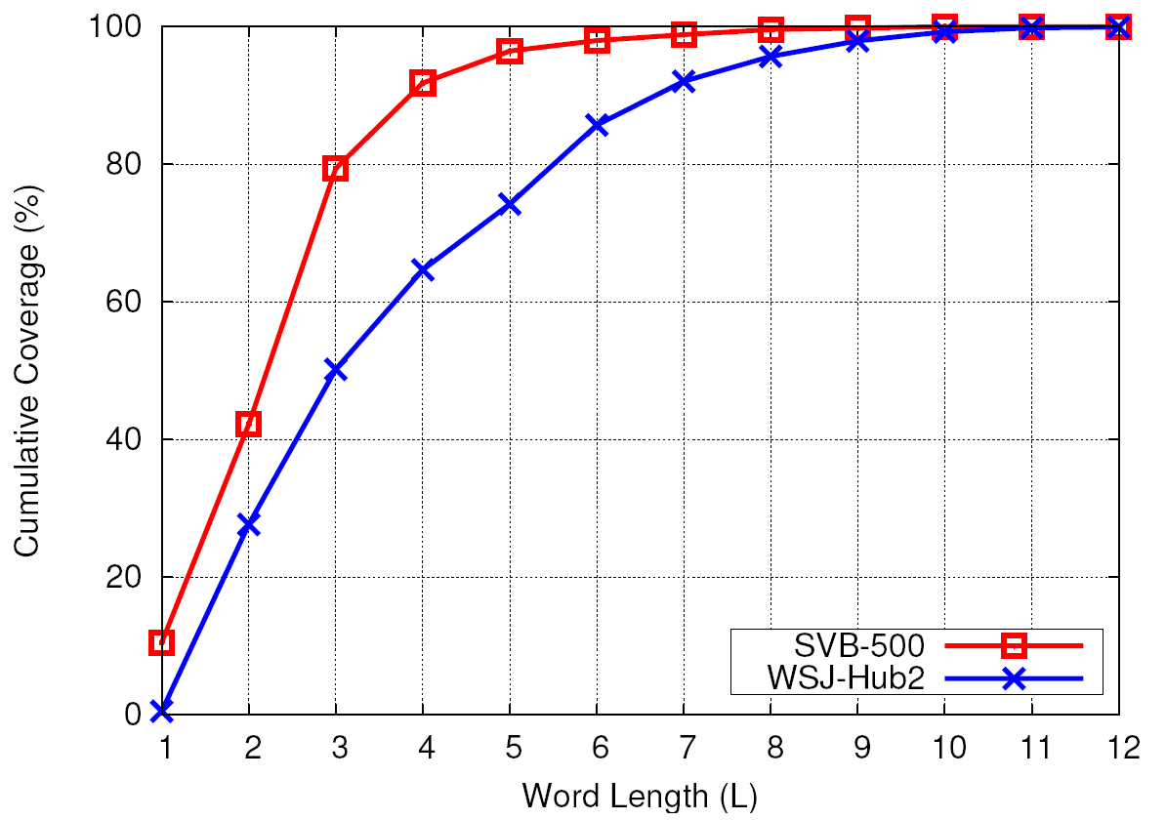
Comparison of Word Tokens Coverage
3.5%
20%
50%
26%
The coverage of words with >= 4 phones is smaller in conversational speech test set (20% vs. 50%).
The coverage of words with >= 6 phones is even much smaller in conversational speech test set (3.5% vs. 26%).
As a result, the improvement of our proposed method in conversational speech may not be as obvious as in read speech.

Slide 17
Breakdown of #Words According to Result in the Conversational Speech Experiment
CD-FWM Without Phone Deletion | CD-FWM With Phone Deletion
 | Correct | Wrong
Correct | 9,961 | 309 (confused)
Wrong | 342 (corrected) | 9,407

Slide 18
Summary & Future Work
We proposed a method of modeling pronunciation variations from the acoustic modeling perspective.
The pronunciation weights are captured naturally by the skip arc probabilities in the context-dependent fragmented word models (CD-FWM).
Currently, phone deletion modeling is not applied on short words (<= 3 phones) which cover 80% of tokens in conversational speech.
We would like to investigate which set of skip arcs can lead to largest gain. If those skip arcs which lead to confusions more than improvement are removed, the recognition performance can be further improved.

Slide 19
The End

