Slide 1

Phone Deletion Modeling in Speech Recognition
Tom, Ko Yu Ting
18-08-2010
Hong Kong University of Science and Technology

Slide 2
Overview
Introduction:
  Basics of Automatic Speech Recognition
  Pronunciation Variation
Review of State-of-the-art Methods
Motivations
Context-dependent Fragmented Word Models (CD-FWM)
Experimental Evaluation
Conclusion & Future Work

Slide 3
Overview
Introduction:
  Basics of Automatic Speech Recognition
  Pronunciation Variation
Review of State-of-the-art Methods
Motivations
Context-dependent Fragmented Word Models (CD-FWM)
Experimental Evaluation
Conclusion & Future Work

Slide 4
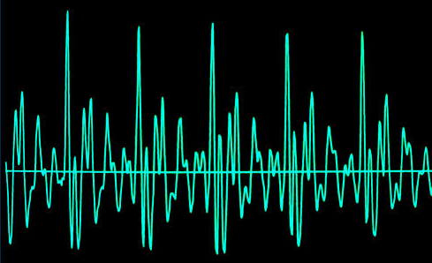
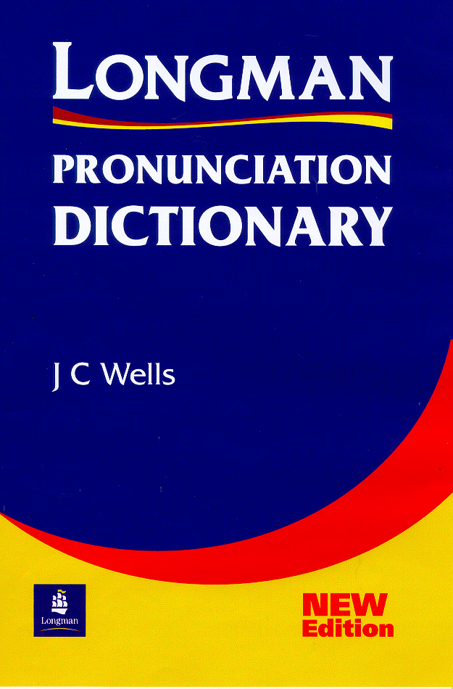
Automatic Speech Recognition (ASR)
Acoustic model
Dictionary
Language model
in order __
to

Slide 5
Phones
A phone is regarded as the elementary unit of sound in human speech.
Every word can be transcribed into a phone sequence to label their pronunciation.
Phone-based modeling is the most popular way in doing acoustic modeling.

Slide 6
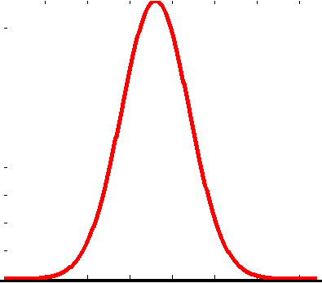
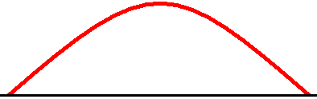
Phone-based Modeling
Dictionary
Word | Phonetic Transcription
ABOUT | ah b aw t
CAT | k ae t
DOG | d ao g
ah
⬄

Slide 7
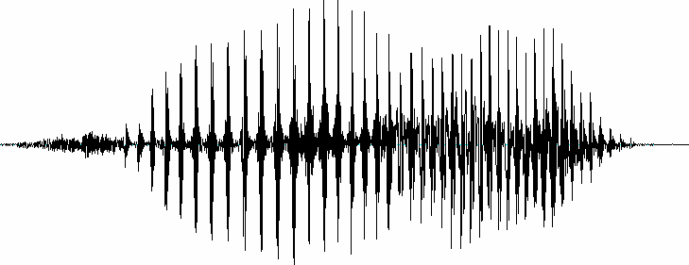
Training of Acoustic Models
I’m Tom, I’m hungry.
ay m t aa m ay m hh ah ng g r iy
ay
iy
m
ah

Slide 8
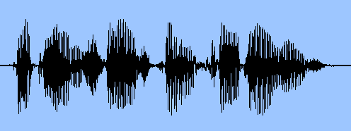
Decoding
Recognizer
CAT
k ae t
k
ae
t
DOG
d ao g
d
ao
g
Dog

Slide 9
Context Dependence
Observation: In human speech, the acoustic behavior of a phone is influenced by its neighboring phones.
“UNTAR” | “STAR”
ah n t aa r | s t aa r
n-t+aa
t
s-t+aa

Slide 10
Mono-units vs. Tri-units
Mono-units: units which are context independent.
Tri-units: units which are context dependent.
t
s
Monophones:
,
……
s-t+aa
n-t+ae
Triphones:
,
……

Slide 11
Tri-unit Expansion
?-t+?
If there are N mono-units, there will be N³ tri-units.
In a phone-based system,
  the number of monophones is ~40
  the total number of triphones is ~64000

Slide 12

Pronunciation Variation
People don’t always speak word in a standard way.
  There are 80 ways of pronouncing the word “AND” (Greenberg,1997).
Several kind of pronunciation variation:
  phone substitutions: substitution of a phone
    “MAN” becomes “MEN”
  vowel reductions: weakening in unstressed vowel
    The ‘A’ in “ABOUT”
  phone deletions: deletion of a phone
    The ‘T’ in “CAT”

Slide 13
Overview
Introduction:
  Basics of Automatic Speech Recognition
  Pronunciation Variation
Review of State-of-the-art Methods
Motivations
Context-dependent Fragmented Word Models (CD-FWM)
Experimental Evaluation
Conclusion & Future Work

Slide 14
Pronunciation Variation Modeling Methods
Multiple Pronunciation Dictionary
Long Units Modeling

Slide 15
Multiple Pronunciation Dictionary
Dictionary
Word | Phonetic Transcription
CAT | k ae t
CAT | k ae
INTERESTING | ih n t r ah s t ih ng
INTERESTING | ih n t r ih s t ih ng
INTERESTING | ih n t er ah s t ih ng
Carnegie Mellon University (CMU) Dictionary

Slide 16
Long Units Modeling
Basic units larger than phones like syllables or whole words are used.
Advantage:
  If syllable models are used, the within-syllable variation can be modeled by the acoustic model.
Disadvantage:
  The number of basic units is too large for reliable training.

Slide 17
Overview
Introduction:
  Basics of Automatic Speech Recognition
  Pronunciation Variation
Review of State-of-the-art Methods
Motivations
Context-dependent Fragmented Word Models (CD-FWM)
Experimental Evaluation
Conclusion & Future Work

Slide 18
Motivations
Phone deletion rate is about 12% in conversational speech. [ Greenberg, “Speaking in shorthand — a syllable-centric perspective for understanding pronunciation variation,” ESCA Workshop 1998 ]
Phone deletions cannot be modeled well by triphone training. [ Jurafsky, “What kind of pronunciation variation is hard for triphones to model?” ICASSP 2001 ]

Slide 19
Explicit Modeling of Phone Deletions
Conceptually, we may explicitly model phone deletions by adding skip arcs.
ah
b
aw
t
Practically, it requires a unit larger than a phone to implement the skip arcs. Since we want to capture the word-specific behavior of phone deletion, we choose to use the whole word models.

Slide 20
Problems in Creating Whole Word Models
assume a vocabulary size of W(~5k)and a set of N(~40) phones:
=> large number of context-dependent models: vs.
=> training data sparsity
W
3
N
3

Slide 21
Overview
Introduction:
  Basics of Automatic Speech Recognition
  Pronunciation Variation
Review of State-of-the-art Methods
Motivations
Context-dependent Fragmented Word Models (CD-FWM)
Experimental Evaluation
Conclusion & Future Work

Slide 22
Solutions
To decrease the number of model parameters by:
Bootstrapping
  construct the word models from triphone models.
Fragmentation
  cut the word units into several segments to limit the increase in the number of units during tri-unit expansion.

Slide 23
Bootstrapping from Triphone Models
Word | Phonetic Transcription | Context-dependent Triphone Units
ABOUT | ah b aw t | sil-ah+b ah-b+aw b-aw+t aw-t+sil
sil-ah+b
b-aw+t
aw-t+sil
ah-b+aw
ah ^ b ^ aw ^ t (ABOUT)

Slide 24
Fragmentation
Consider the model of word “CONSIDER”
k^ah^n^s^ih^d^er
k
ah
n
s
ih
d
er
n^s^ih^dr
k
ah
n
s
ih
dr
er
Segment: 1st 2nd 3rd (Sub Word Unit) 4th

Slide 25
Fragmentation
Word | Phonetic Transcription
ABOUT | ah b aw t
Assume the vocabulary size is 5k and #monophones is 40 :
Not fragmented
Fragmented
CI mono-unit :
ah^b^aw^t
ah b^aw t
CD tri-unit :
? - ah^b^aw^t + ?
? –ah+b^aw ah-b^aw+t b^aw-t+?
#model :
40 x 5k x 40= 8M
(40 x 2 +1) x 5k = 0.4M

Slide 26
Context-dependent Fragmented Word Models (CD-FWM)
Consider the model of word “CONSIDER”
k^ah^n^s^ih^d^er
n^s^ih^dr
k
ah
n
s
ih
dr
er
Segment: 1st 2nd 3rd (Sub Word Unit) 4th

Slide 27
Fragmentation Scheme
The number of segments depends on the length L of a word, which is defined as the number of phones of the word:
L <= 3: the word is represented by the original cross-word triphones, and no phone deletion are allowed.
L = 4 or 5: the word is split into three segments.
L >= 6: the word is split into four segments.
ABOUT | ah b^aw t
?-ah+b^aw ah-b^aw+t b^aw-t+?
CONSIDER | k ah n^s^ih^d er
?-k+ah k-ah+n^s^ih^d ah-n^s^ih^d+er n^s^ih^d-er+?

Slide 28
Overview
Introduction: Basics of Automatic Speech Recognition and Pronunciation Variation
Review of State-of-the-art Methods
Motivations
Context-dependent Fragmented Word Models (CD-FWM)
Experimental Evaluation
  On Read Speech
  On Conversational Speech
Conclusion & Future Work

Slide 29
Setup of the Read Speech Experiment
Training Set : WSJ0 + WSJ1 (46995 utterances), about 44 hours of read speech, 302 speakers
Dev. Set : WSJ0 Nov92 Evaluation Set (330 utterances)
Test Set : WSJ1 Nov93 Evaluation Set (205 utterances)
Vocabulary size in test set : 5000
#Tri-phones : 17,107
#HMM states : 5,864
#Gaussian / state : 16
#State / phone : 3
Language model : Bigram
Dictionary : CMU dictionary (multiple pronunciation)
Feature Vector : standard 39 dimensional MFCC
#Parameters : 5,864 * 16 * 39 * 2 ≈ 7M

Slide 30
Result of the Read Speech Experiment
Model | #CD phones | #CD SWUs | Word Acc.
Cross-word Triphones | 17,107 | 0 | 91.53%
CD-FWM for L >= 6: no phone deletion arcs + phone deletion arcs | 39,793 39,793 | 7,256 7,256 | 91.55% 92.30%
CD-FWM for L >= 4: no phone deletion arcs + phone deletion arcs | 58,581 58,581 | 11,075 11,075 | 91.58% 92.40%

Slide 31
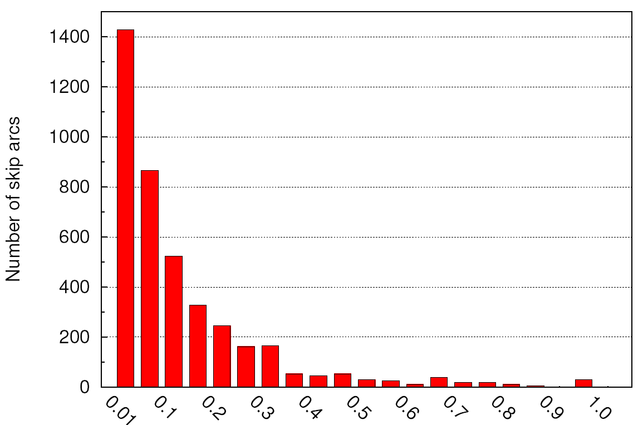
Distribution of Phone Deletion Probabilities
In the experiment of CD-FWM for L>=4, ~540k phone deletion skip arcs were added, only 4k of them have a probability >= 0.01.
The skip arcs with a probability <0.01 are not shown in the plot.
Thus, our proposed method does not give a load to the model complexity.

Slide 32
Read Speech Experiment with a
Single-pronunciation Dictionary
We would like to investigate the effectiveness of our proposed method in the absense of other pronunciation modeling methods.
The CMU dictionary was modified:
  The multiple pronunciation variants of the words with L>=4 were removed.

Slide 33
Result of the Read Speech Experiment with a Single-pronunciation Dictionary
Model | #CD phones | #CD SWUs | Word Acc.
Cross-word Triphones | 17,107 | 0 | 91.20%
CD-FWM for L >= 4: + phone deletion arcs | 58,581 | 11,075 | 91.69%

Slide 34
Multiple Pronunciation vs. Phone Deletion Modeling
91.20% (baseline with single pronunciation dictionary)
+MP
+PD
MP = Multiple Pronunciation Method
PD = Phone Deletion Method
91.53%
91.69%
+PD
+MP
92.40%
When only one pronunciation modeling method is used, PD performs better than MP (91.69% vs. 91.53%).
The net gain when both pronunciation modeling methods are used together (1.20%) is greater than the sum of net gains when the they are used alone (0.49% + 0.33%=0.82%).
  More phone deleted variants are generated when there are more pronunciation variants listed in the dictionary.

Slide 35
Setup of the Conversational Speech Experiment
Training Set : Partition A, B and C of the Svitchboard 500-word tasks (13,597 utterances), about 3.69 hours of conversational speech, 324 speakers
Dev. Set : Partition D of the Svitchboard 500-word tasks (4,871 utterances)
Test Set : Partition E of the Svitchboard 500-word tasks (5,202 utterances)
Vocabulary size in test set : 500
#Tri-phones : 4,558
#HMM states : 660
#Gaussian / state : 16
#State / phone : 3
Language model : Bigram
Dictionary : Switchboard dictionary
Feature Vector : standard 39 dimensional PLP

Slide 36
Result of the Conversational Speech Experiment
Model | #CD phones | #CD SWUs | Word Acc.
Cross-word Triphones | 4,558 | 0 | 44.17%
CD-FWM for L >= 6: no phone deletion arcs + phone deletion arcs | 4,631 4,631 | 79 79 | 44.18% 44.23%
CD-FWM for L >= 4: no phone deletion arcs + phone deletion arcs | 4,908 4,908 | 249 249 | 44.33% 44.43%

Slide 37
Analysis of Word Tokens Coverage
Words differ greatly in terms of their frequency of occurrence in spoken English.
In conversational speech, the most common words occur far more frequently than the least, and most of them are short words with few phones (L<=3).
[ Greenberg, “Speaking in shorthand — a syllable-centric perspective for understanding pronunciation variation,” ESCA Workshop 1998 ]

Slide 38
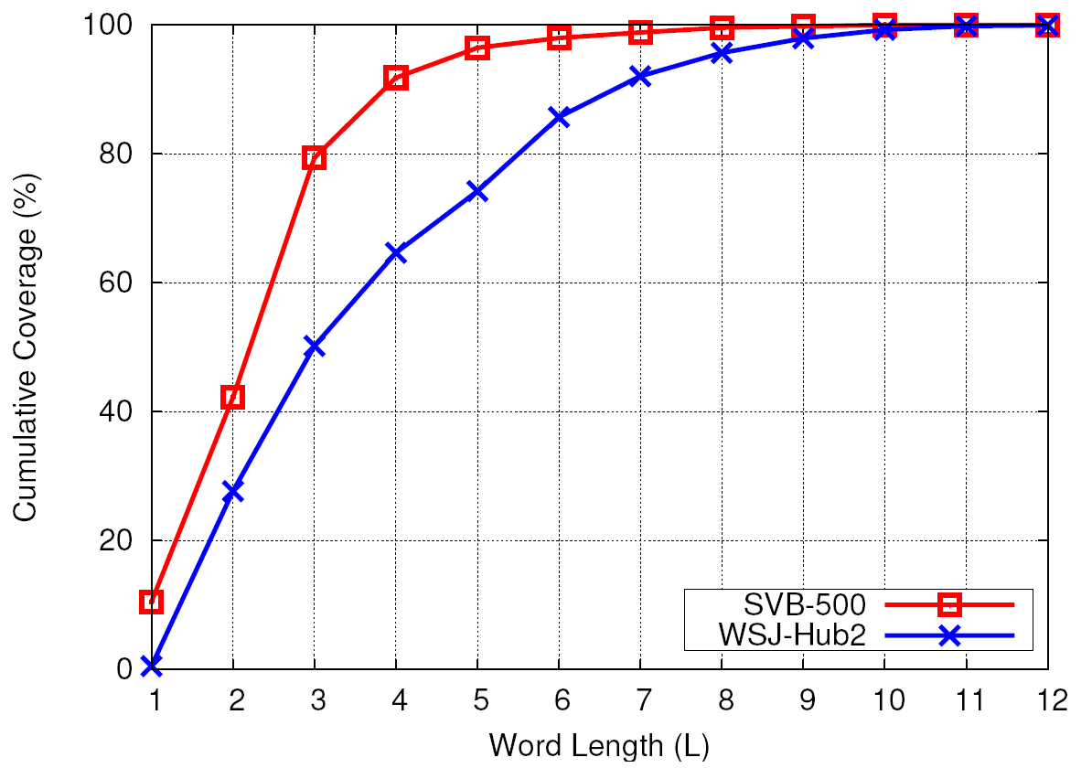
Comparison of Word Tokens Coverage
3.5%
20%
50%
26%
The coverage of words with L>=4 is smaller in conversational speech test set (20% vs. 50%).
The coverage of words with L>=6 is even much smaller in conversational speech test set (3.5% vs. 26%).
As a result, the improvement of our proposed method in conversational speech may not be as obvious as in read speech.

Slide 39
Context-mismatch of Units in Phone Deletion Method
ah-b+aw
aw-t+sil
sil-ah+b
b-aw+t
ah
b
aw
t
ah ^ b ^ aw ^ t
ah ^ b ^ aw ^ t (ABOUT)

Slide 40
Setup of Phone Deletion Modeling on Context-independent System
Training Set : Partition A, B and C of the Svitchboard 500-word tasks (13,597 utterances), about 3.69 hours of conversational speech, 324 speakers
Dev. Set : Partition D of the Svitchboard 500-word tasks (4,871 utterances)
Test Set : Partition E of the Svitchboard 500-word tasks (5,202 utterances)
Vocabulary size in test set : 500
#Mono-phones : 39
#HMM states : 120
#Gaussian / state : 16
#State / phone : 3
Language model : Bigram
Feature Vector : standard 39 dimensional PLP

Slide 41
Bootstrapping from Monophone Models
It is not necessary to fragment the word models in a context-independent system as there is no tri-unit expansion.
Context-independent whole word models (CI-WWMs) were constructed from monophones.
ah
aw
t
b
ah ^ b ^ aw ^ t (ABOUT)

Slide 42
Result of Phone Deletion Modeling on Context-independent System
Model | #Word Units | #Skip arcs | Word Acc.
Monophones | 0 | 0 | 34.08%
CI-WWM for L >= 4: no phone deletion arcs + phone deletion arcs | 251 251 | 0 1,293 | 34.08% 33.44%

Slide 43
Analysis of Confusions Induced by Phone Deletion Modeling in a Context-independent Case
Words | Phonetic Transcription | Word Models
y^uw^z
USE
y uw z
y
uw
z
y^uw^z^d
y uw z d
y
uw
z
d
USED
d

Slide 44
Analysis of Confusions Induced by Phone Deletion Modeling in a Context-dependent Case
Words | Phonetic Transcription | Word Models
y^uw^z
USE
y uw z
i-y+uw
y-uw+z
uw-z+f
y^uw^z
i-y+uw
y-uw+z
uw-z+d
z-d+f
USED
y uw z d
z-d+f

Slide 45
Confusion Matrix of Phone Deletion Modeling in Context-independent System
Without Phone Deletion | With Phone Deletion
 | Correct | Wrong
Correct | 7,355 | 890
Wrong | 793 | 10,983

Slide 46
Confusion Matrix of Phone Deletion Modeling in Context-independent System vs. Context-dependent System
Without Phone Deletion | With Phone Deletion
 | Correct | Wrong
Correct | 7,355 / 9,961 | 890 / 309
Wrong | 793 / 342 | 10,983 / 9,407

Slide 47
Examples of Words Corrected by Modeling Phone Deletion
Words | Phonetic Transcription
PERSONALLY | [p er s ih n ax l iy]
SOMETHING | [s ah m th ih ng]
USED | [y uw z d]

Slide 48
Overview
Introduction:
  Basics of Automatic Speech Recognition
  Pronunciation Variation
Review of State-of-the-art Methods
Motivations
Context-dependent Fragmented Word Models (CD-FWM)
Experimental Evaluation
Conclusion & Future Work

Slide 49
Contributions in Read Speech Recognition
In read speech recognition, our method improves the acoustic model by explicit modeling of phone deletions.
  The experiments shows that our proposed method improves the word recognition accuracy from the baseline 91.53% (given by cross-word triphones) to 92.40% in read speech data.
Furthermore, we have verified that the improvement of our method is additive to that of the existing pronunciation variation modeling method.
Our method of modeling phone deletion does not increase the model complexity.
  The analysis shows that only a small proportion of skip arcs has a probability larger than 0.01, the rest of the skip arcs vanish after re-estimation.

Slide 50
Contributions in Conversational Speech Recognition
Analysis of word tokens coverage is carried out and it explains the modest improvement of our method in conversational speech recognition.
Experiments are carried out to show that the context-mismatch of units in our method actually helps reduce the confusion.

Slide 51
Future Work
Currently, phone deletion modeling is not applied on short words (L<=3) which cover 80% of tokens in conversational speech.
We would like to investigate which set of skip arcs can lead to largest gain. If those skip arcs which lead to confusions more than improvement are removed, the recognition performance can be further improved.

Slide 52
Published Papers
Tom Ko (Ko Yu Ting), Brian Mak, “Improving Speech Recognition by Explicit Modeling of Phone Deletions,” in ICASSP 2010.
Brian Mak, Tom Ko (Ko Yu Ting), “Automatic Estimation of Decoding Parameters Using Large-Margin Iterative Linear Programming,” in INTERSPEECH 2009.
Brian Mak, Tom Ko (Ko Yu Ting), “Min-max Discriminative Training of Decoding Parameters Using Iterative Linear Programming,” in INTERSPEECH 2008.

Slide 53
The End

Slide 54
Result of the Read Speech Experiment
Model | #CD phones | #CD SWUs | #Skip arcs | Word Acc.
Cross-word Triphones | 17,107 | 0 | 0 | 91.53%
CD-FWM for L >= 6: no phone deletion arcs + phone deletion arcs | 39,793 39,793 | 7,256 7,256 | 0 404,562 | 91.55% 92.30%
CD-FWM for L >= 4: no phone deletion arcs + phone deletion arcs | 58,581 58,581 | 11,075 11,075 | 0 542,877 | 91.58% 92.40%

Slide 55
Result of the Read Speech Experiment with a Single Pronunciation Dictionary
Model | #CD phones | #CD SWUs | #Skip arcs | Word Acc.
Cross-word Triphones | 17,107 | 0 | 0 | 91.20%
CD-FWM for L >= 4: + phone deletion arcs | 58,581 | 11,075 | 542,877 | 91.69%

Slide 56
Result of the Conversational Speech Experiment
Model | #CD phones | #CD SWUs | #Skip arcs | Word Acc.
Cross-word Triphones | 4,558 | 0 | 0 | 44.17%
CD-FWM for L >= 6: no phone deletion arcs + phone deletion arcs | 4,631 4,631 | 79 79 | 0 3,513 | 44.18% 44.23%
CD-FWM for L >= 4: no phone deletion arcs + phone deletion arcs | 4,908 4,908 | 249 249 | 0 10,427 | 44.33% 44.43%

