Slide 1

Content Extensions
Why do I need a Content Extension?

Slide 2
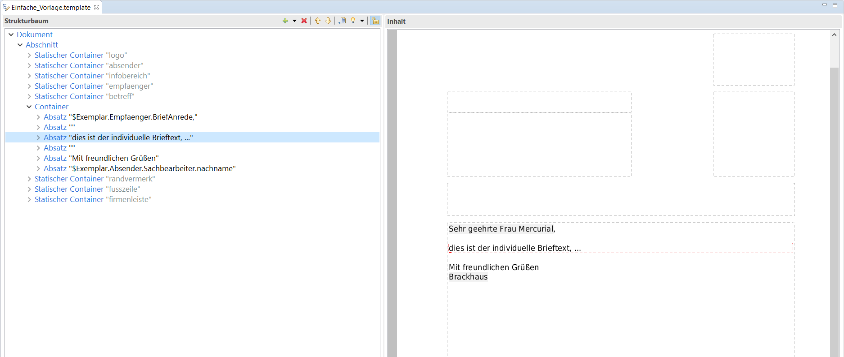
Create a simple template
The entire content of the letter is in the template
The entire content of the letter is in the template

Slide 3
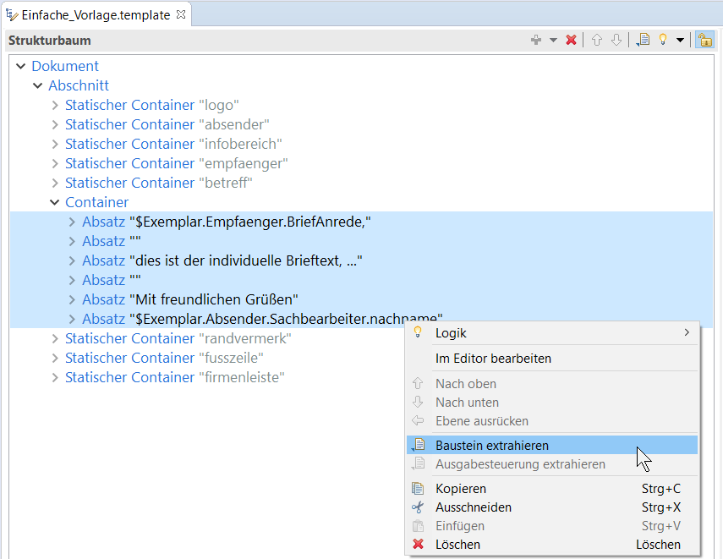
Extract model
The letter content is outsourced to a model (reusability)

Slide 4
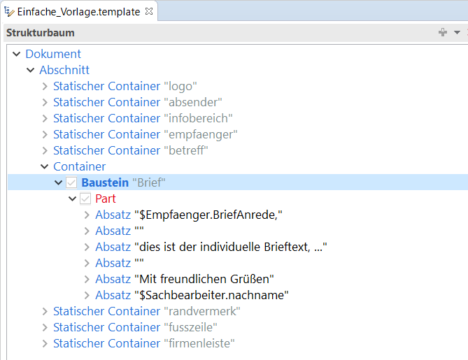
Extracted model
The letter now contains the model. The model contains the text to be output.

Slide 5
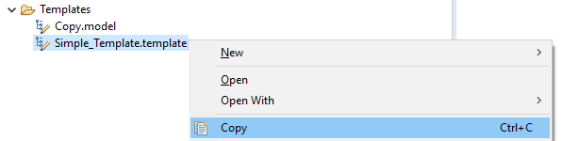
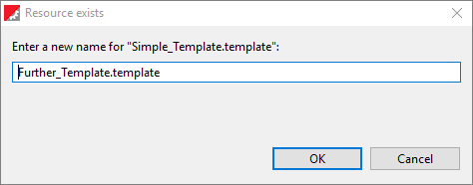
Copy template
The template is now copied to create another template with the same layout.

Slide 6
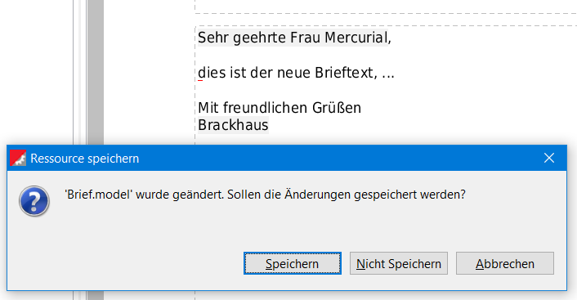
Modify new template
If the text is changed in the new template, this is done in the model!

Slide 7
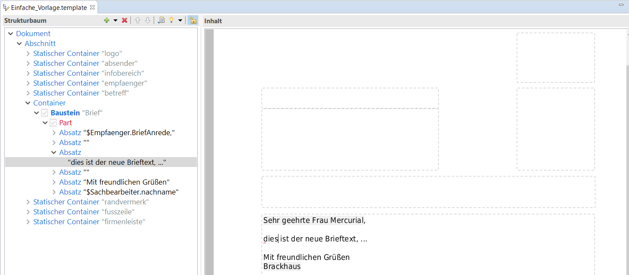
Original template modified
This also changes the original template, which is not desired!

Slide 8
The solution
The text components that are to be identical for all templates (salutation, greeting and signature) remain in the model, which is supplemented by a Content Extension at the point where individual text is to be included.
This Content Extension can then be filled by the template.
The text is stored in the template, not in the model.

Slide 9
Filling the Content Extension
Template
Model
Salutation
Individual
Text
Content Extension
Greeting
Signature

Slide 10
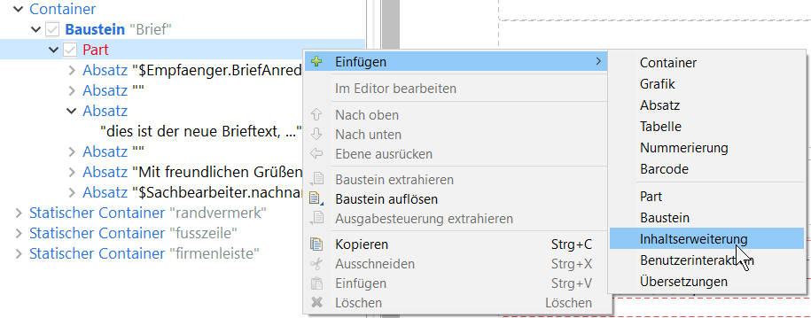
Insert Content Extension
The Content Extension is positioned at the point where the text is to be included.

Slide 11
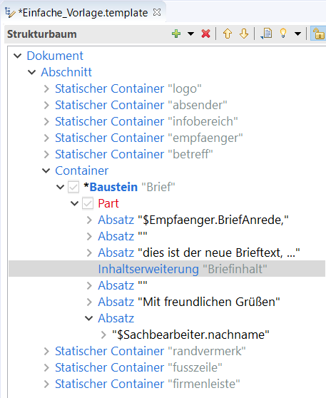
Content Extension in the model
The Content Extension is positioned at the point where the text is to be included.

Slide 12
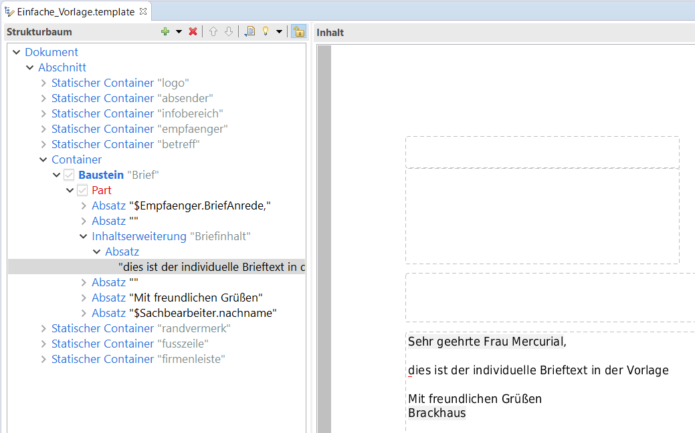
Text in the Content Extension
The Content Extension is filled with text in the template.

Slide 13
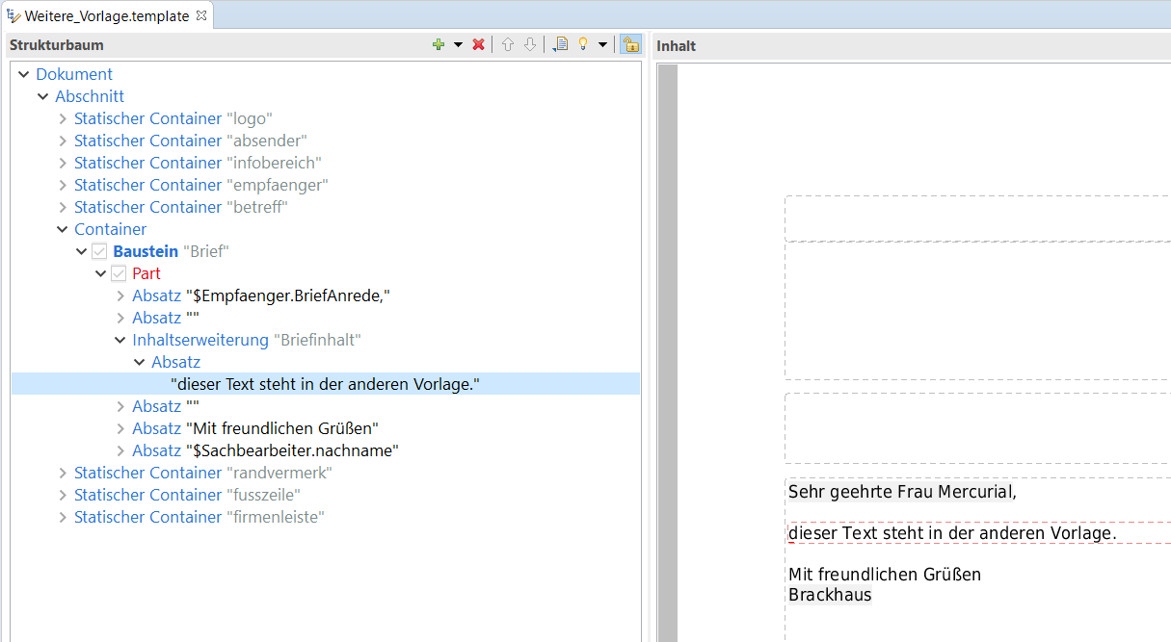
Both templates with different content
The individual text is saved in the template, the basic design in the model.

Slide 14
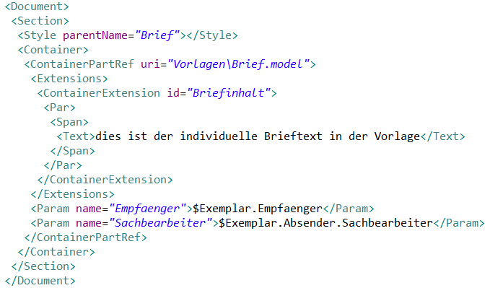
The code view of the template
The code view shows which content is stored in the template and which in the model.

Slide 15
What do you need nested Content Extensions for?
Models are nested in each other!
The correspondence model is included in the template.
The correspondence model in turn includes the copy model.
The copy model includes the letter model whose Content Extension is to be filled.

Slide 16
Copies
Copies
Loop over all copies
Letter
Salutation
Content
Copy
Content Extension
Letter
Greeting
Signature

Slide 17
Correspondencies
Correspondencies
Loop over all Correspondencies
Copy
Letter
Satulation
Content
Correspondence
Content Extension
Copy
Content Extension Letter
Greeting
Signature

Slide 18
Template
Template
Correspondence
Copy
The template fills the content extension of the correspondence.
Letter
Satulation
Individual
Template Text
Content Extension
Correspondence
Content Extension
Copy
Content Extension
Letter
Greeting
Signature

Slide 19
Many thanks for your attention.

Slide 20

















Graphics for free use
Icon | Meaning | Icon | Meaning | Icon | Meaning
 | More Info, Note |  | The goal, the solution, the point that matters |  | Details
 | Warning, Attention |  | The key to… |  | Please note
 | Fast forward ... |  | Done |  | Cross-reference
 | Back |  | Benefit, advantage, effect |  | System dependent, configurable
 | Part of the whole |  | Users
 | The idea behind it, example |  | Working

Slide 21
Head 1 Open Sans 28pt, Colour 100% black
Bullet 1: Open Sans 22pt
Bullet 2: Open Sans 18pt
Bullet 3: Open Sans 16 pt
Kwsoft red: RGB 227-0-24
Content ONLY within the red dotted frame!
Single exception: Footer
Upper edge first line: leading line 5,3, LR: 11,0 and RR 12,0
Foil format 16:9
Table of contents, slide title, place date etc. Opens Sans semibold 10pt

