Slide 1
Utilization of Reductions
and Abstraction Elimination
in Typed Genetic Programming
Tomáš Křen, Roman Neruda
Charles University, Faculty of Mathematics and Physics &
Institute of Computer Science, Academy of Sciences of the Czech Republic

Slide 2
Presentation outline
Types & lambda calculus : Why to use them in GP?
Related work
Generating and reductions
Crossover operators for lambda terms : problems with local variables
Experiment

Slide 3
Types in GP
Types help us overcome the closure requirement.
  No longer need for “everything fitting into everything”.
But they also establish new requirements
  e.g. function arguments must obey type requirements...
  These requirements make the programs more reasonable,
  and reduce the search space.

Slide 4
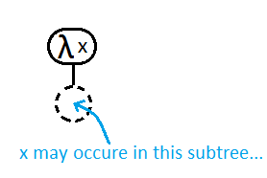
Lambda calculus
Simple yet powerful (mathematical)
functional programming language
It uses anonymous functions very often.
Roughly speaking:
  s-expressions + anonymous functions = lambda calculus
λ <var-name> . <body-expr>
aka
function(<var-name>){ return <body-expr>; }

Slide 5
Benefits of using Functional programing for GP
Complex and/or general programming constructs can be described as higher-order functions
  Example 1: foldr function for implicit recursion
    Another view: generalized for cycle
    Body of for cycle corresponds to anonymous function given to foldr as argument.
Types provide rigorous way to talk about (sub)programs and to enforce constraints.

Slide 6
Related work
Yu : PolyGP
  uses lambda term representation, but restricts the use of outer local variables in the body of an anonymous function.
  Hindley-Milner type system
Briggs and O'Neill : Purely combinator approach
  purely combinator approach
    no anonymous functions, no local variables
  Hindley-Milner type system
Binard and Felty
  Even stronger type system (System F) → non-standard algorithm
  Genes (i.e. subtrees) have fitness

Slide 7
Our approach to typed GP over lambda calculus
Simple type system (Simply typed lambda calculus)
  with future generalizations in mind (H-M, H-M with type classes)
..but complete generating
Anonymous functions
Generalization of the standard GP

Slide 8

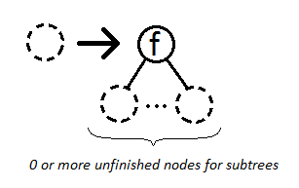
Tree generating terminology
Expansion
  In each step an unfinished node is replaced by a more specific tree:

Slide 9
Local context (aka Γ)
Set of symbol names accompanied with types
“T ∪ F is an initial/global context”
We can add local variables to a context

Slide 10

Expansions for Simply typed lambda calculus

Slide 11
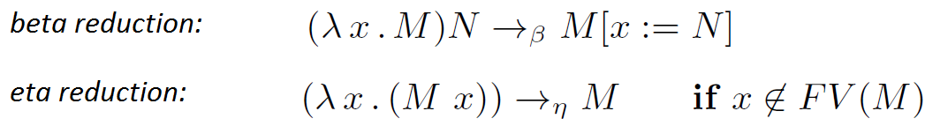
Generating and reductions
Reduction: transformation of one term into another
From reduction arises notion of term equivalence (relative to that reduction)
Normal form: term that can't be reduced
Described method generates long normal form (lnf)
  Each lnf term represent whole beta-eta-equivalence class
  This reduces the search space

Slide 12

Crossover operator for lambda terms
Generalization of simple tree swapping crossover
We need to swap subtrees with a same type
  ..but that is simple
Local variables cause the trouble!
0

Slide 13

Abstraction elimination
An algorithm for getting rid of local variables and anonymous function
  Input: an arbitrary lambda term
  Output: equivalent S-expression (with no local variables and no anonymous functions) that may contain additional new function nodes S,K and I which are defined as:

Slide 14
Hybrid crossover
Each generated term is transformed by abstraction elimination
All terms are typed S-expressions
So now we only need to swap subtrees with the same type
Hybrid because
  lambda term representation during generation phase
    Advantage: reduced search space during generation phase
  Pure combinator representation during the rest
Possible disadvantage: up to quadratic increase in term size

Slide 15
Unpacking crossover
All terms are kept in small βη-normal form
...and transformed right before crossover
After the tree swapping both children are again normalized
So the quadratic increase is only temporary

Slide 16

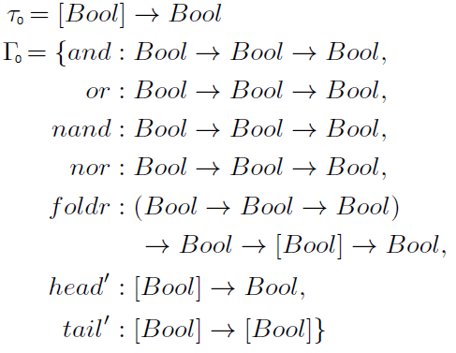
Experiment
We compare performance of hybrid and unpacking crossover.
Even parity problem
  Similar function and terminal set as in PolyGP by T. Yu

Slide 17
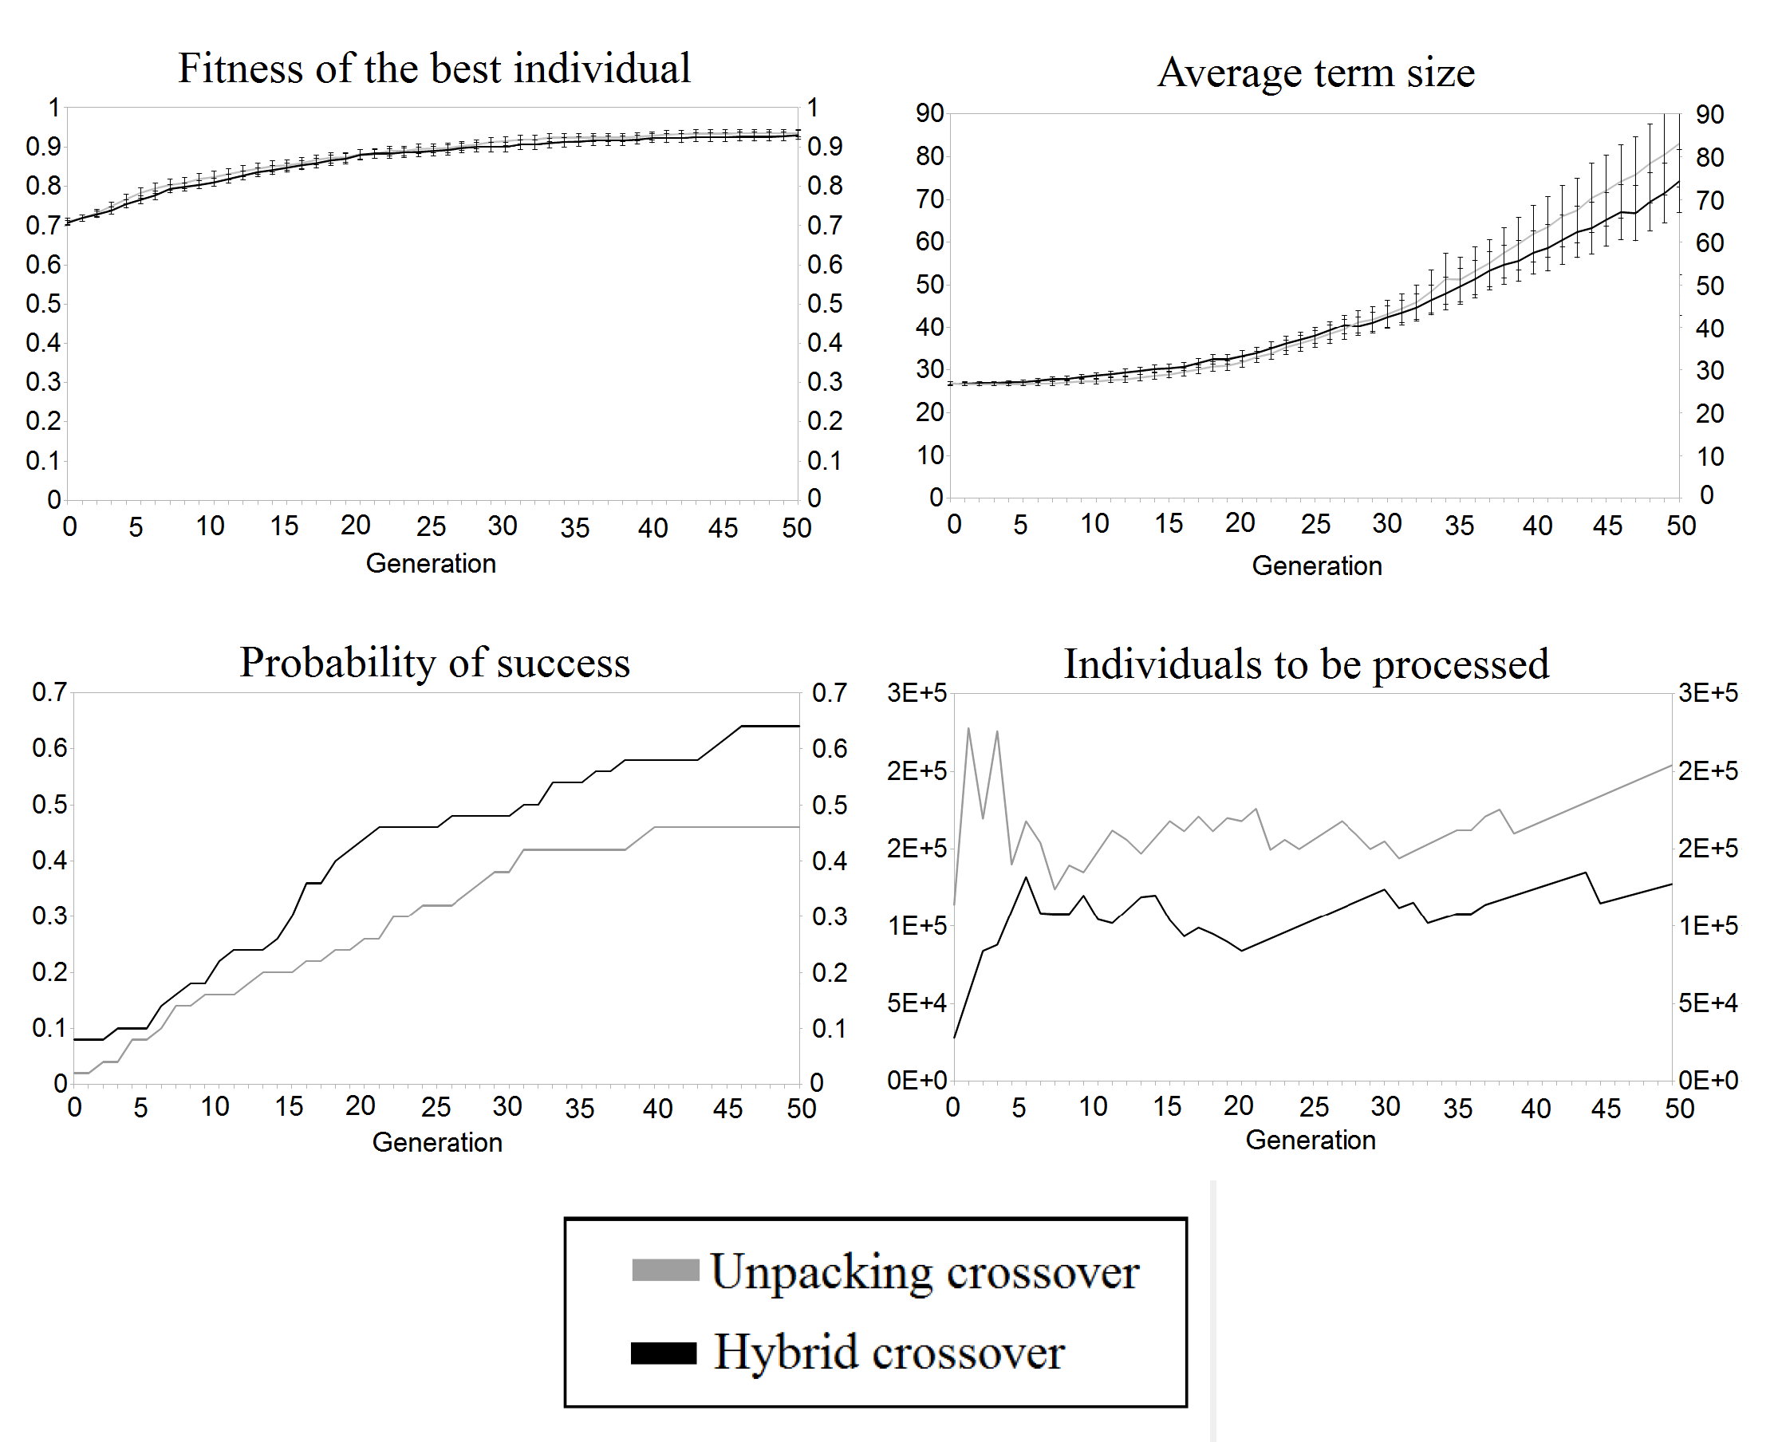
Results
Times: 388 minutes
33 minutes

Slide 18



Results

Slide 19
Conclusions
How to generate lambda terms in lnf
  Why? It reduces search space
How to crossover terms containing local variables
using abstraction elimination technique
  Hybrid vs. Unpacking : Hybrid wins
Future work
  More experiments
  More elaborate analysis (Price's covariance for crossover,...)
  Stronger type systems (H-M, H-M with type classes)

Slide 20
Thank you for your attention!
Any questions?
tomkren@gmail.com
roman@cs.cas.cz

Slide 21
Conclusions (alternativní)
How to generate lambda terms in lnf
  Why? It reduces search space
How to crossover terms containing local variables
using abstraction elimination technique
  Hybrid vs. Unpacking : Hybrid wins
Our more general approach has similar results as more specialized system
Future work
  More experiments
  More elaborate analysis (Price's covariance for crossover,...)
  Stronger type systems (H-M, H-M with type classes)

