Slide 1
Genetické programování v typovaných jazycích
Tomáš Křen

Slide 2
Články
Generating Lambda Term Individuals in Typed Genetic Programming Using Forgetful A*
  Konference IEEE WCCI 2014, Peking
Utilization of Reductions and Abstraction Elimination in Typed Genetic Programming
  Konference GECCO 2014, Vancouver

Slide 3

Standardní generování jedinců
Po jednom:
Aleternativní postup: Víc najednou.
  “Generování sdílených částí může být sdíleno.”

Slide 4
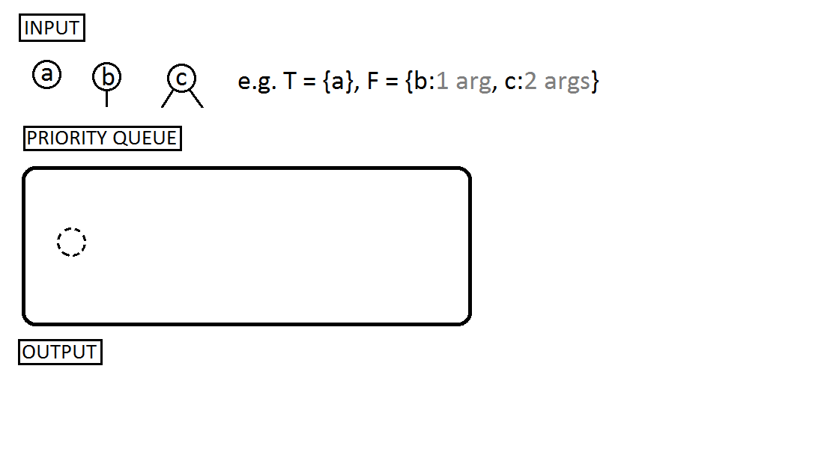
Systematické generování jedinců

Slide 5
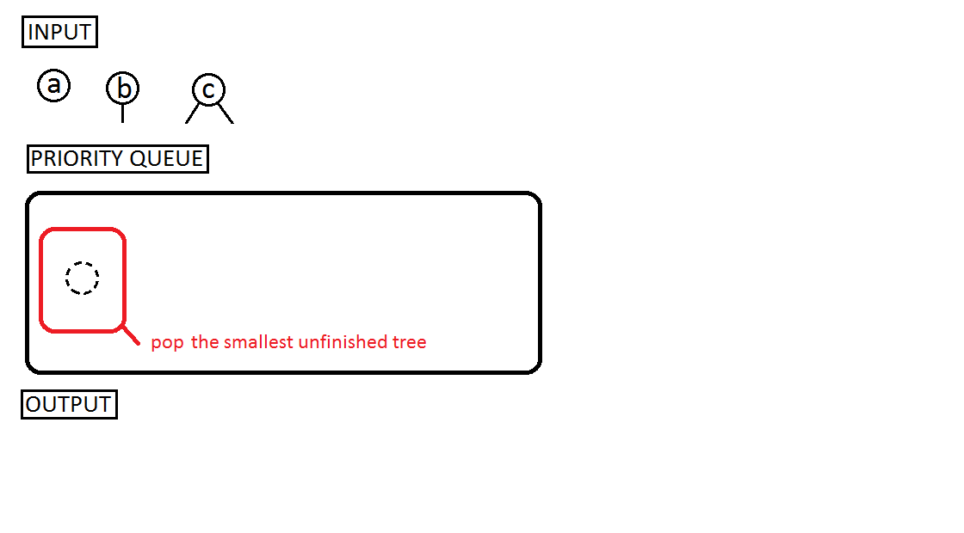

Slide 6
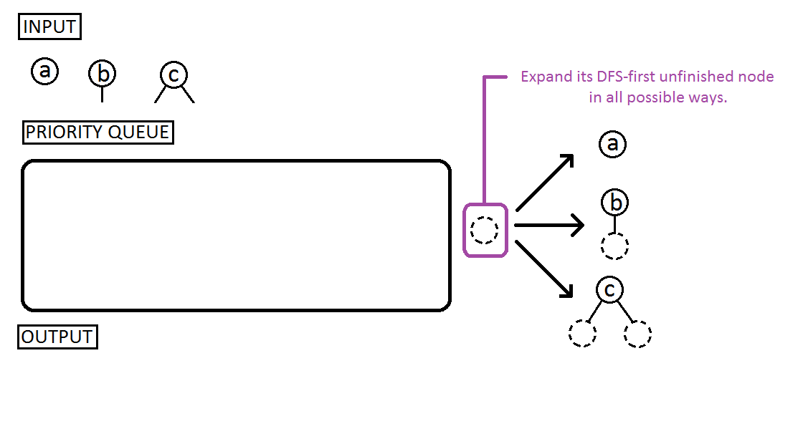

Slide 7
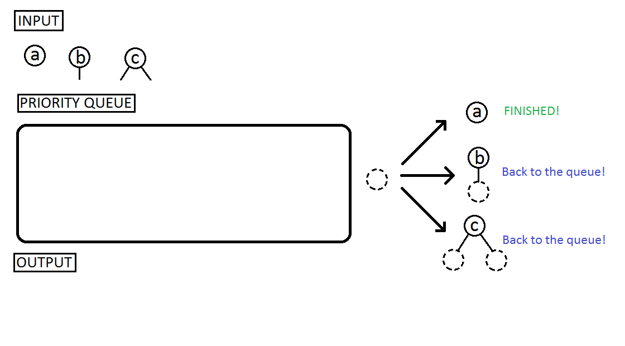

Slide 8
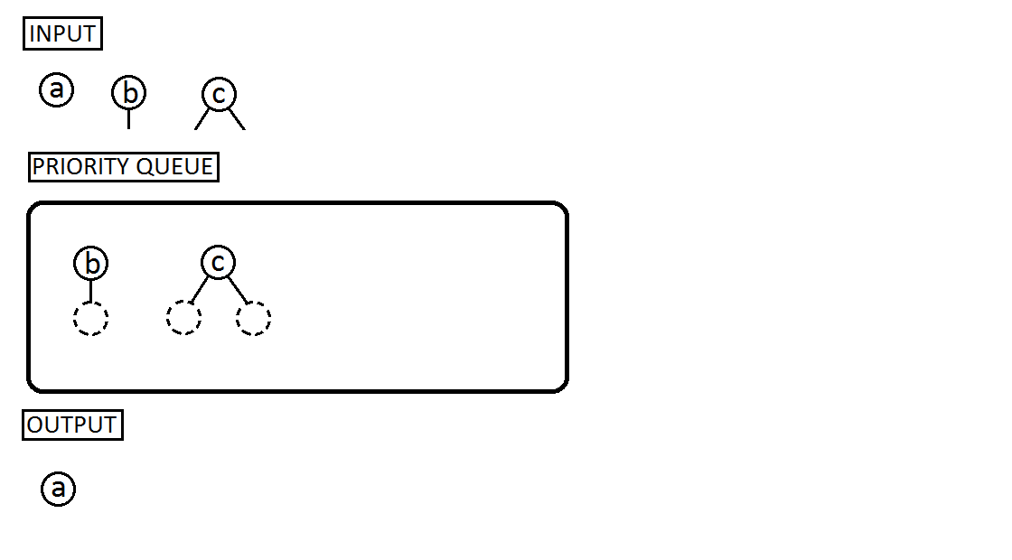

Slide 9
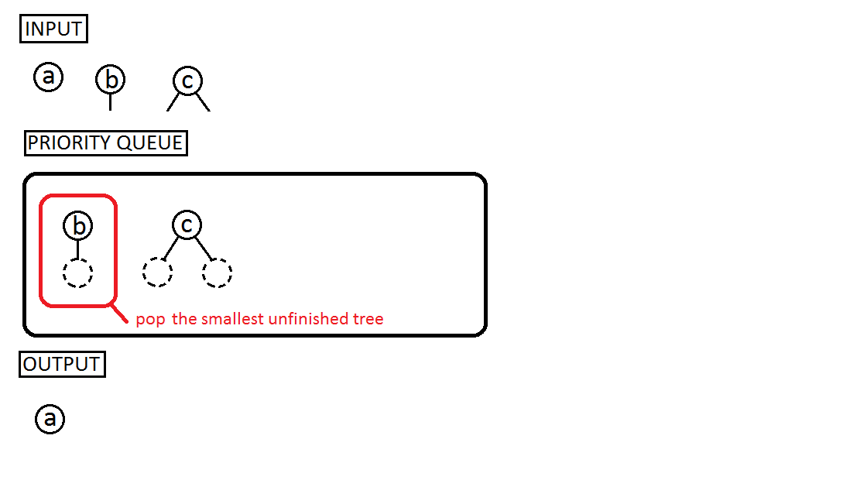

Slide 10
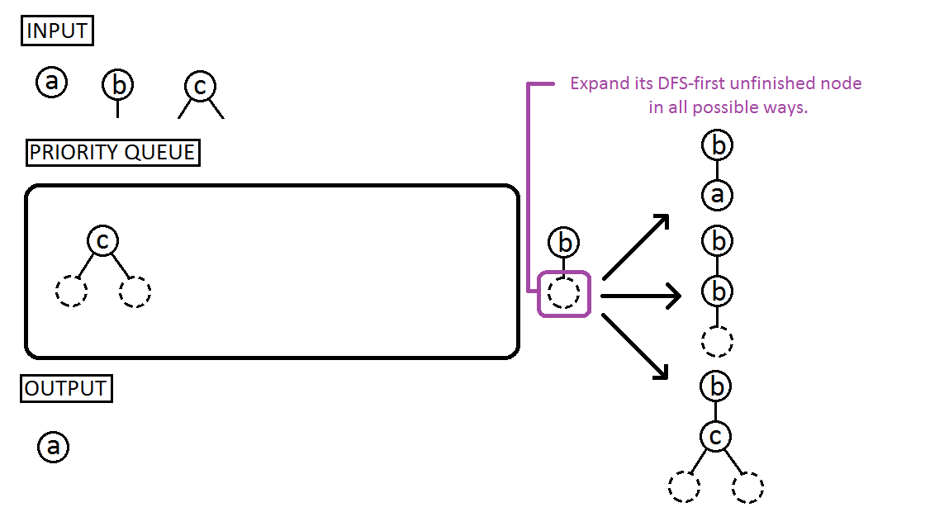

Slide 11
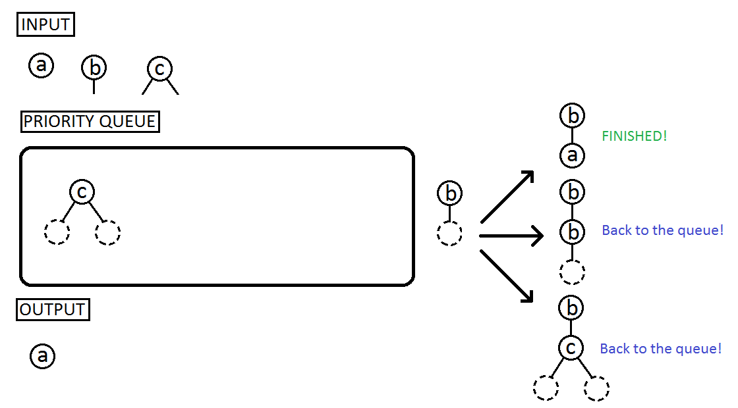

Slide 12
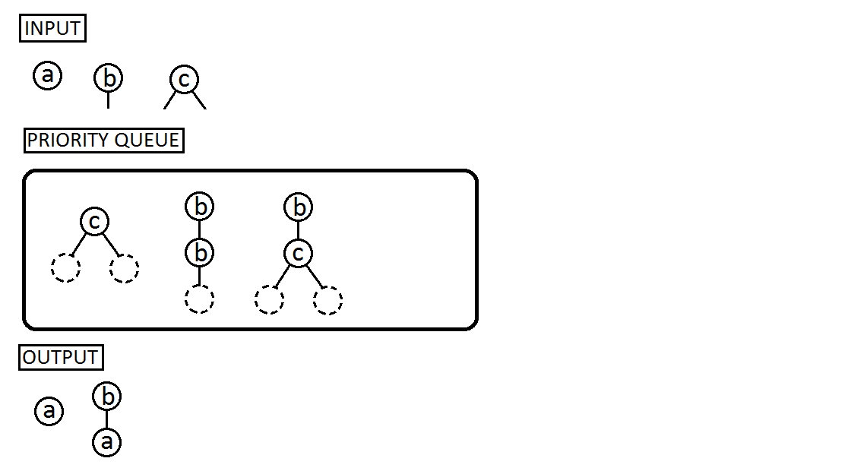

Slide 13
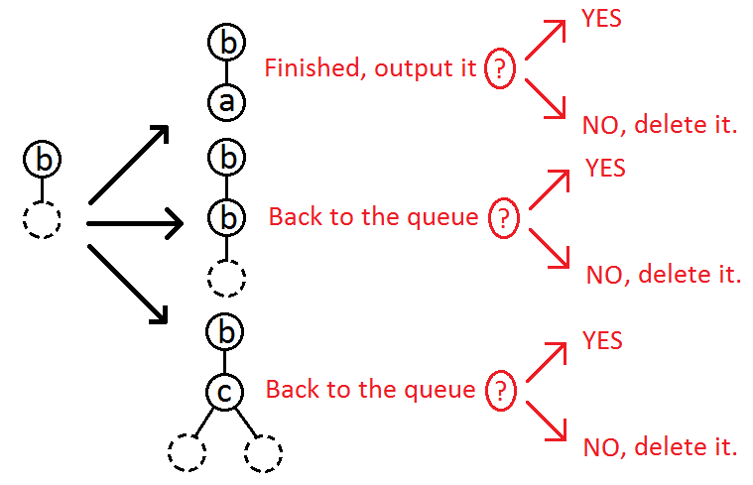
How to make enumeration more random?
We add a new step deciding what to do with an expanded tree:
  keep it,
  or delete it?
We call this additional decision procedure a generating strategy.
  “Keep all” strategy = exhaustive enumeration
  “Delete all but one” strategy = standard generating approach

Slide 14
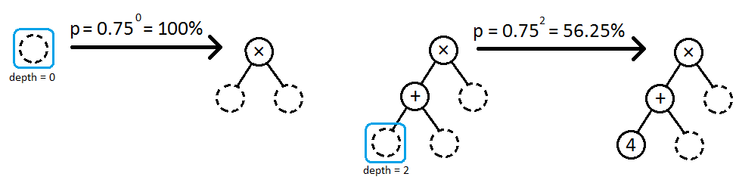
Our geometric strategy
It puts an expanded tree back to the queue with probability p = q^{depth}
Where q is a constant, we used q = 0.75
And depth is depth of the expanded node

Slide 15

Generalization for simply typed lambda calculus

Slide 16
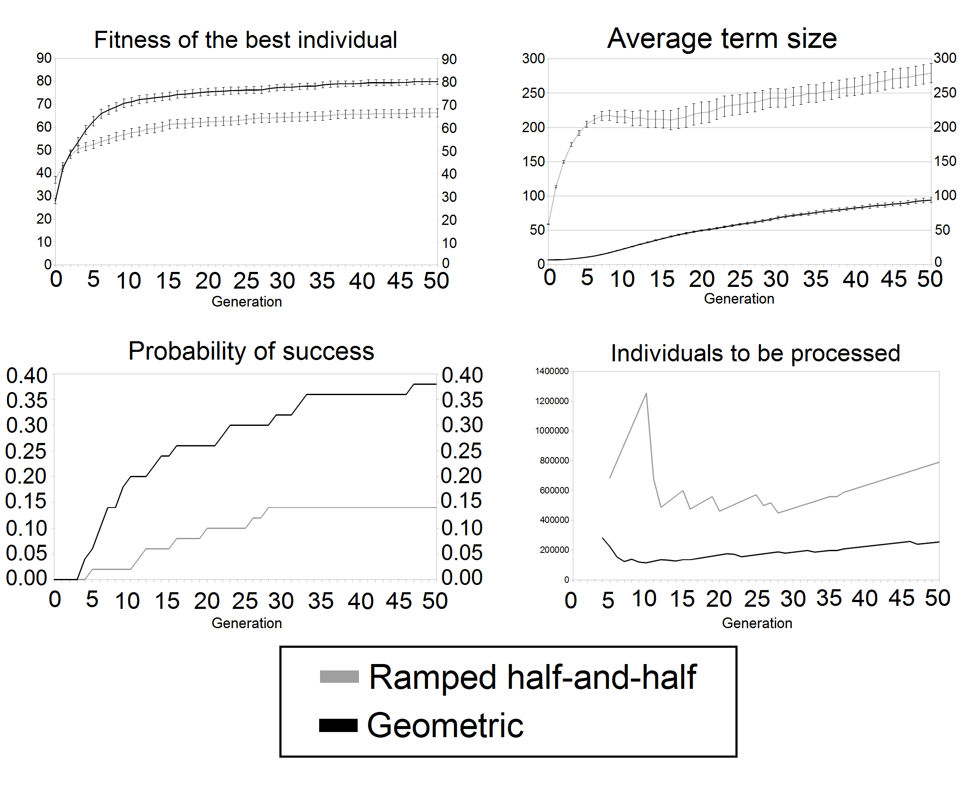
Artificial ant problem
Times: 265 minutes
107 minutes

Slide 17

Crossover operator for lambda terms
Generalization of simple tree swapping crossover
We need to swap subtrees with a same type
  ..but that is simple
Local variables cause the trouble!

Slide 18

Abstraction elimination
An algorithm for getting rid of local variables and anonymous function
  Input: an arbitrary lambda term
  Output: equivalent S-expression (with no local variables or anonymous functions) that may contain additional new function nodes S,K and I which are defined as:

Slide 19
Hybrid crossover
Each generated term is transformed by abstraction elimination
So now all terms are typed S-expressions
So now we only need to swap subtrees with the same type
Hybrid because
  lambda term representation during generation phase
    Advantage: reduced search space during generation phase
  Pure combinator representation during the rest
Possible disadvantage: up to quadratic increase in term size

Slide 20
Unpacking crossover
All terms are kept in small βη-normal form
...and transformed right before crossover
After the tree swapping both children are again normalized
So the quadratic increase is only temporary

Slide 21



Results

