Slide 1
Typed functional genetic programming
Tomáš Křen
Supervisor: Roman Neruda

Slide 2
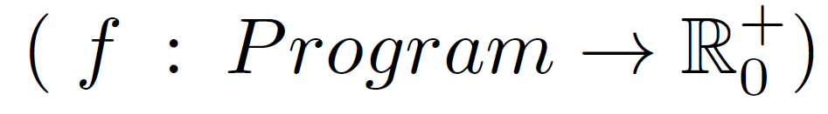
What is Genetic programming?
GP is a technique inspired by biological evolution that for a given problem tries to find computer programs able to solve that problem.
Author of GP: John Koza (1992)
Main inputs:
  Fitness function
  Set of building symbols
Output:
  Programs (a simple S-expression)

Slide 3
GP individual
Syntactic tree of the program.
Non-leaf nodes are function symbols. (set F)
Leaf nodes are variables, constants or values. (set T … Terminals)
Set of building symbols Γ0 = T ∪ F
function(x,y){
return 6*(x*x)+(2+3)*(x*y)+pi;
}
+
+
pi
*
*
6
*
+
*
x
x
2
3
x
y

Slide 4
How it works?
Set of building
symbols
Individuals
generating
procedure
Population 0
Fitness
function
Copy
Pr
Population t
Selection
Population t+1
Pc
Crossover
Pm
Mutation

Slide 5
Types in GP
Types help us overcome the closure requirement.
  No longer need for “everything fitting into everything”.
But they also establish new requirements
  e.g. function arguments must obey type requirements...
  These requirements make the programs more reasonable,
  and reduce the search space.

Slide 6
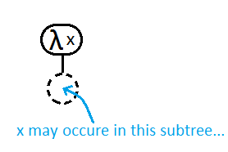
Lambda calculus
Simple yet powerful (mathematical)
functional programming language
It uses anonymous functions very often.
Roughly speaking:
  s-expressions + anonymous functions = lambda calculus
λ <var-name> . <body-expr>
aka
function(<var-name>){ return <body-expr>; }

Slide 7
Benefits of using Functional programing for GP
Complex and/or general programming constructs can be described as higher-order functions
Types provide rigorous way to talk about (sub)programs and to enforce constraints.

Slide 8
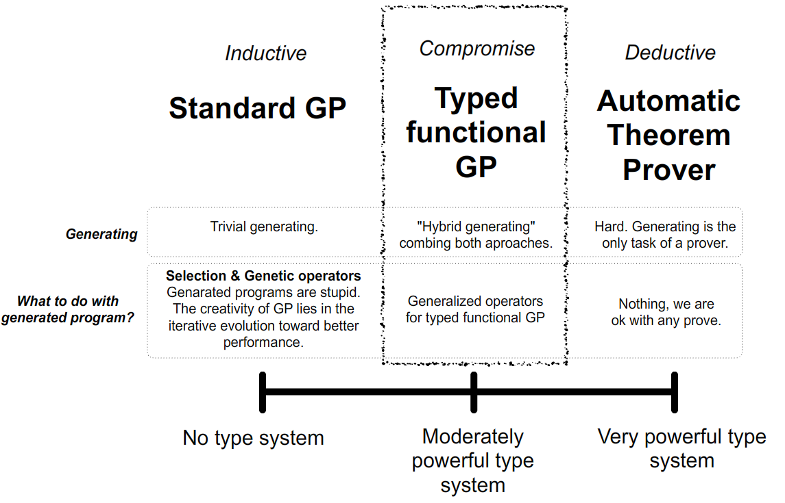
Curry-Howard correspondence

Slide 9

Standard generating procedure
works in separate iterations
  In each iteration one tree individual is generated.
We can do this differently:
  “Generating of shared parts can be shared.”

Slide 10
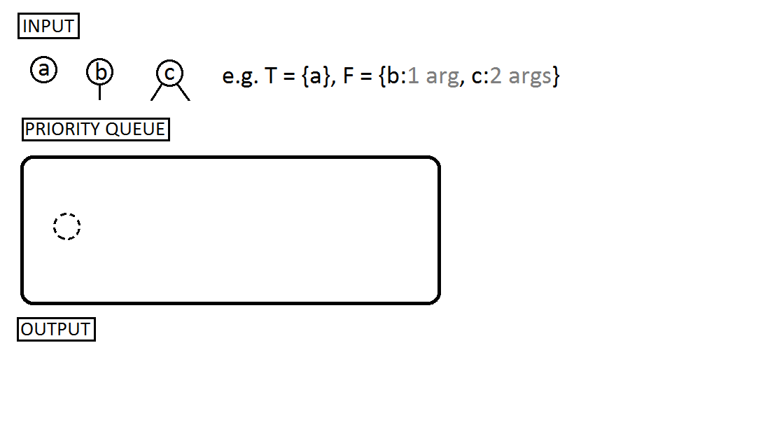
Exhaustive enumeration of individuals

Slide 11
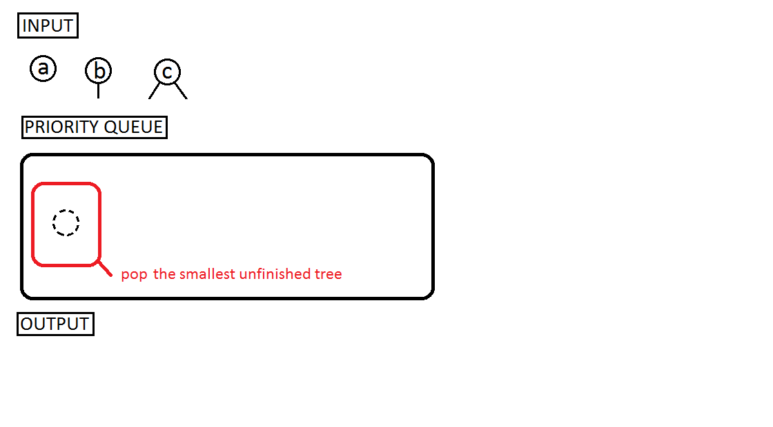

Slide 12
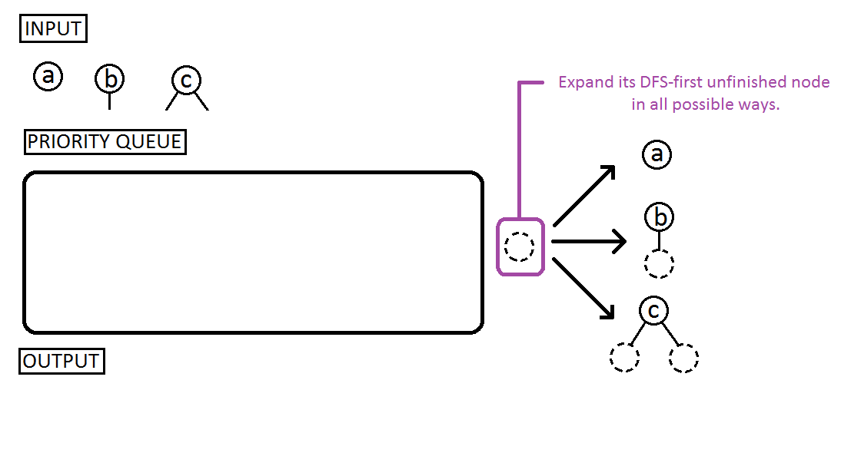

Slide 13
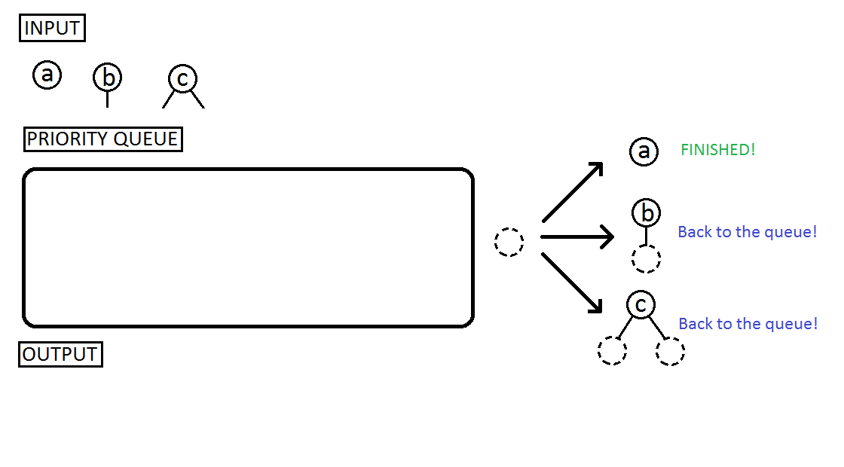

Slide 14
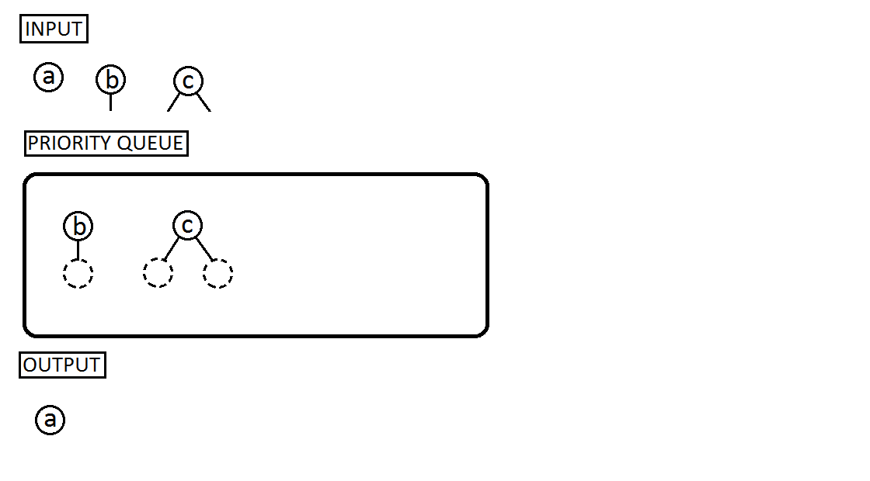

Slide 15
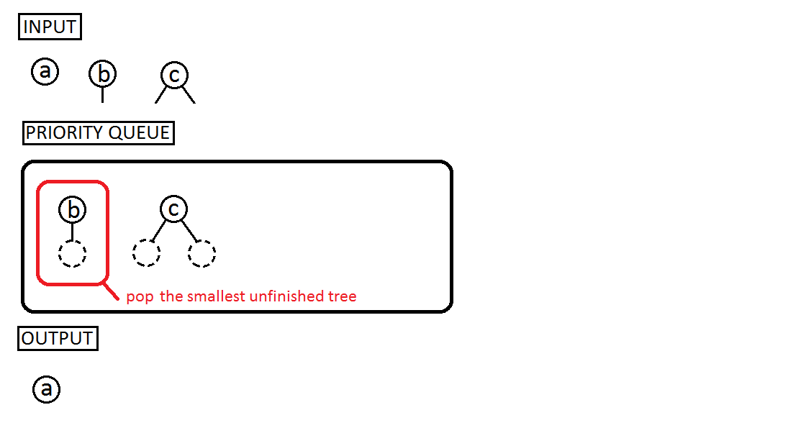

Slide 16
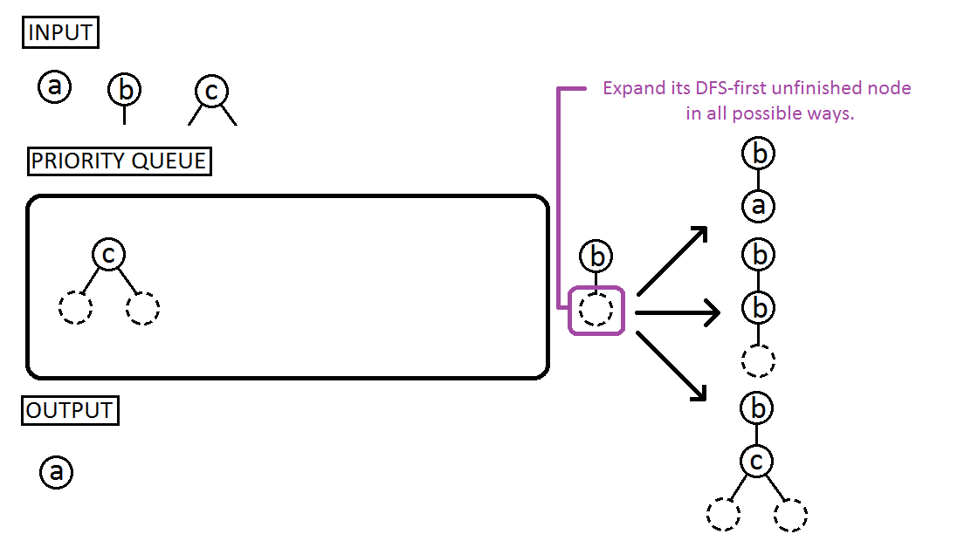

Slide 17
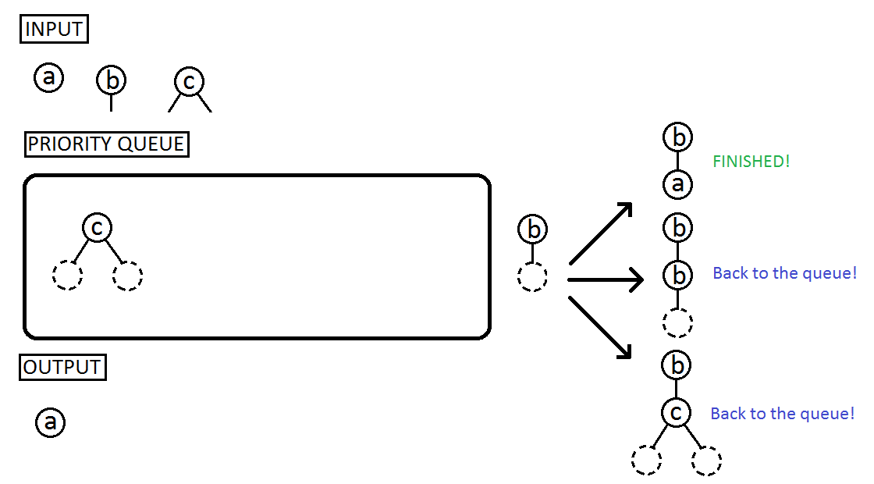

Slide 18
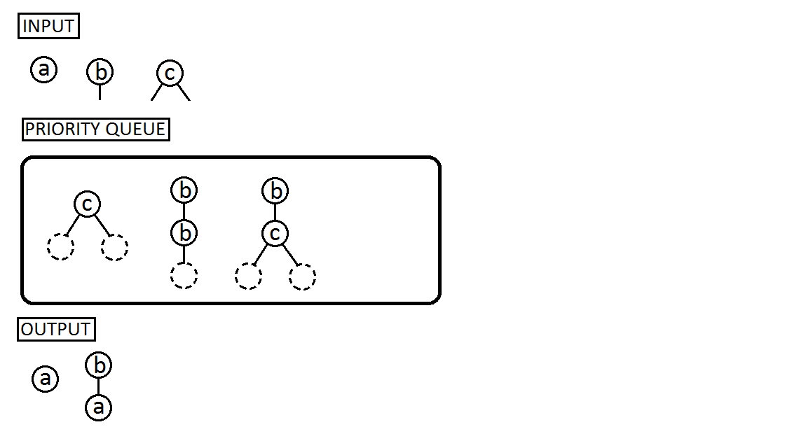

Slide 19
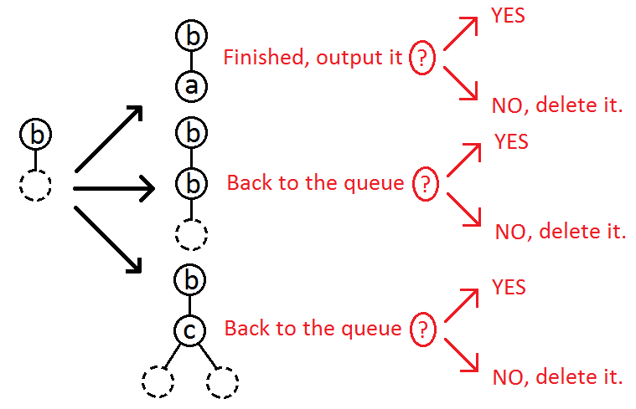
How to make enumeration more random?
We add a new step deciding what to do with an expanded tree:
  keep it,
  or delete it?
We call this additional decision procedure a generating strategy.
  “Keep all” strategy = exhaustive enumeration
  “Delete all but one” strategy = standard generating approach

Slide 20
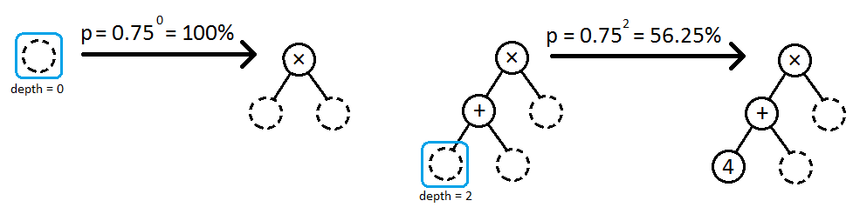
Our geometric strategy
It puts an expanded tree back to the queue with probability p = q^{depth}
Where q is a constant, we used q = 0.75
And depth is depth of the expanded node

Slide 21

Generalization for simply typed lambda calculus

Slide 22
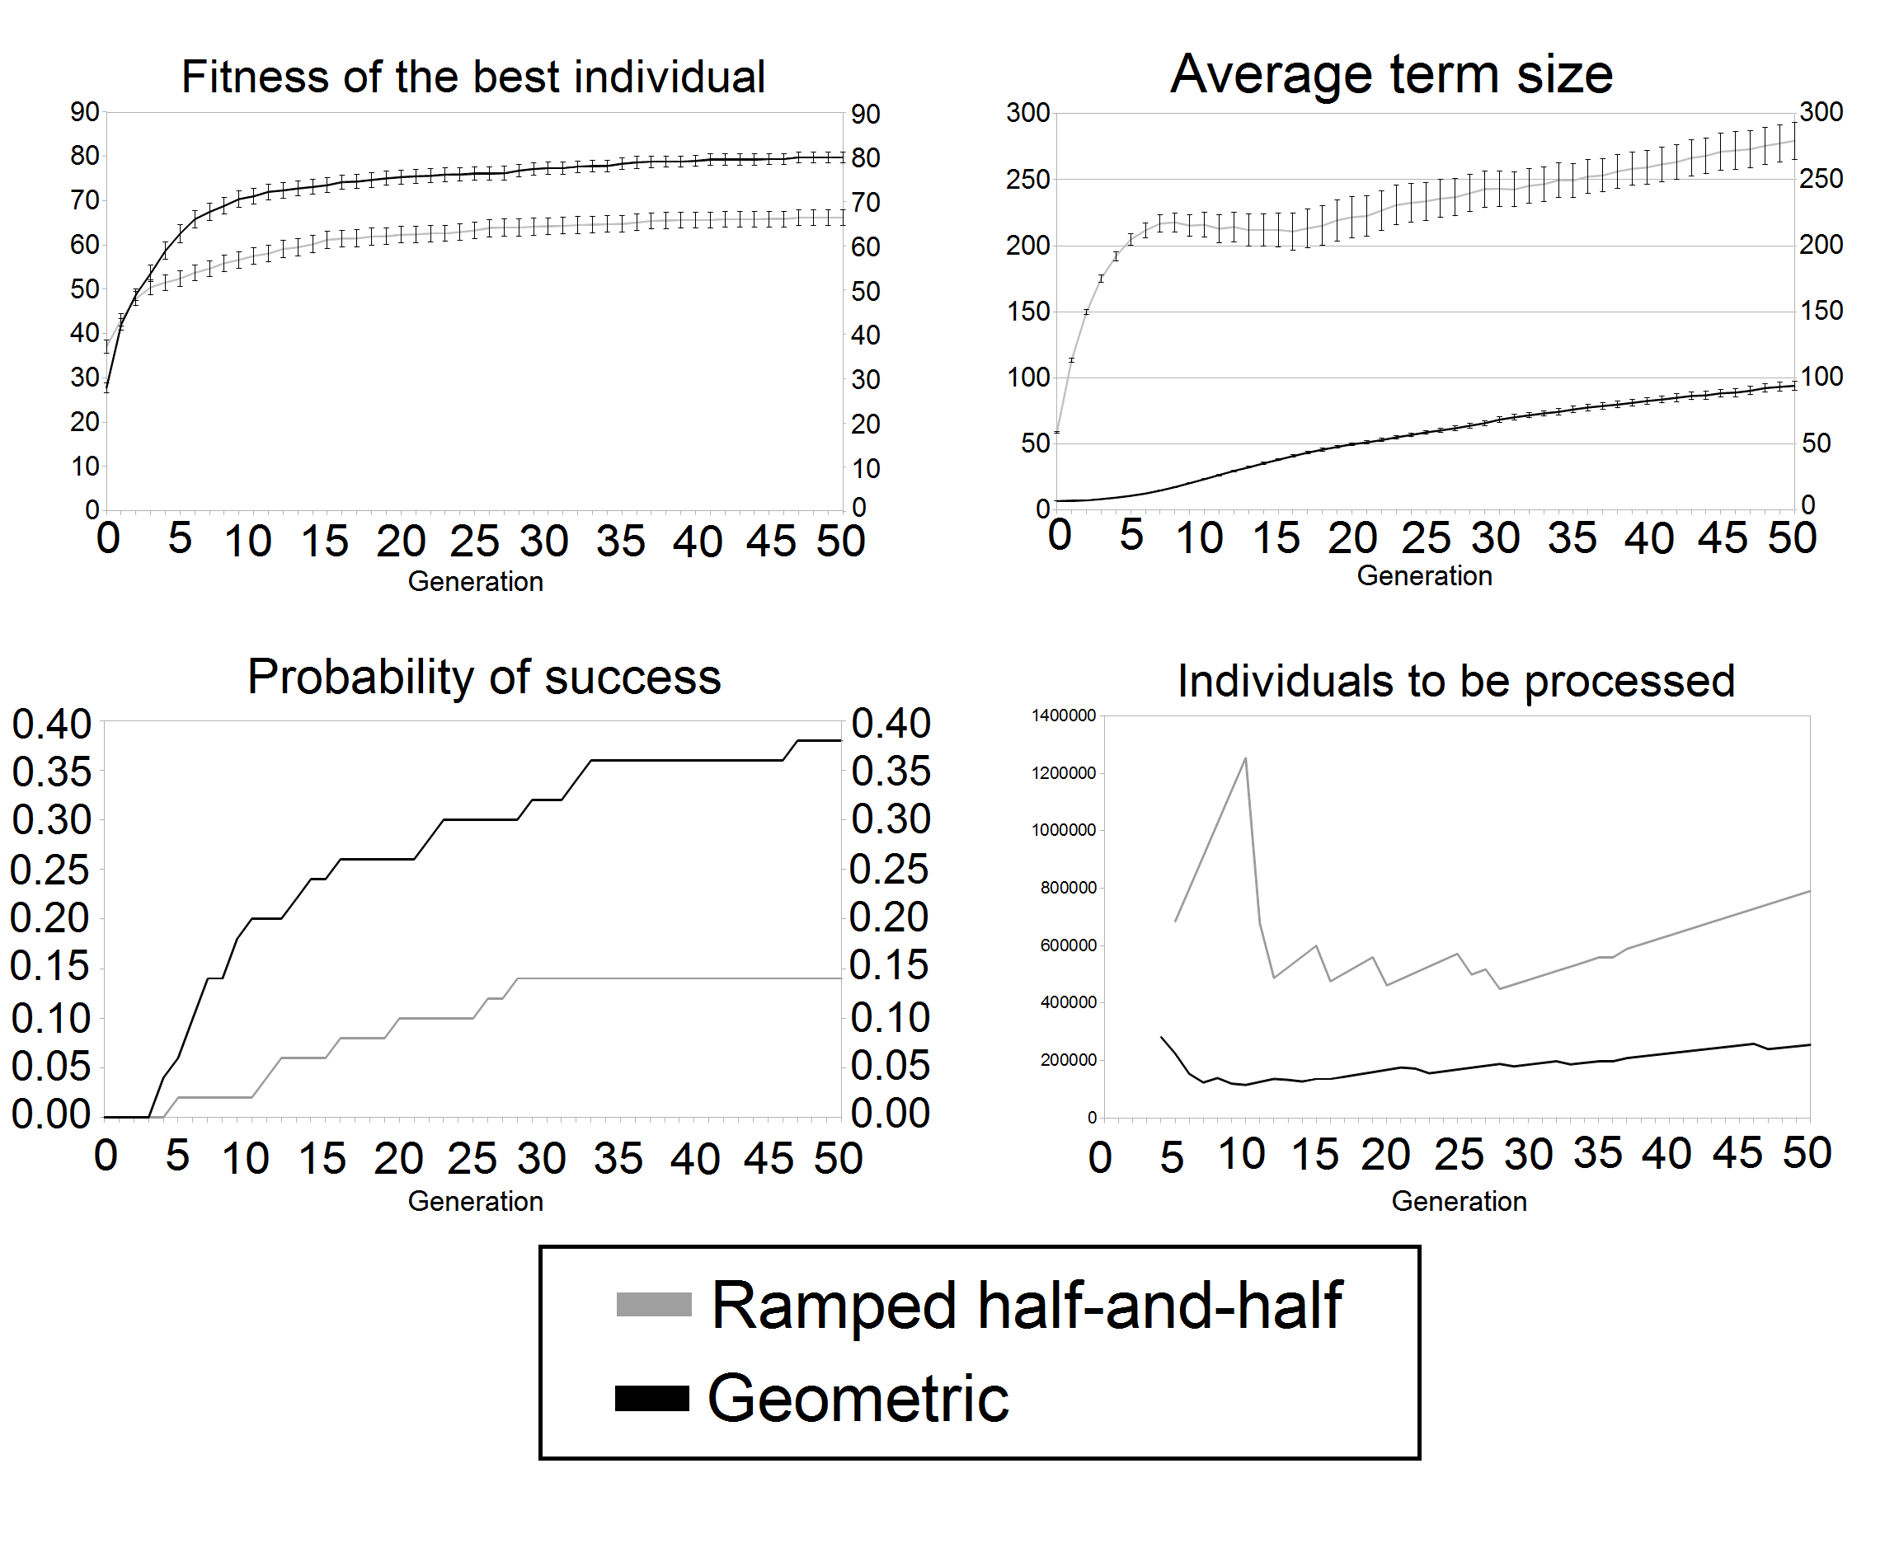
Artificial ant problem
Times: 265 minutes
107 minutes

Slide 23

Crossover operator for lambda terms
Generalization of simple tree swapping crossover
We need to swap subtrees with a same type
  ..but that is simple
Local variables cause the trouble!

Slide 24

Abstraction elimination
An algorithm for getting rid of local variables and anonymous function
  Input: an arbitrary lambda term
  Output: equivalent S-expression (with no local variables or anonymous functions) that may contain additional new function nodes S,K and I which are defined as:

Slide 25
Hybrid crossover
Unpacking crossover
Each generated term is transformed by abstraction elimination
So now all terms are typed S-expressions
So now we only need to swap subtrees with the same type
All terms are kept in small βη-normal form
… and transformed right before crossover
After the tree swapping both children are again normalized
So the quadratic increase is only temporary

Slide 26



Even parity problem

Slide 27
Articles
Generating Lambda Term Individuals in Typed Genetic Programming Using Forgetful A*
  IEEE WCCI 2014, Beijing
Utilization of Reductions and Abstraction Elimination in Typed Genetic Programming
  GECCO 2014, Vancouver

Slide 28
Future work
Implement more general type system
  Hindley–Milner type system
  Hindley–Milner enriched with Type classes
    This enriches the logic with predicates.
Design an interesting problem for this system
  Problems around simulation of simple economy from the multi-agent point of view

