Slide 1
Mass production of microfluidic chips
Tomáš Kysela
IEE1860 BioMEMS
17. 10. 2024

Slide 2
Motivation
Prototyping / research chips
Lasers
Quick
Expansive
Chemical etching
Slow
Cheap

Slide 3
Proposed methods
Micro-milling
Direct ink writing
Polymers
3D printing
Injection molding
Notes:
Micro-milling = submerged under watter to extend service life, remove debris, one by one
Direct ink = hydrofluoric acid harmful to environment, further treatment before emission

Slide 4
Mold creation
3D printing
Metal micro-milling
Sheet cutting

Slide 5
3D printing
3D printed mold
SLA printers
Better results with soluble supports
Single use molds

Slide 6
Sheet cutting
Shape cut from ABS
Polymer poured over it

Slide 7
Metal micro-milling

Slide 8
Materials
Steel S136H
Brass
Aluminum
Copper

Slide 9
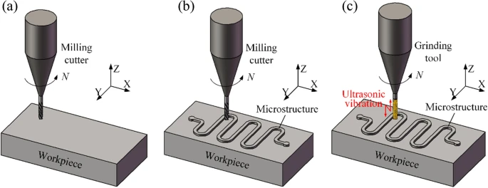
Milling
Multiple milling tools used
First carbide milling tools
Ultrasonic vibrations
Milling process [1]

Slide 10
Mold creation
PMMA
Pressed with temp between 150 and 180°C

Slide 11
Polishing
Abrasive material in water
Silicon carbide
Solid CO2

Slide 12
Sources
[1]
Y. Lu, B. Liu, Z. Zhang, M. Guo, J. Wang, and C. Wang, “Process chain for the mass production of polymeric microfluidic chips,” The International Journal of Advanced Manufacturing Technology, vol. 127, no. 7–8, pp. 3665–3680, Jun. 2023, doi: https://doi.org/10.1007/s00170-023-11773-8.
[2]
M. de Almeida Monteiro Melo Ferraz, J. B. Nagashima, B. Venzac, S. Le Gac, and N. Songsasen, “3D printed mold leachates in PDMS microfluidic devices,” Scientific Reports, vol. 10, no. 1, Jan. 2020, doi: https://doi.org/10.1038/s41598-020-57816-y.
‌[3]
K. Kang, S. Oh, H. Yi, S. Han, and Y. Hwang, “Fabrication of truly 3D microfluidic channel using 3D-printed soluble mold,” Biomicrofluidics, vol. 12, no. 1, p. 014105, Jan. 2018, doi: https://doi.org/10.1063/1.5012548.
‌

