Slide 1

AVERT trial
Mapping mRS to AQoL

Slide 2
AVERT trial (A Very Early Rehabilitation Trial after stroke)
Pragmatic, prospective, parallel-group, multicentre, international, randomised control trial
2104 patients from 56 hospitals in five countries: UK, Australia, New Zealand, Malaysia, and Singapore
Very early mobilisation (VEM) vs. usual care (US)
Outcome assessments: 3- and 12-months post stroke
Assessment of Quality of Life (AQoL) and mRS

Slide 3
Aims
Does VEM reduce death and disability at 3 months post stroke?
Does VEM reduce the number and severity of complications at 3 months post stroke?
Does VEM improve quality of life (QoL) at 12 months post stroke?
Is VEM cost-effective?

Slide 4
Outcomes
Primary: Survival without major disability (mRS score of 0–2) at 3 months after stroke.
Secondary: Ordinal shift of the mRS, time taken to achieve unassisted walking for 50 m, proportion of patients achieving walking by 3 months, death and the number of non-fatal SAEs, HRQoL

Slide 5
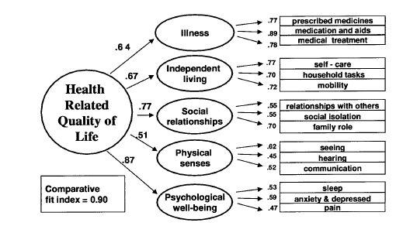
mRS and AQoL
mRS
Scale | Description
0 | No symptoms: no symptoms at all
1 | No significant disability: no significant disability despite symptoms; able to perform all usual duties and activities
2 | Slight disability: slight disability; unable to perform all normal activities but able to look after own affairs without assistance
3 | Moderate disability: moderate disability requiring some help but able to walk without assistance
4 | Moderately severe disability: moderately severe disability; unable to walk without assistance and unable to attend to own bodily needs without assistance
5 | Severe disability: severe disability bedridden, incontinent, and requiring constant nursing care and attention
6 | Dead
AQoL

Slide 6
Mapping in stroke
modified Rankin Scale (mRS): widely used measure to assess global disability
Clinicians’ preference: capture patient's condition and are responsive to changes
Economic evaluation: optimal usage of scarce healthcare resources
Preference-based utility measures calculate quality-adjusted life years (QALY)

Slide 7
Mapping
Ordinary least square (OLS): simple and commonly used
Robust MM-estimator: influence of potential outliers
Generalised linear model (GLM): flexible framework to handle different types of relationships
Beta-based mixture model (betamix): capture multimodality
Tobit model: violating the normality assumption
Adjusted limited dependent variable mixture model (aldvmm): mass of observations at the upper limit, a gap between the mass at 1 and the next feasible utility value

Slide 8
Models
Four models for each of the regression techniques
Model 1a: using the mRS score, age and gender as the key predictive variable;
Model 1b: Model 1a without age and gender as predictors
Model 2a: Aset of binary variables of mRS scores was used as predictors by developing dummy variables for each mRS state. AQoL was regressed to the dummies of the mRS score along with age and gender
Model 2b: Model 2a without the impact of age and gender

Slide 9
Validation
Goodness-of-fit tests: Mean absolute error (MAE), root mean square error (RMSE), and mean error (ME)
Internal: Five-fold cross-validation 80% of the data used for algorithm development and 20% for performance assessment
External: Using 12-month data

Slide 10
Support
Machine learning

Slide 11
AVERT details
mRS | Number and % of patients at baseline | Number and % of patients at 3-month | Mean (SD) AQoL at 3m by mRS at 3 months | Mean (SD) AQoL at 12m by mRS at 12 months
0 | 14 (0.67%) | 186 (8.93%) | 0.8096 (0.2177) | 0.8539 (0.1877)
1 | 116 (5.51%) | 404 (19.4%) | 0.786 (0.2082) | 0.7714 (0.2061)
2 | 153 (7.27%) | 415 (19.92%) | 0.6299 (0.2345) | 0.6278 (0.2409)
3 | 258 (12.26%) | 456 (21.89%) | 0.3676 (0.2089) | 0.3423 (0.2081)
4 | 964 (45.82%) | 267 (12.82%) | 0.1070 (0.1232) | 0.1107 (0.1217)
5 | 599 (28.47%) | 195 (9.36%) | 0.0325 (0.0643) | 0.0287 (0.0669)
6 | 0 | 160 (7.68%) | 0 | 0
Total | 2104 (100%) | 2083 (100%) | 0.4479 (0.3516) | 0.4629 (0.3661)
 | Total (n) | Males (n) | Females (n)
Australia | 1054 | 675 | 379
Malaysia | 123 | 68 | 55
New Zealand | 189 | 108 | 81
Singapore | 128 | 82 | 46
UK | 610 | 353 | 257
By gender, All countries |  | 1286 | 818
Total All countries | 2104 | 70.62; 12.79 (16.4-100.31)

Slide 12
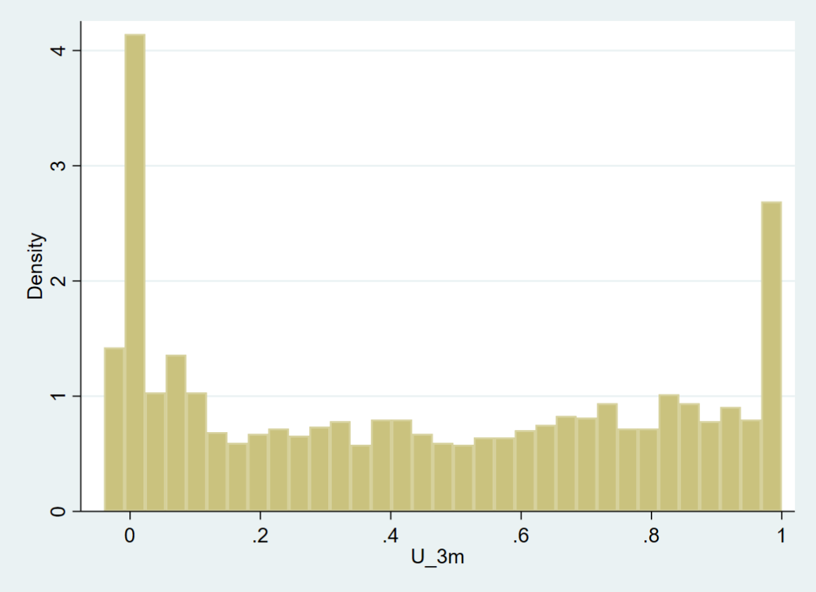
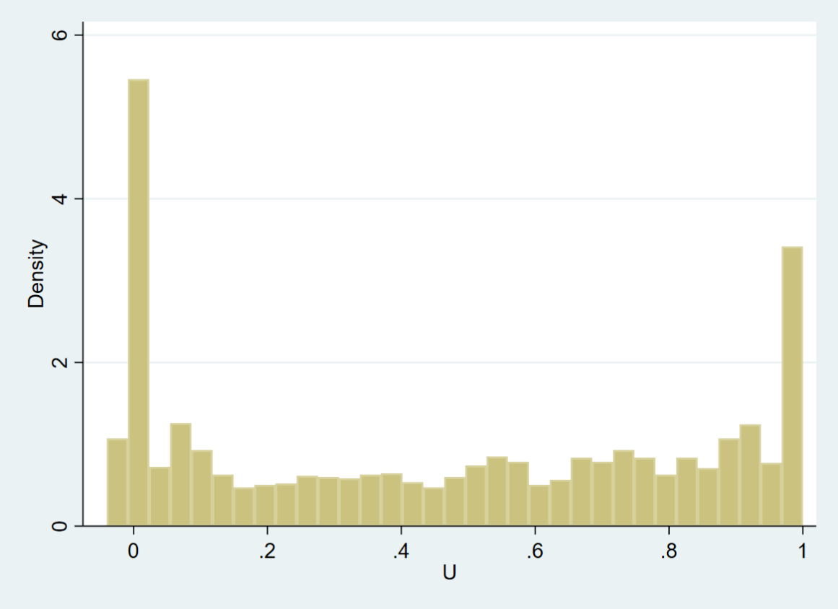
AQoL 3 and 12 months
3 months
12 months

Slide 13
Results
Development model
 | Model 1a |  |  | Model 1b |  |  | Model 2a |  |  | Model 2b
 | MAE | ME | RMSE | MAE | ME | RMSE | MAE | ME | RMSE | MAE | ME | RMSE
OLS | 0.160406 | 0.000000 | 0.201062 | 0.160911 | 0.000000 | 0.201591 | 0.139734 | 0.000000 | 0.187953 | 0.139906 | 0.000000 | 0.18836
MM | 0.159948 | -0.011601 | 0.201843 | 0.160445 | -0.011048 | 0.202368 | 0.136594 | -0.024233 | 0.195225 | 0.136192 | -0.023700 | 0.195611
GLM log | 0.181738 | -0.015119 | 0.220506 | 0.181919 | -0.015198 | 0.221369 | 0.138301 | 0.000000 | 0.187599 | 0.138769 | -0.000007 | 0.188243
GLM logit | 0.144103 | -0.014386 | 0.193046 | 0.144163 | -0.014715 | 0.193386 | 0.139734 | 0.000194 | 0.187953 | 0.138770 | -0.000005 | 0.188243
Tobit | 0.160406 | 0.000000 | 0.201062 | 0.160911 | 0.000000 | 0.201591 | 0.142606 | 0.000000 | 0.188799 | 0.139906 | 0.000000 | 0.18836
Betamix | 0.15334 | 0.007061 | 0.196455 | 0.153608 | 0.006807 | 0.196938 | 0.142606 | 0.005410 | 0.188799 | 0.143132 | 0.005793 | 0.189382
ALDVMM | 0.167539 | 0.027533 | 0.205407 | 0.16633 | 0.026400 | 0.204352 | Convergence not achieved |  |  | 0.139078 | -0.000863 | 0.1893237
Validation analysis
 | Model 1a |  |  | Model 1b |  |  | Model 2a |  |  | Model 2b
 | MAE | ME | RMSE | MAE | ME | RMSE | MAE | ME | RMSE | MAE | ME | RMSE
OLS | 0.160681 | -0.000015 | 0.201388 | 0.161012 | 0.000057 | 0.201806 | 0.139962 | 0.000037 | 0.188617 | 0.139113 | 0.000083 | 0.188880
MM | 0.16019 | -0.011643 | 0.202107 | 0.16055 | -0.011040 | 0.202494 | 0.136808 | -0.024258 | 0.195515 | 0.136367 | -0.023718 | 0.195840
GLM log | 0.181137 | -0.015177 | 0.220115 | 0.182083 | -0.015153 | 0.221638 | 0.138756 | 0.000047 | 0.188472 | 0.139116 | 0.000077 | 0.188880
GLM logit | 0.14432 | -0.014253 | 0.193471 | 0.144244 | -0.014589 | 0.193648 | 0.139081 | 0.000267 | 0.188713 | 0.139115 | 0.000080 | 0.188880
Tobit | 0.160257 | -0.006939 | 0.201697 | 0.160629 | -0.006804 | 0.202085 | 0.138925 | -0.006180 | 0.188957 | 0.137994 | -0.006078 | 0.189188
Betamix | 0.149736 | -0.000816 | 0.194722 | 0.149907 | -0.001583 | 0.195046 | 0.144080 | -0.007784 | 0.189315 | 0.144347 | -0.004791 | 0.190099
ALDVMM | 0.160857 | 0.000053 | 0.200155 | 0.161147 | 0.000091 | 0.200484 | 0.139695 | -0.000719 | 0.187889 | 0.139695 | -0.000719 | 0.187889

Slide 14
Results
12 months
 | Model 1a |  |  | Model 1b |  |  | Model 2a |  |  | Model 2b
 | MAE | ME | RMSE | MAE | ME | RMSE | MAE | ME | RMSE | MAE | ME | RMSE
OLS | 0.7797377 | 0.77953 | 0.800944 | 0.1564678 | 0.003339 | 0.19502 | 0.135289 | -0.0036 | 0.183105 | 0.1356075 | -0.00364 | 0.183568
MM | 0.15581 | -0.00873 | 0.195722 | 0.156819 | -0.00827 | 0.196699 | 0.130799 | -0.03141 | 0.188991 | 0.130169 | -0.03111 | 0.18951
GLM log | 1.365056 | 1.365056 | 1.414692 | 1.363411 | 1.363411 | 1.412932 | 18.27023 | -18.2702 | 18.47086 | 2.601015 | 2.601015 | 4.029095
GLM logit | 1.381044 | 0.699556 | 1.745727 | 1.384783 | 0.697825 | 1.749973 | 2.140727 | 1.736205 | 3.819122 | 2.141996 | 1.734863 | 3.818777
Tobit | 0.155613 | 0.003349 | 0.194285 | 0.156468 | 0.003339 | 0.19502 | 0.135289 | -0.0036 | 0.183105 | 0.135608 | -0.00364 | 0.183568
Betamix
ALDVMM

Slide 15
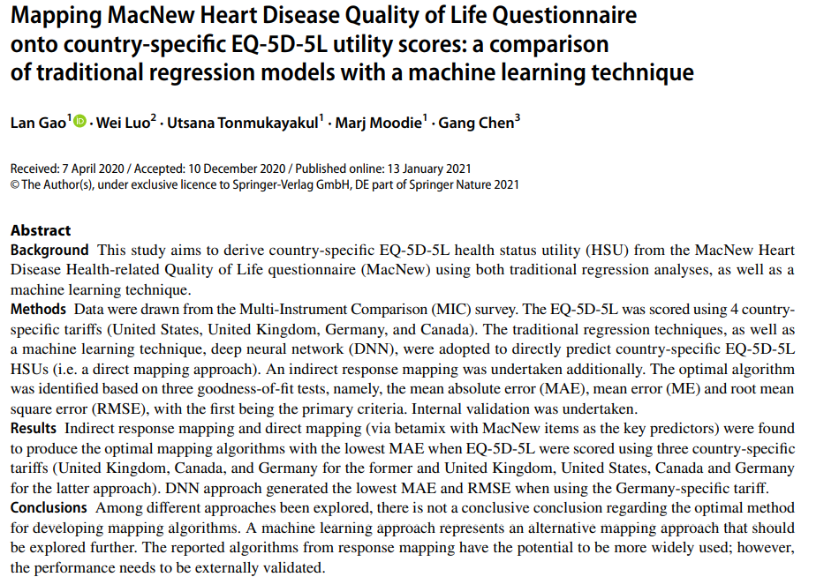

Slide 16
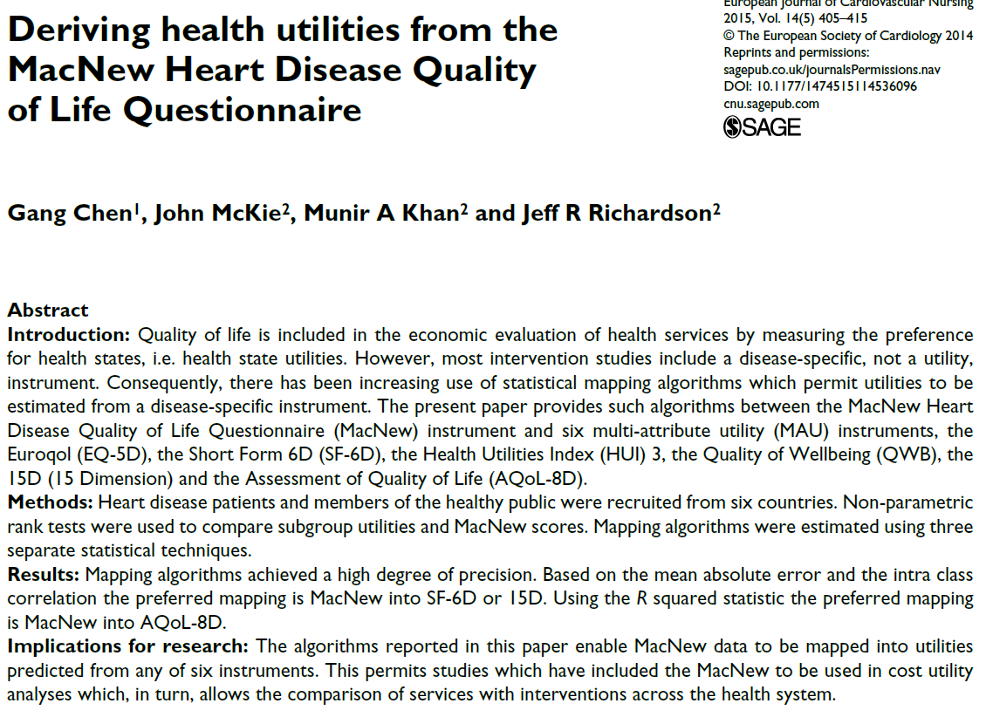
Similar papers

Slide 17
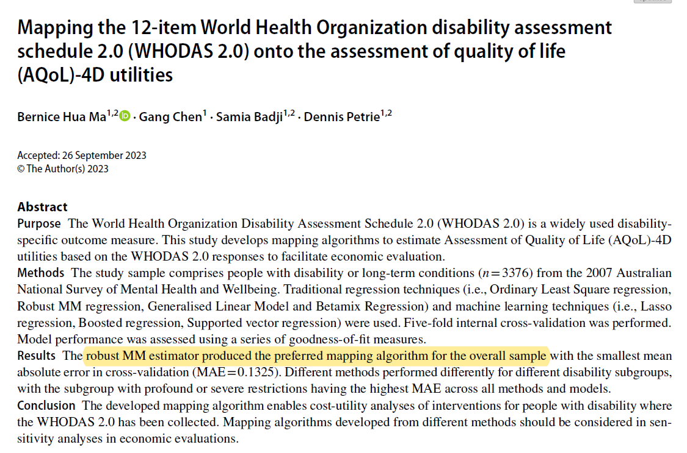

Slide 18
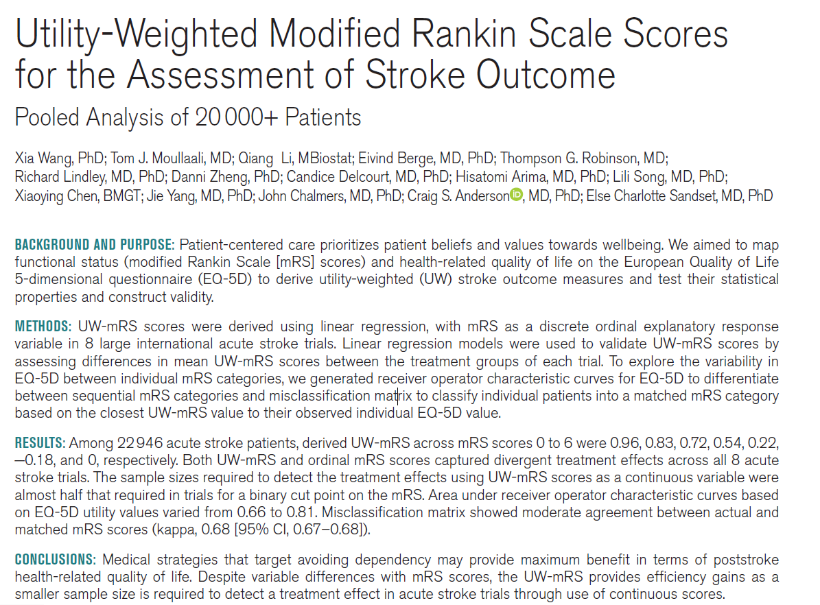

Slide 20
Thank you

