Slide 1

QUANTIZATION
The Size Matters

Slide 2
Why size matters?
A neural model can be characterized by 4 parameters: size of the model, size of the training dataset, cost of training, performance after training. Each of these four variables can be precisely defined into a real number, and they are empirically found to be related by simple statistical laws, called "scaling laws". These are usually written as {N,D,C,L} (number of parameters, dataset size, computing cost, loss).
In May/2020, OpenAI (GPT-3 paper→ https://arxiv.org/abs/2005.14165 ) tacitly announced their data scaling laws (also called the Kaplan scaling laws) for LLMs:
In plain English, GPT-3/Kaplan scaling laws said that…
300B tokens can be used to train an LLM of size 175B parameters
So, we need around 1.7 text tokens per parameter
In Sep/2022, DeepMind (Chinchilla paper → https://arxiv.org/abs/2203.15556 ) found new data scaling laws (also called the Chinchilla or Hoffman scaling laws) for ‘data optimal’ LLMs:
In plain English, Chinchilla/Hoffman scaling laws say that…
1,400B (1.4T) tokens should be used to train a data-optimal LLM of size 70B parameters
So, we need around 20 text tokens per parameter

Slide 3
Model | Number Parameters | Size | Training Dataset
Flan-T5 L | 780M | 3.15Gb | 750GB
Mistral-7B-v0.1 | 7 Billions | 15GB | ?
Llama 2 7B | 7 Billions | 30GB | 2 trillions of tokens
Llama 2 13B | 13 Billions | 50GB | 2 trillions of tokens
Falcon 40B | 40 Billion | 72GB | 1 Trillion of tokens
GPT-3 | 175 Billions | 17GB | 45TB of Data
GPT-4 | 1.76 Trillions | 45 GB | 13 Trillions of tokens
https://the-decoder.com/gpt-4-architecture-datasets-costs-and-more-leaked/
Cost training GPT-4 approx. 63 Millions dollars

Slide 4
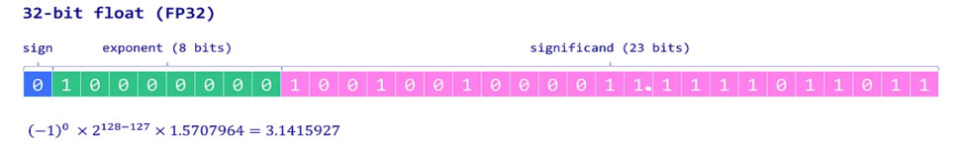
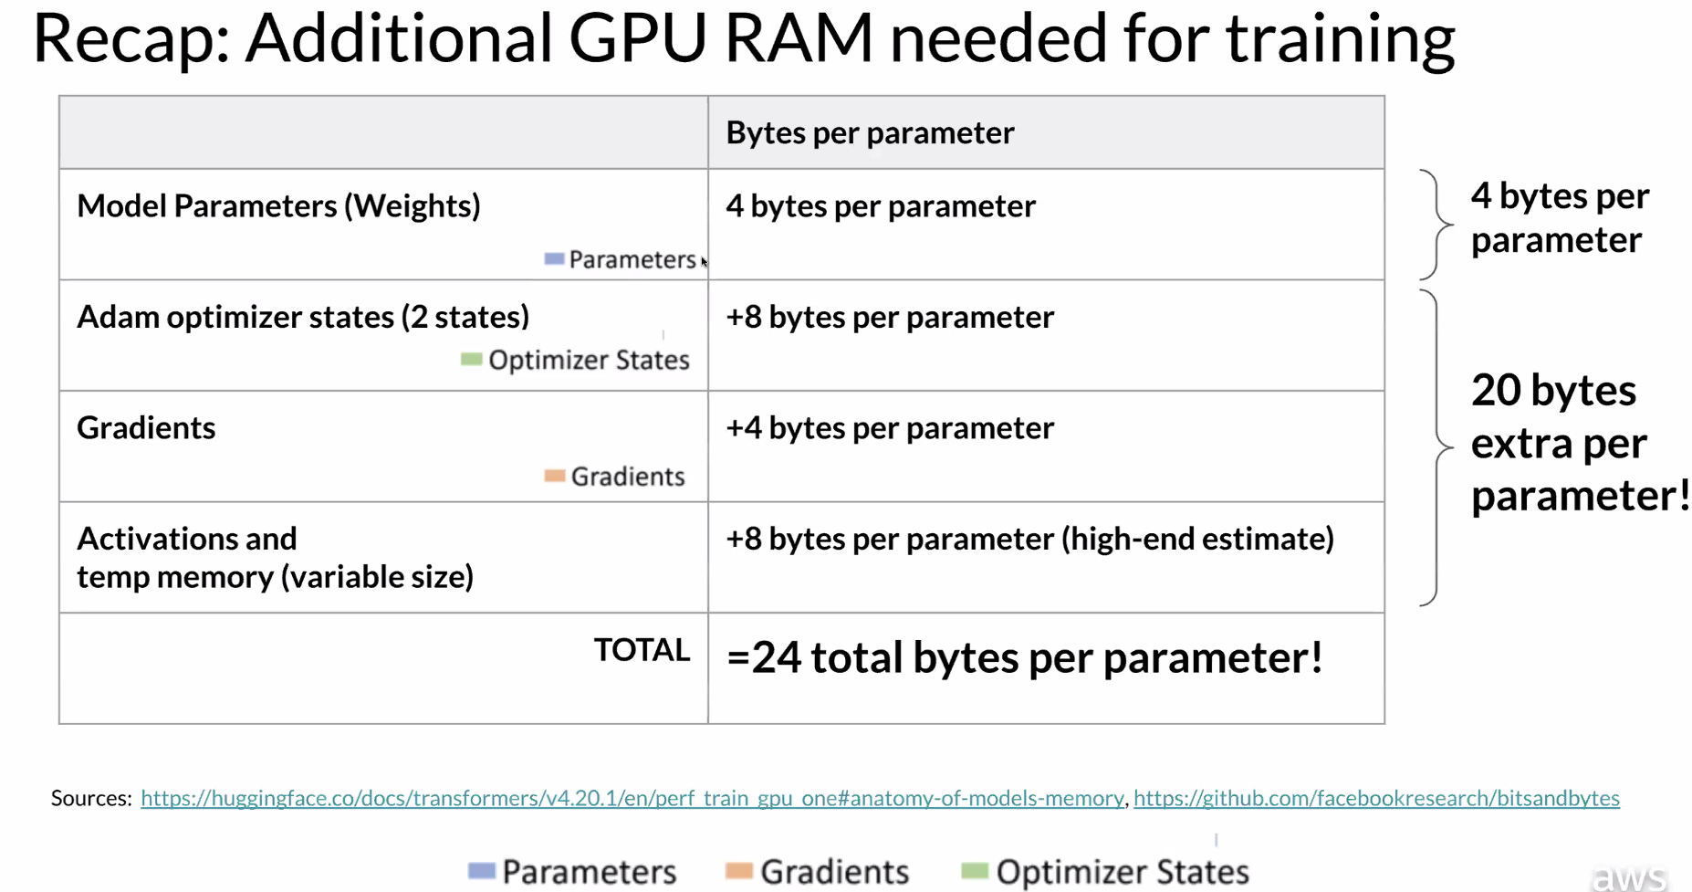
Memory Challenges

Slide 5
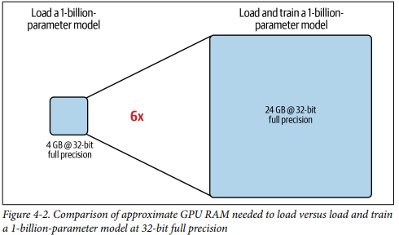


Memory Challenges

Slide 6
Quantization
Quantization is a technique to reduce the computational and memory costs of running inference by representing the weights and activations with low-precision data types like 8-bit integer (int8) instead of the usual 32-bit floating point (float32).
Reducing the number of bits means the resulting model requires less memory storage, consumes less energy (in theory), and operations like matrix multiplication can be performed much faster with integer arithmetic. It also allows to run models on embedded devices, which sometimes only support integer data types.

Slide 7
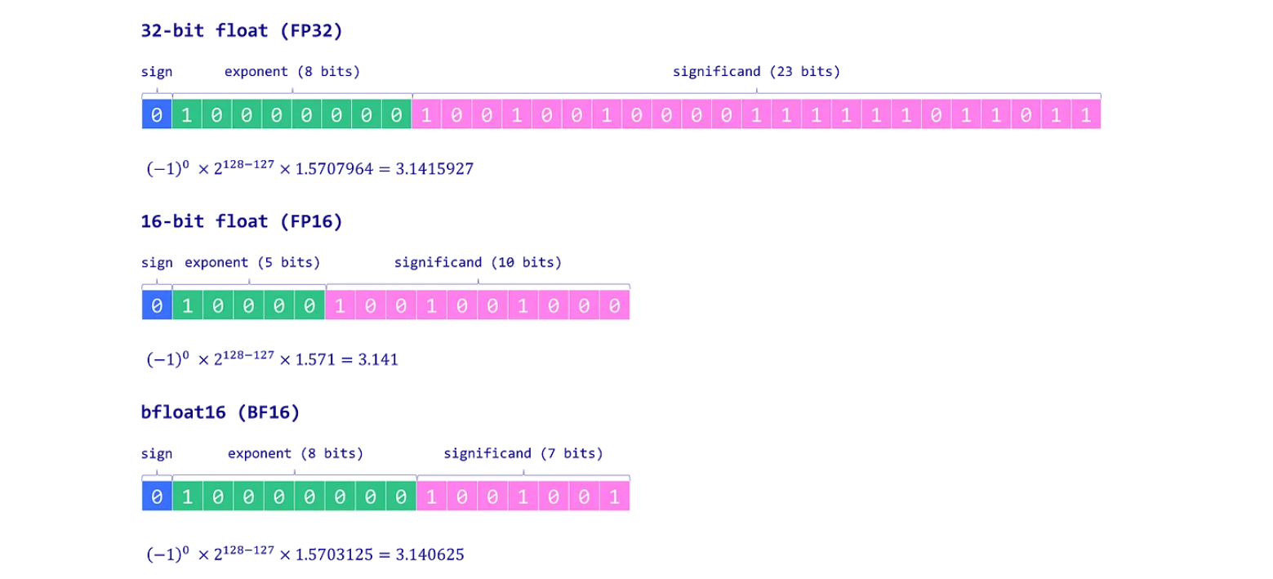

Quantization
https://www.wikihow.com/Convert-a-Number-from-Decimal-to-IEEE-754-Floating-Point-Representation

Slide 8
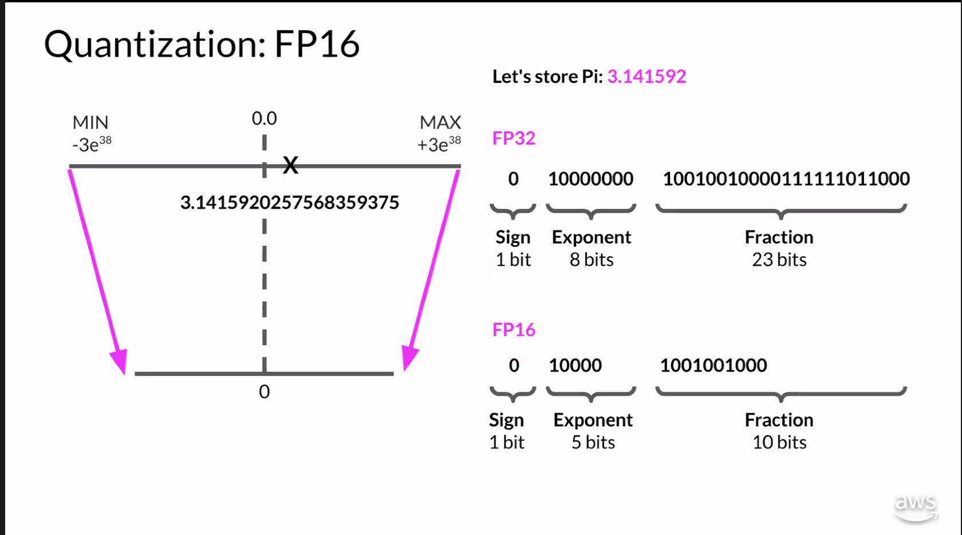
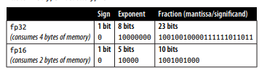
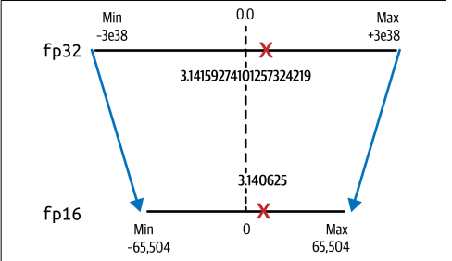

Slide 9
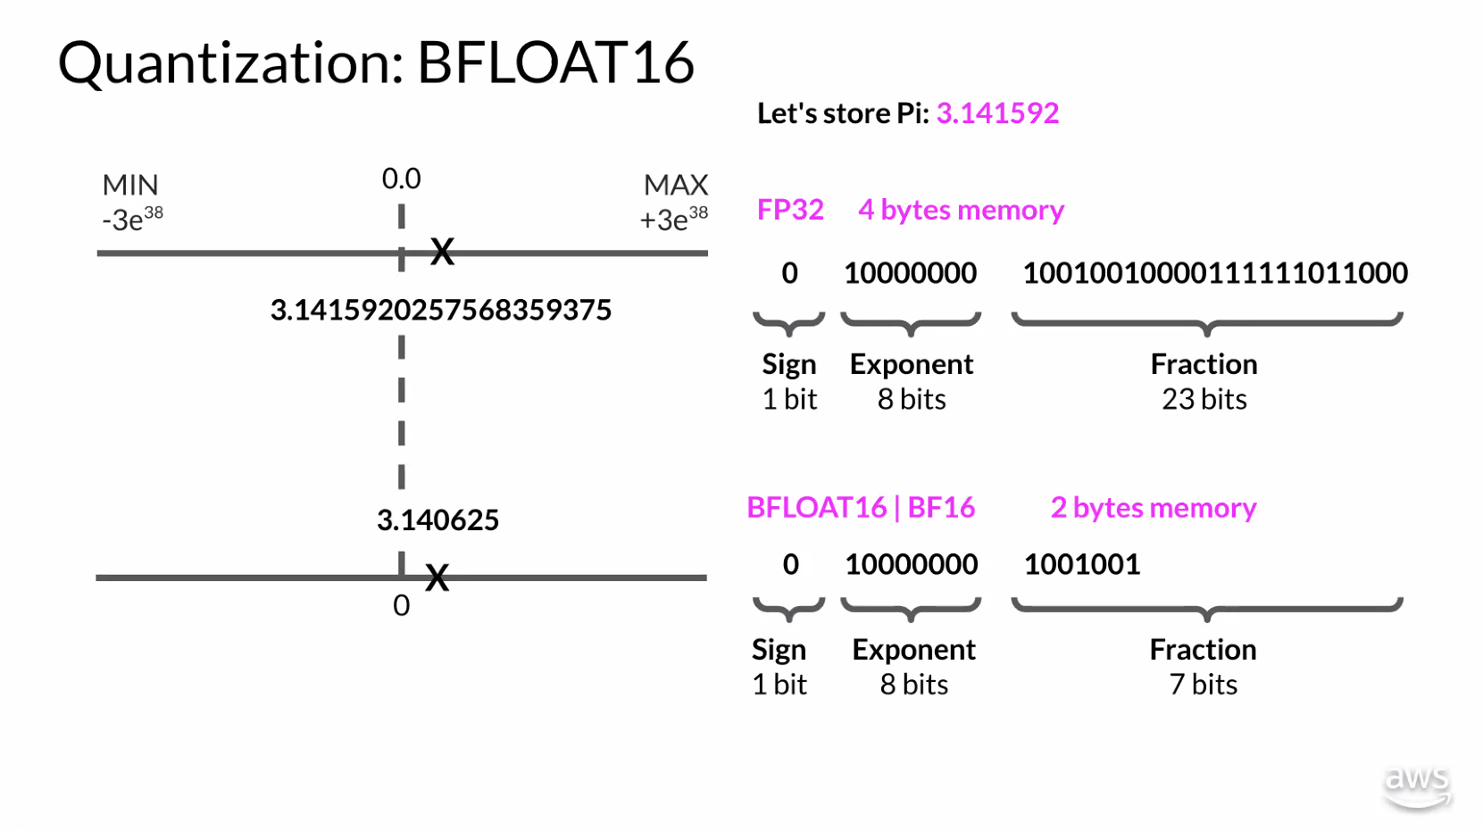

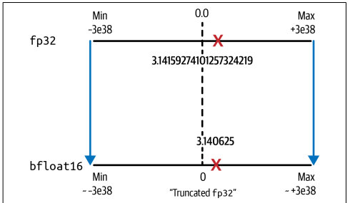

Slide 10
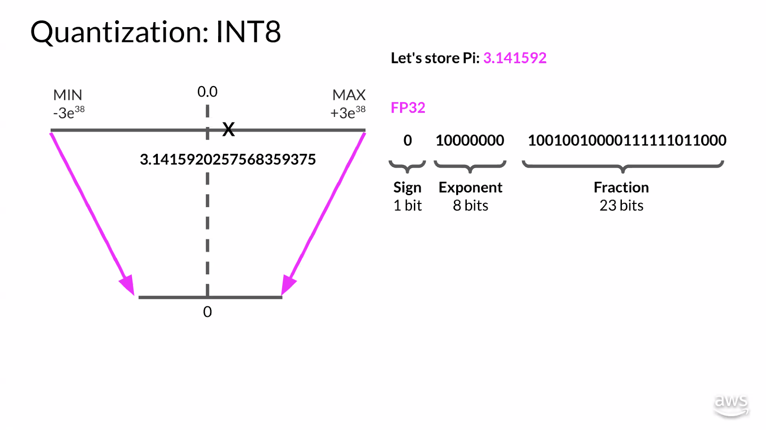

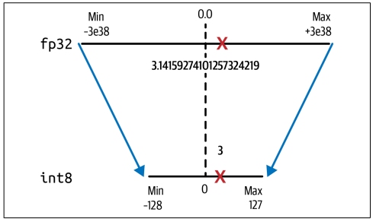

Slide 11
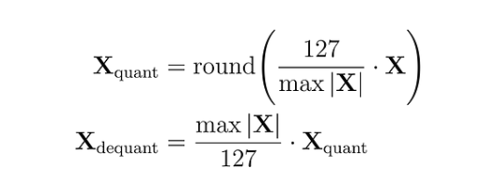
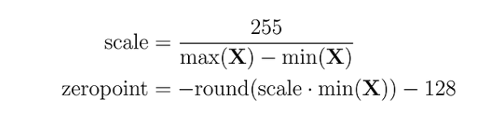
Naïve 8-bit Quantization
absmax quantization: For instance, let’s say we have an absolution maximum value of 3.2. A weight of 0.1 would be quantized to round(0.1 × 127/3.2) = 4. If we want to dequantize it, we would get 4 × 3.2/127 = 0.1008, which implies an error of 0.008
zero-point quantization: Let’s take an example: we have a maximum value of 3.2 and a minimum value of -3.0. We can calculate the scale is 255/(3.2 + 3.0) = 41.13 and the zero-point -round(41.13 × -3.0) - 128 = 123 -128 = -5, so our previous weight of 0.1 would be quantized to round(41.13 × 0.1 -5) = -1

Slide 12
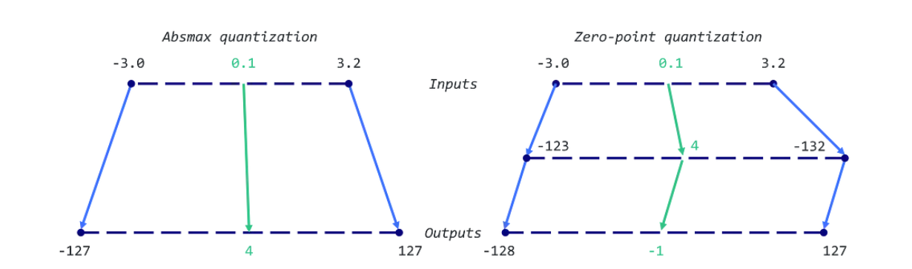
Naïve 8-bit Quantization

Slide 13
Links
https://huggingface.co/docs/optimum/concept_guides/quantization
https://pytorch.org/blog/quantization-in-practice/
https://paperswithcode.com/method/chinchilla
https://arxiv.org/abs/2203.15556v1
https://towardsdatascience.com/a-new-ai-trend-chinchilla-70b-greatly-outperforms-gpt-3-175b-and-gopher-280b-408b9b4510
https://lifearchitect.ai/chinchilla/
https://aws.amazon.com/blogs/machine-learning/technology-innovation-institute-trains-the-state-of-the-art-falcon-llm-40b-foundation-model-on-amazon-sagemaker/
https://www.amazon.co.uk/NVIDIA-Tesla-A100-Ampere-Graphics/dp/B0BGZJ27SL

