Slide 1
Interpreting and Controlling Linguistic Features in Multilingual Language Models
Doctoral Defense
Tomasz Limisiewicz

Slide 2
Tokenization and Text Representation
ACL
Gender Debiasing
ICLR AACL GeBNLP
National Grant
Multilingual LLMs
NAACL EMNLP
University Grant
Interpretability
ACL EMNLP

Slide 3

Motivation
Neural networks and Language Models have become powerful tool to process language.
BUT
Their behaviour is not fully understood, poses risk of harmful generation and reliance on biases. Thus Language Models are not realliable for many applications!
Doctoral Defence

Slide 4

Motivation
Neural networks and Language Models have become powerful tool to process language.
BUT
Language Models are not reliable for many applications!
Doctoral Defence

Slide 5
Transformers
Transformers are currently the most popular architecture to model language.
Doctoral Defence

Slide 6
Transformers
Transformers are currently the most popular architecture to model language.
What are they used for?
Language Models: system to predict words in text
Doctoral Defence

Slide 7
Transformers
Transformers are currently the most popular architecture to model language.
What are they used for?
Language Models: system to predict words in text
Doctoral Defence

Slide 8
Transformers
Transformers are currently the most popular architecture to model language.
What are they used for?
Language Models: system to predict words in text
What do they look like?
Doctoral Defence

Slide 9
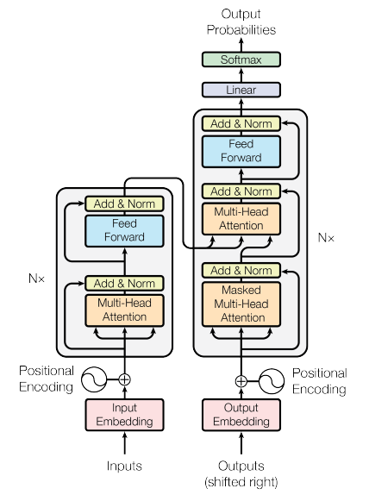
Vaswani et al. (2017)

Slide 10

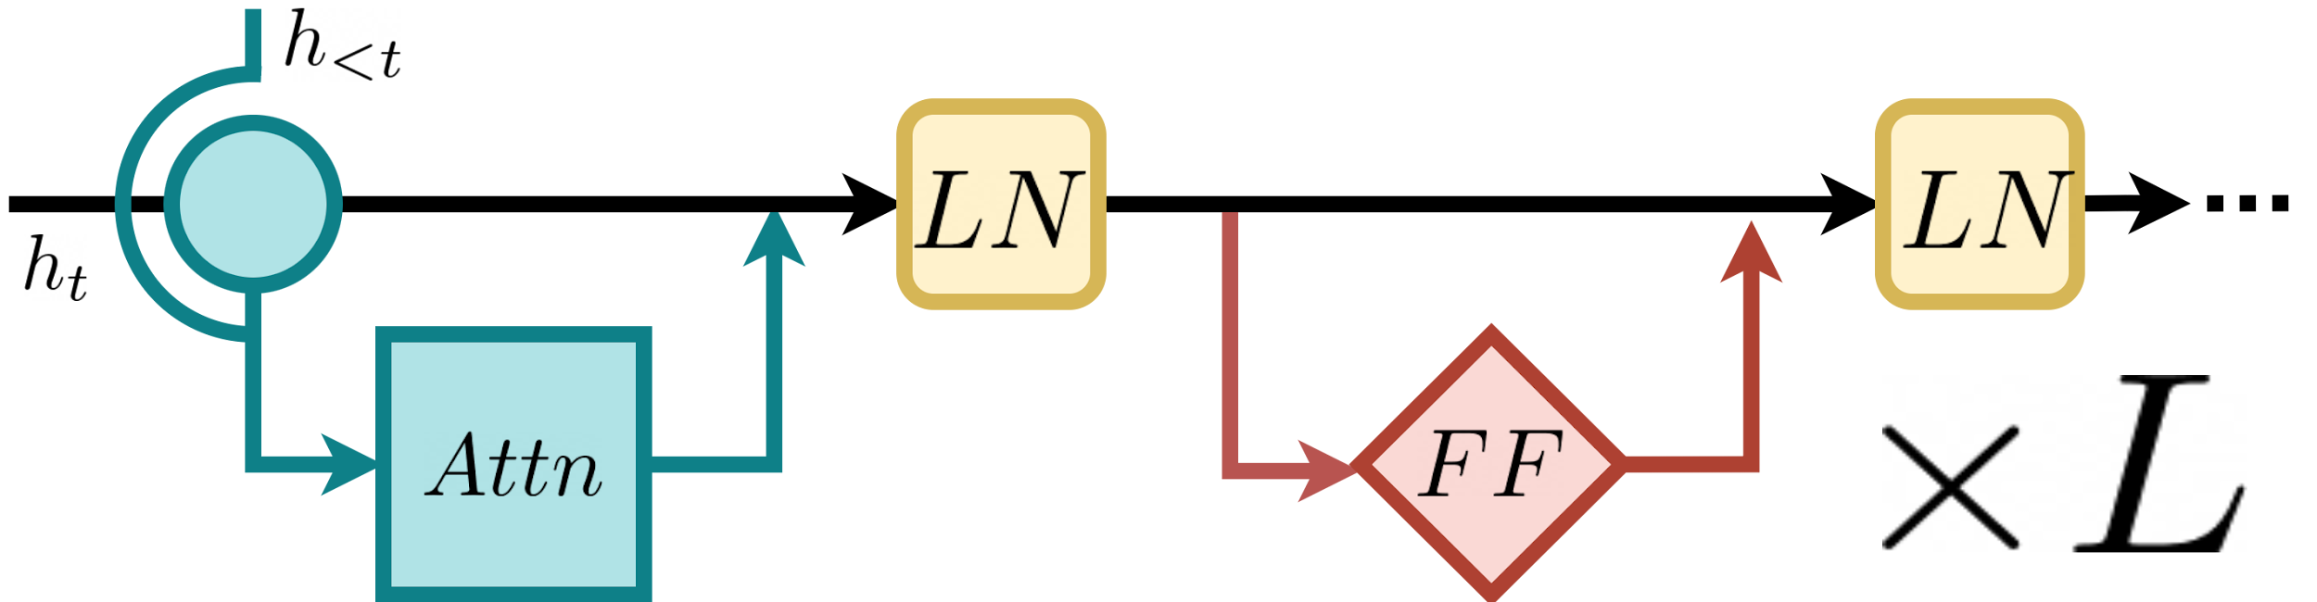
Vaswani et al. (2017)

Slide 11
Transformer
1
2
3

Slide 12
Latent States

Slide 13
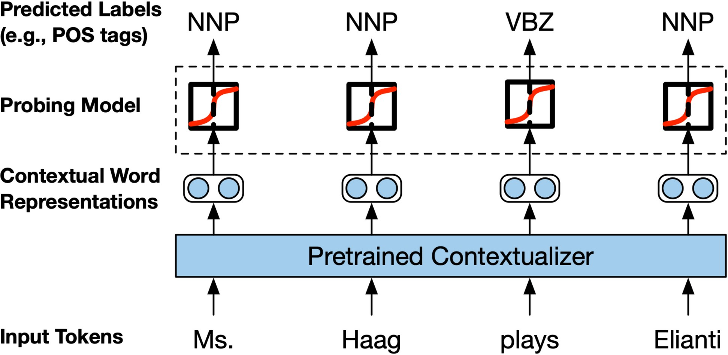
Probing
A network’s parameters are fixed (frozen).
A new simple network (probe) is trained for auxiliary task.
Liu et al. (2015)
Latent States

Slide 14
Linguistic Structures
DEP Dependency tree from Universal Dependencies Nivre et al. (2020)
The team focus is prevention and education .
9
10
10
LEX Hypernymy from WordNet
Miller (1995)
The team focus is prevention and education .
11
5
8
Latent States

Slide 15
Structural Probe
Approximation of the dependency tree distance:
Hewitt and Manning (2019)
Latent States
Introduction Experiments Next steps Q&A

Slide 16
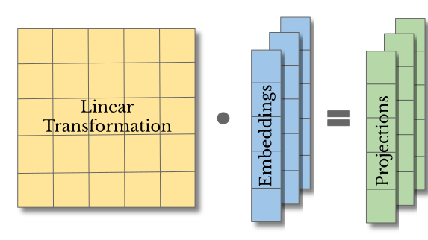
Structural Probe
Latent States

Slide 17
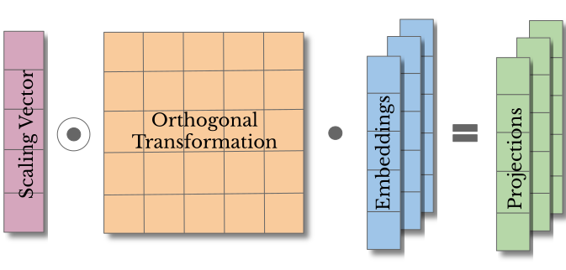
Orthogonal Structural Probe
Latent States
Introduction Experiments Next steps Q&A

Slide 18
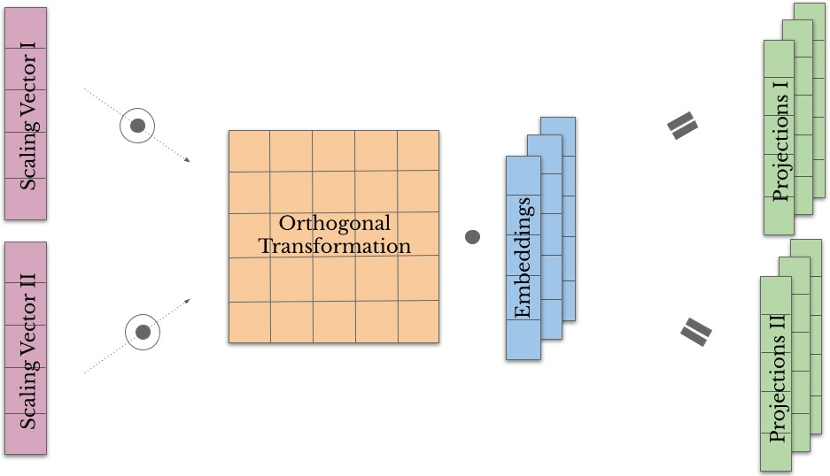
Orthogonal Structural Probe
Latent States
Introduction Experiments Next steps Q&A

Slide 19
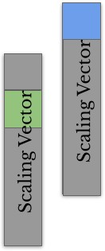
Disentanglement
Latent States
Introduction Experiments Next steps Q&A

Slide 20
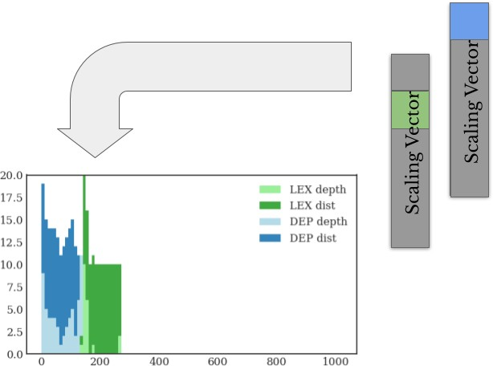
Disentanglement
Latent States
Introduction Experiments Next steps Q&A

Slide 21
Disentanglement
25
LEX depth LEX dist DEP depth DEP dist
LEX depth LEX dist DEP depth DEP dist
17.5
20
15.0
15
12.5
10.0
10
7.5
5
5.0
2.5
0 ₀
200
400
600
800
1000
0.0 ₀
200
400
600
800
1000
(a) Layer 1
(b) Layer 6
20.0
 | LEX depth LEX dist DEP depth DEP dist
LEX depth LEX dist DEP depth DEP dist
17.5
20
15.0
15
12.5
10.0
10
7.5
5.0
5
2.5
0.0 ₀
200
400
600
800
1000
0 ₀
200
400
600
800
1000
(c) Layer 16
Introduction Experiments Next steps Q&A
(d) Layer 24
Latent States

Slide 22
Over-Fitting to Data
1.00
DEP Depth DEP Distance LEX Depth LEX Distance POS Depth POS Distance SELECTIVITY
0.95
0.90
0.85
Spearman’s Correlation
0.80
0.75
0.70
0.65
Structural Probes
Orthogonal Probes
setting
Orthogonal Probes Multitask
Figure: Selectivity is difference between averaged correlations for DEP, LEX, POS structures and RAND
Latent States

Slide 23
Orthogonal Probes (Other Experiments)
Allow to disentangle specific linguistic signals in the model
Reveals sharing of information across languages [Multilingual]
Can be used to filter-out unwanted signal [Gender Bias]
Latent States

Slide 24
Attention

Slide 25
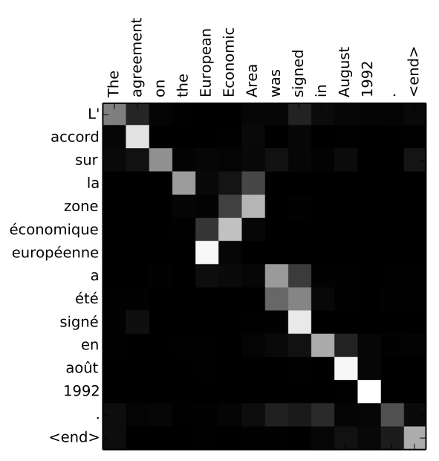
Attention
Attention allows a model to focus on different words in a sentence based on their relevance to each other.
Bahdanau et al. (2015)
Attention

Slide 26
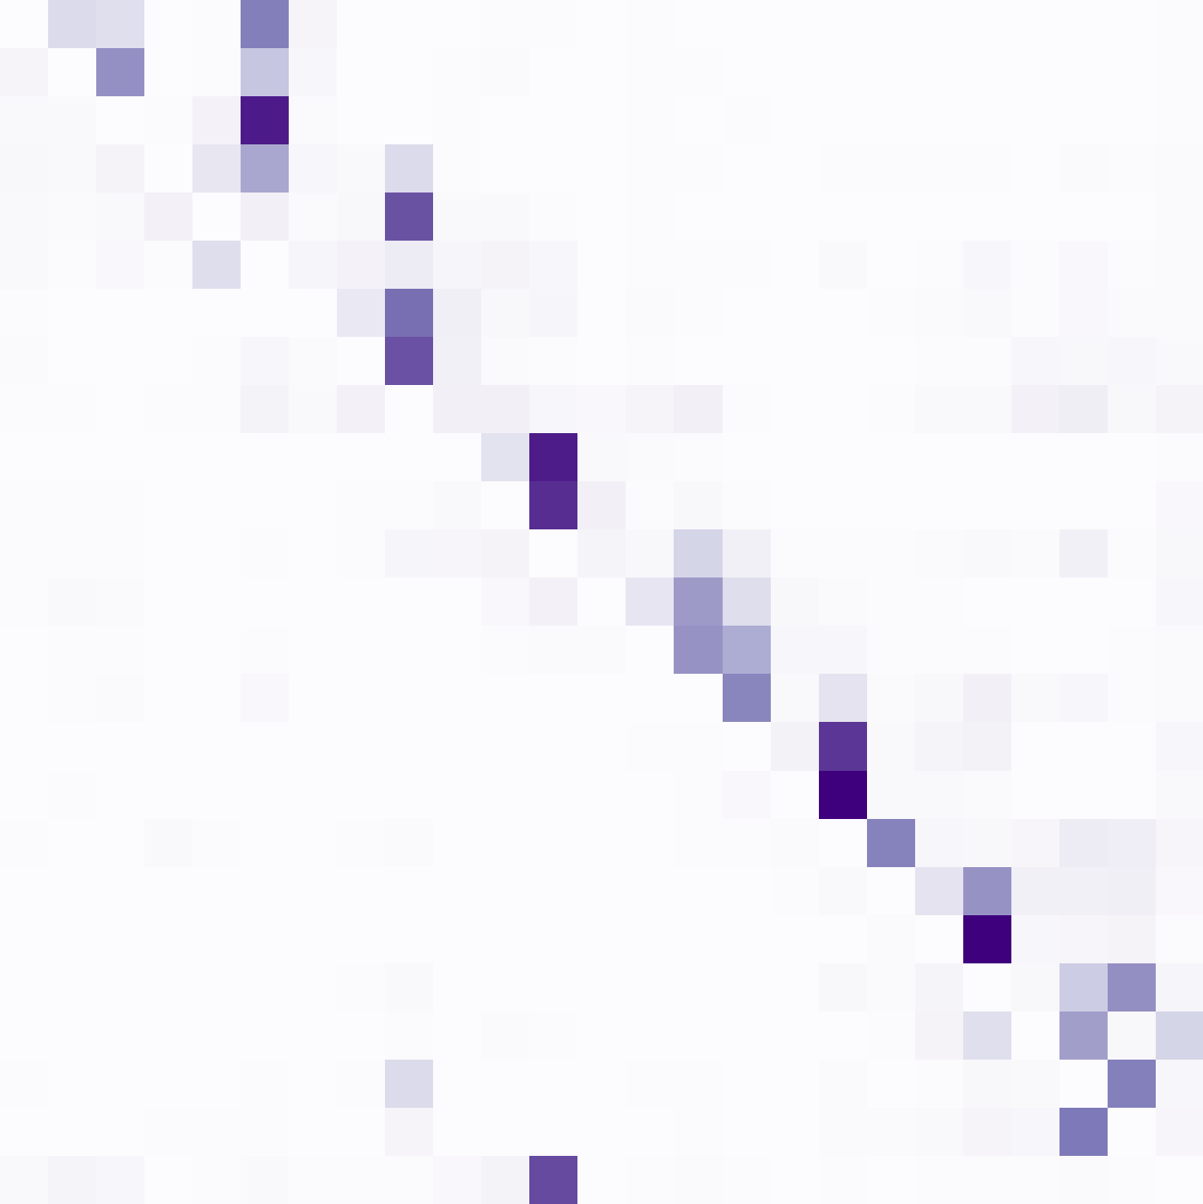
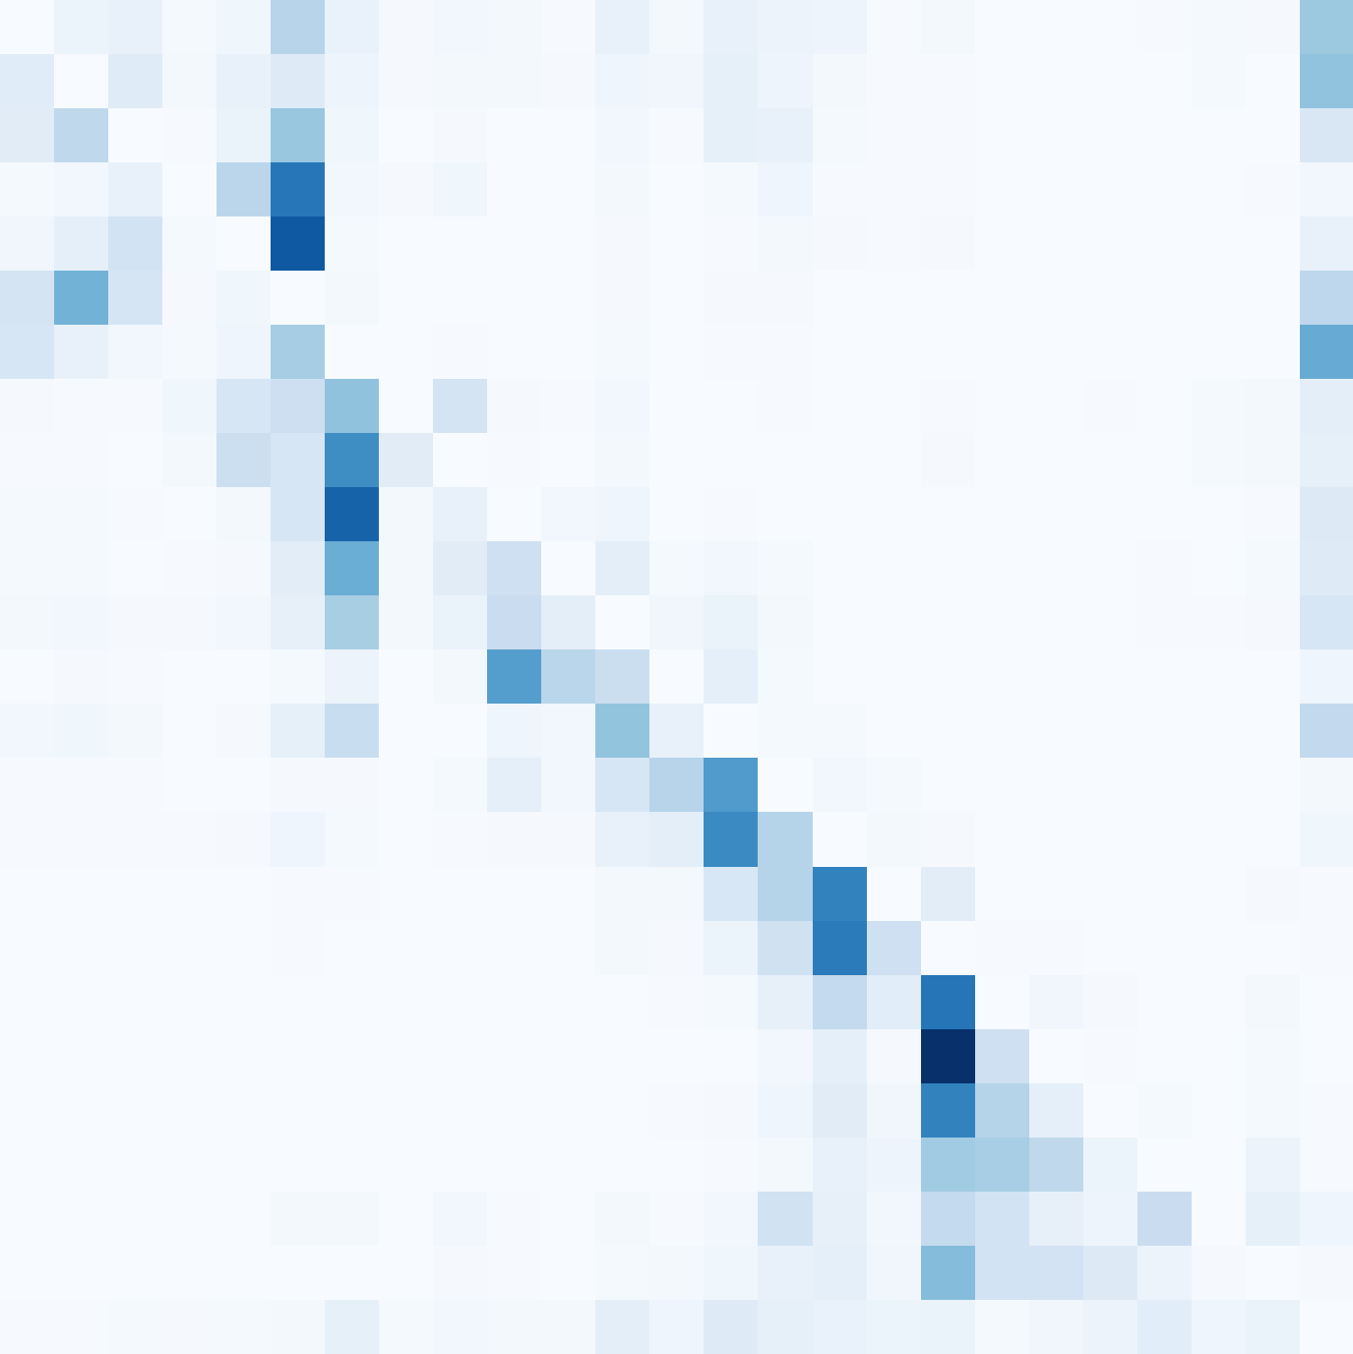
Attention and Dependency Relations
Self-attention in a particular heads of a language model aligns with dependency relations
there is
considerable
energy saving
potential
in public
buildings
,
for example
,
which would facilitate
the transition
towards
a stable
,
green economy
.
X
X
X
X
there is
considerable
energy saving
potential
in public
buildings
,
for example
,
which would facilitate
the transition
towards
a stable
,
green economy
.
there is
considerable
energy saving
potential
in public
buildings
,
for example
,
which would facilitate
the transition
towards
a stable
,
green economy
.
X
X
X
Attention
AMOD L6H8
OBJ L8H10

Slide 27
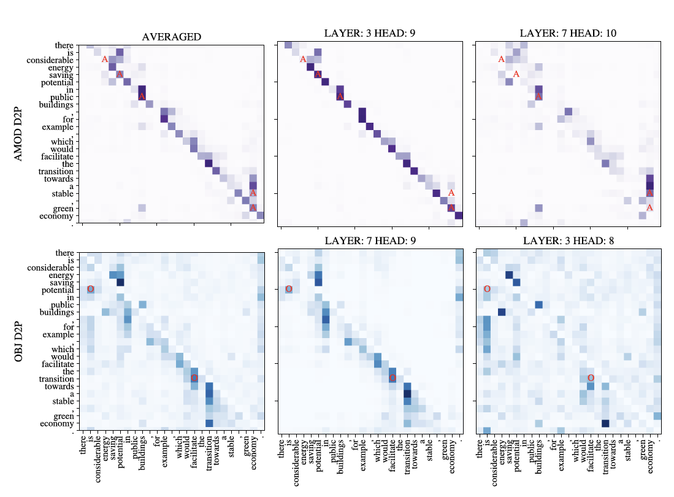
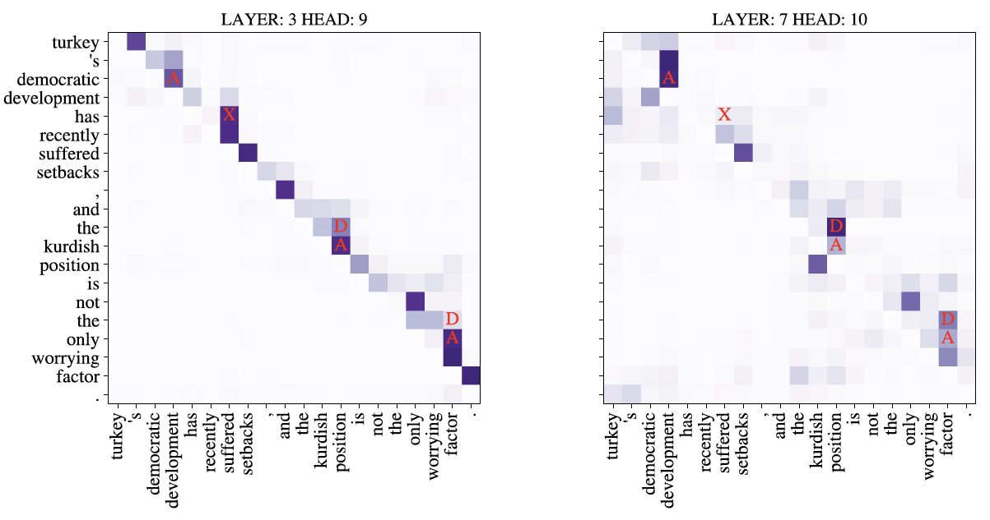
Syntax in Attention Heads
More Specific in Attention
More General in Attention
Adjectives (top row), Objects (bottom row)
Adjectives, Determiners, auXiliers
Attention

Slide 28
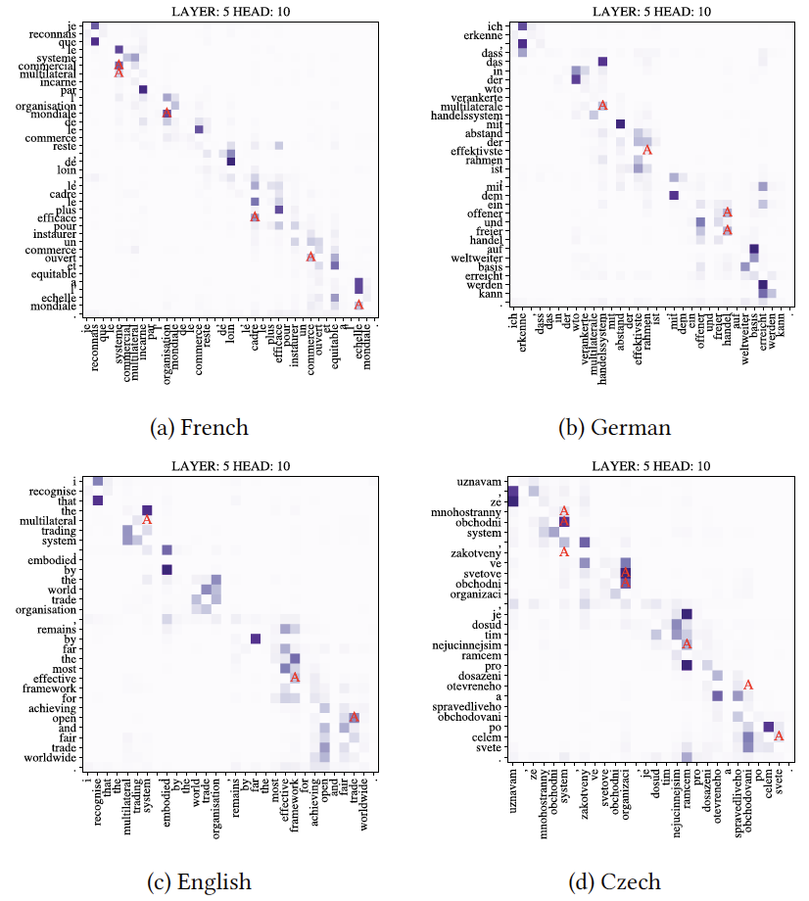
Multilingual Syntax in Attention Heads
Attention

Slide 29
Head Ensembling
We average (ensemble) attention heads in search of syntactic patterns
The method allows extracting labeled dependency trees
(52% UAS, 22% LAS on English UD)
A small town with two minarets glides by .
Attention

Slide 30
Feed Forward

Slide 31
Feed Forward
Feed-Forwards are fully connected layers applied to each position in the sentence.
.
IN
OUT
ACTIVATION
Feed Forward

Slide 32
Gender Bias in Language Model
We use a simple linear model to mitigate stereotypical signal influence on predictions:
“The lifeguard laughed because ___”
Stereotype
nurse -0.9 mechanic 0.6
receptionist -0.7 lifeguard 0.6
PM(“he”) - PM(“she”) ≈ af ⋅ xf + as ⋅ xs + b
Feed Forward

Slide 33
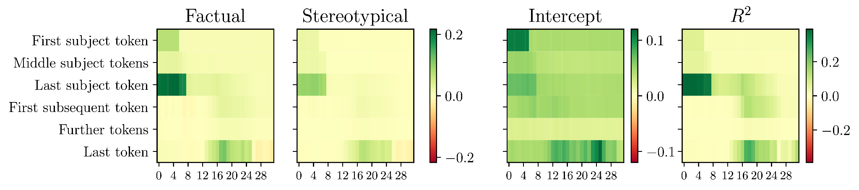
Gender Bias in Feed Forwards
With a method: causal tracing, we discover that the feed forwards in mid-upper have the highest impact on biased prediction of the model;
Feed Forward

Slide 34
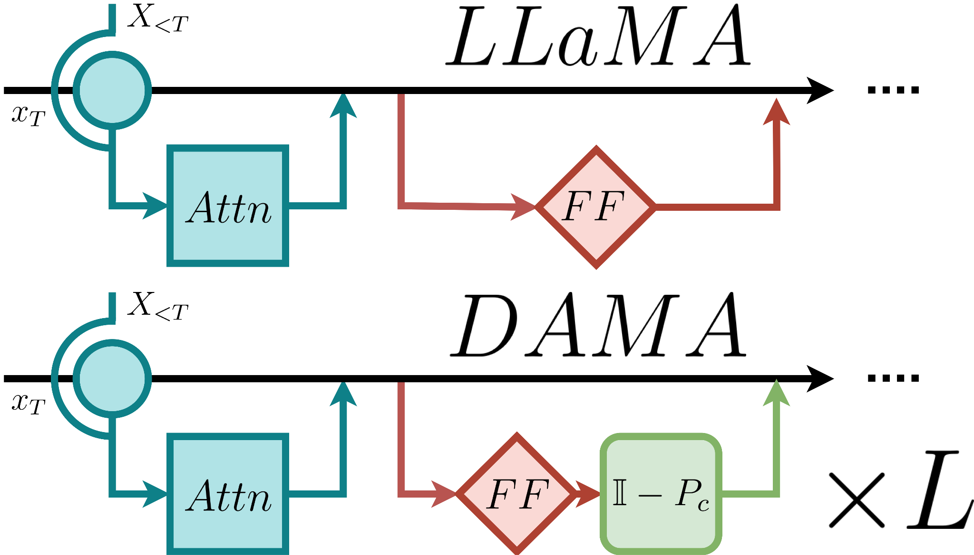
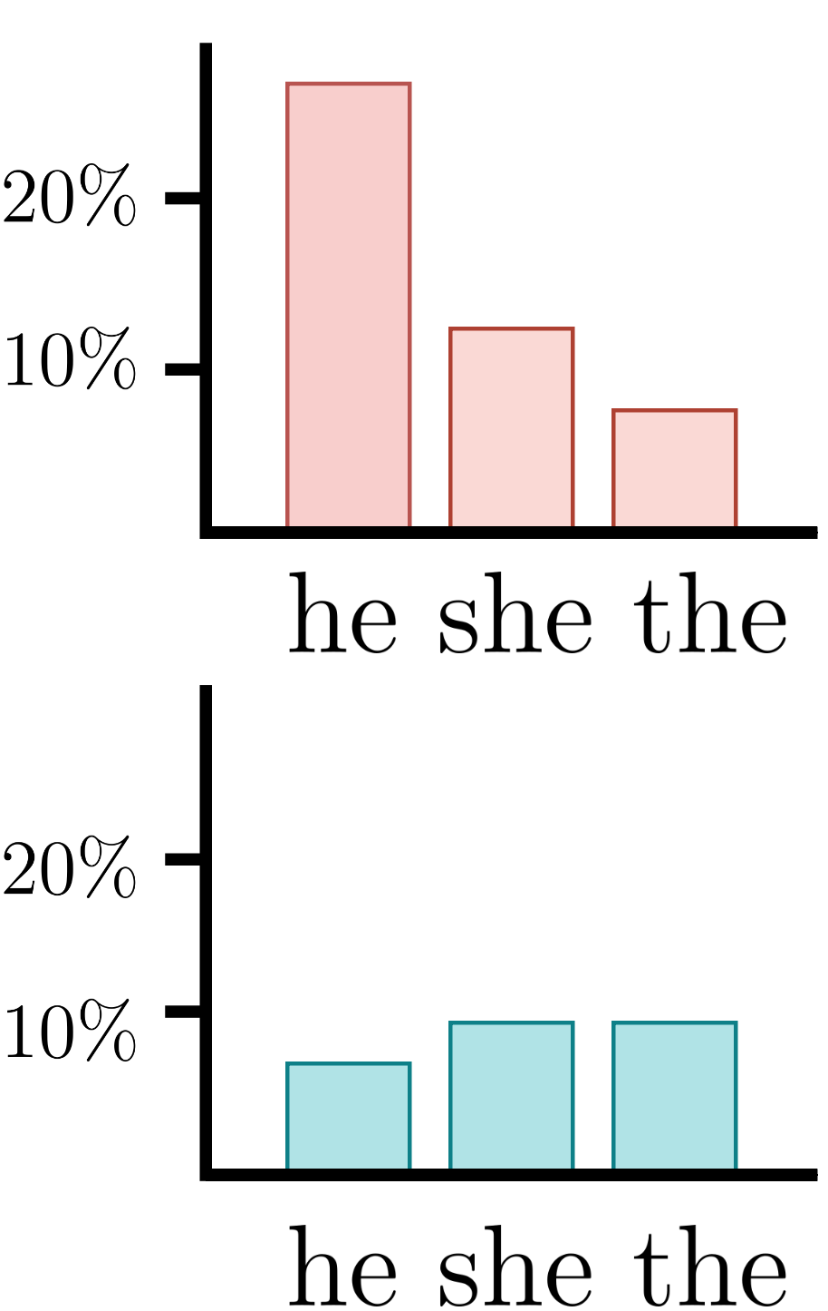

Debiasing Algorithm through Model Adaptation
We adapt the feed-forward layers by applying projections.
“The lifeguard laughed because ___”
Feed Forward

Slide 35
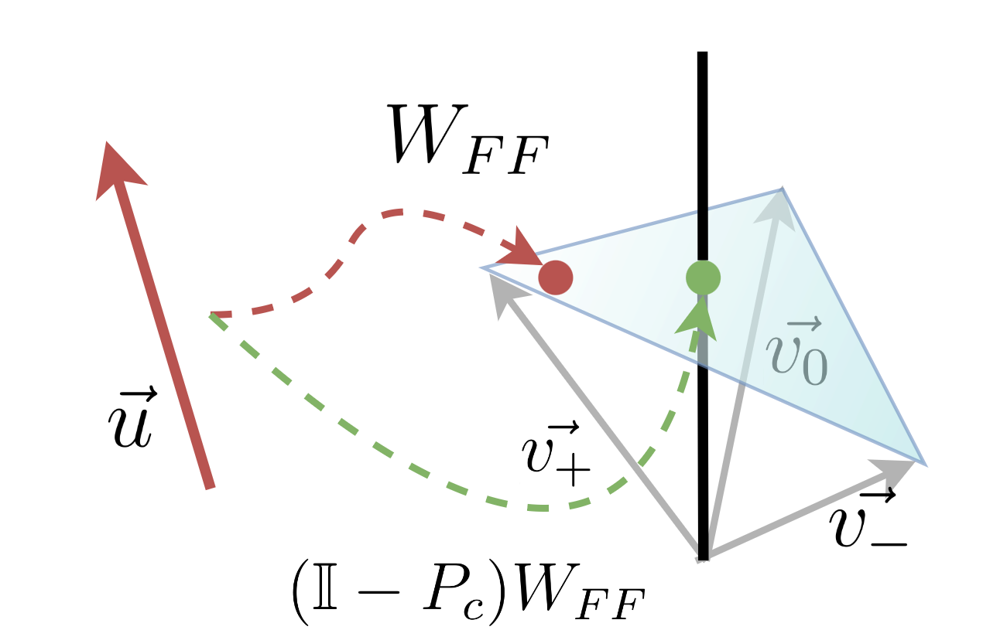
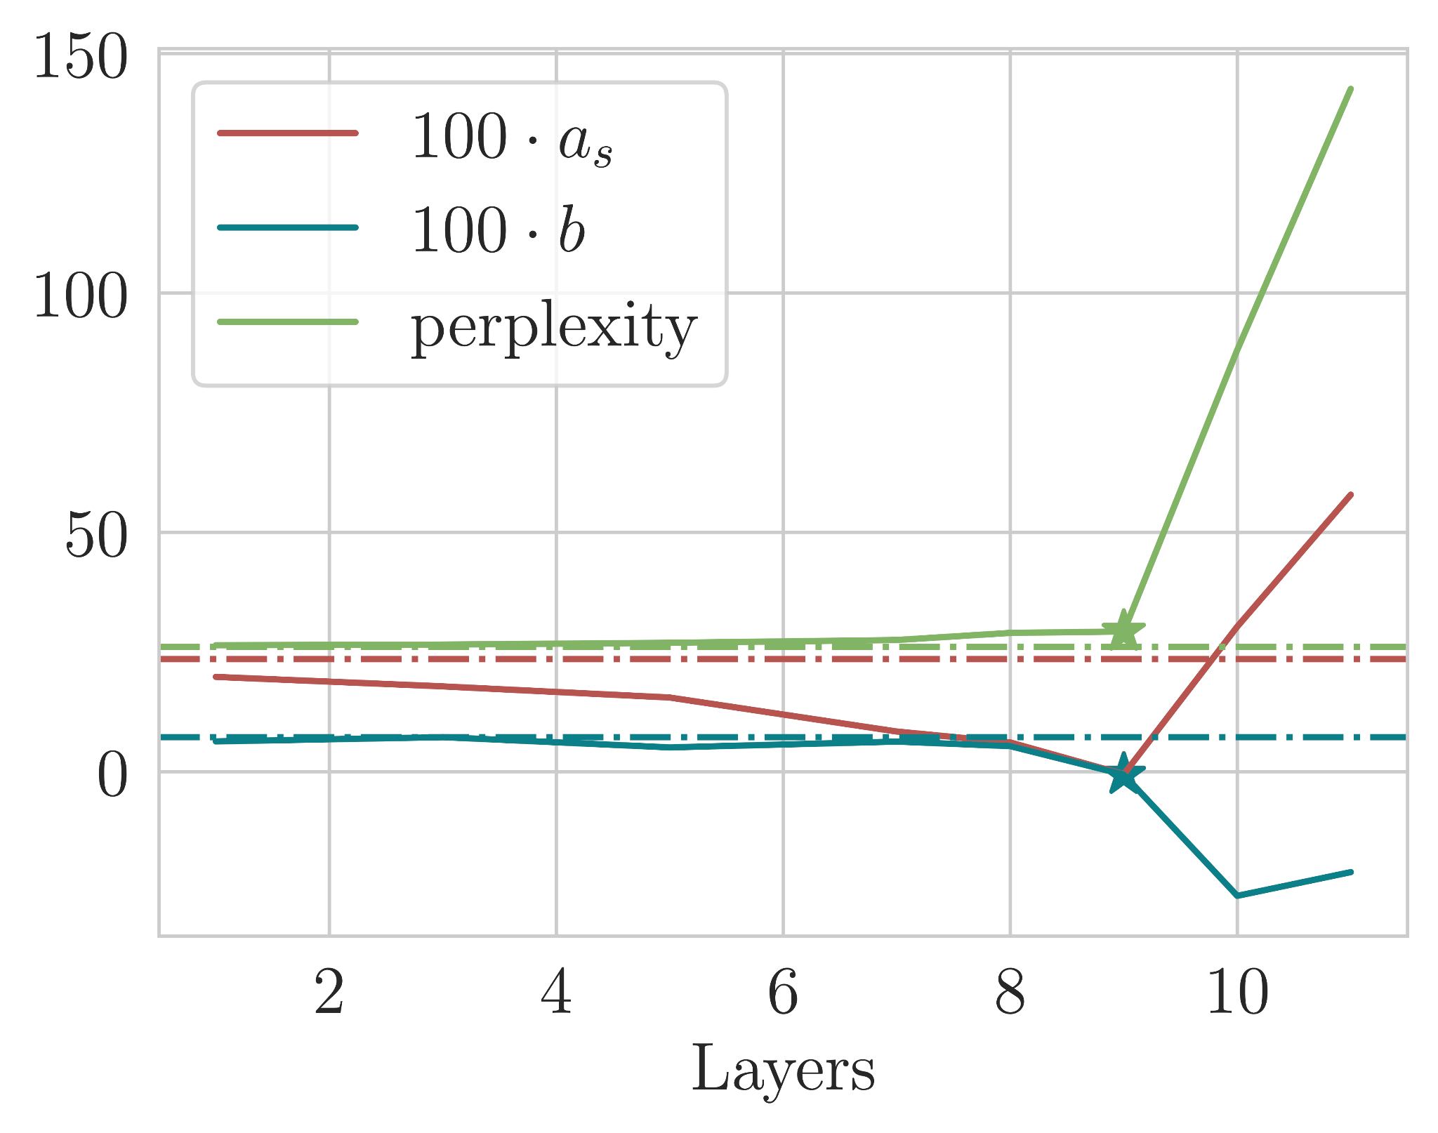
Debiasing Algorithm through Model Adaptation
Projections nullifies gender signal
We intervene in ⅓ mid-upper layers
Feed Forward

Slide 36
DAMA: Results
METHOD | Language Modeling |  |  |  | WinoBias |  | End-task
 | Factual (af) | Stereotyp (as) | Intercept (b) | Perplexity | △ S | △G | MMLU
LLaMA 7B | 0.320 | 0.235 | 0.072 | 26.1 | 40.3% | 3.0% | 30.3
FT LoRA | 0.261 | 0.144 | -0.040 | 51.1 | 34.4% | 5.6% | 26.6
MEMIT | 0.282 | 0.209 | 0.071 | 26.1 | 40.5% | 3.3% | 30.2
DAMA | 0.038 | -0.005 | -0.006 | 28.9 | 31.5% | 2.3% | 30.8
Feed Forward

Slide 37


Slide 38
Doctoral Defence
Summary
Linguistic signals are distributed throughout language models
In multilingual models representation is often shared across languages
We use and propose multiple tools to identify and control specific signals, e.g. harmful biases

Slide 39
Questions about DAMA (Theoretical Perspective)
How does DAMA compare to linear removal methods like INLP or LEACE, both
theoretically and empirically?
 | INLP | LEACE | DAMA
Projection | PLS | oblique | PLS
Dimensions | pre-set | self-adapted | pre-set
Task | classification | classification | LM
Model Editing | ❌ | ❌* | ✔️
Q&A

Slide 40
Questions about DAMA (Empirical Perspective)
How does DAMA compare to linear removal methods like INLP or LEACE, both
theoretically and empirically?
METHOD | Language Modeling |  |  |  | WinoBias |  | End-task
 | Factual (af) | Stereotyp (as) | Intercept (b) | Perplexity | △ S | △G | ARC
LLaMA 7B | 0.320 | 0.235 | 0.072 | 26.1 | 40.3% | 3.0% | 69.2
DAMA | 0.038 | -0.005 | -0.006 | 28.9 | 32.5% | 2.3% | 68.7
DAMA + LEACE | 0.019 | -0.019 | -0.002 | 29.4 | 25.5% | 1.6% | 67.4
Q&A

Slide 41
Questions about DAMA
Would DAMA also work at any layer(s) or do we really need to localize the information first for it to work well?
starting from 21st layer
Q&A

Slide 42
Questions about Attention Head Ensemble
Why the LAS scores are so much lower than the UAS scores?
52% UAS, 22% LAS on English UD
Q&A

Slide 43
Syntax in Attention Heads
More Specific in Attention
More General in Attention
Adjectives (top row), Objects (bottom row)
Adjectives, Determiners, auXiliers
Q&A

Slide 44
Multilingual Analysis

Slide 45
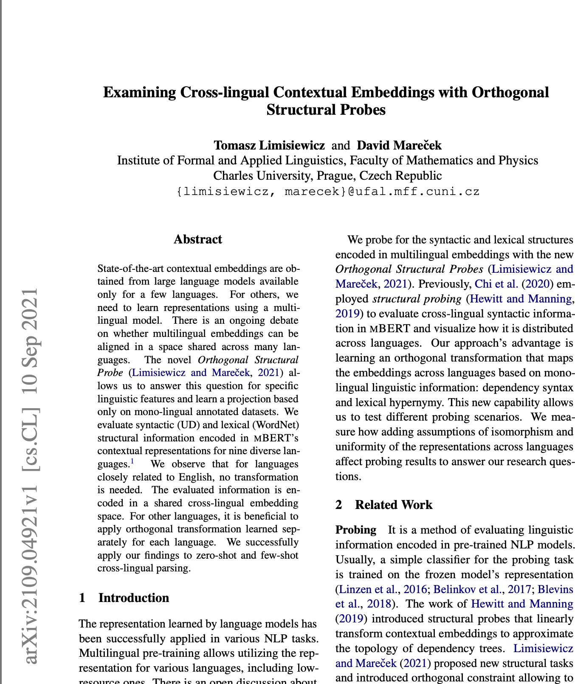
Multilingual Approach
Tomasz Limisiewicz and David Mareček. Examining cross-lingual contextual embeddings with orthogonal structural probes.
In Proceedings of the 2021 Conference on Empirical Methods in Natural Language Processing (EMNLP). Association for Computational Linguistics, November 2021a
Probing for syntactic and lexical information in multilingual representations (mBERT)
Covers 9 diverse languages
Motivation: How similar are the representations across languages?
Multilingual Analysis
Introduction Experiments Next steps Q&A

Slide 46
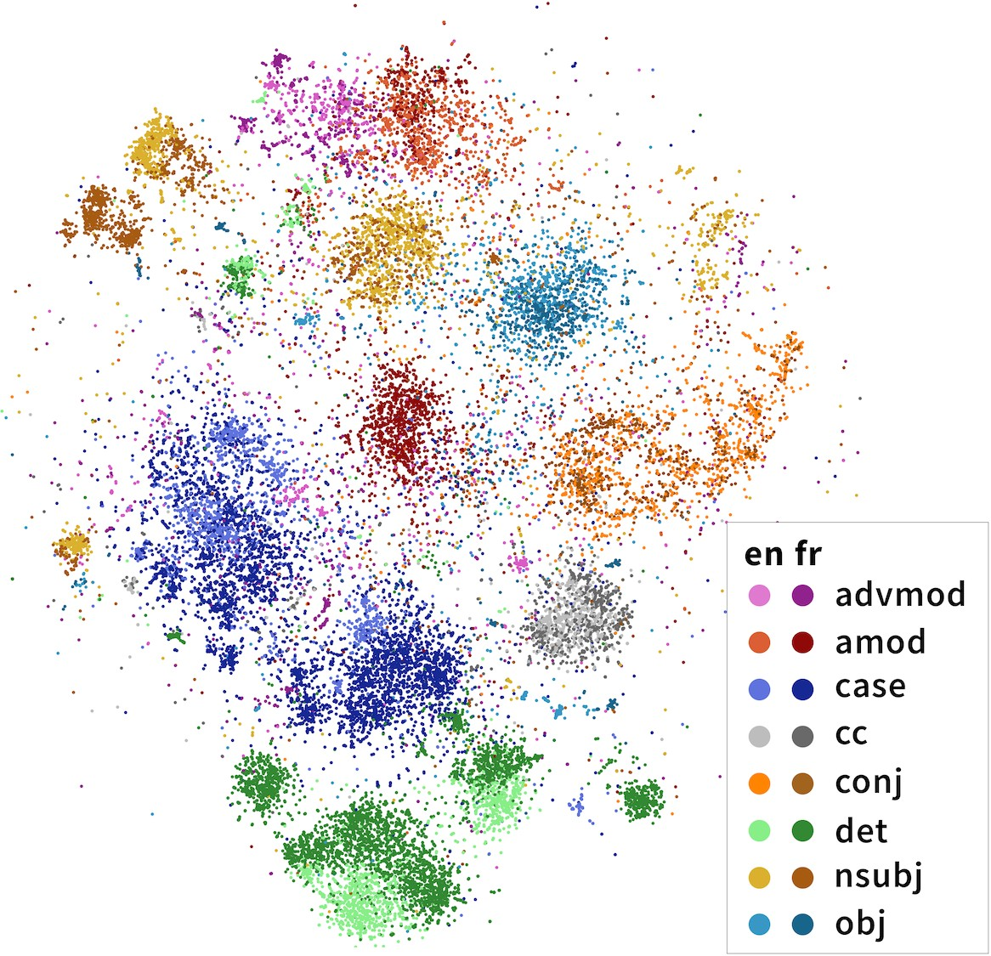
How the Representation Vary Across Languages?
To what extent embeddings are similar across languages. What can affect this similarity Vulić et al. (2020)
  Is language signal encoded uniformly across languages?
  Will applying orthogonal map improve cross-lingual transfer?
We can study relations between languages based on the multilingual probes Chi et al. (2020)
Figure: Visualization of multilingual representation (Chi et al., 2020)
Multilingual Analysis
Introduction Experiments Next steps Q&A

Slide 47
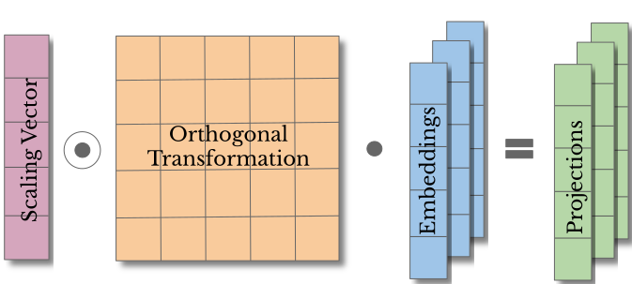
Multilingual Approach
Our approaches and corresponding assumptions about the likeness of the cross-lingual embeddings:
In-Lang no assumption We train a separate instance of a probe for each language.
Multilingual Analysis
Introduction Experiments Next steps Q&A

Slide 48
Multilingual Approach
Our approaches and corresponding assumptions about the likeness of the cross-lingual embeddings:
In-Lang no assumption We train a separate instance of a probe for each language.
MappedLangs isomorphity assumption We train a shared Scaling Vector for each probing task and a separate Orthogonal Transformation per language.
Multilingual Analysis
Introduction Experiments Next steps Q&A

Slide 49
Multilingual Approach
Our approaches and corresponding assumptions about the likeness of the cross-lingual embeddings:
In-Lang no assumption We train a separate instance of a probe for each language.
MappedLangs isomorphity assumption We train a shared Scaling Vector for each probing task and a separate Orthogonal Transformation per language.
AllLangs uniformity assumption Both the Scaling Vector and Orthogonal Transformation are shared across languages.
Multilingual Analysis
Introduction Experiments Next steps Q&A

Slide 50
Multilingual Approach
Our approaches and corresponding assumptions about the likeness of the cross-lingual embeddings:
In-Lang no assumption We train a separate instance of a probe for each language.
MappedLangs isomorphity assumption We train a shared Scaling Vector for each probing task and a separate Orthogonal Transformation per language.
COMPARABLE PERFORMANCE
AllLangs uniformity assumption Both the Scaling Vector and Orthogonal Transformation are shared across languages.
PERFORMANCE DEPENDS ON
TYPOLOGICAL DIFFERENCES
Multilingual Analysis
Introduction Experiments Next steps Q&A

Slide 51
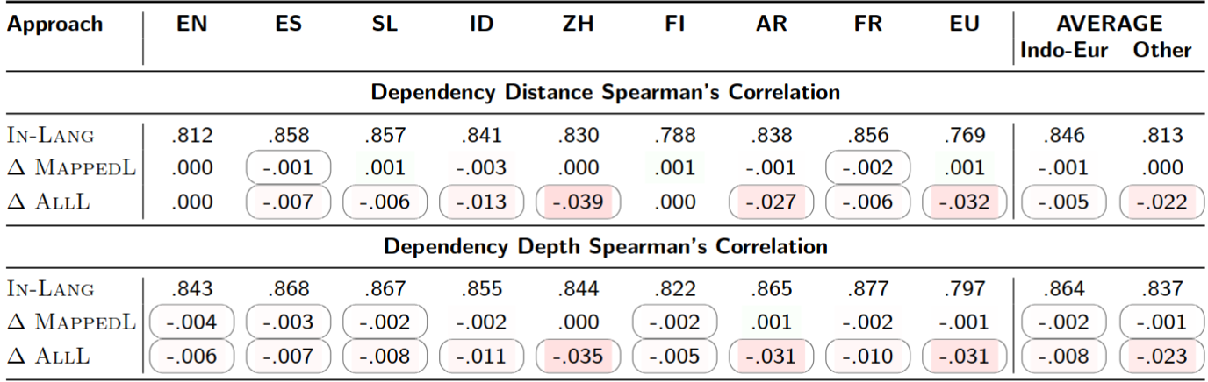
Results for Dependency Probes
Multilingual Analysis

Slide 52
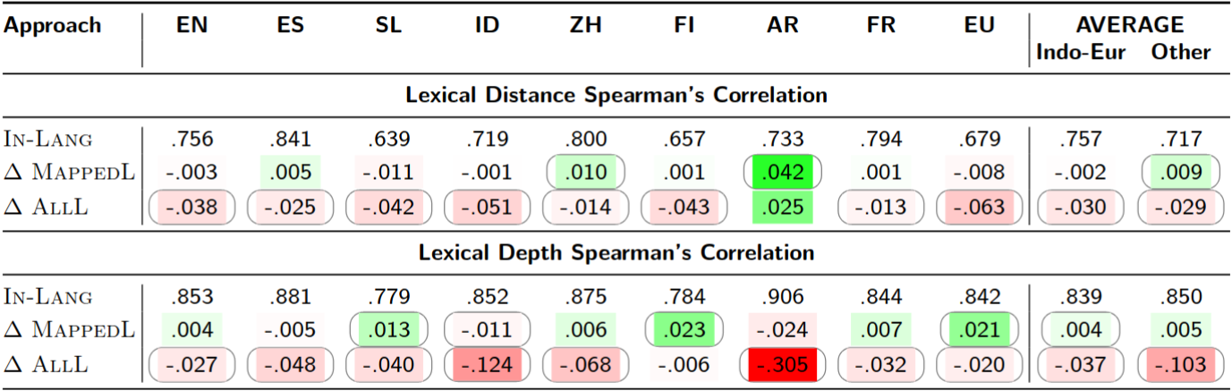
Results for Lexical Probes
Multilingual Analysis

Slide 53
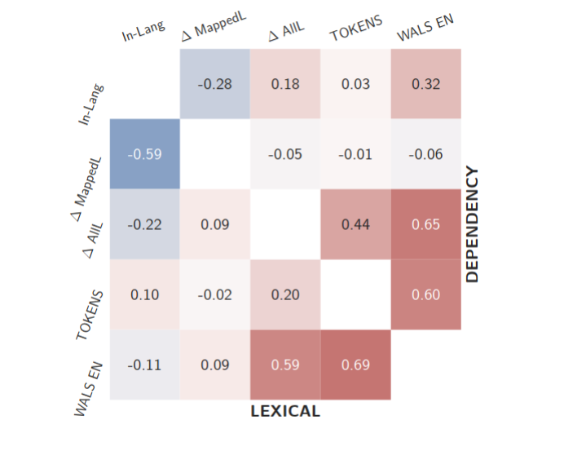
Trends
LANGUAGE SPECIFIC:
TOKENS number of tokens used in mBERT pre-training for a language
WALS EN Hamming (string) similarity between features in WALS
PROBING RESULTS:
In-Lang (no assumption)
MappedLangs (isomorphity assumption)
AllLangs (uniformity assumption)
Multilingual Analysis

Slide 54
Trends
LANGUAGE SPECIFIC:
TOKENS number of tokens used in mBERT pre-training for a language
WALS EN Hamming (string) similarity between features in WALS
PROBING RESULTS:
In-Lang (no assumption)
MappedLangs (isomorphity assumption)
AllLangs (uniformity assumption)
Multilingual Analysis

Slide 55
Trends
Syntactic and lexical information is uniformly encoded across mBERT’s representations of languages similar to English.
For other languages, the orthogonal mapping can improve results.
Multilingual Analysis

