Slide 1


Internal Hackathon BIT Mesra, Deoghar SMART INDIA HACKATHON 2026
TITLE PAGE
Problem Statement ID – SIH26164
Problem Statement Title- Enterprise Cryptographic Discovery & Analysis Tool (ECDAT)
Theme- Blockchain & Cybersecurity
PS Category- Software
Team ID- 22
Team Name – ARC

Slide 2
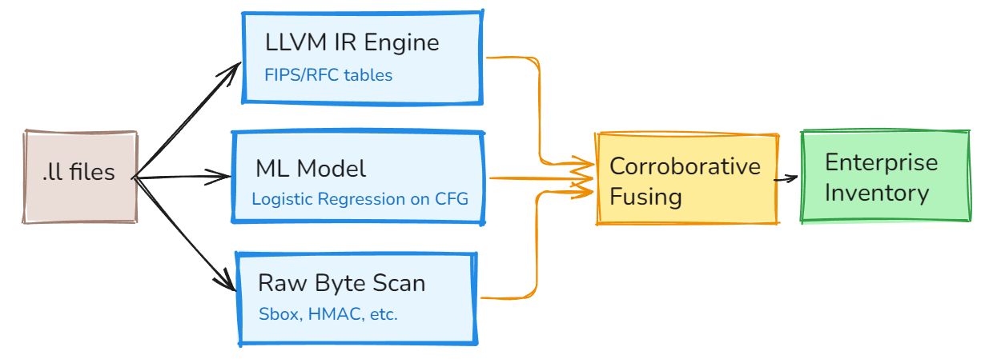
ECDAT — Crypto Discovery
ARC
Proposed Solution (Describe your Idea/Solution/Prototype)
Inventory crypto in enterprise binaries without execution kits
Unique: IR + AI corroboration + stripped evidence; weak flagged

Slide 3
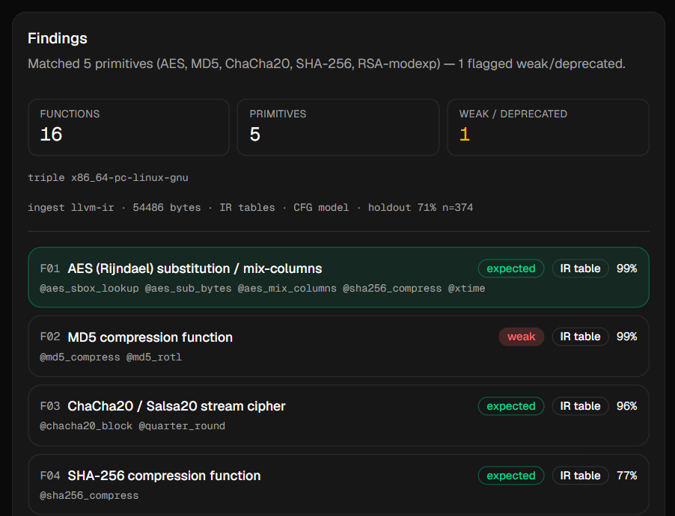
TECHNICAL APPROACH
ARC
Tech Stack:
Clang LLVM IR
Next.js prototype
Softmax logistic regression
on CFG/opcode features

Slide 4
FEASIBILITY AND VIABILITY
ARC
Following Modern Cryptographic Standards
Working prototype
No Sandboxing required
No execution of unknown binaries
Works offline
Machine Independent

Slide 5
IMPACT AND BENEFITS
ARC
Audience: NTRO / enterprise App Security
Know where AES, RSA, TLS, weak hashes live
“where is the crypto, and what is weak?”
Benefits:
faster crypto audit
weak-primitive flags
SBOM-style inventory for compliance

Slide 6
RESEARCH AND REFERENCES
ARC
Standards Followed
FIPS-197/180
RFC 7748
NIST SP
OpenSSL/libsodium tables

