Slide 1
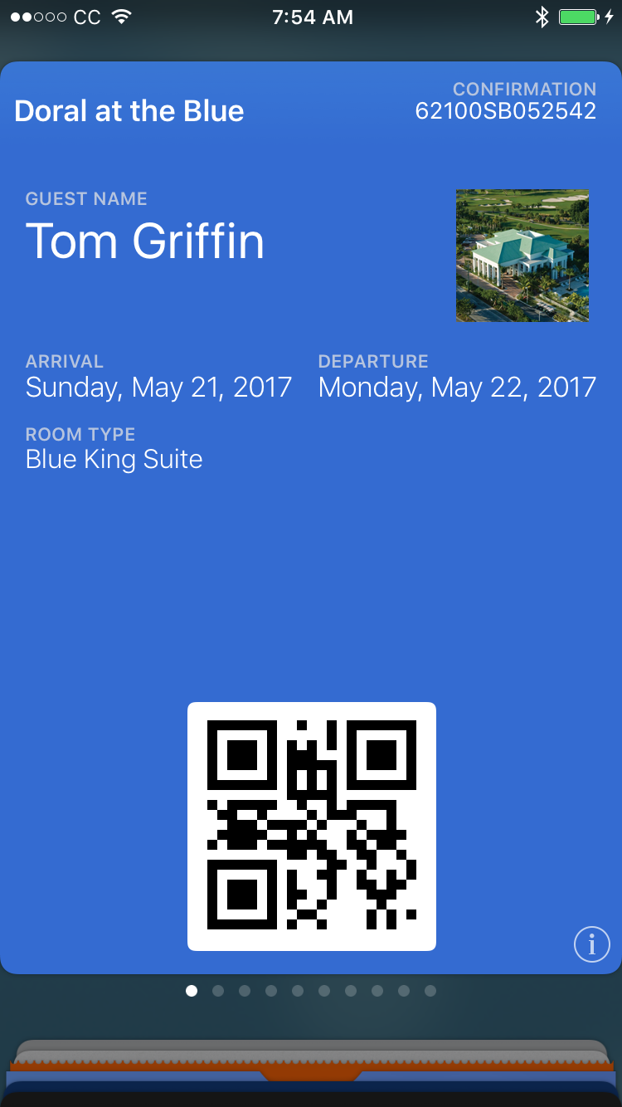
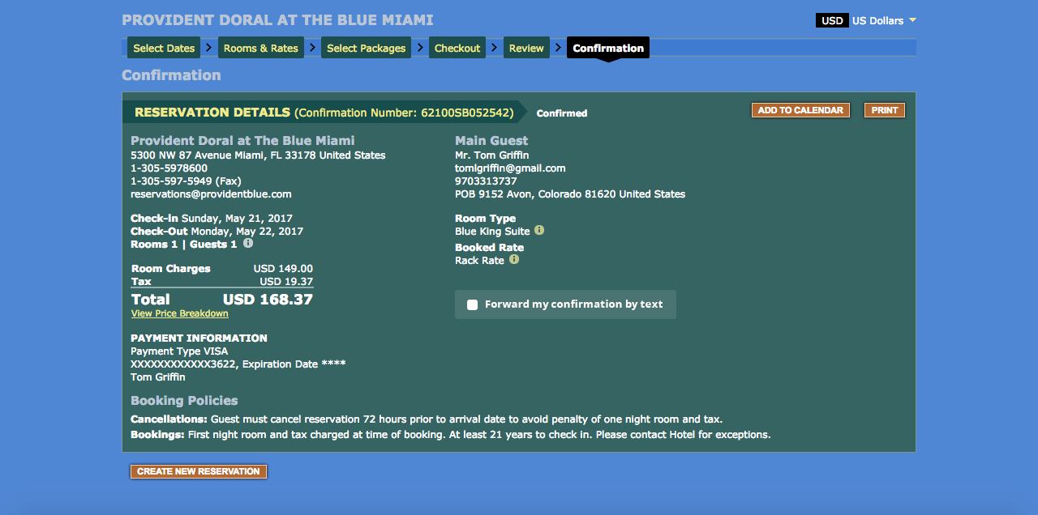
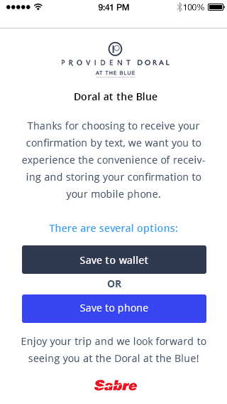
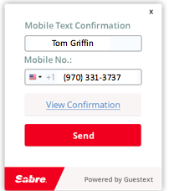
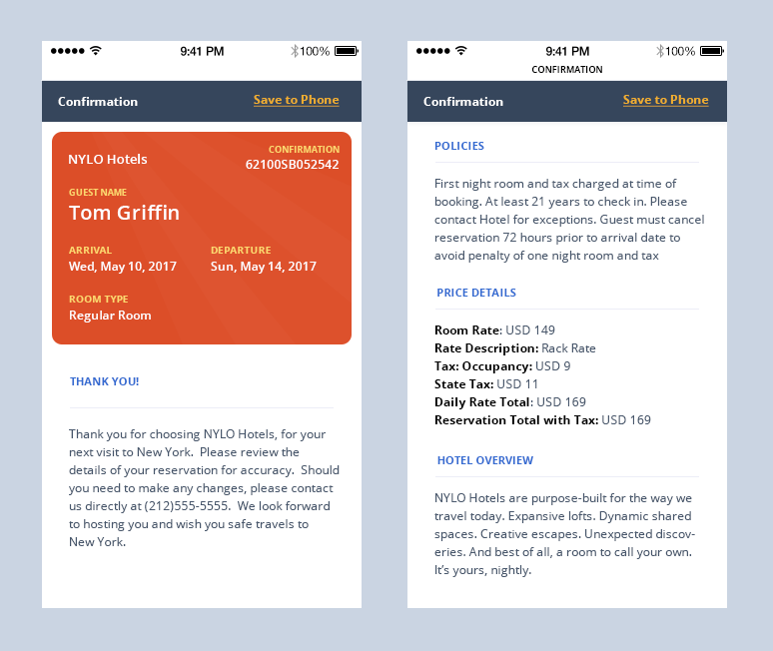
Sabre Process Workflow
If guest chooses the passbook form
Take a check box and make it live on the confirmation image as an html. When that happens the widget image will slide out on the page
Iphone Message image with my name Tom Griffin message that says in box, click here to view confirmation
If guest chooses the mobile home page

