Slide 1
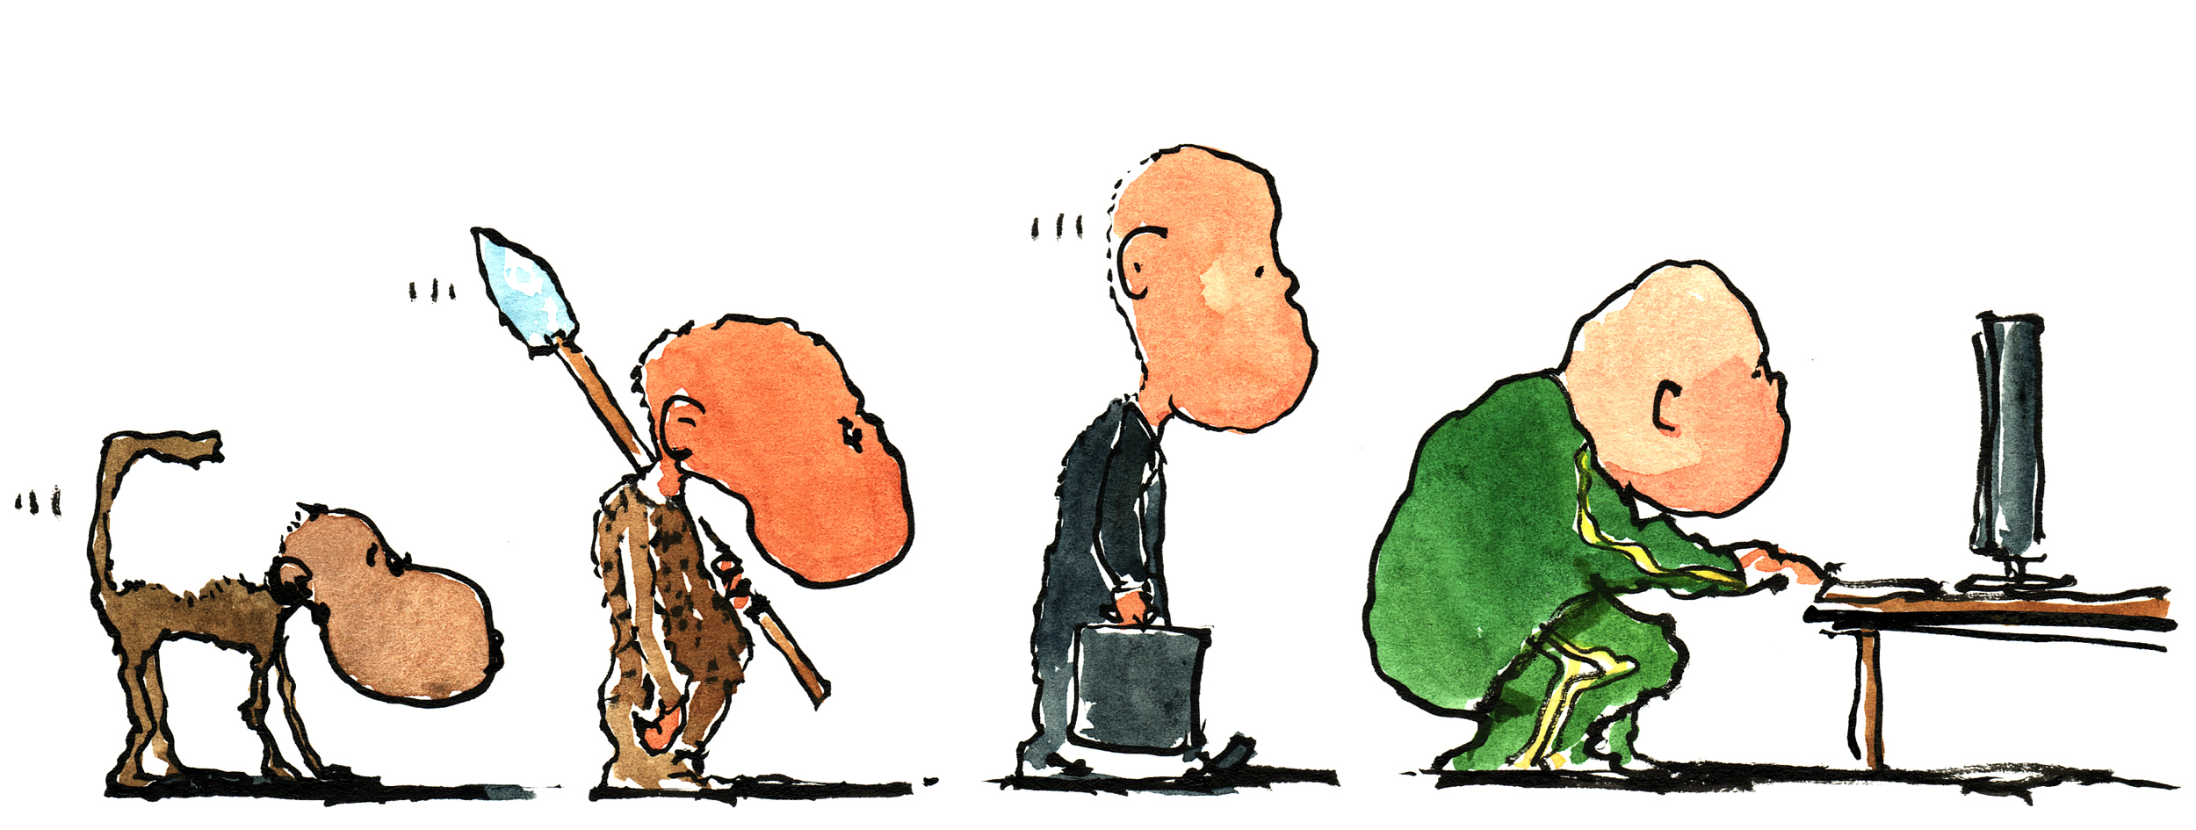

Man Chain illustration by Frits Ahlefeldt-Laurvig | CC BY-ND
Les 5: Execution Control Structures
Programming (TICT-V1PROG-15)
HBO-ICT propedeuse blok 1

Slide 2
Execution Control Structures
Program Structure Diagrams (PSDs)
Conditional Structures
Iteration Patterns
Two-Dimensional Lists
while Loop

Slide 3
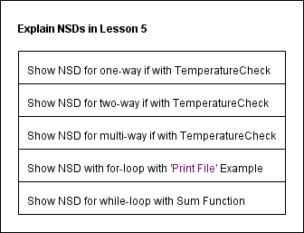
Program Structure Diagram (PSD)
Also known as Nassi/Shneiderman Diagram (NSD)
A graphical design representation for structured programming
Reduce bigger problems in smaller subproblems
Reduce a subproblem in smaller sub-subproblems
Repeat this until flow-control and statements remain.
For example, to explain PSDs in this
lesson, this top-level PSD was used:
Notes:
Laat door middel van Structorizer zien hoe je een PSD maakt.

Slide 4
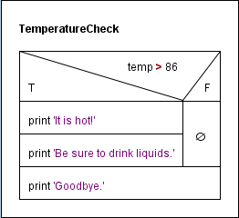
One-way if in PSD
In a low-level PSD, only flow-control and statements remain!
You can draw a PSD by hand..., or:
You can use Structorizer to create a PSD!

Slide 5
One-way if statement
if <condition>:
<indented code block>
<non-indented statement>
if temp > 86:
print('It is hot!')
print('Be sure to drink liquids.')
print('Goodbye.')
if temp > 86:
print('It is hot!')
print('Be sure to drink liquids.')
print('Goodbye.')
if temp > 86:
print('It is hot!')
print('Be sure to drink liquids.')
print('Goodbye.')
The value of temp is 50.
The value of temp is 90.
temp > 86:
True
print('It is hot!')
False
print('Be sure to drink liquids.')
Print('Goodbye.')

Slide 6
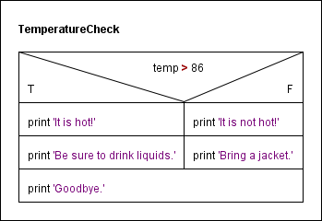
Two-way if in PSD

Slide 7
Two-way if statement
if <condition>:
<indented code block 1>
else:
<indented code block 2>
<non-indented statement>
if temp > 86:
print('It is hot!')
print('Be sure to drink liquids.')
else:
print('It is not hot.')
print('Bring a jacket.')
print('Goodbye.')
if temp > 86:
print('It is hot!')
print('Be sure to drink liquids.')
else:
print('It is not hot.')
print('Bring a jacket.')
print('Goodbye.')
if temp > 86:
print('It is hot!')
print('Be sure to drink liquids.')
else:
print('It is not hot.')
print('Bring a jacket.')
print('Goodbye.')
The value of temp is 50.
The value of temp is 90.
temp > 86:
True
False
print('It is hot!')
print('It is not hot!')
print('Be sure to drink liquids.')
print('Bring a jacket.')
print(‘Goodbye.')

Slide 8
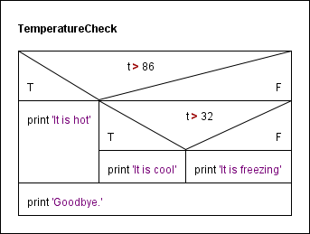
Multi-way (new) if in PSD

Slide 9
Multi-way if statement
The value of t is 90.
The value of t is 50.
The value of t is 20.
t > 86:
def temperature(t):
if t > 86:
print('It is hot')
elif t > 32:
print('It is cool')
else:
print('It is freezing’)
print('Goodbye')
def temperature(t):
if t > 86:
print('It is hot')
elif t > 32:
print('It is cool')
else:
print('It is freezing’)
print('Goodbye')
def temperature(t):
if t > 86:
print('It is hot')
elif t > 32:
print('It is cool')
else:
print('It is freezing’)
print('Goodbye')
def temperature(t):
if t > 86:
print('It is hot')
elif t > 32:
print('It is cool')
else:
print('It is freezing’)
print('Goodbye')
True
False
t > 32:
True
print('It is hot')
print('It is cool')
False
print('It is freezing')
print('Goodbye')

Slide 10
Ordering of conditions
What is the wrong with this re-implementation of temperature()?
def temperature(t):
if t > 32:
print('It is cool')
elif t > 86:
print('It is hot')
else: # t <= 32
print('It is freezing')
print('Goodbye')
def temperature(t):
if 86 >= t > 32:
print('It is cool')
elif t > 86:
print('It is hot')
else: # t <= 32
print('It is freezing')
print('Goodbye')
The conditions must be mutually exclusive,
either explicitly
The conditions must be mutually exclusive,
either explicitly or implicitly
def temperature(t):
if t > 86:
print('It is hot')
elif t > 32: # 86 >= t > 32
print('It is cool')
else: # t <= 32
print('It is freezing')
print('Goodbye')

Slide 11
Exercise
Write function BMI() that:
takes as input a person’s height (in inches) and weight (in pounds)
computes the person’s BMI and prints an assessment, as shown below
The function does not return anything.
The Body Mass Index is the value (weight * 703)/height² . Indexes below 18.5 or above 25.0 are assessed as underweight and overweight, respectively; indexes in between are considered normal.
BMI(weight, height):
'prints BMI report’
bmi = weight*703/height**2
if bmi < 18.5:
print('Underweight')
elif bmi < 25:
print('Normal')
else: # bmi >= 25
print('Overweight')
>>> BMI(190, 75)
Normal
>>> BMI(140, 75)
Underweight
>>> BMI(240, 75)
Overweight

Slide 12
Iteration loop pattern
Iterating over every item of an explicit sequence
iterating over the characters of a text file
iterating over the lines of a text file
>>> infile = open('test.txt') >>> content = infile.read() >>> for char in content:
print(char, end='')
>>> infile = open('test.txt') >>> lines = infile.readlines() >>> for line in lines:
print(line, end='')

Slide 13
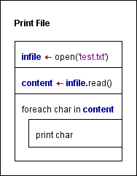
Iteration loop pattern in PSD

Slide 14
Counter loop pattern
Iterating over an implicit sequence of numbers
>>> pets = ['cat', 'dog', 'fish', 'bird']
>>> for animal in pets:
print(animal, end=' ')
cat dog fish bird
>>> for i in range(len(pets)):
print(pets[i], end=' ')
cat dog fish bird
animal =
'cat'
i =
0
pets[0] is printed
animal =
'dog'
i =
1
pets[1] is printed
animal =
'fish'
i =
2
pets[2] is printed
animal =
'bird'
i =
3
pets[3] is printed

Slide 15
Accumulator loop pattern
Accumulating something in every loop iteration
>>> lst = [3, 2, 7, 1, 9]
>>> lst = [3, 2, 7, 1, 9]
>>> res = 0
>>> lst = [3, 2, 7, 1, 9]
>>> res = 0
>>> for num in lst:
res = res + num
>>> lst = [3, 2, 7, 1, 9]
>>> res = 0
>>> for num in lst:
res = res + num
>>> res
22
>>> lst = [3, 2, 7, 1, 9]
>>> res = 0
>>> for num in lst:
res += num
>>> res
22
For example: the sum of numbers in a list
lst =
[3, 2, 7, 1, 9]
res = 0
shorthand notation
num =
3
res = res + num (= 3)
accumulator
num =
2
res = res + num (= 5)
num =
7
res = res + num (= 12)
num =
1
res = res + num (= 13)
num =
9
res = res + num (= 22)

Slide 16
Exercise
Write function acronym() that:
takes a phrase (i.e., a string) as input
returns the acronym for the phrase
>>> acronym('Random access memory')
'RAM'
>>> acronym("GNU's not UNIX")
'GNU'
def acronym(phrase):
'return the acronym of the input string phrase'
# split phrase into a list of words
words = phrase.split()
# accumulate first character, as an uppercase, of every word
res = ''
for w in words:
res = res + w[0].upper()
return res

Slide 17
Nested loop pattern
>>> n = 5
>>> nested2(n)
0
0 1
0 1 2
0 1 2 3
0 1 2 3 4
Nesting a loop inside another
>>> n = 5
>>> nested(n)
0 1 2 3 4
>>>
>>> n = 5
>>> nested(n)
0 1 2 3 4 0 1 2 3 4 0 1 2 3 4 0 1 2 3 4 0 1 2 3 4
>>>
>>> n = 5
>>> nested(n)
0 1 2 3 4
0 1 2 3 4
0 1 2 3 4
0 1 2 3 4
0 1 2 3 4
When j = 0 inner for loop should print 0
When j = 1 inner for loop should print 0 1
When j = 2 inner for loop should print 0 1 2
When j = 3 inner for loop should print 0 1 2 3
When j = 4 inner for loop should print 0 1 2 3 4
def nested(n):
def nested2(n):
for j in range(n):
for i in range(j+1):
print(i, end=' ’)
print()
def nested(n):
for j in range(n):
for i in range(n):
print(i, end=' ')
def nested(n):
for j in range(n):
for i in range(n):
print(i, end=' ’)
print()
def nested(n):
for i in range(n):
print(i, end=' ')
def nested(n):
for j in range(n):
for i in range(n):
print(i, end=' ’)
print()
def nested2(n):
for j in range(n):
for i in range(n):
print(i, end=' ’)
print()

Slide 18
Two-dimensional lists
The list [3, 5, 7, 9] can be viewed as a 1-D table
[3, 5, 7, 9] =
3 | 5 | 7 | 9
>>> lst = [[3,5,7,9],
[0,2,1,6],
[3,8,3,1]]
>>> lst
[[3, 5, 7, 9],
[0, 2, 1, 6],
[3, 8, 3, 1]]
>>> lst[0]
[3, 5, 7, 9]
>>> lst[1]
[0, 2, 1, 6]
>>> lst[2]
[3, 8, 3, 1]
>>> lst[0][0]
3
>>> lst[1][2]
1
>>>
>>> lst = [[3,5,7,9],
[0,2,1,6],
[3,8,3,1]]
>>> lst
[[3, 5, 7, 9],
[0, 2, 1, 6],
[3, 8, 3, 1]]
>>> lst[0]
[3, 5, 7, 9]
>>>
>>> lst = [[3,5,7,9],
[0,2,1,6],
[3,8,3,1]]
>>> lst
[[3, 5, 7, 9],
[0, 2, 1, 6],
[3, 8, 3, 1]]
>>> lst[0]
[3, 5, 7, 9]
>>> lst[1]
[0, 2, 1, 6]
>>>
>>> lst = [[3,5,7,9],
[0,2,1,6],
[3,8,3,1]]
>>> lst
[[3, 5, 7, 9],
[0, 2, 1, 6],
[3, 8, 3, 1]]
>>> lst[0]
[3, 5, 7, 9]
>>> lst[1]
[0, 2, 1, 6]
>>> lst[2]
[3, 8, 3, 1]
>>>
>>> lst = [[3,5,7,9],
[0,2,1,6],
[3,8,3,1]]
>>> lst
[[3, 5, 7, 9],
[0, 2, 1, 6],
[3, 8, 3, 1]]
>>> lst[0]
[3, 5, 7, 9]
>>> lst[1]
[0, 2, 1, 6]
>>> lst[2]
[3, 8, 3, 1]
>>> lst[0][0]
3
>>>
>>> lst = [[3,5,7,9],
[0,2,1,6],
[3,8,3,1]]
>>>
>>> lst = [[3,5,7,9],
[0,2,1,6],
[3,8,3,1]]
>>> lst
[[3, 5, 7, 9],
[0, 2, 1, 6],
[3, 8, 3, 1]]
>>>
>>> lst = [[3,5,7,9],
[0,2,1,6],
[3,8,3,1]]
>>> lst
[[3, 5, 7, 9],
[0, 2, 1, 6],
[3, 8, 3, 1]]
>>> lst[0]
[3, 5, 7, 9]
>>> lst[1]
[0, 2, 1, 6]
>>> lst[2]
[3, 8, 3, 1]
>>> lst[0][0]
3
>>> lst[1][2]
1
>>> lst[2][0]
3
>>>
How to represent a 2-D table?
0
1
2
3
[3, 5, 7, 9] =
3 | 5 | 7 | 9
0 | 2 | 1 | 6
3 | 8 | 3 | 1
3 | 5 | 7 | 9
0 | 2 | 1 | 6
3 | 8 | 3 | 1
3 | 5 | 7 | 9
0 | 2 | 1 | 6
3 | 8 | 3 | 1
3 | 5 | 7 | 9
0 | 2 | 1 | 6
3 | 8 | 3 | 1
3 | 5 | 7 | 9
0 | 2 | 1 | 6
3 | 8 | 3 | 1
3 | 5 | 7 | 9
0 | 2 | 1 | 6
3 | 8 | 3 | 1
[ [3, 5, 7, 9]
[0, 2, 1, 6]
[3, 8, 3, 1] ]
0
3 | 5 | 7 | 9
0 | 2 | 1 | 6
3 | 8 | 3 | 1
[0, 2, 1, 6] =
1
[3, 8, 3, 1] =
2
A 2-D table is just a list of rows (i.e., 1-D tables)

Slide 19
Nested loop pattern and 2-D lists
A nested loop is often needed to access all objects in a 2-D list
>>> table = [[3, 5, 7, 9],
[0, 2, 1, 6],
[3, 8, 3, 1]]
>>> print2D(table)
3 5 7 9
0 2 1 6
3 8 3 1
>>>
def print2D(t):
'prints values in 2D list t as a 2D table'
def print2D(t):
'prints values in 2D list t as a 2D table'
# for every row of t
# for every object in the row
# print object
def print2D(t):
'prints values in 2D list t as a 2D table'
for row in t:
for item in row
print(item, end=' ')
def print2D(t):
'prints values in 2D list t as a 2D table'
for row in t:
for item in row
print(item, end=' ')
print()
(Using the iteration loop pattern)

Slide 20
Exercise
Implement function pixels() that takes as input:
a two-dimensional list of nonnegative integer entries (representing the values of pixels of an image)
and returns the number of entries that are positive (i.e., the number of pixels that are not dark). Your function should work on two-dimensional lists of any size.
>>> lst = [[0, 156, 0, 0], [34, 0, 0, 0], [23, 123, 0, 34]]
>>> pixels(lst)
5
>>> l = [[123, 56, 255], [34, 0, 0], [23, 123, 0], [3, 0, 0]]
>>> pixels(lst)
7

Slide 21
while loop
Introduction to Computing Using Python
if <condition>:
<indented code block>
<non-indented statement>
while <condition>:
<indented code block>
<non-indented statement>
condition
True
<indented code block>
False
<non-indented statement>

Slide 22
while loop
Example: compute the smallest multiple of 7 greater than 37.
i = 7
i = 7
Idea: generate multiples of 7 until we get a number greater than 37
14
21
35
7
28
i =
42
i <= 37 ?
i <= 37 ?
>>> i = 7 >>> while i <= 37: i += 7
>>> i = 7 >>> while i <= 37: i += 7 >>> i 42
True
>>> i = 7
>>>
True
>>> i = 7 >>> while i <= 37: i += 7 >>> i 42
i += 7
i += 7
False
False
i
i

Slide 23
Infinite loop pattern
An infinite loop provides a continuous service
>>> hello2()
What is your name?
>>> hello2()
What is your name? Sam
Hello Sam
What is your name?
>>> hello2()
What is your name? Sam
Hello Sam
What is your name? Tim
Hello Tim
What is your name?
>>> hello2()
What is your name? Sam
Hello Sam
What is your name? Tim
Hello Tim
What is your name? Alex
Hello Alex
What is your name?
A greeting service
The server could instead be a time server, or a web server, or a mail server, or…
def hello2():
'''a greeting service; it repeatedly requests the name
of the user and then greets the user''’
while True:
name = input('What is your name? ')
print('Hello {}'.format(name))

Slide 24
The break statement
The break statement:
is used inside the body of a loop
when executed, it interrupts the current iteration of the loop
execution continues with the statement that follows the loop body.
def cities2():
lst = []
while True:
city = input('Enter city: ')
if city == '':
return lst
lst.append(city)
def cities2():
lst = []
while True:
city = input('Enter city: ')
if city == '':
break
lst.append(city)
return lst

Slide 25
break and continue statements
The continue statement:
is used inside the body of a loop
when executed, it interrupts the current iteration of the loop
execution continues with next iteration of the loop
The break statement:
is used inside the body of a loop
when executed, it interrupts the current iteration of the loop
execution continues with the statement that follows the loop body.
In both cases, only the innermost loop is affected
>>> before0(table)
2 3
4 5 6
>>> table = [
[2, 3, 0, 6],
[0, 3, 4, 5],
[4, 5, 6, 0]]
>>> ignore0(table)
2 3 6
3 4 5
4 5 6
def before0(table):
for row in table:
for num in row:
if num == 0:
break
print(num, end=' ’)
print()
def ignore0(table):
for row in table:
for num in row:
if num == 0:
continue
print(num, end=' ’)
print()

Slide 26
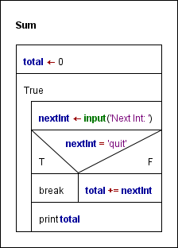
Exercise
Write function sum() according to this PSD:
Use a while-loop!
>>> sum()
next int: 5
next int: 4
next int: quit
9
def sum():
total = 0
while True:
nextInt = input('next int: ')
if nextInt == 'quit':
break
total += int(nextInt)
print(total)

Slide 27
Assignment(s)
This lesson:
Complete Perkovic Exercises
Complete Practice Exercises
Complete the Final Assignment
Next lesson:
Complete Preparation assignments (read literature!!)
Optionally, start with:
Perkovic Exercises
Practice Exercises
Final Assignment (‘E-tickets’)

