Slide 1


Man Chain illustration by Frits Ahlefeldt-Laurvig | CC BY-ND
Les 7: Catching Exceptions, CSV-files
Programming (TICT-V1PROG-15)
HBO-ICT propedeuse blok 1

Slide 2
Catching Exceptions, CSV files
Exceptional Control Flow
CSV (Comma Separated Value) files

Slide 3
Catching and handling exceptions
It is possible to override the default behavior (print error information and “crash”) when an exception is raised, using try/except statements
If an exception is raised while executing the try block, then the block of the associated except statement is executed
try:
strAge = input('Enter your age: ')
intAge = int(strAge)
print('You are {} years old.'.format(intAge))
except:
print('Enter your age using digits 0-9!')
strAge = input('Enter your age: ')
intAge = int(strAge)
print('You are {} years old.'.format(intAge))
Default behavior:
The except code block is the exception handler
Custom behavior:
>>> ========== RESTART ==========
>>>
Enter your age: fifteen
Enter your age using digits 0-9!
>>>
>>> ======================== RESTART ========================
>>>
Enter your age: fifteen
Traceback (most recent call last):
File "/Users/me/age1.py", line 2, in <module>
intAge = int(strAge)
ValueError: invalid literal for int() with base 10: 'fifteen'
>>>

Slide 4
Format of a try/except statement
def readAge(filename):
'converts first line of file filename to an integer and prints it'
try:
infile = open(filename)
strAge = infile.readline()
age = int(strAge)
print('age is', age)
except ValueError:
print('Value cannot be converted to integer.')
It is possible to restrict the except statement to catch exceptions of
a specific type only
>>> readAge('age.txt')
Value cannot be converted to integer.
>>> readAge('age.text')
Traceback (most recent call last):
File "<pyshell#11>", line 1, in <module>
readAge('age.text')
File "/Users/me/ch7.py", line 12, in readAge
infile = open(filename)
IOError: [Errno 2] No such file or directory: 'age.text'
>>>
>>> readAge('age.txt')
Value cannot be converted to integer.
>>>
1 fifteen
age.txt
default exception handler prints this

Slide 5
Multiple exception handlers
def readAge(filename):
'converts first line of file filename to an integer and prints it'
try:
infile = open(filename)
strAge = infile.readline()
age = int(strAge)
print('age is',age)
except IOError:
# executed only if an IOError exception is raised
print('Input/Output error.')
except ValueError:
# executed only if a ValueError exception is raised
print('Value cannot be converted to integer.')
except:
# executed if an exception other than IOError or ValueError is raised
print('Other error.')
It is possible to restrict the except statement to catch exceptions of
a specific type only

Slide 6
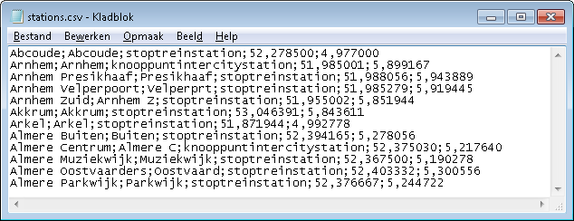
CSV (Comma Separated Values)
The most common import and export format for spreadsheets
A delimiter (usually NOT a comma) is used to separate ‘columns’

Slide 7
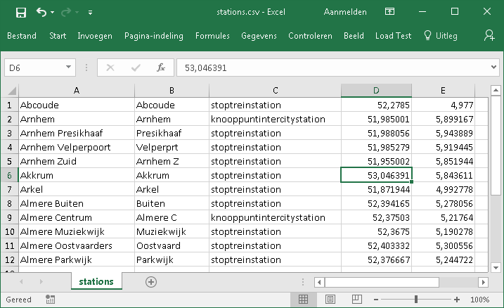
CSV – open with Excel
When Excel opens a .csv file, it uses the current default data format settings to interpret how to import each column of data.
If you want more flexibility in converting columns to different data formats, you can use the Import Text Wizard.

Slide 8
CSV files
CSV files are difficult:
Used charset?
Used delimiter?
Escape sequences?
Quotes?
Line termination?
printer;2;c02;Jõpïé
printer 2 c02 Jõpïé
printer;"b03;b02";jan's
printer;4;a04;"""Mr. Kees"""
Don’t create your own CSV-parser/writer!
Best Practice voor Python: use a library
Notes:
Bespreek de issues die ermee zijn

Slide 9
CSV – reading files
After this with-statement, the file is closed!
import csv
with open('stations.csv', 'r') as myCSVFile:
reader = csv.reader(myCSVFile, delimiter=';')
for row in reader:
print("Station: {}, Type: {}".format(row[0], row[2]))
Station : Abcoude, Type: stoptreinstation
Station : Arnhem, Type: knooppuntintercitystation
Station : Arnhem Presikhaaf, Type: stoptreinstation
Station : Arnhem Velperpoort, Type: stoptreinstation
Station : Arnhem Zuid, Type: stoptreinstation
Station : Akkrum, Type: stoptreinstation
Station : Arkel, Type: stoptreinstation
Station : Almere Buiten, Type: stoptreinstation
Station : Almere Centrum, Type: knooppuntintercitystation
Station : Almere Muziekwijk, Type: stoptreinstation
Station : Almere Oostvaarders, Type: stoptreinstation
Station : Almere Parkwijk, Type: stoptreinstation
row is a list!
Notes:
Leg uit:
try / except / finally
result als list
delimiter
# Print alle regels
import csv
csv.register_dialect('delimiter_semicolon', delimiter=';')
for name in sorted(csv.list_dialects()):
print ('Dialect: "%s"' % name)
print()
f = open('csv.csv', 'rt')
try:
reader = csv.reader(f, dialect="delimiter_semicolon")
#reader = csv.reader(f, dialect="excel")
for row in reader:
#print (row) # Print alle regels
print (row[3]) # Print alle types
finally:
f.close()

Slide 10
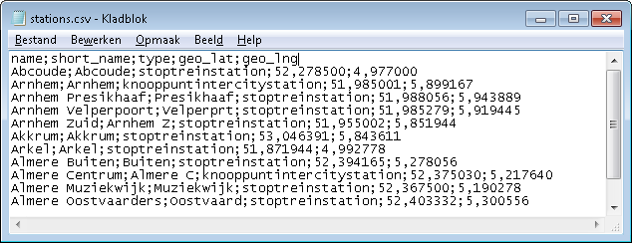
CSV – columnnames
Make sure that the number of columnnames is equal to the number of columns!
Notes:
Leg uit:
try / except / finally
result als list
delimiter
# Print alle regels
import csv
csv.register_dialect('delimiter_semicolon', delimiter=';')
for name in sorted(csv.list_dialects()):
print ('Dialect: "%s"' % name)
print()
f = open('csv.csv', 'rt')
try:
reader = csv.reader(f, dialect="delimiter_semicolon")
#reader = csv.reader(f, dialect="excel")
for row in reader:
#print (row) # Print alle regels
print (row[3]) # Print alle types
finally:
f.close()

Slide 11
CSV – columnnames + dict-reader
import csv
with open('stations.csv', 'r') as myCSVFile:
reader = csv.DictReader(myCSVFile, delimiter=';')
for row in reader:
print("Treinstation: {}, Type: {}".format(row['name'], row['type']))
Station : Abcoude, Type: stoptreinstation
Station : Arnhem, Type: knooppuntintercitystation
Station : Arnhem Presikhaaf, Type: stoptreinstation
Station : Arnhem Velperpoort, Type: stoptreinstation
Station : Arnhem Zuid, Type: stoptreinstation
Station : Akkrum, Type: stoptreinstation
Station : Arkel, Type: stoptreinstation
Station : Almere Buiten, Type: stoptreinstation
Station : Almere Centrum, Type: knooppuntintercitystation
Station : Almere Muziekwijk, Type: stoptreinstation
Station : Almere Oostvaarders, Type: stoptreinstation
Station : Almere Parkwijk, Type: stoptreinstation
row is a dict!
First line is not printed!
Notes:
Bespreek voor- en nadelen

Slide 12
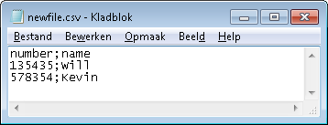
CSV – writing files
import csv
with open('newfile.csv', 'w', newline='') as myCSVFile:
writer = csv.writer(myCSVFile, delimiter=';')
writer.writerow(('number', 'name'))
while True:
name = input('Name? ')
if name == '':
break
number = input('Number? ')
writer.writerow((number, name))
Columnnames (one tuple!), optional!
Values, one tuple!!
Name? Will
Number? 135435
Name? Kevin
Number? 578354
Name?
Notes:
Bespreek voor- en nadelen

Slide 13
Assignment(s)
This lesson:
Complete Perkovic Exercises
Complete Practice Exercises
Complete the Final Assignment
Next lesson:
Complete Preparation assignments (read literature!!)
Optionally, start with:
Perkovic Exercises
Practice Exercises
Final Assignment (‘Stations-XML’)

