Slide 1

BOOTCAMP SANTANDER FRONTEND - E1
Proyecto Final || Sprint #1
Guía de Componentes

Slide 2
Colors
rgba(153, 153, 153, 1)
rgba(153, 153, 153, 1)
rgba(73, 79, 81, 1)
rgba(236, 0, 0, 1)
rgba(0, 0, 0, 1)

Slide 3



Text & Headers
font-size: 40px;
font-size: 32px;
font-size: 24px;
Properties
font-family: Open Sans;
font-style: normal;
font-weight: normal;

Slide 4
Header
Crear Cuenta
Iniciar Sesión
16px
16px
16px
auto
auto
8px
16px
Properties
width: 100vw;
height: 64px;
background: rgba(255, 255, 255, 0.25);
backdrop-filter: blur(4px);
padding: 16px;

Slide 5
Footer
16px
20px
16px
auto
auto
8px
Properties
max-width: 1024px; //horizontally centered
height: 64px;
background: rgba(255, 255, 255, 0.25);
backdrop-filter: blur(4px);
padding: 16px 0;
font-size: 12px;

Slide 6

Categories Menu
16px
128px
16px
16px
2px
40px * 40px
16px
Properties
max-width: 1024px; //horizontally centered
height: 128px;
background: rgba(73, 79, 81, 1);
border-radius: 16px;
padding: 16px;
font-size: 16px;

Slide 7
Cart Item
8px
64px
8px
8px
8px
font-size: 16px;
auto
16px
24px
8px
font-size: 24px;
font-weight: bold;
border-radius: 8px;
Properties
max-width: 1024px; //horizontally centered
height: 80px;
background: rgba(255, 255, 255, 1);
border-radius: 16px;
padding: 8px;

Slide 8
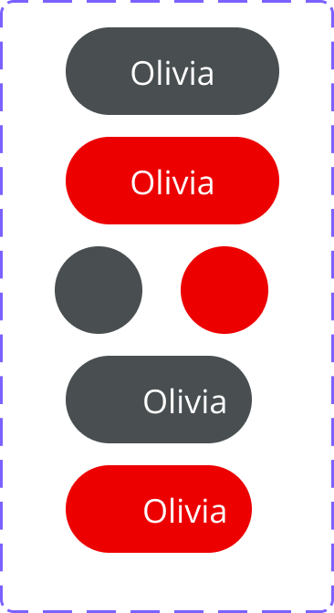
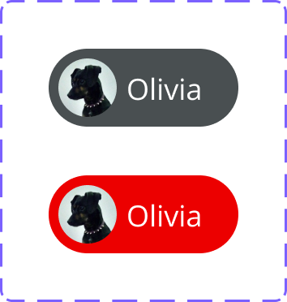
Buttons
Properties
width: auto;
height: 32px;
background: rgba(73, 79, 81, 1);
border-radius: 16px;
padding: 8px 16px;
font-size : 12px;
color: rgba(255, 255, 255, 1);
Properties (hover state)
background: rgba(236, 0, 0, 1);
Properties (image)
width: 24px;
height: 24px;
padding:4px;
4px
8px
4px
8px
8px
8px
16px

Slide 9


Cart Button
Properties
width: 32px;
height: 32px;
background: rgba(73, 79, 81, 1);
border-radius: 16px;
padding: 8px;
color: rgba(255, 255, 255, 1);
8px
border-radius: 8px;
width: 12px;
height: 8px;
font-size: 8px;
background: rgba(236, 0, 0, 1);
8px
8px
8px

Slide 10
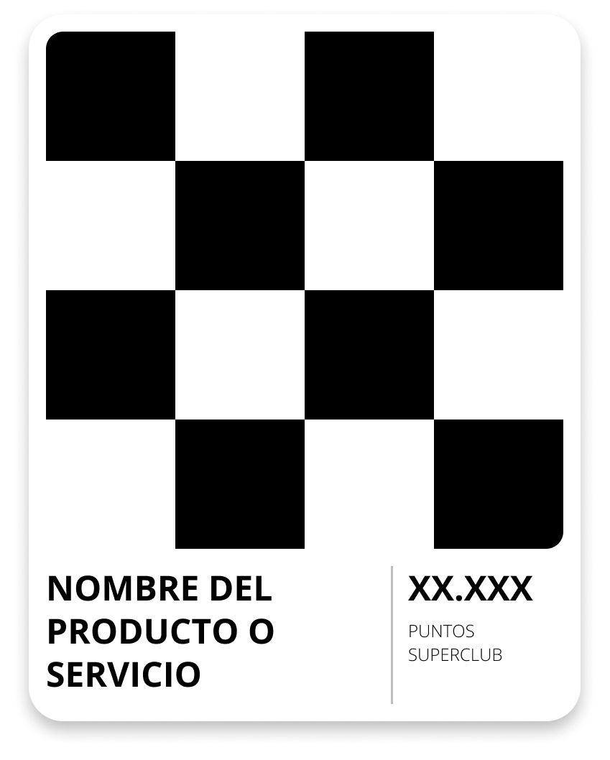
Product Item
8px
Properties
max-width: 256px; //optional
height: 32px;
background: rgba(255, 255, 255, 1);
border-radius: 16px;
padding: 8px;
color: rgba(0, 0, 0, 1);
Properties (image)
border-radius: 8px;
width: 240px; //optional
height: 240px;
8px
8px
8px
8px
Properties (Product Name & Points Value)
font-size: 16px;
font-weight: bold;
color: rgba(0, 0, 0, 1);
Properties (Legend)
font-size: 8px;
font-weight: light;
color: rgba(0, 0, 0, 1);

Slide 11
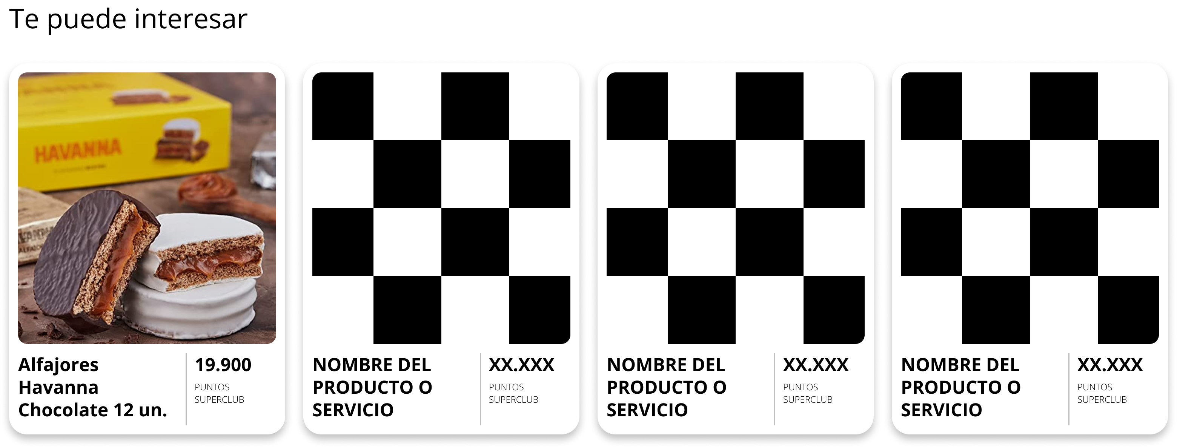
Product Group
H3
24px
16px
max-width: 1024px

Slide 12

Product Hero
8px
8px
8px
16px
8px
Properties
max-width: 512px; //optional
height: 256px;
border-radius: 16px;
padding: 8px;
color: rgba(255, 255, 255, 1);
Properties (image)
border-radius: 8px;
width: 112px; height: 112px;
Properties (text)
font-size: 20px;
font-weight: bold;//first line only
font-weight: 400;

Slide 13



Inputs
8px
8px
16px
8px
16px
Properties
width: auto;
height: 32px;
border-radius: 16px;
padding: 8px 16px;
color: rgba(0, 0, 0, 1);
background: rgba(255, 255, 255, 1);

