Slide 1
BZRS 2026 E.Coli short-term gene expression and evolution dynamics
Tommaso Cappelli, van Nimwegen research group, 24/08/2026

Slide 2
Overview What were the most striking results?
Studying the effect of viral
genome activation
in competitive, short-term, multi strain,
E.Coli environment
Analysis of E.Coli evolution dynamics over short-term lineages frequently switching
growth media, through
variant calling and coverage analysis
Biozentrum Research Summer
Computational analysis of 92 E.Coli
strains core genomes to understand
the impact of clonal interference and recombination
Using breseq algorithm to validate the expectation maximization algorithm to
estimate strains’ frequency in mixed cultures.

Slide 3
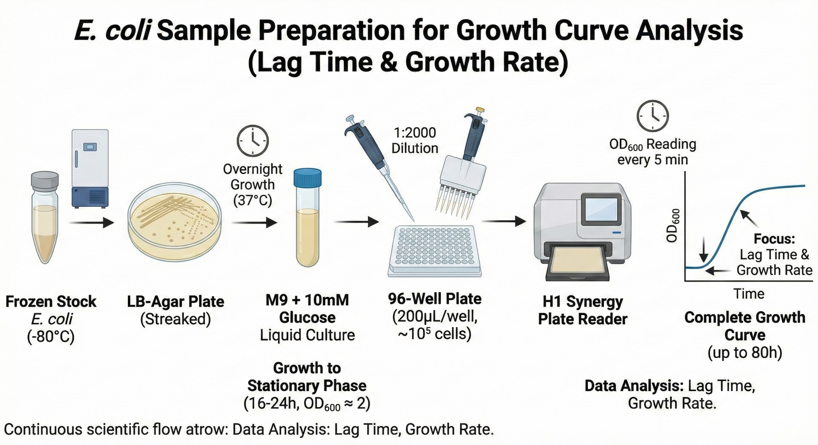
Dataset: our lab previously performed a short-term evolution experiment
Single LB Agar colony
(B8 strain)
M9 glucose preculture O/N
M9 succinate1 plate
M9 glucose plate
M9 succinate2 plate
x3 lineages
After 10
generations
After 10
generations
DNA sequencing
Growth measure
+DNA sequencing
Growth measure
+DNA sequencing
Growth measure
+DNA sequencing
Avg growth rate increases at the end of the experiment.

Slide 4
Questions
Does the growth rate change due to phenotypical adaptation, or is it correlated to genome evolution?
If genome evolution happens to be the main factor, what kinds of mutation arise and what genes do they affect?

Slide 5
Methods: the breseq algorithm What’s behind the variant calling pipeline to detect genetic mutations in the 3 lineages.
Standard
Polymorphism (-p)
Haploid genomes with a mean coverage of 40 (120) reads per base;
max 1000bp reads
Mode
Optimized for
Genbank file (.gbk) from the original sample
.gd files for data analysis
.fasta, .bam., .gff files for IGV
Genome
Raw data
breseq
Index.html for variant calling
Summary.html for coverage and statistics
.fastq.gz files with the mapped reads
Reads
Visual output
Frequency and score cutoffs, minimum total/variant coverage, noindels close to RAs, cutoff for Fisher’s test on bias.
Parameters
Variants
Read alignments (RA)
Missing coverage (MC)
New junctions (JC)

Slide 6
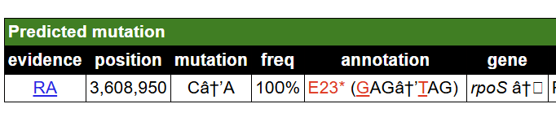
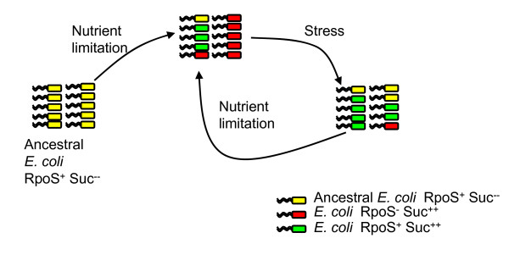
The deactivation of rpoS upregulates the duplication rate. Lineage 2 , 0.82-0.85 – Growth rate consistently high in succinate
In all 3 samples of the lineage we can immediately notice a dominant mutation on the gene rpoS, that deactivates it by creating an ending sequence.
rpoS protein, σ^{S}, binds to RNA polymerase instead of σ⁷⁰ and regulates the default stress response.
Deactivating the stress response increases the growth rates
Genome evolution

Slide 7
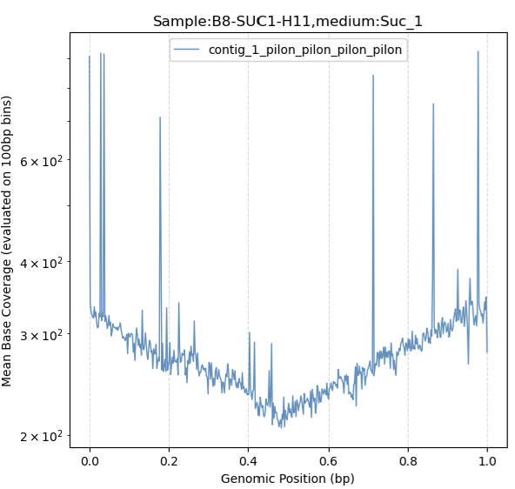
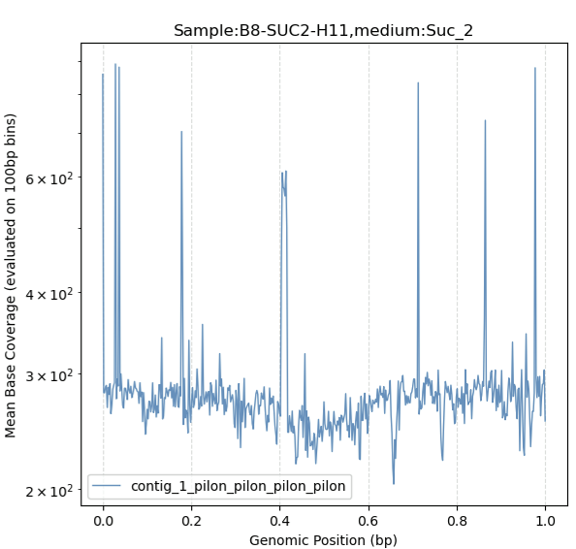
Variant calling doesn’t always tell the full story Lineage 3 , .39 vs .81 – Spike in growth rate for the 2nd sample
GLU and SUC2 sample have NO predicted mutation over 10%.
Looking at the coverage profile:
The 1st succinate coverage profile feature a singular V-shape.
The 2nd features a new spike (mean coverage has doubled) of around 60kb.

Slide 8
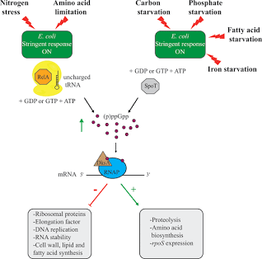
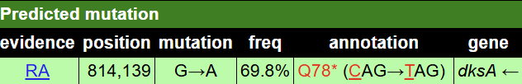
Variant calling tracks down the v-shape of the first coverage. Lineage 3, .39 vs .81 – V-shape for the 1st sample
The only striking mutation that appears in the 1st succinate sample for this weil is another SNV, that creates a stop codon in dksA.
DksA, (p)ppGpp -> binding factors to RNAP, that links σ^{S}.
Up-regulation survival-related genes (shrinkage, succinate breakdown).
Growth rate doesn’t seem to increase
-> overall biological picture still uncertain.

Slide 9
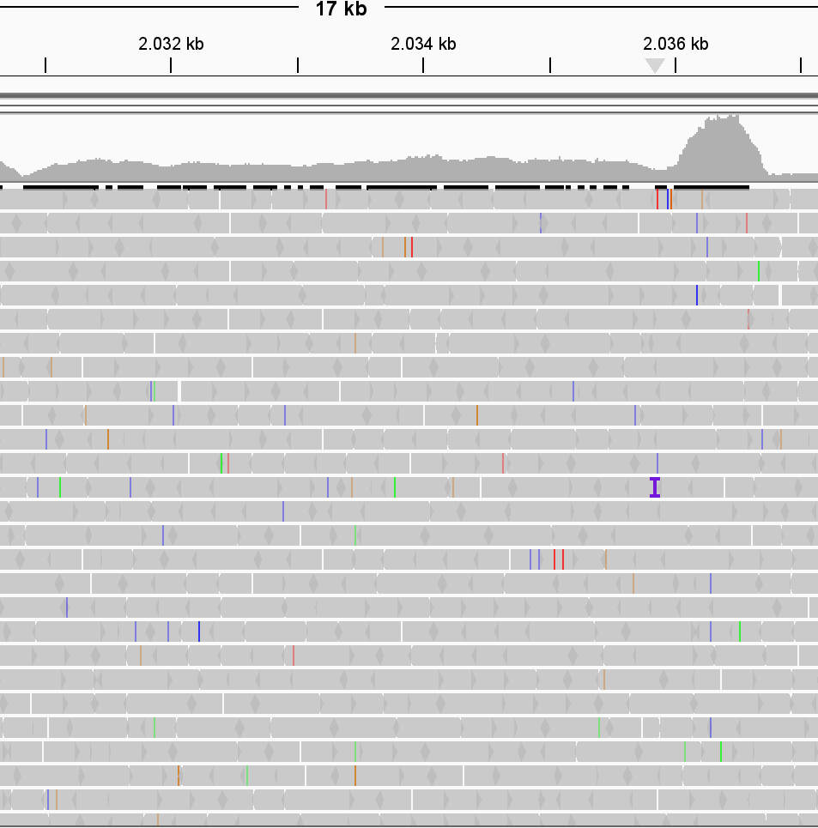
The duplication of rssB affects the influence of rpoS. Lineage 3, .39 vs .81 – Spike in growth rate for the 2nd sample
0-1900
The inside region has x2 coverage as the rest of the genome, and it contains rssB.
rssB decreases rpoS activity, since σ^{S} is degradated more often by ClpXP thanks to the adaptor.
1900bp spikes at the borders are due to copies of the same insertion sequences.

Slide 10
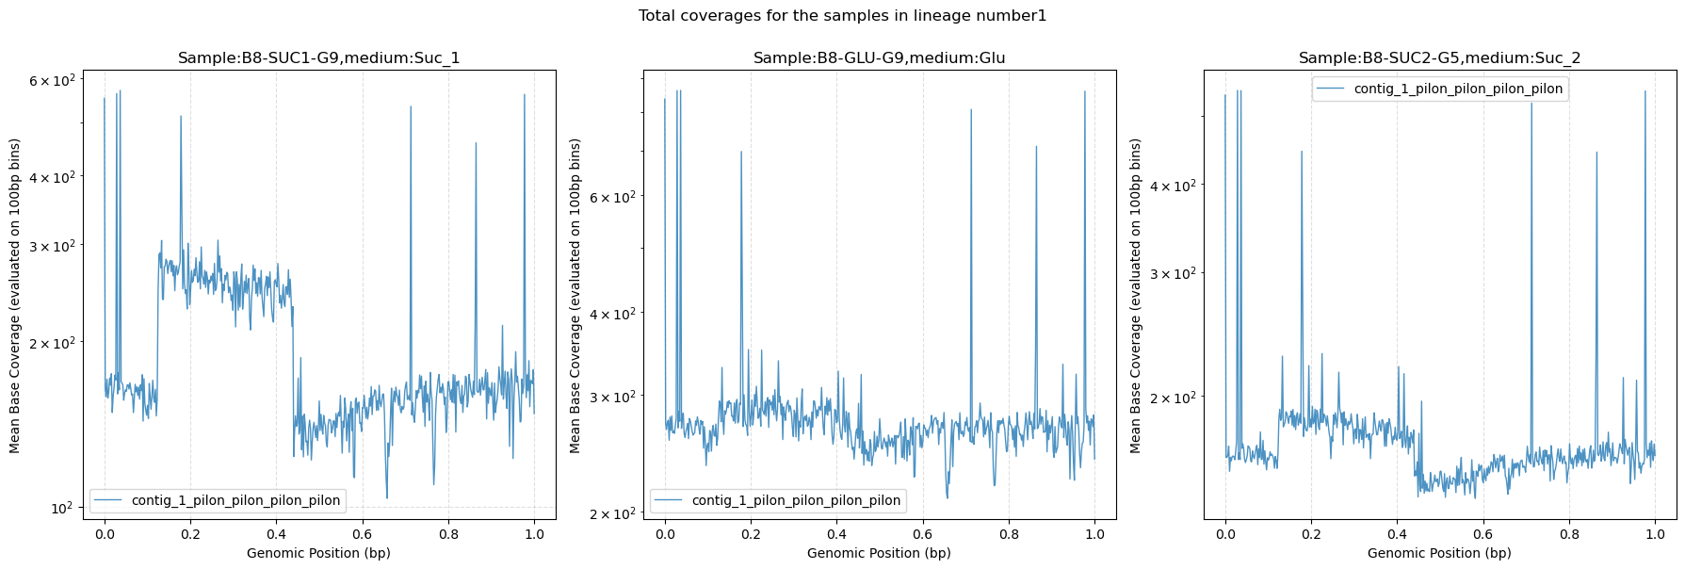
An incredibly wide region doubles its coverage. Lineage 1 – growth rates 0.55-0.71

Slide 11
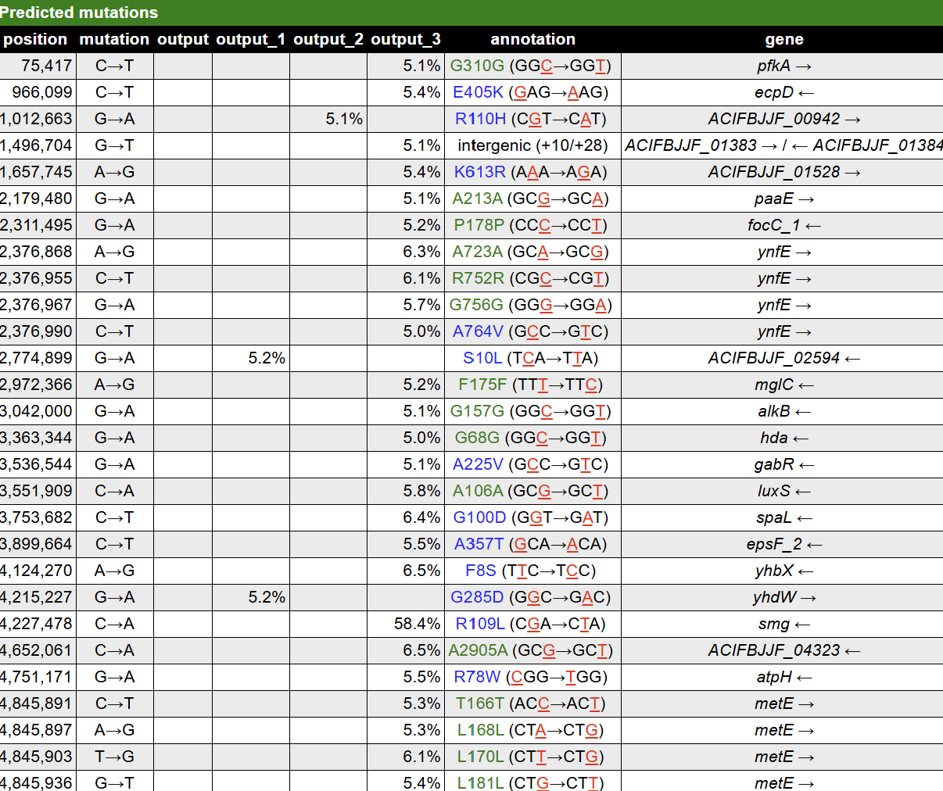
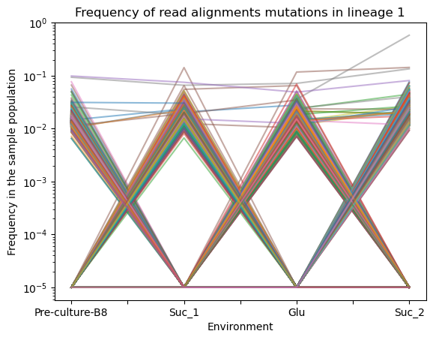
The variants from lineage 1 aren’t correlated with the growth rates. Lineage 1 – growth rates 0.55-0.71; predicted mutations in SUC2
Smg is the only high frequency mutation that has developed significantly in the second succinate sample.
Lower frequency mutations seem to appear in «hotspots».
Variants in lineage 1.
No filters (5% wall) on variant calling

Slide 12
Final summary – biological picture Hypotesis of the adaptation process of B8 to succinate.
The alarmone (p)ppGpp
is released
+ optimzing the adaptation in the new growth media
Conversion of succinate into nutrients
Culture moved to succinate:
the breakdown requires more energy
In glucose, σ⁷⁰ handles RNAP to enhance ribosome synthesis
DksA and (p)ppGpp act together on RNAP.
Less affinity for σ⁷⁰
σ^{s} slows down energy consumption and growth rate drops.
rssB sends σ^{s} to the protease ClpXP
rssB duplication
dksA SNV
rpoS SNV
σ^{s} forces the RNAP to transcribe genes dedicated to survival.
The gene dksA produces its own regulatory protein DksA.
The gene rpoS produces its own protein σ^{s}.

Slide 13
Thanks for your attention!

Slide 14
References
1 | Identification of mutations in laboratory evolved micobes from next-generation sequencing data using breseq, D.E. Deatherage and J. Barrick, 2014
2 | Polymorphism and selection of rpoS in pathogenic E.Coli, S.M. Chiang et.al, 2009
3 | The response regulator rssB controls stability of the sigma(S) subunit of RNA polymerase in Escherichia Coli, A.Muffler et al., 1996
4 | Promoter-specific control of E. coli RNA polymerase by ppGpp and a general transcription factor, Jeffrey W. Roberts, 2009

Slide 15
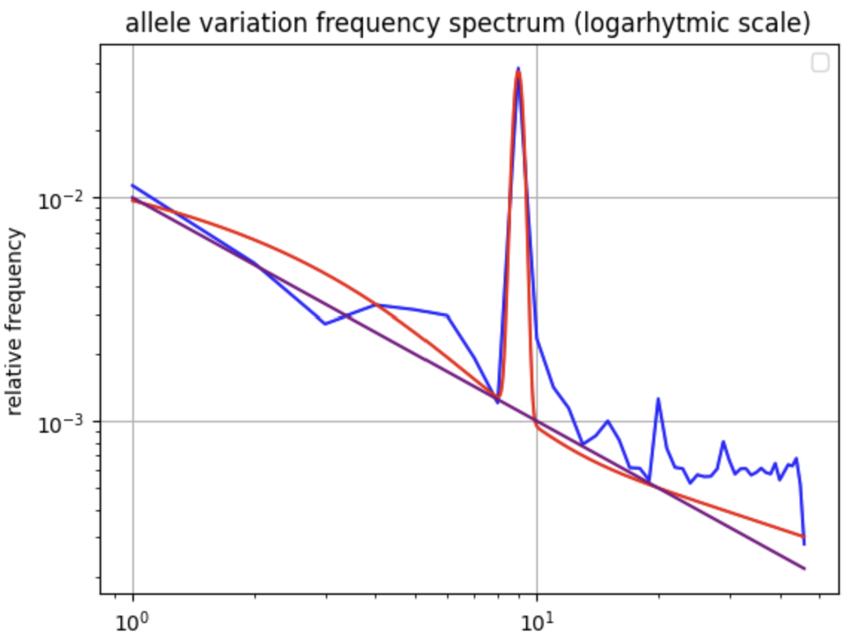
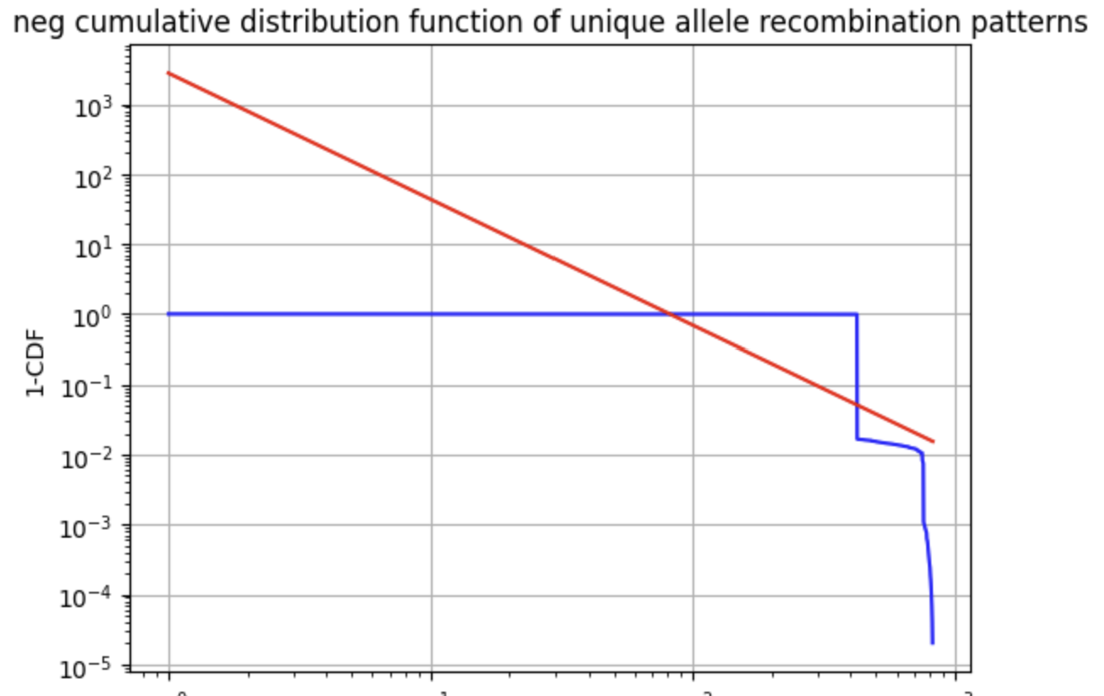
1. Computational analysis of 92 E.Coli strains core genomes to understand the impact of mutations and recombination
Hypotesis: only a mutation can happen per bp (binary model)
Starting point: data from the RECOPHY website (4M+ bases for 92 strains)
Focus: allele variation frequency (# of genes with n strains with a variation) for each SNP and nCDF of unique genes with the same allele variation frequency.
Results: lots of bases with the same, unique allele variation pattern ->The 9 strains will have a significantly further common ancestor from the others.

Slide 16
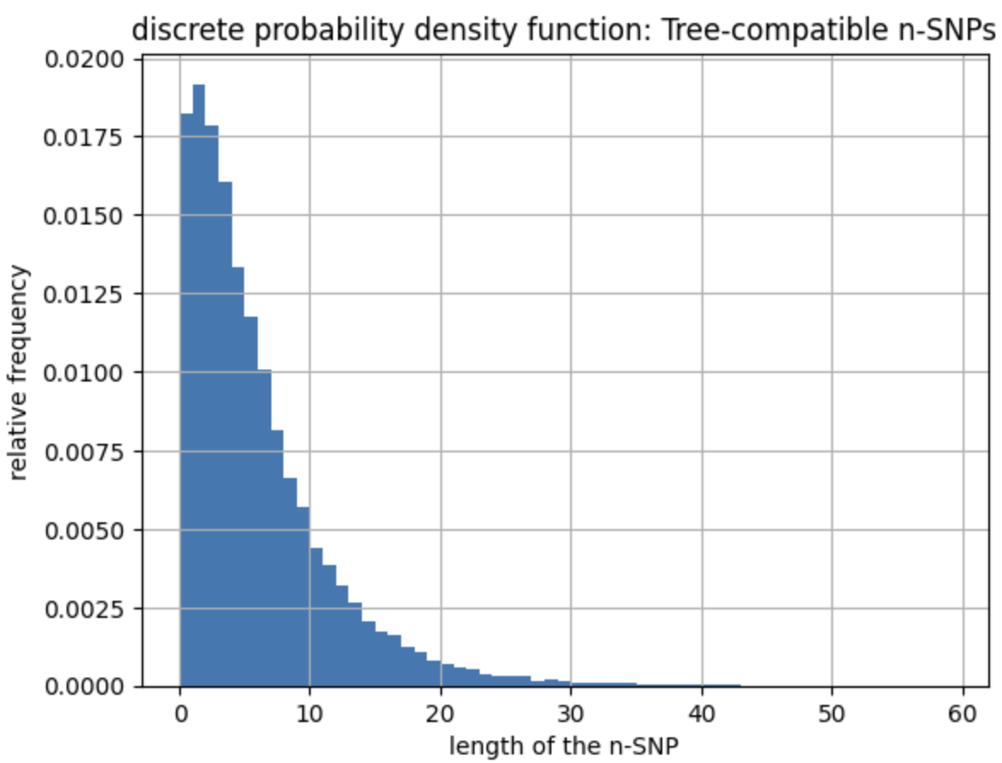
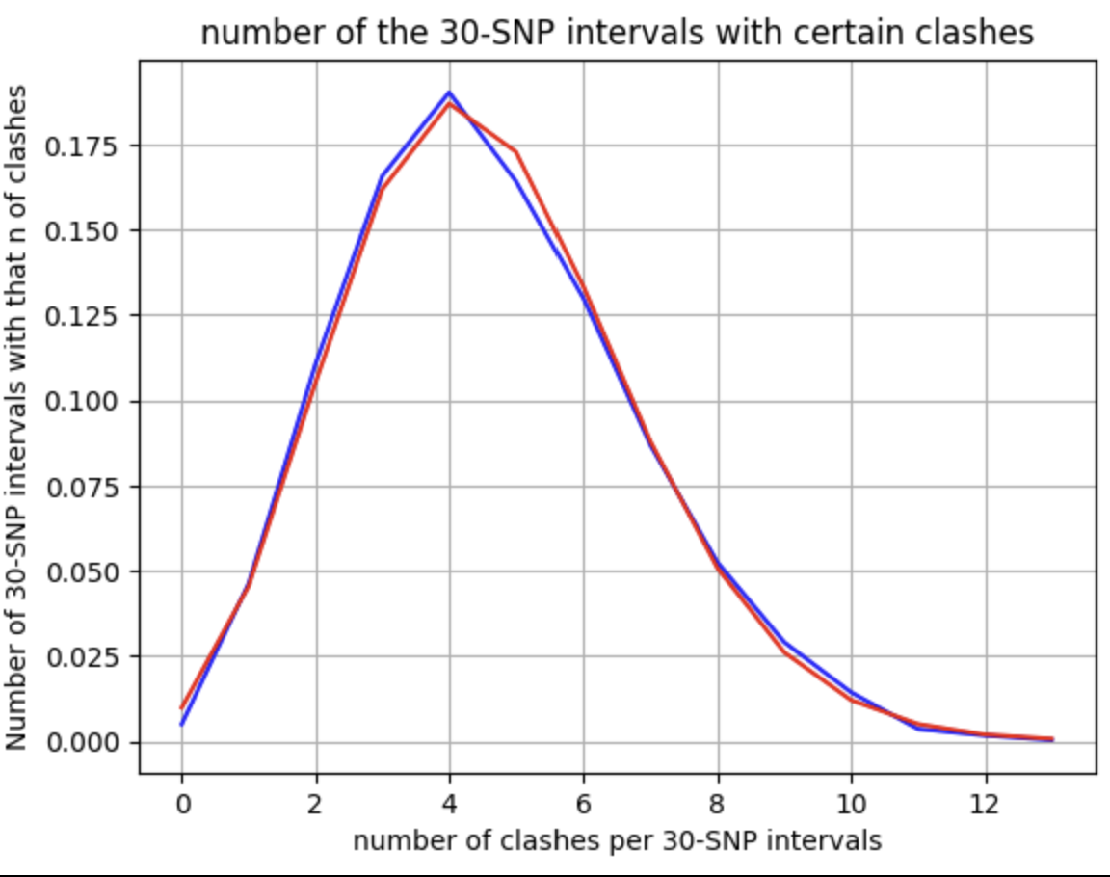
Implementing the 4-gamete-test to assess how meaningful is
Assuming that a bp can only mutate once if there were no recombination events, finding in 2 bps every possible row combination (00,01,10,11) means there has been a recombination event and a clash.
Lots of incompatible SNPs: recombination has played a significant role in evolution.
The number of clashes for each 30-SNP intervals strongly resembles a Poisson curve. Surprising how well it’s fitting a binomial.

Slide 17
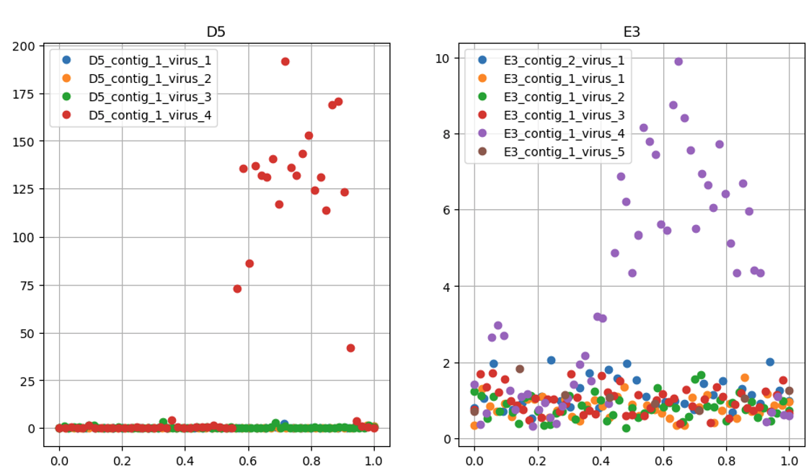
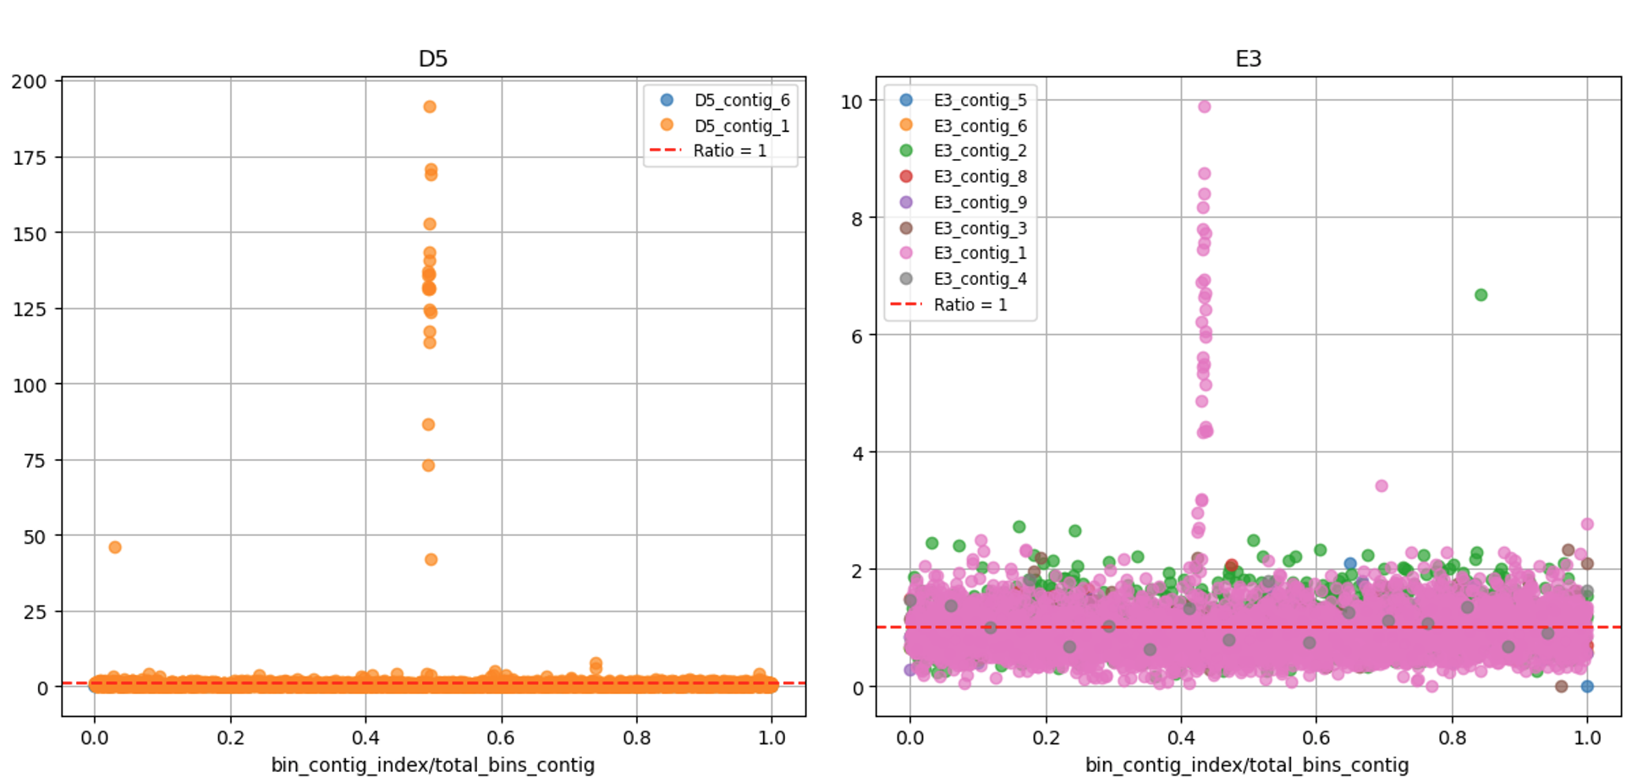
3. Studying the efficiency of an experimental algorithm to track the frequencies and assign detected reads to multiple strains
One of the most important topics of the lab is to study the effect of media and genomic evolution in the competition of multiple E.Coli strains in the same sample. To do so, it is necessary to map the reads from each sample correctly to the right strain, and then estimate the frequencies.
In chloromphenical, the main growth media used to provide stress condition, we could notice multiple viral activation through plots regarding the coverages.

Slide 18
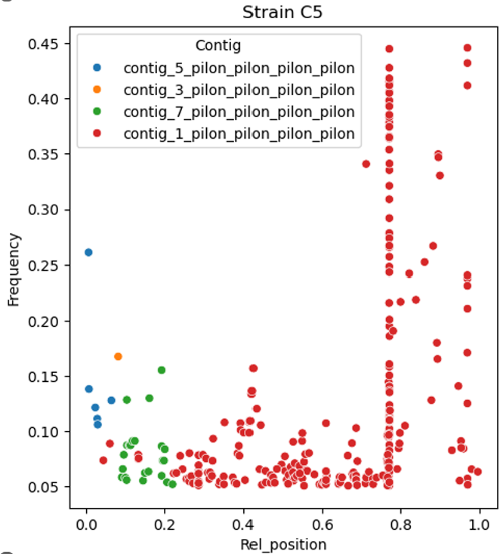
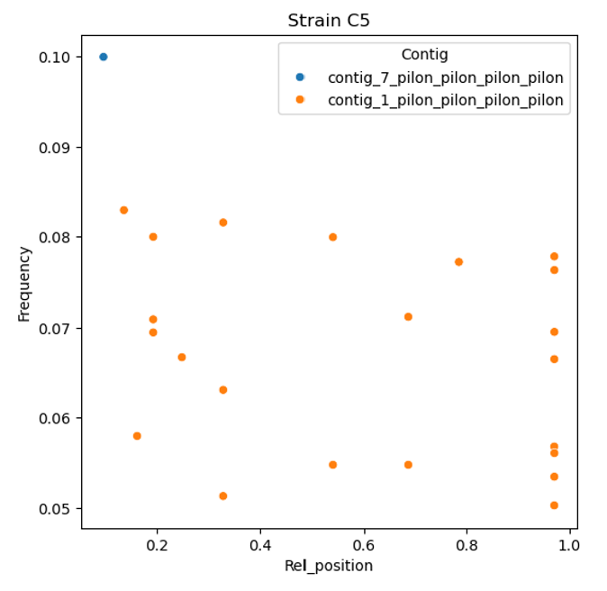
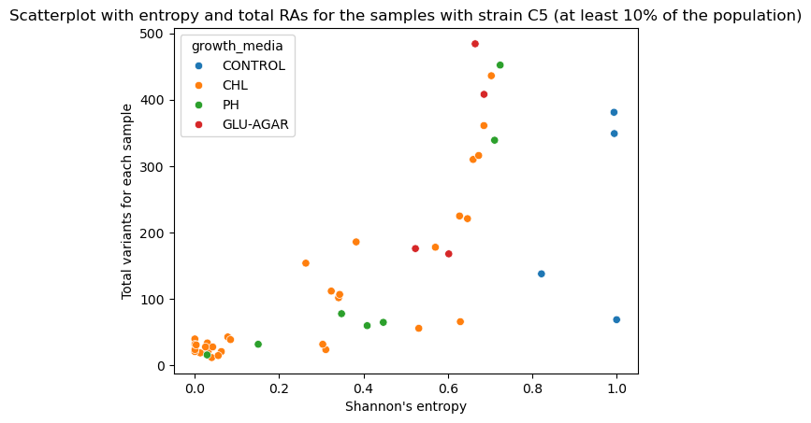
3. Studying the efficiency of an experimental algorithm to track the frequencies and assign detected reads to multiple strains
Trying to run breseq, the same algorithm used for single strain sample, with its standard filters showcased new issues in localized sections of low frequency strains.
The outstanding number of variations in so few regions, along with other statistics from the PhDs working at these project, confirmed the possibility of misalignment.
This assumption was then corroborated by scatterplots entropy-# mutations per each sample that had a strain. For C5, the dominant strain of CHL, we can notice some samples with a more various population spike at insanely high levels, probably artifacts.

