Slide 1
ML 2023 Project
Tommaso Di Riccio, Marco Minniti, Francesco Simonetti
Mensa Martiri
Computer science - curriculum: Artificial Intelligence
Date: 24/01/2024 Project type: A

Slide 2
Objectives
Implement a Neural Network simulator with multiple functionalities to solve classification and regression problems.
With the help of (random) grid search, K-Fold and double K-Fold find the best network architecture and hyperparameters configuration to obtain a model able to predict the CUP challenge targets with a low error.
We used a Feedforward Neural Network trained with gradient descent algorithm, using backpropagation to calculate the gradients.

Slide 3
Method – Overview
Programming language: Python
Used libraries:
Numpy: to perform linear algebra operations
Sklearn: to performs the one-hot-encoding on the monk datasets
Pandas: to read the csv of the datasets
Seaborn: to plot the results
We exploit Python classes to effortlessly incorporate new functionalities without the need to modify existing code.

Slide 4
Method – Code
Brief code description:
Network: a class representing the structure of the network with the methods for training, validating and predicting.
Layer: a class representing a layer of the Neural Network. It contains the number of units, with all the weights, and the activation function chosen by the user. During training, each layer compute its gradient and the error signal to propagate to the previous layer.

Slide 5
Method – Code
Training: containing all the class representing learning methods (e.g. Gradient Descent). Gradient Descent class implements the following features:
Online / Minibatch / Batch
Momentum
Nesterov momentum
Learning rate decay
L2 Regularization
Early stopping or stopping the training when improvement on TR loss is low

Slide 6
Method – Code
Functions:
Activation functions: Identity, Sigmoid, Tanh, ReLU, Leaky ReLU, SeLU
Loss functions: Mean Squared Error, Mean Euclidean Error, Binary Cross Entropy
Metric functions: Binary Accuracy
Model selection: Grid search, Random grid search, K-Fold, Double K-Fold
Utils: generic utility functions (e.g., dataset reading, weights init, …)

Slide 7
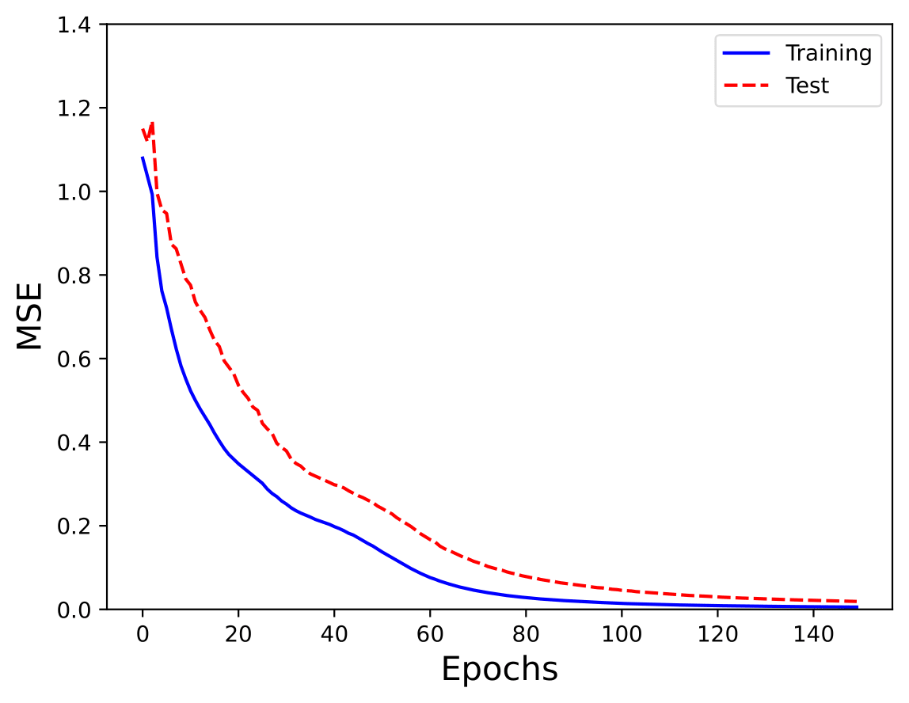
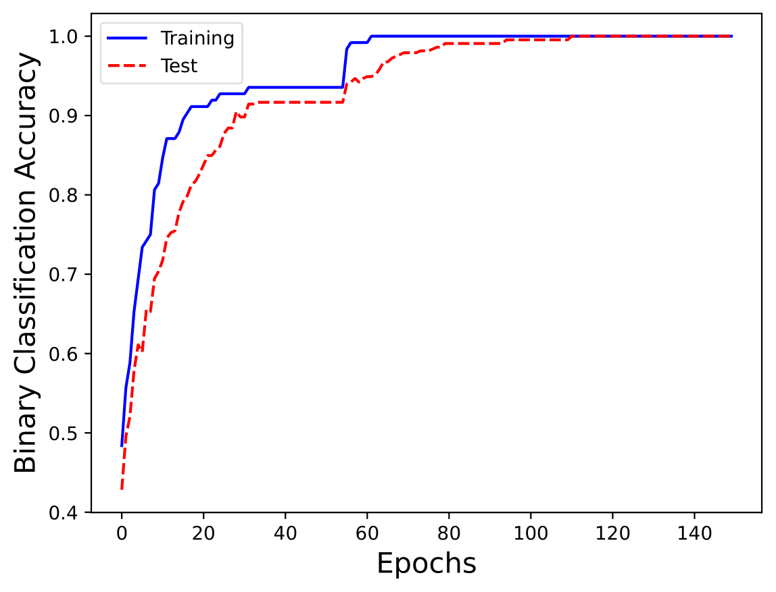
Monk Results – Monk 1
Network: 2 Layer, 4 hidden units, Activation functions: ReLU and Tanh
Parameters: Batch, Learning rate: 0.5, Momentum: 0.5, No regularization

Slide 8
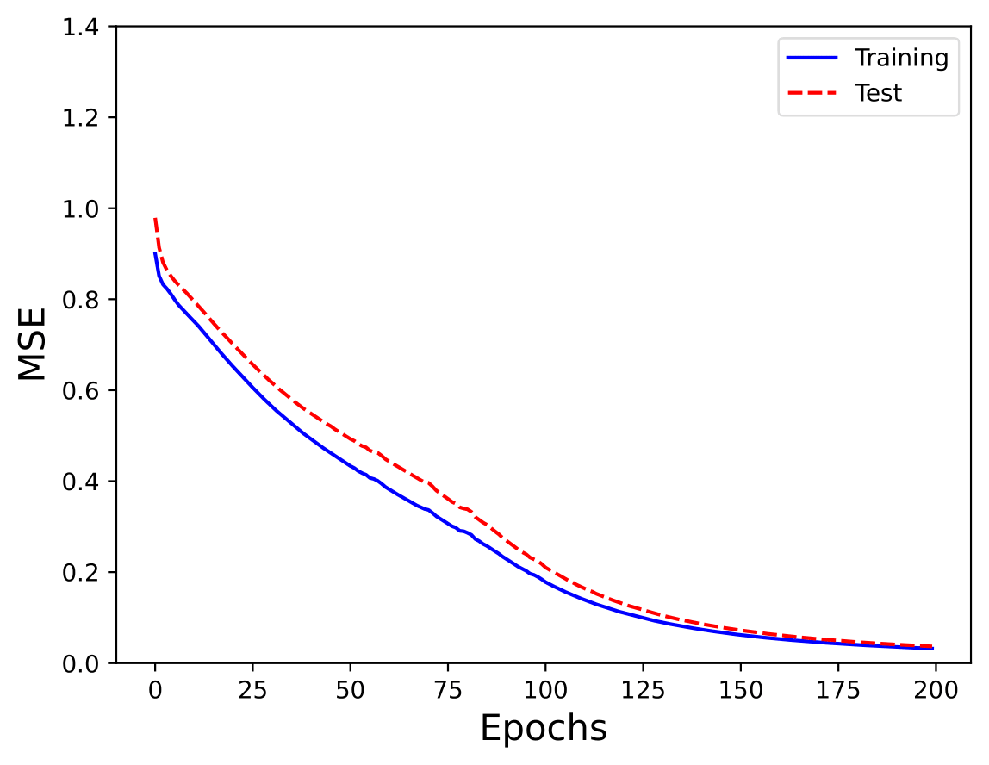
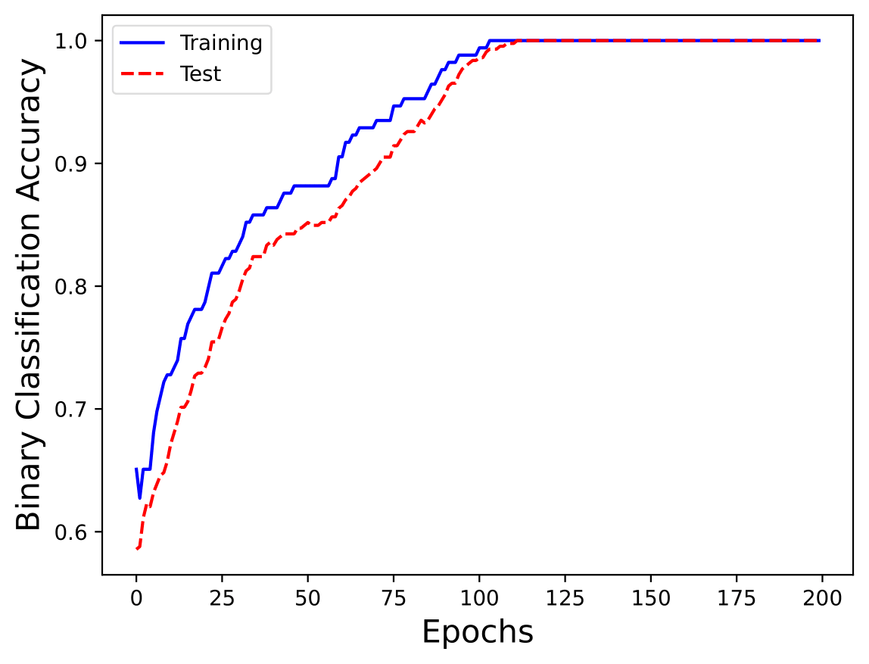
Monk Results – Monk 2
Network: 2 Layer, 3 hidden units, Activation functions: ReLU and Tanh
Parameters: Batch, Learning rate: 0.2, Momentum: 0.5, No regularization

Slide 9
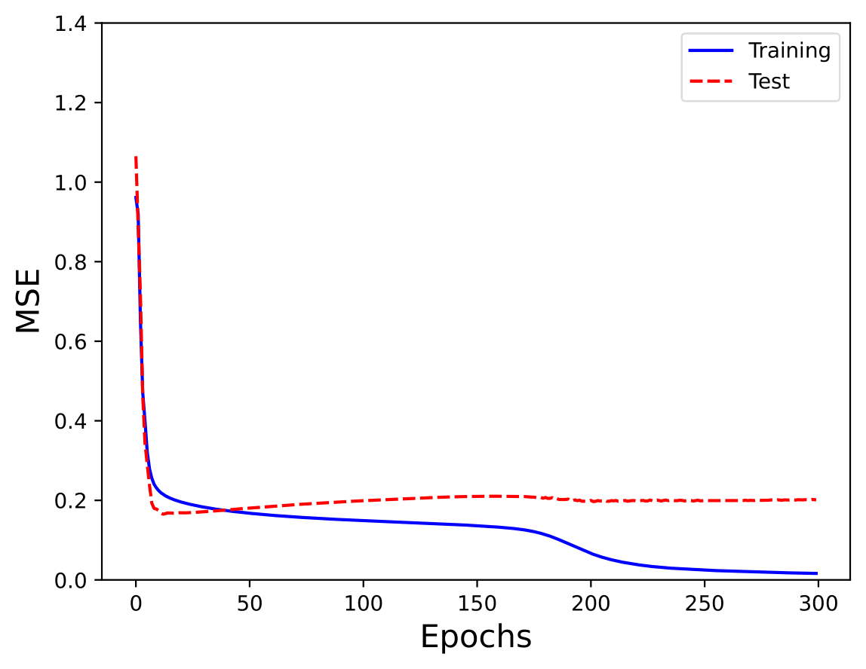
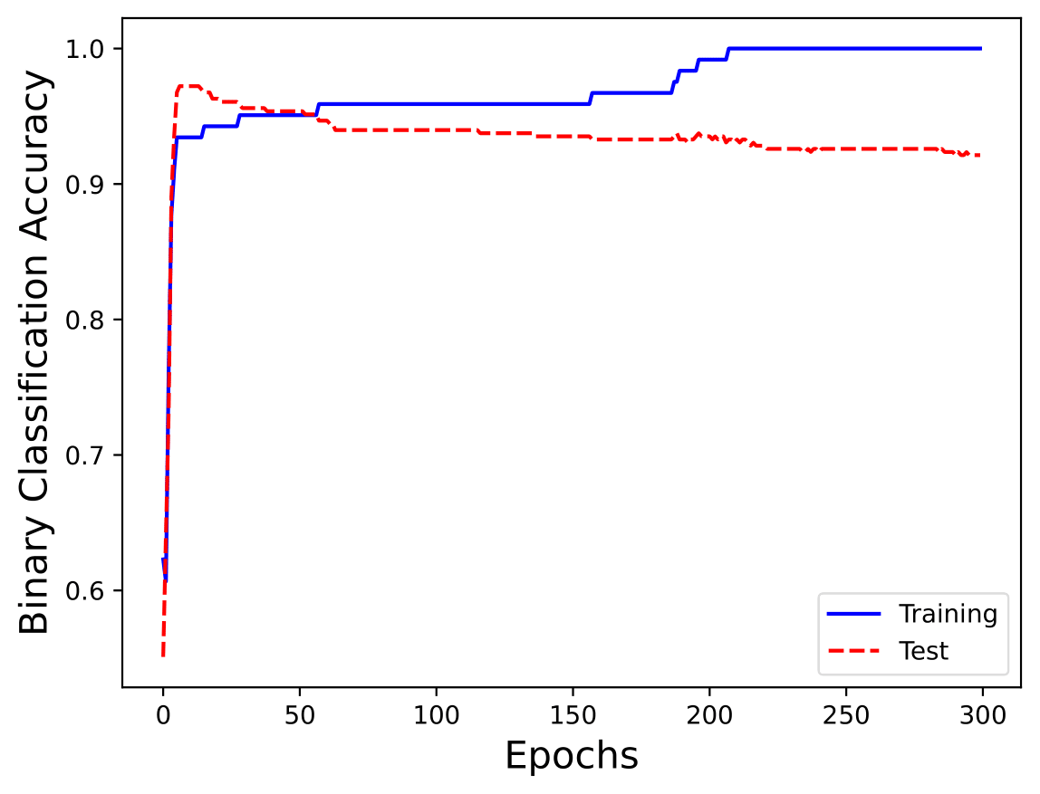
Monk Results – Monk 3 (no regularization)
Network: 2 Layer, 4 hidden units, Activation functions: ReLU and Tanh
Parameters: Batch, Learning rate: 0.3, Momentum: 0.5, No regularization

Slide 10
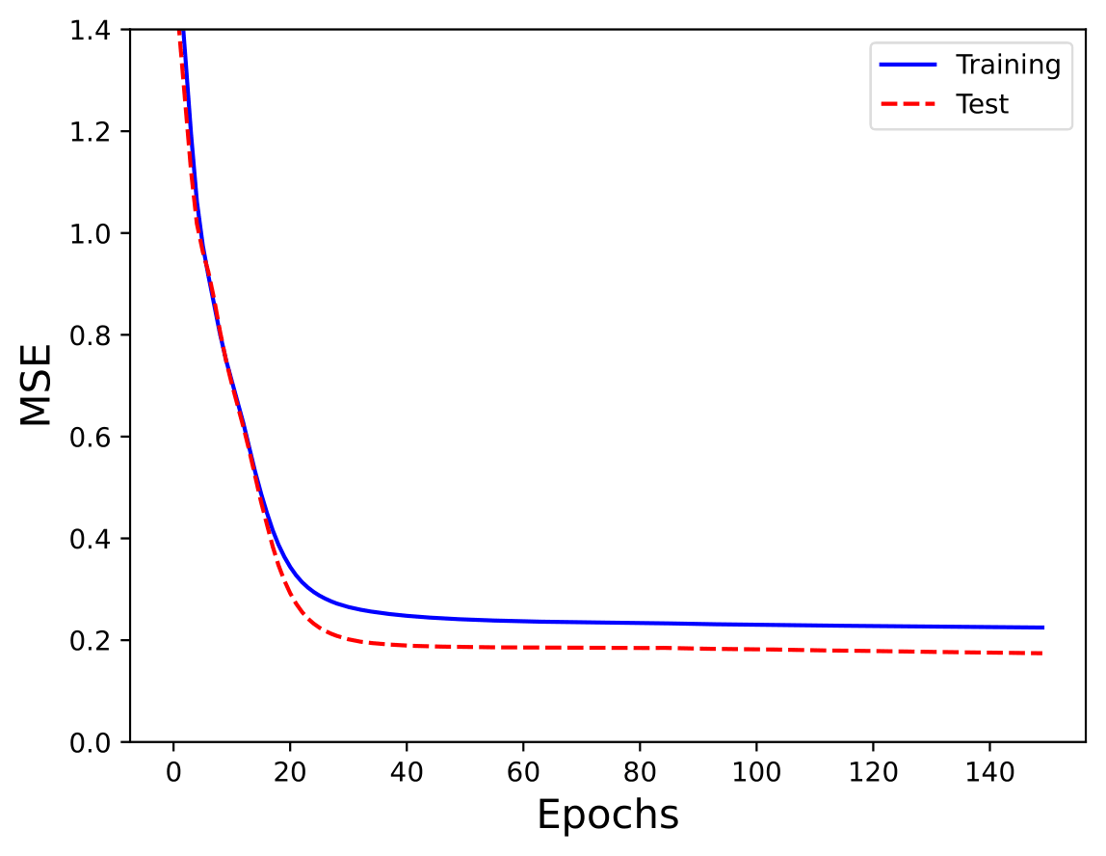
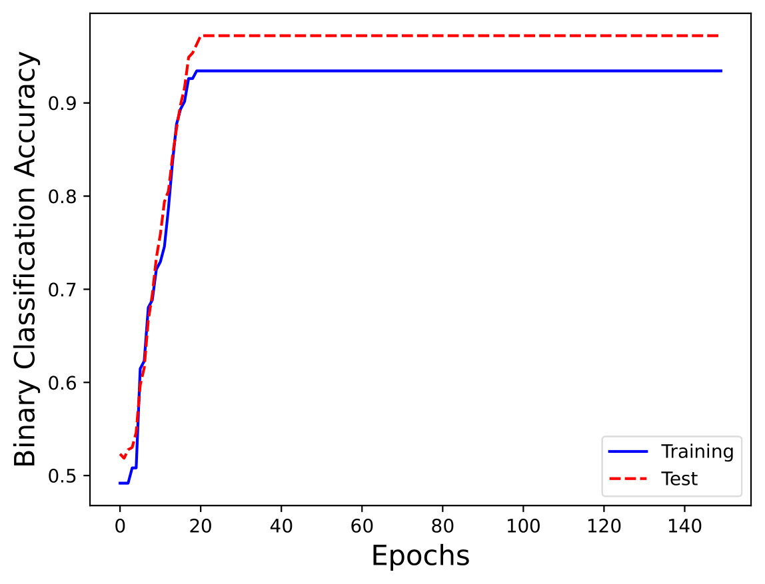
Monk Results – Monk 3 (with regularization)
1 -
Network: 2 Layer, 4 hidden units, Activation functions: ReLU and Tanh
Parameters: Batch, Learning rate: 0.3, Momentum: 0.5, Lambda = 0.01

Slide 11
Monk Results – Recap
Best run:
Task | #Units, eta, lambda | MSE (TR / TS) | Accuracy (TR / TS) (%)
Monk 1 | (4, 1) 0.5 0 | 0.0055 / 0.0110 | 100% / 100%
Monk 2 | (3, 1) 0.2 0 | 0.0198 / 0.0231 | 100% / 100%
Monk 3 | (4, 1) 0.3 0 | 0.0199 / 0.2117 | 100% / 92.36%
Monk 3 (reg.) | (4, 1) 0.3 0.01 | 0.2249 / 0.1744 | 93% / 97.22%

Slide 12
Monk Results – Recap
Average on 200 runs:
Task | #Units, eta, lambda | MSE (TR / TS) | Accuracy (TR / TS) (%)
Monk 1 | (4, 1) 0.5 0 | 0.0936 / 0.1461 | 98% / 97%
Monk 2 | (3, 1) 0.2 0 | 0.1135 / 0.1367 | 96% / 95%
Monk 3 | (4, 1) 0.3 0 | 0.1392 / 0.1782 | 97% / 94%
Monk 3 (reg.) | (4, 1) 0.3 0.01 | 0.2435 / 0.1889 | 93% / 97.22%

Slide 13
CUP Validation schema – Data splitting
5-Fold-CV Training + Validation (90%) | Hold-out Internal Test (10%)
First, we did a retraining on Training + Validation data to estimate the error on the Hold-out dataset.
At the end, we did a retraining on all data before estimating the outputs for the CUP test data.

Slide 14
CUP Validation schema – Preliminary trials
We experimented with various network architectures, beginning with smaller ones (2 layers, a few dozen units) and progressively increasing their sizes, culminating in a 5-layer structure with six hundred units.
For each architecture, we performed a grid search to evaluate different activation functions, learning rates, batch sizes, momentum values, and regularization lambdas.
Following these initial grid searches, we executed a more refined grid search to find the optimal parameters based on the best-performing configurations identified in the previous steps.

Slide 15
CUP Validation schema – Grid search
Hyperparameters | Configuration tested
Number of layer | From 2 to 5 layers
Units on each layer | From 10 to 200 units
Activation functions | ReLU, Leaky ReLU, SeLU, Tanh
Weight initialization | Random uniform, Glorot and Bengio [1]
Epochs | From 500 to 100 000
Batch size | From 50 to all data
Learning rate | From 0.0001 to 0.008
Momentum alpha | From 0 to 0.95
Nesterov momentum | True - False
Regularization lambda | None - From 0.000005 to 0.0001
Early stopping | True - False

Slide 16
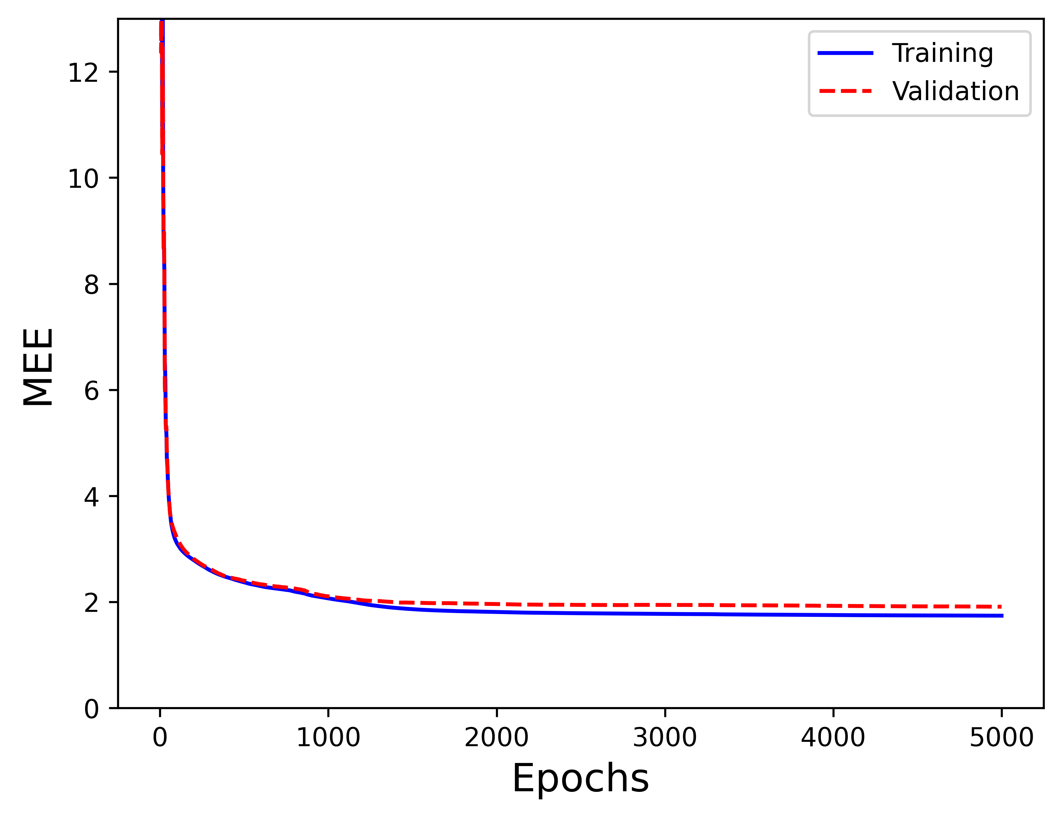
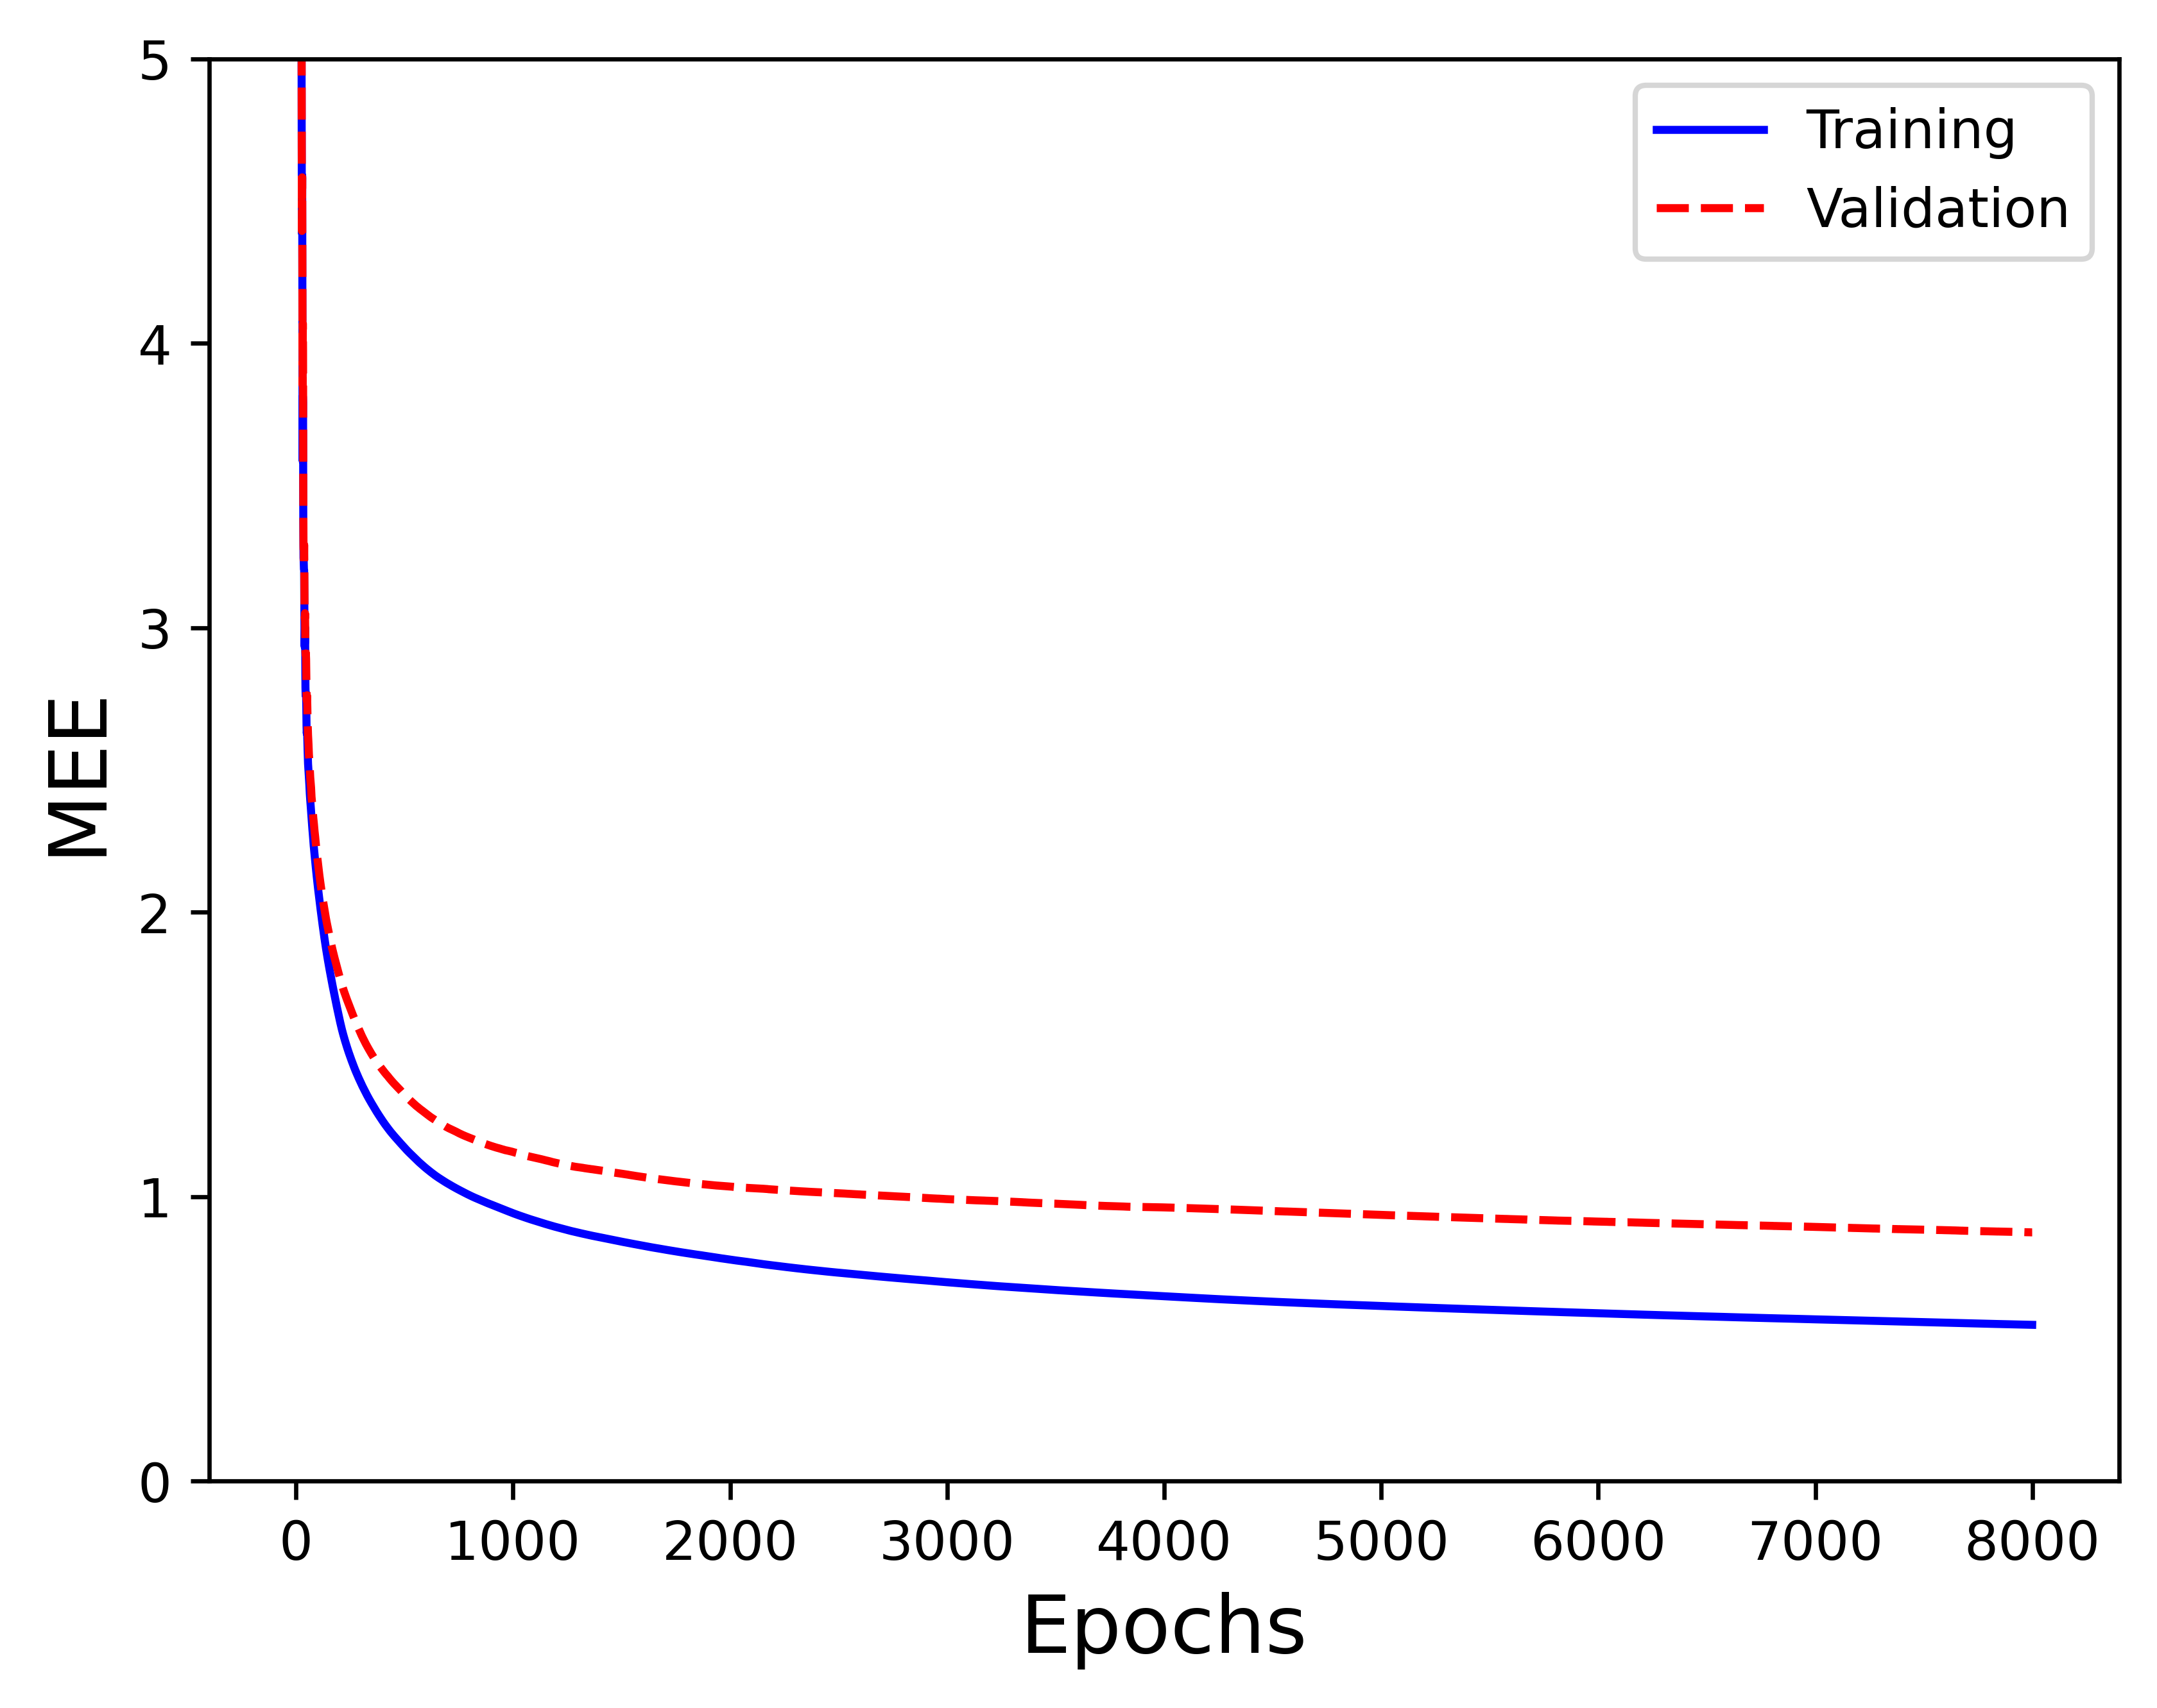
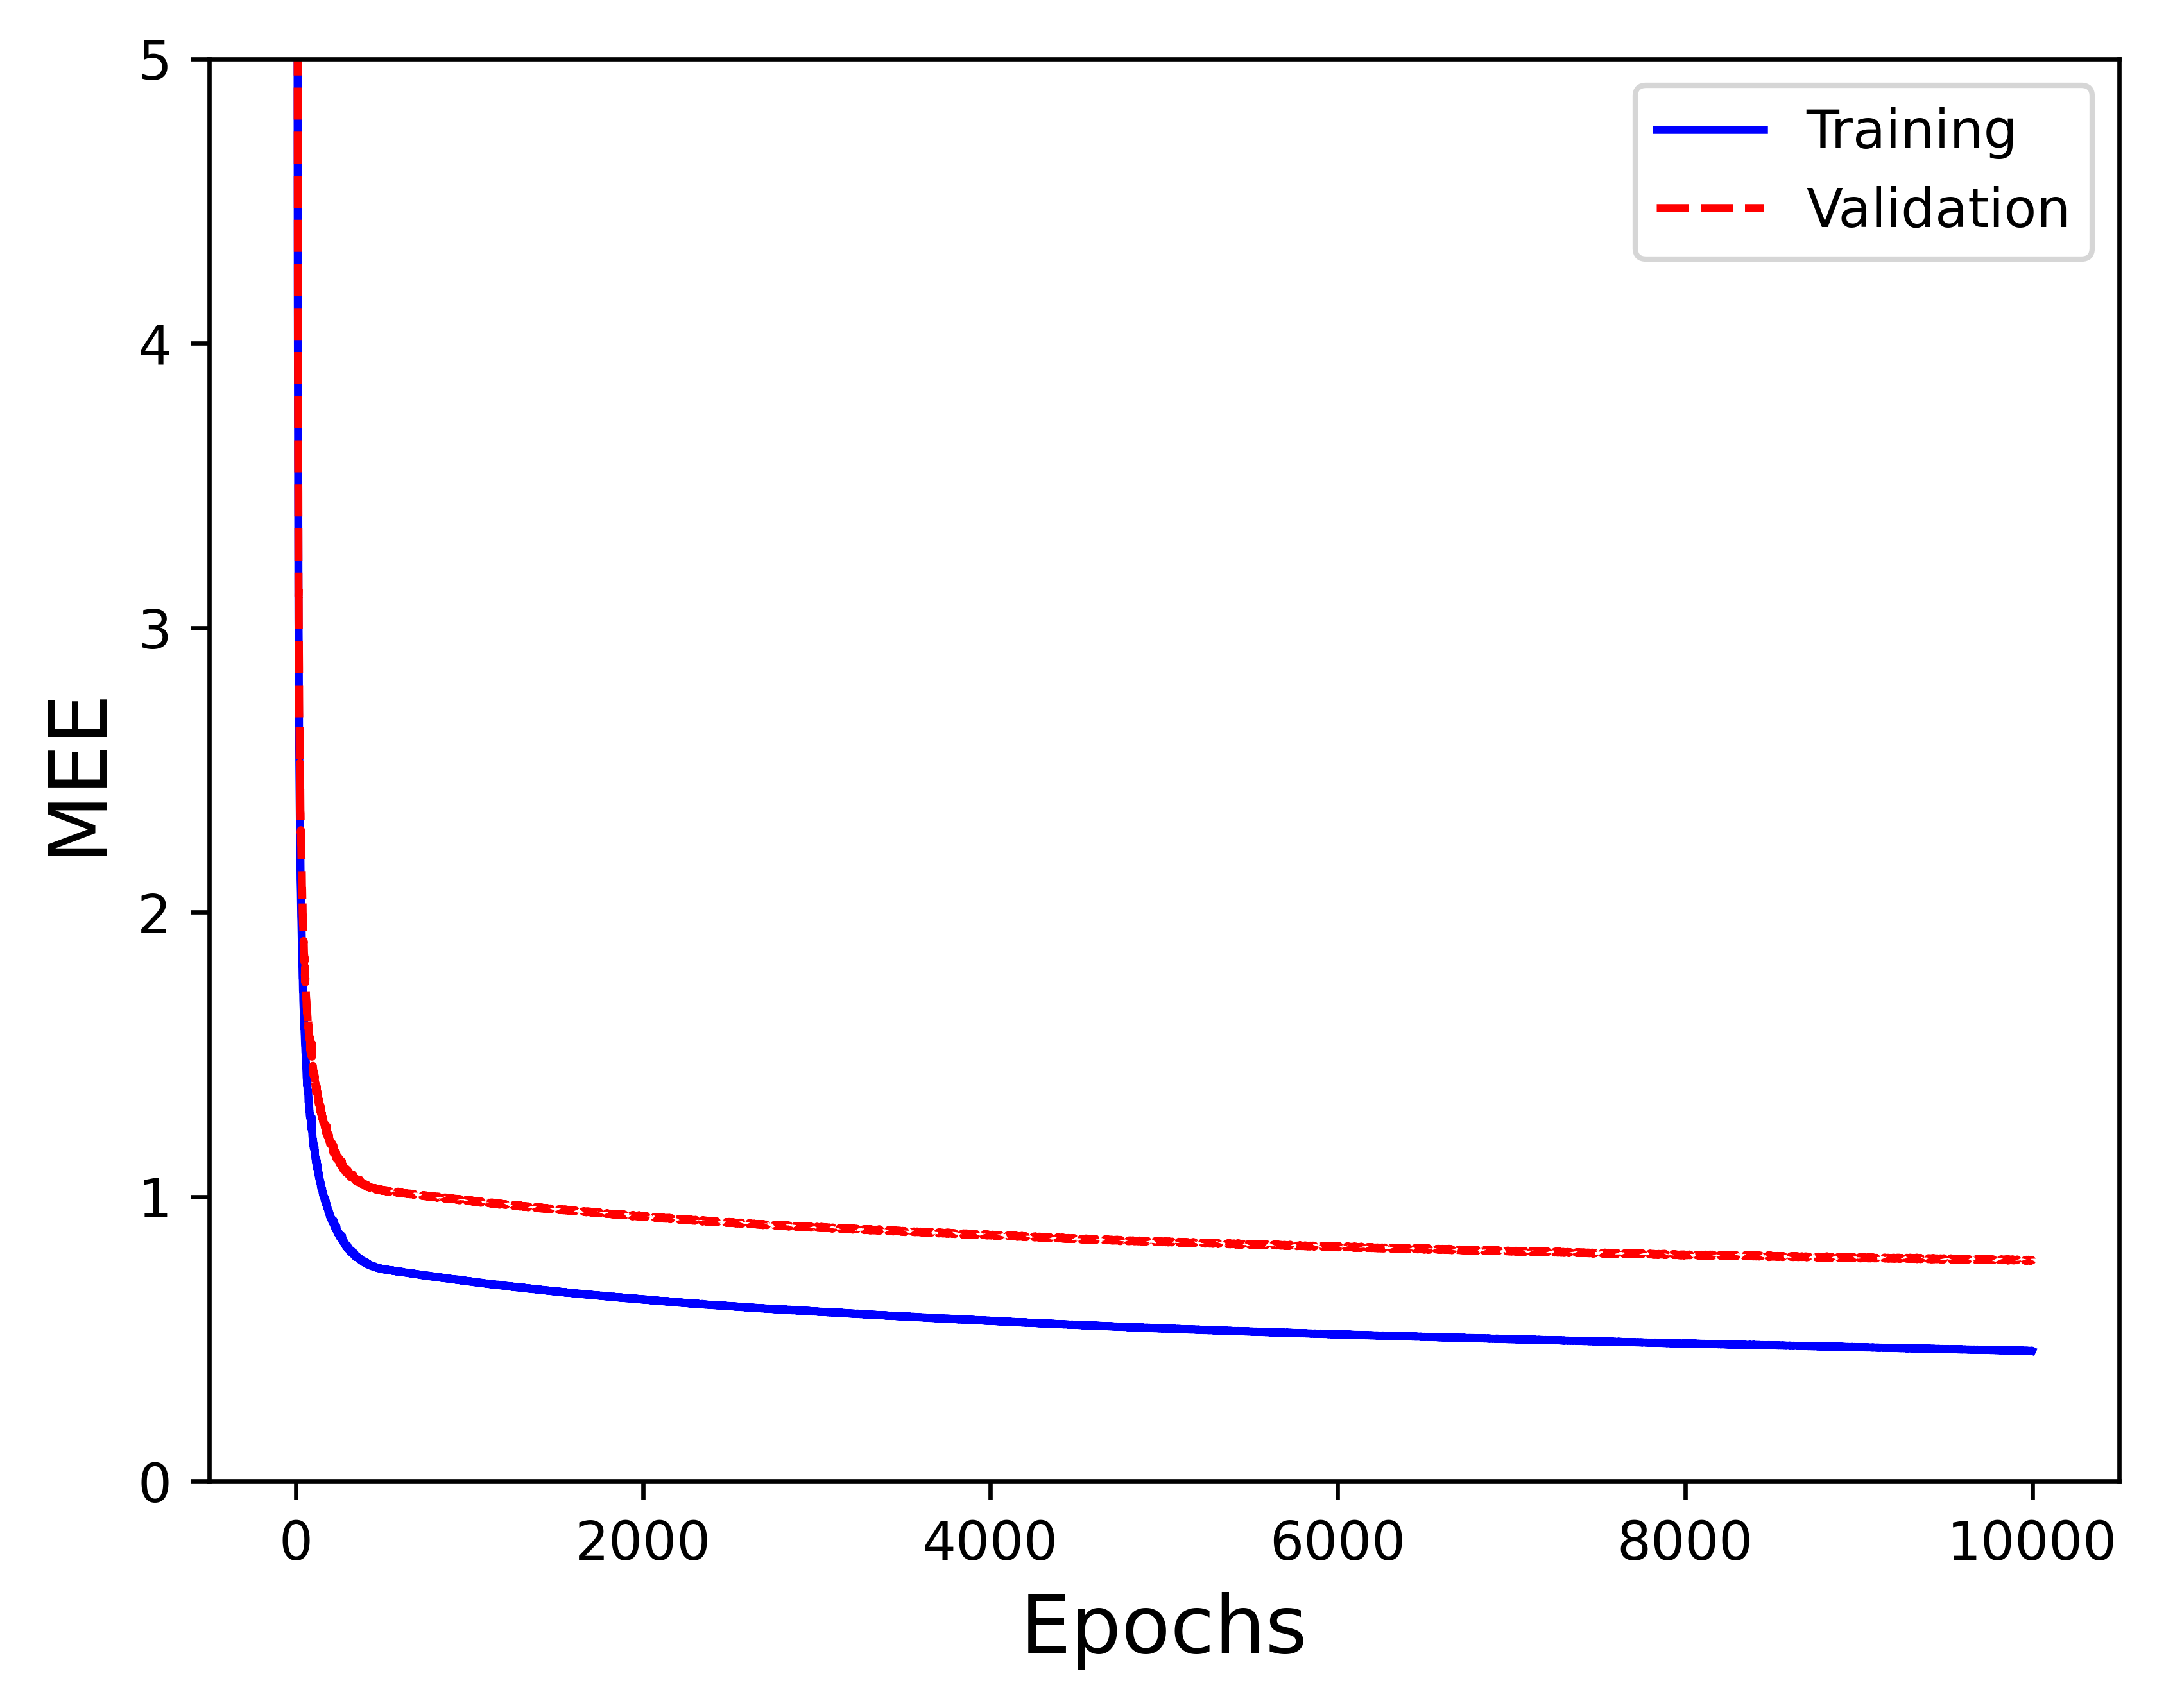
CUP Validation schema – Grid search
Training MEE: 1.9000
Validation MEE: 2.1368
Training MEE: 0.5500
Validation MEE: 0.8747
Training MEE: 0.4600
Validation MEE: 0.7773
Units: (10, 3)
Activations func: (Relu, Identity)
Learning rate: 0.008
Momentum alpha: 0.85
Batch
Lambda: 0
Units: (30, 30, 3)
Activations func: (Selu, Selu, Identity)
Learning rate: 0.008
Momentum alpha: 0.85
Batch
Lambda: 0
Units: (40, 40, 40, 40, 3)
Activations func: (Selu, Selu, Selu, Selu, Identity)
Learning rate: 0.0005 → 0.00005
Momentum alpha: 0.9
Minibatch size: 200
Lambda: 0

Slide 17
CUP Results
With the various grid searches, we noted that with more layers and more units the validation loss tends to decrease.
In all the grid searches in which is possible to have no regularization, the best model is the one not regularized.
At the same time a higher momentum is preferred.
In the preliminary trials Nesterov Momentum seemed to have a negligible effect on the training results. Then, we chose to stick with classical momentum to reduce the number of hyperparameters combinations in the grid searches.

Slide 18
CUP Results
Using minibatch find a learning rate to have a stable learning curve turns out to be more complex and require using another hyperparameters for the learning rate decay. At the same time batch give good results, stable learning curves with a tradeoff on training speed.
The results from the grid search show little improvement on validation loss when SeLU is used as activation functions for the hidden layers.
Given this, we chose to move towards large models with either no or low regularization, a high momentum, trained with batch and we did a last grid search.

Slide 19
CUP Results
The parameters of the best model found by the last grid search are the following:
Layers: 5
Units: (150, 150, 150, 150, 3)
Activation functions: (Selu, Selu, Selu, Selu, Identity)
Learning rate: 0.0006
Momentum alpha: 0.9
Nesterov Momentum: False
Batch
Lambda: 0
Stopping criteria: stop training when loss improvement on TR is below 1e-6
Loss function: MSE
Weight initialization: “normalized initialization” - Xavier Glorot and Yoshua Bengio [1]

Slide 20
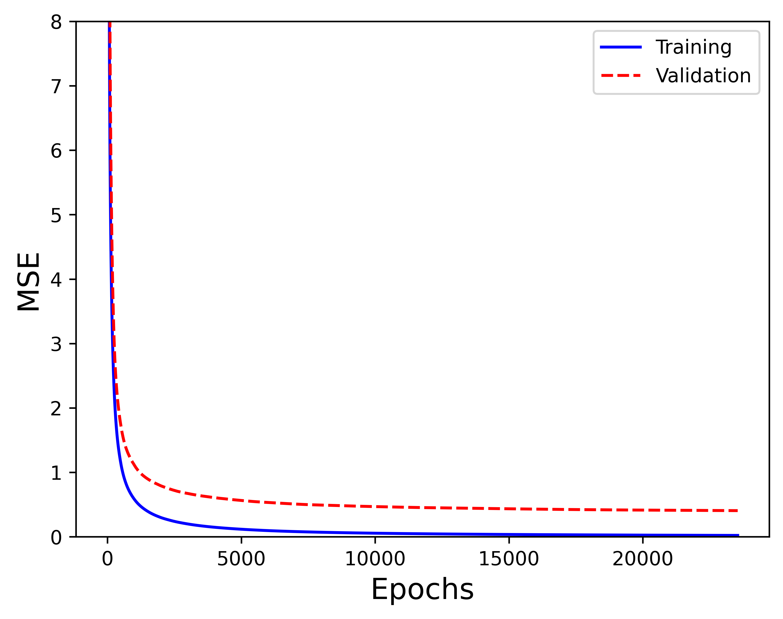
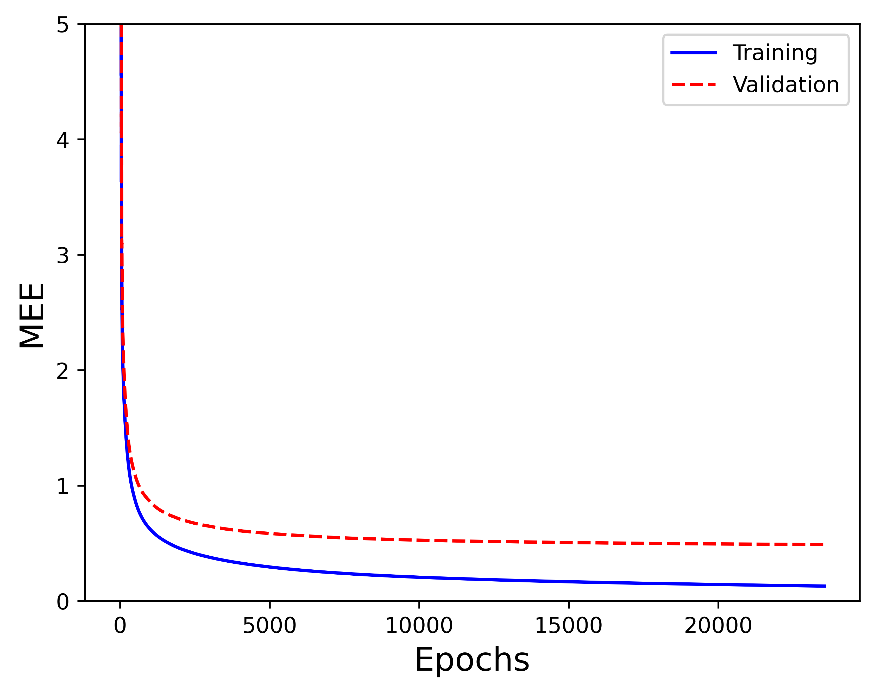
CUP Results - Validation
 | TR SET | VL SET
MSE | 0.0216 | 0.4061
MEE | 0.1290 | 0.4886

Slide 21
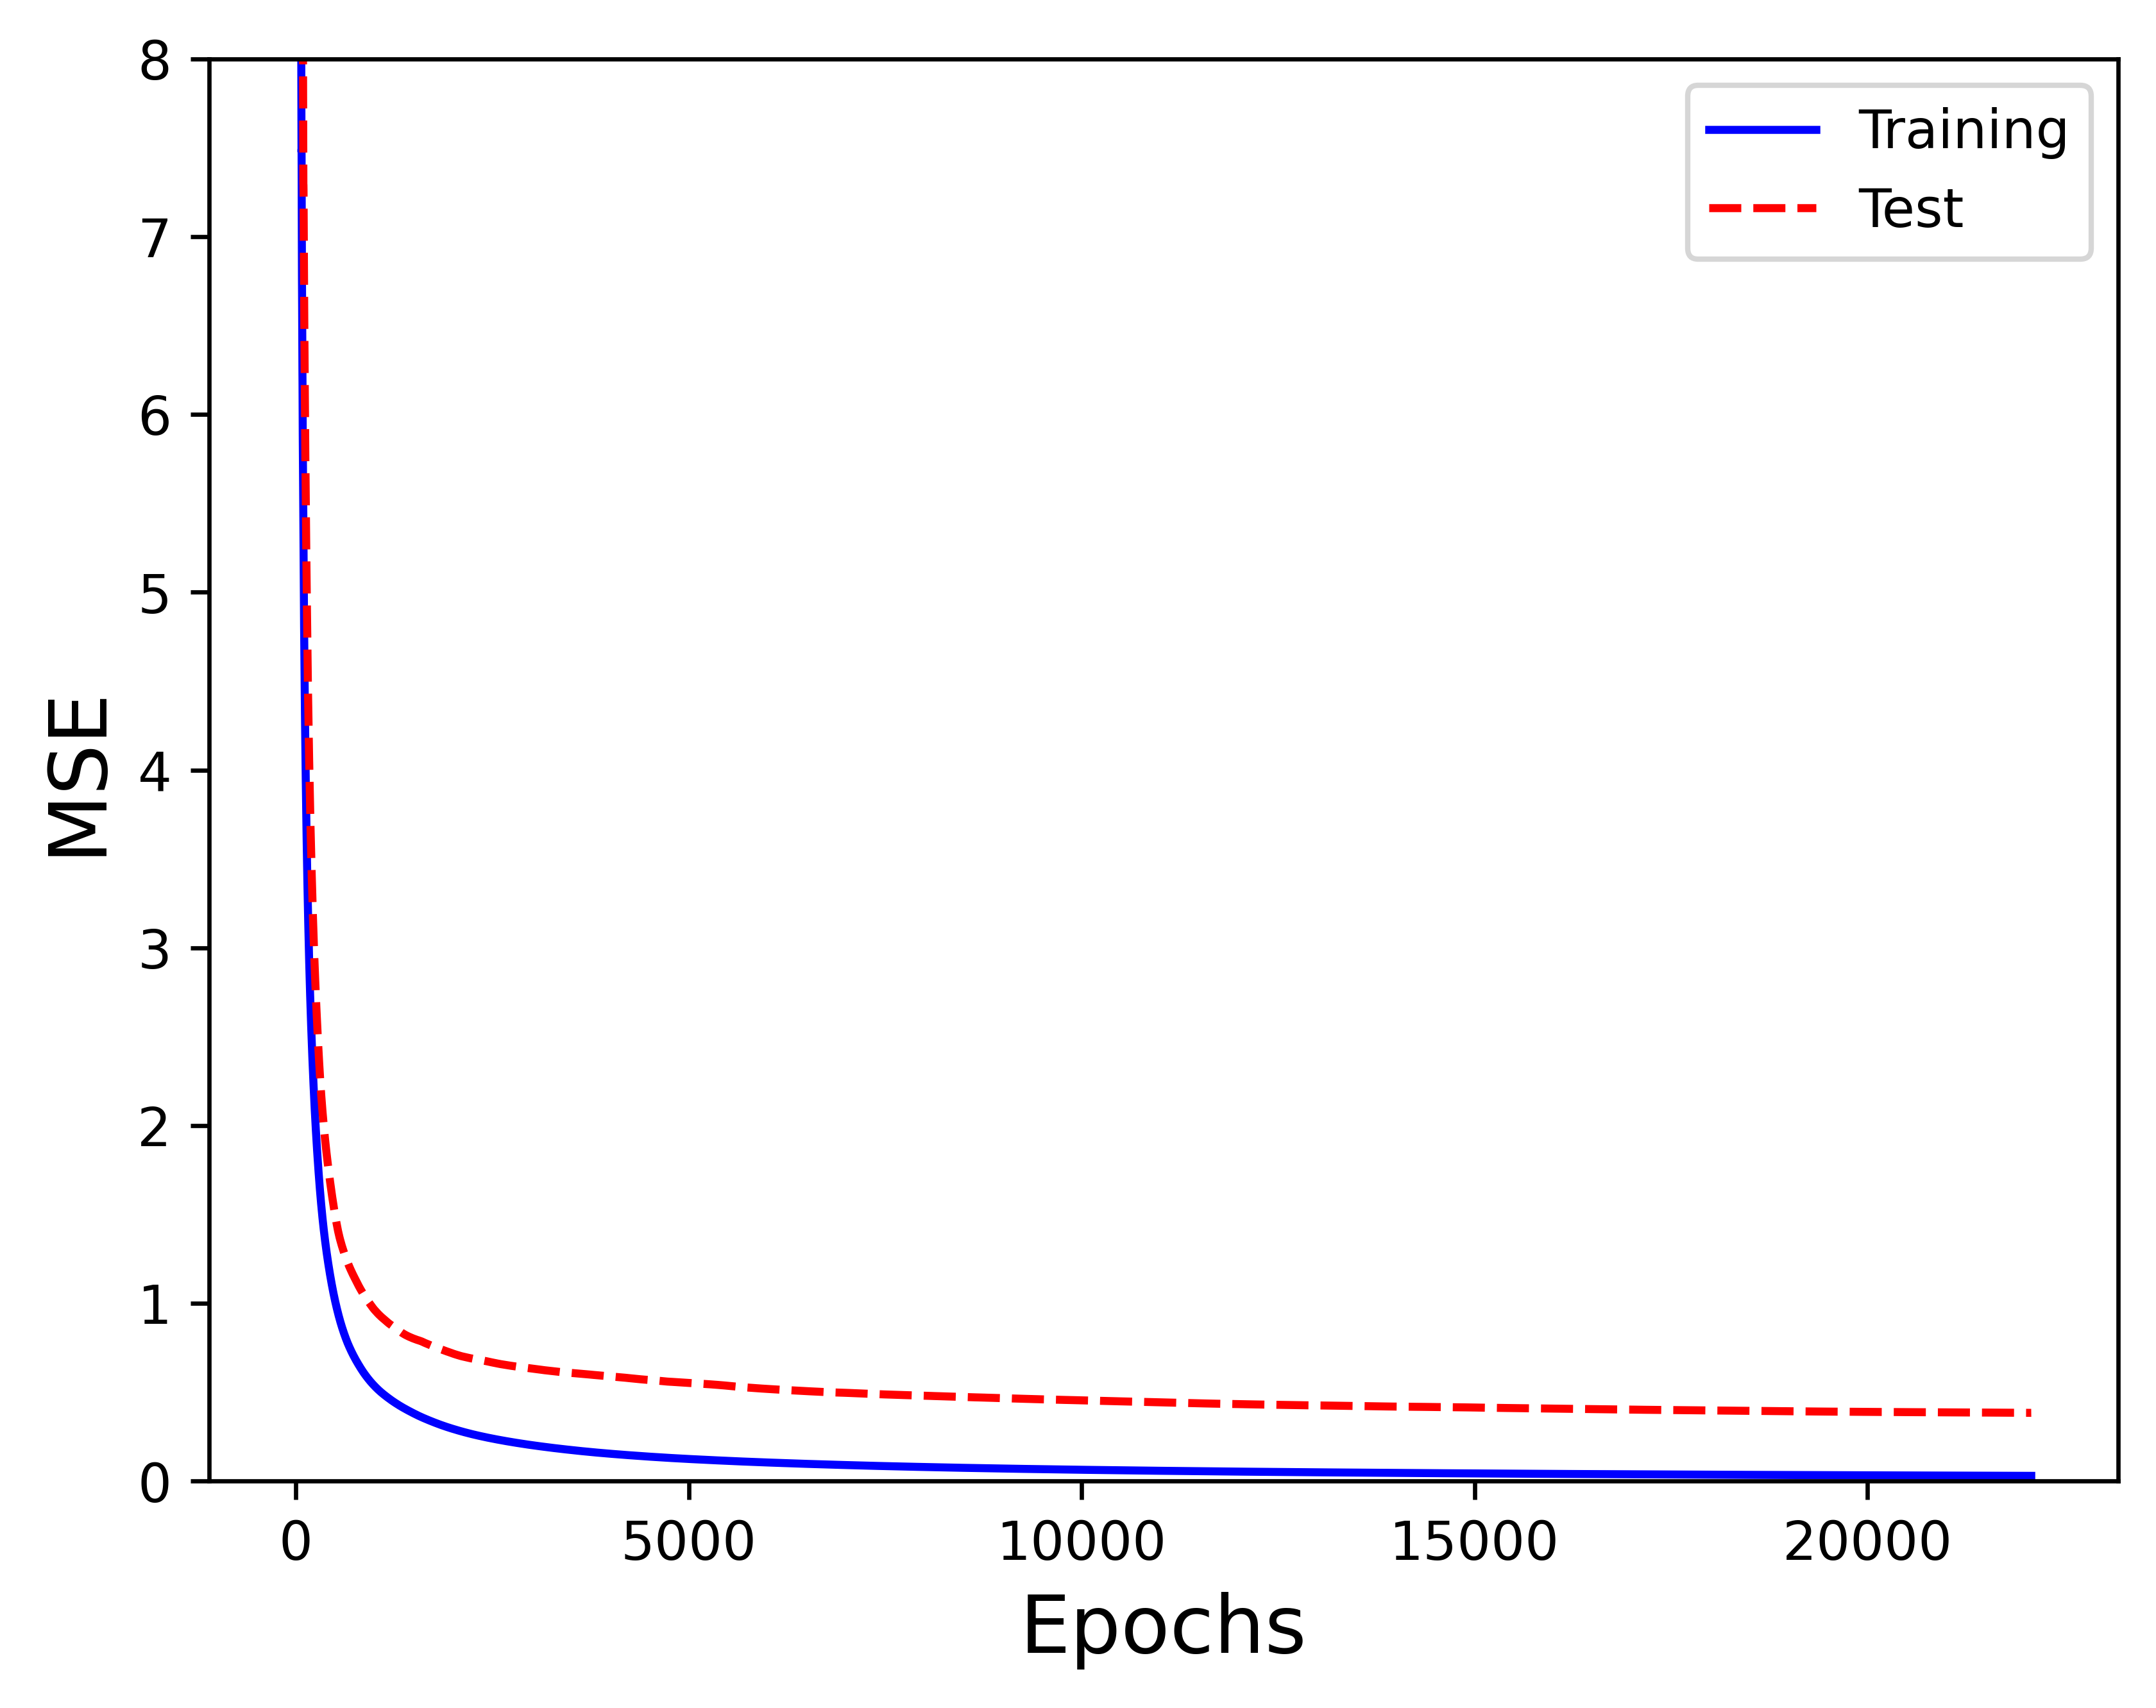
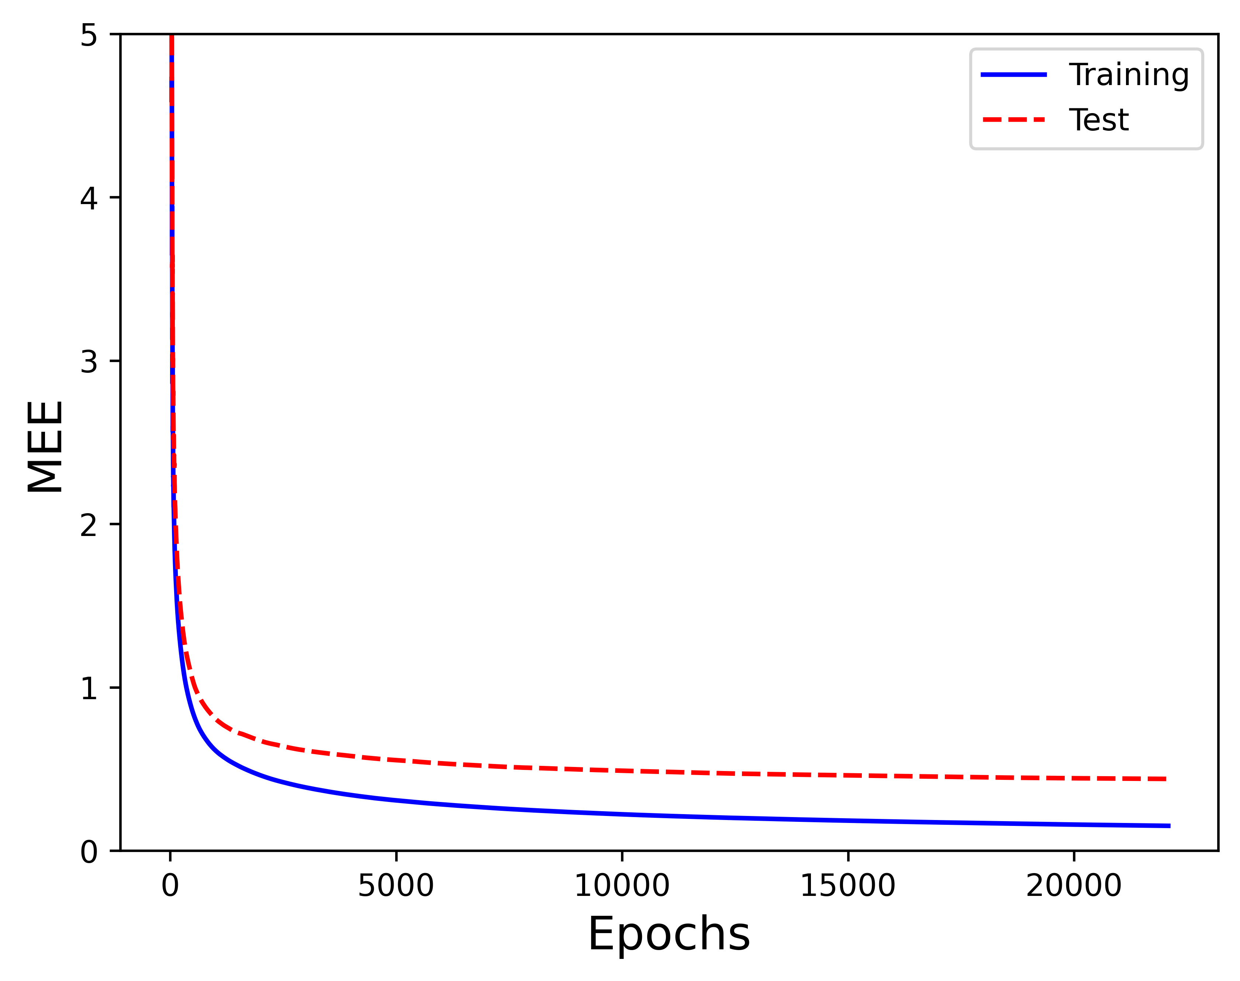
CUP Results - Test
 | TR SET | TS SET
MSE | 0.0299 | 0.3843
MEE | 0.1523 | 0.4396

Slide 22
CUP Results – Computing time
First laptop:
Intel i7 8-th generation, non-dedicated GPU: ≈ 14 minutes
Second laptop:
Intel i9 9-th generation, non-dedicated GPU: ≈ 9 minutes
This computing time are the results of an optimization of the backpropagation phase. We rewrite the entire code switching from the old version, where the gradients were computed one pattern at the time using only scalar product and summed, to a new version in which gradients are computed for all the data in the batch using matrix product. With the same hardware, this training is unfeasible using the old version.

Slide 23
Discussion
To experiment, we tried many times to overfit the data with big networks and many training epochs but were unable to do so. We only observed that the validation loss starts to decrease slower than the training loss. To verify if there were any issues with our simulator, we conducted tests with Keras and obtained the same results.
ReLU (and its variants like Leaky ReLU and SeLU) tends to perform better than other activation functions during the training, with a more uniform and stable gradient descent.
Momentum is essential for good learning (especially with batch)

Slide 24
Discussion
We realized that performing model selection requires a lot of time, more than we had anticipated. Given that small tweaks to neural network hyperparameters yield significant variations in both training dynamics and outcomes, the combinations of hyperparameters to test are truly numerous, and for each is required a careful review.
Rescaling the data using znorm (mean to 0, standard deviation to 1) did not improve the results
Monk training highlights the impact of weight initialization in small networks on the final accuracy.

Slide 25
Conclusions
This project allowed us to find a connection between the theory and the practice studied during the course, indeed we dialed with overfitting, regularization, network architectures, and many other aspects discussed in the lectures.
Creating an NN simulator from scratch was a demanding challenge, but very educational. This collaborative project not only expanded our technical knowledge but also enriched our experience in working collaboratively within a group setting.
In conclusion regarding our project, we believe we've not only delved into fascinating concepts but also acquired practical skills that will prove precious in our academic and professional journey ahead.

Slide 26
Conclusions
Name of the results file:
MensaMartiri_ML-CUP23-TS.csv
MensaMartiri_abstract.txt
Team name: Mensa Martiri
Team members: Tommaso Di Riccio, Marco Minniti, Francesco Simonetti

Slide 27
References
[1] X. Glorot & Y. Bengio: Understanding the difficulty of training deep feedforward neural networks. In Proceedings of the Thirteenth International Conference on Artificial Intelligence and Statistics, 249–256, 2010

Slide 28
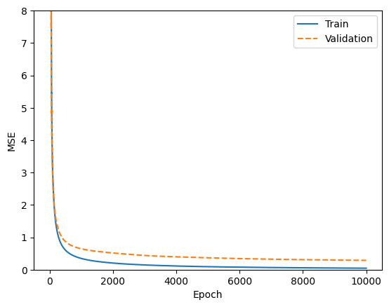
Appendix
Result of the training with Keras mentioned in slide 20:
ing
Training loss: 0.0448
Validation loss: 0.2865

