Slide 1
ML 2023 Project
Tommaso Di Riccio, Marco Minniti, Francesco Simonetti
Mensa Martiri
Computer science - curriculum: Artificial Intelligence
Date: 24/01/2024 Project type: A

Slide 2
Objectives
Implement a Neural Network simulator with multiple functionalities to solve classification and regression problems
With the help of grid search, k-fold and double k-fold find the best network architecture and hyperparameters configuration to obtain a model able to predict, with a low error, the CUP challenge targets
We used a Feedforward Neural Network trained with gradient descent algorithm, using backpropagation to calculate the gradients.

Slide 3
Method
Programming language: Python
Used libraries:
Numpy: to perform linear algebra operations
Sklearn: to performs the one-hot-encoding on the monk dataset
Pandas: to read the csv of the dataset
Seaborn: to plot the results

Slide 4
Method
Brief code description:
Network: a class representing the structure of the network with the methods for training, testing and predicting.
Layer: a class representing a layer of the Neural Network. It contains the number of units, with all the weights, and the activation function chosen by the user. During training, each layer compute its gradient and the error signal to propagate to the previous layer.

Slide 5
Method
Training: containing all the class representing learning methods (e.g. Gradient Descent). Gradient Descent class implements the following features:
Online / Minibatch / Batch
Momentum
Nesterov momentum
Learning rate decay
Regularization
Early stopping

Slide 6
Method
Functions:
Activation functions: Identity, Sigmoid, Tanh, ReLU, Leaky ReLU, SeLU
Loss functions: Mean Squared Error, Mean Euclidean Error, Binary Cross Entropy
Metric functions: Binary Accuracy
Model selection: grid search, k-fold, double k-fold
Utils: generic utility functions (e.g., dataset reading, weights init, …)

Slide 7
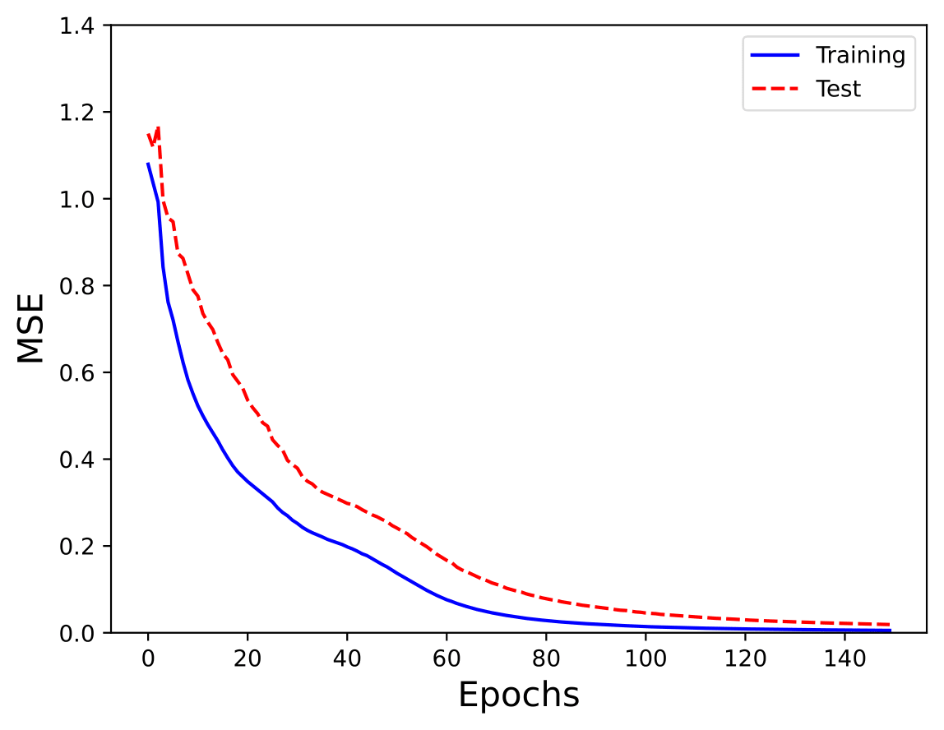
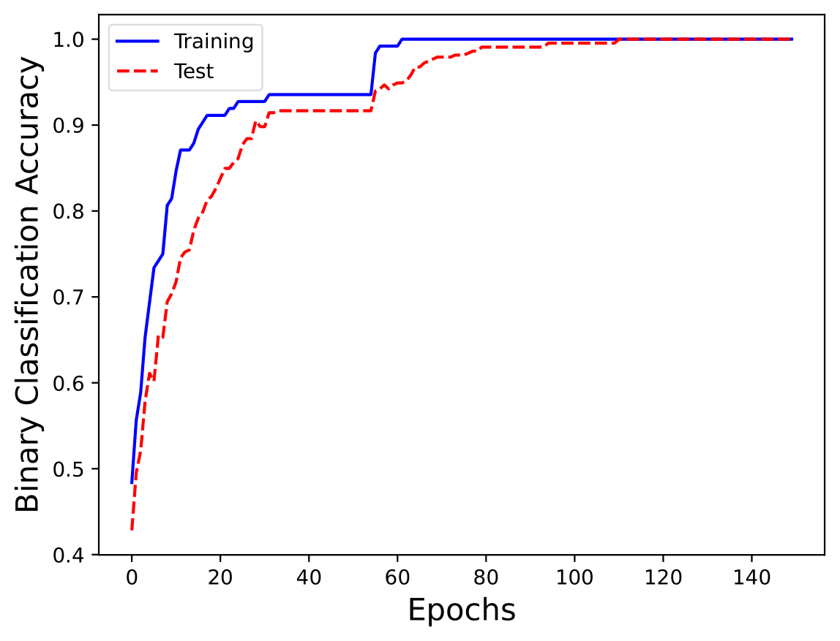
Monk Results – Monk 1
Network: 2 Layer, 4 hidden units, Activation functions: ReLU and Tanh
Parameters: Batch, Learning rate: 0.5, Momentum: 0.5, No regularization

Slide 8
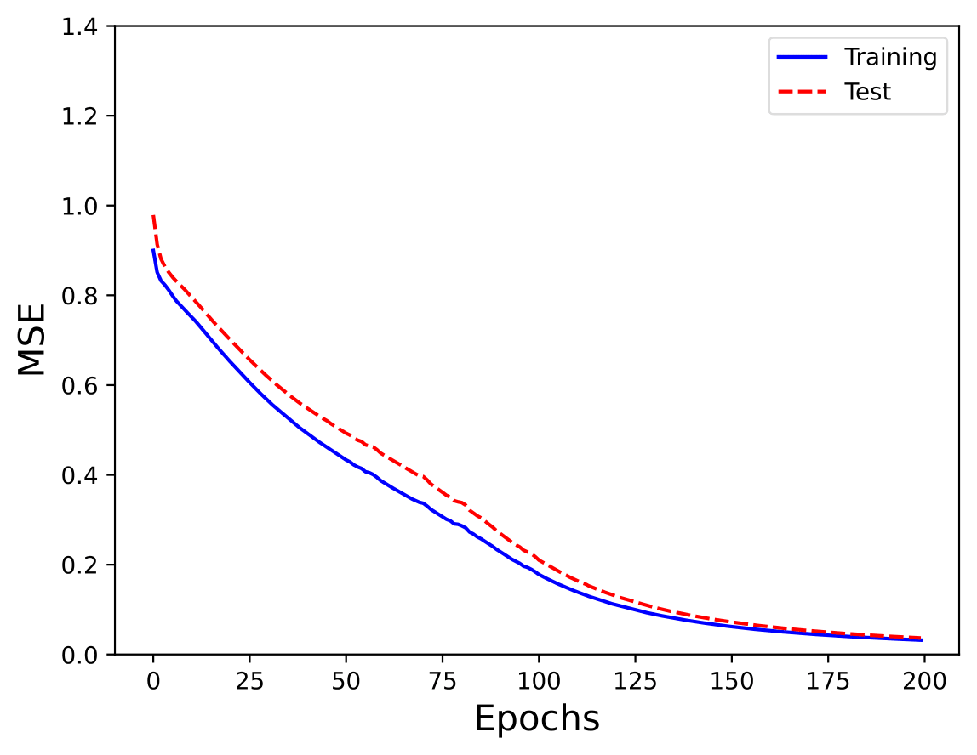
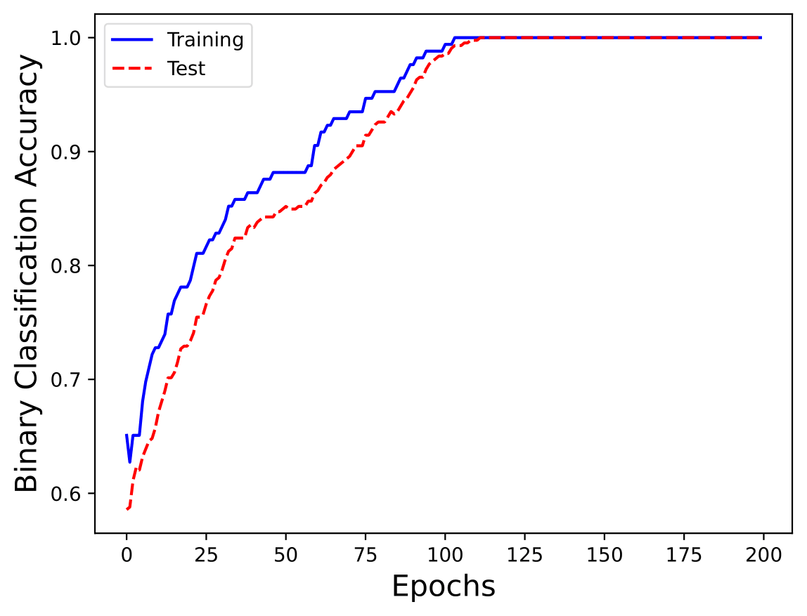
Monk Results – Monk 2
Network: 2 Layer, 3 hidden units, Activation functions: ReLU and Tanh
Parameters: Batch, Learning rate: 0.2, Momentum: 0.5, No regularization

Slide 9
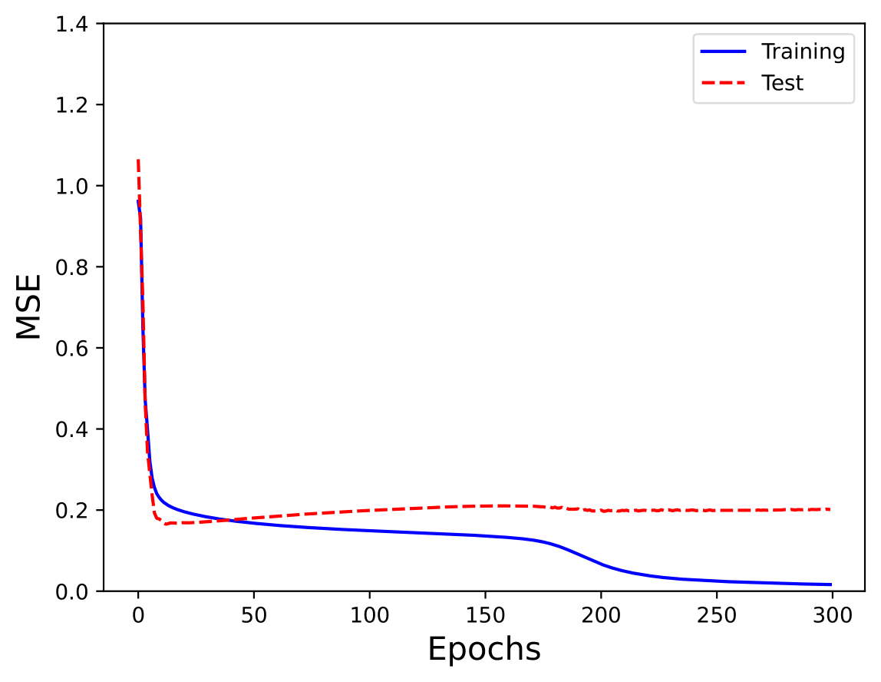
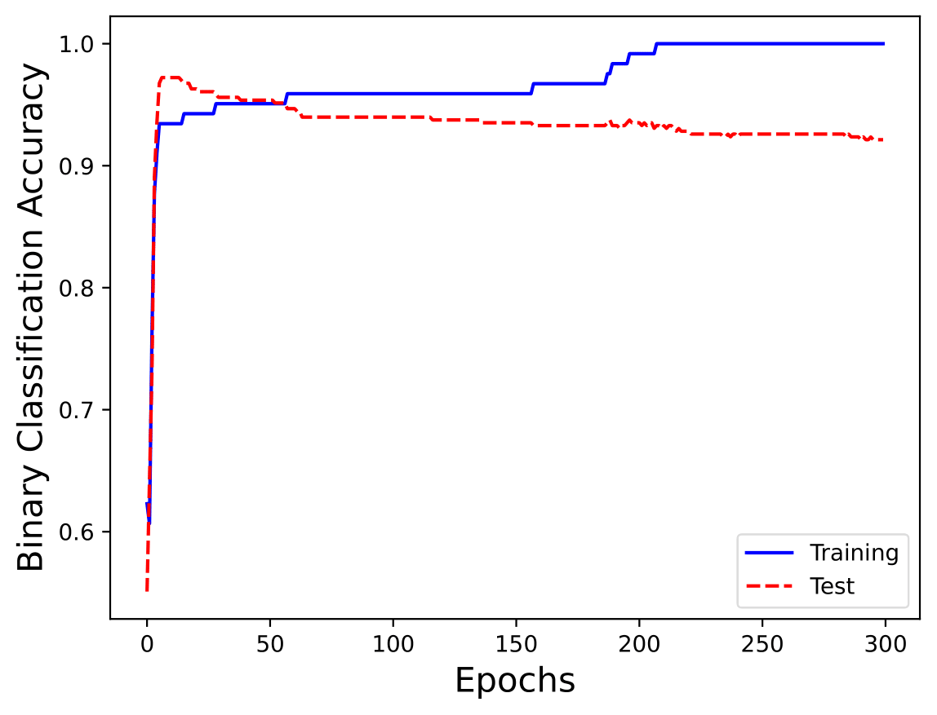
Monk Results – Monk 3 (no regularization)
Network: 2 Layer, 4 hidden units, Activation functions: ReLU and Tanh
Parameters: Batch, Learning rate: 0.3, Momentum: 0.5, No regularization

Slide 10
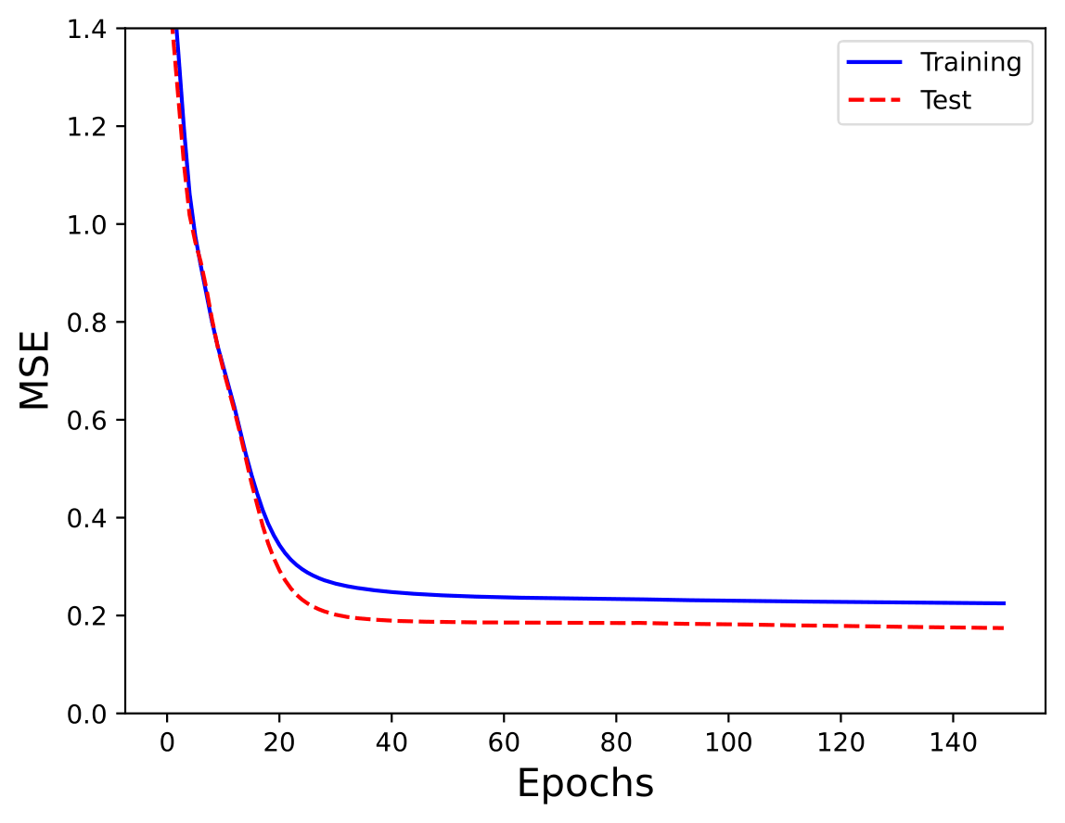
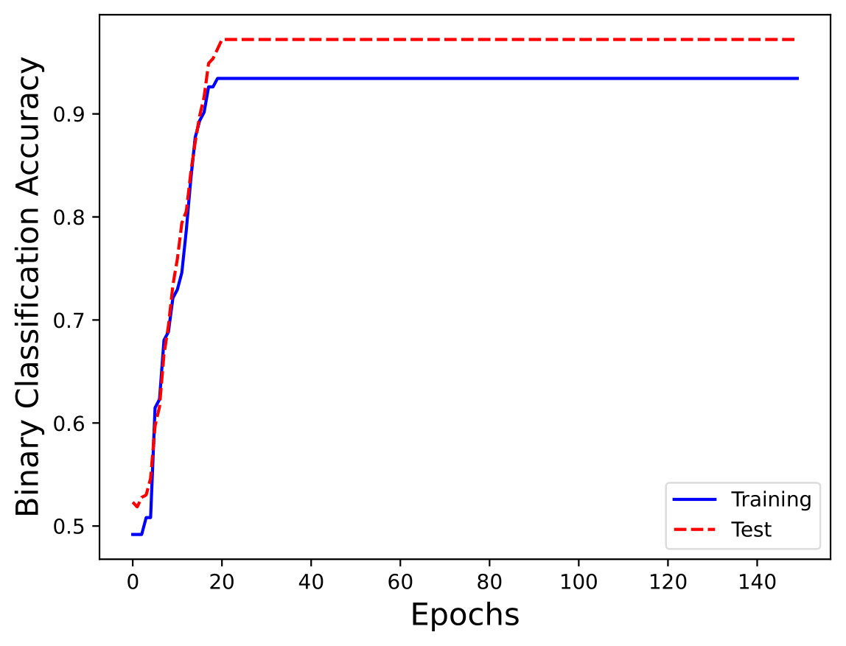
Monk Results – Monk 3 (with regularization)
Network: 2 Layer, 4 hidden units, Activation functions: ReLU and Tanh
Parameters: Batch, Learning rate: 0.3, Momentum: 0.5, Lambda = 0.01

Slide 11
Monk Results – Recap
Task | #Units, eta, lambda | MSE (TR / TS) | Accuracy (TR / TS) (%)
Monk 1 | (4, 1), 0.5, 0 | 0.0055 / 0.0110 | 100% / 100%
Monk 2 | (3, 1), 0.2, 0 | 0.0198 / 0.0231 | 100% / 100%
Monk 3 | (4, 1), 0.3, 0 | 0.0199 / 0.2117 | 100% / 92.36%
Monk 3 (reg.) | (4, 1), 0.3, 0.01 | 0.2249 / 0.1744 | 93% / 97.22%

