Slide 1
ML 2023 Project
Tommaso Di Riccio, Marco Minniti, Francesco Simonetti
Mensa Martiri
Computer science - curriculum: Artificial Intelligence
Date: 24/01/2024 Project type: A

Slide 2
Objectives
Implement a Neural Network simulator with multiple functionalities to solve classification and regression problems.
With the help of grid search (also random), K-Fold and double K-Fold find the best network architecture and hyperparameters configuration to obtain a model able to predict, with a low error, the CUP challenge targets.
We used a Feedforward Neural Network trained with gradient descent algorithm, using backpropagation to calculate the gradients.

Slide 3
Method
Programming language: Python
Used libraries:
Numpy: to perform linear algebra operations
Sklearn: to performs the one-hot-encoding on the monk datasets
Pandas: to read the csv of the datasets
Seaborn: to plot the results
We exploit Python classes to effortlessly incorporate new functionalities without the need to modify existing code.

Slide 4
Method
Brief code description:
Network: a class representing the structure of the network with the methods for training, testing and predicting.
Layer: a class representing a layer of the Neural Network. It contains the number of units, with all the weights, and the activation function chosen by the user. During training, each layer compute its gradient and the error signal to propagate to the previous layer.

Slide 5
Method
Training: containing all the class representing learning methods (e.g. Gradient Descent). Gradient Descent class implements the following features:
Online / Minibatch / Batch
Momentum
Nesterov momentum
Learning rate decay
L2 Regularization
Early stopping or stop the training when improvement on TR loss is low

Slide 6
Method
Functions:
Activation functions: Identity, Sigmoid, Tanh, ReLU, Leaky ReLU, SeLU
Loss functions: Mean Squared Error, Mean Euclidean Error, Binary Cross Entropy
Metric functions: Binary Accuracy
Model selection: Grid search, K-Fold, Double K-Fold
Utils: generic utility functions (e.g., dataset reading, weights init, …)

Slide 7
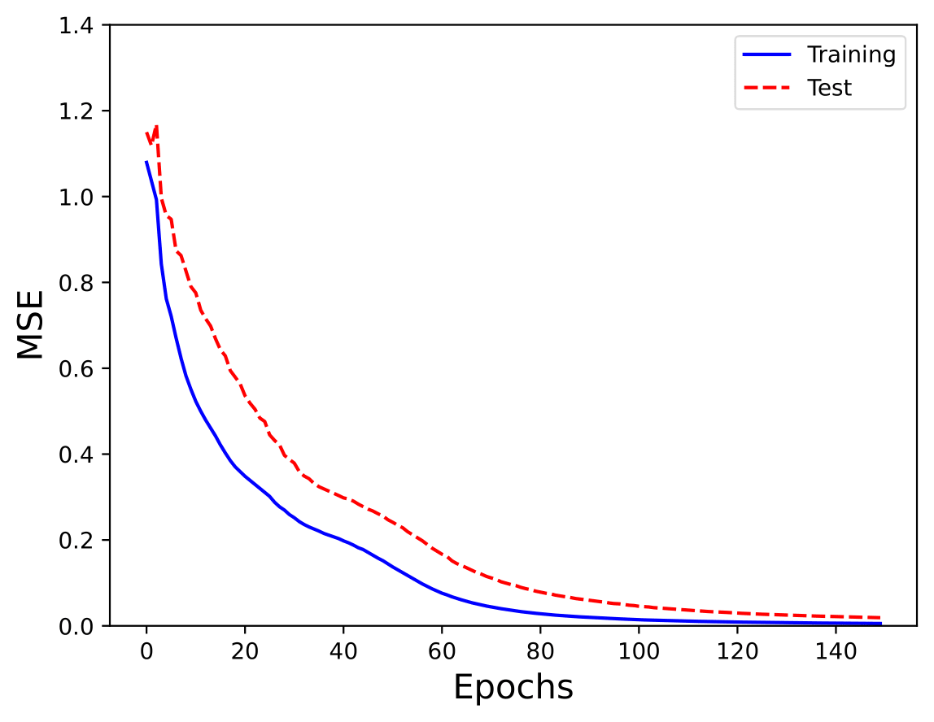
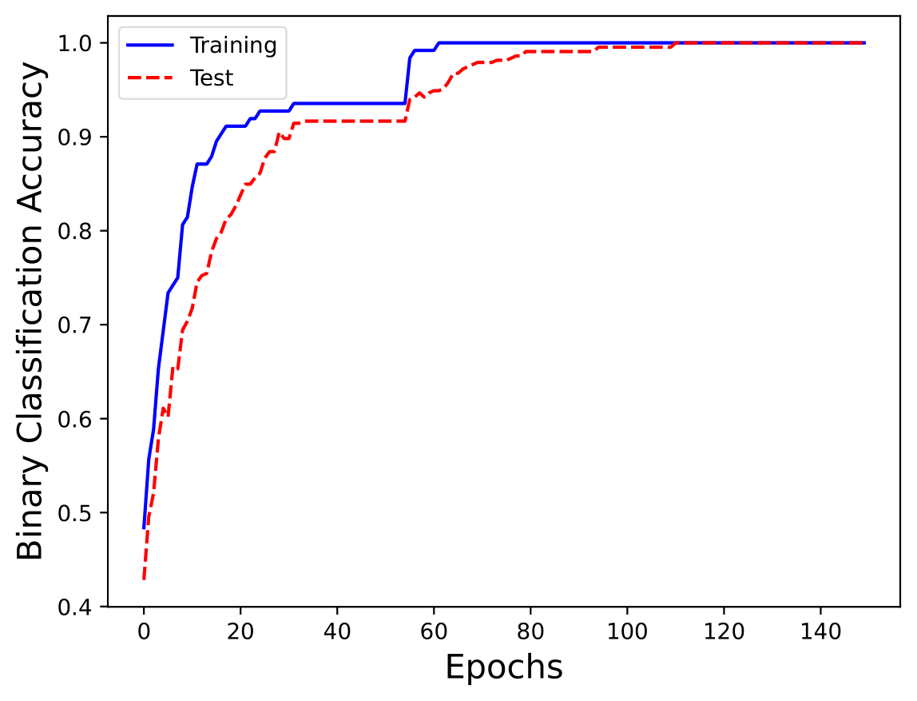
Monk Results – Monk 1
Network: 2 Layer, 4 hidden units, Activation functions: ReLU and Tanh
Parameters: Batch, Learning rate: 0.5, Momentum: 0.5, No regularization

Slide 8
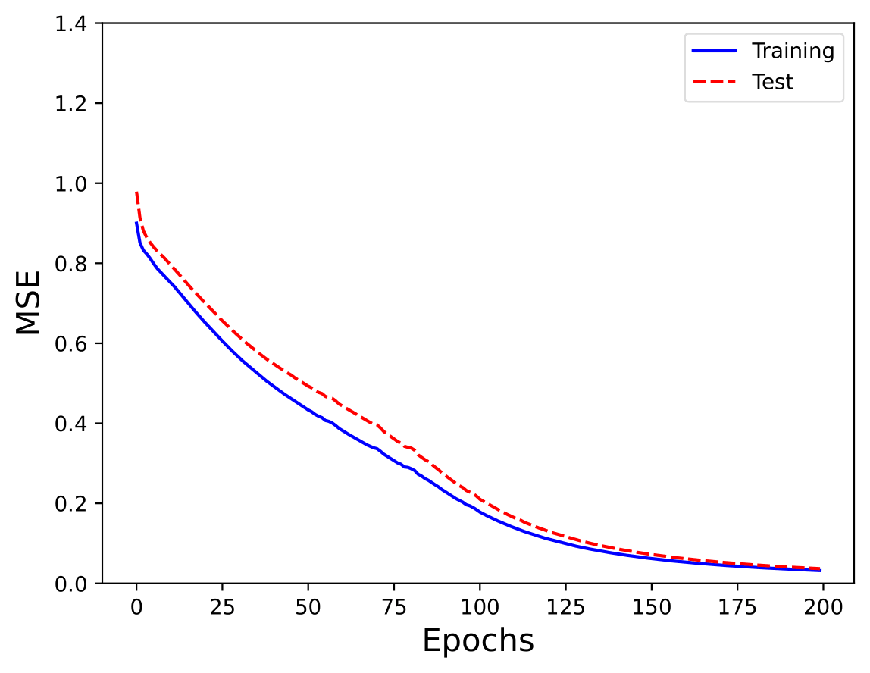
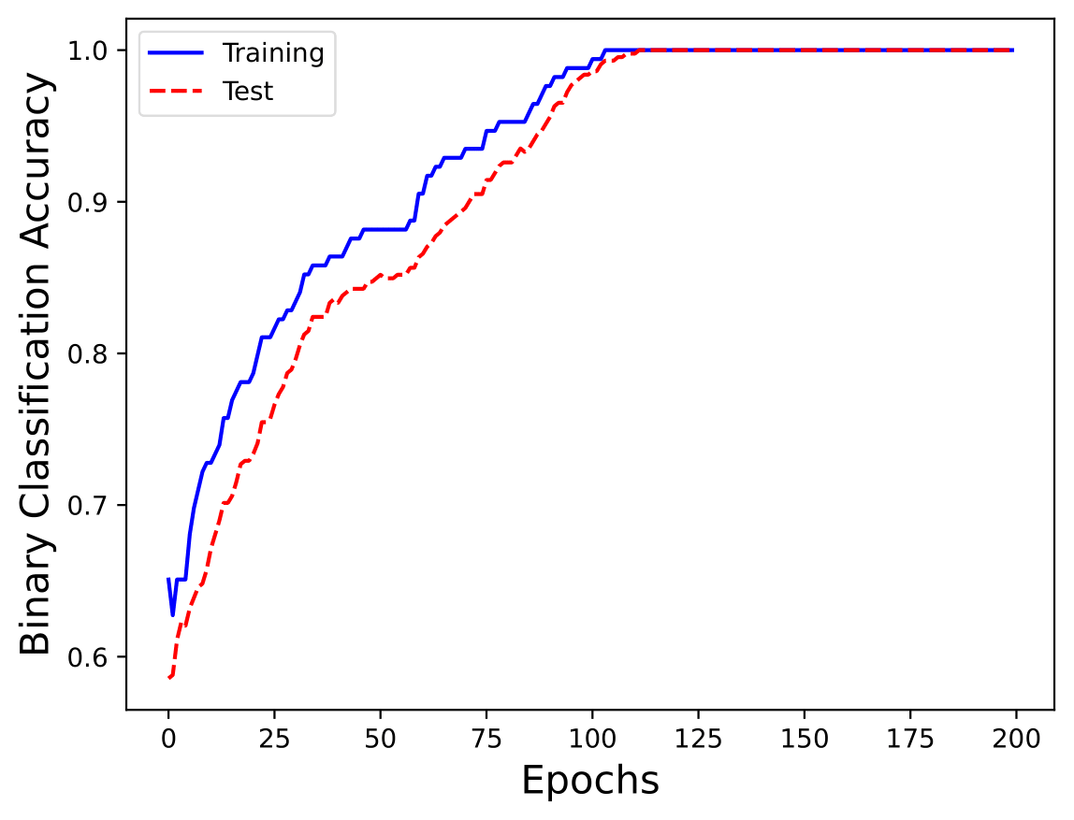
Monk Results – Monk 2
Network: 2 Layer, 3 hidden units, Activation functions: ReLU and Tanh
Parameters: Batch, Learning rate: 0.2, Momentum: 0.5, No regularization

Slide 9
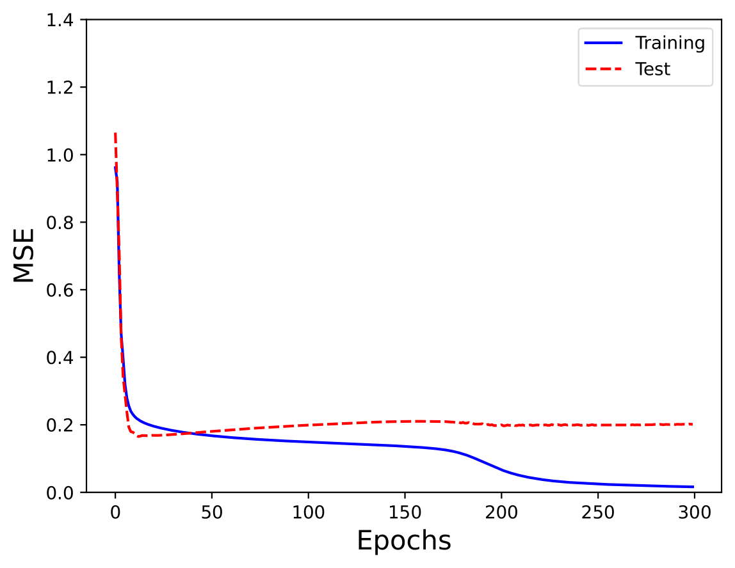
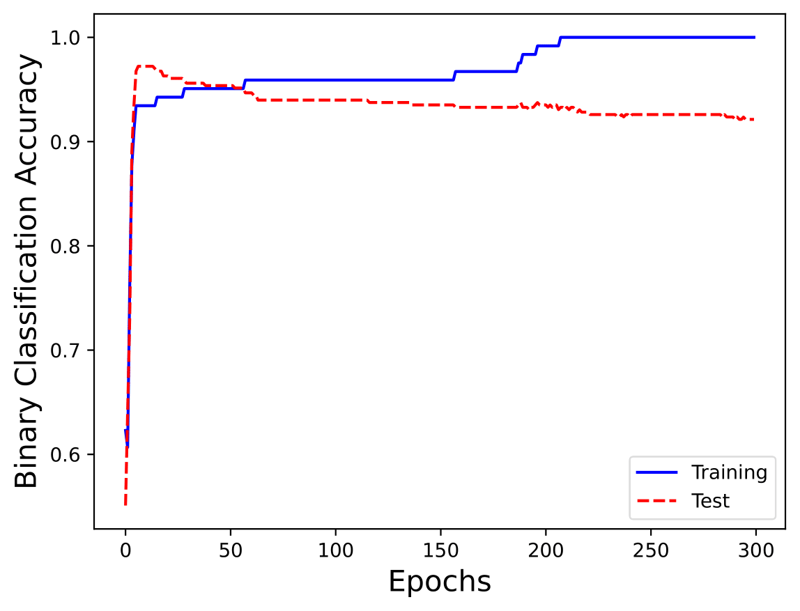
Monk Results – Monk 3 (no regularization)
Network: 2 Layer, 4 hidden units, Activation functions: ReLU and Tanh
Parameters: Batch, Learning rate: 0.3, Momentum: 0.5, No regularization

Slide 10
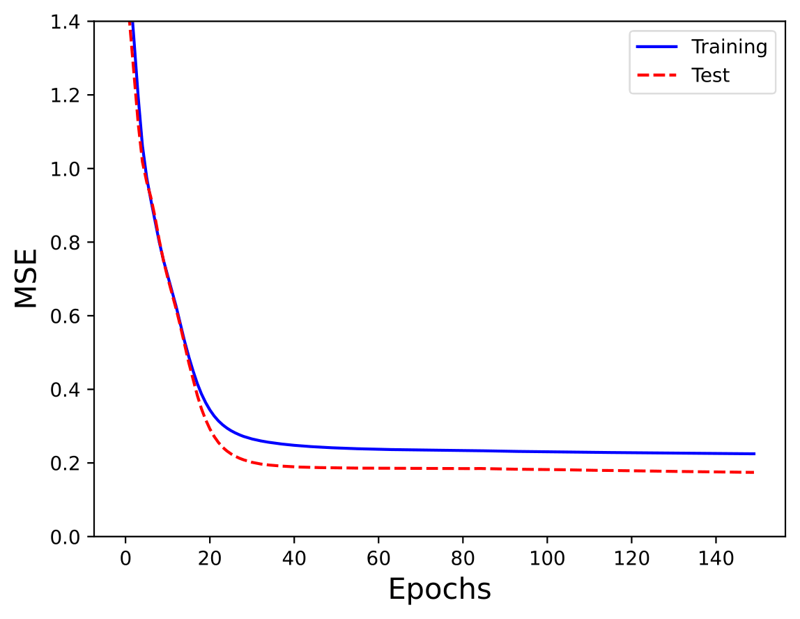
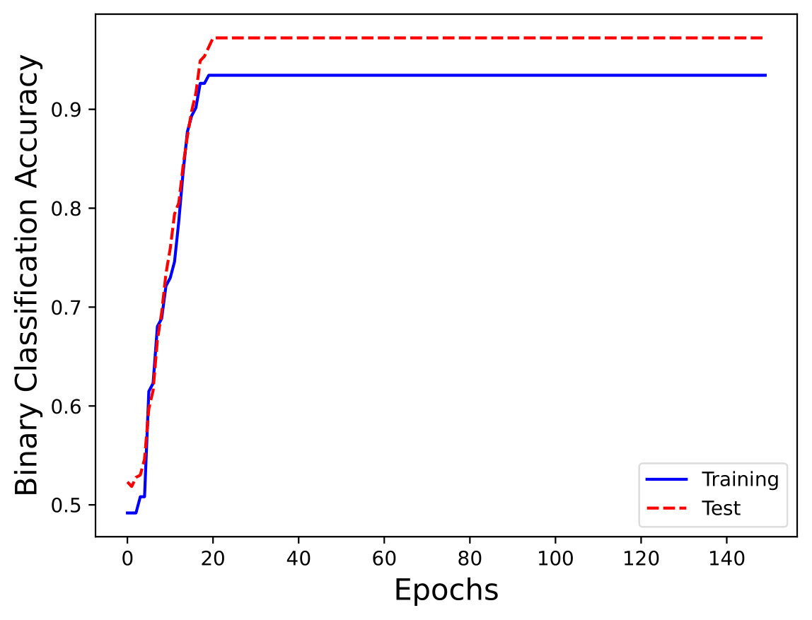
Monk Results – Monk 3 (with regularization)
Network: 2 Layer, 4 hidden units, Activation functions: ReLU and Tanh
Parameters: Batch, Learning rate: 0.3, Momentum: 0.5, Lambda = 0.01

Slide 11
Monk Results – Recap
Task | #Units, eta, lambda | MSE (TR / TS) | Accuracy (TR / TS) (%)
Monk 1 | (4, 1) 0.5 0 | 0.0055 / 0.0110 | 100% / 100%
Monk 2 | (3, 1) 0.2 0 | 0.0198 / 0.0231 | 100% / 100%
Monk 3 | (4, 1) 0.3 0 | 0.0199 / 0.2117 | 100% / 92.36%
Monk 3 (reg.) | (4, 1) 0.3 0.01 | 0.2249 / 0.1744 | 93% / 97.22%

Slide 12
CUP Validation schema – Data splitting
5-Fold-CV Training + Validation (90%) | Hold-out Internal Test (10%)
First, we did a retraining on Training + Validation data to estimate the error on the Hold-out dataset.
At the end, we did a retraining on all data before estimating the outputs for the CUP test data

Slide 13
CUP Validation schema – Preliminary trials
We experimented with various network architectures, beginning with smaller ones (2 layers, a few dozen units) and progressively increasing their sizes, culminating in a 5-layer structure with nearly one thousand units.
For each architecture, we performed a grid search to evaluate different activation functions, learning rates, batch sizes, momentum values, and regularization lambdas.
Following these initial grid searches, we executed a more refined grid search to find the optimal parameters based on the best-performing configurations identified in the previous steps.

Slide 14
CUP Validation schema – Grid search
Hyperparameters | Configuration tested
Number of layer | From 2 to 5 layers
Units on each layer | From 10 to 200 units
Activation functions | ReLU, Leaky ReLU, Selu, Tanh
Weight initialization | Random uniform, Glorot and Bengio [1]
Epochs | From 500 to 100 000
Batch size | From 50 to all data
Learning rate | From 0.0001 to 0.008
Momentum alpha | From 0 to 0.95
Nesterov momentum | True - False
Regularization lambda | 0, 0.0001, 0.00001, 0.000005
Early stopping | True - False

Slide 15
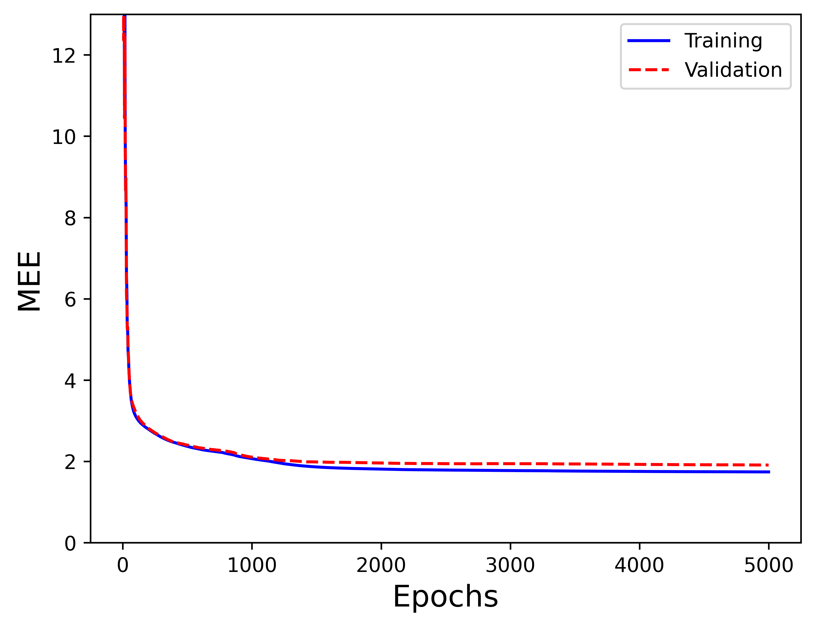
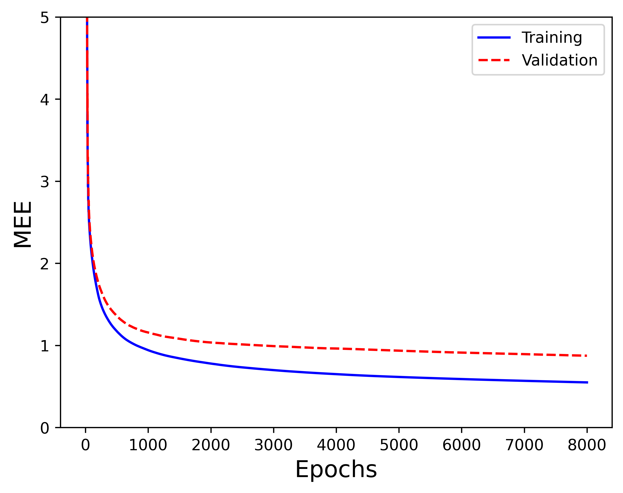
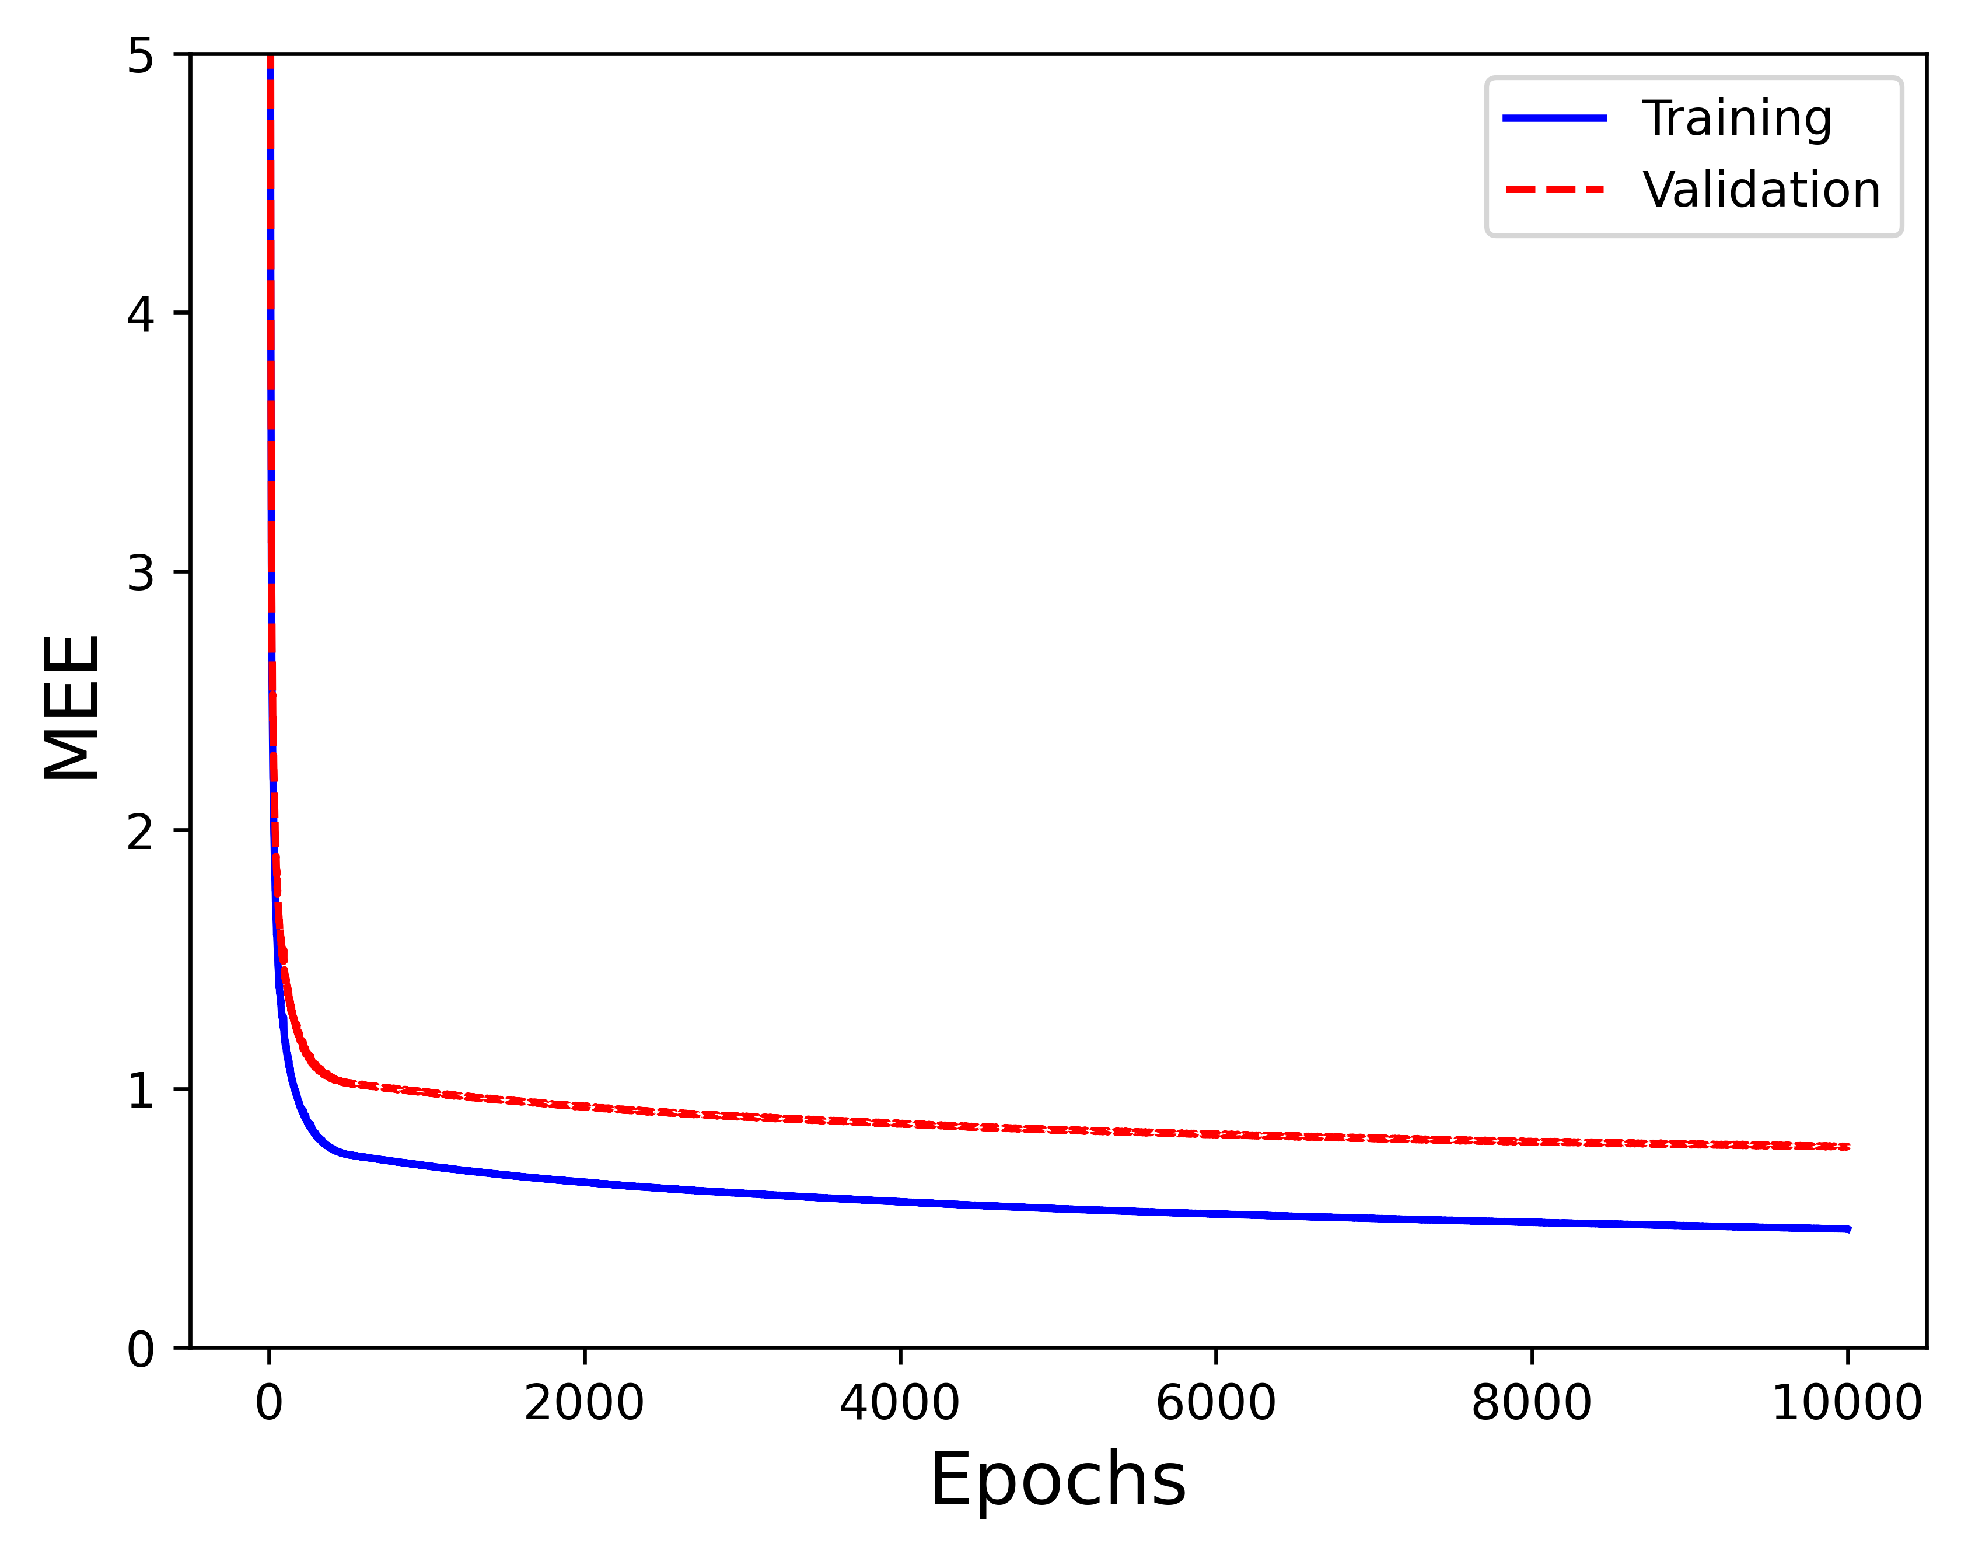
CUP Validation schema – Grid search
Training MEE: 1.9000
Validation MEE: 2.1368
Training MEE: 0.5500
Validation MEE: 0.8747
Training MEE: 0.4600
Validation MEE: 0.7773
Units: (10, 3)
Activations func: (Relu, Identity)
Learning rate: 0.008
Momentum alpha: 0.85
Batch
Lambda: 0
Units: (30, 30, 3)
Activations func: (Selu, Selu, Identity)
Learning rate: 0.008
Momentum alpha: 0.85
Batch
Lambda: 0
Units: (40, 40, 40, 40, 3)
Activations func: (Selu, Selu, Selu, Selu, Identity)
Learning rate: 0.0005 → 0.00005
Momentum alpha: 0.9
Minibatch size: 200
Lambda: 0

Slide 16
CUP Results
With the various grid searches, we noted that with more layer and more units the validation loss tends to decrease.
In all the grid search in which was possible to have no regularization, the best model was the one not regularized.
At the same time a higher momentum was preferred.
Training the model with batch shows a more stable curve with very low impact on the training speed.
Given this, we chose to move towards large models with either no or low regularization, a high momentum, trained with batch and we did a last grid search.

Slide 17
CUP Results
The parameters of the best model found by the last grid search are the following:
Layers: 5
Units: (150, 150, 150, 150, 3)
Activation functions: (Selu, Selu, Selu, Selu, Identity)
Learning rate: 0.0006
Momentum alpha: 0.9
Nesterov Momentum: False
Batch
Lambda: 0
Stopping criteria: stop training when loss improvement on TR is below 1e-6
Loss function: MSE
Weight initialization: “normalized initialization” - Xavier Glorot and Yoshua Bengio [1]

Slide 18
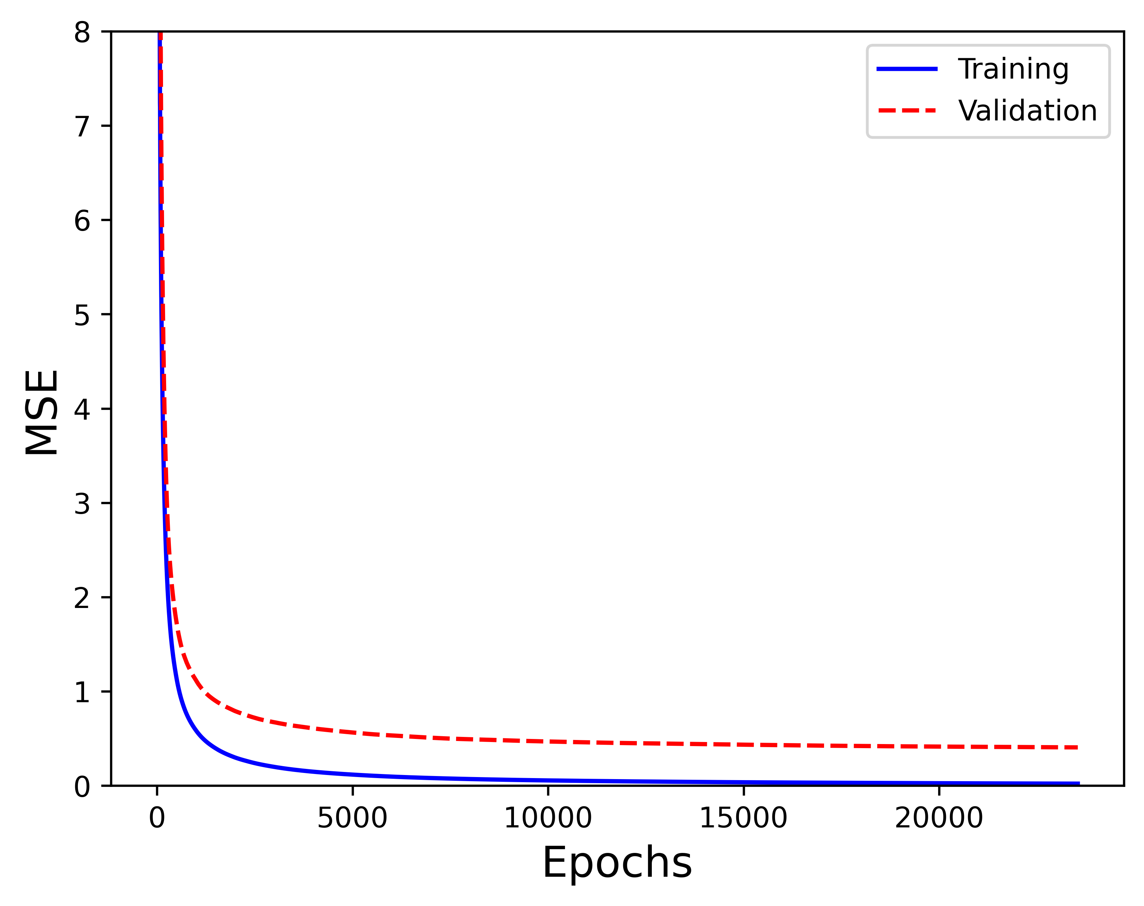
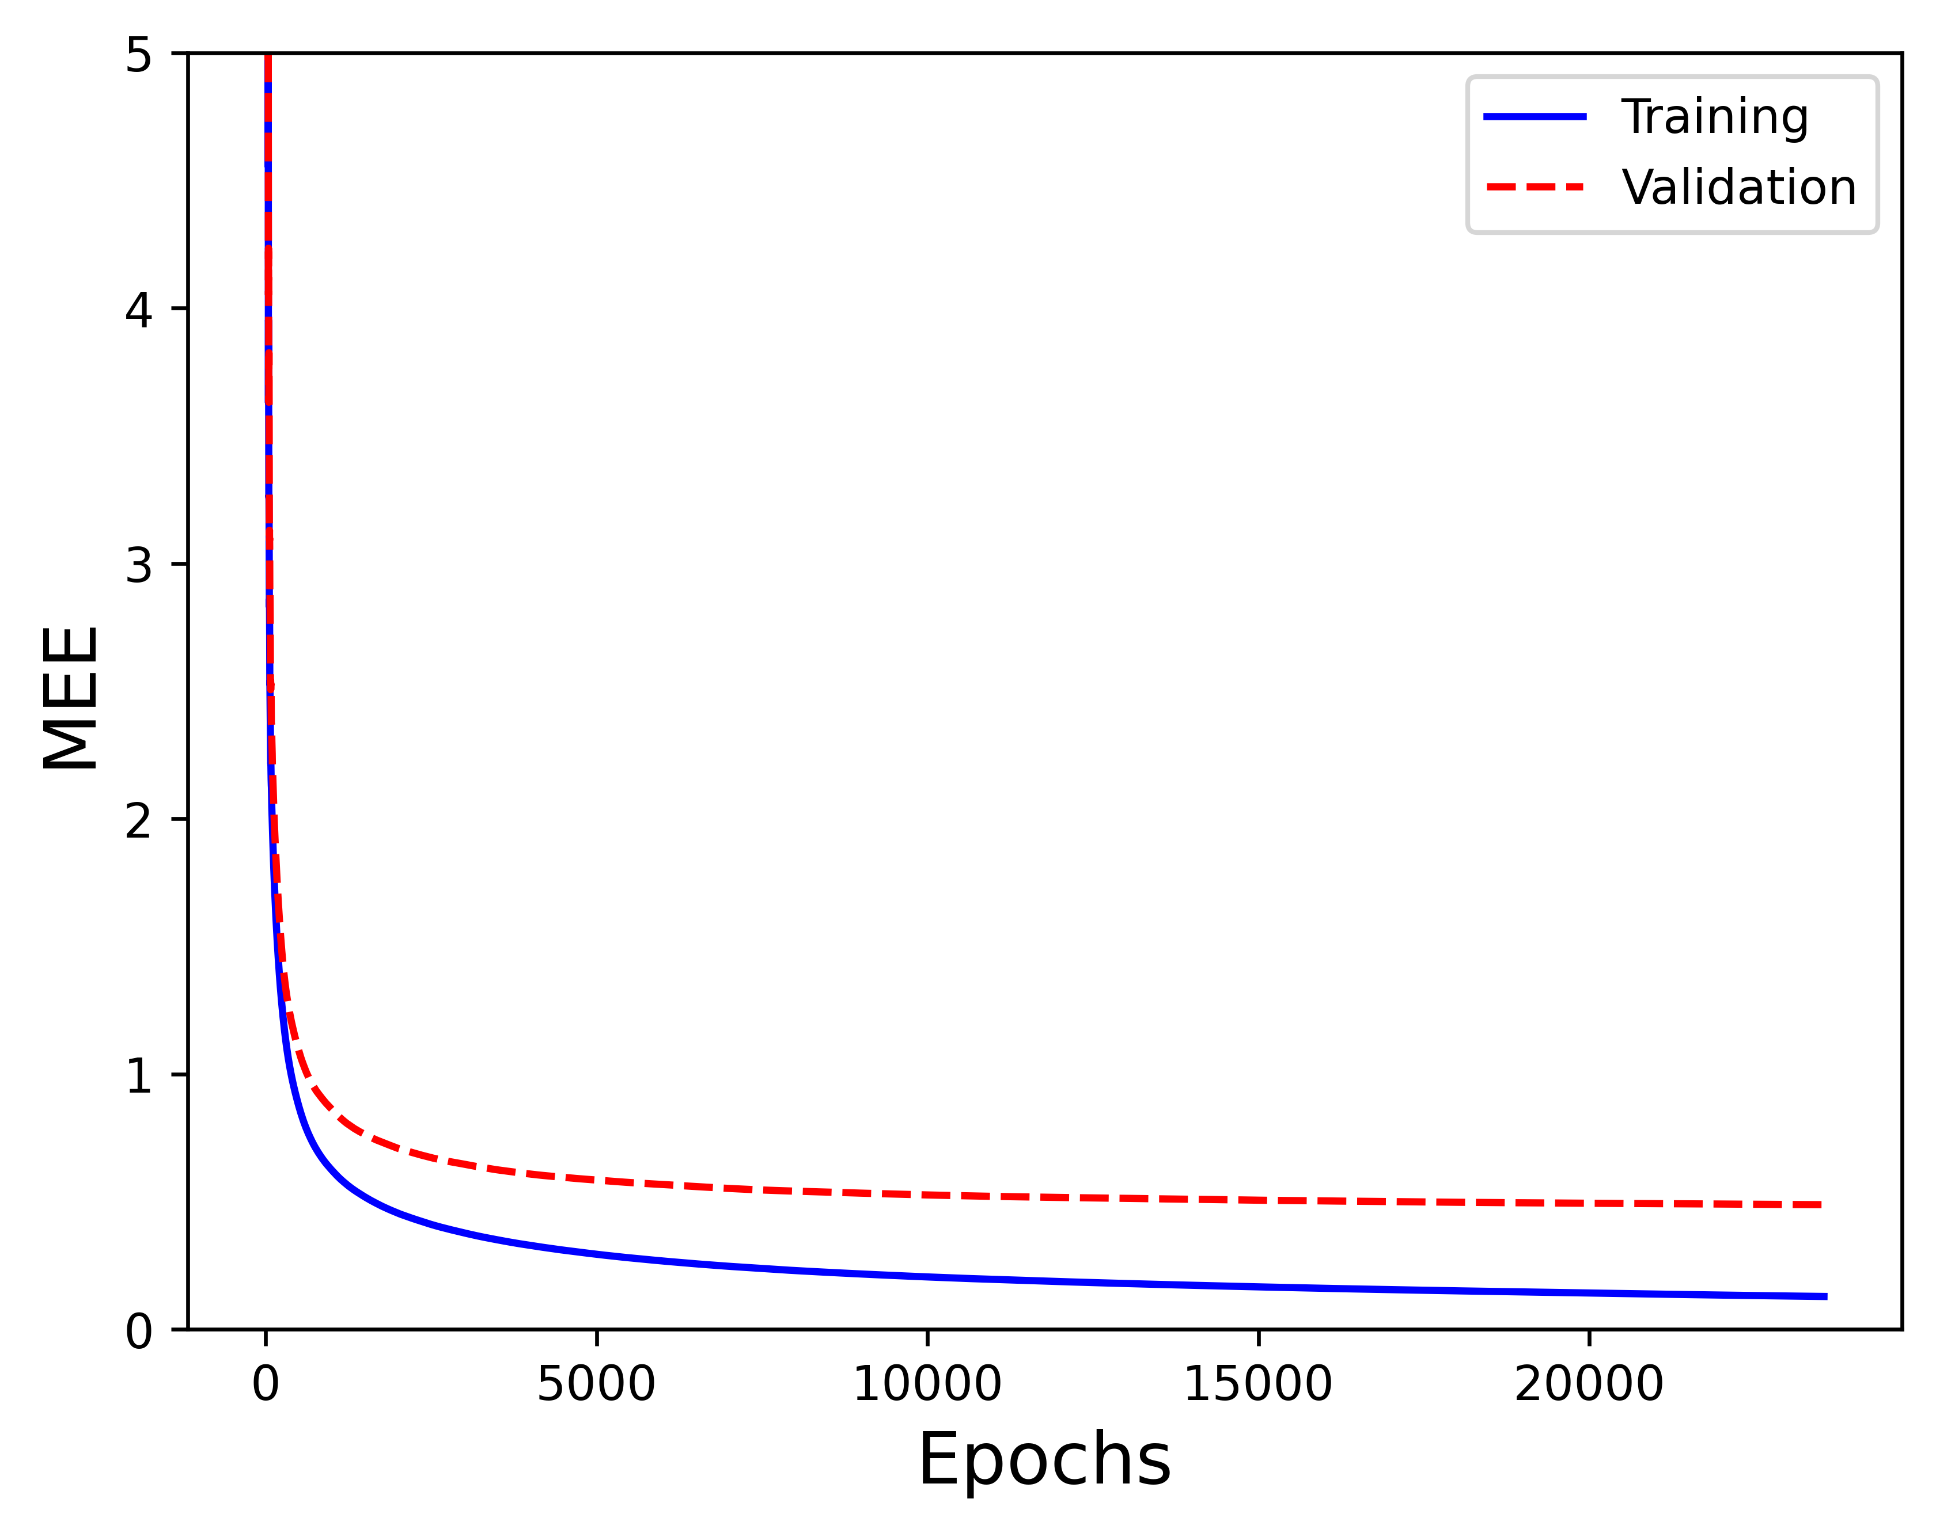
CUP Results - Validation
 | TR SET | VL SET
MSE | 0.0216 | 0.4061
MEE | 0.1290 | 0.4886

Slide 19
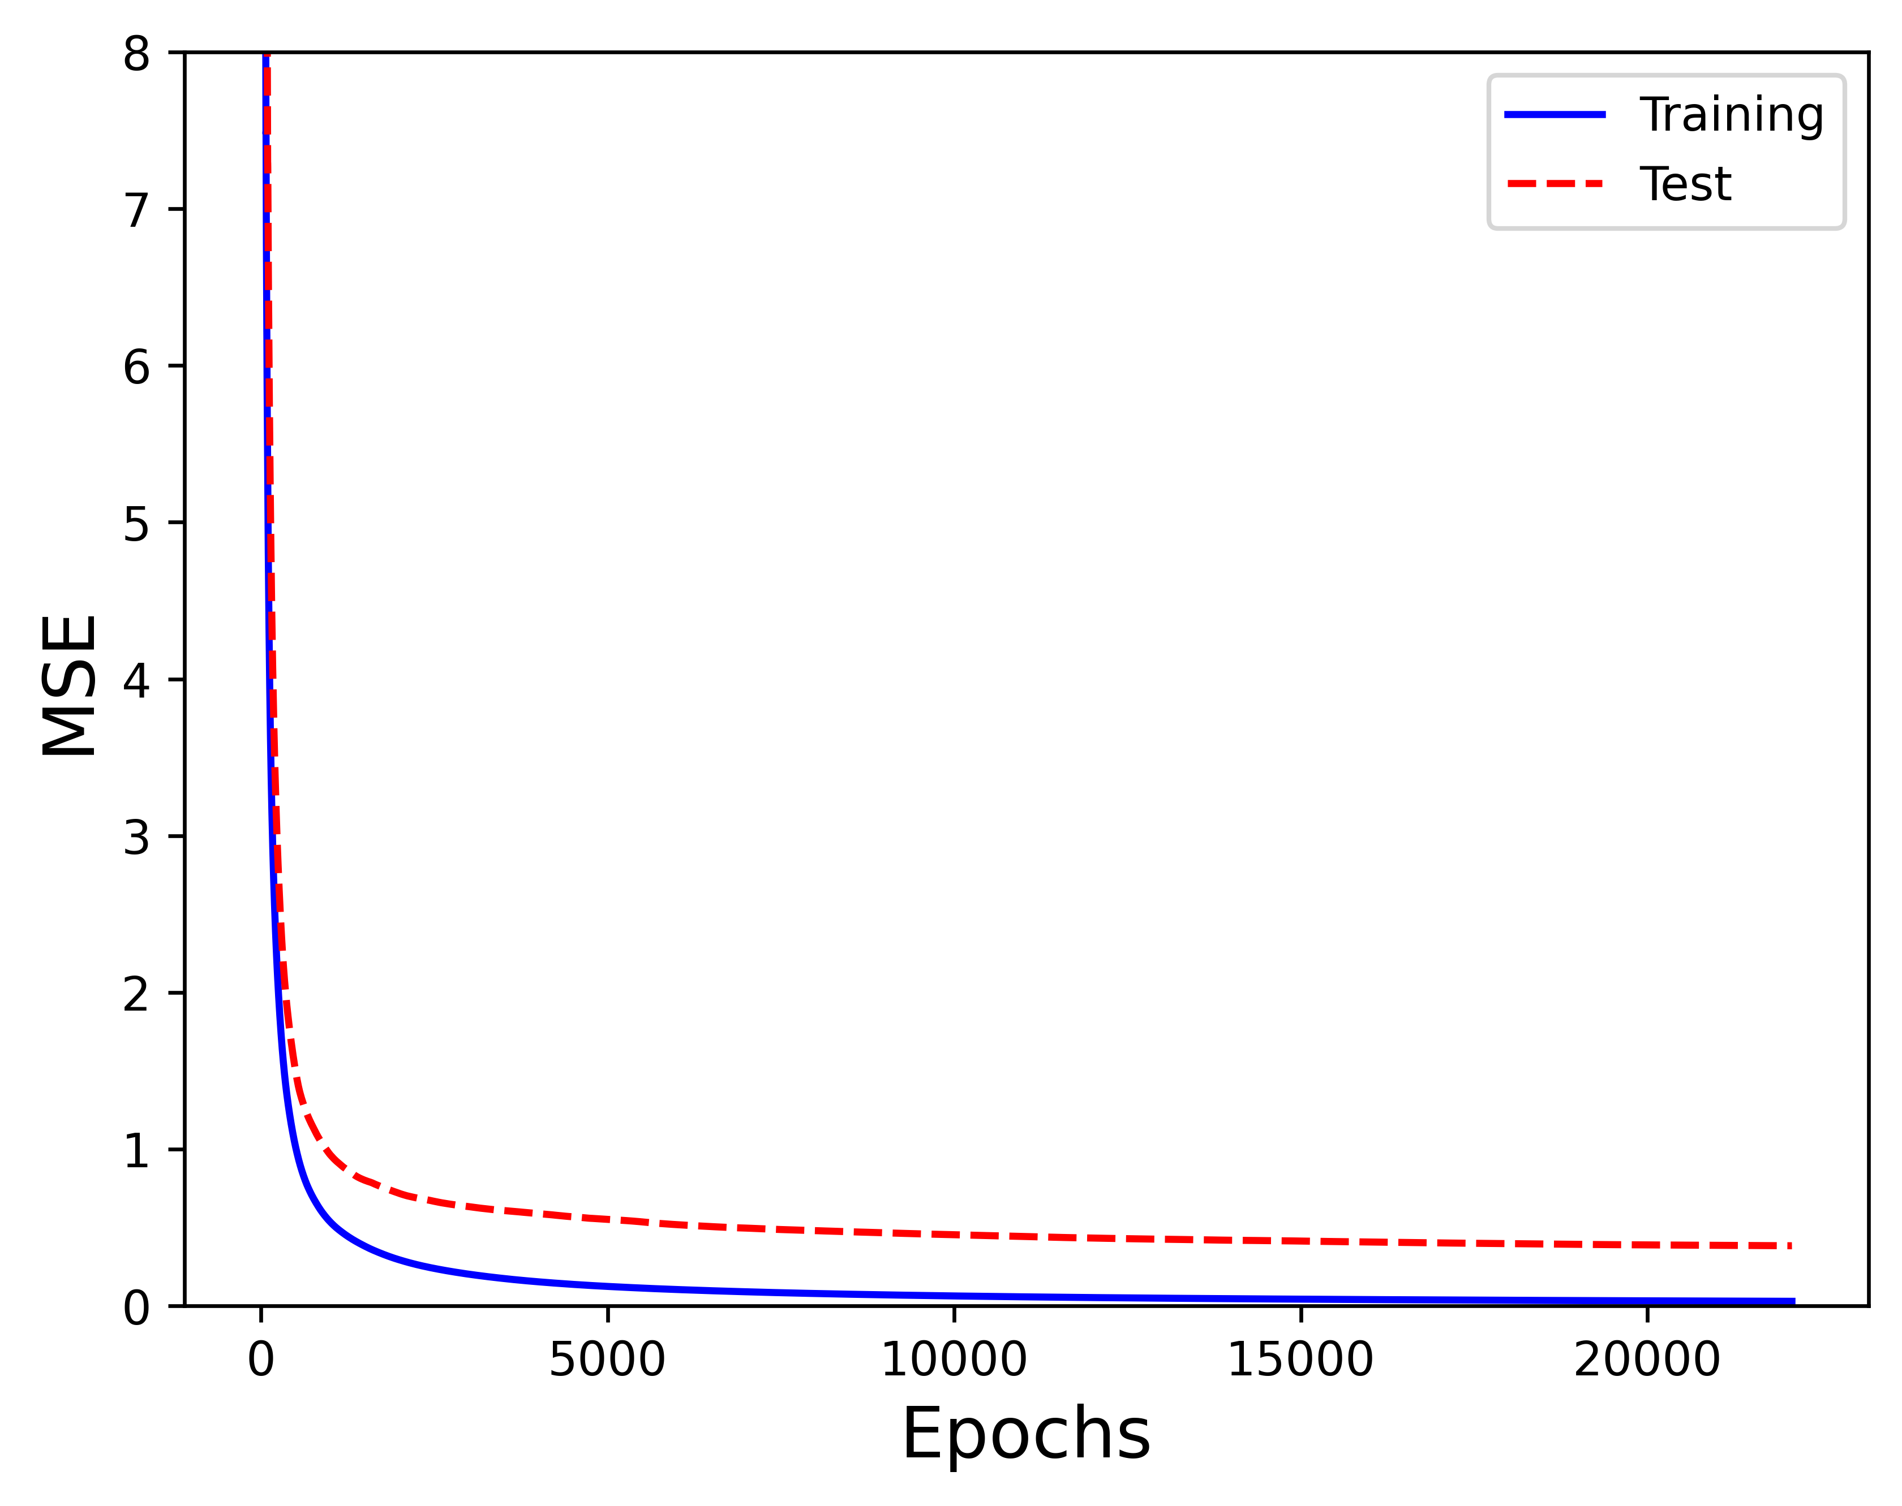
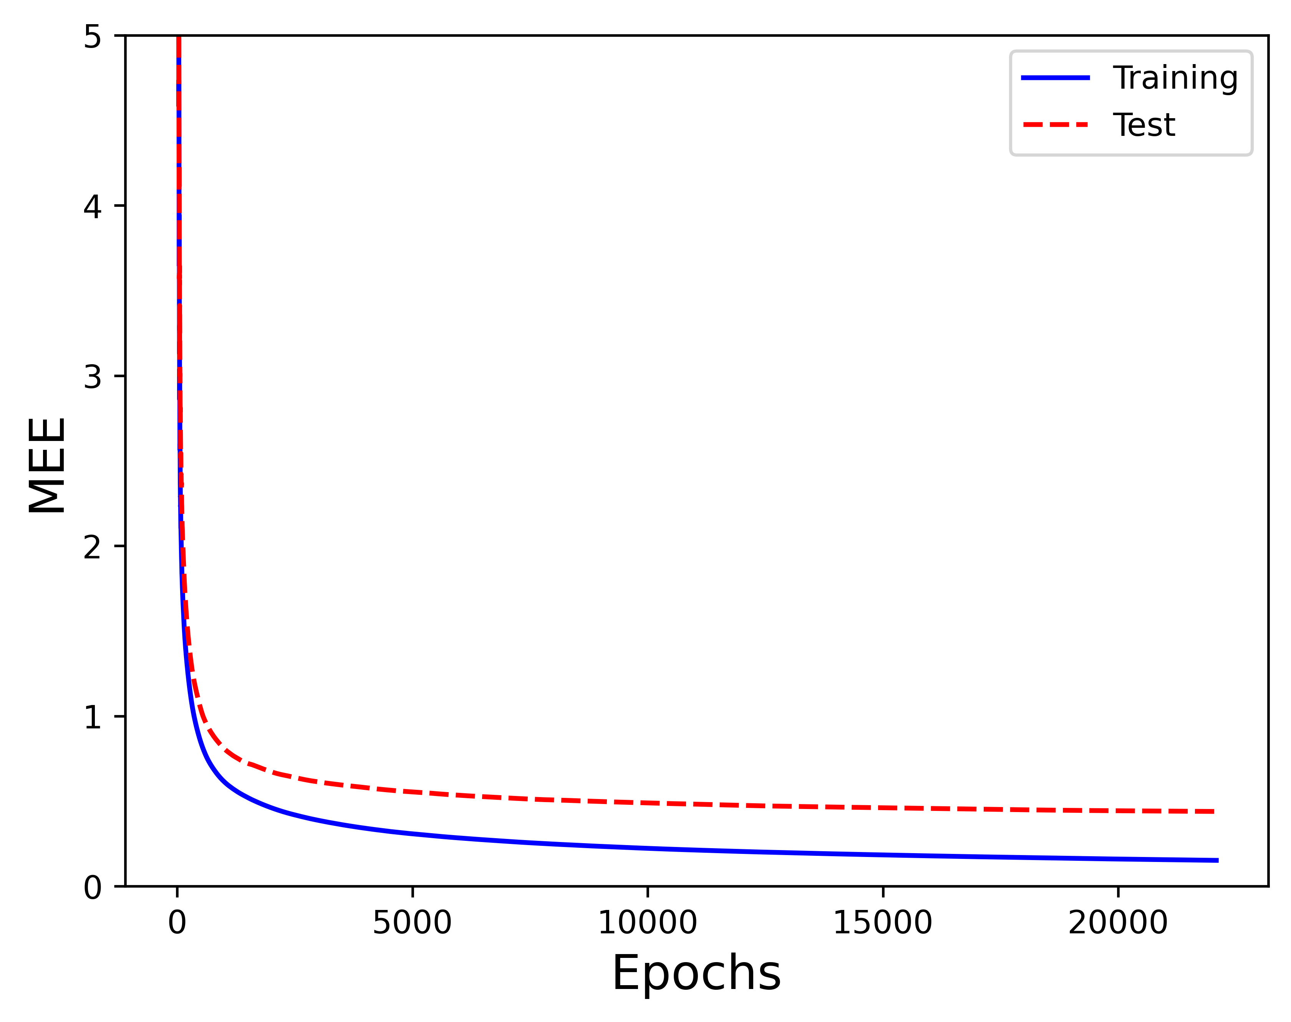
CUP Results - Test
 | TR SET | TS SET
MSE | 0.0299 | 0.3843
MEE | 0.1523 | 0.4396

Slide 20
Discussion
To experiment, we tried many times to overfit the data with big networks and many training epochs but were unable to do so. We only observed that the validation loss start to decrease slower than the training loss. To verify if there were any issues with our simulator, we conducted tests with Keras and obtained the same results.
Computing gradients for all the patterns with matrix multiplication, instead of computing them for one pattern at time using scalar products gives a massive improvement in executions time. This enhancement enables the testing of bigger networks and higher epochs in reasonable time.
Momentum is essential for good learning (especially with batch)

Slide 21
Discussion
ReLU (and its variants like Leaky ReLU and SeLU) tends to perform better than other activation functions during the training, with a more uniform and stable gradient descent.
We realized that performing model selection require a lot of time, more than we had anticipated. Given that small tweaks to neural network hyperparameters yield significant variations in both training dynamics and outcomes, the combinations of hyperparameters to test are truly numerous, and for each is required a careful review.
Rescaling the data using znorm (mean to 0, standard deviation to 1) did not improve the results

Slide 22
Conclusions
This project allowed us to find a connection between the theory and the practice studied during the course, indeed we dialed with overfitting, regularization, networks architecture and many other aspects discussed in the lectures.
Creating an NN simulator from scratch was a demanding challenge, but very educational. This collaborative project not only expanded our technical knowledge but also enriched our experience in working collaboratively within a group setting.
In conclusion regarding our project, we believe we've not only delved into fascinating concepts but also acquired practical skills that will prove precious in our academic and professional journey ahead.

Slide 23
Conclusions
Name of the results file:
MensaMartiri_ML-CUP23-TS.csv
MensaMartiri_abstract.txt
Team name: Mensa Martiri
Team members: Tommaso Di Riccio, Marco Minniti, Francesco Simonetti

Slide 24
References
[1] X. Glorot & Y. Bengio: Understanding the difficulty of training deep feedforward neural networks. In Proceedings of the Thirteenth International Conference on Artificial Intelligence and Statistics, 249–256, 2010

Slide 25
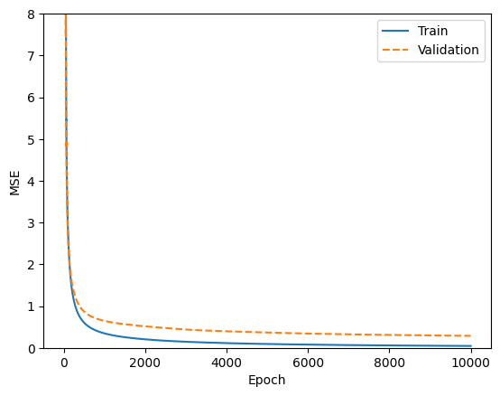
Appendix
Result of the training with Keras mentioned in slide 20:
ing
Training loss: 0.0448
Validation loss: 0.2865

