Slide 1
x₁
x₂
w₁
x₃
w₂
x₄
w₃
f
w₄
…
y
w_{N-1}
x_{N-1}
w_{N}
x_{N}

Slide 2
Latent Space N-dimensional
1
1
Additional Hidden Layers
Additional Hidden Layers
1
Inputs, M-dimensional
Outputs, M-dimensional
N
M
M

Slide 3
Latent Space N-dimensional
1
1
1
Inputs, M-dimensional
Encoder
Decoder
Outputs, M-dimensional
N
M
M

Slide 4
1
1
Inputs, M-dimensional
Outputs, N-dimensional
Pooling layer 2
N
M
Pooling layer 1
Convolutional layer 2
Convolutional layer 1
Flattening layer
Fully-connected layer

Slide 5
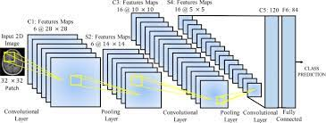

Slide 6
x₁
x₂
w₁
x₃
w₂
x₄
w₃
f
w₄
…
y
w_{N-1}
x_{N-1}
w_{N}
x_{N}

Slide 7
Algorithm / data
(A)
output
“A” is the algorithm
Algorithm / data
(C)
Inputs (if any)
Generative network
(B)
“B” is the algorithm
output
Noise source

