Slide 1
Where to build the cinema?
Data Science Capstone

Slide 2
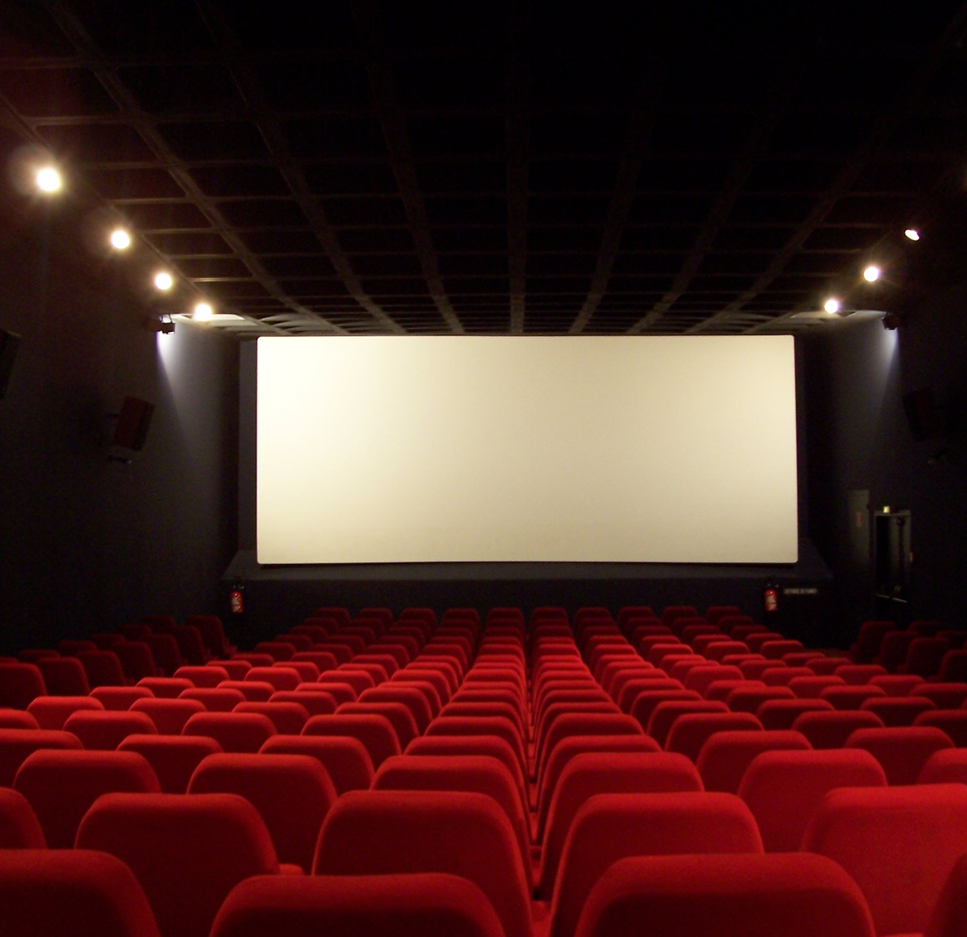
Business Problem
Suppose that a multinational company that operates in the film industry would like to open a new cinema in Toronto, and it takes you in charge to offer them the best solution to which strategically is the best spot where to build the new cinema, considering the surrounding areas after a detailed analysis.

Slide 3
Data Presentation
I will use the data related to the neighborhoods of Toronto, and I will enrich them with more specific details about what I can find in the venues of the different areas in order to have a more complete overview. In this task Foursquare will play a vital role because it will ensure a precise and fast survey of the activities/shops around and will allow an efficient comparison of the different areas.

Slide 4
Methodology
In this project I am going to compare different areas around Toronto, trying to identify the optimal choice considering different parameters such as:
parking availability
presence of restaurants in the nearby
Therefore using a K-nn algorithm I will be able to identify different clusters across the city and visualizing them select the optimal one, where I can find opportunities in terms of unanswered demands from the residents and synergies with existing activities/shops

Slide 5
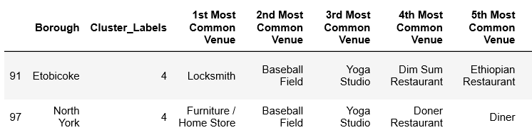
Results

Slide 6
Results
As you can notice the best area where build a cinema is that one described by Cluster 4 where due to the proximity to the stadium we have parking availability and of course the presence of dining restaurants that can play an important role, attracting people. Moreover there is not a cinema competitor in the nearby resulting therefore in a full potential client base

