Slide 1
SynthSense Project
04.04.2020
Sensor Data Formats
Chris, Steve, Tommaso, Yuan

Slide 2
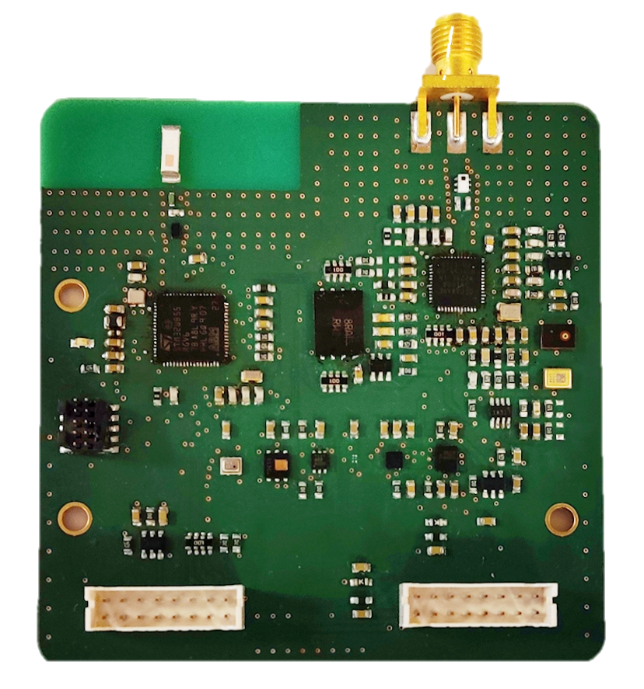
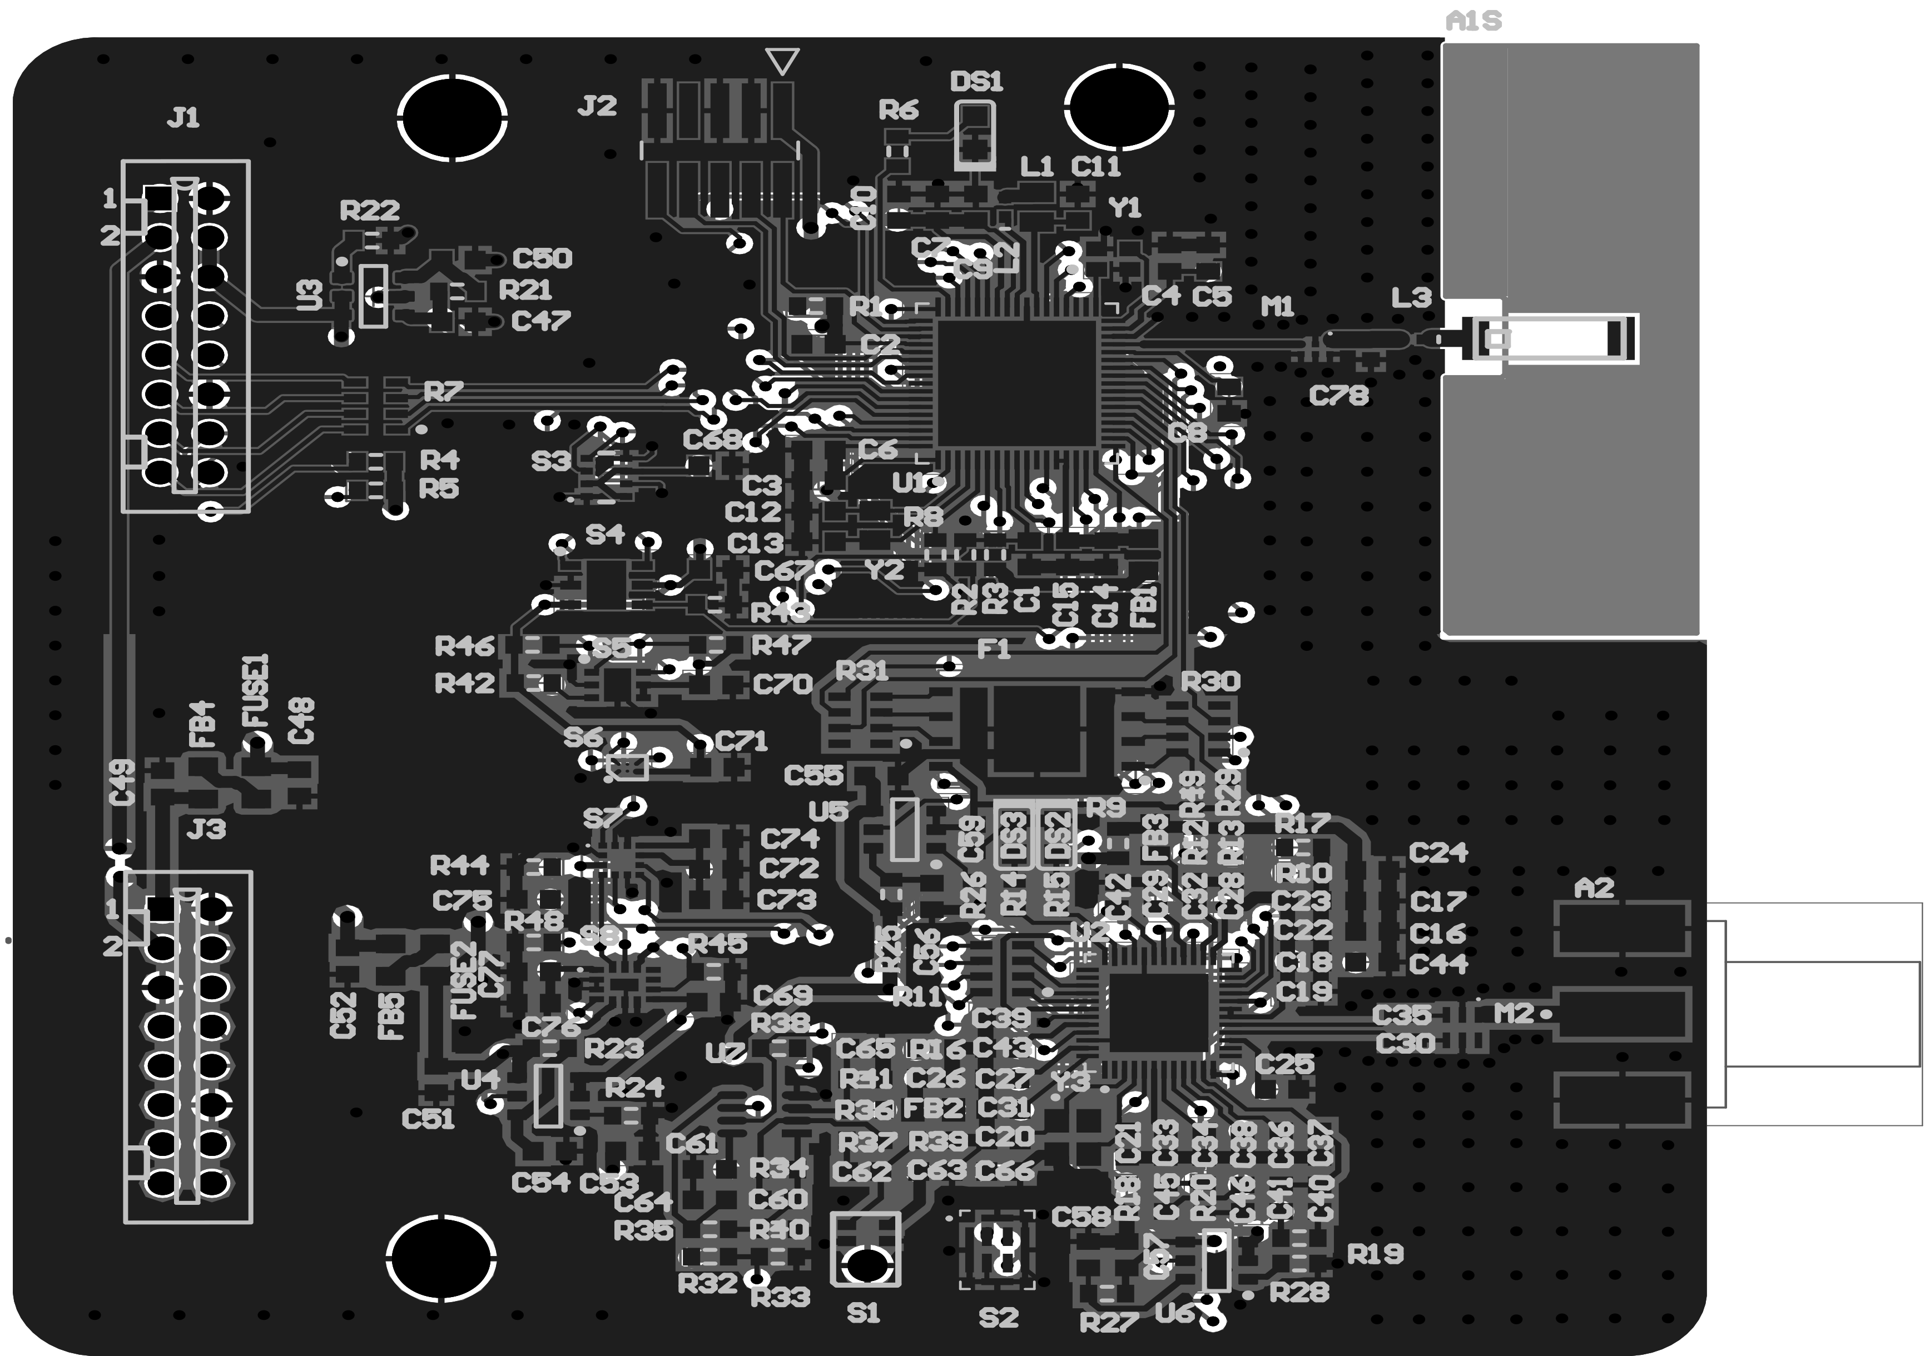
Energy Efficient Sensor Node
SynthSense Project
04.04.2020
Microcontroller
Ultra-Wide Band
IMU
Light
Bluetooth Low Energy
Microphone
Temperature
Barometer
Pressure
Magnetometer
Humidity
Design Highlights
Energy efficiency is achieved through separated power domains and wake up audio
Bit rate is maximised through UWB communication (6.8 Mbps)
Implementation of UWB ranging
BLE synchronisation for a coherent sampling
External I2C, SPI, & analogue sensors
Operating Conditions
3.3V & 5V voltage supply (DC)
Estimated sub-10 mA average current when sensors run below 1 KHz sampling rate (energy modelling on progress)
Estimated 0.5 W peak power consumption (energy modelling on progress)

Slide 3
Internal Sensors File
SynthSense Project
04.04.2020
Single binary sequence;
The binary (.dat) file is composed by N block, equal to the number of stored samples. The file does not have a fixed size.
Each data block is composed as follow, with little-endian order. It has a fixed size of 68 bytes. Each valued is saved as a single floating point precision (4 bytes)
Variables order
Temp. | Temp. 2 | Humidity | Bar | MAGx | MAGy | MAGz | ACCx | ACCy | ACCz | ANGx | ANGy | ANGz | ADC0 | ADC1 | ADC2 | ADC3
°C | °C | % | Pa | mG | mG [Gauss] | mG | G | G | G | mdps | mdps | mdps | V | V | V | V
single | single | single | single | single | single | single | single | single | single | single | single | single | single | single | single | single
Little Endian

Slide 4
Audio File
SynthSense Project
04.04.2020
Single binary sequence (FIFO – first sample at the beginning of the file);
The binary (.dat) file is composed by N block, equal to the number of stored samples. The file does not have a fixed size;
Each data block is composed of 16bit (2 bytes little endian). The audio is a non-compressed single-tone 16Ksps format.

