Slide 1
CSE 403
Lecture 15
UI Automation / Functional Testing
Reading:
How to Break Software, Ch. 2, Whittaker
slides created by Marty Stepp
http://www.cs.washington.edu/403/

Slide 2
Recall: Kinds of testing
unit testing: looks for errors in objects or subsystems
integration testing: find errors when connecting subsystems
system testing: test entire system behavior as a whole, with respect to scenarios and requirements
  functional testing: test whether system meets requirements
  performance testing: nonfunctional requirements, design goals
  acceptance / installation testing: done by client

Slide 3
Functional testing
ad-hoc: Just run the product and click things.
UI automation: Simulate usage of a product's UI in code.
  "record" usage and play back later
  or write code to simulate mouse clicks
Many developers rely too much on ad-hoc testing.
  pro: Simple; fast; does not require specialized knowledge
  con: Inaccurate; must be repeated many times; poor at catching regressions; costs more and more time later in the project
  The ideal is a mix of both kinds of UI testing.

Slide 4
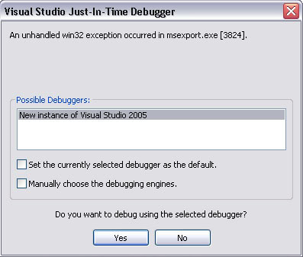
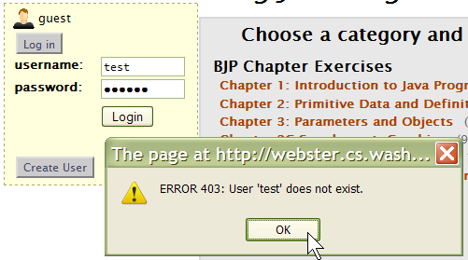
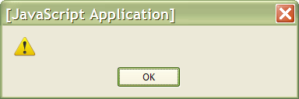
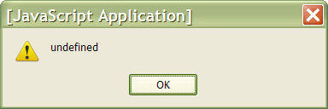
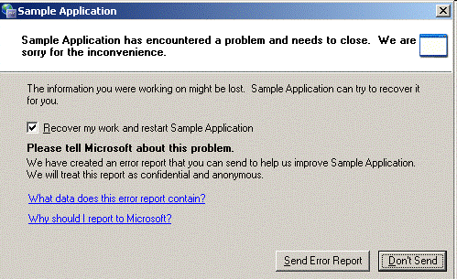
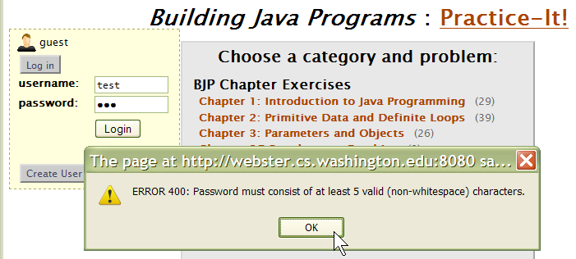
Flush out error messages
  empty strings (or strings made entirely of spaces, etc.)
  invalid strings (too short, too long; special characters)
  0 or negative numbers
  settings that do not make sense in combination

Slide 5
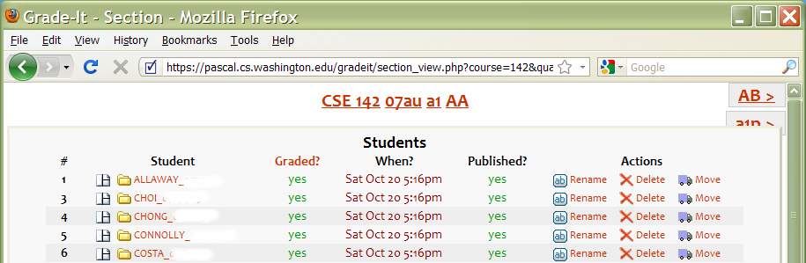
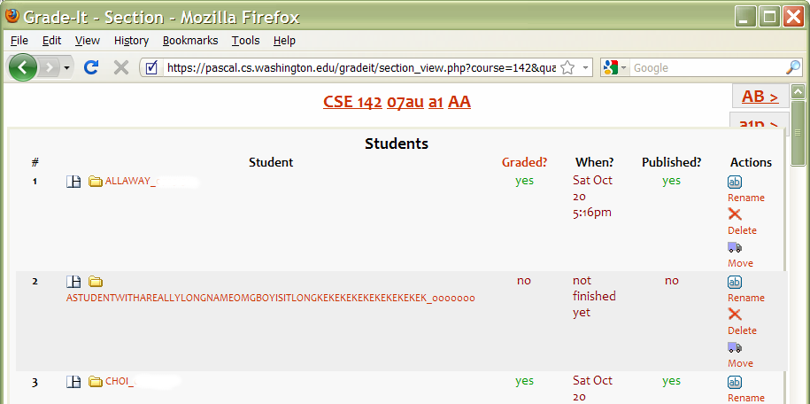
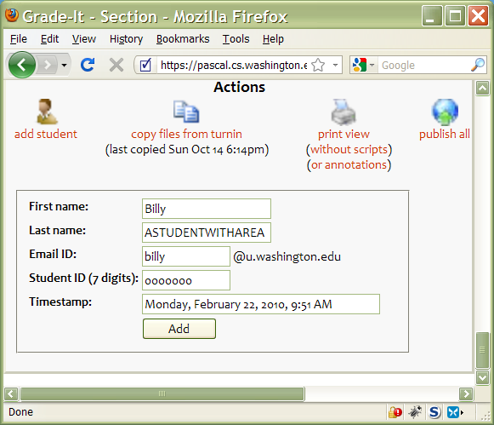
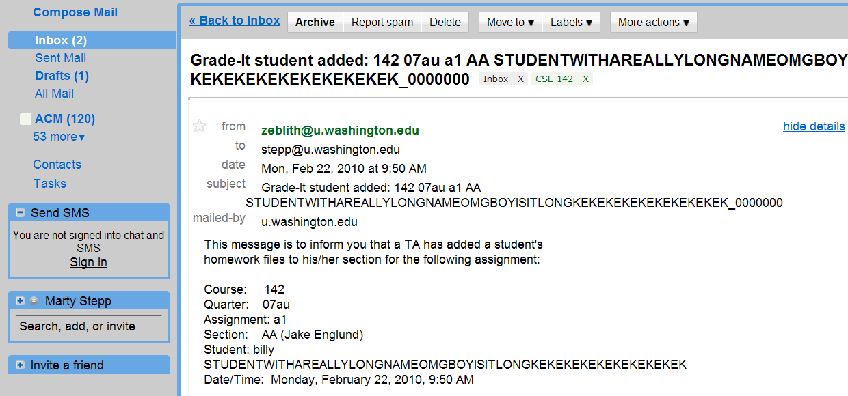
Input buffer overflows
When prompted for input, try to put in a very long string
  Will it be accepted, leading to a strange appearance on the UI?

Slide 6
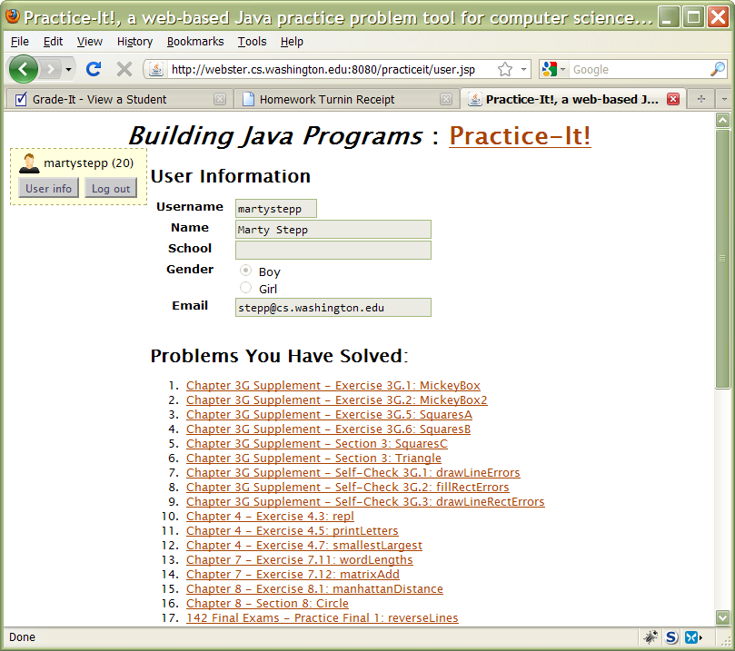
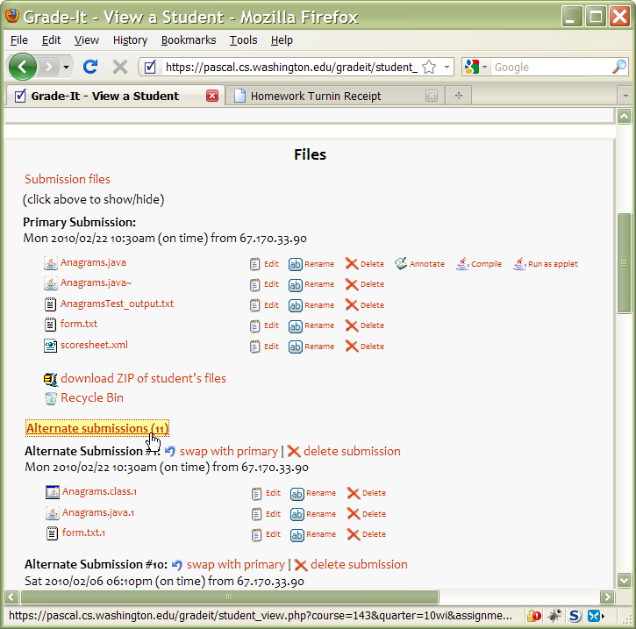
Overflow data structures
Whenever a UI shows a page or list, try to add to that list until it overflows, causing crashes, errors, or awkward appearance

Slide 7
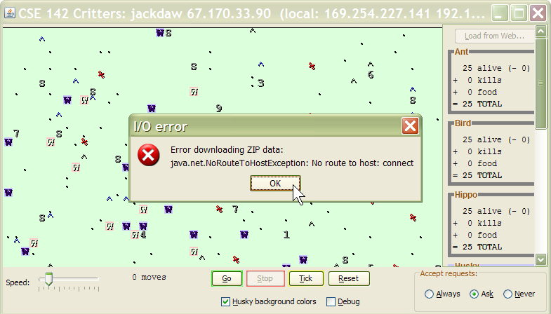
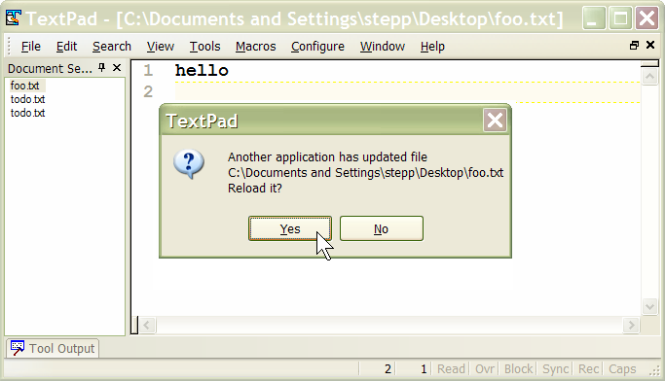
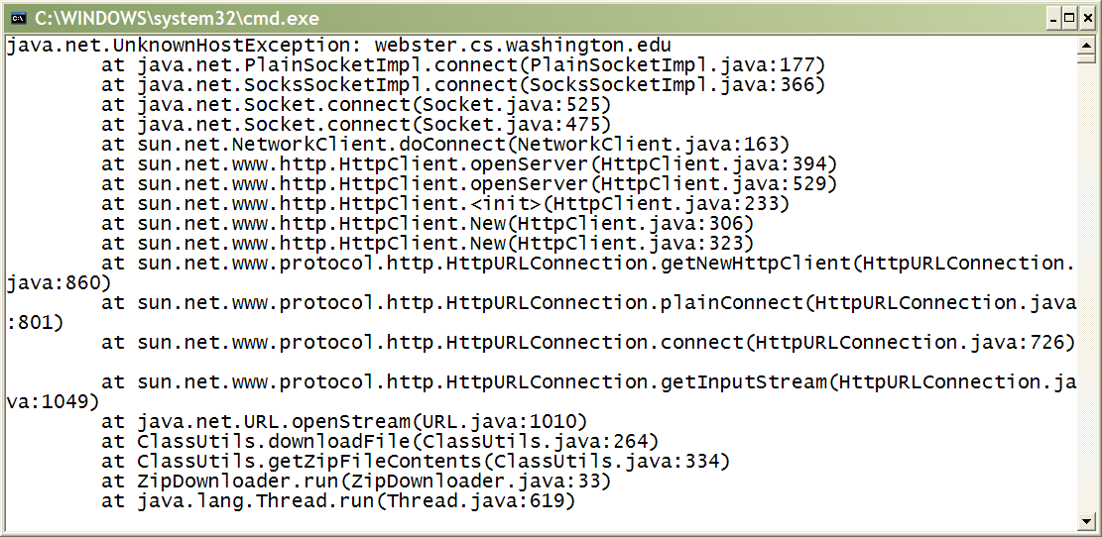
Violate app's assumptions
What does the app's GUI do if:
  The file it is using gets externally modified or deleted?
  The network goes down (or just slows down) unexpectedly?
  The OS amount of memory available drops?
  The processor becomes busy and the app slows down?

Slide 8
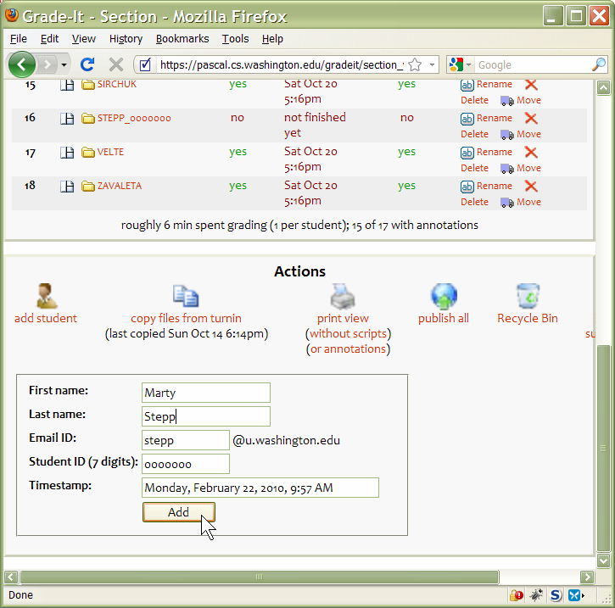
Repeat/duplicate inputs
Try the same input multiple times to expose bugs:
  re-add an existing user
  create a file that already exists
  delete a file that is already deleted
  or that does not exist
  click the button to perform an
  action multiple times
    "Buy", "Order", "Check Out"
    Will the customer be charged twice?
  web apps: click "Back" and then
  try an action again
    Was the developer expecting this?

Slide 9
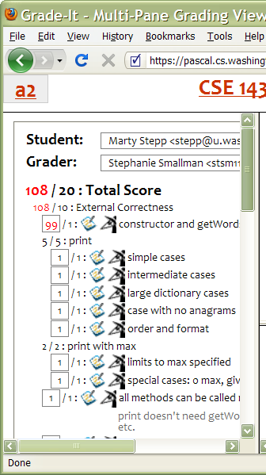
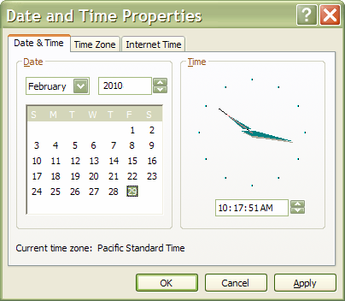
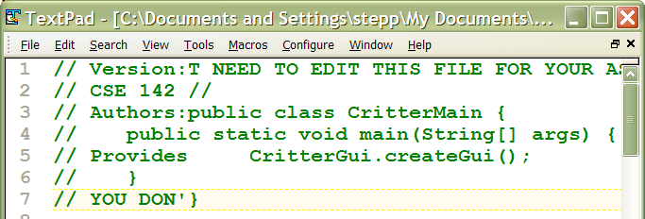
Cause invalid outputs
Most GUIs stop you from supplying bad input.
  But maybe you can still cause bad output.
Example: Set calendar to an invalid date:
  The UI properly restricts you to Feb 1-28.
  Choose a leap year, then select Feb 29.
  Change year back to a non-leap year.
  Feb 29 will still be shown as a valid choice.
Example: TextPad "Block Select" feature
  toggle on, copy text, toggle off, paste

Slide 10
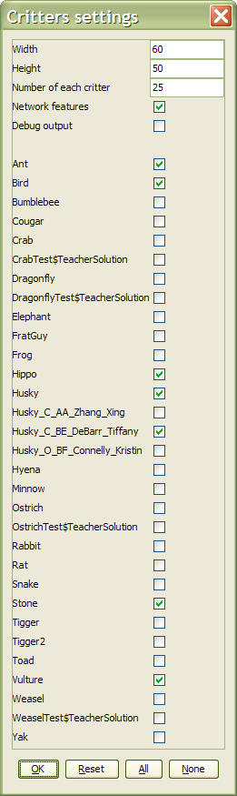
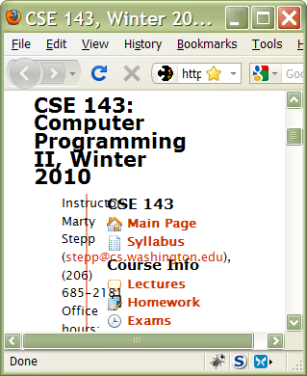
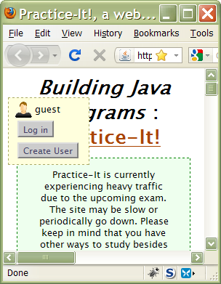
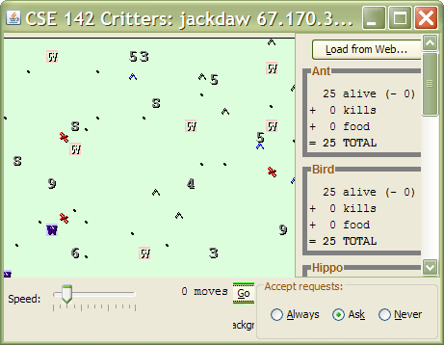
Test moving / sizing
Many UI designers don't consider what their screen or page will look like when resized to extremes
  try resizing the window or adding input to grow a window's size
    does the window add scrollbars?
    do some controls disappear or overlap?
    does text begin to wrap in odd ways?

Slide 11
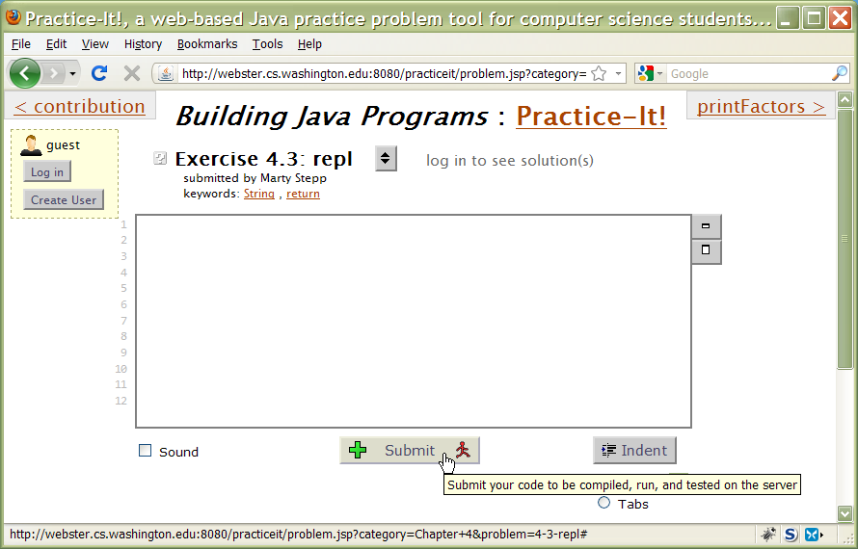
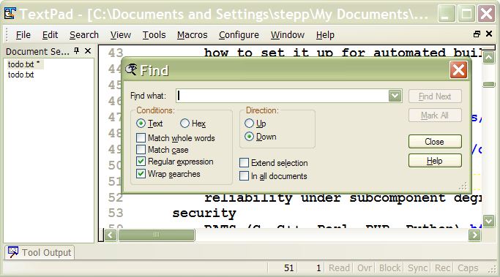


Test enabling / disabling
Enable/disable elements to indicate whether they can be used.
Test the enabling/disabling of all UI elements.
  Do elements disable/re-enable when they are supposed to?
  Is it ever possible to click an element that shouldn't be clickable, or impossible to click an element that should be clickable?

Slide 12
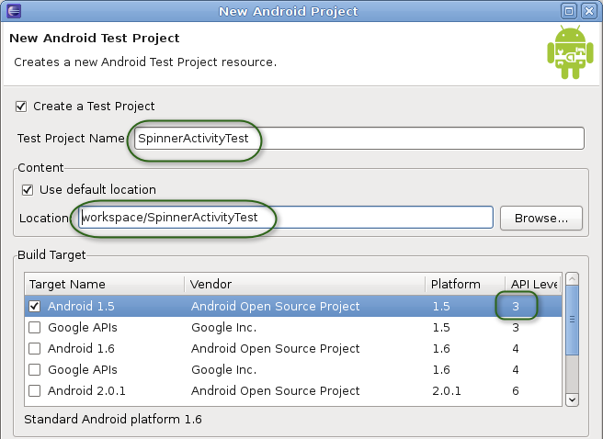
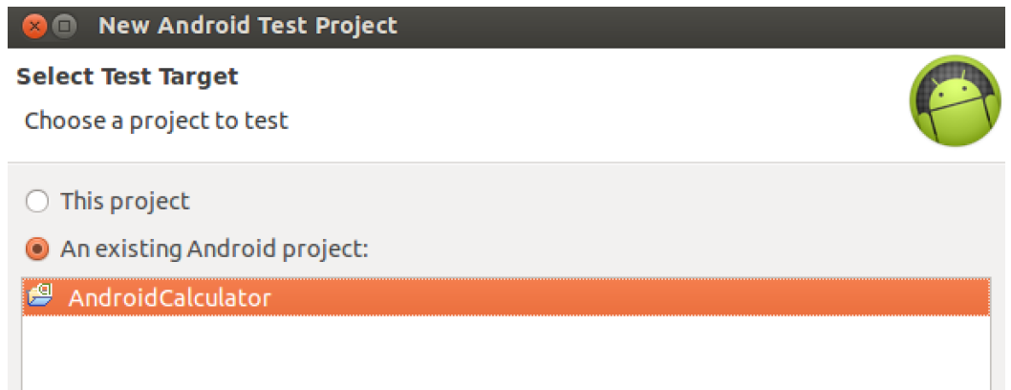
Android testing
Google recommends creating an entire separate test Eclipse project to store your unit tests for an Android app
  http://developer.android.com/tools/testing/
put in tests/ subdir of main app
  MyProject/
    AndroidManifest.xml
    res/ ... (resources for main app)
    src/ ... (source code for main app) ...
    tests/
      AndroidManifest.xml
      res/ ... (resources for tests)
      src/ ... (source code for tests)

Slide 13
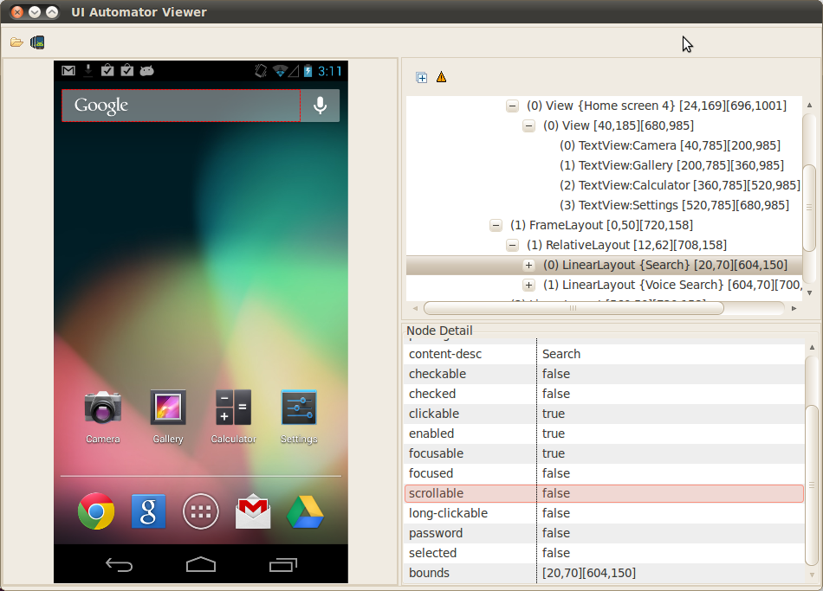
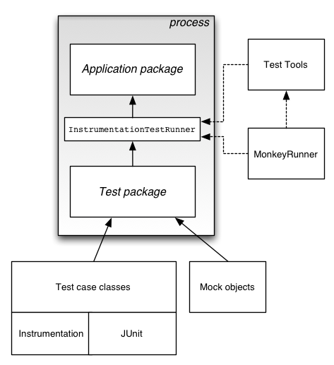
Android UI testing
uiautomatorviewer
  allows you to inspect current
  state of an on-screen UI
UiAutomatorTestCase
  a specialized JUnit test that can
  construct and interact with UI controls
UI Automater Monkey
  simulates pseudo-random UI interaction
  to test UI robustness and stress testing

Slide 14
Android UI test example
import com.android.uiautomator.core.*;
import com.android.uiautomator.testrunner.*;
public class LaunchSettings extends UiAutomatorTestCase {
public void testDemo() throws UiObjectNotFoundException {
getUiDevice().pressHome();
// simulate a user bringing up the All Apps screen
UiObject allAppsButton = new UiObject(new UiSelector().description("Apps"));
allAppsButton.clickAndWaitForNewWindow();
// simulate the user bringing up the Apps tab
UiObject appsTab = new UiObject(new UiSelector().text("Apps"));
appsTab.click();
// simulate a user swiping until they come to the Settings app icon
UiScrollable appViews = new UiScrollable(new UiSelector().scrollable(true));
appViews.setAsHorizontalList();
// simulate a user click to launch the app
UiObject settingsApp = appViews.getChildByText(new UiSelector()
.className(android.widget.TextView.class.getName()), "Settings");
settingsApp.clickAndWaitForNewWindow();
// validate that the package name is the expected one
UiObject settingsValidation = new UiObject(new UiSelector()
.packageName("com.android.settings"));
assertTrue("Unable to detect Settings", settingsValidation.exists());
}
}

Slide 15
Android UI test code 2
// Start main activity of the application under test
mActivity = getActivity();
// Get a handle to Activity object's main UI widget, a Spinner
mSpinner = (Spinner) mActivity.findViewById(
com.android.example.spinner.R.id.Spinner01);
// Set Spinner to a known position
mActivity.setSpinnerPosition(TEST_STATE_DESTROY_POSITION);
// Stop activity - onDestroy() should save state of Spinner
mActivity.finish();
// Re-start Activity - onResume() should restore Spinner state
mActivity = getActivity();
// Get Spinner's current position
int currentPosition = mActivity.getSpinnerPosition();
// Assert that current position is same as the starting position
assertEquals(TEST_STATE_DESTROY_POSITION, currentPosition);

Slide 16
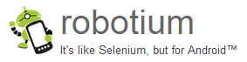
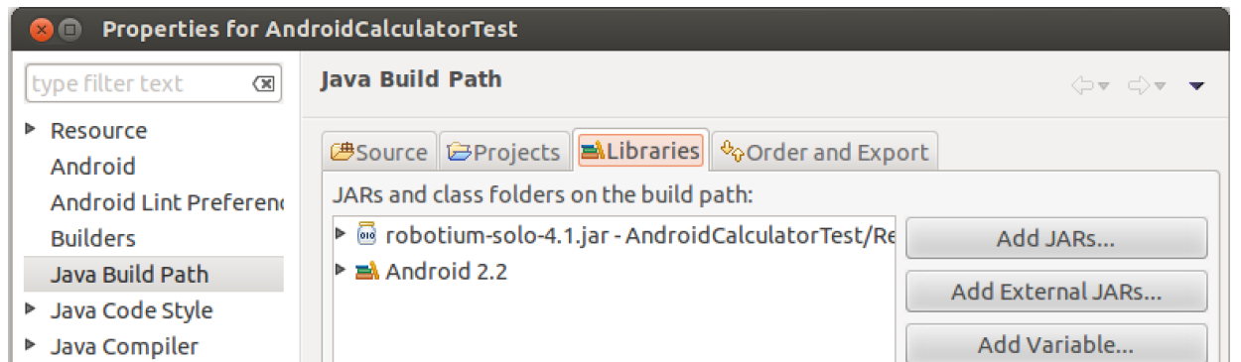
Robotium
Robotium
  UI test automation tool
  for Android apps
  based on very popular Selenium web app UI test tool
  http://code.google.com/p/robotium/
  tutorials:
    http://www.youtube.com/watch?v=VYk1_kpSzQg
    https://code.google.com/p/robotium/wiki/RobotiumTutorials

Slide 17
Robotium test code
import com.jayway.android.robotium.solo.*;
public class EditorTest extends
ActivityInstrumentationTestCase2<EditorActivity> {
private Solo solo;
public EditorTest() {
super(EditorActivity.class);
}
public void setUp() throws Exception {
solo = new Solo(getInstrumentation(), getActivity());
}
public void testPreferenceIsSaved() throws Exception {
solo.sendKey(Solo.MENU);
solo.clickOnText("More");
solo.clickOnText("Preferences");
solo.clickOnText("Edit File Extensions");
assertTrue(solo.searchText("rtf"));
solo.clickOnText("txt");
solo.clearEditText(2);
solo.enterText(2, "robotium");
solo.clickOnButton("Save");
solo.goBack();
solo.clickOnText("Edit File Extensions");
assertTrue(solo.searchText("application/robotium"));
}
public void tearDown() throws Exception {
solo.finishOpenedActivities();
}
}

Slide 18

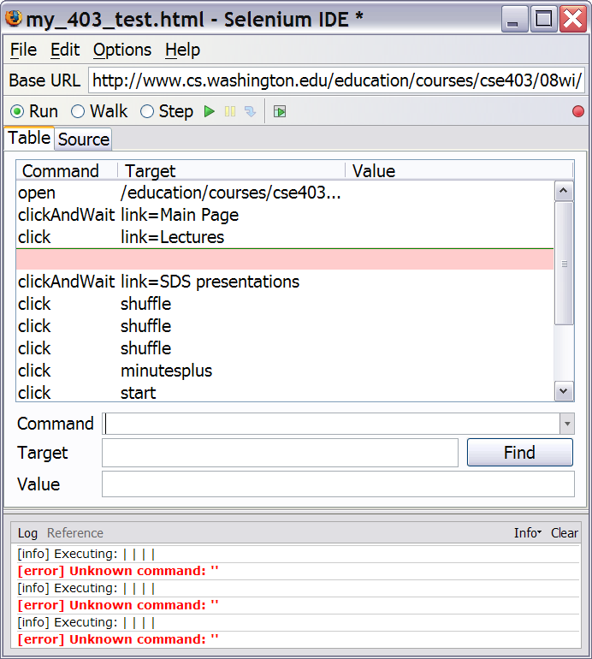
Selenium
Records and plays back automated "test cases"
of walking through a web app's UI
can assert various aspects of the web page state
to make sure the page looks right
tests can be saved as HTML
  or can be written in:
    Java
    Ruby
    Python
    ...

Slide 19
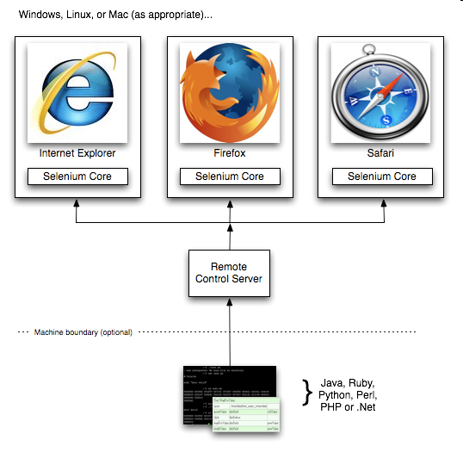
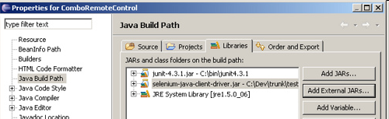
Components of Selenium
Selenium IDE - record/playback tool as Firefox add-on
  produces Selenium Core test cases
Selenium Core - HTML/JS framework that runs in any browser
  for testing browser compatibility
Selenium Remote Control (RC) -
automation framework
  for running tests on a schedule
  used with Eclipse or a dedicated server

Slide 20
Example Selenium test
import com.thoughtworks.selenium.*;
public class NewTest extends SeleneseTestCase {
public void setUp() throws Exception {
setUp("http://www.google.com/", "*firefox");
}
public void testNew() throws Exception {
selenium.open("/");
selenium.type("q", "marty stepp");
selenium.click("btnG");
selenium.waitForPageToLoad("30000");
assertTrue(selenium.isTextPresent(
"University of Washington"));
}
}

Slide 21
Selenium example 2
import java.util.*;
import org.openqa.selenium.*;
import org.openqa.selenium.firefox.*;
public class GoogleSuggest {
public static void main(String[] args) throws Exception {
WebDriver driver = new FirefoxDriver();
driver.get("http://www.google.com/webhp?complete=1&hl=en");
// Enter the query string "Cheese"
WebElement query = driver.findElement(By.name("q"));
query.sendKeys("Cheese");
long end = System.currentTimeMillis() + 5000; // Sleep 5 sec
while (System.currentTimeMillis() < end) {
WebElement resultsDiv = driver.findElement(
By.className("gac_m"));
if (resultsDiv.isDisplayed()) break;
}
// And now list the suggestions
List<WebElement> allSuggestions = driver.findElements(
By.xpath("//td[@class='gac_c']"));
for (WebElement suggestion : allSuggestions) {
System.out.println(suggestion.getText());
} } }

Slide 22
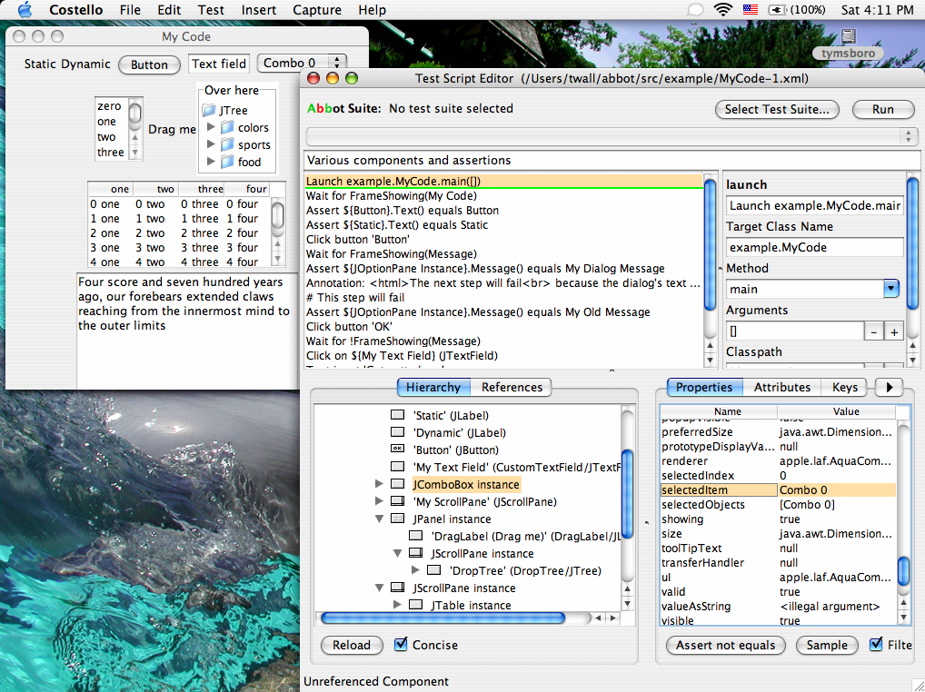
Java Swing UI testing
Abbot - Functional UI testing for Java desktop app GUIs
  (not for Android apps)
  works with Costello companion app
  http://abbot.sourceforge.net/

