Slide 1





Risks and Rewards
of Rolling Your Own
Criminal Justice Data
NICAR 2016 ■ DENVER, COLORADO ■ bit.ly/cjcar16

Slide 2
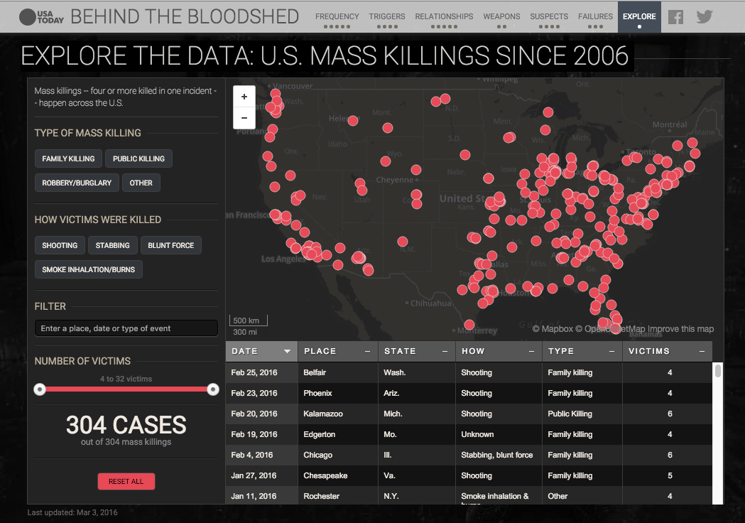
Behind
The Bloodshed
by USA Today
In 2012, USA TODAY set out to find how common mass killings were in America. What we found is they are far more common than people thought, many do not involve a gun and most involve some kind of ‘innocent bystander.’ Perhaps more importantly: the FBI’s data is wrong about the nation’s most brutal crimes nearly half of the time.
@jodiupton

Slide 3
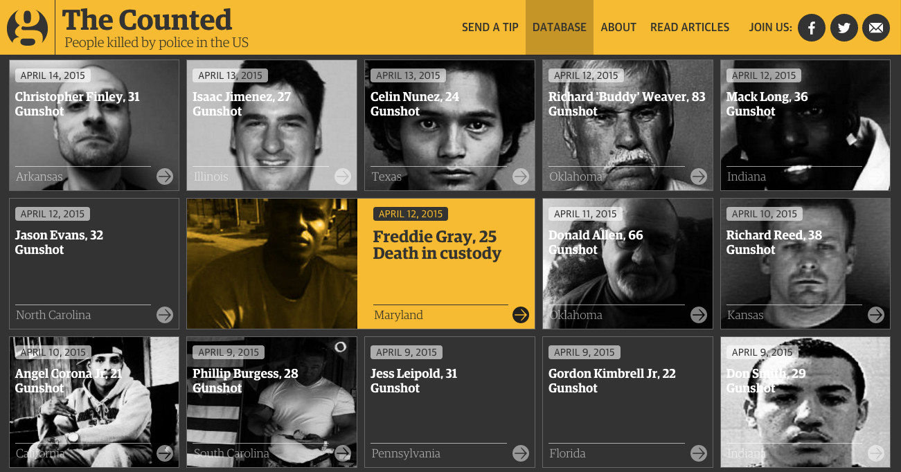
The Counted
by The Guardian
The Counted works to count the number of people killed by police and other law enforcement agencies in the United States throughout 2015 and 2016, to monitor their demographics and to tell the stories of how they died.
@kenandavis

Slide 4
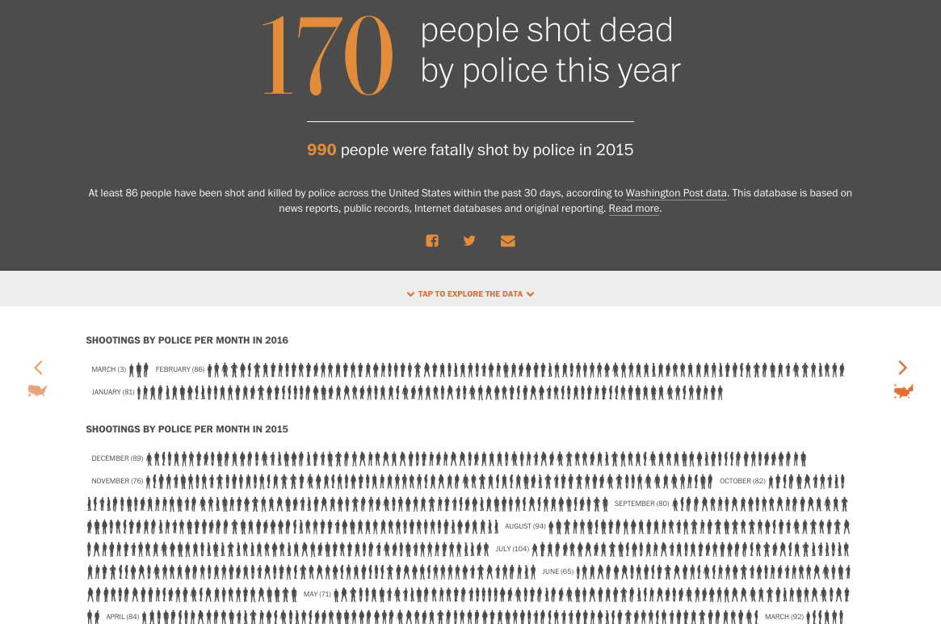
Police Shootings
by The Washington Post
In 2015, The Washington Post chronicled every on-duty police shooting by an officer in the U.S. The effort continues in 2016.
@dataeditor

Slide 5
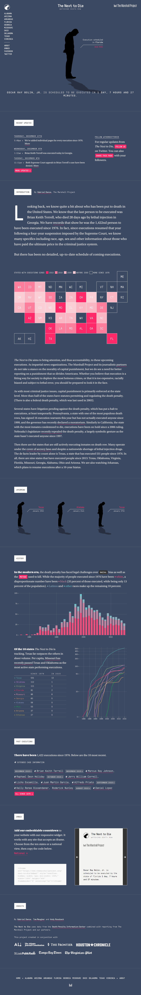

The Next To Die
by The Marshall Project
Looking back, we know quite a bit about who has been executed in America. Looking ahead, however, we knw very little about who is to be executed and how their cases move through the system. This project shines a light on these cases and the death penalty in action nationwide.
@gabrieldance
& @ultracasual

Slide 6
bit.ly/cjcar16
NICAR 2016 ■ DENVER, COLORADO

