Slide 1
IMPLICIT ASSOCIATION TEST
Predicting unconscious discrimination

Slide 2
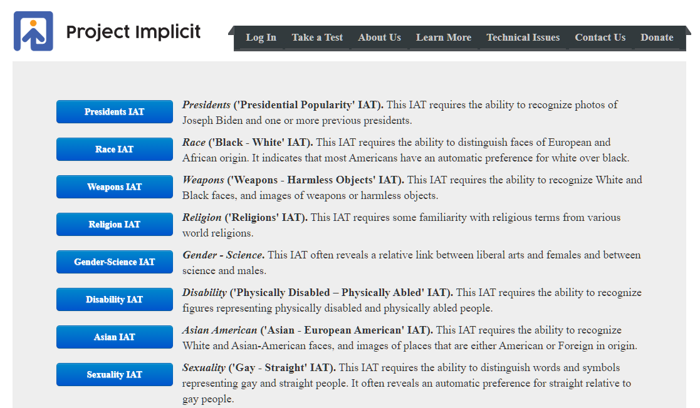
The IAT measures the strength of associations between concepts (e.g., black people, gay people) and evaluations (e.g., good, bad) or stereotypes (e.g., athletic, clumsy). The main idea is that making a response is easier when closely related items share the same response key.

Slide 3
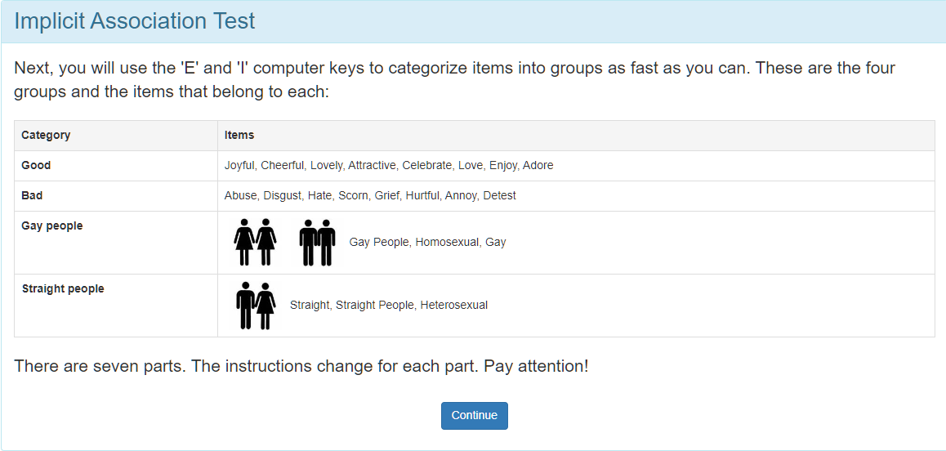
THE TEST

Slide 4
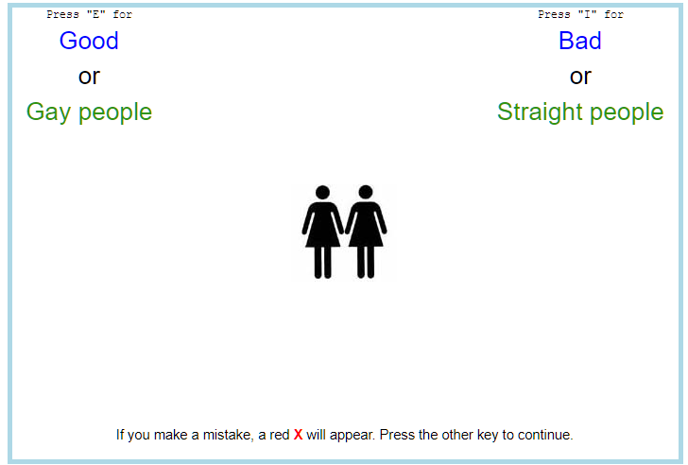
THE TEST
E
I
PART I | PART II | IAT
Good Gay | Good Straight | Time
Bad Straight | Bad Gay
Time A | Time B | Difference
The difference in time reaction between the 2 groups is the IAT

Slide 5
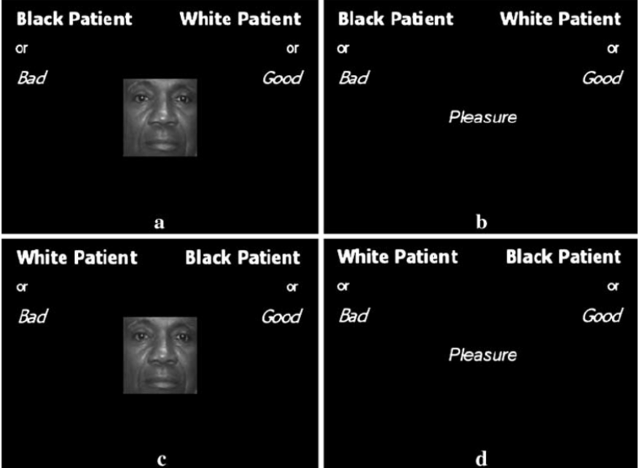

Slide 6
IS IT POSSIBLE TO PREDICT IMPLICIT SEXUAL DISCRIMINATION?

Slide 7
INDEPENDENT VARIABLES
THE TEST REQUIRES TO FILL A SHORT QUESTIONNAIRE
Socio demographics: Age, sex (assigned at birth), race, education level
Political view (liberal vs conservative) (1-7)
Religiosity (1-4)
Gender identity (1 "Male" 2 "Female" 3 "Trans male/Trans man" 4 "Trans female/Trans woman" 5 "Genderqueer/Gender nonconforming" 6 "A different identity“)
Sexuality - 5-point scale (after 7/11/2016) (1 "Heterosexual" 2 "Homosexual" 3 "Bisexual" 4 "Queer" 5 "Other“)
Preference for: 1 "I strongly prefer Gay People to Straight People." - 7 "I strongly prefer Straight People to Gay People."
Do you have a family member who is gay?
Do you have a friend who is gay?
Do you have friendly interactions with gay people on a regular basis?
Have you ever met a gay person?
9. Please rate how warm or cold you feel toward the following groups: Extremely cold" 1 "Very cold" - 10 "Extremely warm"
Gay men, Lesbian Women, Straight Men, Straight Women.
10. Opinion. Do you think it should be legal for same-sex partners to adopt a child?
11. Opinion. Do you think it should be legal for business owners to refuse to serve same-sex partners?
12. Opinion. Which of the following statements best reflects your belief? 1 "Transgender people should use the bathroom/locker rooms of the sex they were assigned at birth" 2 "Transgender people should use the bathrooms/locker rooms of their preferred gender identity“
13. Opinion. Marriage between same sex people "Should be valid" 2 "Should not be valid" 3 "No opinion“
14. Opinion. Relationships between same sex people "Should be valid" 2 "Should not be valid" 3 "No opinion“

Slide 8
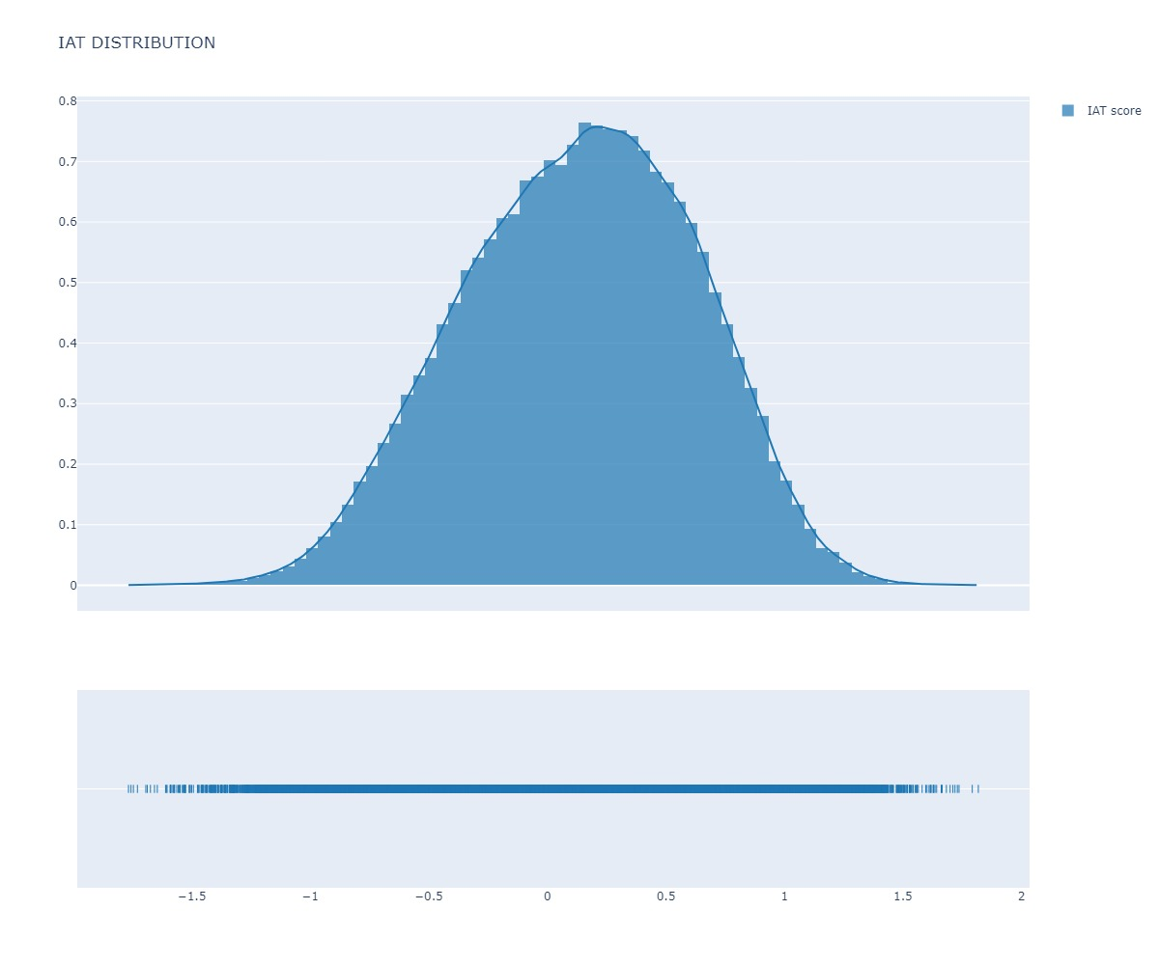
TARGET VARIABLE: IAT
 | iat
count | 104237
mean | 0.133715
std | 0.489585
min | -1.7668
25% | -0.21474
50% | 0.155336
75% | 0.495058
max | 1.817866

Slide 9
CLEANING PROCESS
Cleaning missing values (from 1.5 millions to 100.000 records)
Only finished tests
Only first tests (to avoid the learning process)
Recategorizing variables: - Opinions: take the average as ‘gender prejudice’ - How do you feel…: average as ‘gender feel’ - categorical variables recoded as dummies (race (6 groups), binary vs non binary)

Slide 10
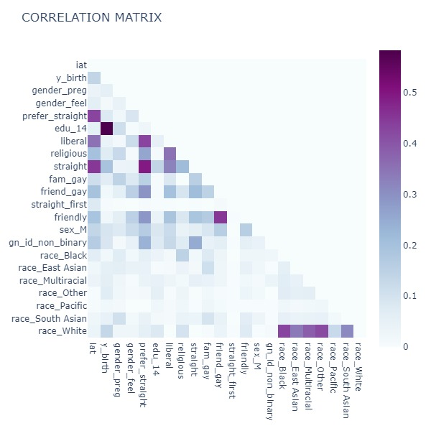
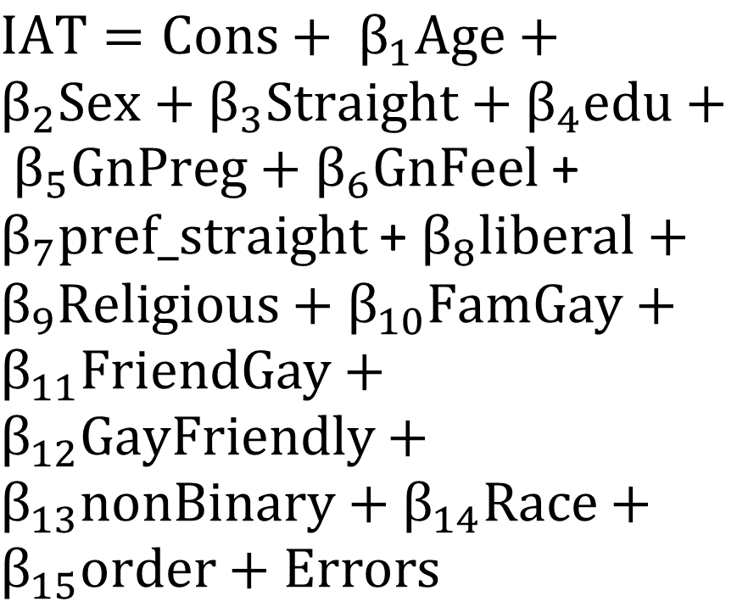
Correlation matrix and model
$IAT=Cons+ β_{1}Age+β_{2}Sex+β_{3}Straight+β_{4}edu+ β_{5}GnPreg+β_{6}GnFeel$ + $β_{7}pref_straight$ + $β_{8}liberal+β_{9}Religious+β_{10}FamGay+β_{11}FriendGay+β_{12}GayFriendly+β_{13}nonBinary+β_{14}Race+β_{15}order+Errors$

Slide 11
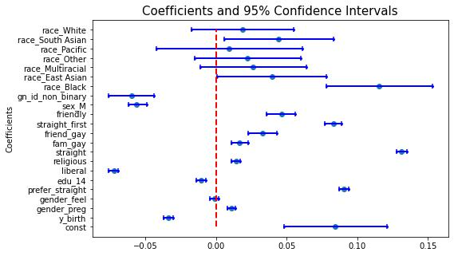
OLS COEFFICIENTS (TRAINING DATASET)

Slide 12
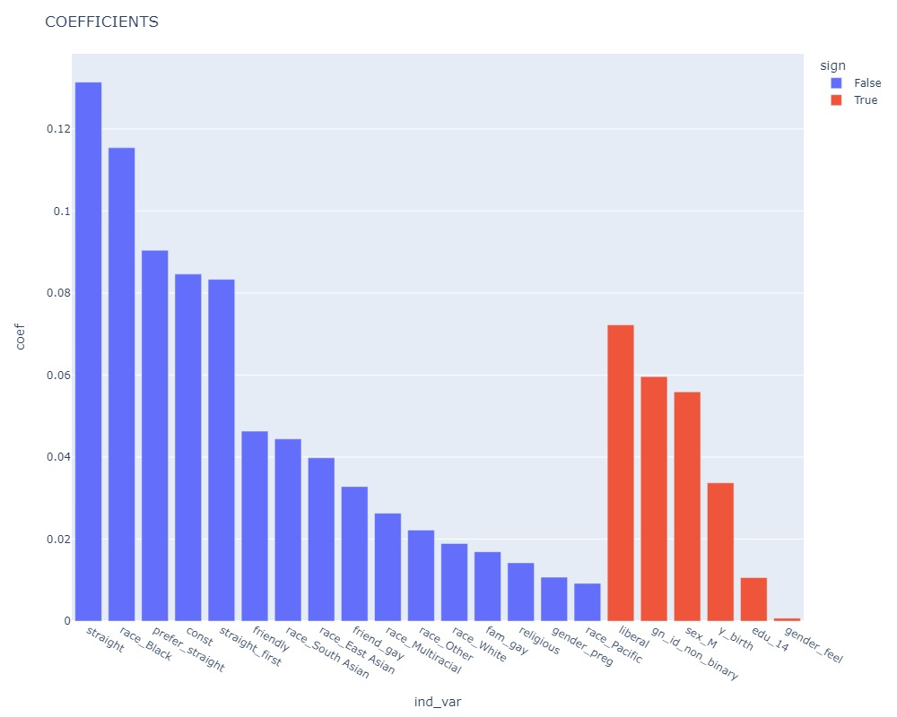
COEFFICIENTS’ SIZE

Slide 13
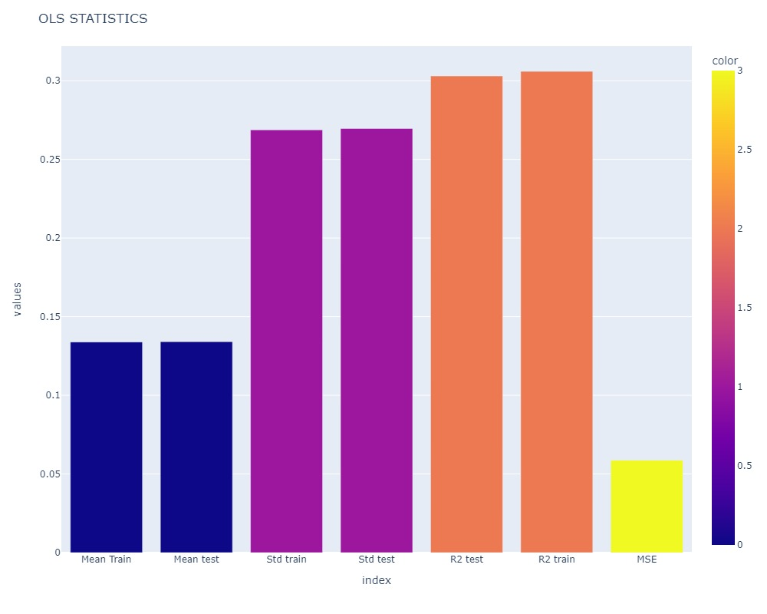
PREDICT Y ON THE TEST SET
 | values
Mean Train | 0.133875
Mean test | 0.134083
Std train | 0.268768
Std test | 0.269622
R2 test | 0.303
R2 train | 0.305953
MSE | 0.058683

Slide 14
ATTEMPTS TO INCREASE R2 (FAILED)
Removed IAT outliers (people that take too long or to short to reply)
Transform gender_feel in logarithmic scale
Drop some multicollinear variables

Slide 15
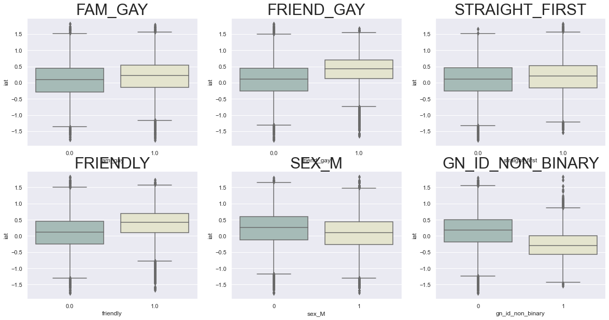
CATEGORICAL VARS AND IAT

Slide 16
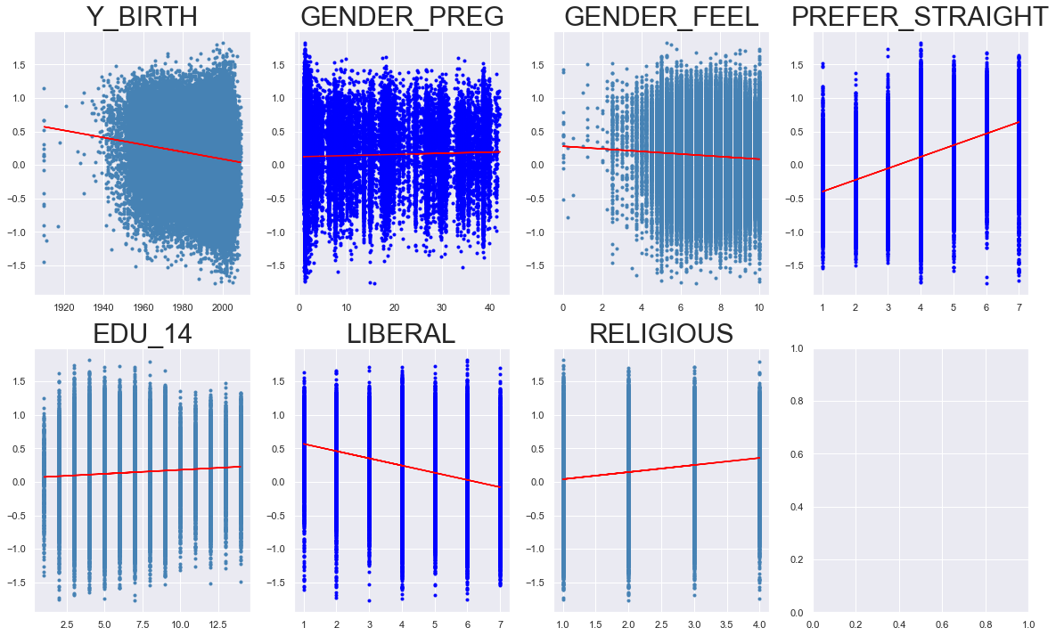
CONTINOUS VARIABLES AND IAT

Slide 17
