Slide 1
Smoothing
This dark art is why NLP is taught in the engineering school.
If you saw something happen 1 out of 3 times, is its probability really 1/3?
If you saw something happen 0 out of 3 times, is its probability really 0?
If you saw something happen 3 out of 3 times, is its probability really 1?
Relative frequency estimation
considered harmful

Slide 2
Parameter Estimation
p(x₁=h, x₂=o, x₃=r, x₄=s, x₅=e, x₆=s, …)
≈ p(h | BOS, BOS)
* p(o | BOS, h)
* p(r | h, o)
* p(s | o, r)
* p(e | r, s)
* p(s | s, e)
* …
trigram model’s
parameters
4470/ 52108
395/ 4470
1417/ 14765
1573/ 26412
1610/ 12253
2044/ 21250
values of
those parameters, as naively estimated from Brown corpus.

Slide 3
Terminology: Types vs. Tokens
Word type = distinct vocabulary item
A dictionary is a list of types (once each)
Word token = occurrence of that type
A corpus is a list of tokens (each type has many tokens)
We’ll estimate probabilities of the dictionary types by counting the corpus tokens
26 types
300 tokens
a | 100
b | 0
c | 0
d | 200
e | 0
…
z | 0
Total | 300
100 tokens of this type
0 tokens of this type
200 tokens of this type
(in context)

Slide 4
How to Estimate?
p(z | xy) = ?
Suppose our training data includes … xya .. … xyd … … xyd … but never xyz
Should we conclude p(a | xy) = 1/3? p(d | xy) = 2/3? p(z | xy) = 0/3?
NO! Absence of xyz might just be bad luck.

Slide 5
Smoothing the Estimates
Should we conclude p(a | xy) = 1/3? reduce this p(d | xy) = 2/3? reduce this p(z | xy) = 0/3? increase this
Discount the positive counts somewhat
Reallocate that probability to the zeroes
Especially if the denominator is small …
1/3 probably too high, 100/300 probably about right
Especially if numerator is small …
1/300 probably too high, 100/300 probably about right

Slide 6
Add-One Smoothing
xya | 1 | 1/3 | 2 | 2/29
xyb | 0 | 0/3 | 1 | 1/29
xyc | 0 | 0/3 | 1 | 1/29
xyd | 2 | 2/3 | 3 | 3/29
xye | 0 | 0/3 | 1 | 1/29
…
xyz | 0 | 0/3 | 1 | 1/29
Total xy | 3 | 3/3 | 29 | 29/29

Slide 7
Add-One Smoothing
300 observations instead of 3 – better data, less smoothing
xya | 100 | 100/300 | 101 | 101/326
xyb | 0 | 0/300 | 1 | 1/326
xyc | 0 | 0/300 | 1 | 1/326
xyd | 200 | 200/300 | 201 | 201/326
xye | 0 | 0/300 | 1 | 1/326
…
xyz | 0 | 0/300 | 1 | 1/326
Total xy | 300 | 300/300 | 326 | 326/326

Slide 8
Smoothing
Hey, don’t they teach estimation over in the stats department?
Statisticians design “estimators” that estimate true properties from small samples.
A smoothing heuristic is just an estimator for probabilities.
Can we get better estimators?

Slide 9
Problem with Add-One Smoothing
We’ve been considering just 26 letter types …
xya | 1 | 1/3 | 2 | 2/29
xyb | 0 | 0/3 | 1 | 1/29
xyc | 0 | 0/3 | 1 | 1/29
xyd | 2 | 2/3 | 3 | 3/29
xye | 0 | 0/3 | 1 | 1/29
…
xyz | 0 | 0/3 | 1 | 1/29
Total xy | 3 | 3/3 | 29 | 29/29

Slide 10
Problem with Add-One Smoothing
Suppose we’re considering 20000 word types, not 26 letters
see the abacus | 1 | 1/3 | 2 | 2/20003
see the abbot | 0 | 0/3 | 1 | 1/20003
see the abduct | 0 | 0/3 | 1 | 1/20003
see the above | 2 | 2/3 | 3 | 3/20003
see the Abram | 0 | 0/3 | 1 | 1/20003
…
see the zygote | 0 | 0/3 | 1 | 1/20003
Total | 3 | 3/3 | 20003 | 20003/20003

Slide 11
Problem with Add-One Smoothing
Suppose we’re considering 20000 word types, not 26 letters
see the abacus | 1 | 1/3 | 2 | 2/20003
see the abbot | 0 | 0/3 | 1 | 1/20003
see the abduct | 0 | 0/3 | 1 | 1/20003
see the above | 2 | 2/3 | 3 | 3/20003
see the Abram | 0 | 0/3 | 1 | 1/20003
…
see the zygote | 0 | 0/3 | 1 | 1/20003
Total | 3 | 3/3 | 20003 | 20003/20003
“Novel event” = 0-count event (never happened in training data).
Here: 19998 novel events, with total estimated probability 19998/20003.
So add-one smoothing thinks we are extremely likely to see novel events, rather than words we’ve seen in training data.
It thinks this only because we have a big dictionary: 20000 possible events.
Is this a good reason?
600.465 - Intro to NLP - J. Eisner

Slide 12
Infinite Dictionary?
In fact, aren’t there infinitely many possible word types?
see the aaaaa | 1 | 1/3 | 2 | 2/(∞+3)
see the aaaab | 0 | 0/3 | 1 | 1/(∞+3)
see the aaaac | 0 | 0/3 | 1 | 1/(∞+3)
see the aaaad | 2 | 2/3 | 3 | 3/(∞+3)
see the aaaae | 0 | 0/3 | 1 | 1/(∞+3)
…
see the zzzzz | 0 | 0/3 | 1 | 1/(∞+3)
Total | 3 | 3/3 | (∞+3) | (∞+3)/(∞+3)

Slide 13
Add-Lambda Smoothing
A large dictionary makes novel events too probable.
To fix: Instead of adding 1 to all counts, add λ = 0.01?
This gives much less probability to novel events.
But how to pick best value for λ?
That is, how much should we smooth?

Slide 14
Add-0.001 Smoothing
Doesn’t smooth much (estimated distribution has high variance)
xya | 1 | 1/3 | 1.001 | 0.331
xyb | 0 | 0/3 | 0.001 | 0.0003
xyc | 0 | 0/3 | 0.001 | 0.0003
xyd | 2 | 2/3 | 2.001 | 0.661
xye | 0 | 0/3 | 0.001 | 0.0003
…
xyz | 0 | 0/3 | 0.001 | 0.0003
Total xy | 3 | 3/3 | 3.026 | 1

Slide 15
Add-1000 Smoothing
Smooths too much (estimated distribution has high bias)
xya | 1 | 1/3 | 1001 | 1/26
xyb | 0 | 0/3 | 1000 | 1/26
xyc | 0 | 0/3 | 1000 | 1/26
xyd | 2 | 2/3 | 1002 | 1/26
xye | 0 | 0/3 | 1000 | 1/26
…
xyz | 0 | 0/3 | 1000 | 1/26
Total xy | 3 | 3/3 | 26003 | 1

Slide 16
Smoothing
Hey, don’t they teach estimation over in the stats department?
How would statisticians think about what we’re doing here?
Add-λ smoothing can actually be derived as the best thing to do … if you have certain assumptions and goals. (Ask me about this!)
But what does “best” mean?

Slide 17
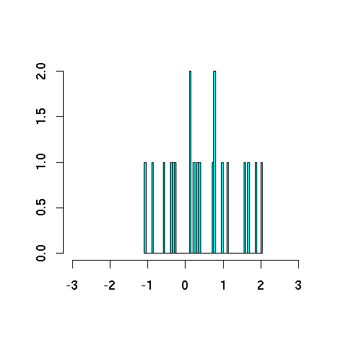
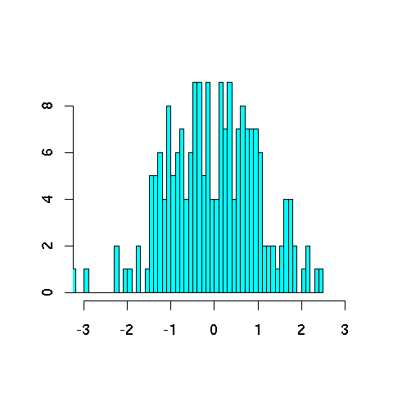
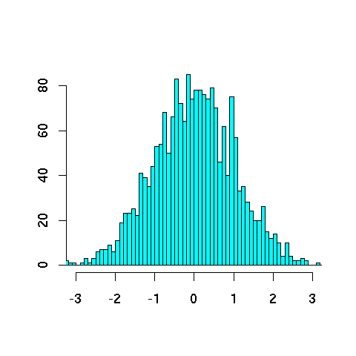
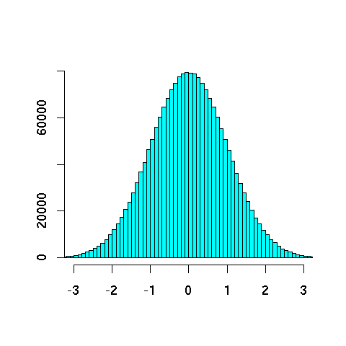
Never trust a sample under 30
20
200
2000
2000000

Slide 18
Never trust a sample under 30
Smooth out the bumpy histograms to look more like the truth
(we hope!)

Slide 19
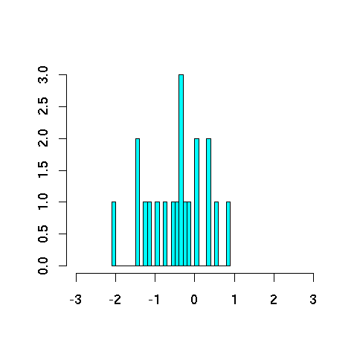
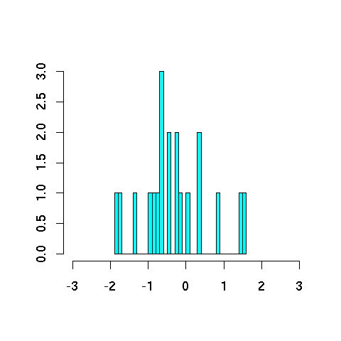
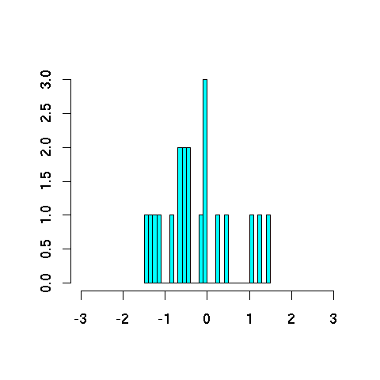
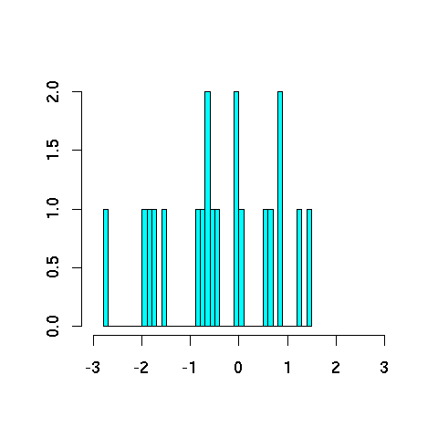
Smoothing reduces variance
20
20
Different samples of size 20 vary considerably
(though on average, they give the correct bell curve!)
20
20

Slide 20
Smoothing reduces variance
truth
truth
bias
average
unsmoothed estimates from different samples
estimates are correct on average: such an estimation method is called unbiased
estimates are typically far from truth (high variance = mean squared distance)
smoothed estimates from different samples
estimates are incorrect on average: such an estimation method is called biased
but estimates are typically close to average (high variance = mean squared distance)
and so may tend to be closer to truth, too

Slide 21
Smoothing reduces variance
truth
truth
truth
truth
variance
variance
bias
bias
no smoothing (λ=0)
“overfit” (memorize) the training data
less smoothing (small λ>0)
more smoothing (large λ>0)
“underfit” (ignore) the training data
Where’s best?

Slide 22
Add-Lambda Smoothing
A large dictionary makes novel events too probable.
To fix: Instead of adding 1 to all counts, add λ = 0.01?
This gives much less probability to novel events.
But how to pick best value for λ?
That is, how much should we smooth?
E.g., how much probability to “set aside” for novel events?
Depends on how likely novel events really are!
Which may depend on the type of text, size of training corpus, …
Can we use the data to find the most appropriate λ value?
λ is an example of a “hyperparameter” (a “tuning knob” we can use to adjust our system’s behavior)

Slide 23
Setting Smoothing Parameters
How to pick best value for λ? (in add- λ smoothing)
Try many λ values & report the one that gets best results?
How to measure whether a particular λ gets good results?
Is it fair to measure that on test data (for setting λ)?
Story: Stock scam …
Moral: Selective reporting on test data can make a method look artificially good. So it is unethical.
Rule: Test data cannot influence system development. No peeking! Use it only to evaluate the final system(s). Report all results on it.
Training
Test
Also, tenure letters …
General Rule of Experimental Ethics: Never skew anything in your favor.
Applies to experimental design, reporting, analysis, discussion.
Feynman’s Advice: “The first principle is that you must not fool yourself, and you are the easiest person to fool.”

Slide 24
Setting Smoothing Parameters
How to pick best value for λ?
Try many λ values & report the one that gets best results?
How to fairly measure whether a λ gets good results?
Hold out some “development data” for this purpose
Training
Test
Dev.
Training
… and report results of that final model on test data.
Pick λ that gets best results on this 20% …
Now use that λ to get smoothed counts from all 100% …
… when we collect counts from this 80% and smooth them using add-λ smoothing.
600.465 - Intro to NLP - J. Eisner

Slide 25
Setting Smoothing Parameters
Here we held out 20% of our training set (yellow) for development.
Would like to use > 20% yellow:
Would like to use > 80% blue:
Could we let the yellow and blue sets overlap?
☹ 20% not enough to reliably assess λ
☹ Best λ for smoothing 80%
≠ best λ for smoothing 100%
☹ Ethical, but foolish
Training
Test
Dev.
Training
… and report results of that final model on test data.
Pick λ that gets best results on this 20% …
Now use that λ to get smoothed counts from all 100% …
… when we collect counts from this 80% and smooth them using add-λ smoothing.
600.465 - Intro to NLP - J. Eisner

Slide 26
5-fold Cross-Validation (“Jackknifing”)
☹ 20% not enough to reliably assess λ
☹ Best λ for smoothing 80%
≠ best λ for smoothing 100%
Would like to use > 20% yellow:
Would like to use > 80% blue:
Old version: Train on 80%, test on 20%
If 20% yellow too little: try 5 training/dev splits as below
Pick λ that gets best average performance
☺ Tests on all 100% as yellow, so we can more reliably assess λ
☹ Still picks a λ that’s good at smoothing the 80% size, not 100%.
But now we can grow that 80% without trouble …
Dev.
Training
Dev.
Dev.
Dev.
animation
Dev.
Test
Dev.
600.465 - Intro to NLP - J. Eisner

Slide 27
Cross-Validation Pseudocode
for λ in {0.01, 0.02, 0.03, … 9.99}
for each of the 5 blue/yellow splits
train on the 80% blue data, using λ to smooth the counts
test on the 20% yellow data, and measure performance
goodness of this λ = average performance over the 5 splits
using best λ we found above:
train on 100% of the training data, using λ to smooth the counts
test on the red test data, measure performance & report it
Dev.
Dev.
Dev.
Dev.
Dev.
Training
Test
600.465 - Intro to NLP - J. Eisner

Slide 28
N-fold Cross-Validation (“Leave One Out”)
(more extreme version of strategy from last slide)
…
Test
To evaluate a particular λ during dev, test on all the training data: test each sentence with smoothed model from other N-1 sentences
☺ Still tests on all 100% as yellow, so we can reliably assess λ
☺ Trains on nearly 100% blue data ((N-1)/N) to measure whether λ is good for smoothing that much data: nearly matches true test conditions
☺ Surprisingly fast: why?
Usually easy to retrain on blue by adding/subtracting 1 sentence’s counts
600.465 - Intro to NLP - J. Eisner

Slide 29
Smoothing reduces variance
Remember: So does backoff (by increasing size of sample). Use both?
20
20
200
20
20

Slide 30
Use the backoff, Luke!
Why are we treating all novel events as the same?
p(zygote | see the) vs. p(baby | see the)
Unsmoothed probs: count(see the zygote) / count(see the)
Smoothed probs: (count(see the zygote) + 1) / (count(see the) + V)
What if count(see the zygote) = count(see the baby) = 0?
baby beats zygote as a unigram
the baby beats the zygote as a bigram
∴ see the baby beats see the zygote ? (even if both have the same count, such as 0)
600.465 - Intro to NLP - J. Eisner

Slide 31
Use the backoff, Luke!
Why are we treating all novel events as the same?
p̂(baby | see the) = (count(see the baby) + λ) / (count(see the) + λV)
baby beats zygote as a unigram
the baby beats the zygote as a bigram
∴ see the baby beats see the zygote ? (even if both have the same count, such as 0)
p̂(baby | see the) = (count(see the baby) + λV p̂(baby | the)) / (count(see the) + λV)
Check: Summing p̂(z | see the) over all z gives 1 (denominator is constant; adding all numerators gives the denominator)
600.465 - Intro to NLP - J. Eisner

Slide 32
Backoff smoothing as model averaging
count(see the baby) + λV (1/V) count(see the) + λV
p̂(baby | see the) =
p̂(baby | see the) =
= α ∙ + (1-α) ∙ p̂(baby | the)
where α = count(see the) / (count(see the) + λV) ∈ [0,1]
A weighted average!
Low weight on the trigram estimate when count(see the) is small
count(see the baby) + λV p̂(baby | the) count(see the) + λV
count(see the baby) count(see the)
600.465 - Intro to NLP - J. Eisner

Slide 33
Backoff smoothing as model averaging
count(see the baby) + λV (1/V) count(see the) + λV
p̂(baby | see the) =
p̂(baby | see the) =
Before, we were averaging the trigram relative frequency estimate with the uniform distribution.
Now we’re averaging it with the “backed-off” (bigram) distribution.
Backed-off distribution is itself just an estimate, but a pretty good one:
Close to what we want since it still considers 2 of the 3 words (low bias)
Based on more data (low variance)
We can estimate it by backing off to unigram distribution, in turn (lowers variance more)
count(see the baby) + λV p̂(baby | the) count(see the) + λV
600.465 - Intro to NLP - J. Eisner

Slide 34
More general model averaging
Jelinek-Mercer smoothing (“deleted interpolation”):
Use a weighted average of backed-off naïve models: p̂_{average}(z | xy) = μ₃ p̂(z | xy) + μ₂ p̂(z | y) + μ₁ p̂(z) where μ₃ + μ₂ + μ₁ = 1 and all are ≥ 0
The weights μ can depend on the context xy
If we have “enough data” in context xy, can make μ₃ large. E.g.:
If count(xy) is high
If the entropy of z is low in the context xy
Learn the weights on held-out data w/ jackknifing
Different μ₃ when xy is observed 1 time, 2 times, 3-5 times, …
600.465 - Intro to NLP - J. Eisner

Slide 35
More Ideas for Smoothing
Cross-validation is a general-purpose wrench for tweaking any constants in any system.
Here, the system will train the counts from blue data, but we use yellow data to tweak how much the system smooths them (λ) and how much it backs off for different kinds of contexts (μ₃ etc.)
Is there anything more specific to try in this case?
Remember, we’re trying to decide how much to smooth.
E.g., how much probability to “set aside” for novel events?
Depends on how likely novel events really are …
Which may depend on the type of text, size of training corpus, …
Can we figure this out from the data?

Slide 36
How likely are novel events?
Is there any theoretically nice way to pick λ?
20000 types
300 tokens
300 tokens
a | 150 |  | 0
both | 18 |  | 0
candy | 0 |  | 1
donuts | 0 |  | 2
every | 50 | versus | 0
farina | 0 |  | 0
grapes | 0 |  | 1
his | 38 |  | 0
ice cream | 0 |  | 7
…
0/300
0/300
which zero would you expect is really rare?

Slide 37
How likely are novel events?
20000 types
300 tokens
300 tokens
a | 150 |  | 0
both | 18 |  | 0
candy | 0 |  | 1
donuts | 0 |  | 2
every | 50 | versus | 0
farina | 0 |  | 0
grapes | 0 |  | 1
his | 38 |  | 0
ice cream | 0 |  | 7
…
determiners:
a closed class

Slide 38
How likely are novel events?
20000 types
300 tokens
300 tokens
a | 150 |  | 0
both | 18 |  | 0
candy | 0 |  | 1
donuts | 0 |  | 2
every | 50 | versus | 0
farina | 0 |  | 0
grapes | 0 |  | 1
his | 38 |  | 0
ice cream | 0 |  | 7
…
(food) nouns:
an open class

Slide 39
How common are novel events?
Counts from Brown Corpus (N ≈ 1 million tokens)
N₆ *
N₅ *
N₄ *
N₃ *
N₂ *
doubletons (occur twice)
N₁ *
singletons (occur once)
N₀ *
novel words (in dictionary but never occur)
N2 = # doubleton types
N2 * 2 = # doubleton tokens
∑_{r} N_{r} = total # types = T (purple bars)
∑_{r} (N_{r} * r) = total # tokens = N (all bars)

Slide 40
How common are novel events?
1 *
the
1 *
EOS
N₆ *
abdomen, bachelor, Caesar …
N₅ *
aberrant, backlog, cabinets …
N₄ *
abdominal, Bach, cabana …
N₃ *
Abbas, babel, Cabot …
N₂ *
aback, Babbitt, cabanas …
N₁ *
abaringe, Babatinde, cabaret …
N₀ *

Slide 41
Witten-Bell Smoothing Idea
If T/N is large, we’ve seen lots of novel types in the past, so we expect lots more.
Imagine scanning the corpus in order.
Each type’s first token was novel.
So we saw T novel types (purple).
N₆ *
N₅ *
N₄ *
N₃ *
unsmoothed → smoothed
N₂ *
doubletons
2/N → 2/(N+T)
N₁ *
singletons
1/N → 1/(N+T)
N₀ *
novel words
0/N → (T/(N+T)) / N₀
Intuition: When we see a new type w in training, ++count(w); ++count(novel)
So p(novel) is estimated as T/(N+T), divided among N₀ specific novel types

Slide 42
Good-Turing Smoothing Idea
Partition the type vocabulary into classes (novel, singletons, doubletons, …) by how often they occurred in training data
Use observed total probability of class r+1 to estimate total probability of class r
N₆*
N₅*
N₄*
N₃*
obs. (tripleton)
unsmoothed → smoothed
1.2%
est. p(doubleton)
2/N → (N₃*3/N)/N₂
N₂*
obs. p(doubleton)
(N₃*3/N)/N₂
1.5%
N₁*
obs. p(singleton)
est. p(singleton)
1/N → (N₂*2/N)/N₁
(N₂*2/N)/N₁
2%
N₀*
est. p(novel)
0/N → (N₁*1/N)/N₀
(N₁*1/N)/N₀
r/N = (N_{r}*r/N)/N_{r} → (N_{r+1}*(r+1)/N)/N_{r}

Slide 43
Justification of Good-Turing
obs. (tripleton)
…
1.2%
est. p(doubleton)
obs. p(doubleton)
1.5%
est. p(singleton)
obs. p(singleton)
2%
est. p(novel)
Justified by leave-one-out training! (Leave out 1 word at a time.)
Instead of just tuning λ, we will tune
p(novel)=0.02 [= frac. of yellow dev. words that were novel in blue training]
p(singleton)=0.015 [= frac. of yellow dev. words that were singletons in blue training]
p(doubleton)=0.012 [= frac. of yellow dev. words that were doubletons in blue training]
i.e.,
p(novel) = fraction of singletons in full training
p(singleton) = fraction of doubletons in full training, etc.
Example: c(aback)=2. On the 2 folds where yellow=aback, aback was a singleton in blue data, so we’d be rewarded for assigning a high prob to training singletons. Overall, we’ll get such a reward on 1.5% of the folds.
Better variant: leave out 1 document at a time?

Slide 44
Witten-Bell vs. Good-Turing
Estimate p(z | xy) using just the tokens we’ve seen in context xy. Might be a small set …
Witten-Bell intuition: If those tokens were distributed over many different types, then novel types are likely in future.
Formerly covered on homework 3
Good-Turing intuition: If many of those tokens came from singleton types , then novel types are likely in future.
Very nice idea (but a bit tricky in practice)
See the paper “Good-Turing smoothing without tears”

Slide 45
Good-Turing (old slides)
Intuition: Can judge rate of novel events (in a context) by rate of singletons (in that context)
Let N_{r} = # of word types with r training tokens
e.g., N₀ = number of unobserved words
e.g., N₁ = number of singletons
Let N = Σ r N_{r} = total # of training tokens

Slide 46
Good-Turing (old slides)
Let N_{r} = # of word types with r training tokens
Let N = Σ r N_{r} = total # of training tokens
Naïve estimate: if x has r tokens, p(x) = ?
Answer: r/N
Total naïve probability of all word types with r tokens?
Answer: N_{r} r / N.
Good-Turing estimate of this total probability:
Defined as: N_{r+1} (r+1) / N
So proportion of novel words in test data is estimated by proportion of singletons in training data.
Proportion in test data of the N₁ singletons is estimated by proportion of the N₂ doubletons in training data. Etc.
So what is Good-Turing estimate of p(x)?

Slide 47
Smoothing + backoff
Basic smoothing (e.g., add-λ, Good-Turing, Witten-Bell):
Holds out some probability mass for novel events
E.g., Good-Turing gives them total mass of N₁/N
Divided up evenly among the novel events
Backoff smoothing
Holds out same amount of probability mass for novel events
But divide up unevenly in proportion to backoff prob.
600.465 - Intro to NLP - J. Eisner

Slide 48
Smoothing + backoff
Note: The best known backoff smoothing methods:
modified Kneser-Ney (smart engineering)
Witten-Bell + one small improvement (Carpenter 2005)
hierarchical Pitman-Yor (clean Bayesian statistics)
All are about equally good.
Note:
A given context like xy may be quite rare – perhaps we’ve only observed it a few times.
Then it may be hard for Good-Turing, Witten-Bell, etc. to accurately guess that context’s novel-event rate as required
We could try to make a better guess by aggregating xy with other contexts (all contexts? similar contexts?).
This is another form of backoff. By contrast, basic Good-Turing, Witten-Bell, etc. were limited to a single implicit context.
Log-linear models accomplish this very naturally.
600.465 - Intro to NLP - J. Eisner

Slide 49
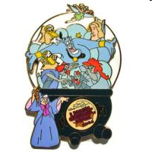
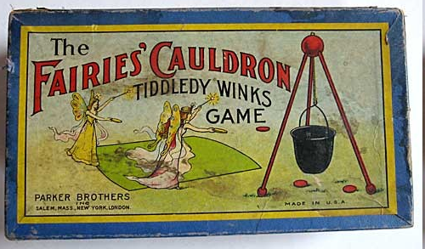
Smoothing as Optimization
We’ve been estimating conditional probabilities using modified count ratios.
Instead, maybe we could find a formula that yields conditional probabilities, and estimate the parameters (numbers) that appear in that formula.
In fact, optimize them! Not to make the probabilities individually good, but to ensure that together, they achieve good cross-entropy or task performance.
600.465 - Intro to NLP - J. Eisner

Slide 50
Conditional Modeling
Given a context x
Which outcomes y are likely in that context?
We need a conditional distribution p(y | x)
A black-box function that we call on x, y
p(NextWord=y | PrecedingWords=x)
y is a unigram
x is an (n-1)-gram
p(Category=y | Text=x)
y ∈ {personal email, work email, spam email}
x ∈ ∑* (it’s a string: the text of the email)
Remember: p can be any function over (x,y)!
Provided that p(y | x) ≥ 0, and ∑_{y} p(y | x) = 1
600.465 - Intro to NLP - J. Eisner

Slide 51
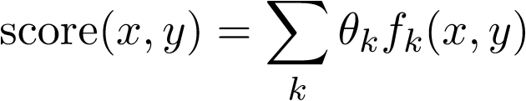
Linear Scoring
How well does y go with x?
Simplest option: a linear function of (x,y). But (x,y) isn’t a number.
So describe it by one or more numbers:“numeric features” that you pick.
Then just use a linear function of those numbers.
Weight of feature k
To be learned …
Ranges over all features, e.g., k=5 (numbered features) or k=“see Det Noun” (named features)
Whether (x,y) has feature k(0 or 1)
Or how many times it fires (≥ 0)
Or how strongly it fires (real #)
We need a conditional distribution p(y | x)
Convert our linear scoring function to this distribution p
Require that p(y | x) ≥ 0, and ∑_{y} p(y | x) = 1; not true of score(x,y)

Slide 52
What features should we use?
Weight of feature k
To be learned …
p(NextWord=y | PrecedingWords=x)
y is a unigram
x is an (n-1)-gram
p(Category=y | Text=x)
y ∈ {personal email, work email, spam email}
x ∈ ∑* (it’s a string: the text of the email)
Ranges over all features, e.g., k=5 (numbered features) or k=“see Det Noun” (named features)
Whether (x,y) has feature k (0 or 1)
Or how many times it fires (≥ 0)
Or how strongly it fires (real #)

Slide 53
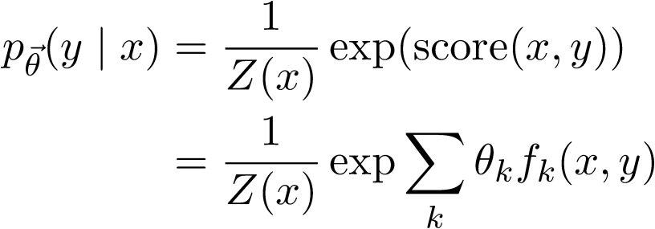

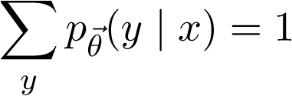
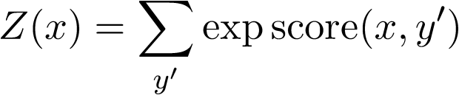
Log-Linear Conditional Probability (interpret score as a log-prob, up to a constant)
unnormalized
prob (at least
it’s positive!)
where we choose Z(x) to ensure that
thus,
sum of unnormalized
probabilities of all the
output candidates y’
Sometimes just written as Z
600.465 - Intro to NLP - J. Eisner

Slide 54


Training θ
This version is “discriminative training”: to learn to predict y from x, maximize p(y|x).
Whereas “joint training” learns to model x, too, by maximizing p(x,y).
n training examples
feature functions f₁, f₂, …
Want to maximize p(training data|θ)
Easier to maximize the log of that:
Alas, some weights θ_{i} may be optimal at -∞ or +∞.
When would this happen? What’s going “wrong”?

Slide 55
Training θ
This version is “discriminative training”: to learn to predict y from x, maximize p(y|x).
Whereas “joint training” learns to model x, too, by maximizing p(x,y).
n training examples
feature functions f₁, f₂, …
Want to maximize p(training data|θ) ⋅ p_{prior}(θ)
Easier to maximize the log of that:
to avoid
overfitting
Encourages weights close to 0: “L2 regularization” (other choices possible)
That’s where our smoothing went! Choose θ by cross-validation on dev data.
L2 corresponds to a Gaussian prior, since Gaussian bell curve is just exp(quadratic).

Slide 56
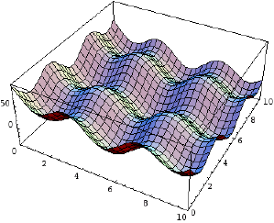
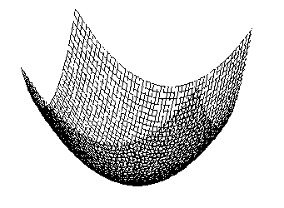
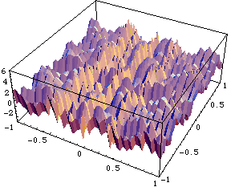
Gradient-based training
Gradually adjust θ in a direction that increases this
For this, use your favorite function maximization algorithm.
gradient descent, conjugate gradient, variable metric,etc.
(Go take an optimization course: 550.{361,661,662}.)
(Or just download some software!)
nasty non-differentiable cost function with local minima
nice smooth and convex cost function: pick one of these

Slide 57
Gradient-based training
Gradually adjust θ in a direction that improves this
Gradient ascent to gradually increase f(θ):
while (∇f(θ) ≠ 0) // not at a local max or min
θ = θ + ∈⋅∇f(θ) // for some small ∈ > 0
Remember: ∇f(θ) = (∂f(θ)/∂θ₁, ∂f(θ)/∂θ₂, …)
So update just means: θ_{k} += ∂f(θ)/∂θ_{k}
This takes a little step “uphill” (direction of steepest increase).
This is why you took calculus. ☺

Slide 58
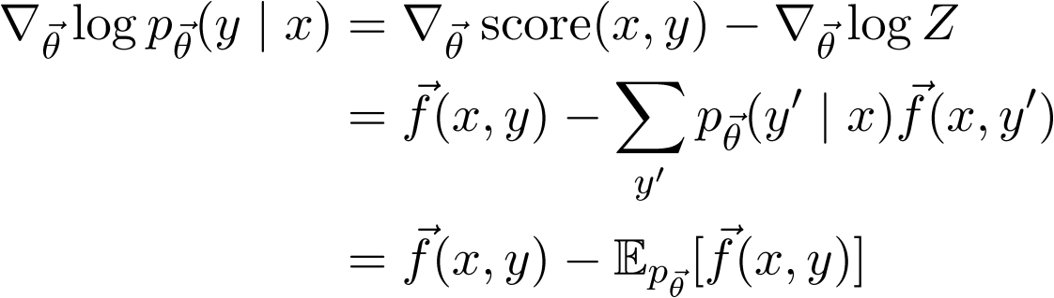
Gradient-based training
Gradually adjust θ in a direction that improves this
The key part of the gradient works out as …

Slide 59
Maximum Entropy
Suppose there are 10 classes, A through J.
I don’t give you any other information.
Question: Given message m: what is your guess for p(C | m)?
Suppose I tell you that 55% of all messages are in class A.
Question: Now what is your guess for p(C | m)?
Suppose I also tell you that 10% of all messages contain Buy and 80% of these are in class A or C.
Question: Now what is your guess for p(C | m), if m contains Buy?
OUCH!
600.465 - Intro to NLP - J. Eisner

Slide 60
Maximum Entropy
 | A | B | C | D | E | F | G | H | I | J
Buy | .051 | .0025 | .029 | .0025 | .0025 | .0025 | .0025 | .0025 | .0025 | .0025
Other | .499 | .0446 | .0446 | .0446 | .0446 | .0446 | .0446 | .0446 | .0446 | .0446
Column A sums to 0.55 (“55% of all messages are in class A”)
600.465 - Intro to NLP - J. Eisner

Slide 61
Maximum Entropy
 | A | B | C | D | E | F | G | H | I | J
Buy | .051 | .0025 | .029 | .0025 | .0025 | .0025 | .0025 | .0025 | .0025 | .0025
Other | .499 | .0446 | .0446 | .0446 | .0446 | .0446 | .0446 | .0446 | .0446 | .0446
Column A sums to 0.55
Row Buy sums to 0.1 (“10% of all messages contain Buy”)
600.465 - Intro to NLP - J. Eisner

Slide 62
Maximum Entropy
 | A | B | C | D | E | F | G | H | I | J
Buy | .051 | .0025 | .029 | .0025 | .0025 | .0025 | .0025 | .0025 | .0025 | .0025
Other | .499 | .0446 | .0446 | .0446 | .0446 | .0446 | .0446 | .0446 | .0446 | .0446
Column A sums to 0.55
Row Buy sums to 0.1
(Buy, A) and (Buy, C) cells sum to 0.08 (“80% of the 10%”)
Given these constraints, fill in cells “as equally as possible”: maximize the entropy (related to cross-entropy, perplexity)
Entropy = -.051 log .051 - .0025 log .0025 - .029 log .029 - …
Largest if probabilities are evenly distributed
600.465 - Intro to NLP - J. Eisner

Slide 63
Maximum Entropy
 | A | B | C | D | E | F | G | H | I | J
Buy | .051 | .0025 | .029 | .0025 | .0025 | .0025 | .0025 | .0025 | .0025 | .0025
Other | .499 | .0446 | .0446 | .0446 | .0446 | .0446 | .0446 | .0446 | .0446 | .0446
Column A sums to 0.55
Row Buy sums to 0.1
(Buy, A) and (Buy, C) cells sum to 0.08 (“80% of the 10%”)
Given these constraints, fill in cells “as equally as possible”: maximize the entropy
Now p(Buy, C) = .029 and p(C | Buy) = .29
We got a compromise: p(C | Buy) < p(A | Buy) < .55
600.465 - Intro to NLP - J. Eisner

Slide 64
Maximum Entropy
 | A | B | C | D | E | F | G | H | I | J
Buy | .051 | .0025 | .029 | .0025 | .0025 | .0025 | .0025 | .0025 | .0025 | .0025
Other | .499 | .0446 | .0446 | .0446 | .0446 | .0446 | .0446 | .0446 | .0446 | .0446
Given these constraints, fill in cells “as equally as possible”: maximize the entropy
Now p(Buy, C) = .029 and p(C | Buy) = .29
We got a compromise: p(C | Buy) < p(A | Buy) < .55
Punchline: This is exactly the maximum-likelihood log-linear distribution p(y) that uses 3 binary feature functions that ask: Is y in column A? Is y in row Buy? Is y one of the yellow cells? So, find it by gradient ascent.
600.465 - Intro to NLP - J. Eisner

