Slide 1
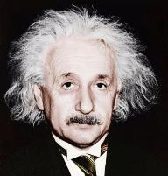
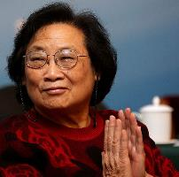
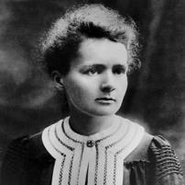


Key Points
Where to Invest in Faculty for the Future?
Basic Science
Focus
Pasteur’s Quadrant
Direct Impact on Society
Notes:
Youyou Tu, Nobel Prize in Medicine, Basic Scientist who studies parasites, and has helped create targeted therapy for malaria.

