Slide 1
Student PC Process Overview*
Thomas Moyer
* Based on slides prepared by Thorsten Holz for last year’s Student PC

Slide 2

Welcome
Thank you for volunteering your time for the 2019 IEEE S&P Student PC!
>110 applications, 43 selected – very competitive!

Slide 3
Agenda
Goals of the Student PC
How program committees operate
PC member considerations
What makes a good review
Timeline
Next steps

Slide 4
Student PC Goals
The Student PC is primarily an educational experience
Learn “how the sausage is made”
Expected outcomes
You will be able to interpret reviews on your papers
You will be able to write better papers
You will become a future leader in the community

Slide 5
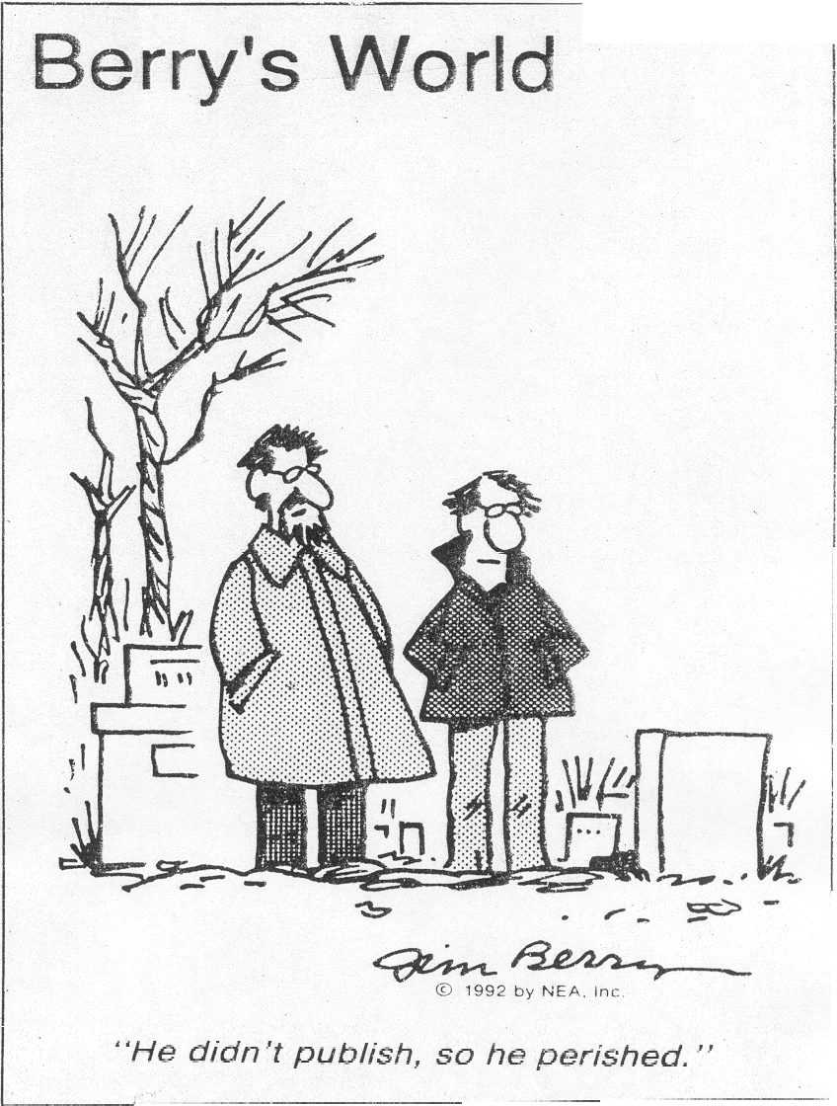
Publication Venues
Venues for publication:
Tech report
Workshop
Conference
Journal
Often your work will work through these from preliminary to archival versions of the work, sometimes branching or joining.
Book: less frequent, more work.

Slide 6
Publication Tiers
Not all publication venues are valued the same. Publication “tiers” tell the story
1st tier - IEEE S&P, USENIX Sec, CCS, TISSEC, JCS
1.5 NDSS
2nd tier - ACSAC, ACNS, ESORICS, CSF, RAID, TOIT
3rd tier - SecureComm, ICISS
4th tier - HICS
SCIgen (WMSCI 2005)
https://pdos.csail.mit.edu/archive/scigen/

Slide 7
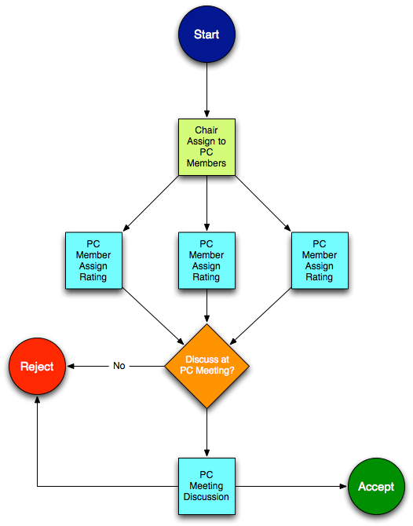
Conference Publication
The Program Chair is the person who marshals the reviewing and decision. This is different than the general chair.
PC members review, rate and discuss, the paper, then vote on which ones are accepted.
The acceptance rate is the ratio of accepted to submitted papers.

Slide 8
Paper Confidentiality
All papers, reviews, and all discussion are confidential!
What if …
I see something really cool?
Wait for the paper to be published (good reason to push for it)
The paper is related to my lab mate’s research?
You must keep it to yourself.
The paper solves the exact problem as my research?
Don’t bid on it, potentially mark yourself as a conflict.
Other questions?
Make all possible effort to mentally firewall ideas
I trust that you will honor these rules!

Slide 9
PC Conflicts
If a PC member and an author have a pre-existing relationship, the process loses efficacy.
You are not a conflict with someone just because you know them and are friendly with them
IEEE S&P’19 CFP defines conflicts as follows:
The PC member is a co-author of the paper.
The PC member has been a co-worker in the same company or university within the past two years.
The PC member has been a collaborator within the past two years.
The PC member is or was the author’s primary thesis advisor, no matter how long ago.
The author is or was the PC member’s primary thesis advisor, no matter how long ago.
The PC member is a relative or close personal friend of the author.
If you have questions, ask the chair!

Slide 10
Paper Bidding
Once papers are submitted, PC members bid for the papers they want to review
Options depend on the review system
HotCRP allows ranking: -20 to 20 is typical range
Use -100 to declare a conflict
If you don’t bid, you will not like the assigned papers
Even if you bid, you may get papers you don’t want
We will have the option to swap papers in case this is needed
Take-away: always bid on/against papers!

Slide 11

Paper Evaluation
A paper is evaluated on
Novelty
Correctness
Impact
Presentation
Relevance
“hotness”

Slide 12
Writing a Good Review
There are several articles describing how to (not) write reviews. Here are a few recommendations
"Thoughts on Reviewing”: http://www.icir.org/mallman/pubs/All08a/All08a.pdf
“Notes on Constructive and Positive Reviewing”: http://www.cs.utexas.edu/users/mckinley/notes/reviewing.html
"How NOT to review a paper The tools and techniques of the adversarial reviewer”: http://www.sigmod.org/publications/sigmod-record/0812/p100.open.cormode.pdf

Slide 13
Golden Rule
Write a review that you would want to receive if you were the one who wrote this paper
Poor reviews …
are noticed by chair
are noticed by colleagues
If you write reviews that are chronically late and low quality, it will hurt your reputation.

Slide 14
Structure of a Review
Summary – demonstrates what the reviewer understood, usually a paragraph.
Strengths – look for the good in the paper. Say something substantial!
Weaknesses – stick to the main weaknesses, things that cannot be changed easily
Additional Comments – other comments that will help the authors improve their paper.
Structure this further, as appropriate
Expand on strengths, weaknesses
Separate out “minor nits,” etc.
Length – should be more than 1-2 paragraphs. Good reviews are 100+ lines (but length isn’t everything)

Slide 15
Don’t be Lazy
Goodness – Look for reasons to accept the paper. It is easy to find problems.
100s to 1000s of hours likely went into the paper (even if bad)
Novelty – if you think a paper is not novel, give evidence. If they don’t cite appropriate works, give direction / examples.
Difference between “fundamentally missed a critical comparison in the field” and “needs to cite some paper”
Technical vs. Philosophical – Clearly differentiate your technical and philosophical issues with a paper
Clarity – give your review structure, organization, and clarity. Don’t just ramble. Don’t just give comments in the order they appear in the paper.

Slide 16
Assigning a Score
The score determines if you think the paper is above or below “the bar”
Every reviewer has a different scale
Stay away from the “borderline” score, pick something!
Match the content of your review, changing your review if necessary
Ask: “Do I like this paper better than other papers I have seen published?”
Every paper has weaknesses, even great papers

Slide 17
Comments to the PC
Review forms frequently allow you to enter information that will not be seen by the authors
Not required, but consider entering
Reiteration of overwhelming praise
Blunt comments not appropriate for the authors (particularly if you really need to get it out of your system – but do remember others can see)
Caveats to your score
Acknowledgements of sub-reviewers

Slide 18
Multiple Rounds
Some program committees have been moving towards multiple rounds of reviews.
Helps focus reviewers’ time and effort on papers that have a chance.
For example:
Two reviews in Round 1
If at least a borderline score, advance to Round 2 for one or two more reviews.
Note: we will only have one round

Slide 19
Online Discussion
Some PCs are entirely online, whereas others combine both online discussion and an in-person meeting
A good PC member is active during online discussion
Summarizes the strengths and weaknesses of all reviews
Encourages other reviewers to engage in discussion
Identifies when a review is wrong
It is okay to change your mind (and your review) after seeing others’ reviews.
But don’t do so just because of who wrote the review

Slide 20
In-Person Meeting
A selection of the submitted papers will be discussed in an in-person meeting (based on online discussion)
For each paper a discussion lead is assigned
Summarizes the paper
Summarizes the reviews as a whole (positive and negative)
States his/her opinion
Other reviewers follow with their thoughts
Don’t feel like you have to reiterate comments already made
For each paper, decide on: accept, reject
In some cases: accept-if-room, tabled

Slide 21
Shepherding
A paper can be conditionally accepted if there are weaknesses that the PC believe really need to be addressed, and they want to make sure it happens
Sometimes shepherding has teeth
Usually required to ensure clarity or tone down claims
Additional experiments are out of scope

Slide 22
Timeline
Jan 11: reviews assigned
3 papers per-person due to shortened timeline
Jan 20: reviews due
Jan 21-24: discussion period
Jan 25: in-person meeting
More details were sent out via e-mail

Slide 23
Next Steps
Log into HotCRP (if you haven’t already)
https://hotcrp.thomasmoyer.org/student-pc
Review assignments will follow shortly after this call
Read recommendations for how to (not) write reviews
Keep an eye on your email

Slide 24

Questions?
Ask now, or follow up in an email.

