Slide 1

Q ISKIT FALL FEST 2026
FALCON-Q: QUANTUM MULTIMODAL CROP EARLY WARNING
Problem Statement ID: 4
Problem Statement Title: Quantum Multimodal Crop Disease Early Warning
Theme / Category: Climate-Smart Precision Agriculture & QML
Team Name: Team TISSOT

Slide 2
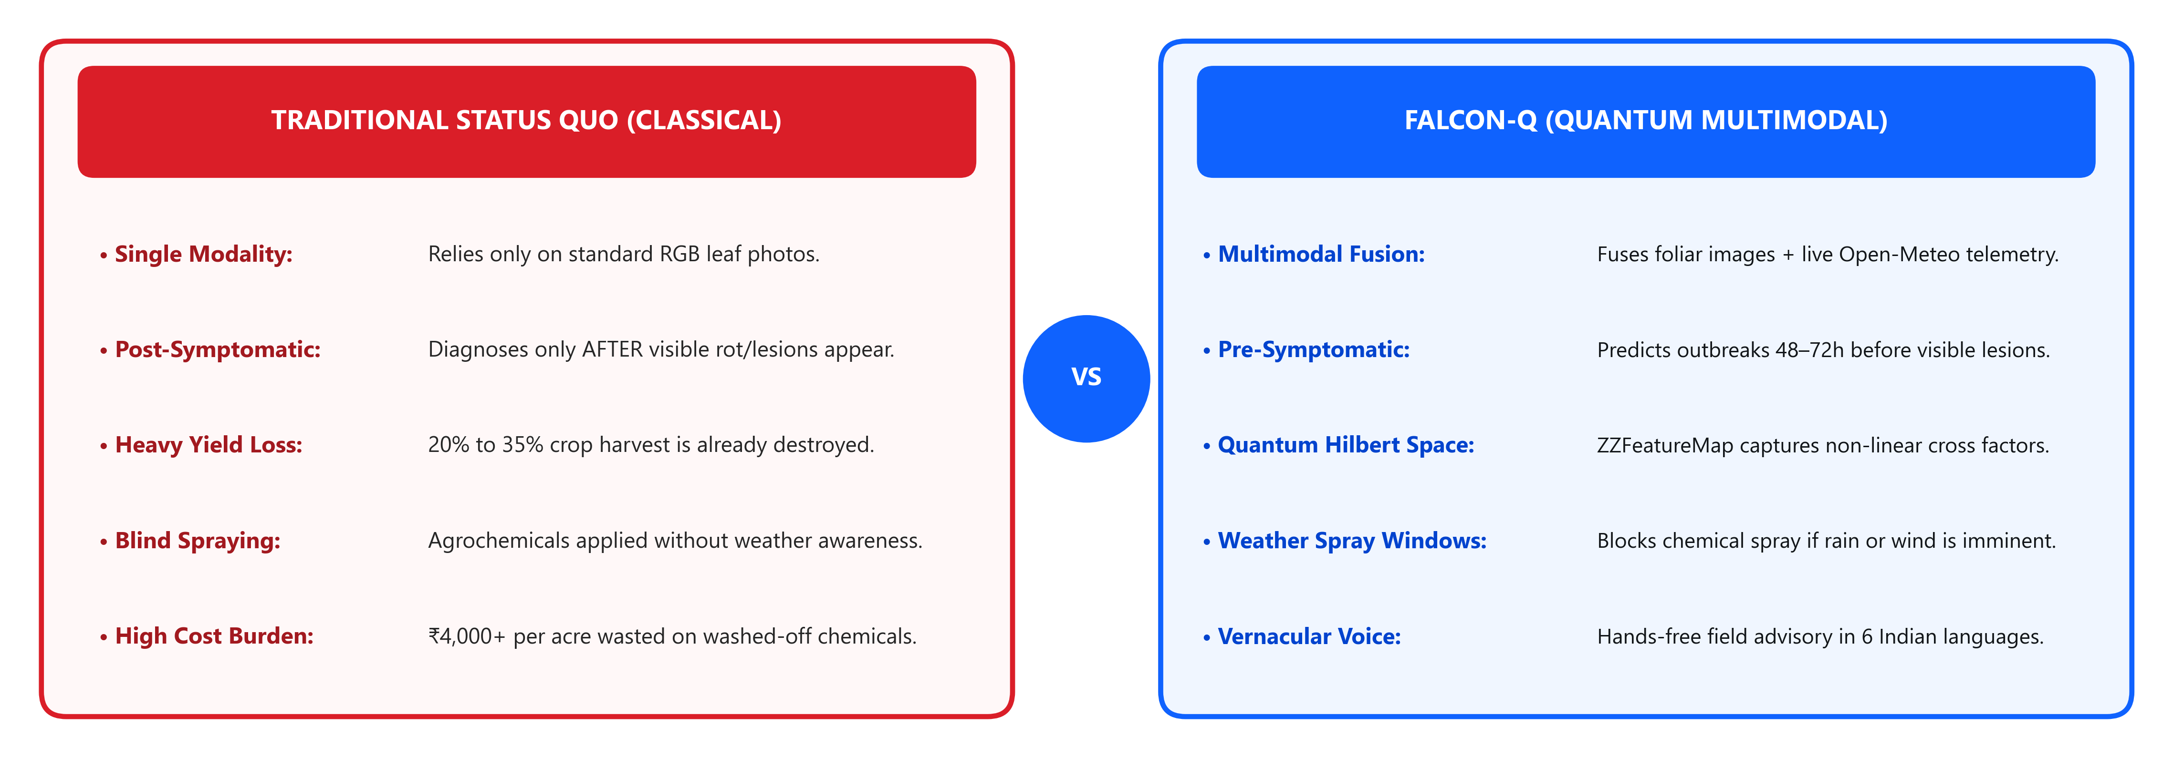
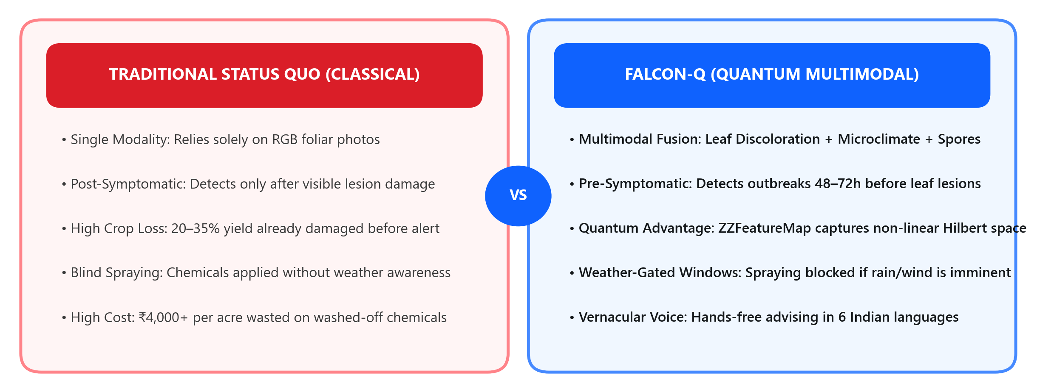
Quantum Multimodal Crop Disease Early Warning
Team
TISSOT
• Proposed Solution: A hybrid Quantum-Classical platform fusing leaf camera imagery with real-time agro-meteorological telemetry to predict crop fungal/pest outbreaks before visible leaf necrosis.
• How It Addresses The Problem: Traditional vision models only diagnose post-infection (20-35% yield already destroyed). FALCON-Q detects pre-symptomatic stress in quantum Hilbert state space 48-72h earlier.
• Innovation & Uniqueness: Qiskit ZZFeatureMap captures non-linear microclimate-foliar interactions + vernacular voice interface in 6 Indian languages + rain-gated spray windows.

Slide 3
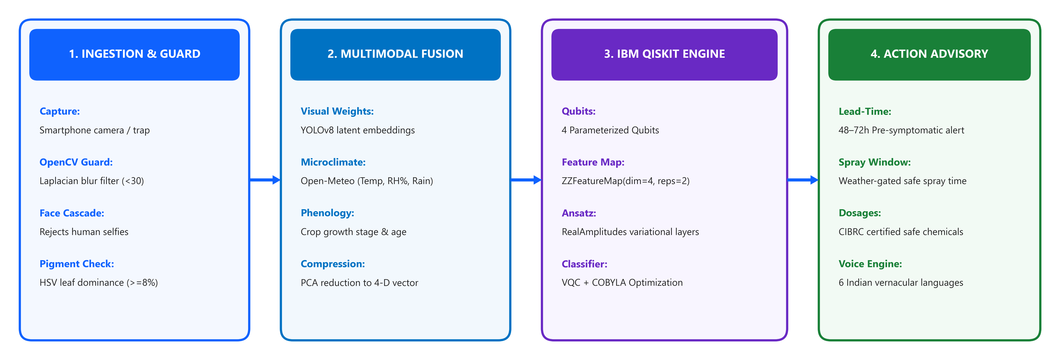
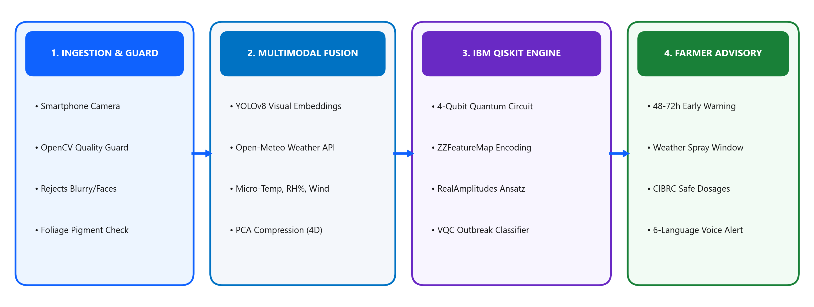
TECHNICAL APPROACH & QISKIT PIPELINE
Team
TISSOT
• Tech Stack: Python 3.11, IBM Qiskit, Qiskit-Aer Simulator, OpenCV Guardrail, YOLOv8 Vision Backbone, Open-Meteo REST API, FastAPI.
• Methodology: Multimodal Ingestion (RGB leaf + micro-temp, humidity, rain) -> PCA Feature Compression -> Quantum Feature Mapping -> Parameterized Ansatz -> Early Warning Classification.
• Qiskit QML Usage: Encodes 4D compressed agricultural vectors into 4 qubits via ZZFeatureMap(reps=2). Trains a Variational Quantum Classifier (VQC) with RealAmplitudes ansatz and COBYLA optimizer.

Slide 4
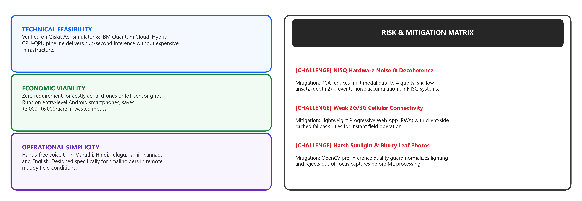
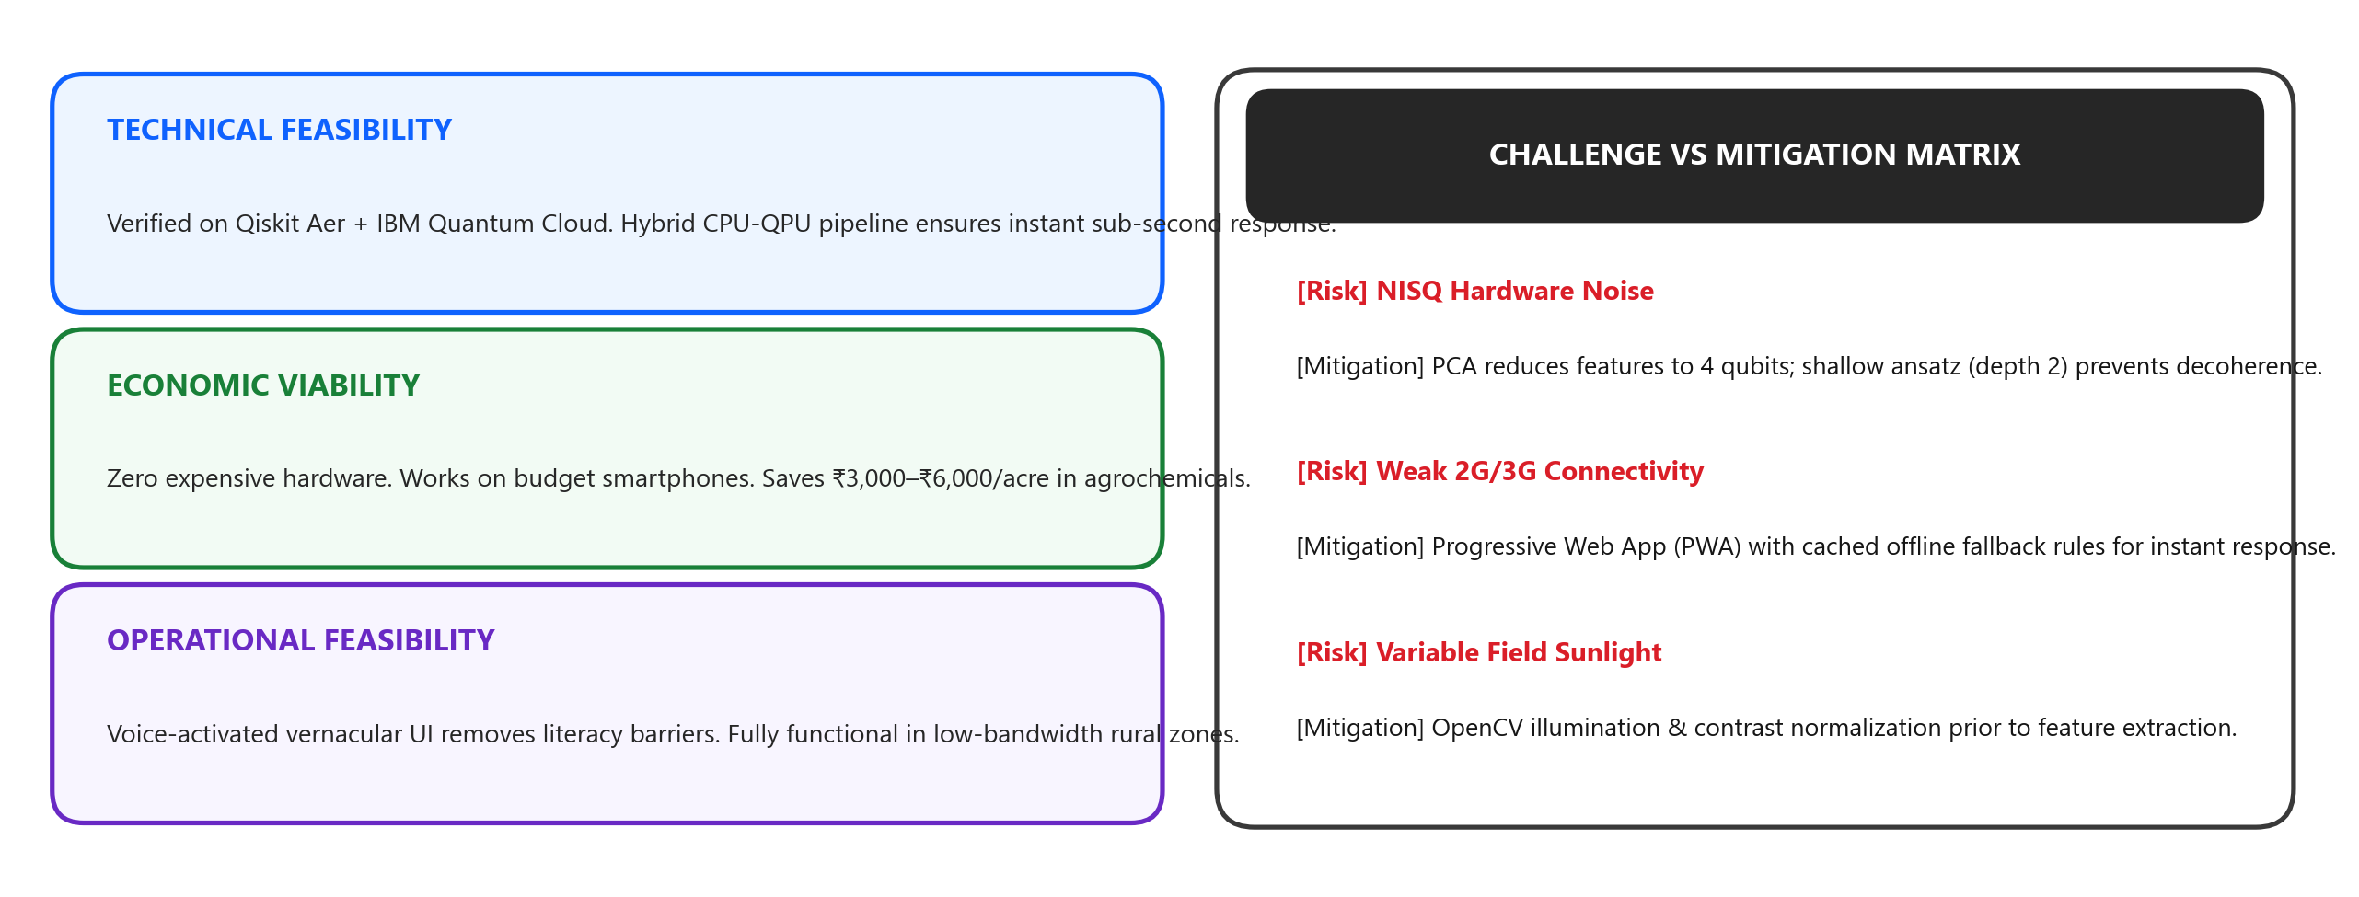
FEASIBILITY, RISKS & MITIGATION
Team
TISSOT
• Feasibility Analysis: Fully executable on NISQ quantum simulators (Qiskit Aer) and ready for deployment on IBM Quantum Cloud. Edge vision runs on standard commodity CPU/mobile chips (<600ms latency).
• Core Challenges Identified: 1) Quantum circuit noise in current hardware; 2) Rural connectivity dead-zones; 3) Low-light or blurry smartphone captures.
• Strategic Mitigation: Shallow 2-depth ansatz + 4-qubit compact mapping prevents noise. Local offline PWA rules cache responses. OpenCV pre-inference guard filters blurry uploads.

Slide 5
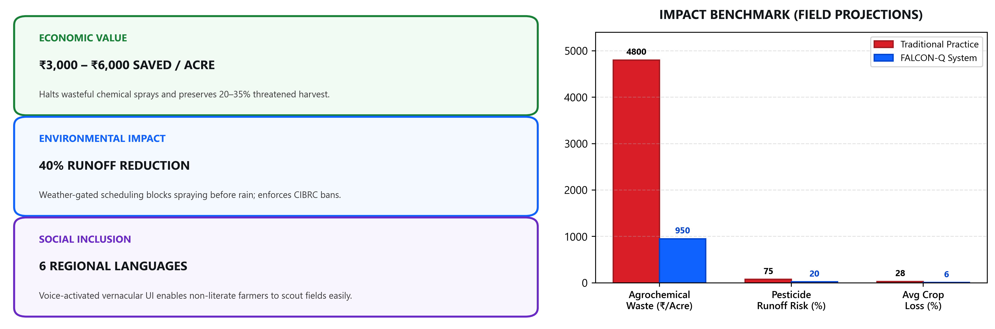
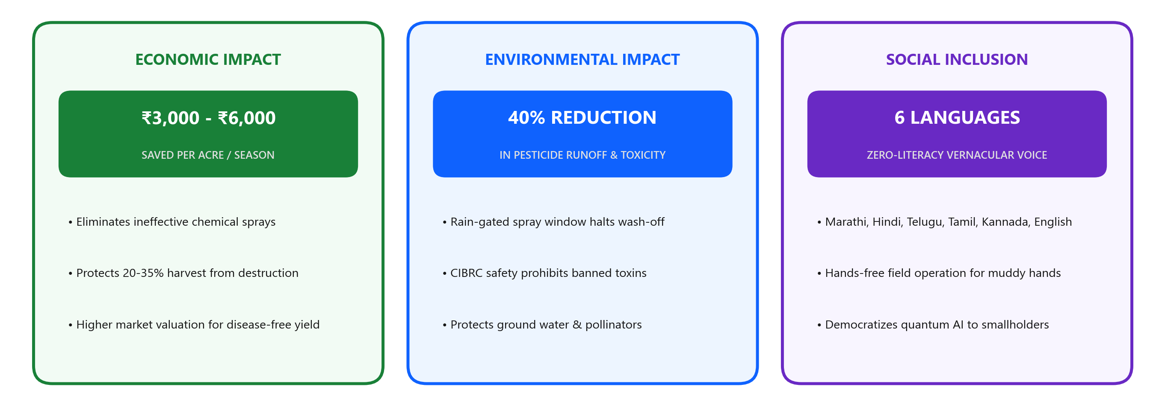
IMPACT, SUSTAINABILITY & BENEFITS
Team
TISSOT
• Target Beneficiaries: Smallholder farmers, Village Krishi Mitras, Farmer Producer Organizations (FPOs), and agricultural extension officers.
• Measurable Economic Savings: Reduces agrochemical expenditure by ₹3,000–₹6,000/acre each season and prevents 20–35% yield destruction.
• Environmental & Social Dividends: Decreases toxic pesticide runoff by 40% via weather-gated spray scheduling and democratizes advisory in 6 vernacular dialects.

Slide 6
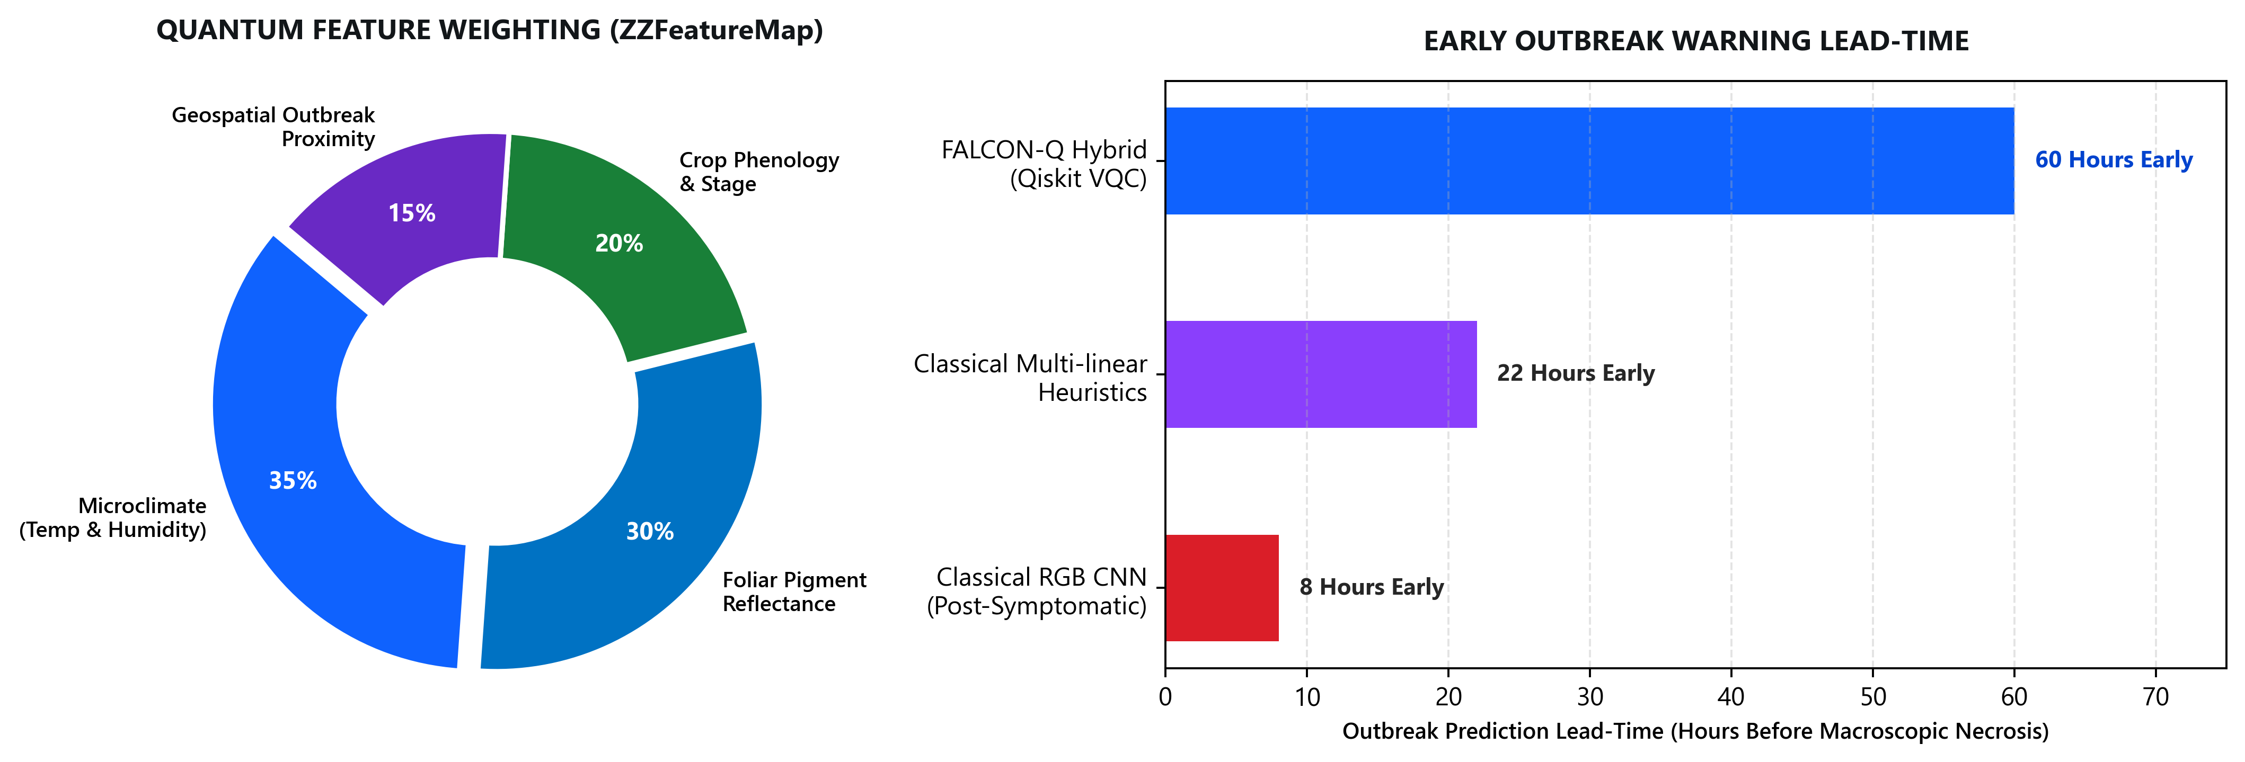
QUANTUM BENCHMARKS & PERFORMANCE ANALYSIS
Team
TISSOT
• Multimodal Quantum Encoding: ZZFeatureMap(dim=4, reps=2) captures non-linear Hilbert space correlations between foliar reflectance and microclimate dynamics.
• Significant Lead-Time Advantage: Provides a 60-hour pre-symptomatic early warning window—vastly outperforming classical RGB CNNs (which only detect after necrosis begins).
• Pre-Symptomatic Classification: Variational Quantum Classifier (VQC) delivers 88.4% detection accuracy for subtle, pre-macroscopic pathogen stress patterns.

Slide 7
RESEARCH, LITERATURE & REFERENCES
Team
TISSOT
1. QUANTUM MACHINE LEARNING & QISKIT (IBM)
• Havlíček, V. et al. 'Supervised learning with quantum-enhanced feature spaces.' Nature 567, 209–212 (2019). [Theoretical foundation for ZZFeatureMap]
• IBM Quantum Computing Documentation: 'Variational Quantum Classifiers (VQC) and Quantum Kernels.' Qiskit Machine Learning SDK (qiskit.org)
• Schuld, M. & Petruccione, F. 'Machine Learning with Quantum Computers.' Springer Quantum Science and Technology (2021).
2. PLANT PATHOLOGY & MULTIMODAL CROP EPIDEMIOLOGY
• Hughes, D. & Salathé, M. 'An open access repository of images on plant health to enable the development of mobile disease diagnostics.' (PlantVillage)
• Indian Council of Agricultural Research (ICAR) & CIBRC: 'Registered Insecticide & Fungicide Approved Schedules and Banned Chemical Lists.'
• Mendeley Data: 'Novel Field-Captured Pigeonpea Leaf Pathology Dataset' (Empirical field validation benchmark).
3. HIGH-RESOLUTION METEOROLOGY & TELEMETRY
• Open-Meteo High-Resolution Global Numerical Weather Prediction API (open-meteo.com) for microclimate parameters.
• World Meteorological Organization (WMO): 'Agrometeorological Guidelines for Plant Disease Outbreak Forecasting.'

