Slide 1
Online Disjoint Spanning Trees and Polymatroid Bases
Weihao Zhu
Univ. of Illinois, Urbana-Champaign
Joint work with Karthekeyan Chandrasekaran (UIUC) & Chandra Chekuri (UIUC)

Slide 2
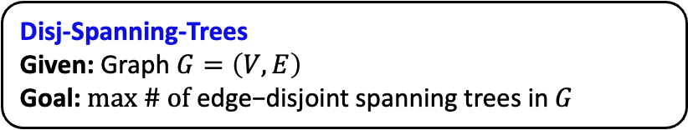
Disjoint Spanning Trees
Disj-Spanning-Trees
Given: Graph $G=\left(V, E\right)$
Goal: $max \# of \text{edge}\text{−}\text{disjoint} \text{spanning} \text{trees} \text{in} G$
$G$ may contain parallel edges

Slide 3

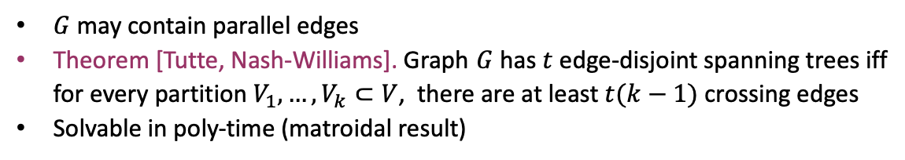







Disjoint Spanning Trees
Disj-Spanning-Trees
Given: Graph $G=\left(V, E\right)$
Goal: $max \# of \text{edge}\text{−}\text{disjoint} \text{spanning} \text{trees} \text{in} G$
$$C$$
$$B$$
$$A$$
$G$ may contain parallel edges
Theorem [Tutte, Nash-Williams]. Graph $G$ has $t$ edge-disjoint spanning trees iff for every partition $V_{1}, …, V_{k}⊂V$, there are at least $t(k−1)$ crossing edges
Solvable in poly-time (matroidal result)
$$D$$
$$E$$
$$OPT=2$$
Crossing edges: $AC$, $AD$, $AE$, $BE$

Slide 4
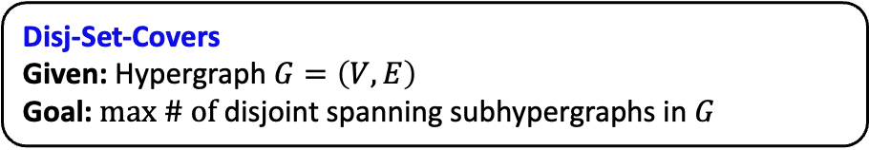
Disjoint Set Covers
Disj-Set-Covers
Given: Hypergraph $G=\left(V, E\right)$
Goal: $max \# of \text{disjoint} \text{spanning} \text{subhypergraphs} \text{in} G$
$V$ is the collection of elements
Each hyperedge $e∈E$ is a set

Slide 5


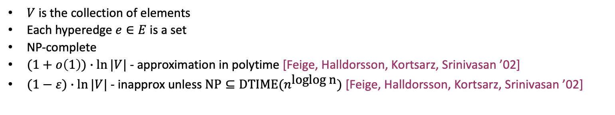
Disjoint Set Covers
Disj-Set-Covers
Given: Hypergraph $G=\left(V, E\right)$
Goal: $max \# of \text{disjoint} \text{spanning} \text{subhypergraphs} \text{in} G$
$V$ is the collection of elements
Each hyperedge $e∈E$ is a set
NP-complete
$(1+o\left(1\right))∙ln⁡|V|$ - approximation in polytime [Feige, Halldorsson, Kortsarz, Srinivasan ’02]
$(1−ε)∙ln⁡|V|$ - inapprox unless $\text{NP}⊆\text{DTIME}(n^{\text{loglog} \text{n}})$ [Feige, Halldorsson, Kortsarz, Srinivasan ’02]
$$OPT=2$$

Slide 6
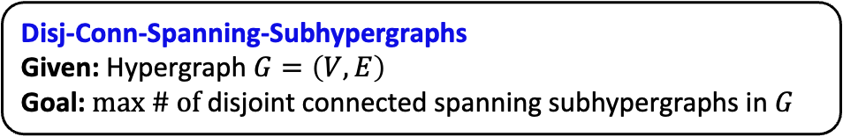
Disjoint Connected Spanning Subhypergraphs
Disj-Conn-Spanning-Subhypergraphs
Given: Hypergraph $G=\left(V, E\right)$
Goal: $max \# of \text{disjoint} \text{connected} \text{spanning} \text{subhypergraphs} \text{in} G$
Generalization of Disj-Spanning-Trees & Disj-Set-Covers

Slide 7
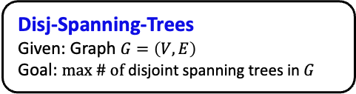

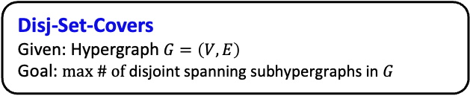
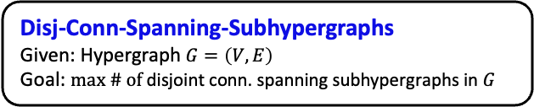
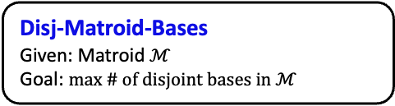
Disjoint Spanning Trees: Generalizations and Variants
Disj-Conn-Spanning-Subhypergraphs
Given: Hypergraph $G=\left(V, E\right)$
Goal: $max \# of \text{disjoint} \text{conn}\text{. }\text{spanning} \text{subhypergraphs} \text{in} G$
Disj-Matroid-Bases
Given: Matroid $ℳ$
Goal: $max \# of disjoint bases in ℳ$
Disj-Set-Covers
Given: Hypergraph $G=\left(V, E\right)$
Goal: $max \# of \text{disjoint} \text{spanning} \text{subhypergraphs} \text{in} G$
Disj-Spanning-Trees
Given: Graph $G=\left(V, E\right)$
Goal: $max \# of \text{disjoint} \text{spanning} \text{trees} \text{in} G$
Disj-Dominating-Sets
Solvable in poly-time [Tutte, Nash-Williams]
$O\left(\text{log}\left|V\right|\right)$ - approx

Slide 8
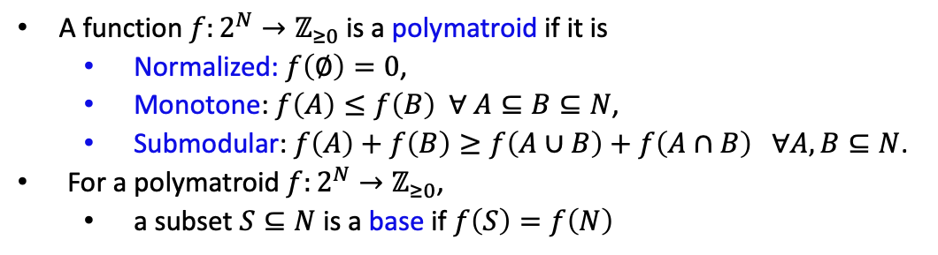
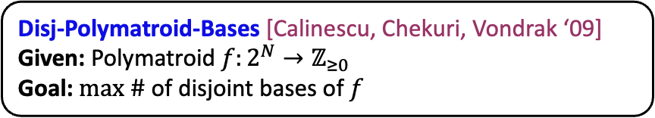

Unified View of Packing Problems
Disj-Polymatroid-Bases [Calinescu, Chekuri, Vondrak ‘09]
Given: Polymatroid $f:2^{N}→ℤ_{≥0}$
Goal: $max \# \text{of} \text{disjoint} \text{bases} \text{of} f$
Disj-Polymatroid-Bases
$$≜opt\left(f\right)$$
Disj-Matroid-Bases
Disj-Conn-Spanning-Subhypergraphs
A function $f:2^{N}→ℤ_{≥0}$ is a polymatroid if it is
Normalized: $f\left(∅\right)=0$,
Monotone:$f\left(A\right)≤f\left(B\right) ∀ A⊆B⊆N$,
Submodular: $f\left(A\right)+f\left(B\right)≥f\left(A∪B\right)+f\left(A∩B\right) ∀A, B⊆N$.
For a polymatroid $f:2^{N}→ℤ_{≥0}$,
a subset $S⊆N$ is a base if $f\left(S\right)=f\left(N\right)$
Disj-Spanning-Trees
Disj-Set-Cover
Disj-Dominating-Sets

Slide 9
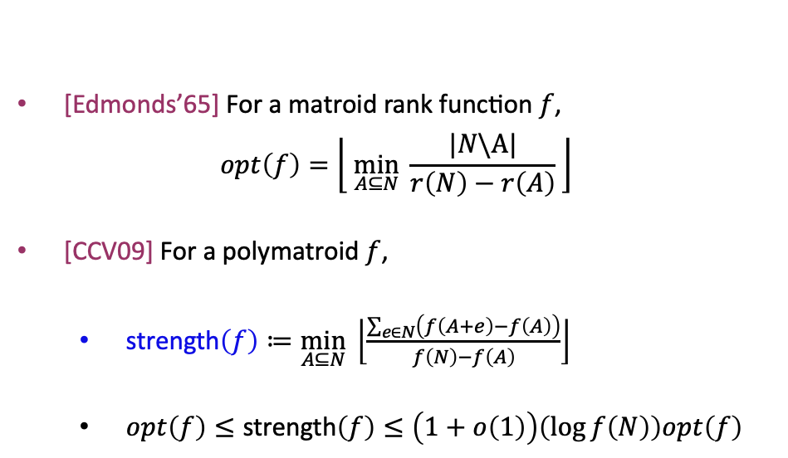
Unified View of Packing Problems
Disj-Polymatroid-Bases [Calinescu, Chekuri, Vondrak ‘09]
Given: Polymatroid $f:2^{N}→ℤ_{≥0}$
Goal: $max \# \text{of} \text{disjoint} \text{bases} \text{of} f$
$$≜opt\left(f\right)$$
[Edmonds’65] For a matroid rank function $f$,
$$opt\left(f\right)=\left\lfloor \left.\min_{A⊆N}{\frac{|N\backslash A|}{r\left(N\right)−r\left(A\right)}} \right\rfloor \right.$$
[CCV09] For a polymatroid $f$,
strength$\left(f\right)≔\min_{A⊆N}\left\lfloor \frac{\sum_{e∈N}{\left(f\left(A+e\right)−f\left(A\right)\right)}}{f\left(N\right)−f\left(A\right)}\right\rfloor$
$opt\left(f\right)≤\text{strength}\left(f\right)≤\left(1+o\left(1\right)\right)\left(\log{f\left(N\right)}\right)opt\left(f\right)$

Slide 10

Unified View of Packing Problems
Disj-Polymatroid-Bases [Calinescu, Chekuri, Vondrak ‘09]
Given: Polymatroid $f:2^{N}→ℤ_{≥0}$
Goal: $max \# \text{of} \text{disjoint} \text{bases} \text{of} f$
$$≜opt\left(f\right)$$
strength$\left(f\right)≔\min_{A⊆N}\left\lfloor \frac{\sum_{e∈N}{\left(f\left(A+e\right)−f\left(A\right)\right)}}{f\left(N\right)−f\left(A\right)}\right\rfloor$
[CCV09]’s $O\left(\log{f\left(N\right)}\right)$ - approximation algorithm:
Color each element with a random color $∈_{U}\left[1,Θ\left(\frac{\text{strength}\left(f\right)}{\log{f\left(N\right)}}\right)\right]$
Each color forms a base with constant probability

Slide 11
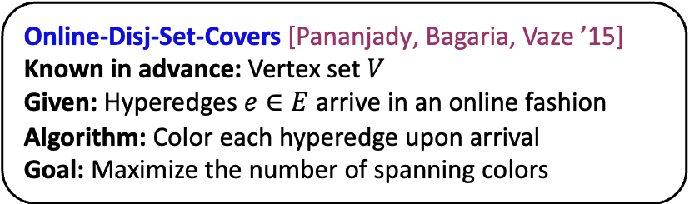
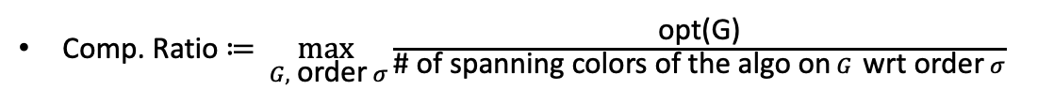


Online Disjoint Set Covers
Online-Disj-Set-Covers [Pananjady, Bagaria, Vaze ’15]
Known in advance: Vertex set $V$
Given: Hyperedges $e∈E$ arrive in an online fashion
Algorithm: Color each hyperedge upon arrival
Goal: Maximize the number of spanning colors
Defn. A color is a spanning color if the hyperedges with that color form a set cover.
$$ALG=1$$
Comp. Ratio $≔\max_{ G, \text{order} σ}{\frac{\text{opt}\text{(}\text{G}\text{)}}{\text{\# }\text{of} \text{spanning} \text{colors} \text{of} \text{the} \text{algo} \text{on} G \text{wrt} \text{order} σ}}$
$$OPT=2$$

Slide 12
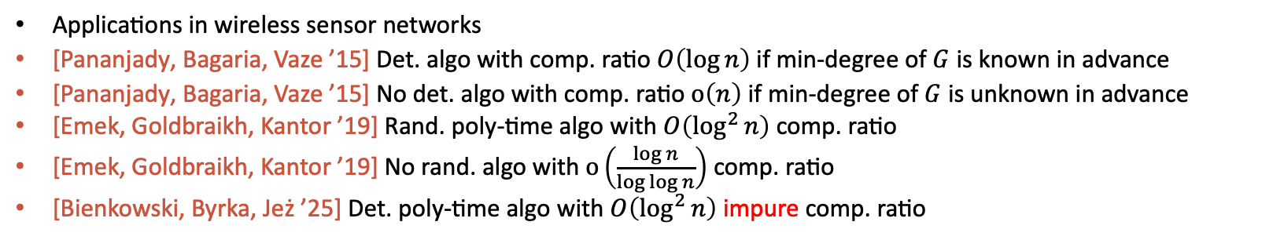
Online Disjoint Set Covers
Applications in wireless sensor networks
[Pananjady, Bagaria, Vaze ’15] Det. algo with comp. ratio $O\left(\log{n}\right)$if min-degree of $G$ is known in advance
[Pananjady, Bagaria, Vaze ’15] No det. algo with comp. ratio $o\left(n\right)$ if min-degree of $G$ is unknown in advance
[Emek, Goldbraikh, Kantor ’19] Rand. poly-time algo with $O\left(\log^{2}{n}\right)$ comp. ratio
[Emek, Goldbraikh, Kantor ’19] No rand. algo with $o\left(\frac{\log{n}}{\log{\log{n}}}\right)$ comp. ratio
[Bienkowski, Byrka, Jeż ’25] Det. poly-time algo with $O\left(\log^{2}{n}\right)$ impure comp. ratio
Qn. Is there an online model for Disj-Polymatroid-Bases?

Slide 13
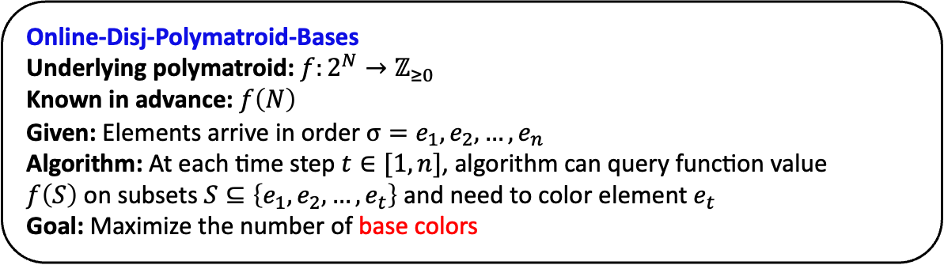
Unified View of Online Packing Problems
Online-Disj-Polymatroid-Bases
Underlying polymatroid: $f:2^{N}→ℤ_{≥0}$
Known in advance: $f\left(N\right)$
Given: Elements arrive in order $σ=e_{1},e_{2},…, e_{n}$
Algorithm: At each time step $t∈[1,n]$, algorithm can query function value $f\left(S\right)$on subsets $S⊆\left\{e_{1}, e_{2}, …, e_{t}\right\}$ and need to color element $e_{t}$
Goal: Maximize the number of base colors
Defn. A color is a base if the set $S$ of elements with that color is a base of $f$
Comp. Ratio $≔\max_{ f, \text{order} σ}{\frac{opt\left(f\right)}{\text{\# }\text{of} \text{base} \text{colors} \text{of} \text{the} \text{algo} \text{on} f \text{wrt} \text{order} σ}}$

Slide 14
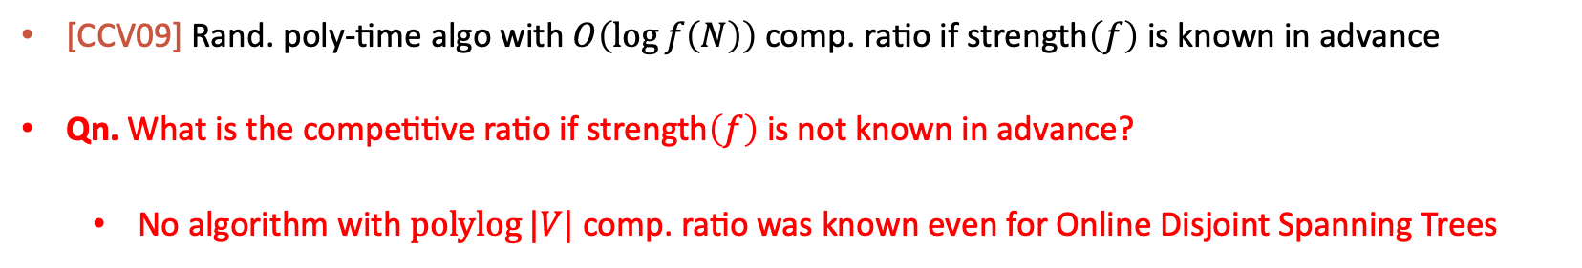
Online Disjoint Polymatroid Bases
[CCV09] Rand. poly-time algo with $O\left(\log{f\left(N\right)}\right)$ comp. ratio if $\text{strength}\left(f\right)$ is known in advance
Qn. What is the competitive ratio if $\text{strength}\left(f\right)$ is not known in advance?
No algorithm with $\operatorname{polylog}{|V|}$comp. ratio was known even for Online Disjoint Spanning Trees

Slide 15
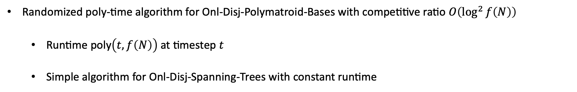
Our Results
Randomized poly-time algorithm for Onl-Disj-Polymatroid-Bases with competitive ratio $O\left(\log^{2}{f\left(N\right)}\right)$
Runtime poly$\left(t, f\left(N\right)\right)$ at timestep $t$
Simple algorithm for Onl-Disj-Spanning-Trees with constant runtime

Slide 16
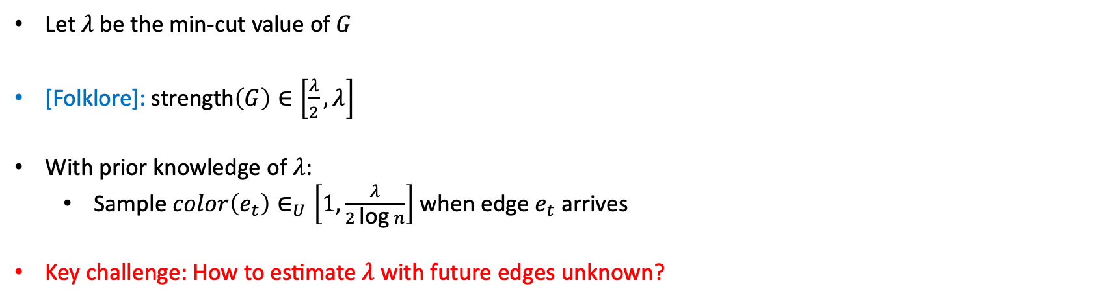
Online Disjoint Spanning Trees
Let $λ$be the min-cut value of $G$
[Folklore]: $\text{strength}\left(G\right)∈\left[\frac{λ}{2},λ\right]$
With prior knowledge of $λ$:
Sample $color\left(e_{t}\right)∈_{U}\left[1,\frac{λ}{2\text{log}{n}}\right]$ when edge $e_{t}$ arrives
Key challenge: How to estimate $λ$with future edges unknown?

Slide 17

Online Disjoint Spanning Trees
Algorithm: When edge $e_{t}=\left\{u, v\right\}$ arrives,
$η_{t}←\# \text{of} \text{edges} \text{between} u \text{and} v \text{that} \text{have} \text{arrived} \text{so} \text{far}$
Sample $R_{t}∈_{U}[\log{η_{t}},\log{η_{t}}+2\log{n}]$
Sample $\text{color}\left(e_{t}\right)∈_{U}\left[1, \frac{2^{R_{t}}}{8\log^{2}{n}}\right]$
For every timestep $t∈[1,m]$, $2^{R_{t}}$ is an estimation of $λ$

Slide 18
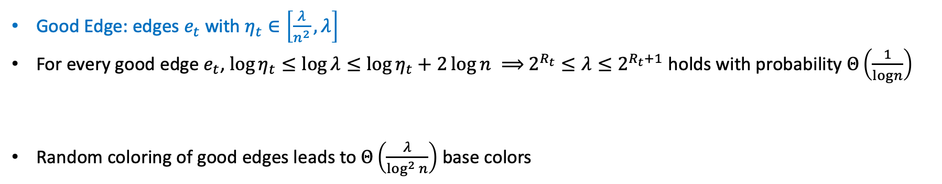
Online Disjoint Spanning Trees - Analysis
Algorithm: When edge $e_{t}=\left\{u, v\right\}$ arrives,
$η_{t}←\# \text{of} \text{edges} \text{between} u \text{and} v \text{that} \text{have} \text{arrived} \text{so} \text{far}$
Sample $R_{t}∈_{U}[\log{η_{t}},\log{η_{t}}+2\log{n}]$
Sample $\text{color}\left(e_{t}\right)∈_{U}\left[1, \frac{2^{R_{t}}}{8\log^{2}{n}}\right]$
Good Edge: edges $e_{t}$with $η_{t}∈\left[\frac{λ}{n^{2}},λ\right]$
For every good edge $e_{t}$, $\log{η_{t}}≤\log{λ}≤log{η_{t}}+2\log{n} ⟹$ $2^{R_{t}}≤λ≤2^{R_{t}+1}$ holds with probability $Θ\left(\frac{1}{logn}\right)$
Random coloring of good edges leads to $Θ\left(\frac{λ}{\log^{2}{n}}\right)$ base colors
Lemma. The subgraph $G′$ of good edges has min-cut value $λ(G^{′})>\frac{1}{2}λ$

Slide 19
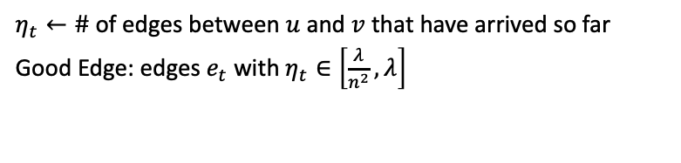


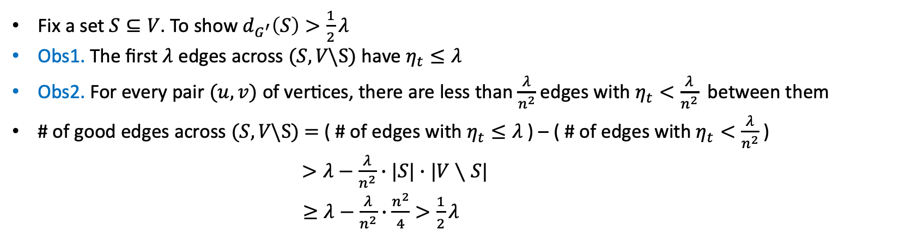
Online Disjoint Spanning Trees - Analysis
$$η_{t}←\# \text{of} \text{edges} \text{between} u \text{and} v \text{that} \text{have} \text{arrived} \text{so} \text{far}$$
Good Edge: edges $e_{t}$with $η_{t}∈\left[\frac{λ}{n^{2}},λ\right]$
Lemma. The subgraph $G′$ of good edges has min-cut value $λ(G^{′})>\frac{1}{2}λ$
Fix a set $S⊆V$. To show $d_{G^{′}}\left(S\right)>\frac{1}{2}λ$
Obs1. The first $λ$ edges across $(S, V\backslash S)$ have $η_{t}≤λ$
Obs2. For every pair $(u,v)$ of vertices, there are less than $\frac{λ}{n^{2}}$ edges with $η_{t}<\frac{λ}{n^{2}}$ between them
# of good edges across $(S, V\backslash S)$ $=$ ( # of edges with $η_{t}≤λ$ ) – ( # of edges with $η_{t}<\frac{λ}{n^{2}}$ )
$>λ−\frac{λ}{n^{2}}∙|S|∙|V∖S|$
$≥λ−\frac{λ}{n^{2}}∙\frac{n^{2}}{4}>\frac{1}{2}λ$
.
.
.
$$S$$
$$V\backslash S$$

Slide 20

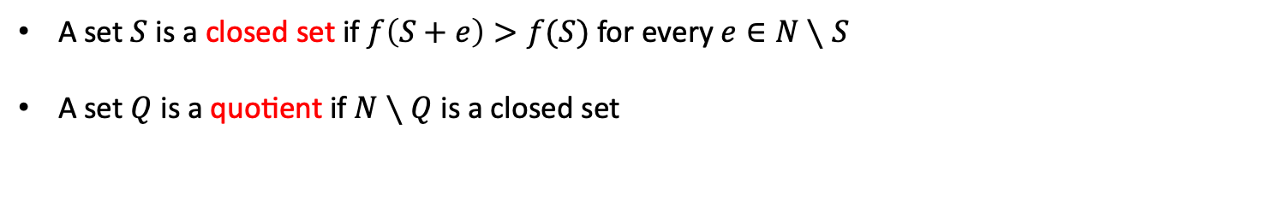



Quotients
A set $S$ is a closed set if $f\left(S+e\right)>f(S)$ for every$e∈N∖S$
A set $Q$ is a quotient if $N∖Q$ is a closed set
$$N$$
$$S$$
$$Q$$
$f\left(S+e\right)>f(S)$ $∀ e∈Q$

Slide 21
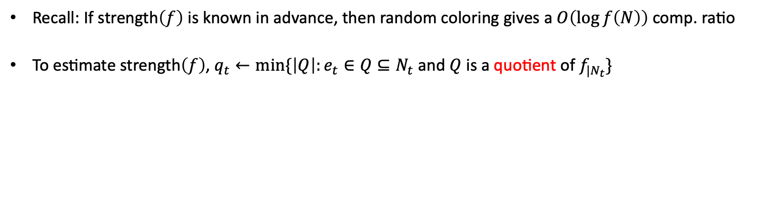
Online Disjoint Polymatroid Bases
Recall: If strength$\left(f\right)$ is known in advance, then random coloring gives a $O\left(\log{f\left(N\right)}\right)$ comp. ratio
To estimate strength$\left(f\right)$, $q_{t}←min⁡\{\left|Q\right|:e_{t}∈Q⊆N_{t}$ and $Q$ is a quotient of $f_{|N_{t}}\}$
Lemma. For every $j≥1$, $\left|\left\{t∈\left[1,n\right]:q_{t}=j\right\}\right|≤f\left(N\right)$

Slide 22

Open Problems
Can we narrow the gap between the upper bound and the lower bound of the competitive ratio?
Online Disjoint Spanning Trees
Do we need to know $f\left(N\right)$ in advance to get polylog competitive ratio?

Slide 23
Thank you

