Slide 1
Chapter 11: Nanometer Design Studies
11.1 Transistor Design Considerations
11.2 Deep-Submicron Effects
11.3 Transconductance Scaling
11.4 Transistor Design
11.5 Op Amp Design Examples
11.6 High-Speed Amplifier
11.7 Summary

Slide 2
Transistor Design Considerations
Large signal model is necessary in two cases:
  When transistor experiences large voltage (or current changes) due to input or output signals, disobeying the small-signal model
  When transistor must be biased, requiring certain terminal voltages so as to carry a specified current
Former case occurs occasionally while latter almost always occurs
Large-signal behavior of nanometer MOSFETs departs from “long-channel” model developed
Due to technology scaling, several effects manifest altering the I/V characteristics

Slide 3
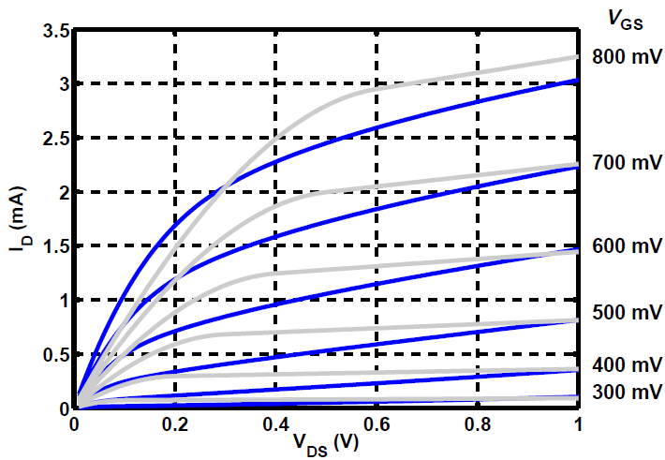
Transistor Design Considerations
Above figure plots the actual I_{D}-V_{DS} characteristics of an NFET with W/L = 5 μm/40 nm and V_{TH} ≈ 300 mV (using a BSIM4 model) as against a “best-fit” long-channel square-law approximation
The two models diverge considerably
  Cannot perform bias calculations using square-law model

Slide 4
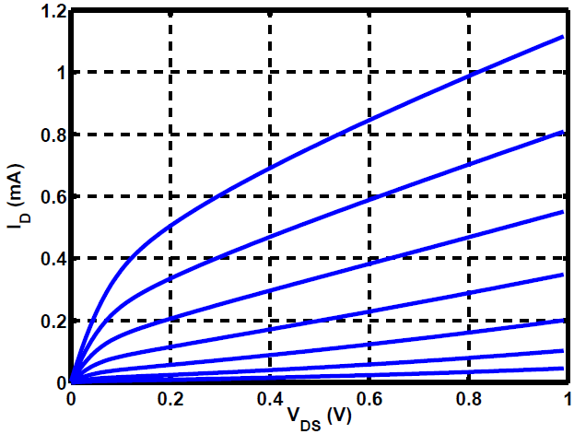
Transistor Design Considerations
MOS small-signal model still holds for short-channel devices
Expressions relating g_{m} and r_{O} to bias conditions need revision
Difficult to distinguish between triode and saturation regions
Can associate a “knee” point to each curve as a rough boundary
Above figure plots actual 40-nm device characteristics for V_{GS} – V_{TH} = 50 mV, 100 mV, …, 350 mV
Knee points are observed below V_{DS} = 0.2 V (W = 5μm and V_{TH} ≈ 200 mV)

Slide 5
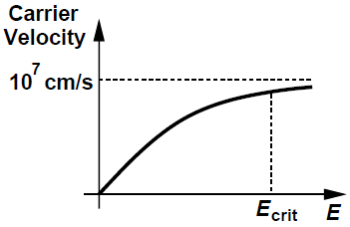
Deep-Submicron Effects
Velocity Saturation:
In a MOSFET, as V_{DS} and hence the electric field along the source-drain path increase, ‘v’ does not increase proportionally
Carriers experience “velocity saturation”, i.e., mobility falls
Effect arises because length of MOSFETs has shrunk from 1 μm to 40 nm while the allowable drain-source voltage has decreases from 5 V to about 1 V
Lateral electric field has exceeded E_{crit} in fig. below

Slide 6
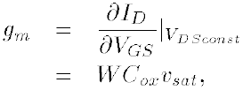
Deep-Submicron Effects
Velocity Saturation:
Suppose charge carriers reach saturated velocity, v_{sat} as soon as they depart from the source
Since I = Q_{d}∙v where Q_{d} is the charge density per unit length and given by WC_{ox}(V_{GS} - V_{TH}), we have
Extreme velocity saturation creates three departures from square-law behavior
  I_{D} is linearly proportional to overdrive and independent of channel length
  I_{D} reaches saturation even for V_{DS} < V_{GS} – V_{TH}
  g_{m} of a fully velocity-saturated MOSFET emerges to be relatively constant

Slide 7
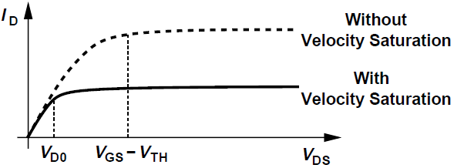
Deep-Submicron Effects
Velocity Saturation:
Above figure shows that I_{D} saturates even for V_{DS} < V_{GS} - V_{TH} due to velocity saturation
Knee points occur at relatively small V_{DS}’s even for moderate overdrives

Slide 8
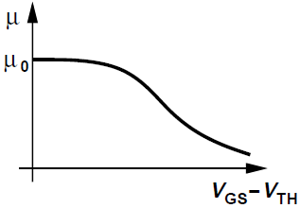
Deep-Submicron Effects
Mobility Degradation with Electric Field:
Mobility of charge carriers in the channel also declines as the gate-source voltage and the vertical field increase
We intuitively expect that g_{m} no longer follows the linear relationship g_{m} = μC_{ox}(W/L)(V_{GS} – V_{TH}), with the overdrive voltage

Slide 9
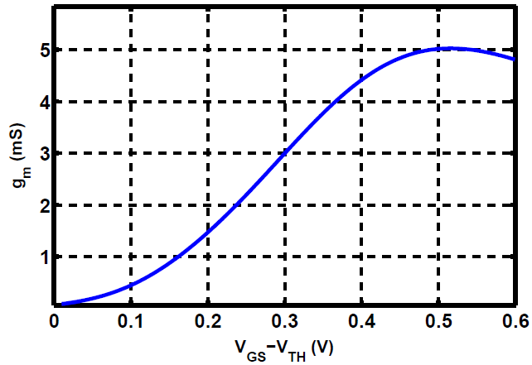
Deep-Submicron Effects
Mobility Degradation with Electric Field:
Above figure shows the nonlinear relationship between g_{m} and V_{GS} – V_{TH} for the 5 μm/40 nm NFET device

Slide 10
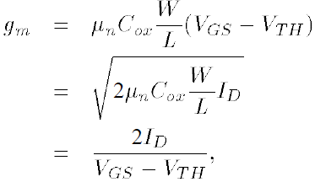

Transconductance Scaling
Suppose a transistor operates in the saturation region but does not provide the required transconductance, from g_{m} equations,
Adjustment in three parameters, namely, W/L, V_{GS} – V_{TH}, or I_{D} can scale g_{m}
Assume a long-channel device and hence

Slide 11
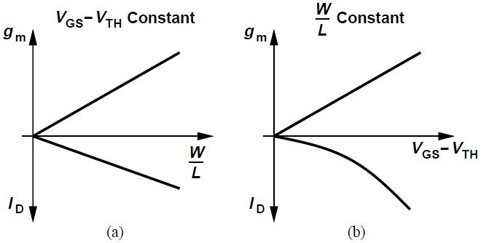
Transconductance Scaling
If W/L is increased while keeping V_{GS} – V_{TH} constant, both g_{m} and I_{D} linearly scale with W/L and so does the power consumption [Fig. (a)]
If V_{GS} – V_{TH} is increased but keep W/L constant, thus requiring a higher drain current [Fig. (b)]
In the former case, device capacitances rise whereas in the latter, V_{DS,min} increases

Slide 12
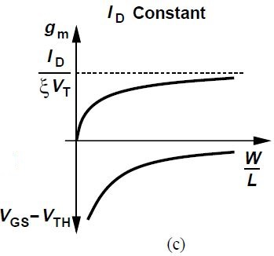
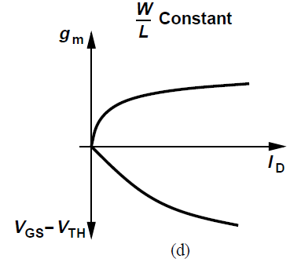
Transconductance Scaling
If W/L is increased with I_{D} constant, V_{GS} – V_{TH} is lowered [Fig. (c)]
g_{m} does not climb indefinitely however, due to subthreshold conduction
If W/L is held constant and I_{D} is increased, then V_{GS} – V_{TH} and hence V_{DS,min} rises

Slide 13
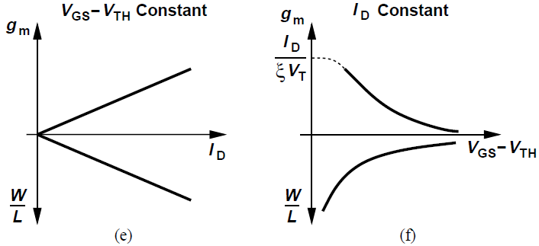
Transconductance Scaling
If I_{D} is increased while V_{GS} – V_{TH} is constant, W/L is needed to increase [Fig. (e)]
Alternatively, if V_{GS} – V_{TH} is lowered with I_{D} kept constant, W/L must increase [Fig. (f)]
For V_{GS} – V_{TH} ≈ 0, device enters subthreshold region and g_{m} ≈ I_{D}/(ξV_{T})
Device capacitances increase in both cases

Slide 14
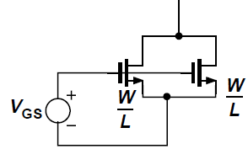
Transconductance Scaling - Example
Linear scaling of g_{m} and I_{D} with W/L holds regardless of transistor characteristics
Consider two identical transistors are connected in parallel, each with transconductance g_{m}
If V_{GS} changes by ΔV, then drain current of each device changes by g_{m}ΔV, hence current of composite device changes by 2g_{m}ΔV; parallel combination exhibits a transconductance 2g_{m}
Scaling preserves device “current density” (I_{D}/W)
Bias overdrive voltage and g_{m}/I_{D} ratio remains constant

Slide 15
Transistor Design
A given transistor in a circuit is characterized by many parameters
Assume transistor operates in saturation
Interested in:
  Bias quantities: I_{D} and V_{GS} – V_{TH} (=V_{DS,min})
  Small-signal parameter: g_{m}
  Physical parameter: W/L
Typical transistor design problem:
  Given two of g_{m}, I_{D} and V_{GS} – V_{TH}, determine the other two parameters

Slide 16
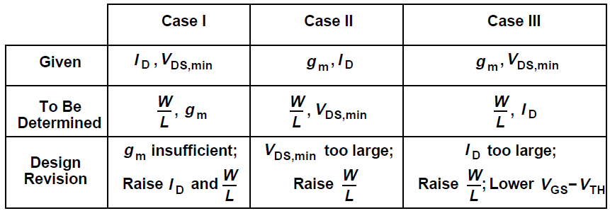
Transistor Design
Design problems shown above are “overconstrained”
Two given parameters lead to certain values for the other two, even though results may not always be desirable
Design revisions are necessary in such a case

Slide 17
Design for given I_{D} and V_{DS,min}
Suppose for a given transistor, we have chosen:
  A bias current (according to a power budget)
  Minimum V_{DS} (according to voltage headroom restrictions imposed by supply voltage and output swing requirements)
We wish to determine the dimensions and transconductance of the device, recognizing that square-law models are inaccurate
Three-step approach
Consider I_{D} = 0.5 mA and V_{DS,min} = 200 mV as an example

Slide 18
Design for given I_{D} and V_{DS,min}
Step 1: Select a reference transistor, with a width W_{REF} and length equal to minimum allowable value, L_{min} (e.g., L_{min} = 40 nm). Choose W_{REF} = 5 μm as an example
Step 2: Using actual device models and a circuit simulator, plot I_{D}-V_{DS} characteristics of the reference transistor for different values of V_{GS} – V_{TH}
  Typically V_{GS} – V_{TH} ranges from 50 mV to 600 mV
  Can construct the characteristics with the overdrive incrementing in steps of 50 mV

Slide 19
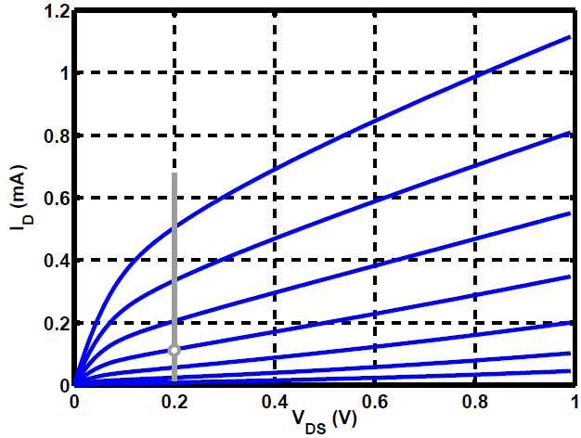
Design for given I_{D} and V_{DS,min}
Above figure shows results for W_{REF}/L_{min} = 5 μm/40 nm and overdrive ranging from 50 mV to 350 mV
Step 3: Since in our example, I_{D} = 0.5 mA and V_{DS,min} = 200 mV, we draw a vertical line at V_{DS} = 200 mV and find its intersection with the plots
If device obeyed square law, we would choose the plot for V_{GS} – V_{TH} = V_{DS,min} = 200 mV

Slide 20
Design for given I_{D} and V_{DS,min}
Step 3 (contd.): Short-channel device remains in saturation even for V_{GS} – V_{TH} = 350 mV and V_{DS} = 200 mV
  Situation is more complex, proceed with V_{GS} – V_{TH} = 200 mV for now
This procedure yields one operating point for the reference transistor satisfying V_{DS} requirement

Slide 21
Design for given I_{D} and V_{DS,min}
Step 4: The drain current, I_{D,REF} is not close to the necessary value, 0.5 mA, in our example
We must scale the width and hence the drain current of the transistor
Since I_{D,REF} ≈ 100 μA above, we choose a transistor width of (500 μA/ 100 μA) x W_{REF} = 5W_{REF} = 25 μm

Slide 22
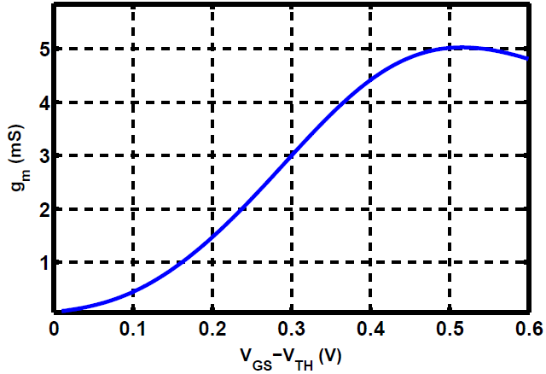
Design for given I_{D} and V_{DS,min}
Step 4 (contd.): From I_{D}-V_{DS} plots, g_{m} of the reference transistor can be approximated from g_{m} = ΔI_{D}/ ΔV_{GS} ≈ 2 mS
To get a more accurate value of g_{m}, we plot g_{m} versus V_{GS} – V_{TH} for V_{DS} = 200 mV using simulations as shown above
This predicts g_{m} = 1.5 mS for V_{GS} – V_{TH} = 200 mV

Slide 23
Design for given I_{D} and V_{DS,min}
Step 4 (contd.): If both width and drain current are scaled up by a factor of 5, g_{m} increases to 7.5 mS
If this is insufficient, W/L must be increased further
We can perform scaling to determine width and transconductance of other transistors in the circuit, using I_{D} and g_{m} plots for the reference device

Slide 24
Design for given I_{D} and V_{DS,min}
Step 4 (contd.): We typically choose V_{GS} – V_{TH} ≈ V_{DS,min} to obtain a higher g_{m} even though it translates to a wider transistor

Slide 25
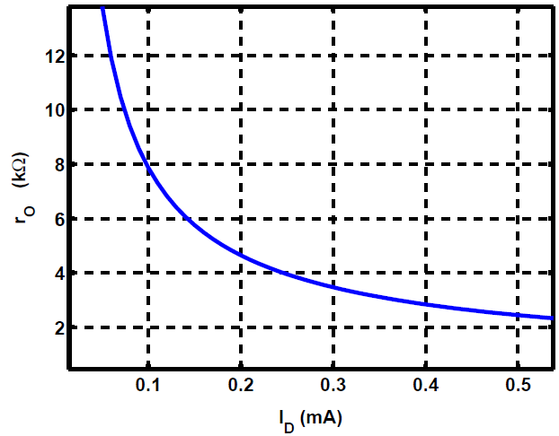
Design for given I_{D} and V_{DS,min}
Output impedance r_{O} of short-channel devices cannot be expressed as 1/(λI_{D})
We use simulations to plot r_{O} for the reference device as a function of I_{D} as shown above
Reference transistor carries a current of 100 μA, exhibiting r_{O} = 8 kΩ
When width and drain current are scaled up by factor of 10, r_{O} falls by the same factor to 800 Ω

Slide 26
Design for given g_{m} and I_{D}
In many analog circuits, a given transistor must provide sufficient transconductance while consuming minimal power
Suppose we are given a specified transconductance g_{m1} and an upper limit for the drain bias current I_{D1}, seeking the corresponding values of W/L and V_{GS} – V_{TH}
Assume g_{m1} = 10 mS and I_{D1} = 1 mA
To determine whether g_{m1} can be obtained with I_{D} ≤ I_{D1}, we note that maximum gm occurs in the subthreshold region and is given by I_{D}/(ξV_{T}) where ξ = 1.5
For I_{D} = 1 mA, g_{m} cannot exceed 26 mS at room temperature
Since g_{m1} < I_{D1}/(ξV_{T}), this design is feasible

Slide 27
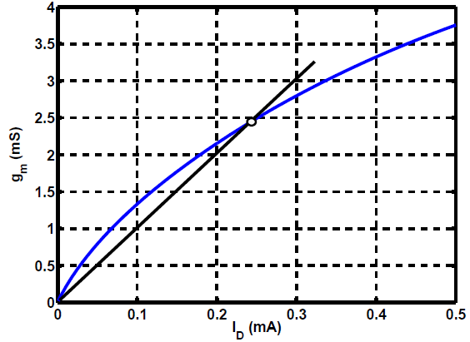
Design for given g_{m} and I_{D}
Step 1: Using simulations, we plot g_{m} as a function of I_{D} for a reference transistor, e.g., W_{REF}/L_{min} = 5 μm/40 nm
Step 2: We identify the point (I_{D1},g_{m1}) on the g_{m}-I_{D} plane and draw a line through the origin and this point, obtaining the intersection at (I_{D,REF},g_{m,REF}) = (240 μA, 2.4 mS) and a corresponding overdrive

Slide 28
Design for given g_{m} and I_{D}
Step 3: We multiply W_{REF} by g_{m1}/g_{m,REF} = 4.2 so as to travel on the straight line to point (I_{D1}, g_{m1}) while maintaining the same overdrive
This completes the transistor design

Slide 29

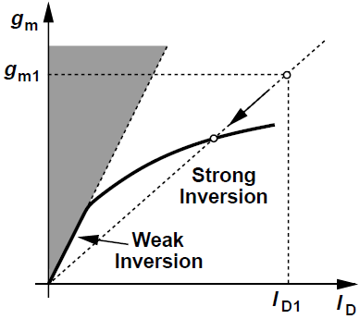
Design for given g_{m} and I_{D}
Above procedure elicits two questions
Question 1: Does the straight line passing through the origin and (I_{D1},g_{m1}) always intersect the g_{m}-I_{D} plot?
For a square-law device in strong inversion, ssssss has a slope of infinity at the origin, guaranteeing an intersection point
In the subthreshold region, on the other hand, sssss which means the (I_{D},g_{m}) combinations in the gray region are not achievable

Slide 30
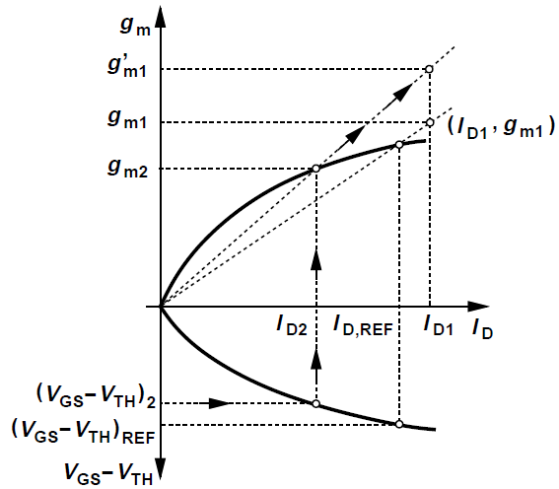
Design for given g_{m} and I_{D}
Question 2: If (V_{GS} – V_{TH})_{REF} is excessively large, then by factor must W be increased?
In above figure, suppose an overdrive of (V_{GS} – V_{TH})₂ < (V_{GS} – V_{TH})_{REF} is desired
We then find the corresponding current I_{D2} and transconductance g_{m2} on the g_{m}-I_{D} plane

Slide 31
Design for given g_{m} and I_{D}
Next, we draw a line through the origin and the point (I_{D2},g_{m2}) continue to I_{D} = I_{D1}, i.e., we multiply W_{REF} by I_{D1}/I_{D2}
The resulting width guarantees an overdrive of (V_{GS} – V_{TH})₂ at a drain current of I_{D1} and provides a transconductance of at least g_{m1}

Slide 32
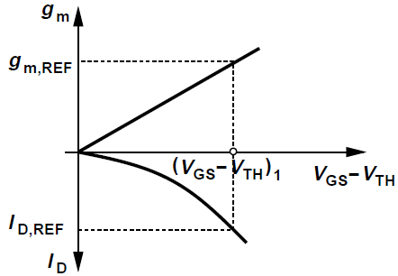
Design for given g_{m} and V_{DS,min}
In some designs, the transconductance is dictated by some performance requirements (voltage gain, noise, etc.) and the minimum V_{DS} by the voltage headroom, without an explicit specification of I_{D}
Step 1: We use simulations to plot g_{m} as a function of V_{GS} – V_{TH} for the reference transistor
Now we select (V_{GS} – V_{TH})₁ = V_{DS,min} and obtain the corresponding transconductance g_{m,REF}
It is helpful to plot I_{D} on the same plane and find I_{D,REF} at (V_{GS} – V_{TH})₁

Slide 33
Design for given g_{m} and V_{DS,min}
Step 2: To reach the required transconductance g_{m1}, we scale the transistor width by a factor of g_{m1}/g_{m,REF}
  I_{D} scales by the same factor
If the resulting I_{D} is too large, we redesign for a given g_{m} and I_{D}
Device is now smaller and has a smaller transconductance

Slide 34
Design for given g_{m}
Suppose a design problem only specifies the transconductance, and we wish to compute the remaining parameters
Two scenarios may be envisaged
We select a certain W/L and raise I_{D} until the desired transconductance, g_{m1} is reached
  Required I_{D} and hence power consumption may be excessive
  Overdrive voltage may be excessively large
We select a reasonable value for I_{D} (perhaps according to a power budget) and increase W/L to obtain g_{m1}
  Increasing W/L (hence decreasing V_{GS}) eventually drives device into subthreshold region, where g_{m} cannot exceed I_{D}/(ξV_{T})

Slide 35
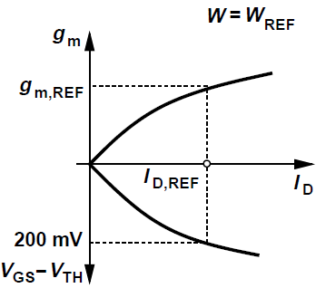
Design for given g_{m}
First, we construct plots representing g_{m} and V_{GS} – V_{TH} as a function of I_{D} for the reference device, using simulations
  Here V_{DS} is kept constant and approximately equal to V_{DD}/2
We select a reasonable value for V_{GS} – V_{TH}, e.g., 200 mV, which points to I_{D,REF} and g_{m,REF}
Next, we scale the width and drain current by a factor of g_{m1}/g_{m,REF}

Slide 36
Choice of Channel Length
If the selection of I_{D}, V_{GS} – V_{TH} and g_{m} does not yield a sufficiently high r_{O}, we must increase the transistor length
To maintain the same drain current, overdrive and g_{m}, the width must also be scaled proportionally
Such scaling is not straightforward
  If drawn length increases from L_{min} to 2L_{min}, effective length increases from L_{min} – 2L_{D} to 2L_{min} – 2L_{D}
We must use simulations to construct the I_{D}-V_{DS}, g_{m} and r_{O} characteristics for several channel lengths, e.g., 60 nm, 80 nm, 100 nm (drawn values)

Slide 37
Op Amp Design Examples
Consider an op-amp design example in 40-nm technology
We target the following specifications
  Differential output voltage swing = 1 V_{pp}
  Power consumption = 2mW
  Voltage Gain = 500
  Supply Voltage = 1 V
Single-ended output swing of 0.5 V_{pp} is small enough to make telescopic or folded-cascode op-amps a plausible choice
Begin with minimum allowable width and length devices unless otherwise dictated by current, transconductance, V_{D,sat}, output resistance, etc

Slide 38
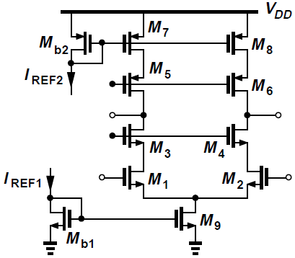
Design 1: Telescopic Op-Amp
Consider the telescopic op-amp topology shown above to meet previously mentioned requirements
Of the total supply current of 2 mA, we allocate 50 μA each to I_{REF1} and I_{REF2}, and 0.95 mA for each branch of the differential pair
To accommodate a single-ended peak-peak swing of 0.5 V, we must distribute the remaining 0.5 V over M₉, M_{1,2}, M_{3,4}, M_{5,6} and M_{7,8}, allowing 100 mV for each

Slide 39
Design 1: Telescopic Op-Amp
With the bias currents and overdrives known, we can determine W/L’s by examining I/V characteristics
For L = 40 nm, the intrinsic gain g_{m}r_{O} of NMOS devices is around 7-10 and for PMOS devices is 5-7
It is difficult to raise g_{m}r_{O} beyond 10 for PFETs
If we approximate gm as 2I_{D}/(V_{GS} – V_{TH}) = 2 x 0.95 mA/100 mV = 19 mS, we estimate r_{O} ≈ 530 Ω from g_{m}r_{O} ≈ 10

Slide 40
Design 1: Telescopic Op-Amp
If g_{m1,2} ≈ 19 mS, then for the gain G_{m}R_{out} to reach 500, the op-amp output impedance must exceed 26 kΩ
However, with g_{m3,4}r_{O3,4} ≈ 10 and r_{O7,8} ≈ 530 Ω, we have (g_{m3,4}r_{O3,4})r_{O1,2} ≈ 5.3 kΩ, obtaining a voltage gain of only 100 even if the PMOS devices have λ = 0
Telescopic arrangement is impractical for a gain of 500

Slide 41
Design 1: Telescopic Op-Amp
We still continue with the design out of curiosity
Using simulations, we construct the I/V characteristics of NMOS and PMOS devices with L = 40 nm and 80 nm, since minimum length may exhibit unacceptably low r_{O} and g_{m}r_{O}
Simulation parameters must ensure that devices remain in saturation for |V_{DS}| ≥ 100 mV
Since threshold and overdrive elude clear definitions in nanometer technologies, we must adjust V_{GS} in simulations to ensure saturation

Slide 42
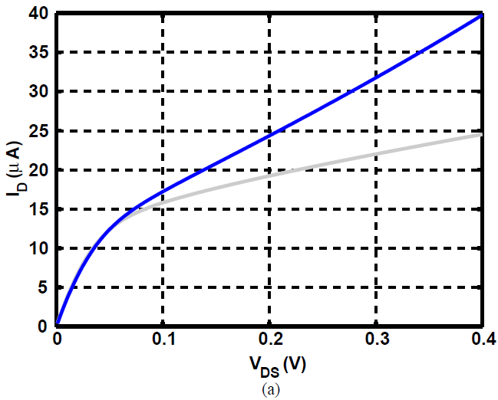
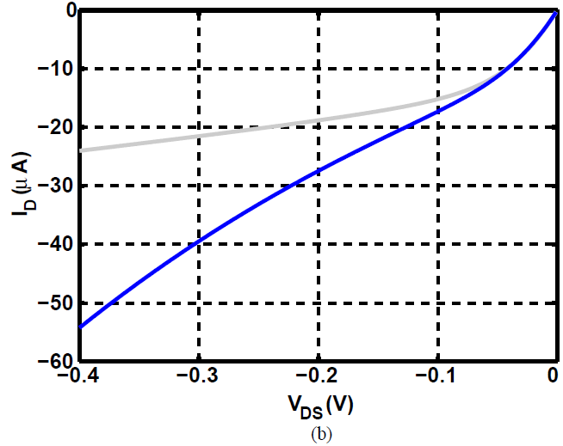
Design 1: Telescopic Op-Amp
Fig. (a) plots I_{D}-V_{DS} curves for (W/L)_{N} = 5 μm/40 nm (blue) and 10 μm/80 nm (gray) with V_{GS} = 300 mV
Fig. (b) plots I_{D}-V_{DS} curves for (W/L)_{P} = 5 μm/40 nm (blue) and 5 μm/80 nm (gray) with V_{GS} = -400 mV
Difficult to distinguish between triode and saturation regions, especially for PFETs

Slide 43
Design 1: Telescopic Op-Amp
40-nm PMOS device displays a decreasing output impedance as |V_{DS}| reaches 400 mV
For other three characteristics, we can roughly identify a “knee” point beyond which slope falls considerably
  V_{GS} chosen to place this point below |V_{DS}| = 100 mV

Slide 44
Design 1: Telescopic Op-Amp
At V_{DS} = 100 mV, the 10 μm/80 nm NMOS provides r_{O} of 22.8 kΩ and I_{D} of 16 μA
If scaled up to carry 950 μA, r_{O} drops to 385 Ω
Similarly, the 5 μm/80 nm PMOS has an r_{O} of 18.45 k Ω at V_{DS} = -100 mV with I_{D} = 15 μA, thus offering r_{O} = 290 Ω if scaled up to carry 950 μA
These low values of r_{O} are discouraging

Slide 45
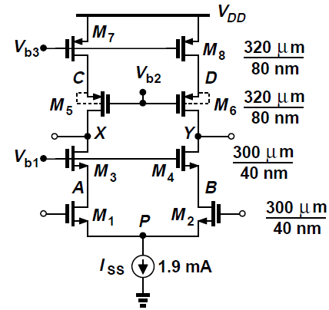
Design 1: Telescopic Op-Amp
We scale the NMOS and PMOS device widths to accommodate a drain current of 950 μA with V_{GS,N} = 300 mV, V_{GS,P} = -400 mV and |V_{DS}| = 100 mV, resulting in the design shown below
Minimum-length devices are used in the signal path to maximize speed and minimize capacitances

Slide 46
Design 1: Telescopic Op-Amp
Bias voltages are tentatively chosen as follows:
Input common-mode level V_{CM,in} = 100 mV for the tail current source plus V_{GS1,2} (= 300 mV)
V_{b1} = V_{D1,2} (= 200 mV) + V_{GS3,4} (= 300 mV)
V_{b2} = V_{DD} – |V_{DS7,8}| – |V_{GS5,6}|
V_{b3} = V_{DD} – |V_{GS7,8}|

Slide 47
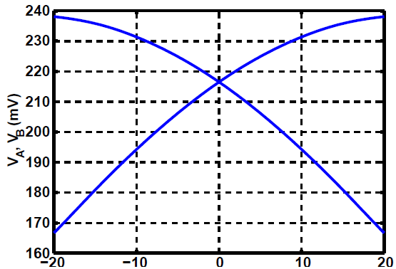
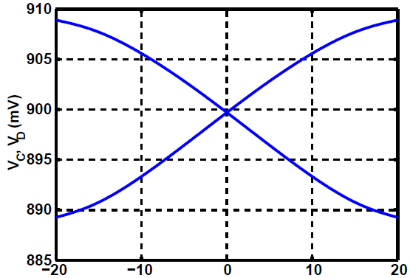
Design 1: Telescopic Op-Amp
We perform a dc sweep of differential input voltage V_{in}
Drain voltages of M₁ and M₂ (V_{A}, V_{B})are around 220 mV in the middle of the range
Drain voltages of M₇ and M₈ (V_{C}, V_{D})are close to targeted value

Slide 48
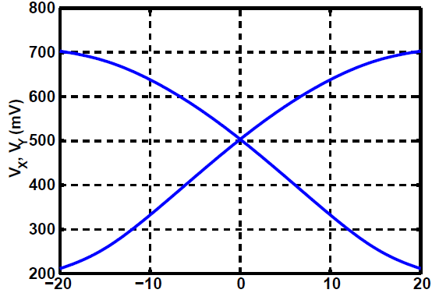
Design 1: Telescopic Op-Amp
Output behavior shown above (V_{X}, V_{Y})
Slope of each single-ended output is approximately 15 near V_{in} = 0, yielding a differential gain of 30
Characteristic becomes nonlinear as each output rises towards 0.7 V

Slide 49
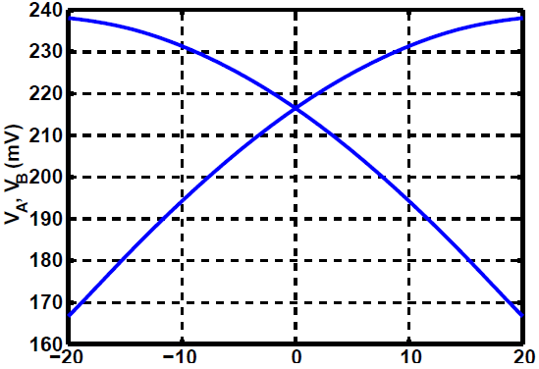
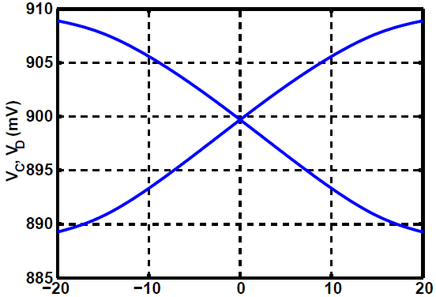
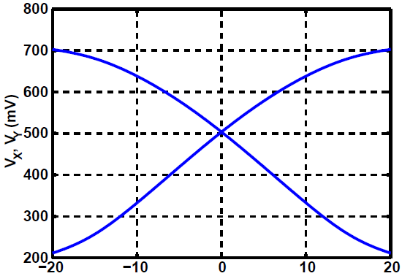
Design 1: Telescopic Op-Amp
Gain can be raised by increasing (W/L)_{3,4} to 600 μm/80 nm, characteristics plotted below
Characteristics exhibit a gain of about 54 but a limited output swing

Slide 50
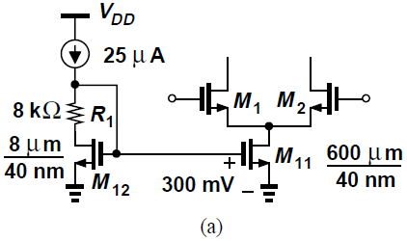
Design 1: Telescopic Op-Amp- Bias Circuit
Op-amp circuit relies on proper choice of bias quantities I_{SS}, V_{b1}, V_{b2} and V_{b3}
I_{SS} and V_{b3} must be established by current mirror action and V_{b2} by low-voltage cascode
V_{b1} requires a different approach
We begin with I_{SS} = 1.9 mA, choosing a channel length of 40 nm and scaling from reference device curves, a width of 600 μm for V_{DS} = 100 mV
With reference current budget of 25 μA, we arrive at the arrangement of Fig. (a), with W₁₂ scaled down from W₁₁ by a factor of 1.9 mA/25 μA

Slide 51
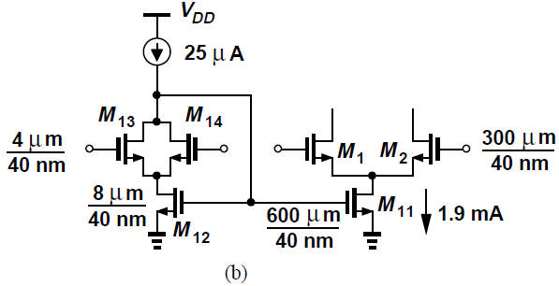
Design 1: Telescopic Op-Amp- Bias Circuit
Since M₁₁ operates with a V_{DS} of 100 mV, R₁ is inserted in series with drain of M₁₂ such that V_{DS12} = V_{GS12} – V_{R1} = 100 mV
Design of Fig. (a) is sensitive to CM level since V_{DS11} = V_{CM,in} – V_{GS1,2} whereas V_{DS12} = V_{GS1,2} – V_{R1}
Drain voltage of M₁₂ must track V_{CM,in}
This can be done as in Fig. (b) where R₁ is replaced by a differential pair driven by V_{in1} and V_{in2}
With proper width scaling, we have V_{GS13,14} = V_{GS1,2} and hence V_{DS12} = V_{DS12}

Slide 52
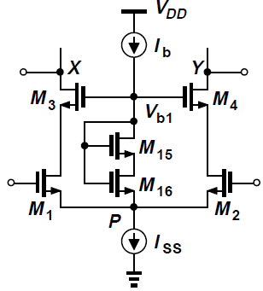
Design 1: Telescopic Op-Amp- Bias Circuit
In op-amp circuit designed, V_{b1} must equal V_{GS3,4} + V_{DS1,2} + V_{P}, where V_{DS1,2} = 100 mV
Diode-connected device in series with a drain-source voltage added to V_{P} can produce V_{b1}
I_{b} must be much less than I_{SS}
We select I_{b} = 15 μA and hence (W/L)_{15,16} = 10 μm/80 nm
If V_{CM,in} rises, so do V_{P} and hence V_{b1}, keeping V_{DS1,2} constant

Slide 53
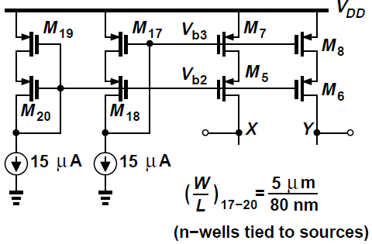
Design 1: Telescopic Op-Amp- Bias Circuit
In order to generate V_{b3} and V_{b2}, a low-voltage cascode is constructed as shown below
M₁₇ and M₁₈ are scaled down respectively down from M_{7,8} and M_{5,6}, ensuring that V_{DS17} = V_{DS7,8}
To create V_{b2} = V_{DD} - |V_{DS7,8}| - |V_{GS5,6}|, a diode-connected device M₂₀ is connected in series with V_{DS} produced by M₁₉

Slide 54
Design 1: Telescopic Op-Amp- Common-Mode Feedback
Due to various mismatches, PMOS currents are not exactly I_{SS}/2, forcing the output CM level to V_{DD} or ground and hence requiring CMFB
Output CM level, V_{CM} must be sensed and fed to the NMOS or PMOS current sources
CM level can be sensed by resistors, triode transistors or source followers
High output impedance of op-amps dictates very large resistors and tight voltage margins demand precise CM control and preclude triode devices
Source followers cannot measure CM level across a wide output swing

Slide 55
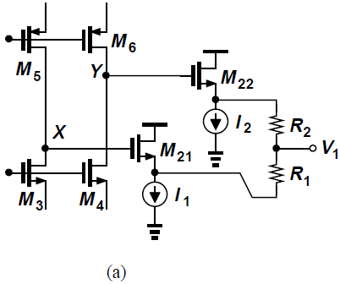
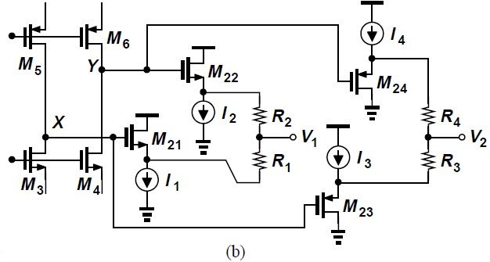

Design 1: Telescopic Op-Amp- Common-Mode Feedback
In Fig. (a), if V_{X} (or V_{Y}) falls, I₁ (or I₂) eventually collapses, disabling the source follower
Complement NMOS followers by PMOS counterparts
In Fig. (b), PMOS followers M₂₃ and M₂₄ also sense the output CM level and drive R₃, R₄ respectively
Here

Slide 56
Design 1: Telescopic Op-Amp- Common-Mode Feedback
A linear combination of V₁ and V₂ can remove V_{GS} terms, yielding a value proportional to V_{CM}
If , then we must choose , obtaining vvvvvv
We can choose so that reconstructed value is equal to actual op-amp output CM level
α and β can be implemented by R₁-R₄
If V₁ and V₂ are shorted, the weighted sum of V₁ and V₂ is produced

Slide 57

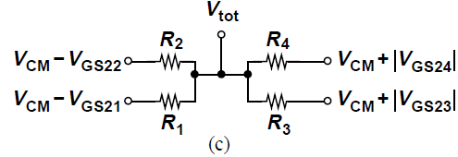
Design 1: Telescopic Op-Amp- Common-Mode Feedback
Using Fig. (c) below, it can be shown that
Where R_{N} = R₁ = R₂ and R_{P} = R₃ = R₄
We therefore choose R_{N}/R_{P} = V_{GS21,22}/|V_{GS23,24}|

Slide 58
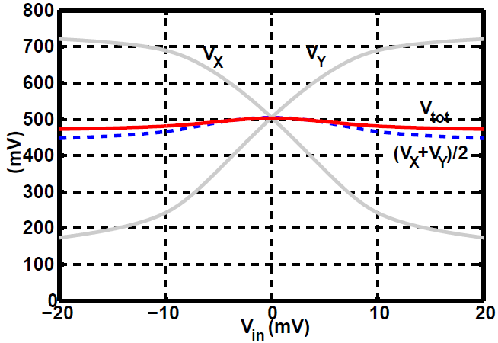
Design 1: Telescopic Op-Amp- Common-Mode Feedback
To evaluate feasibility of this idea, we run a dc sweep and observe the behavior of V_{tot}
We select a bias current of 10 μA and W/L = 10 μm/40 nm for all source followers and R_{N} = R_{P} = 20 kΩ
The 10-μA current sources are also implemented as 10 μm/40 nm transistors
Figure below plots the actual CM level, defined as (V_{X}+V_{Y})/2 and the reconstructed counterpart, V_{tot}

Slide 59
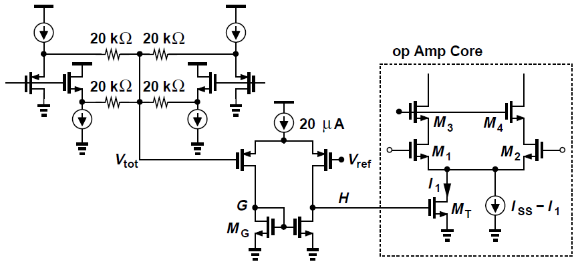
Design 1: Telescopic Op-Amp- Common-Mode Feedback
In the next test, the CMFB loop is closed: we compare V_{tot} to a reference, amplify the error and return the result to control I_{SS}
Error amplifier is designed as a five-transistor OTA with W/L = 5 μm/80 nm for all transistors, tail current of 20 μA and voltage gain of 10
Amplifier output controls a fraction of main tail current I₁

Slide 60
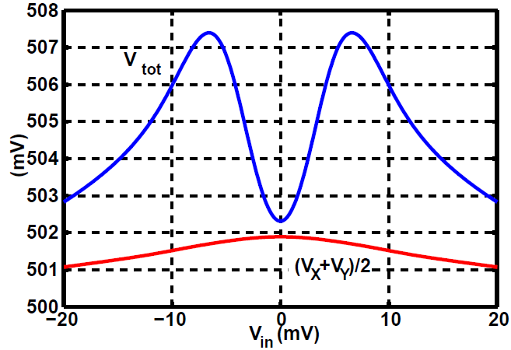
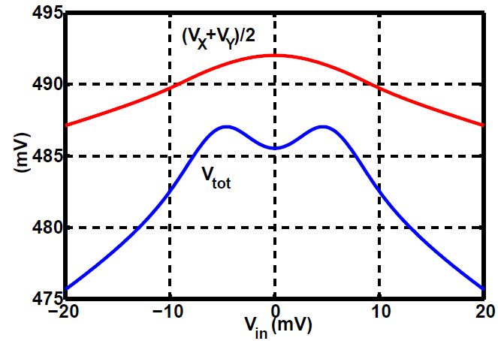
Design 1: Telescopic Op-Amp- Common-Mode Feedback
Figure below shows closed-loop dc sweep results with V_{ref} = 0.5 V
By virtue of feedback, the CM variation is greatly reduced as VX and VY reach high or low values
With a 10% mismatch between PMOS current sources, dc sweep is repeated [Fig. (b)]
  CMFB suppresses mismatch by adjusting I₁
(a)
(b)

Slide 61
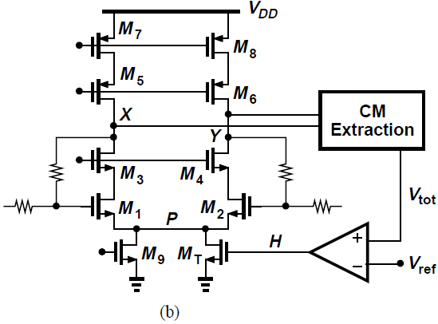
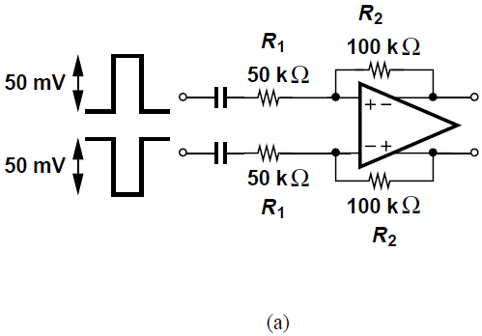
Design 1: Telescopic Op-Amp- CMFB Stability
To investigate stability of CM loop, the overall op amp is placed its intended feedback system, applying differential pulses at input, and examining differential and common-mode behavior at output
Fig. (a) shows a feedback topology for a nominal closed-loop gain of 2
Fig. (b) shows a more detailed diagram highlighting the CM feedback loop

Slide 62
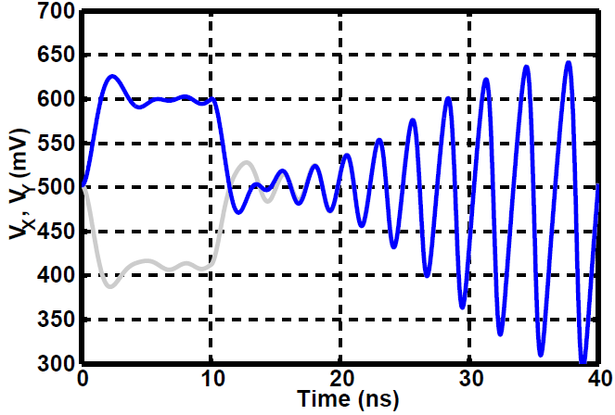
Design 1: Telescopic Op-Amp- CMFB Stability
Output waveforms in response to an input step are plotted below, revealing common-mode instability
CM loop contains a pole at input of error amplifier, one at node H, one at node P, one at the sources of the NMOS cascode devices and one at the main outputs [Refer Fig. (b) on previous slide]
Loop demands compensation

Slide 63
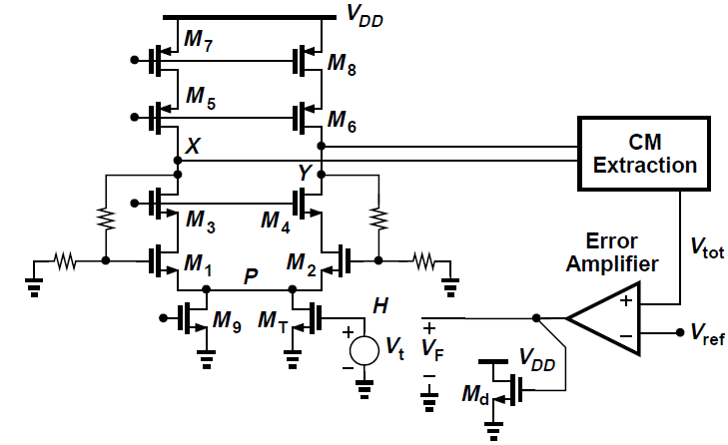
Design 1: Telescopic Op-Amp- CMFB Stability
Break the CM loop at node H as shown below
Error amplifier drives a dummy device M_{d} identical to M_{T} to see loading effect of the latter

Slide 64
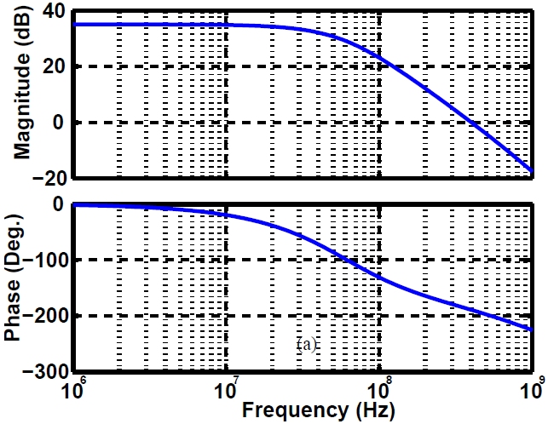
Design 1: Telescopic Op-Amp- CMFB Stability
Fig. (a) plots the magnitude and phase of –V_{F}/V_{t} as a function of frequency, revealing a phase of -190⁰ at the unity-gain frequency
We seek a convenient node for compensation
Error amplifier does not provide signal inversion from V_{tot} to H and hence cannot employ Miller compensation
(a)

Slide 65
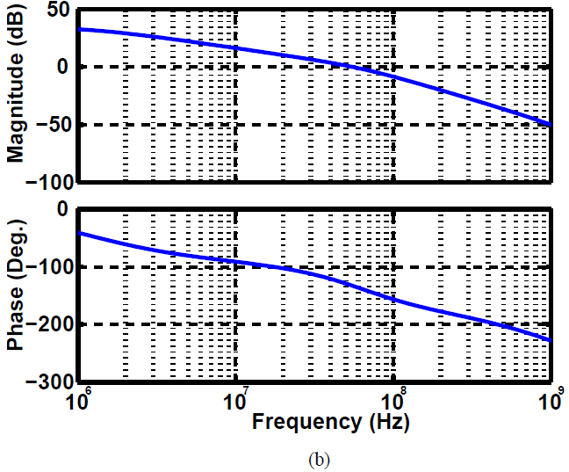
Design 1: Telescopic Op-Amp- CMFB Stability
Adding capacitance from high-impedance nodes X and Y to ground affects differential response
A 3-pF capacitor is tied from error amplifier output to ground, obtaining the response shown in Fig. (b), with a phase margin of 50⁰

Slide 66
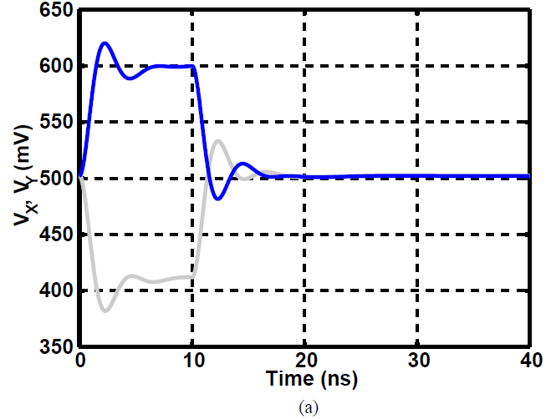

Design 1: Telescopic Op-Amp- CMFB Stability
Closed-loop response of Fig. (a) implies that CMFB loop is properly compensated and CM level incurs differential ringing
Pole formed by large feedback resistors and input capacitance of op-amp is located at a low frequency, degrading phase margin of differential feedback
To compensate differential signal path, two 7-pF capacitors are connected from outputs of op-amp to its inputs to create Miller multiplication [Fig. (b)]

Slide 67
Design 1: Telescopic Op-Amp-Design Summary
Telescopic cascode op-amp for a voltage gain of 500 and a differential output swing of 1 V_{pp} is not achievable with a 1-V supply
General steps followed:
  Allocation of V_{DS} and I_{D} to transistors according to required swings and power dissipation
  Characterization and scaling of MOSFETs for allowable V_{DS} and desired currents
  Quick estimate of achievable voltage gain
  Dc sweep to study bias conditions and nonlinearity
  Design of bias circuitry using current mirrors and low-voltage cascodes
  CMFB design and compensation
  Closed-loop transient analysis to study CM and differential stability

Slide 68
Design 2: Two-Stage Op-Amp
Relatively high voltage gain and 1-V_{pp} swing point to a two-stage configuration as a feasible candidate
Gain of 500 dictates use of cascading in the first stage
With a gain of about 50 in the first stage, gain of second stage can be around 10
Single-ended peak-to-peak swing at output of first stage can be as small as 50 mV, allowing redesign of cascode for greater V_{DS}’s and more robust operation
Partitioning of power budget between two stages requires speed and/or noise specifications
We split the power equally here, with further optimization after one round of complete design
With about 100 μA reserved for bias network, we allocate 1.9 mA/4 = 475 μA to each transistor branch in the first and second stages

Slide 69


Design 2: Two-Stage Op-Amp- First Stage Design
Telescopic-cascode configuration must accommodate a single-ended swing of 50 mV_{pp}, allowing 0.95 V for the sum of five V_{DS}’s
We choose V_{DS,N} = 150 mV and V_{DS,P} = 200 mV and simulate reference transistors [W/L = 5 μm/40 nm (gray) and 10 μm/80 nm (blue)], seeking acceptable knee voltages
Fig. (a) shows curves for V_{GS,N} = 350 mV while Fig. (b) shows curves for V_{GS,P} = - 450 mV

Slide 70

Design 2: Two-Stage Op-Amp- First Stage Design
Width of NMOS transistors in the signal path must be scaled by a factor of 450 μA/50 μA for either L = 40 nm or L = 80 nm
Width of PMOS device must be scaled by a factor of 450 μA/50 μA for either L = 40 nm or L = 80 nm
For tail current device, we choose W = (900 μA/50 μA) x 10 μm and L = 80 nm
First-stage design is shown in Fig. (a) and simulated behavior in Fig. (b), revealing a gain of about 50

Slide 71
Design 2: Two-Stage Op-Amp- Second Stage Design
Second stage must provide a voltage gain of about 10, dictating channel lengths greater than 40 nm for both NMOS and PMOS devices
Output CM level of first stage is around 0.55 V
Consider a transistor having W/L = 10 μm/ 80 nm and determine its g_{m}r_{O} if it is an NFET with V_{GS} ≈ 0.55 V or a PFET with |V_{GS}| ≈ 0.45 V
Using simulations, we get (g_{m}r_{O})_{N} = 12.8 and r_{ON} = 1.86 kΩ at V_{DS} = 0.5 V and I_{D} = 900 μA, and (g_{m}r_{O})_{P} = 17.5 and r_{OP} = 9.75 kΩ at |V_{DS}| = 0.5 V and |I_{D}| = 110 μA
We therefore select the PFET as input of second stage and scale its width to (450 μA/110 μA) x 10 μm ≈ 41 μm, exhibiting an output resistance of 2.38 kΩ
Drain of the PFET is tied to an NMOS current source

Slide 72

Design 2: Two-Stage Op-Amp- Second Stage Design
The NMOS current source must not lower the gain of the second stage, |A_{v2}| below 10
Since |A_{v2}| = g_{mP}(r_{OP}||r_{ON}) ≥ 10, we have r_{ON} ≥ 1.33r_{OP} = 3.0 kΩ at I_{D} = 475 μA
If the 10 μm/80 nm NFET considered before with r_{O} = 1.86 kΩ and I_{D} = 900 μA is scaled down by a factor of 2, it yields r_{ON} = 3.72 kΩ, close to the desired value
Fig. (a) shows op-amp developed so far

Slide 73


Design 2: Two-Stage Op-Amp- Second Stage Design
Fig. (b) plots input-output characteristics
To determine the maximum output swing that the op-amp can handle, we plot the slope of the differential characteristic in Fig. (c), noting that the differential output cannot exceed 450 mV if the gain must not drop below 500

Slide 74


Design 2: Two-Stage Op-Amp- Second Stage Design
To resolve this issue, we double the width and length of the output NFETs, raising the gain and arriving at the results shown below
Now, single-ended swing reaches 530 mV for a minimum gain of 500

Slide 75
Design 2: Two-Stage Op-Amp- Common-Mode Feedback
Two-stage op-amps generally require CMFB for both stages
For first stage, the CMFB scheme described previously can be used
For second stage, the lower output impedance allows the use of resistors for direct sensing of the CM level

Slide 76

Design 2: Two-Stage Op-Amp- Common-Mode Feedback
In topology of Fig. (a), R₁ and R₂ (≈ 30 kΩ) reconstruct the CM level at node G, applying the result to the gates of M₁₁ and M₁₂
Under equilibrium, resistors draw no current, establishing an output CM level equal to V_{GS11,12}
This voltage varies by about 50 mV with PVT
This CMFB loop is stable

Slide 77

Design 2: Two-Stage Op-Amp- Common-Mode Feedback
If V_{GS11,12} is not close to the desired output CM level, we inject a current I_{B} into node G, and the output CM level is shifted by I_{B}R₁/2 (=I_{B}R₂/2), as shown in Fig. (b)
For example, a shift of 100 mV requires a current of (100 mV/30 kΩ) x 2 = 6.7 μA
A positive I_{B} shifts the CM level down and vice versa

Slide 78
Design 2: Two-Stage Op-Amp- Frequency Compensation
Two-stage op-amp contains several poles and demands compensation
First non-dominant pole of two-stage op-amps typically arises from the output node and depends on the load capacitance, C_{L}
Choose a single-ended load capacitance of 1 pF here, obtaining an output pole frequency of around 90 MHz
We begin with the open-loop op-amp, realizing that the feedback network may add its own effects and require changes

Slide 79

Design 2: Two-Stage Op-Amp- Frequency Compensation
Open-loop (differential) magnitude and phase response of the circuit is plotted below
Low-frequency gain is 57 dB (≈ 700) and unity-gain frequency is 3.2 GHz, with a phase margin of 8⁰
Phase reaches -120⁰ at 240 MHz, therefore after compensation for 60⁰ phase margin, the unity-gain bandwidth can drop by a factor of 13

Slide 80
Design 2: Two-Stage Op-Amp- Frequency Compensation
To compensate the op-amp, we begin at 240 MHz and 0 dB on the magnitude plot and draw a straight line toward the y-axis with a slope of -20 dB/dec
The frequency at which this line intersects the magnitude plot is roughly 240 MHz/700 = 344 kHz, yielding the desired value for the dominant pole
Node X is preferred over the output node to produce the dominant pole due to Miller multiplication and pole splitting

Slide 81

Design 2: Two-Stage Op-Amp- Frequency Compensation
With the output resistance of 8 kΩ seen at node X and a voltage gain of about 12 provided by the output stage, we choose a Miller compensation capacitor, C_{C} equal to 4.5 pF so as to create a 344-kHz pole at this node
Resulting open-loop frequency response is shown below

Slide 82
Design 2: Two-Stage Op-Amp- Frequency Compensation
Dominant pole is now located around 340 kHz
Gain crossover occurs at 350 MHz and the phase margin is only 18⁰ because the zero introduced by C_{C}, ω_{z} = g_{m10}/C_{C}, is as low as 250 MHz
We can insert a resistor R_{z}, in series with C_{C}, so as to move the zero to the second pole, ω_{p2},
Second pole can be roughly estimated as the frequency at which ∠H reaches -135° and is equal to 185 MHz

Slide 83

Design 2: Two-Stage Op-Amp- Frequency Compensation
Selecting R_{z} according to (ω_{p2}C_{C})⁻¹ = 190 Ω, the response observed is shown in Fig. (a)
Phase margin rises to 96° because of pole-zero cancellation

Slide 84

Design 2: Two-Stage Op-Amp- Frequency Compensation
C_{C} can be smaller and the unity-gain bandwidth larger
By some iteration, we choose C_{C} = 0.8 pF and R_{z} = 450 Ω, arriving at the response of Fig. (b)
The op-amp now exhibits a unity-gain bandwidth of 1.9 GHz with a phase margin of 65°

Slide 85

Design 2: Two-Stage Op-Amp- Closed-Loop Behavior
Configure the op-amp as a closed-loop amplifier with a nominal gain of 2 and a load capacitance of 1 pF [Fig. (a)]
Small-signal transient response shows significant ringing due to large resistance values used in feedback network [Fig. (b)]

Slide 86

Design 2: Two-Stage Op-Amp- Closed-Loop Behavior
Draw the single-ended equivalent circuit as in Fig. (a) below for loop transmission calculation
We observe that an open-loop pole around [2π(100 kΩ||50 kΩ)C_{in}]⁻¹ ≈ 95 MHz is formed at the input of the op-amp

Slide 87

Design 2: Two-Stage Op-Amp- Closed-Loop Behavior
To improve closed-loop stability, we can reduce R₁ and R₂ to 25 kΩ and 50 kΩ, respectively before the open-loop gain falls appreciably at the cost of double input pole frequency
Alternatively, we can increase the resistance in series with the compensation capacitors from 450 Ω to 1500 Ω, arriving at the response in Fig. (b) below

Slide 88
High-Speed Amplifier
Some applications require an amplifier with fast settling and accurate gain
We design a differential amplifier according to the following specifications:
  Voltage gain = 4
  Gain Error ≤ 1%
  Differential output swing = 1 V_{pp}
  Load capacitance = 1 pF
  Step response settling time to 0.5% accuracy = 5 ns
  V_{DD} = 1 V

Slide 89

High-Speed Amplifier
As shown above, the settling time t_{s}, is defined as the time necessary for the output to reach within 0.5% of its final value
Objective is to minimize the power consumption of the circuit

Slide 90

High-Speed Amplifier: Precision Issues
Maximum tolerable gain error of 1% indicates a closed-loop configuration to make gain relatively independent of PVT
Must design an amplifier with open-loop gain high enough to yield closed-loop gain error of less than 1%
Also, output swing of 1 V_{pp} calls for a two-stage op-amp
We arrive at the feedback arrangement shown below

Slide 91


High-Speed Amplifier: Precision Issues
For the above feedback configuration, closed-loop gain is given by
We choose R₂/R₁ = 4, and ensure that the gain error falls below 1%, obtaining A₀ ≥ 500

Slide 92


High-Speed Amplifier: Precision Issues
If R₁ and R₂ are large enough not to reduce the open-loop gain of the op-amp, they form a significant pole with the input capacitance, degrading the phase margin
Consider capacitive feedback as shown in Fig. (a)
Closed-loop gain is now C₁/C₂, or more accurately,
C_{in} denotes the (single-ended) input capacitance of the op-amp

Slide 93

High-Speed Amplifier: Precision Issues
In the single-ended counterpart of Fig. (b) for loop transmission calculation, we observe that C₁ and C₂ do not contribute additional poles because (C₁+C_{in})C₂/(C₁+C₂+C_{in}) simply appears in parallel with C_{L}

Slide 94

High-Speed Amplifier: Precision Issues
To provide bias for the op-amp inputs, we add two feedback resistors so that the input and output dc levels become equal [Fig. (a)]
Finite time constant at X and Y leads to a high-pass response

Slide 95

High-Speed Amplifier: Precision Issues
If A₀ = ∞, then
The corner frequency, 1/(2πR_{F}C₂), must be chosen less than the minimum frequency of interest
We proceed assuming R_{F}C₂ is sufficiently large
Capacitive-feedback amplifier’s gain also depends on C_{in}
For example, if C_{in} ≈ (C₁+C₂)/5 then A₀ must be 20% higher than that predicted previously
We can choose C₁+C₂ >> C_{in} but at the cost of settling speed

Slide 96

High-Speed Amplifier: Speed Issues
The amplifier must settle to 0.5% accuracy in 5 ns
Assuming a linear, first-order circuit, we can write the step response as
The time necessary for V_{out} to reach 0.995V₀ is t_{s} = -τ*ln 0.005 = 5.3τ, i.e., τ must be no more than 0.94 ns
Closed-loop amplifier must achieve a -3-dB bandwidth of at least 1/(2π × 0.94 ns) ≈ 170 MHz

Slide 97



High-Speed Amplifier: Speed Issues
If the op-amp is modeled by a dependent current source, G_{m}V_{in}, and an output resistance, R_{out}, then the closed-loop time constant is given by
G_{m}R_{out} is assumed much greater than unity; above expression can be rewritten as
Op-amp sees the series combination of C₂ and C₁+C_{in} in parallel with C_{L}

Slide 98
High-Speed Amplifier: Speed Issues
The foregoing model is not accurate for a two-stage op-amp since the internal pole also affects the response
Consider a frequency-compensated two-stage op-amp
If the loop gain falls to 1 at the second pole ω_{p2}, the phase margin is about 45° for unity-gain feedback
To compensate the op-amp for a closed-loop gain of 4, |βH| must fall to 0 dB at ω_{p2} (i.e., circuit is not compensated for unity-gain feedback)

Slide 99




High-Speed Amplifier: Speed Issues
As shown in Fig. (a), we begin at ω = ω_{p2} and draw a line with slope -20 dB/decade toward the y-axis, seeking its intercept with the plot of |βH| [Fig. (a)]
Between the compensated dominant pole ω’_{p1}, and ω_{p2}, we can approximate the compensated βH(s) as βA₀/(1 + s/ω’_{p1}); we set its magnitude to 1 at ω_{p2}
⇒
⇒

Slide 100

High-Speed Amplifier: Speed Issues
To construct the closed-loop frequency response with the value of ω’_{p1} calculated before, we plot the magnitude of the loop transmission |βH|, for β = 1, and after compensation [Fig. (b)]
The closed-loop response begins at A₀/(1+ βA₀) at low frequencies and begins to roll off at ω ≈ ω_{p2}
The two responses intersect at ω ≈ βA₀ω’_{p1} ≈ ω_{p2}
We choose this bandwidth equal to 2π(170 MHz)/125 = 2π(1.36 MHz)

Slide 101
High-Speed Amplifier: Op-Amp Design
Based on foregoing calculations, we seek a two-stage op-amp with an open-loop gain of 500, a dominant pole at 1.36 MHz and a second pole at 170 MHz and a differential output swing of 1 V_{pp}
Prototype designed earlier can serve our purpose
Since the compensation can be relaxed to suit a feedback factor of 1/5, the dominant pole of the op-amp need not be as low as 344 kHz
If the feedback factor is reduced from 1 to β, then the dominant pole can increase by roughly a factor of 1/β
Compensation capacitor can be lowered from 4.5 pF to 0.9 pF, raising the dominant pole frequency from 340 kHz to 1.7 MHz
For the feedforward zero to cancel the second pole, R₂ must rise by the same factor, reaching 950 Ω

Slide 102

High-Speed Amplifier: Closed-Loop Small-Signal Performance
Above figure shows overall op-amp and its closed-loop environment
For a nominal gain of 4, we choose C₁ = 1pF and C₂ = 0.25 pF
With C_{in} ≈ 50 fF, gain equation predicts a gain error less than 1% if A₀ > 520
For a settling time of 5 ns, we select R_{F}C₂ > 10 μs, i.e., R_{F} = 40 MΩ

Slide 103

High-Speed Amplifier: Closed-Loop Small-Signal Performance
Applying a differential input step of 25 mV, we expect an output around 99 mV (for 1% gain error)
Fig. (a) is the differential output waveform and Fig. (b) is a close-up showing the fine settling
Final value is equal to 98.80 mV, a result of insufficient open-loop gain

Slide 104

High-Speed Amplifier: Closed-Loop Small-Signal Performance
In order to increase gain, if we raise the length (and hence width) of the first-stage input transistors, C_{in} also increases, counteracting A₀
Instead, we double the (drawn) width and length of the NMOS cascode transistors, obtaining the output shown below
Now the gain error is below 1%

Slide 105
High-Speed Amplifier: Closed-Loop Small-Signal Performance
If the output reaches 99.1 mV at t = ∞, the settling time t_{s} to 1% precision must be defined as follows:
  Find the time at which V_{out} = 99.1 mV ± 0.01 × 99.1 mV ≈ 99.1 mV ± 1 mV
  From Fig. (b) on previous slide, we obtain t_{s} ≈ 5.8 ns
From Fig. (a) on slide 104, output appears “overcompensated”, thus speed can be improved

Slide 106

High-Speed Amplifier: Closed-Loop Small-Signal Performance
With C_{C} = 0.3 pF and R_{z} = 700 Ω, we observe the settling behavior shown below
Settling time drops to 800 ps, a remarkable improvement
R_{z} is reduced in this case, moving the zero to higher frequencies

Slide 107

High-Speed Amplifier: Op-Amp Scaling
If the settling time is much shorter than the required value, we can trade speed for power dissipation by “linear scaling”
Beginning with the response in Fig. (a), we scale down all transistor widths and bias currents by a factor of α, thereby reducing the power by the same factor while retaining the voltage gain and the headroom

Slide 108


High-Speed Amplifier: Op-Amp Scaling
With the load capacitance fixed, the output pole (before compensation) is scaled down by a factor of α [Fig. (b)]
To maintain the same phase margin, the dominant pole after compensation must also be scaled down by this factor [Fig. (c)]
Since the output impedance of first stage is multiplied by α, C_{C} should remain unchanged
To place the zero introduced by R_{z} atop ω_{p2}/α, we multiply R_{z} by α

Slide 109

High-Speed Amplifier: Op-Amp Scaling
Let us try α = 2
Fig. (a) plots the output waveform, revealing the same final values as before and an overdamped response with t_{s} ≈ 2.5 ns

Slide 110


High-Speed Amplifier: Op-Amp Scaling
We can try scaling by another factor of 4 (i.e., α = 8 with respect to the original design), observing the heavily overdamped response in Fig. (b)
Now, we adjust C_{C} and R_{z} manually to optimize the speed
With C_{C} = 0.15 pF and R_{z} = 9 kΩ, the step response appears as in Fig. (c), exhibiting t_{s} ≈ 4.5 ns

Slide 111

High-Speed Amplifier: Op-Amp Scaling
Linear scaling along with some adjustment of C_{C} and R_{z} affords an eightfold reduction of power and area
Minimal design effort needed because it does not alter circuit’s gain and swing values
Scaling gives rise to longer settling and higher noise (and offset)

Slide 112
High-Speed Amplifier: Large-Signal Behavior
The amplifier’s ultimate test is with large signal swings (1 V_{pp,diff})
Open-loop gain may drop as some transistors sustain less V_{DS}, and speed may suffer due to slewing
In previous simulations, the differential output begins from zero, jumps to some value, and returns to zero
For large-signal tests, V_{out} must swing from -0.5 V to +0.5 V, which can be accomplished by setting the initial differential conditions at the op-amp inputs such that V_{out} = -0.5 V at t = 0

Slide 113

High-Speed Amplifier: Large-Signal Behavior
The large-signal response is shown in Fig. (a)
Total change in V_{out} from t ≈ 20 ns to t ≈ 40 ns is equal to 987.4 mV, about 2.6 mV less than the allowed value for 1% gain error
Settling to 1% from final value is about 6 ns

Slide 114
High-Speed Amplifier: Large-Signal Behavior
Let us first deal with insufficient gain
We can measure voltage gain of each stage under these conditions by dividing its differential output swing by its differential input swing (after the voltages have settled)
We obtain A_{v} = 39.5 and 10.2 for first and second stages respectively (in small-signal operation, these values are equal to 46.3 and 11.2)
Thus, open-loop gain has dropped from 518 to 403

Slide 115

High-Speed Amplifier: Large-Signal Behavior
To raise the gain, we double W and L of the NMOS cascode transistors in the first stage and the NMOS current sources in the second, arriving at the output shown below
Gain error is now less than 1%, but settling has become longer because the pole associated with the source of the NMOS cascode transistors degrades the phase margin

Slide 116


High-Speed Amplifier: Large-Signal Behavior
To address the settling issue, we consider cascode compensation
With some iteration, we reach the design of Fig. (a)
As shown in Fig. (b), the settling to 1% takes less than 5 ns
This performance is achieved with a power of 370 μW

Slide 117
Summary
Three steps in good analog design:
  Closely examine the circuit’s behavior and understand the root cause of undesired phenomena
  Adjust only the circuit parameters that relate to the root cause – do not play blindly with any random device
  Continue to explore various techniques and new ideas, many a time improving performance

