Slide 1
Chapter 12: Bandgap References
12.1 General Considerations
12.2 Supply-Independent Biasing
12.3 Temperature-Independent References
12.4 PTAT Current Generation
12.5 Constant-G_{m} Biasing
12.6 Speed and Noise Issues
12.7 Low-Voltage Bandgap References
12.8 Case Study

Slide 2
General Considerations
Objective of reference generation is to establish a dc voltage or current independent of the supply and process and has a well-defined behavior with temperature
Three forms of temperature dependence:
  Proportional to absolute temperature (PTAT)
  Constant-G_{m} behavior, i.e., such that the transconductance of certain transistors remains constant
  Temperature independent
Two design problems:
  Supply-independent biasing
  Definition of temperature variation

Slide 3
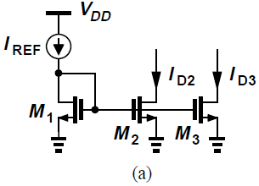
Supply-Independent Biasing
Use of bias currents and current mirrors implicitly assumes a “golden” reference current is available
As shown in Fig. (a), if I_{REF} does not vary with V_{DD}, and channel-length modulation of M₂ and M₃ is neglected, then I_{D2} and I_{D3} remain independent of the supply voltage
How to generate I_{REF}?

Slide 4

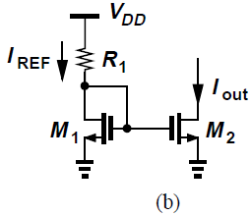
Supply-Independent Biasing
As an approximation of a current source, we tie a resistor from V_{DD} to the gate of M₁ [Fig. (b)]
Output current of this circuit is quite sensitive to V_{DD}:
To arrive at a less sensitive solution, we postulate that the circuit must bias itself, i.e., I_{REF} must somehow be derived from I_{out}

Slide 5
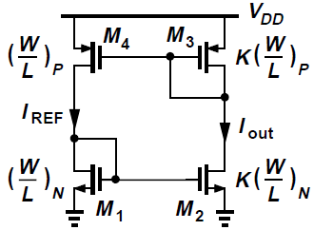
Supply-Independent Biasing
If I_{out} is to independent of V_{DD}, then I_{REF} can be a replica of I_{out}
In circuit below, M₃ and M₄ copy I_{out}, thus defining I_{REF}
I_{REF} is “bootstrapped” to I_{out}
Here, I_{out} = KI_{REF} is channel-length modulation is neglected
Since each diode-connected device feeds from a current source, I_{out} and I_{REF} are relatively independent of V_{DD}

Slide 6
Supply-Independent Biasing
If M₁ - M₄ operate in saturation and λ ≈ 0, the circuit is governed by only one equation, I_{out} = KI_{REF}, and hence can support any current level
If we initially force I_{REF} to be 10 μA, the resulting I_{out} of K × 10 μA “circulates” around the loop, sustaining these current levels in the left and right branches indefinitely

Slide 7
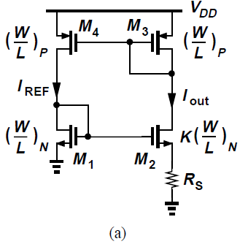
Supply-Independent Biasing
To uniquely define the currents, we add another constraint to the circuit as in Fig. (a)
Resistor R_{S} decreases the current of M₂ while the PMOS devices need I_{out} = I_{REF} due to identical dimensions and thresholds

Slide 8




Supply-Independent Biasing
We can write, , or,
Neglecting body effect,
Hence,
As expected, the current is independent of the supply voltage (but still a function of process and temperature)

Slide 9
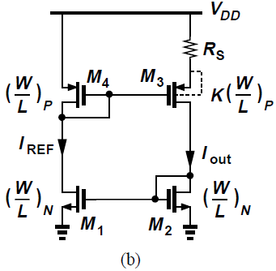
Supply-Independent Biasing
The assumption V_{TH1} = V_{TH2} introduces some error in the foregoing calculations because sources of M₁ and M₂ are at different voltages
Simple remedy is to place the resistor at the source of M₃ while eliminating body effect by tying the source and bulk of each PMOS
Relatively long channel lengths are used for all transistors in the circuit

Slide 10
Supply-Independent Biasing
Important issue in supply-independent biasing is the existence of “degenerate” bias points
In circuit of Fig. (a), if all transistors carry zero current when supply is turned on, they remain off indefinitely
Loop can support zero current in both branches
Circuit can settle in one of two different operating conditions
Called the “start-up” problem

Slide 11
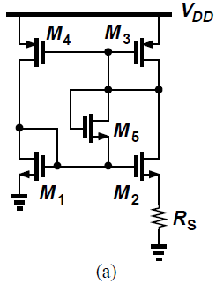
Supply-Independent Biasing
Start-up problem can be solved by adding a mechanism to drive the circuit out of degenerate bias point when supply is turned on
In Fig. (a), diode-connected device M₅ provides a current path from V_{DD} through M₃ and M₁ to ground upon start-up
M₃ and M₁, and hence M₂ and M₄, cannot remain off
This technique is practical only if V_{TH1} + V_{TH5} + |V_{TH3}| < V_{DD} and V_{GS1} + V_{TH5} + |V_{GS3}| > V_{DD} to ensure M₅ remains off after start-up

Slide 12
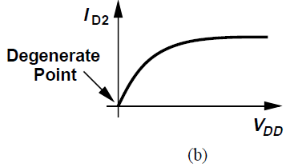
Supply-Independent Biasing
Problem of start-up requires careful analysis and simulation
Supply voltage must be ramped from zero in a dc sweep simulation (such that parasitic capacitances do not cause false start-up) as well as in a transient simulation
Behavior of the circuit must be examined for each supply voltage

Slide 13
Temperature-Independent References
Reference voltages or currents exhibiting little dependence of temperature are useful in analog circuits
If two quantities having opposite temperature coefficients (TCs) are added with proper weighting, the result displays a zero TC
For two voltages V₁ and V₂ that vary in opposite directions with temperature, we choose α₁ and α₂ such that , obtaining a reference voltage, , with zero TC
Characteristics of bipolar transistors have proven the most reproducible and well-defined quantities that can provide positive and negative TCs

Slide 14



Negative-TC Voltage
The base-emitter voltage of bipolar transistors, or more generally, the forward voltage of a pn-junction diode exhibits a negative TC
For a bipolar device, , where
Saturation current I_{S} is proportional to μkTn_{i}², where μ denotes the mobility of minority carriers and n_{i} is the intrinsic carrier concentration of silicon
The temperature dependence of these quantities is expressed as μ ∝ μ₀T^{m}, where m ≈ -3/2, and n_{i}²∝ T³exp[-E_{g}/(kT)], where E_{g} ≈ 1.12 eV is the bandgap energy of silicon
Thus,
where b is proportionality factor

Slide 15



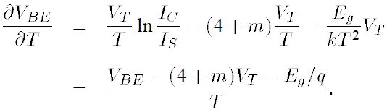
Negative-TC Voltage
Writing , we can now compute the TC of the base-emitter voltage
For simplicity, we assume I_{C} is held constant
Thus,
Using expression derived for I_{S},
Therefore,
Thus,

Slide 16

Negative-TC Voltage
TC of the base-emitter voltage at a given temperature T depends on the magnitude of V_{BE} itself
With V_{BE} ≈ 750 mV and T = 300 K, we have
In old bipolar technologies, where I_{C}/I_{S} was relatively small, V_{BE} ≈ 700 mV and at room temperature
Modern bipolar transistors operate at much higher current densities, exhibiting V_{BE} ≈ 800 mV and hence ddd at T = 300 K
TC of V_{BE} itself depends on temperature, creating error in constant reference generation if the positive-TC quantity exhibits a constant (positive) TC

Slide 17
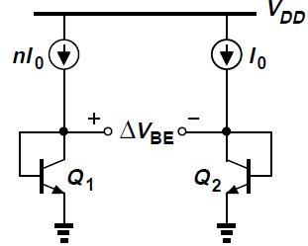
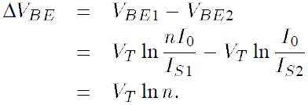

Positive-TC Voltage
If two BJTs operate at unequal current densities, the difference between their base-emitter voltages is directly proportional to the absolute temperature
As shown, if two identical transistors (I_{S1} = I_{S2}) are biased at collector currents of nI₀ and I₀ and their base currents are negligible,
Thus, V_{BE} difference exhibits a positive-TC

Slide 18


Bandgap Reference
With positive and negative-TC voltages, we can develop a reference having a nominally zero TC
We write , where V_{T} ln n is the difference between the base-emitter voltages of two BJTs operating at different current densities
At room temperature, whereas ssss , we set α₁=1 and choose α₂ln n such that
That is, , indicating that, for a zero TC:
Need to devise a circuit that adds V_{BE} to 17.2V_{T}

Slide 19
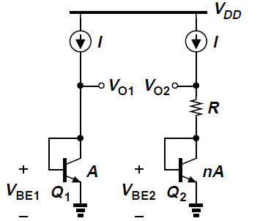
Bandgap Reference
Consider the circuit shown below
Base currents are assumed negligible
Transistor Q₂ consists of n unit transistors in parallel, and Q₁ is a unit transistor
If somehow V_{O1} and V_{O2} are forced to be equal, then V_{BE1} = RI + V_{BE2} and RI = V_{BE1} – V_{BE2} = V_{T} ln n
Thus, V_{O2} = V_{BE2} + V_{T} ln n, suggesting that V_{O2} can serve as a temperature-independent reference if ln n ≈ 17.2 (while V_{O1} and V_{O2} remain equal)

Slide 20
Bandgap Reference
Three modifications needed for previous circuit to be practical:
A mechanism must be added to guarantee V_{O1} = V_{O2}
Since ln n = 17.2 translates to a prohibitively large n, the term RI = V_{T} ln n must be scaled up by a reasonable factor
V_{O2} cannot become temperature-independent because V_{O2} ≈ V_{BE1} ≈ 800 mV whereas for temperature-independence, V_{O2} = V_{BE2} + 17.2V_{T} ≈ 1.25 V

Slide 21
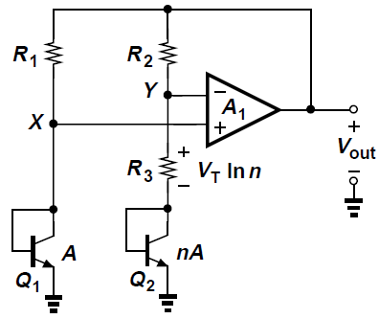
Bandgap Reference
Above implementation accomplishes all three tasks
Amplifier A₁ senses V_{X} and V_{Y}, driving the top terminals of R₁ and R₂ (R₁ = R₂) such that X and Y settle to approximately equal voltages
The reference voltage is obtained at output of the amplifier (rather than at node Y)

Slide 22
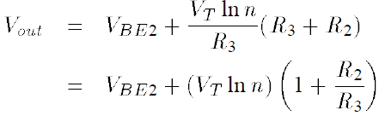
Bandgap Reference
Following earlier analysis, V_{BE1} – V_{BE2} = V_{T} ln n, arriving at a current of V_{T} ln n/R₃ through the right branch and hence an output voltage of
For a zero TC, we must have (1+R₂/R₃)ln n ≈ 17.2, for example n = 31 and R₂/R₃ = 4

Slide 23





Bandgap Reference: Issues
(1) Collector Current Variation:
Circuit violates earlier assumption: I_{C1} and I_{C2}, given by (V_{T} ln n)/R₃, are proportional to T, whereas was derived for a constant current
Assume I_{C1} = I_{C2} ≈ (V_{T} ln n)/R₃
Including in the equation for TC of V_{BE},
Since ,
Thus, the TC is slightly less negative than -1.5 mV/K

Slide 24
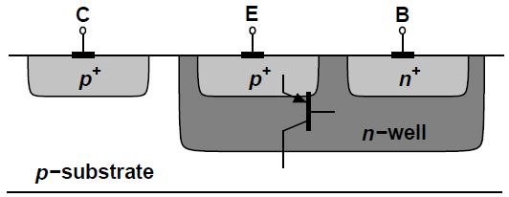
Bandgap Reference: Issues
(2) Compatibility with CMOS Technology:
We must seek structures in a standard CMOS technology that exhibit negative- and positive-TC characteristics
In n-well processes, a pnp transistor can be formed as depicted below
A p+ region (same as S/D region of PFETs) inside an n-well serves as the emitter and the n-well itself as the base
The p-type substrate acts as the collector and is connected to the most negative supply (usually ground)

Slide 25
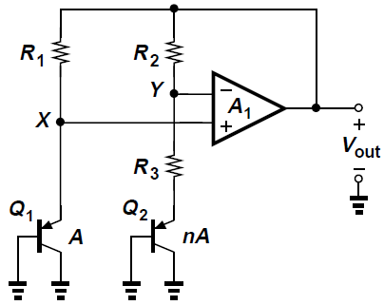
Bandgap Reference: Issues
(2) Compatibility with CMOS Technology:
The circuit can be redrawn as shown below

Slide 26
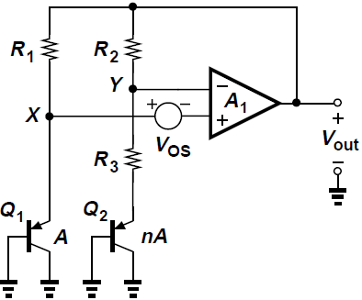
Bandgap Reference: Issues
(3) Op-Amp Offset and Output Impedance:
Op amps suffer from input “offsets”, i.e., the output voltage of the op amp is not zero if the input is zero
Input offset voltage introduces error in the output voltage
Included below, the effect is quantified as

Slide 27
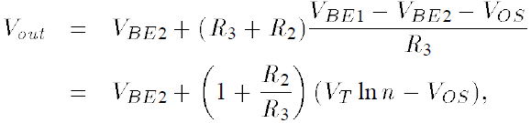
Bandgap Reference: Issues
(3) Op-Amp Offset and Output Impedance:
Thus,
It is assumed that I_{C2} ≈ I_{C1} despite the offset voltage
V_{OS} is amplified by 1+R₂/R₃, introducing error in V_{out}

Slide 28
Bandgap Reference: Issues
(3) Op-Amp Offset and Output Impedance:
Several methods employed to lower the effect of V_{OS}
First, op amp incorporates large devices in a carefully chosen topology to lower the offset
Second, the collector currents of Q₁ and Q₂ can be ratioed by a factor of m such that ΔV_{BE} = V_{T} ln(mn)
Third, each branch may use two pn junctions in series to double ΔV_{BE}

Slide 29
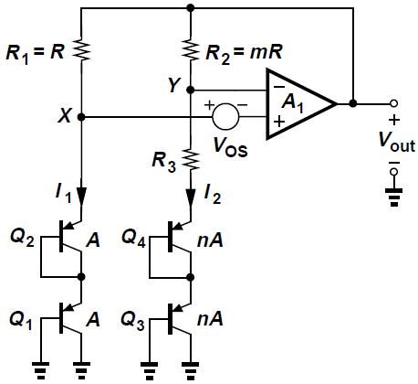
Bandgap Reference: Issues
(3) Op-Amp Offset and Output Impedance:
Circuit below shows a realization using last two techniques
R₁ and R₂ are ratioed by a factor of m, so I₁ = mI₂
Neglecting base currents and assuming A₁ is large, we can write V_{BE1} + V_{BE2} – V_{OS} = V_{BE3} + V_{BE4} + R₃I₂ and V_{out} = V_{BE3} + V_{BE4} + (R₃+R₂)I₂

Slide 30
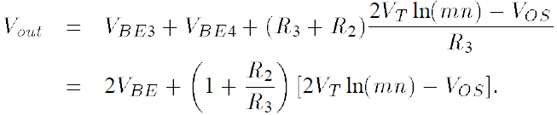
Bandgap Reference: Issues
(3) Op-Amp Offset and Output Impedance:
It follows that
The effect of V_{OS} is reduced by the first term in brackets
However, V_{out} ≈ 2 × 1.25 V = 2.5 V, a value difficult to generate by the op amp at low supply voltages
In these circuit, the op amp drives two resistive branches and hence, must provide a low output impedance

Slide 31
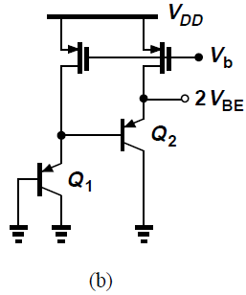
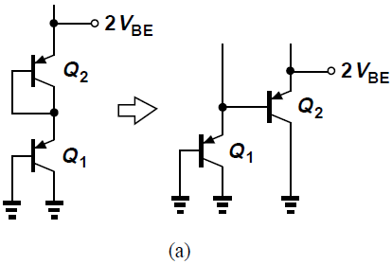
Bandgap Reference: Issues
(3) Op-Amp Offset and Output Impedance:
The implementation shown on slide 29 is not feasible since collectors of Q₂ and Q₄ are not grounded
To use the bipolar structure of CMOS, we modify the series combination of the diodes shown in Fig. (a), converting one of the diodes to an emitter follower
Both transistors are biased by a PMOS current source rather than a resistor to ensure uniform behavior with temperature [Fig. (b)]

Slide 32
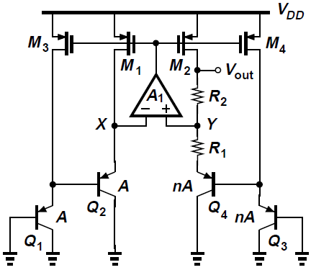
Bandgap Reference: Issues
(3) Op-Amp Offset and Output Impedance:
Overall circuit is shown below, where the op amp adjusts the gate voltage of the PMOS devices so as to equalize V_{X} and V_{Y}
Op amp does not experience resistive loading, but the mismatch and channel-length modulation of the PMOS devices introduce error at the output
Low current gain of the “native” pnp transistors

Slide 33


Bandgap Reference: Issues
(4) Feedback Polarity:
In circuit below, feedback signal produced by the op amp returns to both of its inputs, negative feedback factor is given by
Positive feedback factor is
To ensure an overall negative feedback, β_{P} must be less than β_{N}, roughly by a factor of two

Slide 34





Bandgap Reference: Issues
(5) Bandgap Reference:
To understand the origin of the terminology “bandgap reference”, we rewrite the output voltage equation
Hence
Setting this to zero and substituting for ,
Substituting for VT ln n in the first equation,
V_{REF} is given by a few fundamental numbers: the bandgap voltage of silicon, E_{g}/q, the temperature exponent of mobility, m, and the thermal voltage V_{T}
The term “bandgap” is used because as T→0, V_{REF} →E_{g}/q

Slide 35
Bandgap Reference: Issues
(6) Supply Dependence and Start-Up:
In the circuit below, output voltage is relatively independent of supply voltage as long as open-loop gain of the op amp is sufficiently high
Circuit may require a start-up mechanism because if V_{X} and V_{Y} are equal to zero, the input differential pair of the op amp may turn off
Supply rejection of the circuit typically degrades at high frequencies, mandating “supply regulation”

Slide 36
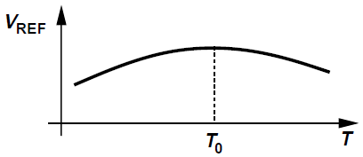
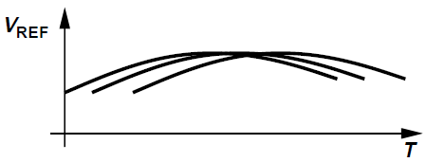
Bandgap Reference: Issues
(7) Curvature Correction:
Bandgap voltages exhibit a finite “curvature”, i.e., their TC is zero at one temperature and positive or negative at others
Curvature arises from temperature variation of base-emitter voltages, collector currents, offset voltages
Many curvature-correction techniques introduced in bipolar bandgap circuits, but rarely used in CMOS counterparts
Samples of CMOS bandgap reference display substantially different zero-TC temperatures due to large offsets and process variations

Slide 37
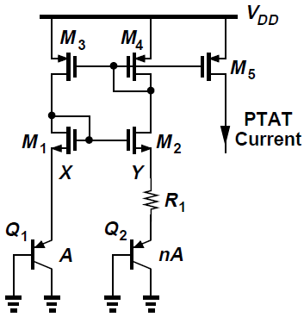
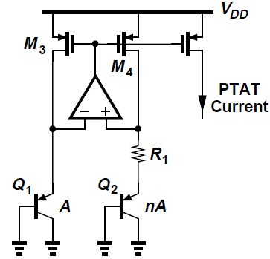
PTAT Current Generation
PTAT currents can be generated by the topology shown in Fig. (a) below
Alternatively, we can combine the supply-independent biasing scheme with a bipolar core, arriving at circuit in Fig. (b)
Assume that M₁-M₂ and M₃-M₄ are identical pairs
For I_{D1} = I_{D2}, the circuit must ensure that V_{X} = V_{Y}
Thus, I_{D1} = I_{D2} = (V_{T} ln n)/R₁, yielding the same behavior for I_{D5}
(a)
(b)

Slide 38

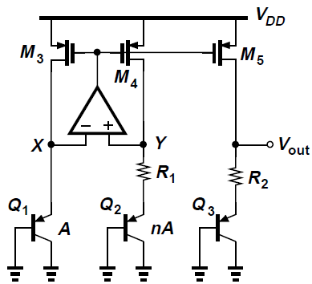
PTAT Current Generation
A modified circuit to provide a bandgap reference voltage is shown below
Idea is to add a PTAT voltage I_{D5}R₂ to a base-emitter voltage; the output therefore equals
All PMOS transistors are assumed identical
The value of V_{BE3} and size of Q₃ are somewhat arbitrary so long as their sum gives a zero TC

Slide 39
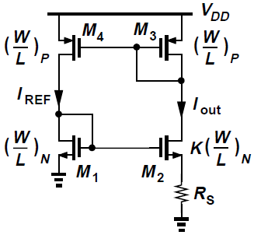

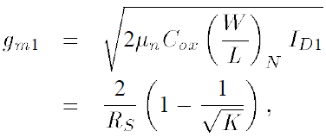
Constant-G_{m} biasing
It is often desirable to bias transistors such that their transconductance does not depend on PVT
Supply-independent bias topology shown can define the transconductance
Bias current is given by
Thus, transconductance of M₁ equals
If temperature coefficient of R_{S} is known, different techniques can cancel the temperature dependence

Slide 40
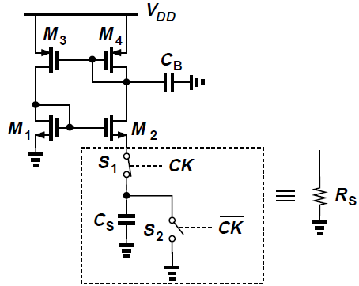
Constant-G_{m} biasing
When a precise clock frequency is available, R_{S} can be replaced by a switched-capacitor equivalent for higher accuracy
Average resistance of (C_{S}f_{CK})⁻¹ is established between source of M₂ and ground, where f_{CK} is the clock frequency
C_{B} shunts high-frequency components resulting from switching to ground

Slide 41
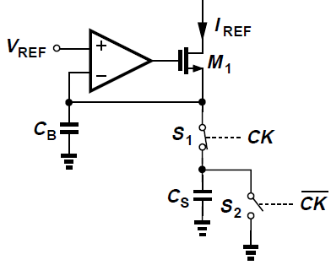
Constant-G_{m} biasing
Switched-capacitor approach can be applied to other circuits as well
As shown, a voltage-to-current converter with a relatively high accuracy can be constructed

Slide 42
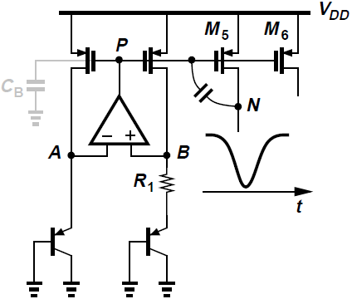
Speed and Noise Issues
Reference generators are low-frequency circuits, but can impact speed of circuits they feed
Various building blocks experience “crosstalk” through reference lines
Caused by finite output impedance of reference generators
In the configuration below, voltage at node N is heavily disturbed by circuit fed by M₅

Slide 43
Speed and Noise Issues
For fast changes in V_{N} the op amp cannot maintain V_{P} constant and bias currents of M₅ and M₆ experience large transient changes
Duration of the transient at node P may be quite long if op amp has a slow response
Reference generator may require a high-speed op amp

Slide 44
Speed and Noise Issues
For low-power applications, high-speed op amp may not be feasible
Alternatively, node P in circuit below can be bypassed to ground by a large capacitor C_{B} to suppress external disturbances
For stability of op amp to not degrade with addition of C_{B}, op amp must be of one-stage nature
C_{B} must be much greater than the capacitance that couples the disturbance to node P

Slide 45
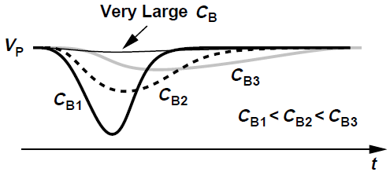
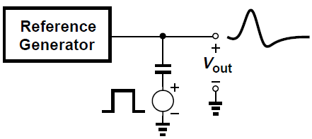
Speed and Noise Issues
As shown below, if C_{B} is not sufficiently large, V_{P} experiences a change and takes a long time to return to its original value, degrading the settling speed of circuits biased by reference generator [Fig. (a)]
Preferable to leave node P agile
In general, response of the circuit must be analyzed by applying a disturbance at the output and observing the settling behavior [Fig. (b)]
(a)
(b)

Slide 46
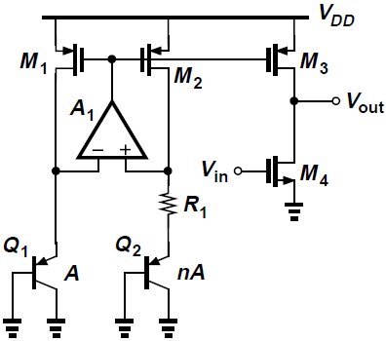
Speed and Noise Issues
Output noise of reference generators may impact the performance of low-noise circuits
As shown below, load current source of a CS stage is driven by a bandgap circuit with a current multiplication factor of N
Thus, noise current of M₁ (or M₂) is multiplied by the same factor as it appears in M₃
M₁-M₃ carry noise due to the op amp A₁ as well

Slide 47
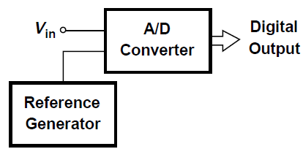
Speed and Noise Issues
As another example, if a high-precision A/D converter employs a bandgap reference voltage with which the analog input signal is compared, then the noise in the reference is directly added to the input

Slide 48


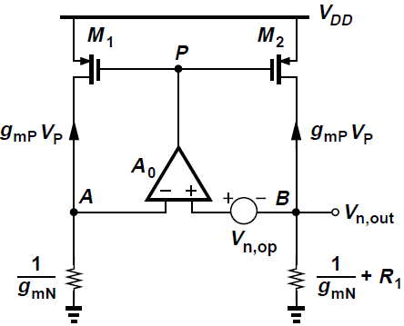
Speed and Noise Issues
As a simple example, let us calculate the output noise voltage of circuit below, considering only the input-referred noise voltage of the op amp, V_{n,op}
Since the small-signal drain currents of M₁ and M₂ are equal to , we have sssssssssssssssss , obtaining the differential voltage at the input of the op amp as

Slide 49




Speed and Noise Issues
Beginning from node A, we can write
Hence,
Since typically ,
Thus, noise of the op amp directly appears at the output

Slide 50
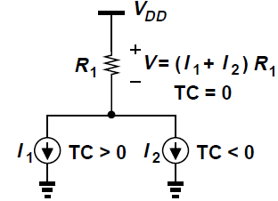
Low-Voltage Bandgap References
Bandgap voltage obtained previously is around 1.25 V, eluding implementation in today’s supplies
Fundamental limitation of addition of 17.2V_{T} to one V_{BE} to achieve a zero TC
It may be possible to add two currents with positive and negative TCs and convert the result to an arbitrary voltage that has a zero TC
We can readily generate a PTAT current given by V_{T} ln n/R
We need another current of the form V_{BE}/R with a negative TC

Slide 51
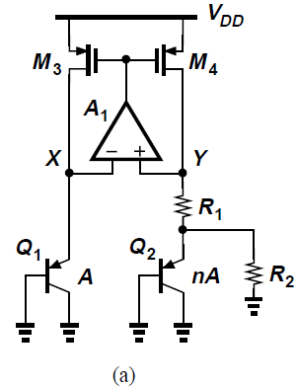
Low-Voltage Bandgap References
Returning to original bandgap circuit of Fig. (a), note that |I_{D4}| = V_{T} ln n/R₁ is a PTAT current
Resistor R₂ is placed in parallel with Q₂
R₁ now carries an additional current of |V_{BE2}|/R₂, i.e., a current with a negative TC
PTAT behavior is now disturbed because I_{C1} ≠ I_{C2}

Slide 52
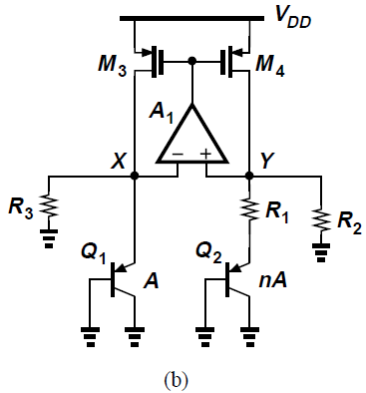
Low-Voltage Bandgap References
A simple modification as shown in Fig. (b) can solve this issue
We tie R₂ from Y to ground and place another resistor in parallel with Q₁
This topology lends itself to low-voltage implementation, requiring a minimum V_{DD} of V_{BE1} + |V_{DS3}|

Slide 53





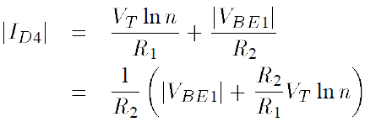
Low-Voltage Bandgap References
To analyze the circuit, we observe that and ssss
Thus,
This yields if
We still have and hence
This current and the current flowing through R₂, |V_{BE1}|/R₂, constitute |I_{D4}|:

Slide 54

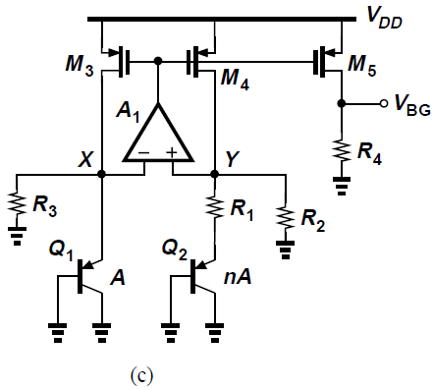
Low-Voltage Bandgap References
Selecting (R₂/R₁)V_{T} ln n approximately equal to 17.2V_{T} renders a zero TC for I_{D4}
This current is then copied and passed through a resistor to generate a zero-TC voltage [Fig. (c)]:
We choose (R₂/R₁)ln n ≈ 17.2, observing that V_{BG} has a zero TC and its value can be lower than 1.25 V

Slide 55
Low-Voltage Bandgap References
Instructive to estimate the lowest supply voltage with which circuit of Fig. (c) can operate properly
With large bipolar transistors and a small bias current, e.g., 10 μA, the base-emitter voltage can be as low as 0.7 V
Wide PMOS devices allow a |V_{DS}| of about 50 mV
Minimum V_{DD} of 0.75 V is achievable
In this case, R₄ tends to be a large resistor, e.g., 50 kΩ

Slide 56
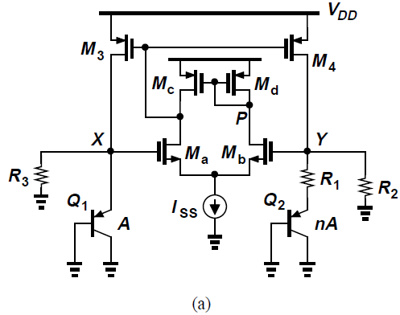
Low-Voltage Bandgap References
The op amp can be realized as a five-transistor OTA
OTA design guidelines:
Large transistor dimensions to minimize flicker noise and offset
V_{GS} of M_{a} and M_{b} plus headroom requires by I_{SS} must not exceed |V_{BE1}|
Transistors are chosen long enough to yield reasonable loop gain

Slide 57
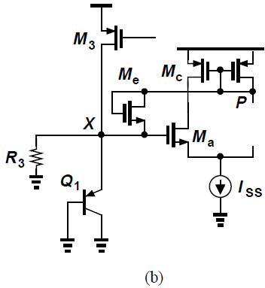
Low-Voltage Bandgap References
Foregoing topology must include a start-up mechanism, else the circuit begins with V_{X} = V_{Y} = 0, M_{a} and M_{b} remain off, and so do M₃ and M₄
Since, with V_{DD} < 1 V, the voltage difference between node P and node X is initially positive but finally negative, we can tie a diode-connected NMOS transistor between these two nodes to ensure start-up [Fig. (b)]
Alternatively, it can be connected between X and V_{DD}

Slide 58



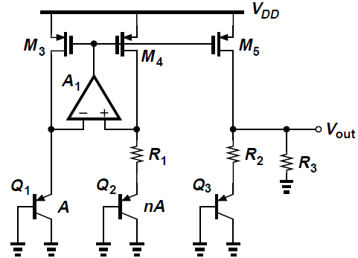
Low-Voltage Bandgap References
Another low-voltage bandgap circuit can be derived by simply a tying a resistor from the output to ground
As shown, the circuit allows some of I_{D5} to flow through R₃:
If the PMOS devices are identical, :

Slide 59
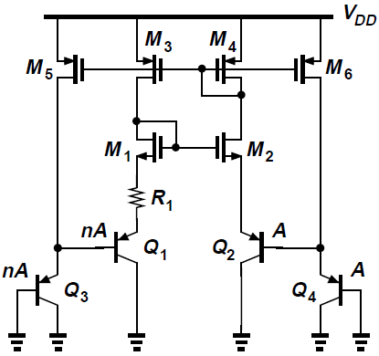
Case Study
We study a bandgap reference circuit designed for high-precision analog systems
A simplified version of the core is shown below, with two series base-emitter voltages in each branch to reduce the effect of MOSFET mismatches
PMOS current mirror ensures equal collector currents for Q₁-Q₄

Slide 60
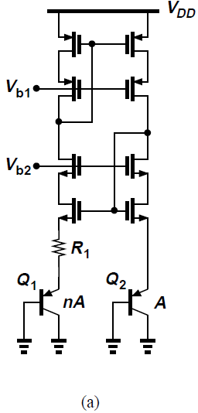
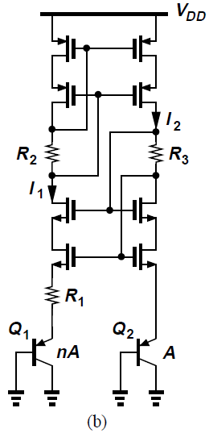
Case Study
Channel-length modulation of MOS devices remains a significant issue
To resolve this issue, each branch can employ both NMOS and PMOS cascode topologies
Fig. (a) shows how the low-voltage cascode is utilized
Fig. (b) shows a “self-biased” version

Slide 61
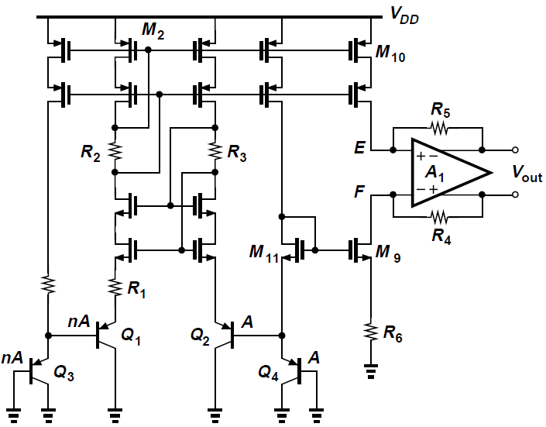
Case Study
The bandgap circuit is designed to generate a floating reference, as shown in figure below
I_{D9} and I_{D10} flow through R₄ and R₅ respectively
M₁₁ sets the gate voltage of M₉ at V_{BE4} + V_{GS11}, establishing a voltage of V_{BE4} across R₆ if M₉ and M₁₁ are identical

Slide 62

Case Study
Thus, I_{D9} = V_{BE4}/R₆, yielding V_{R4} = V_{BE4}(R₄/R₆)
If M₁₀ is identical to M₂, then |I_{D10}| = 2(V_{T} ln n)/R₁ and hence V_{R5} = 2(V_{T} ln n)(R₅/R₁)
Since the op amp ensures V_{E} ≈ V_{F}, we have
Zero TC with proper choice of resistor ratios and n

Slide 63
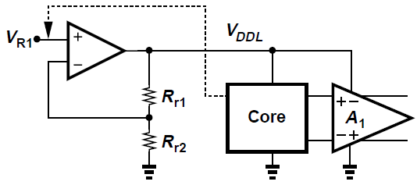
Case Study
To enhance supply rejection, the design regulates the supply voltage of the core and the op amp
Idea is to generate a local V_{DDL}, that is defined by a reference V_{R1} and the ratio of R_{r1} and R_{r2}
Remains relatively independent of the supply voltage

Slide 64

Case Study
To minimize dependence of V_{R1} on the supply, it is established inside the core, as shown below
R_{M} is chosen such that V_{R1} is a bandgap reference

Slide 65

Case Study
Overall implementation is shown below, along with a start-up circuit
Operating from a 5-V supply, reference generator produces a 2-V output consuming 2.2 mW
Supply rejection is 94 dB at low frequencies and drops to 58 dB at 100 kHz

