Slide 1
Chapter 13: Introduction to Switched-Capacitor Circuits
13.1 General Considerations
13.2 Sampling Switches
13.3 Switched-Capacitor Amplifiers
13.4 Switched-Capacitor Integrator
13.5 Switched-Capacitor Common-Mode Feedback

Slide 2
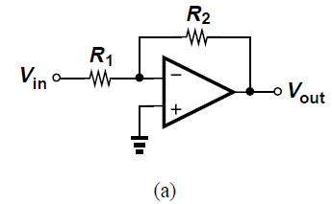
General Considerations
For continuous-time amplifier [Fig. (a)], V_{out}/V_{in} = -R₂/R₁ ideally
Difficult to implement in CMOS technology
Typically, open-loop output resistance of CMOS op-amps is maximized to maximize A_{v}
R₂ heavily drops open-loop gain, affecting precision

Slide 3
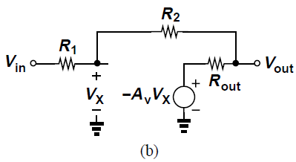

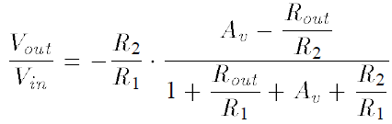
General Considerations
In equivalent circuit of Fig. (b), we can write
Hence,
Closed-loop gain is inaccurate compared to when R_{out} = 0

Slide 4
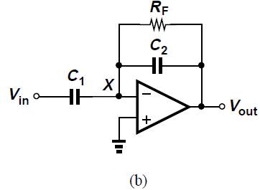
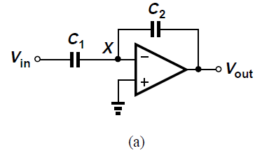
General Considerations
To reduce open-loop gain, resistors can be replaced by capacitors [Fig. (a)]
Gain of this circuit is ideally –C₁/C₂
To set bias voltage at node X, large feedback resistor can be added [Fig. (b)]

Slide 5
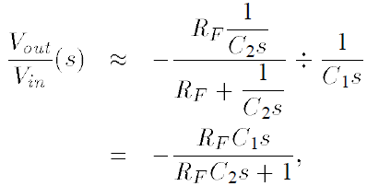

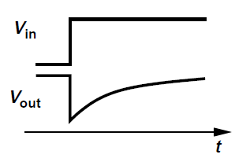
General Considerations
Feedback resistor is not suited to amplify wideband signals
Charge on C₂ is lost through R_{F} resulting in “tail”
Circuit exhibits high-pass transfer function given by
Ddd only if

Slide 6
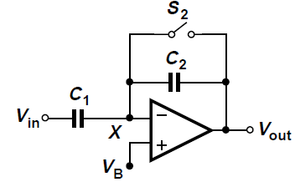
General Considerations
R_{F} can be replaced by a switch
S₂ is turned on to place op amp in unity gain feedback to force V_{X} equal to V_{B}, a suitable common-mode value
When S₂ turns off, node X retains the voltage allowing amplification
When S₂ is on, circuit does not amplify V_{in}

Slide 7
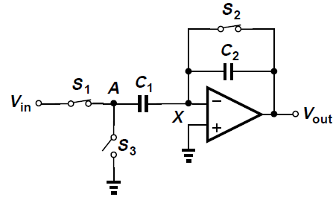
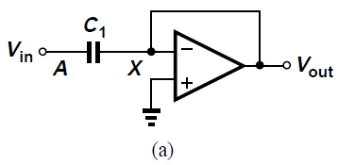
General Considerations
In above circuit, S₁ and S₃ connect left plate of C₁ to Vin and ground, S₂ for unity-gain feedback
Assume large open-loop gain of op amp
First phase: S₁ and S₂ on, S₃ off [Fig. (a)]

Slide 8

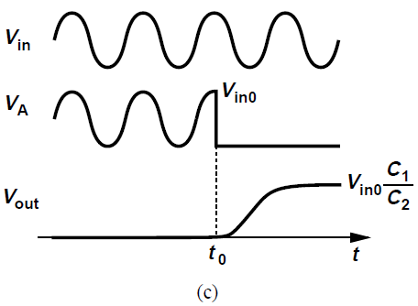
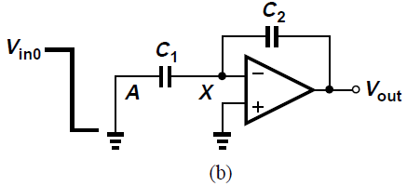
General Considerations
Here, and C₁ samples the input V_{in}
Second phase: At t = t₀, S₁ and S₂ turn off and S₃ turns on, pulling node A to ground [Fig. (b)]
V_{A} changes from V_{in} to 0, therefore V_{out} must change from zero to V_{in0}C₁/C₂ [Fig. (c)]

Slide 9
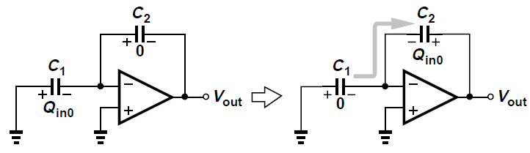
General Considerations
Circuit devotes some time to sample input, setting output to zero and providing no amplification
After sampling, for t > t₀, circuit ignores input voltage, amplifies sampled voltage

Slide 10
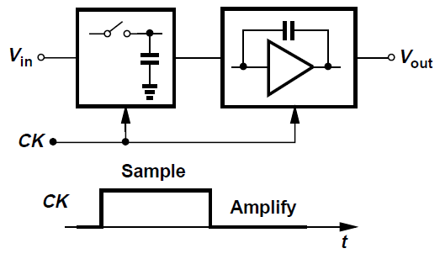
General Considerations
Switched-capacitor amplifiers operate in two phases: Sampling and Amplification
Clock needed in addition to analog input V_{in}

Slide 11
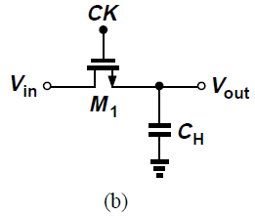
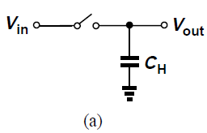
MOSFETS as Switches
Sampling circuit consists of a switch and a capacitor [Fig. (a)]
MOS transistor can function as switch [Fig. (b)] since it can be on while carrying zero current

Slide 12
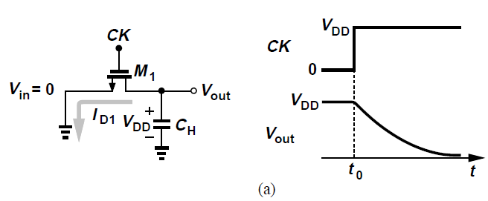
MOSFETS as Switches
CK goes high at t = t₀
Assume V_{in} = 0 and capacitor has initial voltage V_{DD}
At t = t₀, M₁ is in saturation and draws current
As V_{out} falls, at some point M₁ goes into triode region
C_{H} is discharged until V_{out} reaches zero
For V_{out} << 2(V_{DD} - V_{TH}), transistor is an equivalent resistor

Slide 13
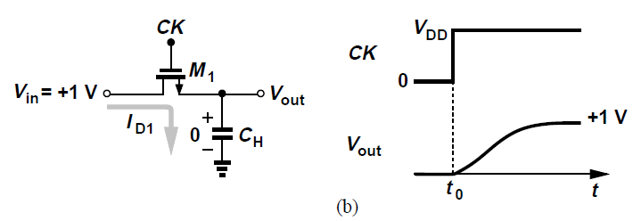
MOSFETS as Switches
If V_{in} = +1 V, V_{out}(t = t₀) = +0 V and V_{DD} = +3 V
Terminal of M₁ connected to C_{H} acts as source, and the transistor turns on with V_{GS} = +3 V but V_{DS} = +1 V
M₁ operates in triode region and charges C_{H} until Vout approaches +1 V
For V_{out} ≈ +1 V, M₁ exhibits an on-resistance of

Slide 14
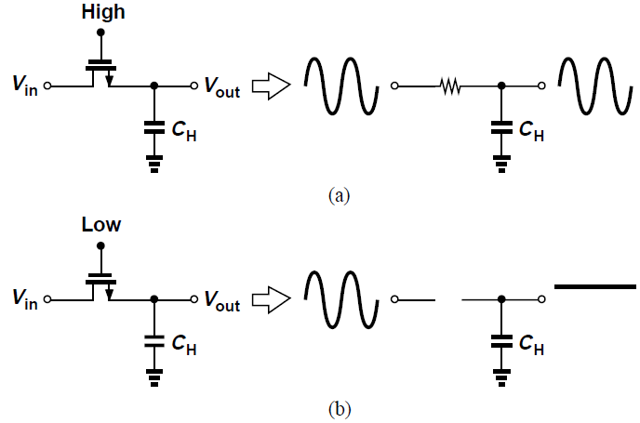
MOSFETS as Switches
When switch is on [Fig. (a)], V_{out} follows V_{in}
When switch is off [Fig. (b)], V_{out} remains constant
Circuit “tracks” signal when CK is high and “freezes” instantaneous value of V_{in} across C_{H} when CK goes low

Slide 15
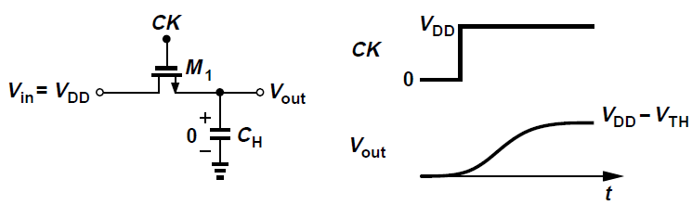
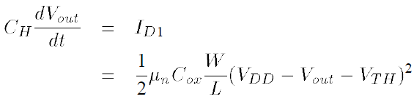
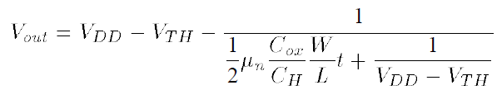
MOSFETS as Switches
Suppose V_{in} = V₀ instead of +1 V
M₁ is saturated and we have:
Solving,
As t → ∞, V_{out} → V_{DD} - V_{TH} so NMOS cannot pull up to V_{DD}

Slide 16
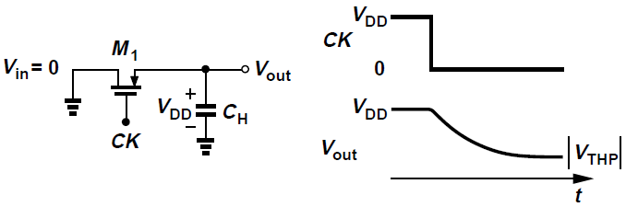
MOSFETS as Switches
Similarly, PMOS transistor fails to operate as a switch if gate is grounded and drain senses an input voltage of |V_{THP}| or less
On resistance rises rapidly as input and output levels fall to |V_{THP}| above ground

Slide 17
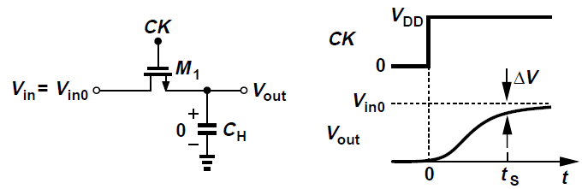
MOSFETS as Switches: Speed Considerations
Measure of speed is the time required for output to go from zero to the maximum input level after switch turns on
Consider output settled within a certain “error band” ΔV around final value
If output settles to 0.1% accuracy after t_{S} seconds, then ΔV/Vin0 = 0.1%
After t = t_{S}, consider source and drain voltages to be approximately equal

Slide 18
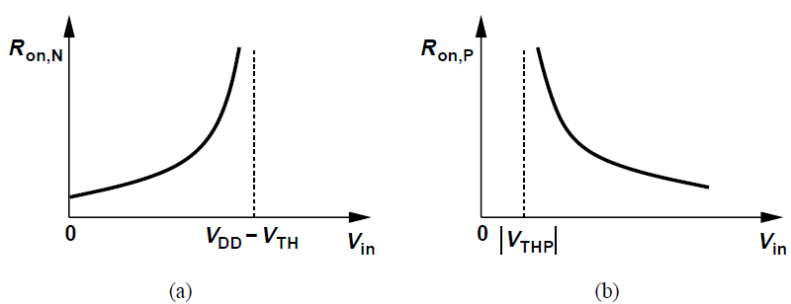
MOSFETS as Switches: Speed Considerations
Sampling speed is given by two factors: switch on-resistance and sampling capacitance
For higher speed, large aspect ratio and small capacitance are needed
On-resistance also depends on input level for both NMOS and PMOS

Slide 19
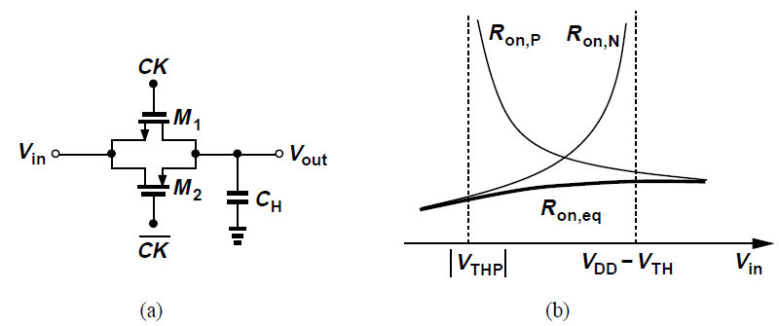
MOSFETS as Switches: Speed Considerations
To allow greater input swings, we can use “complementary” switches, requiring complementary clocks [Fig. (a)]
Equivalent on-resistance shows following behavior [Fig. (b)], revealing much less variation

Slide 20
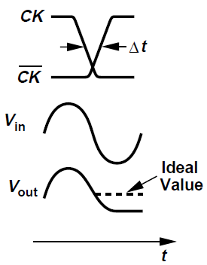
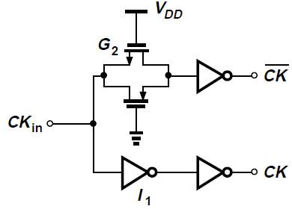
MOSFETS as Switches: Speed Considerations
For high speed signals, NMOS and PMOS switches must turn off simultaneously to avoid ambiguity in sampled value
If NMOS turns off Δt seconds before PMOS, output tends to track input for the remaining Δt seconds, causing distortion
For moderate precision, circuit below is used to provide complementary clocks

Slide 21
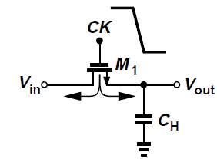
MOSFETS as Switches: Precision Considerations
Speed trades with precision
Channel Charge Injection:
For MOSFET to be on, a channel must exist at the oxide-silicon interface
Assuming V_{in} ≈ V_{out}, total charge in the inversion layer is
When switch turns off, Q_{ch} exits through the source and drain terminals (“channel charge injection”)

Slide 22
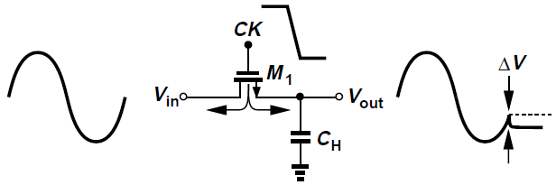

MOSFETS as Switches: Precision Considerations
Charge injected to the left is absorbed by input source, creating no error
Charge injected to the right deposited on C_{H}, introducing error in voltage stored on capacitor
For half of Q_{ch} injected onto C_{H}, error (negative pedestal) equals

Slide 23
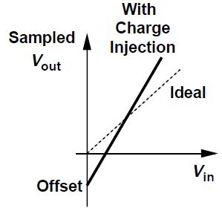


MOSFETS as Switches: Precision Considerations
If all of the charge is deposited on C_{H},
Since we assume Q_{ch} is a linear function of V_{in}, circuit exhibits only gain error and dc offset

Slide 24

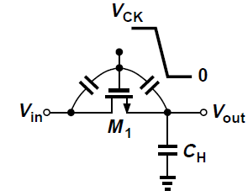
MOSFETS as Switches: Precision Considerations
Clock Feedthrough:
MOS switch couples clock transitions through C_{GD} or C_{GS}
Sampled output voltage has error due to this give by
C_{ov} is the overlap capacitance per unit width
Error ΔV is independent of input level, manifests as constant offset in the input/output characteristic

Slide 25

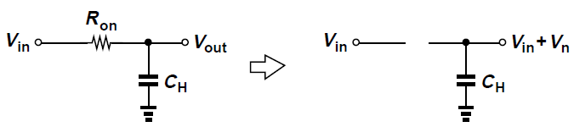
MOSFETS as Switches: Precision Considerations
kT/C Noise:
Resistor charging a capacitor gives a total RMS noise voltage of
On resistance of switch introduces thermal noise at output which is stored on the capacitor when switch turns off
RMS voltage of sampled noise is still approximately equal to

Slide 26
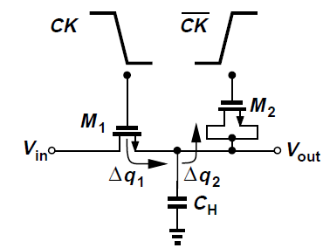


Charge Injection Cancellation
Charge injected by main transistor removed by a dummy transistor M₂
M₂ is driven by so that after M₁ turns off and M₂ turns on, channel charge deposited by M₁ on C_{H} is absorbed by M₂ to create a channel
If W₂ = 0.5W₁, then charge injected by M₁, Δq₁ is equal to that absorbed by M₂

Slide 27
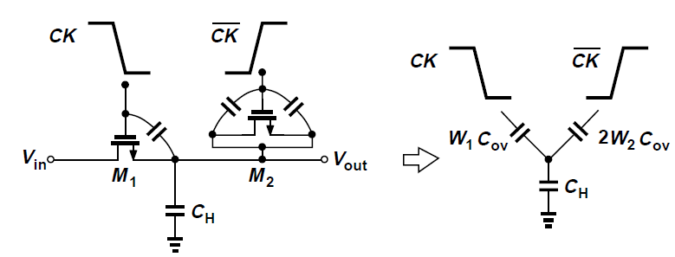
Charge Injection Cancellation
If W₂ = 0.5W₁ and L₂ = L₁, effect of clock feedthrough is suppressed
Total change in V_{out} is zero because

Slide 28
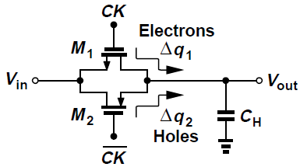

Charge Injection Cancellation
Incorporate both PMOS and NMOS devices so that opposite charge packets injected cancel each other
For Δq₁ to cancel Δq₂, we must have
Cancellation occurs for only one input level
Clock feedthrough is not completely suppressed since C_{GD} of NFETs is not equal to that PFETs

Slide 29
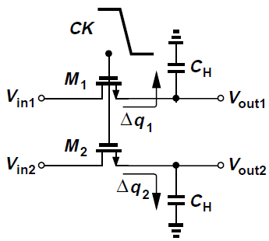

Charge Injection Cancellation
Charge injection appears as a common-mode disturbance, may be countered by differential operation
Δq₁ = Δq₂ only if V_{in1} = V_{in2}, thus overall error is not suppressed for differential signals
Removes constant offset and nonlinear component

Slide 30
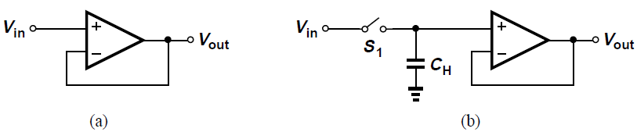
Unity-Gain Sampler/ Buffer
For discrete-time applications, unity-gain amplifier [Fig. (a)] requires a sampling circuit [Fig. (b)]
Accuracy limited by input-dependent charge injected by S₁ onto C_{H}

Slide 31
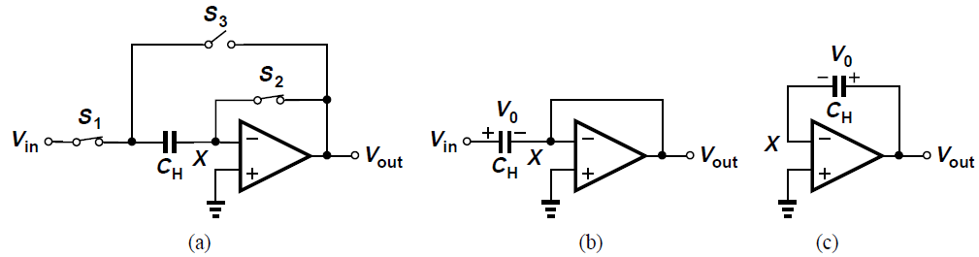
Unity-Gain Sampler/ Buffer
Consider the topology shown in Fig. (a)
In sampling mode, S₁ and S₂ are on, S₃ is off yielding circuit in Fig. (b)
Thus, V_{out} = V_{X} ≈ 0, and the voltage across C_{H} tracks V_{in}
At t = t₀, when V_{in} = V₀, S₁ and S₂ turn off and S₃ turns on, yielding circuit of Fig. (c) [amplification mode]
Op amp requires node X is still a virtual ground, V_{out} rises to approximately V₀→ “frozen” for processing by subsequent stages

Slide 32
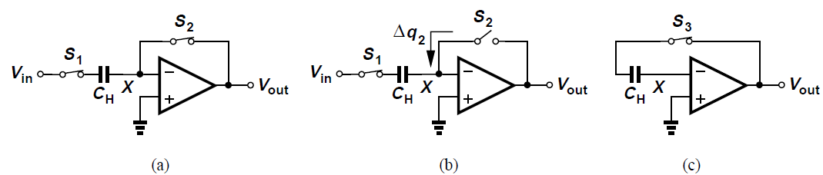
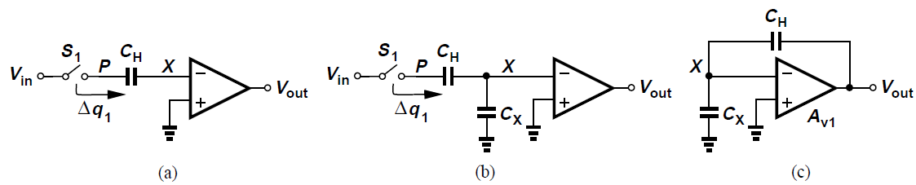
Unity-Gain Sampler/ Buffer
S₂ turns off slightly before S₁ during transition from sampling mode to amplification mode
Charge injected by S₂, Δq₂ is input-independent and constant, producing only an offset
After S₂ turns off, total charge at node X stays constant and charge injected by S₁ does not affect output voltage

Slide 33
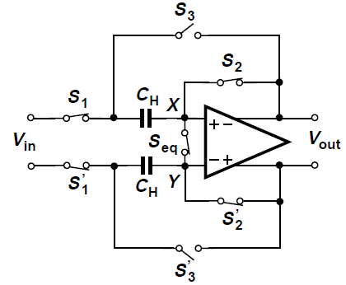
Unity-Gain Sampler/ Buffer
Input-independent charge injected by S₂ can be cancelled by differential operation as shown
Charge injected by S₂ and S₂’ appears as common-mode disturbance at nodes X and Y
Charge injection mismatch between S₂ and S₂’ resolved by adding another switch S_{eq} that turns off slightly after S₂ and S₂’, equalizing the charge at nodes X and Y

Slide 34
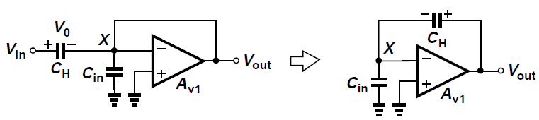
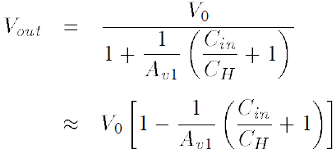

Unity-Gain Sampler/ Buffer
Precision Considerations:
Assume op-amp has a finite input capacitance C_{in} and calculate output voltage when circuit goes from sampling to amplification mode
It can be shown from the above fig. that
Circuit suffers from gain error of approximately

Slide 35
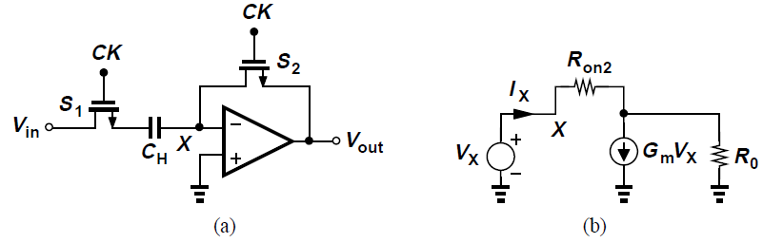

Unity-Gain Sampler/ Buffer
Speed Considerations:
In sampling mode, circuit appears as in Fig. (a)
Use equivalent circuit of Fig. (b) to find time constant in sampling mode
Total resistance in series with C_{H} is R_{on1} and the resistance between X and ground, R_{X}

Slide 36




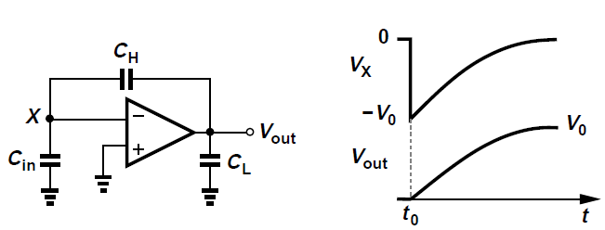
Unity-Gain Sampler/ Buffer
Since typically and ,
Time constant in sampling mode is thus
Consider circuit as it enters amplification mode
Circuit must begin with V_{out} ≈ 0 and eventually produce V_{out} ≈ V₀
For relatively small C_{in}, voltages across C_{L} and C_{H} do not change instantaneously so that V_{X} = -V₀ at the beginning of amplification

Slide 37
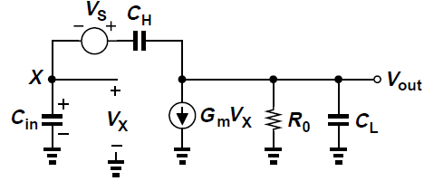

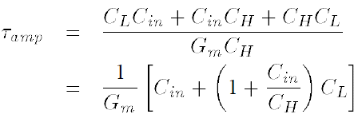
Unity-Gain Sampler/ Buffer
Represent charge on C_{H} by a voltage source V_{S} that goes from zero to V₀ at t = t₀, while C_{H} carries no charge itself
The transfer function V_{out}(s)/V_{in}(s) can be obtained as
This response is characterized by a time constant independent of op-amp output resistance

Slide 38
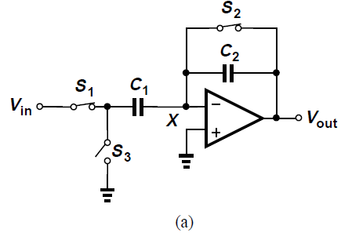
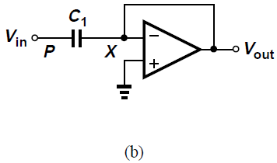
Noninverting Amplifier
In non-inverting amplifier of Fig. (a), in sampling mode, S₁ and S₂ are on while S₃ is off, creating a virtual ground at X and allowing voltage across C₁ to track V_{in} [Fig. (b)]

Slide 39

Noninverting Amplifier
At the end of sampling mode, S₂ turns off first, injecting a constant charge Δq₂ onto node X, after which S₁ turns off and S₃ turns on [Fig. (c)]
Since V_{P} goes from V_{in0} to 0, output voltage changes from 0 to approximately V_{in0}(C₁/C₂), providing a gain of C₁/C₂
Called a “noninverting amplifier” since output polarity is the same as V_{in0} and the gain can be greater than unity

Slide 40

Noninverting Amplifier
Noninverting amplifier avoids input-depending charge injection by turning off S₂ before S₁
After S₂ is off, total charge at node X remains constant, making the circuit insensitive to charge injection of S₁ or charge “absorption” of S₃

Slide 41

Noninverting Amplifier
Charge injected by S₁, Δq₁ changes voltage at node P by ΔV_{P} = Δq₁/C₁ and output voltage by -Δq₁C₁/C₂
After S₃ turns on, V_{P} becomes zero so overall change in V_{P} is 0 – V_{in0} = -V_{in0}, producing overall change in output of –V_{in0}(-C₁/C₂) = V_{in0}C₁/C₂
V_{P} goes from V₀ to 0 with a perturbation due to S₁
Since output is measure after node P is connected to ground, charge injected by S₁ does not affect final output

Slide 42


Noninverting Amplifier
Precision Considerations:
Calculate actual gain if op amp has finite open-loop gain of A_{v1} and input capacitance C_{in}
It can be shown that
Amplifier suffers from a gain error of
Gain error increases with the nominal gain C₁/C₂

Slide 43



Noninverting Amplifier
Speed Considerations:
Consider equivalent circuit in amplification mode [Fig. (a)]
It can be shown for a large G_{m}R₀ that
This gives a time constant of

Slide 44


Precision Multiply-by-Two Circuit
Topology shown in Fig. (a) provides a nominal gain of two while achieving higher speed and lower gain error
Incorporates two equal capacitors C₁ = C₂ = C
In sampling mode [Fig. (b)], node X is a virtual ground, allowing voltage across C₁ and C₂ to track V_{in}

Slide 45


Precision Multiply-by-Two Circuit
During transition to amplification mode [Fig. (c)], S₃ turns off first, placing C₁ around op-amp and left plate of C₂ is grounded
At the moment S₃ turns off, total charge on C₁ and C₂ equals 2V_{in0}C and since voltage across C₂ approaches zero in amplification mode, final voltage across C₁ and hence output are approximately 2V_{in0}
(c)

Slide 46





Switched-Capacitor Integrator
Output of a continuous-time integrator can be expressed as
In Fig. (a), resistor R carries a current of (V_{A} – V_{B})/R
In circuit of Fig. (b), C_{S} is alternately connected to nodes A and B at a clock rate f_{CK}
Average current flowing from A to B is the charge moved in one clock period
Can be viewed as a resistor of value

Slide 47


Switched-Capacitor Integrator
Fig. (a) shows discrete-time integrator
In every clock cycle, C₁ absorbs a charge equal to C₁V_{in} when S₁ is on and deposits it on C₂ when S₂ is on
If V_{in} is constant, output changes by V_{in}C₁/C₂ every clock cycle [Fig. (b)]
Final value of V_{out} after clock cycle can be written as

Slide 48


Switched-Capacitor Integrator
Input-dependent charge injection of S₁ introduces nonlinearity in output voltage
Nonlinear capacitance at node P resulting from source/drain junctions of S₁ and S₂ leads to a nonlinear charge-to-voltage conversion when C₁ is switched to X
Charge stored on the total junction capacitance, C_{j} is not equal to V_{in0}C_{j}, but rather equal to

Slide 49



Switched-Capacitor Integrator
Circuit of Fig. (a) resolves the issues in the simple integrator
In sampling mode [Fig. (b)], S₁ and S₃ are on, S₂ and S₄ are off, allowing voltage across C₁ to track V_{in} while op amp and C₂ hold previous value
In the transition to integration mode, S₃ turns off first, injecting a constant charge onto C₁, S₁ turns off next, and subsequently S₂ and S₄ turn on
Charge stored on C₁ is transferred to C₂ through the virtual ground node

Slide 50

Switched-Capacitor Common-Mode Feedback
In switched-capacitor common-mode feedback, outputs are sensed by capacitors rather than resistors
In circuit above, equal capacitors C₁ and C₂ reproduce at node X the average of the changes in each output voltage
If V_{out1} and V_{out2} experience a positive CM change, then V_{X} and I_{D5} increase, pulling V_{out1} and V_{out2} down
Output CM is V_{GS2} plus voltage across C₁ and C₂

Slide 51

Switched-Capacitor Common-Mode Feedback
Voltage across C₁ and C₂ defined as shown above
During CM level definition, amplifier differential input is zero and S₁ is on
M₆ and M₇ act as a linear sense circuit since their gate voltages are nominally equal
Circuit settles such that output CM level is equal to V_{GS6,7} + V_{GS5}
At the end of this mode, S₁ turns off, leaving a voltage equal to V_{GS6,7} across C₁ and C₂

Slide 52

Switched-Capacitor Common-Mode Feedback
For more accuracy in CM level definition, above circuit may be used
In the reset mode, one plate of C₁ and C₂ is switched to V_{CM} while the other is connected to the gate of M₆
Each capacitor sustains a voltage of V_{CM} – V_{GS6}
In the amplification mode, S₂ and S₃ are on and the other switches are off, yielding an output CM level of V_{CM} – V_{GS6} + V_{GS5}, which is equal to V_{CM} if I_{D3} and I_{D4} are copied properly from I_{REF} so that V_{GS5} = V_{GS6}

