Slide 1
Chapter 14: Nonlinearity and Mismatch
14.1 Nonlinearity
14.2 Mismatch

Slide 2
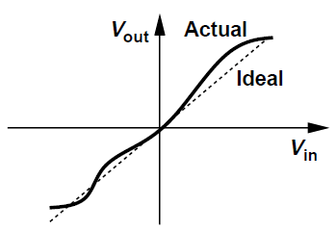
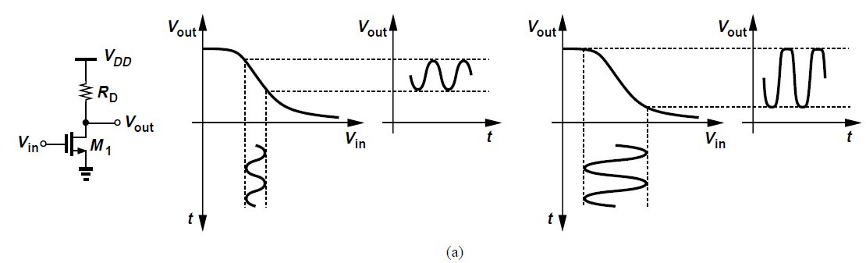
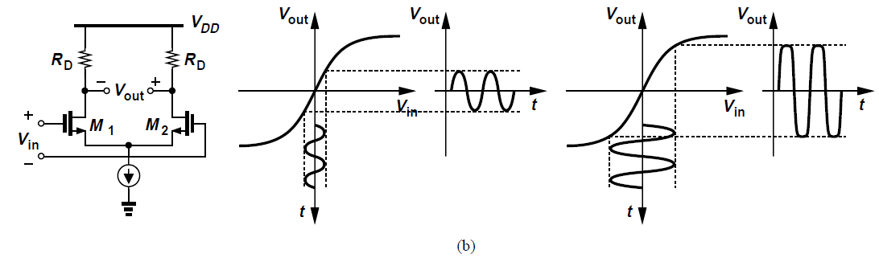
Nonlinearity: General Considerations
Nonlinear characteristic deviates from a straight line as the input swing increases
E.g., Common-source stage or differential pair

Slide 3
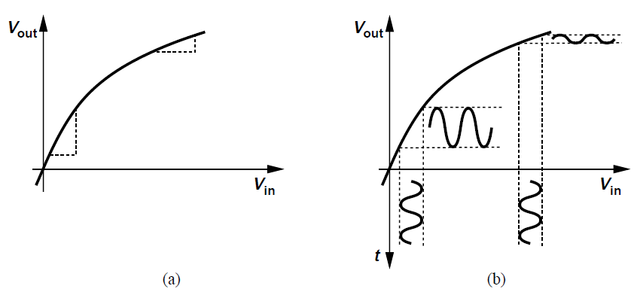
Nonlinearity: General Considerations
Nonlinear input/output characteristic can be approximated by a polynomial in the range of interest
For small x, y(t) ≈ α₁x, indicating that α₁ is the small-signal gain in the vicinity of x ≈ 0

Slide 4
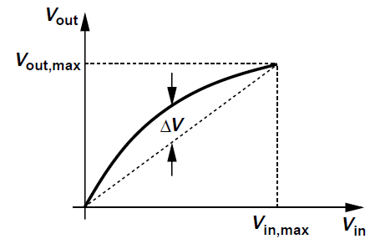
Nonlinearity: General Considerations
Nonlinearity can be quantified by specifying maximum deviation of characteristic from an ideal one
For voltage range of interest [0, V_{in,max}], pass straight line through end points of actual characteristic and obtain maximum deviation ΔV
Normalize to maximum output swing V_{out,max}
1% nonlinearity for an input range of 1 V means

Slide 5
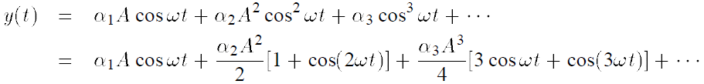

Nonlinearity: General Considerations
Nonlinearity can also be characterized by applying a sinusoid at input and measuring harmonic content of output
If then
Magnitude of n^{th} harmonic grows roughly in proportion to n^{th} power of input amplitude
Quantified by summing the power of all harmonics except fundamental and normalizing to power of fundamental, metric called as “total harmonic distortion” (THD)
For a third-order nonlinearity,

Slide 6
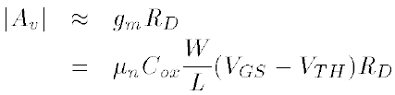
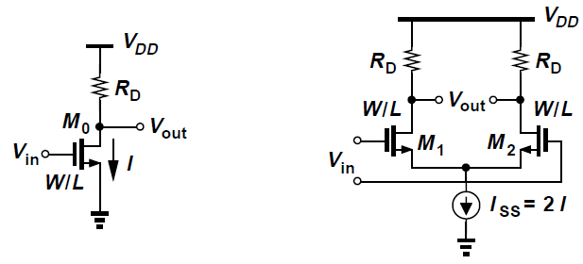
Nonlinearity of Differential Circuits
Differential circuits exhibit “odd-symmetric” characteristic
Even-order terms α_{2j} in polynomial must be zero:
Differential circuit driven by a differential signal produces no even harmonics
Consider two amplifiers providing equal small-signal voltage gain of

Slide 7



Nonlinearity of Differential Circuits
If an input V_{m}cosωt is applied to each circuit, for common-source stage,
Amplitude of second harmonic normalized to fundamental is
For the differential pair, it can be shown that
If , then
Differential pair exhibits much less distortion for same gain and output swing, at the cost of higher power

Slide 8
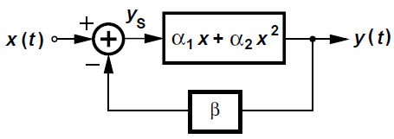


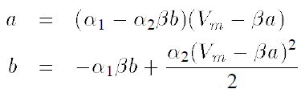
Effect of Negative Feedback on Nonlinearity
Expected that negative feedback would yield higher linearity for a closed-loop system
Consider a “mildly nonlinear” system below
Assume core amplifier has an input/output characteristic
Apply a sinusoidal input postulating that output contains a fundamental and second harmonic approximated as
Through simple analysis, we can get

Slide 9







Effect of Negative Feedback on Nonlinearity
Small nonlinearity means α₂ and b are small quantities, so that and hence
b can be found as
Normalize amplitude of second harmonic to that of fundamental
Without feedback, this ratio would be
Negative feedback reduces relative second harmonic by a factor of and gain by

Slide 10
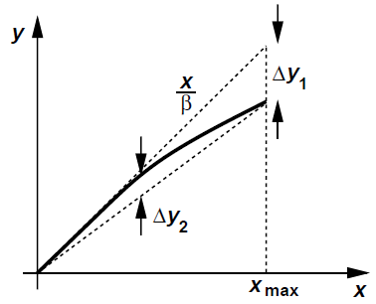


Effect of Negative Feedback on Nonlinearity
Feedforward amplifier in a feedback system suffers from gain error
For a feedforward gain A₀ and feedback factor β, relative gain error is approximately 1/(βA₀)
Possible to derive a relationship between gain error and maximum nonlinearity of overall feedback circuit
In above fig., nonlinearity is always less than gain error
Choose high open-loop amplifier gain so that to guarantee

Slide 11




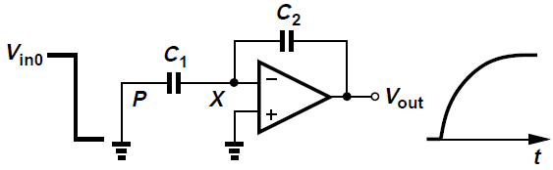
Capacitor Nonlinearity
For a linear capacitor, while for a voltage-dependent capacitor
Total charge on a capacitor sustaining a voltage V₁ is
Charge depends on “history” of voltage rather than instantaneous value
Express each capacitor as
Consider noninverting amplifier below
At the start of amplification mode, C₁ has a voltage of V_{in0} and C₂ a voltage of zero

Slide 12

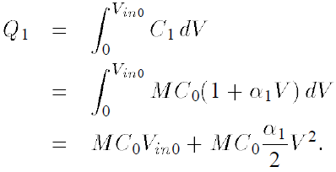
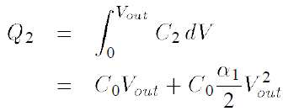


Capacitor Nonlinearity
Assuming where M is the nominal closed-loop gain, charge across C₁ is
Similarly, if , charge across it at the end of amplification mode is
Equating Q₁ and Q₂ and solving for V_{out},
For and for small α₁,
Second term represents nonlinearity resulting from capacitor voltage-dependence

Slide 13
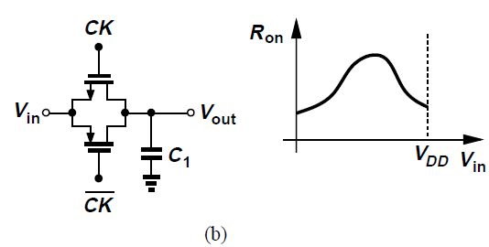
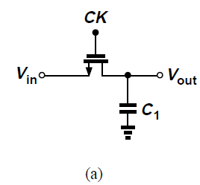
Nonlinearity in Sampling Circuits
On-resistance of MOS switches varies with input and output levels
NMOS switch in Fig. (a) exhibits rising resistance as V_{in} and V_{out} increase
Complementary topology of Fig. (b) displays varying equivalent resistance as V_{in} and V_{out} go from 0 to V_{DD}
R_{on} reaches a peak here due to dependence of mobility on the vertical field in the channel

Slide 14

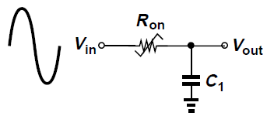


Nonlinearity in Sampling Circuits
We apply a large sinusoid to the input, where V₀ = V_{DD}/2 and seek harmonics at the output
First assume resistance is linear and write output as
In practice, bandwidth must be large enough to negligibly attenuate the signal, i.e., so that
Assume this expression holds for the nonlinear circuit if R_{on} is represented properly
Phase shift from input to output varies as V_{in} and V_{out} vary, creating distortion

Slide 15
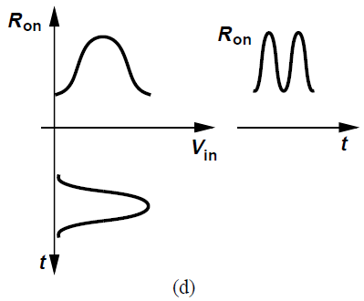
Nonlinearity in Sampling Circuits
For a periodic input, R_{on} also varies periodically and can be approximated by a Fourier series
For a roughly symmetric behavior of R_{on}, the time-domain behavior below is observed where R_{on} varies at twice the input frequency
Thus,

Slide 16

Nonlinearity in Sampling Circuits
For cosine terms with arguments much less than 1 rad,
If only first two harmonics are retained, then
In a differential sampling switch, even-order harmonics are suppressed

Slide 17
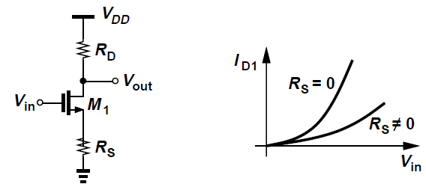

Linearization Techniques
Principle behind linearization is to reduce dependence of circuit’s gain on input level
Make gain relatively independent of bias currents
Simplest method is by means of a linear resistor
Overall transconductance of degenerated CS stage is
For large g_{m}R_{S}, this approaches 1/R_{S}, an input-independent value

Slide 18
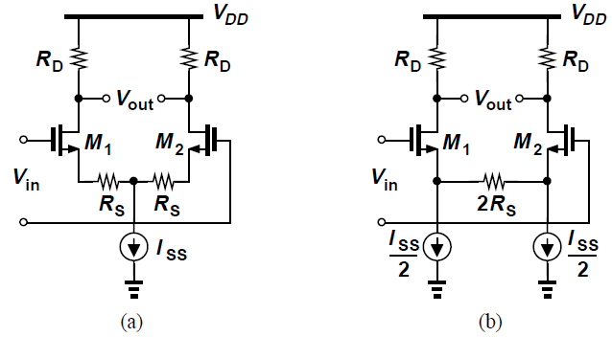
Linearization Techniques
Differential pair can be degenerated as shown in Figs. (a) and (b)
In Fig. (a), degeneration resistors consume headroom of I_{SS}R_{S}/2
Circuit of Fig. (b) does not have this issue but suffers from higher noise and offset voltage

Slide 19
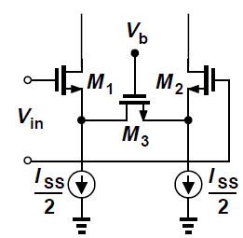
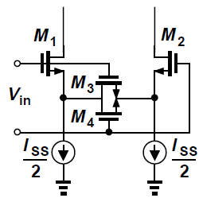
Linearization Techniques
Degeneration resistor can be replaced by a MOSFET operating in deep triode region [Fig. (a)]
For large input swings, M₃ may not remain in deep triode
V_{b} must track V_{in,CM} so that R_{on} is defined accurately
Fig. (b) shows more a practical solution where M₃ and M4 are in deep triode for V_{in} = 0
As V_{G1} > V_{G2}, M₃ stays in triode since V_{D3} = V_{G3} – V_{GS1}
M₄ eventually enters saturation since V_{D4} rises whereas V_{G4}, V_{S4} fall
(a)
(b)

Slide 20
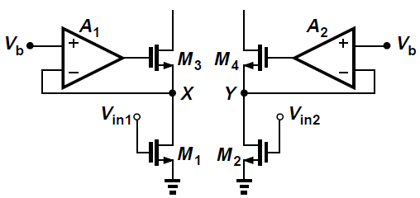
Linearization Techniques
MOSFET operating in triode region can provide a linear I_{D}/V_{DS} characteristic if V_{DS} is held constant
This technique employs amplifiers A₁ and A₂ with cascode devices M₃ and M₄ to force V_{X} and V_{Y} to be equal to V_{b} for varying input levels
g_{m1} = g_{m2} = is small since V_{DS} must be low to ensure M₁, M₂ remain in triode region
V_{in,CM} must be tightly controlled to track V_{b} to define I_{D1} and I_{D2}

Slide 21
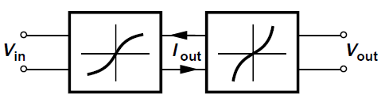


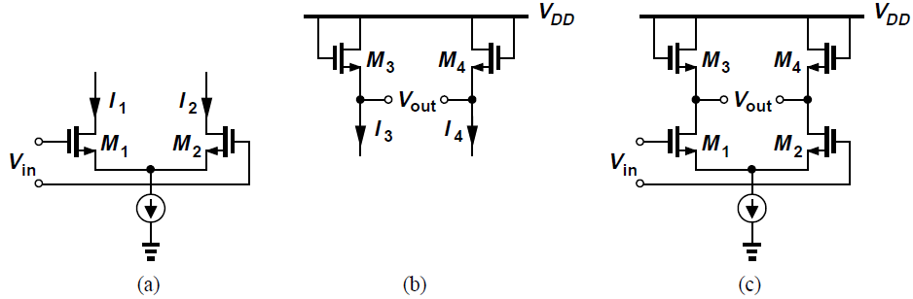
Linearization Techniques
Another approach to linearization: “post-correction”
View the amplifier as a cascade of voltage-to-current (V/I) converter and a current-to-voltage (I/V) converter
If the V/I converter can be described as and the I/V converter as , then V_{out} is a linear function of V_{in} , for e.g. Figs. (a), (b), (c)

Slide 22
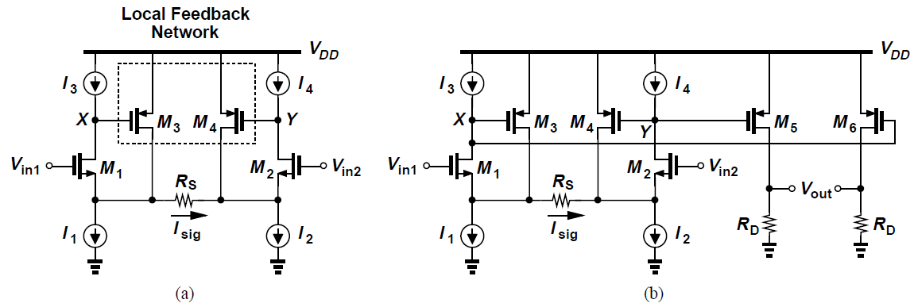
Linearization Techniques
Possible to linearize differential pair further by adding local feedback
Sense output voltage by means of M₃ and M₄ and return a proportional current to the sources of M₁ and M₂
Assume circuit is symmetric and I₁ = … = I₄
Ignoring CLM and body-effect, I_{D1} = I₃ and I_{D2} = I₄ regardless of the input signal

Slide 23



Linearization Techniques
Input transistors maintain a constant V_{GS} as V_{in} = V_{in1} – V_{in2} varies
Current through R_{S} (I_{sig}) must be provided only by M₃ and M₄, we have
Output voltage of this topology can be found to be
Large number of devices in signal path produce significant noise
Dependence of r_{O} upon V_{DS} in short-channel devices introduces some nonlinearity

Slide 24
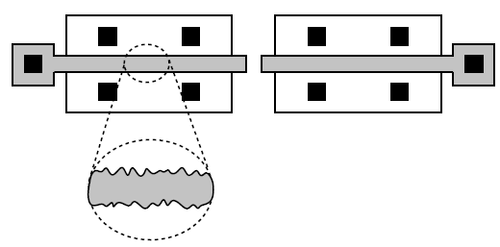
Mismatch
Nominally-identical devices suffer from finite mismatch due to uncertainties in manufacturing process
Gate dimensions of MOSFETs suffer from random, microscopic variations and introduce mismatches between two transistors identically laid out
MOS devices exhibit V_{TH} mismatches since V_{TH} is a function of doping levels in the channel and gate which vary randomly

Slide 25
Mismatch
Study of mismatch consists of two steps:
  Identify and formulate the mechanisms leading to mismatch between devices
  Analyze the effect of device mismatches upon the performance of circuits
For a MOSFET in saturation,
Mismatches between μ, C_{ox}, W, L, and V_{TH} result in mismatches between I_{D}’s (for a given V_{GS}) or V_{GS}’s (for a given I_{D}) of two nominally-identical transistors
Intuitively, as W and L increase, their relative mismatches ΔW/W and ΔL/L, i.e., larger devices exhibit smaller mismatches

Slide 26
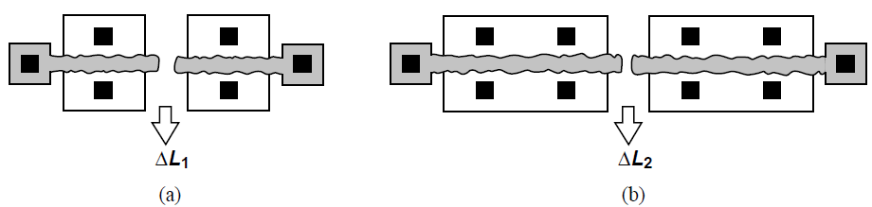



Mismatch
All mismatches decrease as the area, WL increases
As WL increases, random variations experience greater “averaging”, falling in magnitude
For the above case, ΔL₂ < ΔL₁ because if the device is viewed as many smaller parallel transistors, each with width W0, equivalent length is
Overall variation is given by
ΔL₀ is the statistical variation of length of a transistor with width W₀

Slide 27
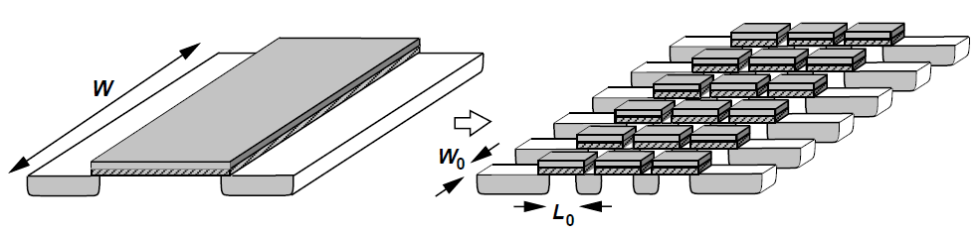
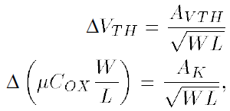
Mismatch
μC_{ox} and V_{TH} suffer from less mismatch if device area increases
A large transistor can be decomposed into a series and parallel combination of small unit transistors with dimensions W₀ and L₀, each exhibiting (μC_{ox})_{j} and V_{THj}
These experience greater averaging as number of unit transistors increases
A_{VTH} and A_{K} are proportionality factors

Slide 28
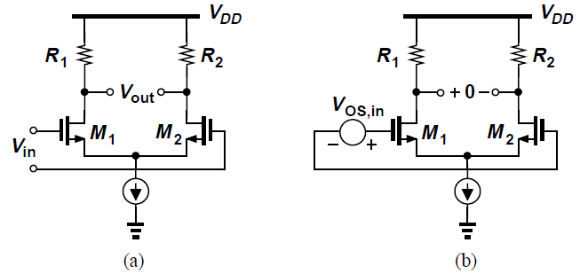
Effect of Mismatch
Mismatches lead to three distinct phenomena:
  DC offsets
  Finite even-order distortion
  Lower common-mode rejection
DC Offsets:
In differential pair of Fig. (a), with V_{in} = 0 and perfect symmetry, V_{out} = 0 but with mismatches V_{out} ≠ 0
Circuit suffers from a “dc offset” equal to the observed value of V_{out} when V_{in} is set to zero

Slide 29

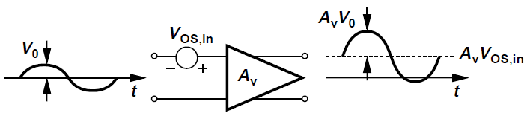
Effect of Mismatch
More meaningful to specify input-referred offset voltage, defined as the input level that forces the output to go to zero
Note that
If a differential pair is to amplify a small input voltage, output contains amplified replicas of both the signal and the offset
In a cascade of direct-coupled amplifiers, the dc offset may experience so much gain that it drives the latter stage into nonlinear operation

Slide 30
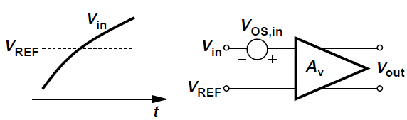


Effect of Mismatch
DC offset also affects the precision with which signals can be measured
If an amplifier is to determine whether the input signal is greater or less than a reference, V_{REF}, then the input-referred offset imposes a lower bound on the minimum V_{in} – V_{REF} that can detected reliably
Input-referred offset voltage of a differential pair can be found as
More accurately,

Slide 31


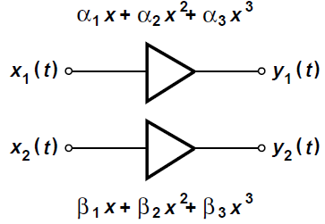
Effect of Mismatch
Even-Order Distortion:
Mismatches introduce finite even-order nonlinearity in differential circuits
If the two signal paths in a differential circuit are represented by and llllll the differential output is given by
For , this reduces to

Slide 32

Effect of Mismatch
If , the second harmonic has an amplitude of , i.e., proportional to the mismatch between second-order coefficients of the input/output characteristic
At high frequencies, signals experience considerable phase shift, even-order distortion may arise from phase mismatch
In circuits dissipating a high power, thermal gradients across the chip may create asymmetries

Slide 33
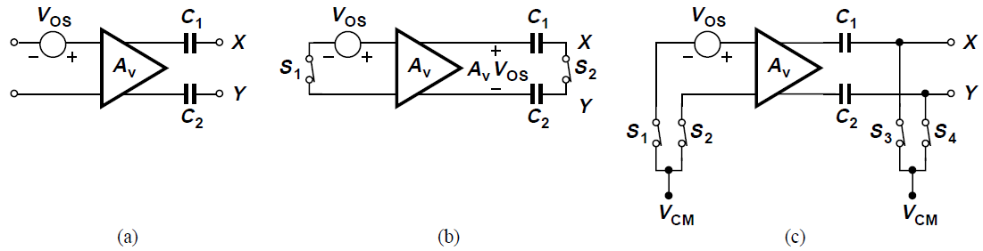
Offset Cancellation Techniques
Differential amplifier with an input-referred offset is followed by two series capacitors [Fig. (a)]
As shown in Fig. (b), inputs are shorted together, driving amplifier output to V_{out} = A_{v}V_{OS}
Assume V_{X} and V_{Y} are shorted during this period as well
A_{v}V_{OS} is stored across C₁ and C₂, zero differential input results in zero differential output
After S₁ and S₂ turn off, there is zero offset voltage
Proper CM voltage needed at input and output

Slide 34
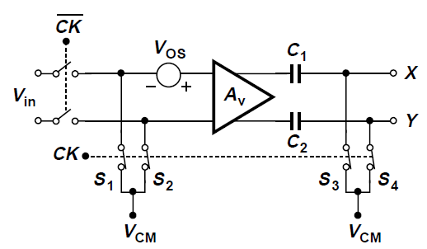
Offset Cancellation Techniques
This technique “measures” the offset by setting the differential input to zero and stores the result on capacitors in series with the output
Requires a dedicated offset-cancellation period during which actual input is disabled
Called “output offset storage”, this technique reduces overall mismatch if S₃-S₄ do not have charge injection mismatch
Large A_{v} may saturate output, hence A_{v} of roughly 10 is used

Slide 35
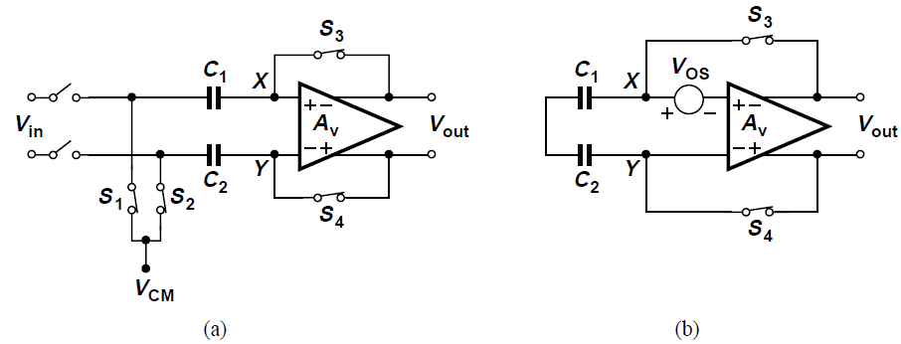
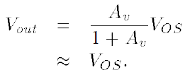
Offset Cancellation Techniques
In application requiring high voltage gain, topology of Fig. (a) may be used
Called “input offset storage”, this incorporates two series capacitors at the input and places amplifier in unity-gain feedback loop during offset cancellation
From Fig. (b),
V_{OS,in} equal V_{OS}/A_{v} if S₃ and S₄ match perfectly

Slide 36
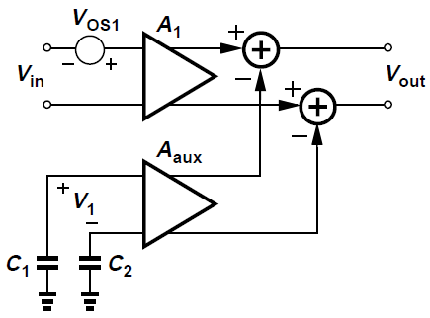

Offset Cancellation Techniques
Offset cancellation can isolate signal path from offset storage capacitors by use of “auxiliary” amplifier
Consider above circuit, where A_{aux} amplifies the differential voltage V₁ stored across C₁ and C₂ and subtracts the result from the output of A₁
If , then for V_{in} = 0, V_{out} = 0 and circuit is free from offsets
C₁ and C₂ do not appear in the signal path

Slide 37


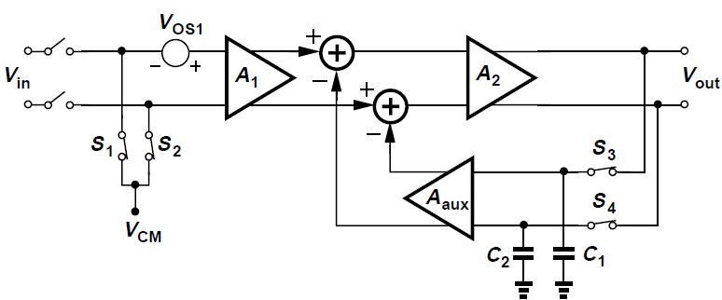
Offset Cancellation Techniques
V₁ is generated by adding a second stage, A₂ and the output is sensed by A_{aux} during offset cancellation
First only S₁ and S₂ are on, yielding
Next, assume S₃ and S₄ turn on , placing A₂ and A_{aux} in a negative feedback loop
V_{out} drops by a factor approximately equal to the loop gain:
Stored across C₁ and C₂, this value is indeed the required V₁ because

Slide 38
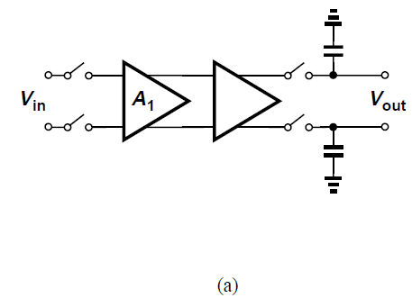
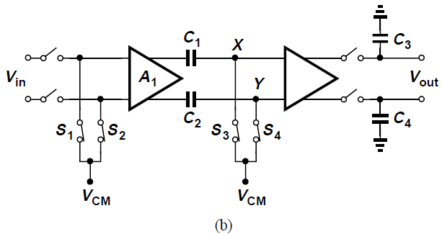
Reduction of Noise by Offset Cancellation
Offset of a differential amplifier can be viewed as a noise component having a very low frequency
Consider a differential amplifier to be used at the front end of a sampling system [Fig. (a)]
Noise of A₁ directly corrupts V_{in}, especially 1/f noise
In Fig. (b), amplifier undergoes offset cancellation before every sampling operation
If time elapsed from end of offset cancellation to end of sampling is Δt, noise frequencies below 1/Δt are suppressed

Slide 39


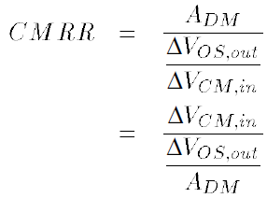
Alternative Definition of CMRR
Consider a differential circuit sensing an input CM change, ΔV_{in,CM}
If the differential output voltage changes by ΔV_{out} while the differential input voltage is zero, we can say that the output offset voltage of the circuit has changed by ΔV_{out}
In other words,
Since , we have

Slide 40


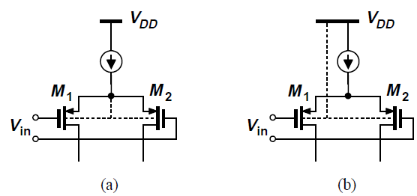
Alternative Definition of CMRR
Since is the input-referred offset voltage, we have
This result proves useful in analyzing behavior of circuits
In circuit of Fig. (a), body effect is eliminated and V_{TH1,2} does not depend on V_{in,CM}
M₁, M₂ in Fig. (b) experience body effect and thus have mismatch in V_{TH1} and V_{TH2}, degrading its CMRR

