Slide 1
Chapter 7: Noise
7.1 Statistical Characteristics of Noise
7.2 Types of Noise
7.3 Representation of Noise in Circuits
7.4 Noise in Single-Stage Amplifiers
7.5 Noise in Current Mirrors
7.6 Noise in Differential Pairs
7.7 Noise-Power Tradeoff
7.8 Noise Bandwidth
7.9 Problem of Input Noise Integration

Slide 2
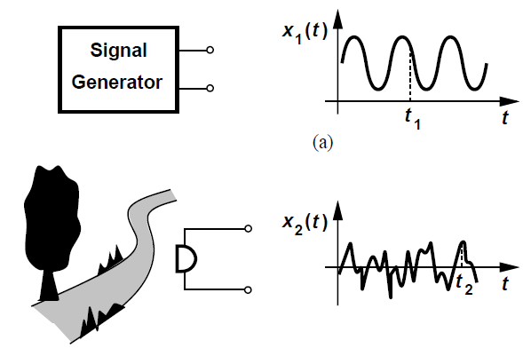
Statistical Characteristics of Noise
Noise is a random process
Value of x₁(t₁) can be predicted from observed waveform, that of x₂(t₂) cannot
  Difference between deterministic and random phenomena
Instantaneous value of noise in time domain is unpredictable

Slide 3
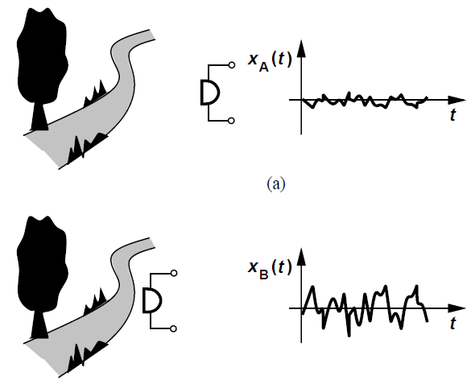

Statistical Characteristics of Noise
Need for a “statistical model” for noise
Average power of noise is predictable
  Applicable to most sources of noise in circuits
Average power delivered by a periodic voltage v(t) with period T to a load resistance R_{L} is defined as

Slide 4

Statistical Characteristics of Noise
For a random signal (aperiodic), measurement must be carried out over a long time
x(t) is a voltage quantity
x_{A}(t) delivers more power to a resistive load than x_{B}(t)

Slide 5
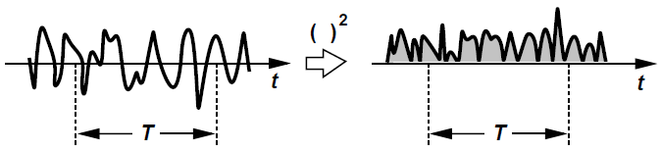


Statistical Characteristics of Noise
To calculate average power of (noise) signal x(t)
  Square the signal
  Find area under resulting waveform for a long period T
  Normalize area to T
For simpler calculations, P_{av} is defined as
P_{av} is expressed in V² rather than W
RMS voltage for noise can be defined as

Slide 6
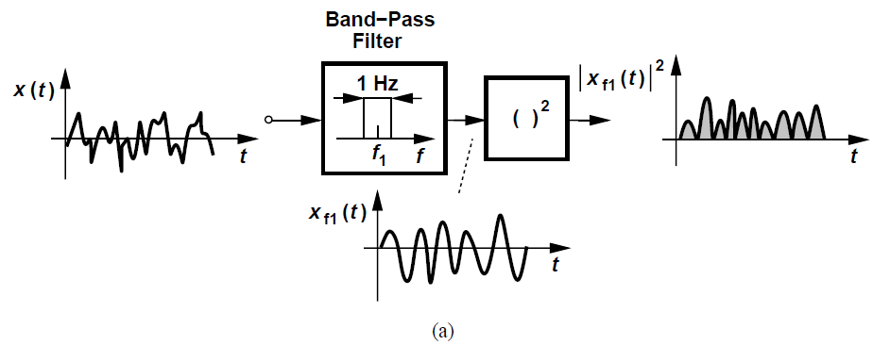
Noise Spectrum
Spectrum describes the frequency content of noise
Also called Power Spectral Density (PSD)
  Shows how much power signal carries at each frequency
PSD S_{x}(f) of a noise waveform x(t) is defined as the average power carried by x(t) in a 1-Hz bandwidth around f
Fig. (a) shows calculation of S_{x}(f₁), i.e., power contained in a specific frequency f₁

Slide 7
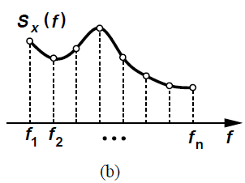
Noise Spectrum
Repeating previous procedure with bandpass filters with different center frequencies, the overall PSD S_{x}(f) can be constructed [Fig. (b)]
S_{x}(f) Represents the power carried by signal (or noise) at all frequencies, i.e., total power
  Generally measured in Watts per Hertz
In signal processing theory, PSD is defined as Fourier transform of Autocorrelation function
  Two definitions are equivalent

Slide 8
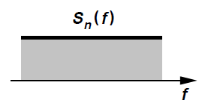
Noise Spectrum
As with P_{av}, it is customary to eliminate R_{L} from S_{x}(f)
S_{x}(f) is expressed in V²/Hz rather than W/Hz
Also common to take the square root of S_{x}(f), expressing result in V/√Hz
Common type of noise PSD is “white noise”
  Displays same value at all frequencies
White noise does not exist strictly speaking since total power carried by noise cannot be infinite
Noise spectrum that is flat in the band of interest is usually called white

Slide 9

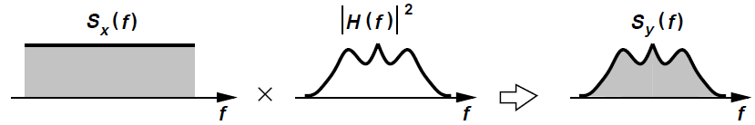
Theorem
If a signal with spectrum S_{x}(f) is applied to a linear time-invariant (LTI) system with transfer function H(s), then the output spectrum S_{Y}(f) is given by
where H(f) = H(s = j2πf)
Spectrum of signal is “shaped” by the transfer function of the system (see Fig. below)

Slide 10
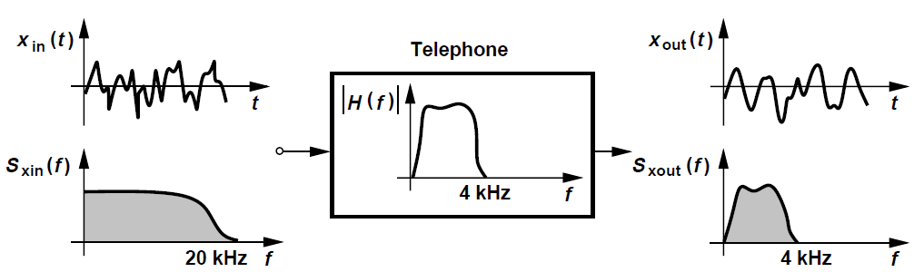
Theorem: Example
Regular telephones have a bandwidth of approximately 4kHz and suppress higher frequency components in caller’s voice
Due to limited bandwidth, x_{out}(t) exhibits slower changes than x_{in}(t)
  Can be difficult to recognize the caller’s voice

Slide 11
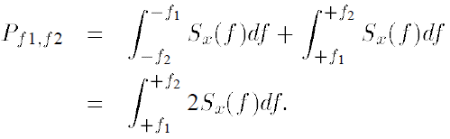
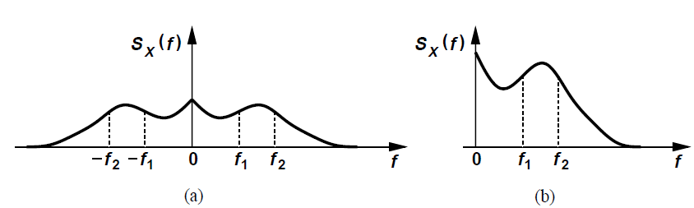
Two-sided and one-sided spectra
S_{x}(f) is an even function of f for real x(t)
The total power carried by x(t) in the frequency range [f₁, f₂] is equal to
Negative-frequency part of the spectrum is folded around the vertical axis and added to the positive-frequency part
Fig. (a) is called “two-sided” spectrum and Fig. (b) is called “one-sided” spectrum

Slide 12
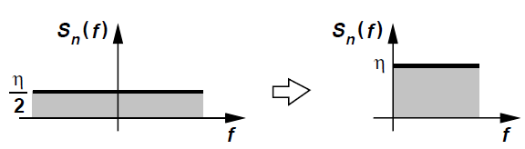
Two-sided and one-sided spectra
Two-sided white spectrum can be folded around the vertical axis to give a one-sided white spectrum as shown above
Spectrum shows the power carried in a small bandwidth at each frequency, revealing how fast the waveform is expected to vary in the time domain

Slide 13
Amplitude Distribution
Although instantaneous value of noise is unpredictable, it is possible to construct a “distribution” of the amplitude by observing the noise waveform for a long time
  The distribution indicates how often each value occurs
Also called the “Probability Density Function” (PDF), the distribution of x(t) is defined as
where X is the measured value of x(t) at some point in time

Slide 14
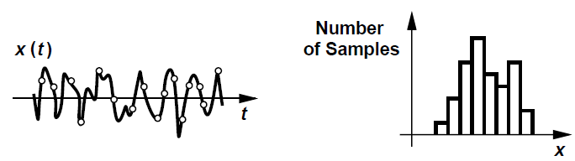
Amplitude Distribution
To estimate distribution, we sample x(t) at many points, construct bins of small width, choose bin height equal to number of samples whose value falls between two edges of the bin and normalize bin heights to total number of samples
Fig. below shows an example amplitude distribution
PDF provides no information as to how fast x(t) varies in the time domain, i.e., the frequency content of x(t)

Slide 15

Central Limit Theorem
The Central Limit Theorem states that if many independent random processes with arbitrary PDFs are added, the PDF of the sum approaches a Gaussian distribution
Many natural phenomena exhibit Gaussian statistics
  E.g., noise of a resistor that results from the random “walk” of a very large number of electrons, each with independent statistics
The Gaussian PDF is defined as
σ and m are the standard deviation and mean of the distribution respectively
For a Gaussian distribution, σ is equal to the rms value of the noise

Slide 16
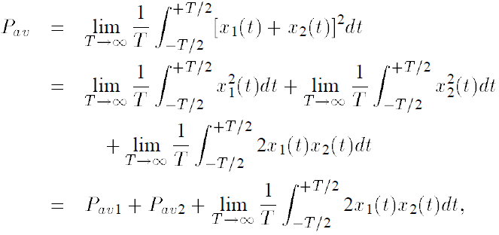
Correlated and Uncorrelated Sources
The Superposition Principle is applicable to deterministic voltages and currents, but not very suitable for random noise signals
Average noise power is of more interest
Consider the sum of two noise waveforms x₁(t) and x₂(t) and take the average of the resulting power
P_{av1} and P_{av2} denote the average power of x₁(t) and x₂(t) respectively
Third term is called “correlation” between x₁(t) and x₂(t)

Slide 17
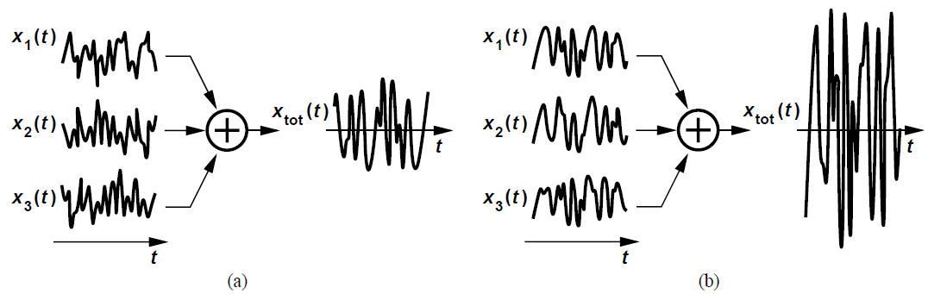
Correlated and Uncorrelated Sources
Correlation integral indicates how “similar” the two waveforms are
Noise waveforms generated by independent devices are uncorrelated and integral vanishes to zero
  P_{av} = P_{av1} + P_{av2}
Superposition holds for the power of uncorrelated noise sources
Total power of correlated noise sources [Fig. (a)] is higher than that of uncorrelated sources [Fig. (b)]

Slide 18


Signal-to-Noise Ratio (SNR)
Signal-to-noise ratio (SNR) is defined as
SNR of a noise-corrupted signal should be high for it to be intelligible
  Audio signals require a minimum SNR of 20 dB
For a sinusoid with peak amplitude A, P_{sig} = A²/2
The total average power carried by noise is equal to the area under its spectrum
P_{noise} can be very large if S_{noise}(f) spans a wide frequency range

Slide 19
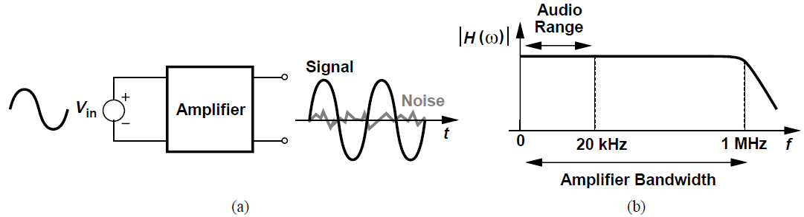
Signal-to-Noise Ratio (SNR)
Above amplifier [Fig. (a)] provides a bandwidth of 1 MHz while sensing an audio signal [Fig. (b)]
Signal is corrupted by all noise components in the 1-MHz bandwidth
  SNR may be unacceptably low
Bandwidth of circuit must be limited to the minimum acceptable value to minimize total integrated noise power
  Within the amplifier or by a series low-pass filter

Slide 20
Noise Analysis Procedure
Output signal of a given circuit is corrupted by noise sources within the circuit
  Interested in noise observed at the output
Four steps:
  Identify the sources of noise and note the spectrum of each
  Find the transfer function from each noise source to the output
  Use the theorem SY(f) = Sx(f)|H(f)|2 to calculate output noise spectrum contributed by each noise source
  Add all the output spectra, accounting for correlated and uncorrelated sources
Integrate the output noise spectrum from -∞ to +∞ to get total output noise power

Slide 21
Types of Noise
Analog signals processed by integrated circuits are corrupted by two types of noise
  Device electronic noise
  “Environmental” noise (Chapter 19)

Slide 22


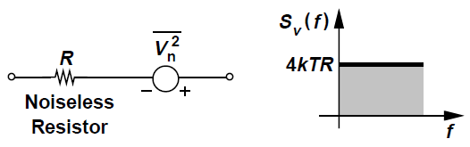
Resistor Thermal Noise
Random motion of electrons in a conductor induces fluctuations in the voltage measured across it even though the average current is zero
Thermal noise of a resistor R can be modeled by a series voltage source, with one-sided spectral density
Here, k = 1.38 X 10⁻²³ J/K is the Boltzmann constant
S_{v}(f) is expressed in V²/Hz, we also write
For a 50-Ω resistor at T = 300 K, thermal noise is 8.28 X 10⁻¹⁹ V²/Hz, or 0.91 nV/√Hz
S_{v}(f) is flat up to 100 THz, and is “white” for our purposes

Slide 23
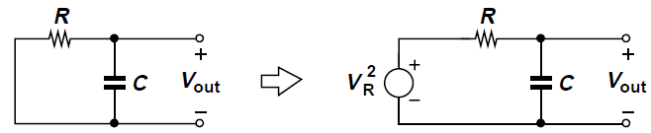

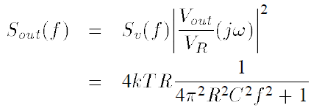
Resistor Thermal Noise: Example
To find: Noise spectrum and total noise power in V_{out}
Solution: Noise spectrum of R is given by S_{v}(f) = 4kTR
Modeling noise by a series voltage source V_{R}, transfer function from V_{R} to V_{out} is
Using theorem, noise spectrum at the output S_{out}(f) is

Slide 24

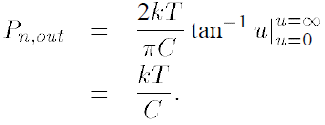
Resistor Thermal Noise: Example
White noise spectrum of the resistor is shaped by a low-pass characteristic
Total noise power at the output is
The integral reduces to
The unit of P_{n,out} is V²/Hz, √kT/C may be considered as the total rms voltage measured at the output

Slide 25
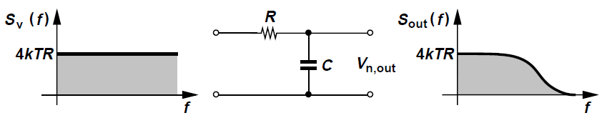
Resistor Thermal Noise: Example
The RC low-pass filter shapes the noise spectrum of the resistor
Total noise at the output (area under S_{out}(f)) is independent of the resistance R
Intuitively, this is because for larger values of R, noise per unit bandwidth increases but the overall bandwidth of the circuit decreases
kT/C noise can only be decreased by increasing R (if T is fixed)

Slide 26
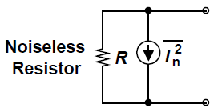


Resistor Thermal Noise
Thermal noise of a resistor can be represented by a parallel current source too
This representation is equivalent to series voltage source representation with
is expressed in A²/Hz
Depending on circuit topology, one model may lead to simpler calculations than the other

Slide 27
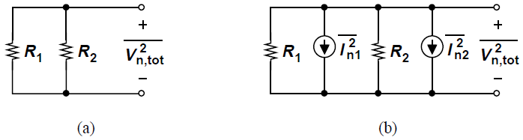
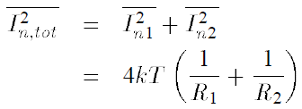
Resistor Thermal Noise: Example
To find: Equivalent noise voltage of two resistors in parallel, R₁ and R₂
Solution:
Each resistor exhibits equivalent noise current with spectral density 4kT/R
Since the two noise sources are uncorrelated, we add the powers

Slide 28

Resistor Thermal Noise: Example
Equivalent noise voltage is given by
This notation assumes a 1-Hz bandwidth

Slide 29

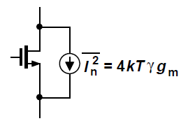
MOSFET Thermal Noise
MOS transistors exhibit thermal noise with the most significant source being the noise generated in the channel
For long-channel MOS devices operating in saturation, the channel noise can be modeled by a current source connected between the drain and source terminals with a spectral density
The coefficient ‘γ’ (not the body effect coefficient) is derived to be 2/3 for long-channel transistors and is higher for submicron MOSFETs
As a rule of thumb, assume γ = 1

Slide 30
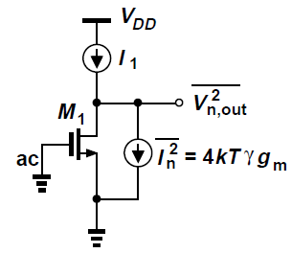

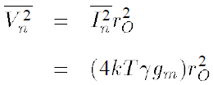
MOSFET Thermal Noise: Example
The maximum output noise occurs if the transistor sees only its own output impedance as the load, i.e., if the external load is an ideal current source
Output noise voltage spectrum is given by

Slide 31
MOSFET Thermal Noise: Example
Noise current of a MOS transistor decreases if the transconductance drops
Noise measured at the output of the circuit does not depend on where the input terminal is because input is set to zero for noise calculation
The output resistance r_{O} does not produce noise because it is not a physical resistor

Slide 32
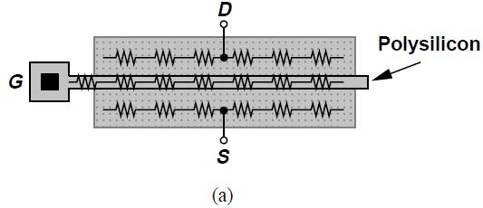
MOSFET Thermal Noise
Ohmic sections of a MOSFET have a finite resistivity and exhibit thermal noise [Fig. (a)]
For a wide transistor, source and drain resistance is negligible whereas the gate distributes resistance may become noticeable

Slide 33
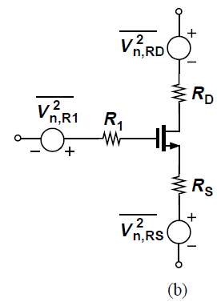
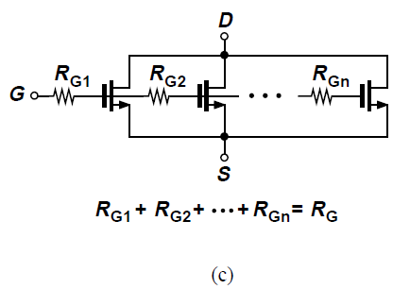


MOSFET Thermal Noise
In the noise model [Fig. (b)], the lumped resistance R₁ represents the distributed gate resistance
In the distributed structure of Fig. (c), unit transistors near the left end see the noise of only a fraction of R_{G} whereas those near the right end see the noise of most of R_{G}
It can be proved that and hence the noise generated by gate resistance is

Slide 34
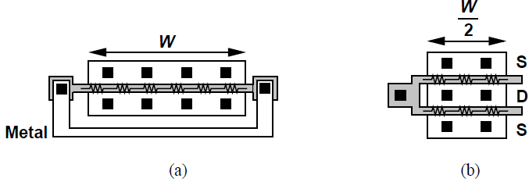
MOSFET Thermal Noise
Effect of R_{G} can be reduced by proper layout
In Fig. (a), the two ends of the gate are shorted by a metal line, reducing the distributed resistance from R_{G} to R_{G}/4
Alternatively, the transistor can be folded as in Fig. (b) so that each gate “finger” exhibits a resistance of R_{G}/2 yielding a total distributed resistance of R_{G}/4 for the composite transistor

Slide 35
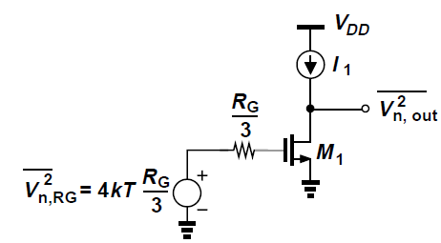


MOSFET Thermal Noise: Example
If the total distributed gate resistance is R_{G}, the output noise voltage due to R_{G} is given by
For the gate resistance noise to be negligible, we must ensure

Slide 36
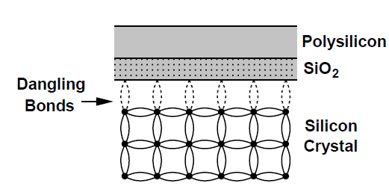
Flicker Noise
At the interface between the gate oxide and silicon substrate, many “dangling” bonds appear, giving rise to extra energy states
Charge carriers moving at the interface are randomly trapped and later released by such energy states, introducing “flicker” noise in the drain current
Other mechanisms in addition to trapping are believed to generate flicker noise

Slide 37

Flicker Noise
Average power of flicker noise cannot be predicted easily
It varies depending on cleanness of oxide-silicon interface and from one CMOS technology to another
Flicker noise is more easily modeled as a voltage source in series with the gate and in the saturation region, is roughly given by
K is a process-dependent constant on the order of 10⁻²⁵ V²F

Slide 38
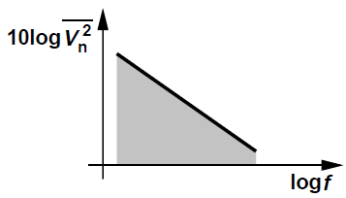
Flicker Noise
The noise spectral density is inversely proportional to frequency
  Trap and release phenomenon occurs at low frequencies more often
Flicker noise is also called “1/f” noise
To reduce 1/f noise, device area must be increased
Generally, PMOS devices exhibit less 1/f noise than NMOS transistors
  Holes are carried in a “buried” channel, at some distance from the oxide-silicon interface

Slide 39
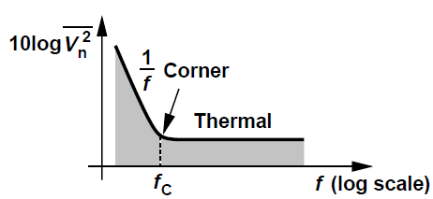
Flicker Noise Corner Frequency
At low frequencies, the flicker noise power approaches infinity
At very slow rates, flicker noise becomes indistinguishable from thermal drift or aging of devices
  Noise component below the lowest frequency in the signal of interest does not corrupt it significantly
Intersection point of thermal noise and flicker noise spectral densities is called “corner frequency” f_{C}

Slide 40
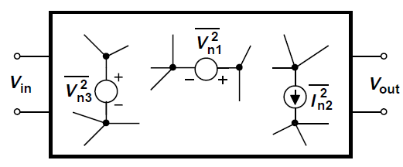
Representation of Noise in Circuits
To find the output noise, the input is set to zero and total noise is calculated at the output due to all the noise sources in the circuit
This is how noise is measured in laboratories and in simulations

Slide 41
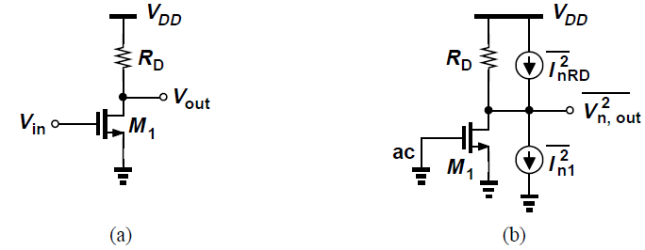




Representation of Noise in Circuits: Example
To find: Total output noise voltage of the common-source stage [Fig. (a)]
Follow noise analysis procedure described earlier
Thermal and flicker noise of M1 and thermal noise of RD are modeled as current sources [Fig. (b)]
Output noise voltage per unit bandwidth, added as power quantities is

Slide 42
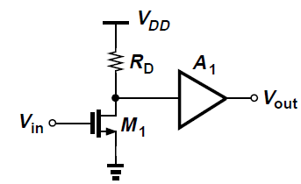
Input-Referred Noise
Output-referred noise does not allow a fair comparison of noise in different circuits since it depends on the gain
In above figure, a CS stage is succeeded by a noiseless amplifier with voltage gain A₁, then the net output noise is now multiplied by A₁²
This may indicate that circuit becomes noisier as A₁ increases, which is incorrect since the signal level also increases proportionally, and net SNR at the output does not depend on A₁

Slide 43
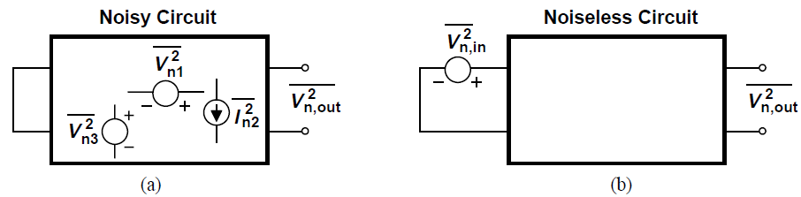


Input-Referred Noise
Input-referred noise represents the effect of all noise sources in the circuit by a single source , at the input such that the output noise in Fig. (b) is equal to that in Fig. (a)
If the voltage gain is A_{v}, then we must have
The input-referred noise voltage in this simple case is simply the output noise divided by the gain squared.

Slide 44
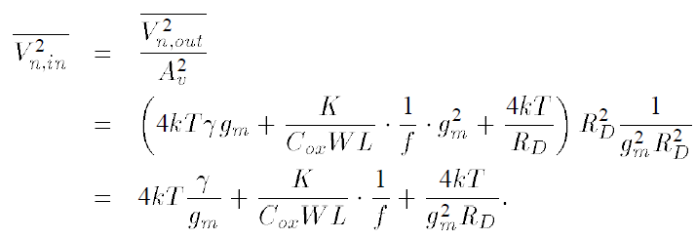
Input-Referred Noise: Example
For the simple CS stage, the input-referred noise voltage is given by
First and third terms combined can be viewed as thermal noise of an equivalent resistance R_{T}, so that the equivalent input-referred thermal noise is 4kTR_{T}

Slide 45
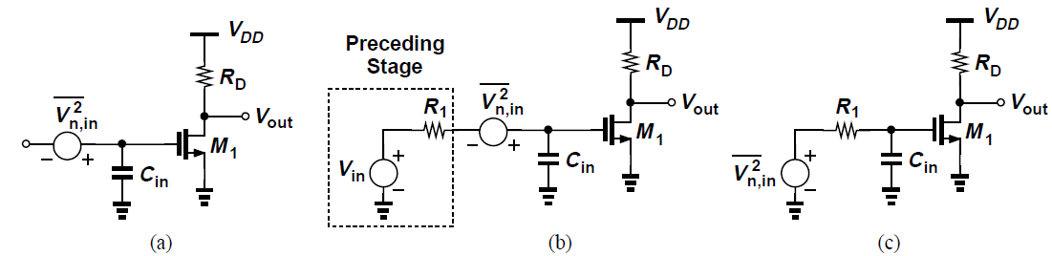
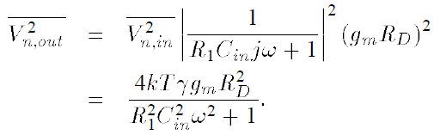
Input-Referred Noise
Single voltage source in series with the input is an incomplete representation of the input-referred noise for a circuit with a finite input impedance and driven by a finite source impedance
For the CS stage, the input-referred noise voltage is independent of the preceding stage
If the preceding stage is modeled by a Thevenin equivalent with an output impedance of R₁, the output noise due to voltage division is

Slide 46


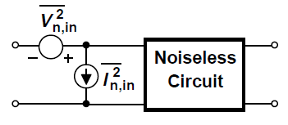
Input-Referred Noise
The previous result is incorrect since the output noise due to M₁ does not diminish as R₁ increases
To solve this issue, we model the input-referred noise by both a series voltage source and a parallel current source, so that if the output impedance of the previous stage assumes large values, thereby reducing the effect of , the noise current still flows through the finite impedance, producing noise at the input
It can be proved that and are necessary and sufficient to represent the noise of any linear two-port circuit

Slide 47
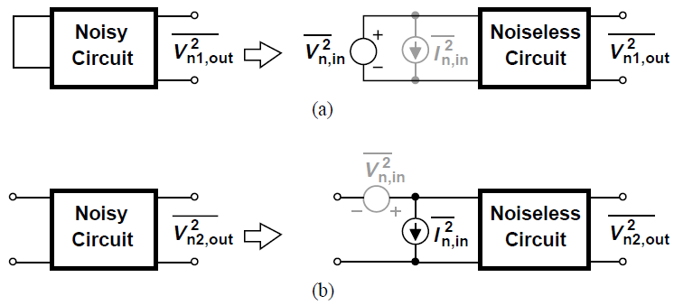
Input-Referred Noise
To calculate and , two extreme cases are considered: zero and infinite source impedances
If the source impedance is zero [Fig. (a)], flows through and has no effect at the output, i.e., the output noise measured arises solely from
If the input is left open [Fig. (b)], then has no effect and the output noise is only due to

Slide 48
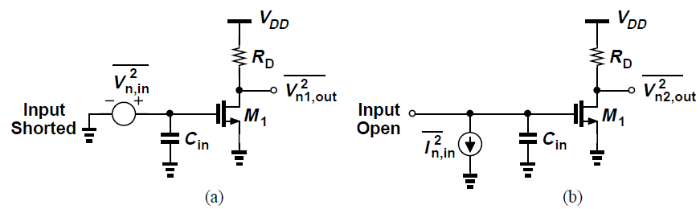


Input-Referred Noise: Example
For the circuit in Fig. (a), the input-referred noise voltage is simply
To obtain the input-referred noise current, the input is left open and we find the output noise in terms of
The noise current flows through C_{in}, generating at the output [Fig. (b)]

Slide 49


Input-Referred Noise: Example
This value must be equal to the output of the noisy circuit when the input is left open [Fig. (b)]
Thus,

Slide 50

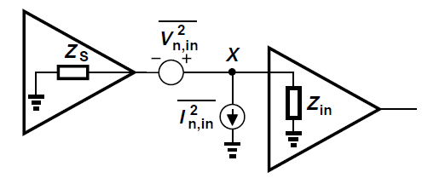



Input-Referred Noise
The input noise current , becomes significant for low enough values of the input impedance Z_{in}
In above figure, Z_{S} denotes the output impedance of the preceding circuit; total noise voltage sensed by the second stage at node X is
If , the effect of is negligible
Thus, the input-referred noise current can be neglected if

Slide 51
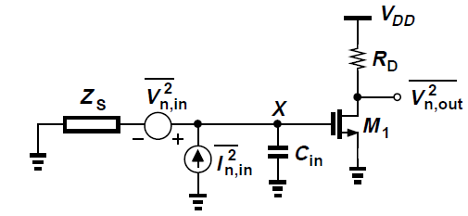
Input-Referred Noise: Correlation
Input-referred noise voltages and currents may be correlated
Noise calculations must include correlations between the two
Use of both a voltage source and a current source to represent the input-referred noise does not “count the noise twice”
It can be proved that the output noise is correct for any source impedance Z_{S}, with both and included

Slide 52
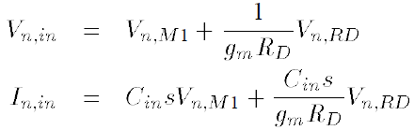
Input-Referred Noise: Correlation
Assuming Z_{S} is noiseless for simplicity, we first calculate the total noise voltage at the gate of M₁ due to and
Cannot apply superposition of powers since they are correlated, but can be applied to voltages and currents since the circuit is linear and time-invariant
Therefore, if V_{n,M1} denotes the gate-referred noise voltage of M₁ and V_{n,RD} the noise voltage of R_{D}, then

Slide 53
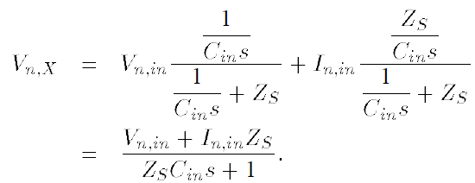
Input-Referred Noise: Correlation
V_{n,M1} and V_{n,RD} appear in both V_{n,in} and I_{n,in}, creating a strong correlation between the two
Adding the contributions of V_{n,in} and I_{n,in} at node X, as if they were deterministic quantities, we have

Slide 54
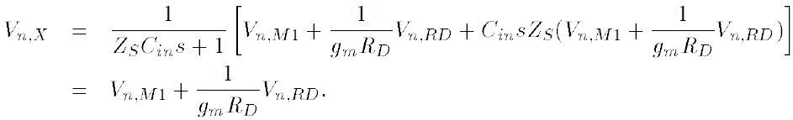
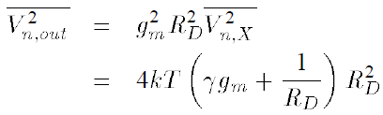
Input-Referred Noise: Correlation
Substituting for V_{n,in} and I_{n,in}
V_{n,X} is independent of Z_{S} and C_{in}
It follows that
V_{n,in} and I_{n,in} do not double count the noise

Slide 55
Input-Referred Noise: Correlation
In some cases, it is simpler to consider the output short-circuit noise current-rather than the output noise voltage
This current is then multiplied by the circuit’s output resistance to yield the output noise voltage or simply divided by a proper gain to give input-referred quantities

Slide 56




Input-Referred Noise: Correlation (Example)
To find: Input-referred noise voltage and current. Assume I₁ is noiseless and λ=0
To compute the input-referred noise voltage, we short the input port [Fig. (b)]. Here, it is also possible to short the output port and hence
The output impedance of the circuit with the input shorted is simply R_{F}, therefore,

Slide 57





Input-Referred Noise: Correlation (Example)
Input-referred noise voltage can be found by dividing previous equation by voltage gain or by G_{m}²
As shown in Fig. (c),
Therefore,

Slide 58





Input-Referred Noise: Correlation (Example)
To find the input-referred noise current [Fig. (d)], we find the output noise current with the input left open
Next, we need to find the current gain of the circuit according to the arrangement in Fig. (c)
Since, and ,
Thus,

Slide 59


Noise in Single-Stage Amplifiers: Lemma
Lemma: The circuits in Fig. (a) and (b) are equivalent at low frequencies if and the circuits are driven by a finite impedance
The noise source can be transformed from a drain-source current to a gate series voltage for arbitrary Z_{S}

Slide 60


Common-Source Stage
From a previous example, the input-referred noise voltage of a simple CS stage was found to be
From above expression, 4kTγ/g_{m} is the thermal noise current expressed as a voltage in series with the gate
To reduce input-referred noise voltage, transconductance must be maximized if the transistor is to amplify a voltage signal applied to its gate [Fig. (a)] whereas it must be minimized if operating as a current source [Fig. (b)]

Slide 61


Common-Source Stage: Example
To find: Input-referred thermal noise, total output thermal noise with a load capacitance C_{L}
Representing the thermal noise of M₁ and M₂ by current sources and noting that they are uncorrelated,

Slide 62


Common-Source Stage: Example
Since the voltage gain is equal to , total noise voltage referred to the gate of M₁ is
Thus, g_{m2} must be minimized because M₂ serves as a current source rather than a transconductor

Slide 63




Common-Source Stage: Example
Total output noise is
A low-frequency input sinusoid of amplitude V_{m} yields an output amplitude equal to and output SNR of

Slide 64

Common-Gate Stage: Thermal Noise
Neglecting channel-length modulation, we represent the thermal noise of M₁ and R_{D} by two current sources [Fig. (b)]
Due to low input impedance of the circuit, the input-referred noise current is not negligible even at low frequencies

Slide 65



Common-Gate Stage: Thermal Noise
To calculate the input-referred noise voltage, we short the input to ground and equate the output noises of the circuits in Figs. (a) and (b)

Slide 66



Common-Gate Stage: Thermal Noise
To calculate the input-referred noise current, we equate the output noises of the circuits in Figs. (c) and (d)
I_{n1} produces no noise at the output since the sum of the currents at the source of M₁ is zero
The output noise voltage is therefore 4kTR_{D} and hence
Thus,

Slide 67




Common-Gate Stage: Thermal Noise
Bias current source in the common-gate stage also contributes thermal noise
Current mirror arrangement establishes bias current of M₁ as a multiple of I₁
If input is shorted to ground, drain noise current of M₂ does not contribute to input-referred noise voltage
If input is open, all of flows from M₁ and R_{D}, producing an output noise of and hence an input-referred noise current of
It is desirable to minimize transconductance of M₂, at the cost of reduced output swing

Slide 68



Common-Gate Stage: Flicker Noise
To compute input-referred 1/f noise voltage and current of above circuit, each 1/f noise generator is modeled by a voltage source in series with the gate of the corresponding transistor (1/f noise of M₀ and M₄ is neglected)
With the input shorted to ground, we have
K_{P} and K_{N} denote flicker noise coefficients of NMOS and PMOS devices respectively

Slide 69




Common-Gate Stage: Flicker Noise
Approximating the voltage gain as ,
With the input open, the output noise is approximately
It follows that

Slide 70



Source Followers: Thermal Noise
Since the input impedance of the source follower is quite high, the input-referred noise current can be neglected for moderate driving source impedances
To compute the input-referred noise voltage, the output noise of M₂ can be expressed as

Slide 71


Source Followers: Thermal Noise
The voltage gain is (from Chapter 3),
Total input-referred noise voltage is
Source followers add noise to the input signal and provide a voltage gain less than unity

Slide 72


Cascode Stage
In the cascode stage of Fig. (a), the noise currents of M₁ and R_{D} flow mostly through R_{D} at low frequencies
Noise contributed by M₁ and R_{D} is quantified in a common-source stage

Slide 73


Cascode Stage
As shown in Fig. (b), M₂ contributes negligibly to noise at the output, especially at low frequencies
If channel-length modulation of M₁ is neglected, then ddddddddd and hence M₂ does not affect V_{n,out}
From another perspective, in the equivalent circuit of Fig. (c), voltage gain from V_{n2} to the output is small if impedance at node X is large

Slide 74

Cascode Stage
At high frequencies, the total capacitance at node X, C_{X} gives rise to a gain, increasing the output noise
This capacitance also reduces the gain from the main input to the output by shunting the signal current produced by M₁ to ground

Slide 75


Noise in Current Mirrors
In the above current-mirror topology,
The factor N is in the range of 5 to 10 to minimize power consumed by reference branch
To determine the flicker noise in I_{D1}, we assume λ = 0 and I_{REF} is noiseless

Slide 76





Noise in Current Mirrors
In the Thevenin equivalent for M_{REF} and its flicker noise, the open-circuit voltage is V_{n,REF} [Fig. (b)] and the Thevenin resistance is 1/g_{m,REF} [Fig. (c)]
The noise voltage at node X and V_{n1} add and drive the gate of M₁, producing
Since and typically , we observe that

Slide 77



Noise in Current Mirrors
It follows that
For the noise of the diode-connected device to be small, we need and hence
This can lead to C_{B} being very high

Slide 78



Noise in Current Mirrors
In order to reduce noise contributed by M_{REF} and avoid a large capacitor, we can insert a resistance between its gate and C_{B}, so that
R_{B} lowers the filter cutoff frequency but also contributes its own noise
The MOS device M_{R} with a small overdrive provides a high resistance and occupies a moderate area [Fig. (b)]

Slide 79


Noise in Differential Pairs
As shown in Fig. (a), a differential pair can be viewed as a two-port circuit
It is possible to model the overall noise as depicted in Fig. (b)
For low-frequency operation, v is negligible

Slide 80



Noise in Differential Pairs
To calculate the thermal component , we first obtain the total output noise with the inputs shorted together [Fig. (a)]
Since I_{n1} and I_{n2} are uncorrelated, node P cannot be considered a virtual ground, so cannot use half-circuit concept
Derive contribution of each source individually [Fig. (b)]

Slide 81



Noise in Differential Pairs
In Fig. (c), to calculate the contribution of I_{n1}, neglecting channel-length modulation, it can be proved that half of I_{n1} flows through R_{D1} and the other half through M₂ and R_{D2} [Fig. (d)]
The differential output noise due to M₁ is equal to

Slide 82






Noise in Differential Pairs
If R_{D1} = R_{D2} = R_{D},
Thus
Taking into account the noise of R_{D1} and R_{D2},
Diving by the square of the differential gain ,

Slide 83



Noise in Differential Pairs
Input-referred noise voltage can also be calculated using the previous lemma
The noise of M₁ and M₂ can be modeled as a voltage source in series with their gates
The noise of R_{D1} and R_{D2} is divided by resulting in previously obtained equation
Including 1/f noise,

Slide 84

Noise in Differential Pairs
If the differential input is zero and the circuit is symmetric, then the noise in I_{SS} divides equally between M₁ and M₂, and produces only a common-mode noise voltage at the output
For a small differential input ΔV_{in}, we have
I_{n} denotes the noise in I_{SS} and I_{n} << I_{SS}
As circuit departs from equilibrium, In is more unevenly divided, generating differential output noise

Slide 85


Noise in five-transistor OTA
The Norton noise equivalent is sought by first computing the output short-circuit noise current
This is then multiplied by the output resistance and divided by the gain to get input-referred noise voltage
Transconductance is approximately g_{m1,2}
Output noise current due to M₁ and M₂ is this transconductance multiplied by gate-referred noises of M₁ and M₂, i.e.,

Slide 86




Noise in five-transistor OTA
The noise current of M₃ primarily circulates through the diode-connected impedance 1/g_{m3}, producing a voltage at the gate of M₄ with spectral density 4kTγ/g_{m3}
This noise is multiplied by g_{m4}² as it emerges from the drain of M₄; the noise current of M₄ also flows directly through the output short-circuit, thus
Multiplying this noise by and dividing the result by , the total input-referred noise is

Slide 87


Noise in five-transistor OTA
The output voltage in the OTA V_{out} is equal to V_{X}
If I_{SS} fluctuates, so do V_{X} and V_{out}
Since the tail noise current In splits equally between M₁ and M₂, the noise voltage at X is given by and so is the noise voltage at the output

Slide 88

Noise-Power Tradeoff
Noise contributed by transistors “in the signal path” is inversely proportional to their transconductance
  Suggests a tradeoff between noise and power consumption
In the simple CS stage of Fig.(a), we double W/L and I_{D1} and halve R_{D}, maintaining voltage gain and output swing
Input-referred thermal and flicker noise power is halved, at the cost of power consumption

Slide 89


Noise-Power Tradeoff
Called “linear scaling”, the earlier transformation can be viewed as placing two instances of the original circuit in parallel [Fig. (b)]
Alternatively, it can be said that the widths of the transistor and the resistor are doubled [Fig. (c)]

Slide 90


Noise-Power Tradeoff
In general, if two instances of a circuit are placed in parallel, the output noise power is halved [Fig. (a)]
Proved by setting the input to zero and constructing a Thevenin equivalent for each [Fig. (b)]
Since V_{n1,out} and V_{n2,out} are uncorrelated, we can use superposition of powers to write

Slide 91




Noise Bandwidth
Total noise corrupting a signal in a circuit results from all frequency components in the bandwidth of the circuit
For a multipole system with noise spectrum as in Fig.(a), total output noise is
As shown in Fig.(b), the total noise can also be expressed as , where the bandwidth B_{n}, called the “noise bandwidth” chosen is such that

Slide 92




Problem of Input Noise Integration
In the CS stage above, where it is assumed λ = 0 and noise of R_{D} is neglected with only thermal noise of M₁ considered
Output noise spectrum is the amplified and low-pass filtered noise of M₁, easily lending to integration
Input-referred noise voltage, however, is simply , carrying an infinite power and prohibiting integration
For fair comparison of different designs, we can divide the integrated output noise by the low-frequency gain, for example,

