Slide 1
Chapter 17: Short-Channel Effects and Device Models
17.1 Scaling Theory
17.2 Short-Channel Effects
17.3 MOS Device Models

Slide 2
Background
The square-law characteristics derived for MOSFETs provide moderate accuracies for devices with minimum channel lengths of greater than several microns.
As device dimensions continue to scale down, reaching below 12 nm, higher order effects necessitate more complex models.
Our objective here is to provide a basic understanding of short-channel effects and review some of the SPICE models developed to reflect such phenomena.
We first describe the ideal scaling theory of MOS transistors. Next, we study short-channel effects.

Slide 3
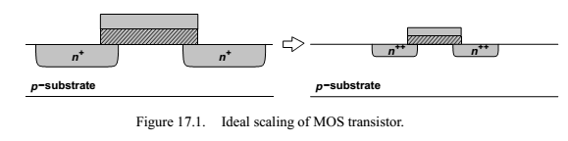
Scaling Theory
The two principal reasons for the dominance of CMOS technology in today’s semiconductor industry are the zero static power dissipation of CMOS logic and the scalability of MOSFETs.
The ideal scaling theory follows three rules:
reduce all lateral and vertical dimensions by α (>1)
reduce the threshold voltage and the supply voltage by α
increase all of the doping levels by α

Slide 4
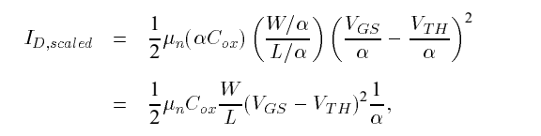
Constant-field scaling
Since the dimensions and voltages scale together, all electric fields in the transistor remain constant, hence the name “constant-field scaling.”
Note that W, L, tox, VDD, VTH and the depth and perimeter of the source and drain junctions scale down by α.
Saturation drain current of a square-law device after scaling :
We observe that the current capability of the transistor drops by a factor of α.

Slide 5
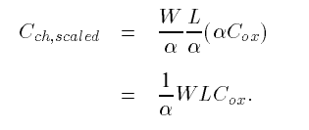

Advantages of Scaling
The advantage of scaling lies in the reduction of capacitances and power dissipation.
The total channel capacitance is :
To calculate the source/drain junction capacitance, we first analyze the effect of ideal scaling on the total width of the depletion region.
Recall that this width is given by :
Where NA and ND denote the doping levels of the two sides of the junction.

Slide 6
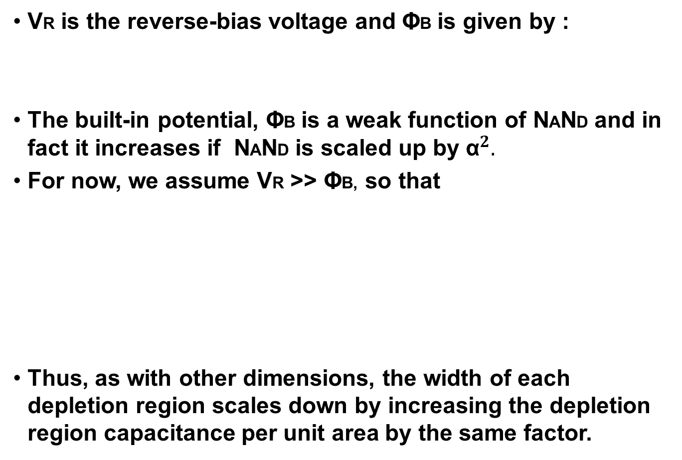

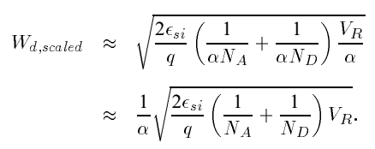
Depletion region capacitance

Slide 7
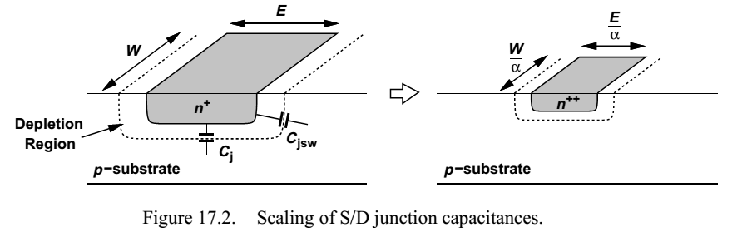
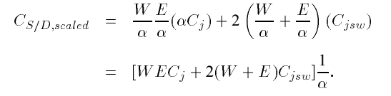
S/D junction capacitances
The bottom-plate capacitance of the S/D junction (per unit area), Cj, increases by a factor of α.
The sidewall capacitance(per unit width), Cjsw remains constant, as the depth of the junction is reduced by α.
All of the capacitances therefore decrease by the scaling factor.

Slide 8
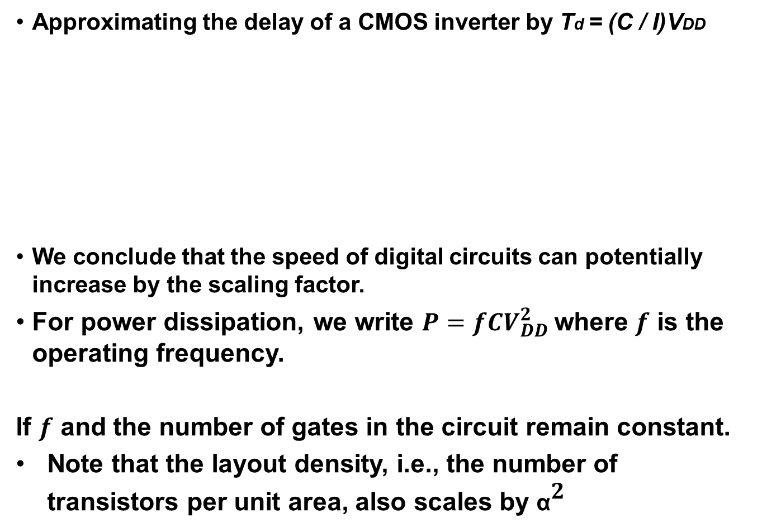
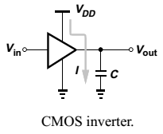
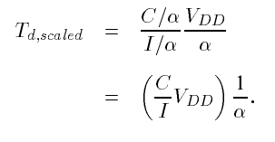

Delay

Slide 9
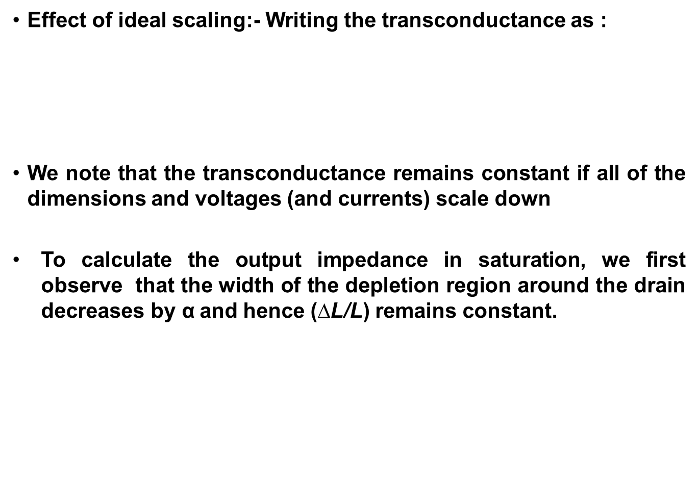
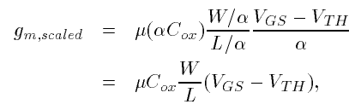
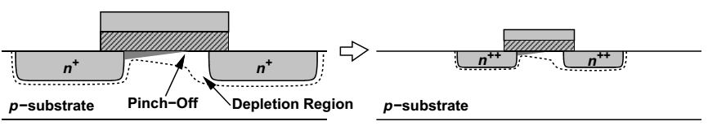
Effect of ideal scaling

Slide 10

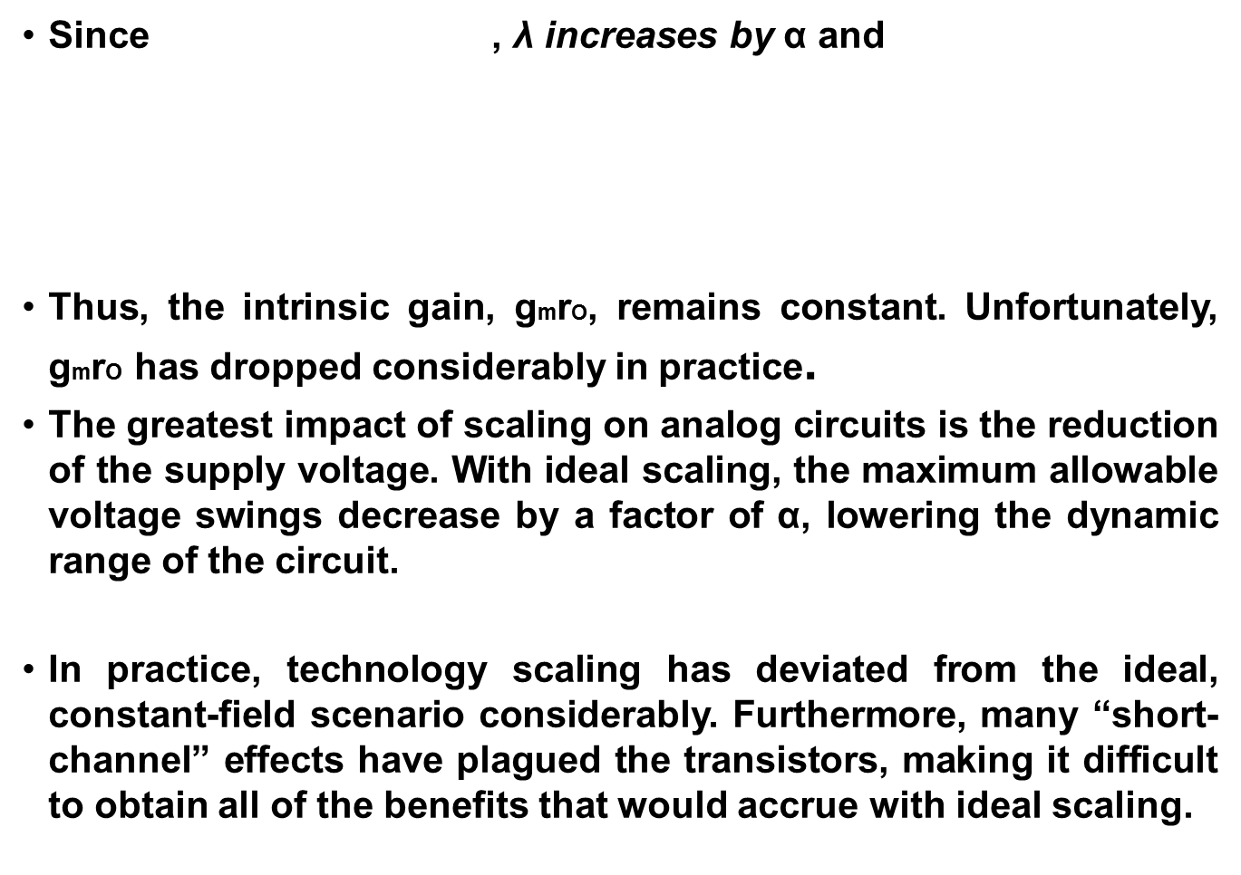
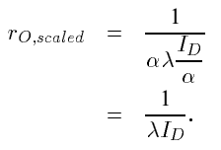
Effect of ideal scaling

Slide 11
Short-Channel Effects
In order to appreciate the need for sophisticated device models, we briefly study some of the phenomena that manifest themselves for short channels
Small-geometry effects arise because five factors deviate the scaling from the ideal scenario:
(1) The electric fields tend to increase because the supply voltage has not scaled proportionally.
(2) The built-in potential term ΦB is neither scalable nor negligible.
(3) The depth of S/D junctions cannot be reduced easily.
(4) The mobility decreases as the substrate doping increases.
(5) The subthreshold slope (described below) is not scalable.

Slide 12
Threshold Voltage Variation
The choice of the threshold voltage is based on the device performance in typical circuit applications.
The upper bound is roughly equal to VDD /4 to avoid degrading the speed of digital CMOS gates.
The lower bound is determined by several factors:
(1) the subthreshold behavior.
(2) variation with temperature and process.
(3)dependence upon the channel length.
Let us first consider the subthreshold behavior.

Slide 13




Subthreshold behavior
For long-channel devices, the subthreshold drain current can be expressed as
where , denotes the capacitance of the depletion region under the gate area, .
This equation reveals two interesting properties :
First, as VDS exceeds a few VT , ID becomes independent of the drain-source voltage.
Second, under this condition the slope of ID on a logarithmic scale equals

Slide 14

Subthreshold behavior
The inverse of this quantity (slope of ID on a logarithmic scale) is usually called the “subthreshold slope”, S:
In order to turn off the transistor by lowering VGS below VTH, S must be as small as possible, i.e., Cd / Cox must be minimized.
The relatively constant magnitude of S severely limits the scaling of the threshold voltage.
For example : A subthreshold slope of 80 mV/dec imposes a lower bound of 400 mV for VTH if the “off current” must be roughly five orders of magnitude lower than the “on current.”

Slide 15
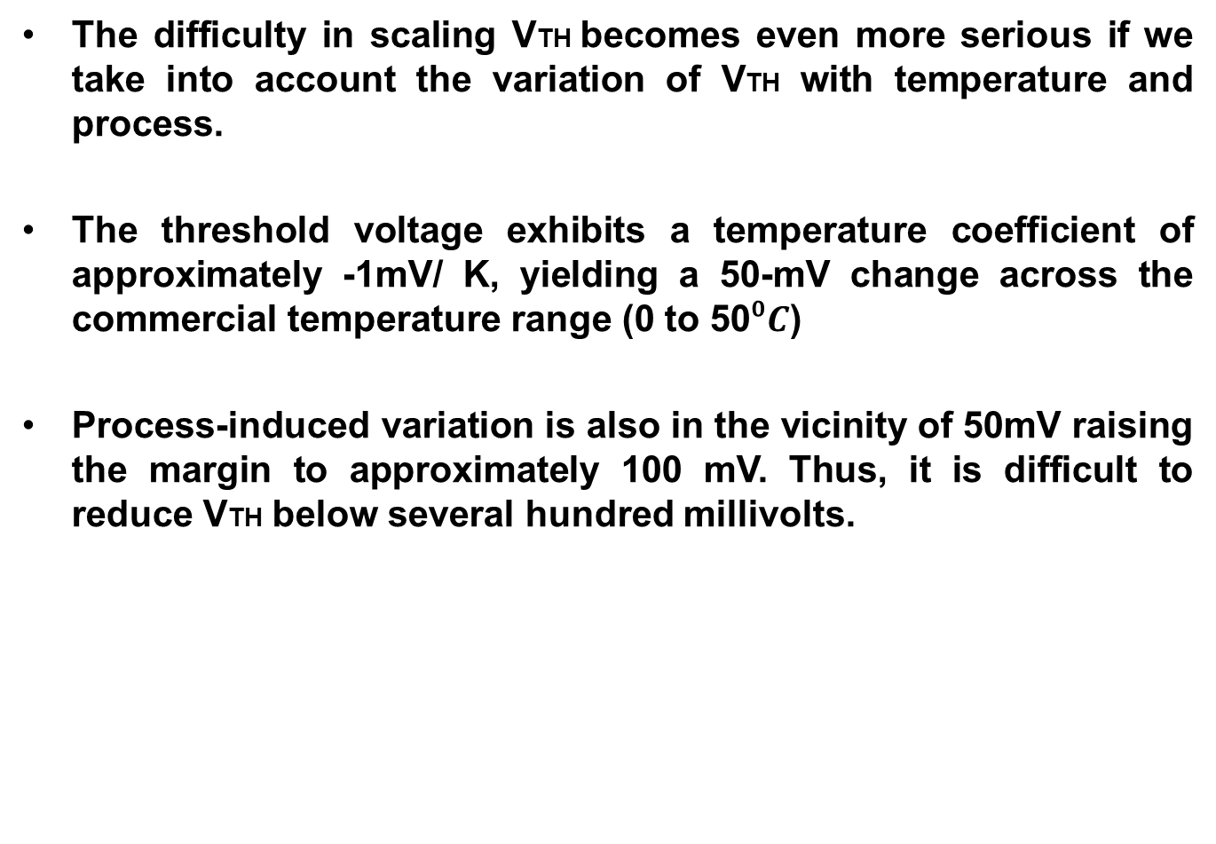
Subthreshold behavior

Slide 16
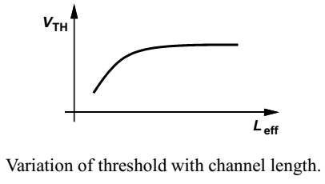
Effect of channel length on threshold
An interesting phenomenon observed in scaled transistors is the dependence of the threshold voltage on the channel length.
As shown in the figure, transistors fabricated on the same wafer but with different lengths yield lower VTH as L decreases.
This is because the depletion regions associated with the source and drain junctions protrude into the channel area considerably, thereby reducing the immobile charge that must be imaged by the charge on the gate

Slide 17
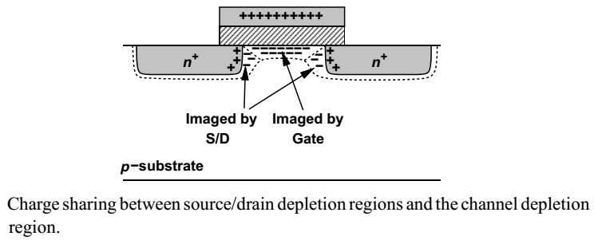
Effect of channel length on threshold
Part of the immobile charge in the substrate is now imaged by the charge inside the source and drain areas rather than by the charge on the gate.
As a result, the gate voltage required to create an inversion layer decreases
Since the channel length cannot be controlled accurately during fabrication, this effect introduces additional variations in VTH.

Slide 18
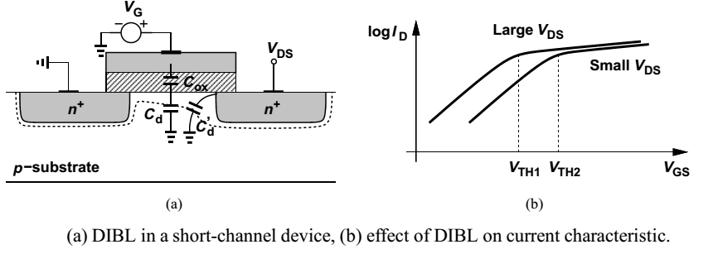
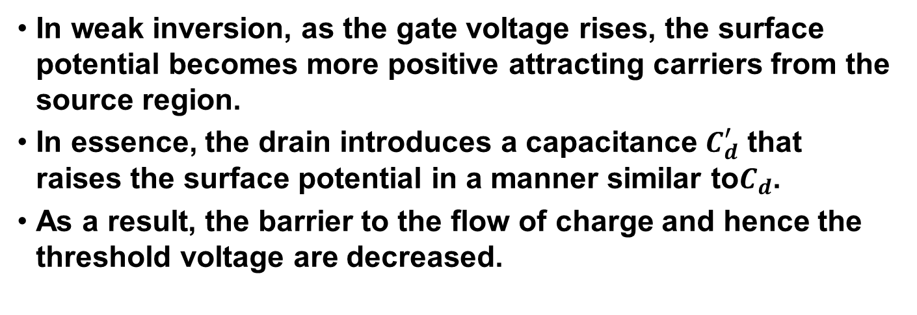
Drain-induced barrier lowering (DIBL)

Slide 19
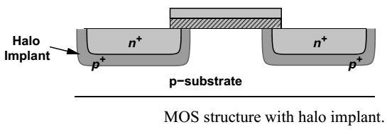
Reverse Short-Channel Effect
In nanometer CMOS technologies, the threshold voltage decreases as the channel length increases from its minimum value.
Let us consider the cross section of a modern device, shown in the figure, wherein a “halo” implant of heavy doping surrounds the source and drain junctions.
This implant reduces the penetration of the drain depletion region into the channel area, thereby improving the device characteristics.

Slide 20



Reverse Short-Channel Effect
The threshold voltage is a function of the substrate doping level, Nsub. We have
where both and
increase as Nsub increases.
Due to the nonuniform substrate doping along the channel the “local” threshold voltage also varies from the source to the drain.
We can take the average along the channel to obtain an overall threshold for a given device structure

Slide 21
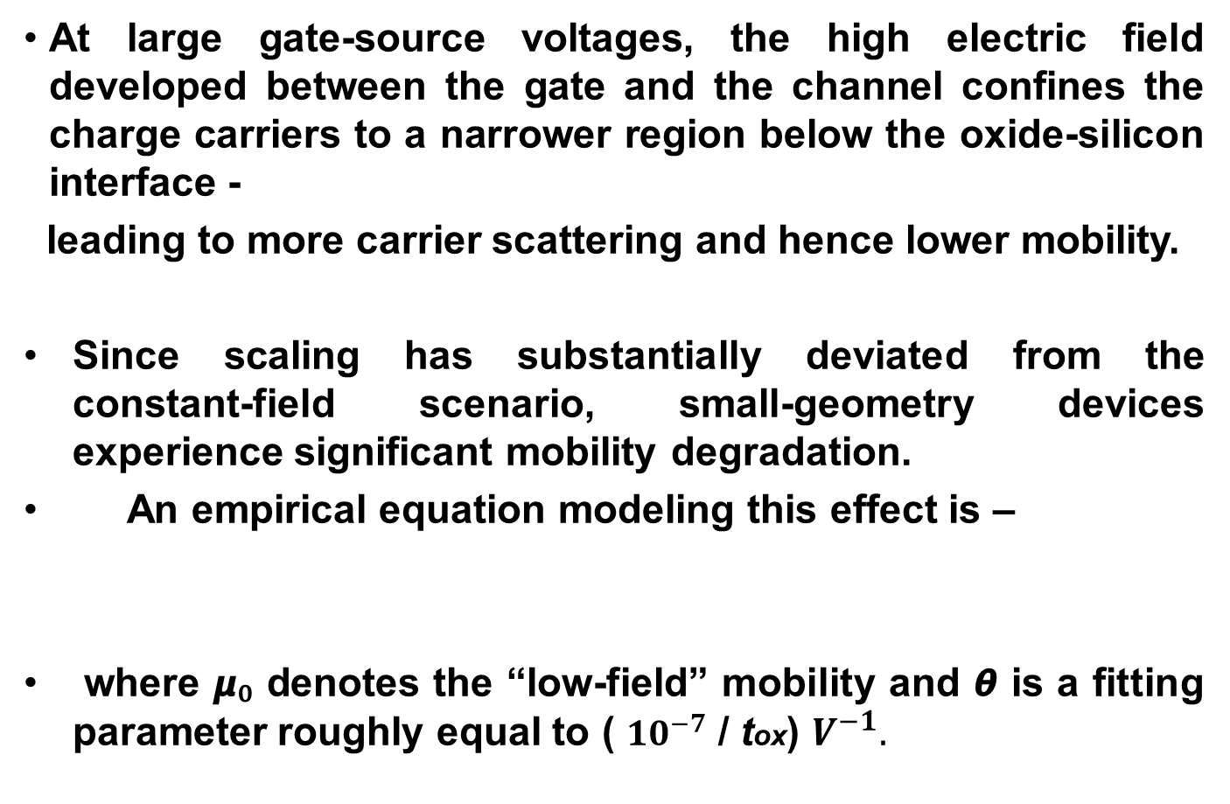

Mobility Degradation

Slide 22


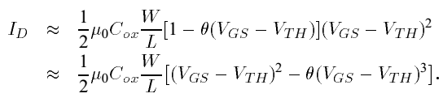
Mobility Degradation
In addition to lowering the current capability and transconductance of MOSFETs, mobility degradation deviates the I/V characteristic from the simple square-law behavior.
And assuming , we obtain
This is a rough approximation but it reveals the existence of higher harmonics in the drain current.
The mobility degradation with the vertical field affects the device transconductance as well

Slide 23

Velocity Saturation
The mobility of carriers also depends on the lateral electric field in the channel, beginning to drop as the field reaches levels of 1 V/𝞵m.
Since the carrier velocity v= 𝞵 E, we note that v approaches a saturated value, about 10⁷cm/s, for sufficiently high fields.
In the extreme case, where carriers experience velocity saturation along the entire channel,
Interestingly, the current is linearly proportional to the overdrive voltage and does not depend on the length

Slide 24
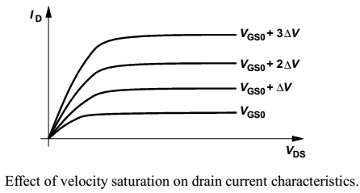
Velocity Saturation
ID-VDS characteristics of devices with L<1𝞵m reveal velocity saturation because equal increments in (VGS-VTH) result in roughly equal increments in ID .
We also note that gm = Vsat W Cox, concluding that the transconductance is a weak function of the drain current and channel length in the velocity-saturation regime.

Slide 25
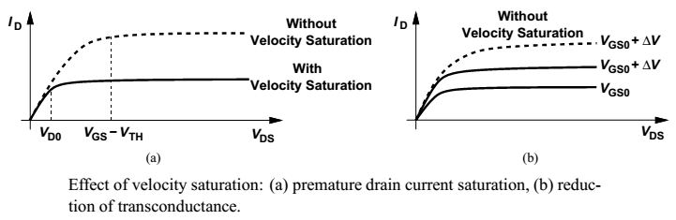
Effect of Velocity Saturation
An important consequence is that, as VGS increases, the drain current saturates well before pinch-off occurs.
As shown in the figure carriers reach velocity saturation if VDS exceeds VD0 < VGS - VTH, yielding a constant current quite lower than that obtained if the device saturated for VDS > VGS- VTH .
Since an increment in VGS gives a smaller increment for ID when velocity saturation occurs, the transconductance is also lower than that predicted by the square law

Slide 26


Velocity Saturation Equations
A compact and versatile equation developed to represent velocity saturation (in the saturation region) is
Where 𝞵eff is given by
Equation for the drain-source voltage at the onset of premature saturation is given by :
If L or Vsat is large, the expression for ID reduces to the square-law relationship.

Slide 27
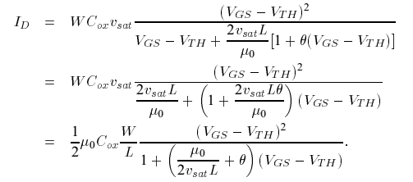
Velocity Saturation Equations
If the overdrive voltage is so small that the denominator of the equation for ID is approximated as 2Vsat L /𝞵eff and 𝞵eff = 𝞵₀, then the device still follows the square-law behavior even if L is relatively small.
The equation for ID (in the velocity saturation regime) can be further simplified to yield additional results. Substituting for 𝞵eff , we have

Slide 28
Hot Carrier Effects
While the average velocity of carriers saturates at high fields, the instantaneous velocity and hence the kinetic energy of the carriers continue to increase, especially as they accelerate towards the drain.
- These are called “hot” carriers.
In the vicinity of the drain region, hot carriers may “hit” the silicon atoms at high speeds, thereby creating impact ionization. As a result, new electrons and holes are generated, with the electrons absorbed by the drain and the holes by the substrate. Thus, a finite drain-substrate current appears.
Also, if the carriers acquire a very high energy, they may be injected into the gate oxide and even flow out the gate terminal, introducing a gate current.

Slide 29
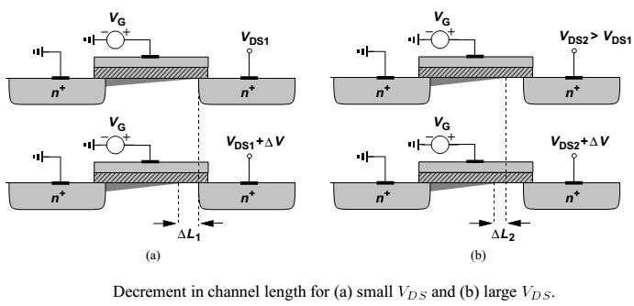
Output Impedance Variation with VDS
As VDS increases and the pinch-off point moves toward the source, the rate at which the depletion region around the source becomes wider decreases, resulting in a higher incremental output impedance.

Slide 30
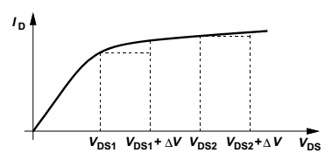

Output Impedance Variation with VDS
In this regime, the output impedance can be approximated as
Where VD,sat is the drain-source voltage at the onset of pinch-off.

Slide 31
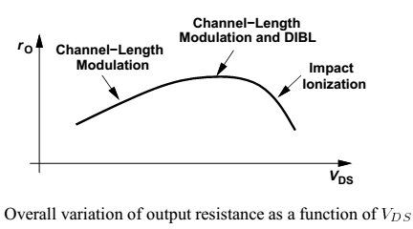
Output Impedance Variation with VDS
In In short-channel devices, as VDS increases further, drain-induced barrier lowering becomes significant, reducing the threshold voltage and increasing the drain current.
This effect roughly cancels that expressed by r₀ equation, giving a relatively constant output impedance.
At sufficiently high drain voltages, impact ionization near the drain produces a large current (flowing from the drain into the substrate), in essence lowering r₀.

Slide 32
MOS Device Models
MOS device modeling continues to pose a challenge—especially for high-frequency operation.
Our objective is to develop a basic understanding of some of the models to the extent necessary for simulations.
The utility of a model is given by the accuracy it provides in various regions of operation for different device dimensions, the ease with which its parameters can be measured, and the efficiency that it allows in simulations.

Slide 33
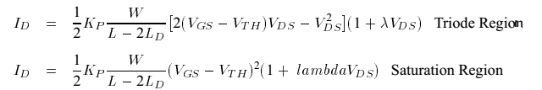
Level 1 Model
Also known as the Shichman and Hodges Model and is based on the following equations:
Note that this model does not include subthreshold conduction or any short-channel effects.
Since in the simple model, CGS abruptly changes from (2/3)WLCox + WCov in saturation to (1/2)WLCox + Wcov in the triode region most computation algorithms experience convergence difficulties here.

Slide 34
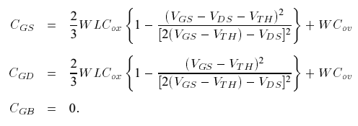
Level 1 Model
CGS and CGD in the triode region are formulated as
We note that if the device operates at the edge of saturation, VGS - VDS=VTH, CGS = (2/3)WLCox + WCov, and CGD = WCov
Thus, the capacitance values change continuously from one region to another.
The Level 1 model maintains reasonable I/V accuracy for channel lengths as small as roughly 4𝞵m, but it still predicts the output impedance of transistors in saturation quite poorly.

Slide 35
Level 2 Model
The Level 1 model began to manifest its shortcomings as channel lengths fell below approximately 4𝞵m. The Level 2 model was then developed to represent many high-order effects.
The assumption that we made in deriving the square-law characteristics was a constant threshold voltage along the channel.
This assumption is not correct even for long channel devices because the charge in the depletion region under the channel varies according to the local voltage.

Slide 36
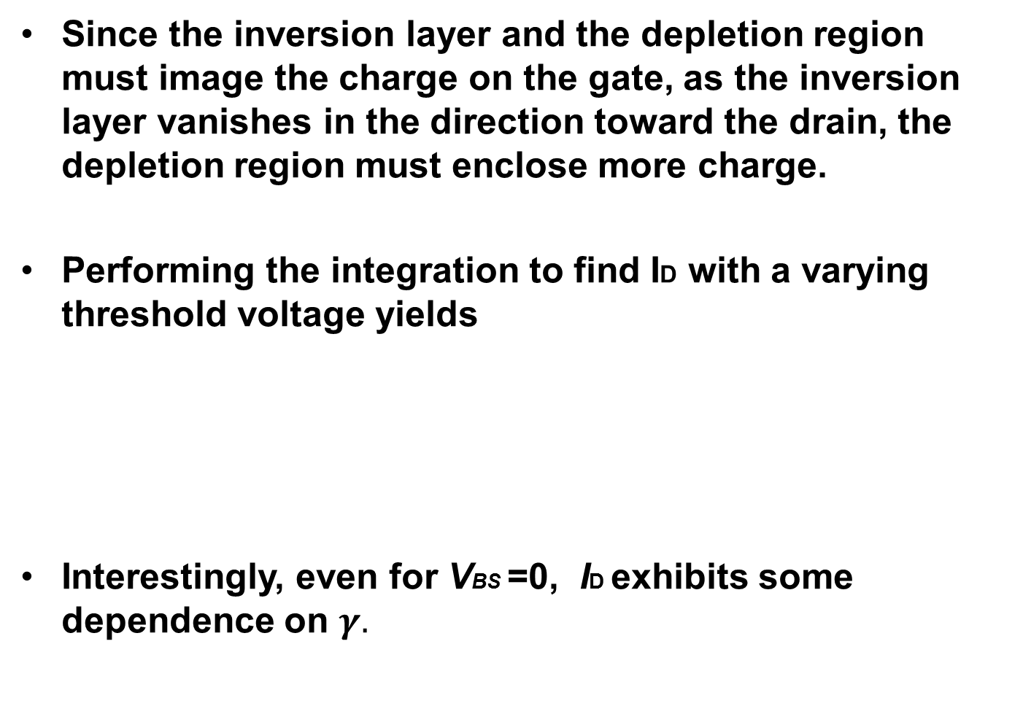

Level 2 Model

Slide 37


Level 2 Model
Moreover, for small VDS, the equation reduces to that of the Level 1 model, but for large VDS the drain current is less than that predicted by the square law.
It can also be shown that the edge of the saturation region is given by
In the saturation region, the drain current is
Where ID,sat is calculated from ID for VDS = VDS,sat.

Slide 38

Level 2 Model
Modeling channel-length modulation or, more generally, the finite output impedance has always remained a difficult problem. Representing such phenomena by only λ is far from accurate.
Using simple relationships for the depletion region of a pn junction, we can write
Where VD,sat denotes the pinch-off voltage.
The principal difficulty in the above approach is that both the drain current and its derivative are discontinuous at the edge of the triode region.

Slide 39


Level 2 Model
To resolve this issue, ∆L is actually obtained by a “fixed-up” equation:
Where V1=(VDS – VD,sat)/4. The channel-length modulation coefficient is expressed as λ =∆L/(L VDS)
The Level 2 model also includes the degradation of the mobility with the vertical field in the channel. The mobility is calculated from
Where Uc denotes the gate-channel critical electric field, Ut is a fitting parameter between 0 and 0.5, and Ue is an exponent in the vicinity of 0.15.

Slide 40

Level 2 Model
The subthreshold behavior implemented in the Level 2 model defines a voltage Von as
and NFS is an empirical constant.
The drain current is then expressed as:
Where Ion is the drain current calculated in strong inversion for VGS=Von.

Slide 41
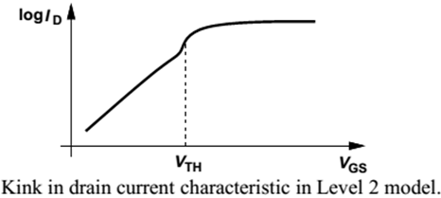
Level 2 Model
An important drawback of this representation is the discontinuity in the slope of ID as the device goes from the subthreshold region to strong inversion (as seen in the figure), leading to various difficulties and errors in simulation.
Level 2 model provides reasonable I/V accuracy for wide, short devices in the saturation region with L ≈ 0.7𝞵m but it suffers from substantial error in representing the output impedance.

Slide 42

Level 3 Model
The Level 3 model realization is somewhat similar to the Level 2 model, with some equations simplified and many empirical constants introduced to improve the accuracy for channel lengths as small as 1𝞵m.
This model expresses the threshold voltage as:
where Fs and Fn represent short-channel and narrow-channel effects respectively and 𝞷 models drain-induced barrier lowering (DIBL).

Slide 43
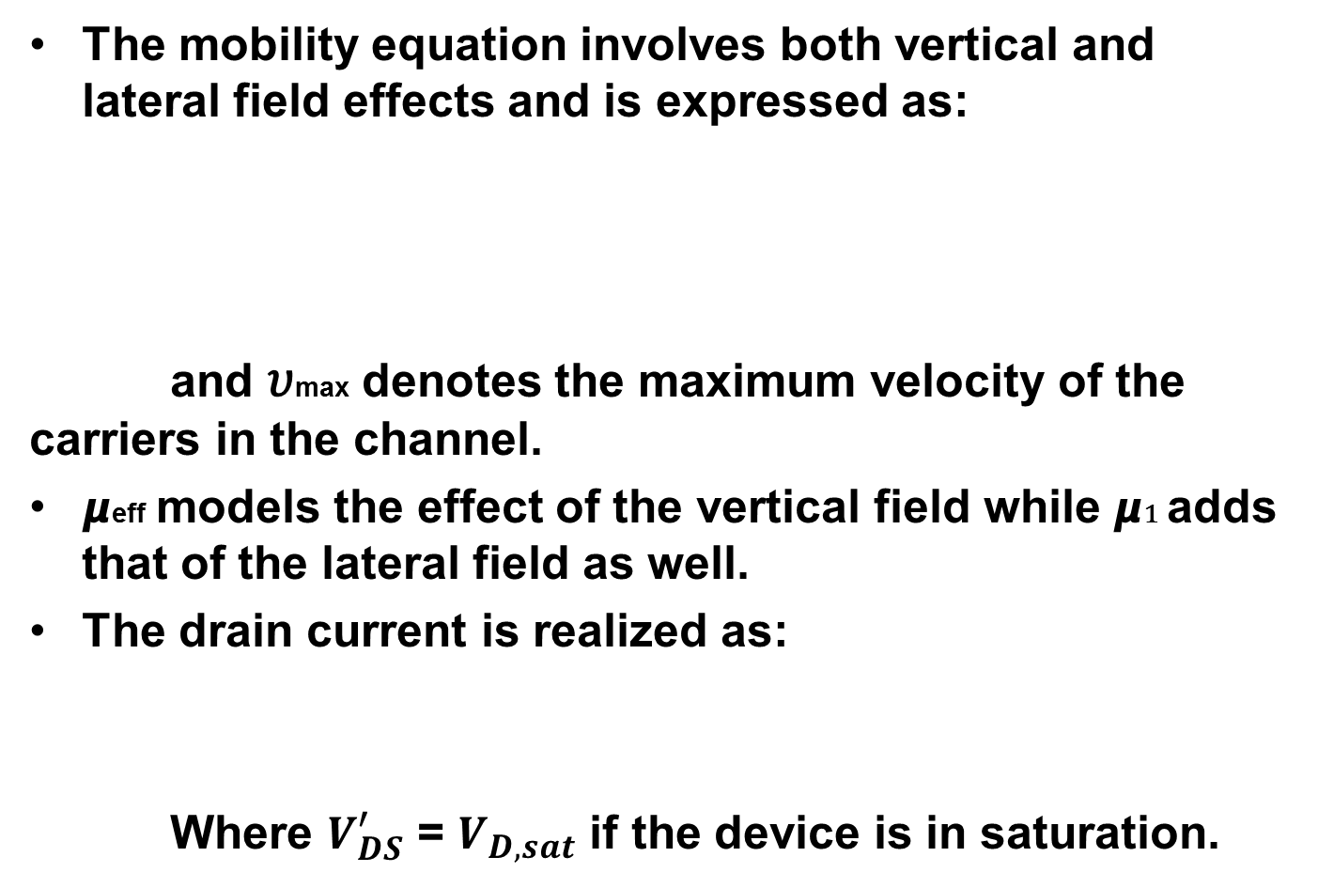



Level 3 Model

Slide 44
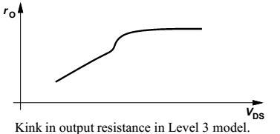
Level 3 Model
Level 3 model, as with the Level 2 model, exhibits moderate accuracy for wide, short transistors but suffers from large errors for longer channels.
An important drawback of the Level 3 model is the discontinuity of the derivative of ID with respect to VDS at the edge of the triode region, leading to large errors in the calculation of the output impedance.

Slide 45
BSIM Series
The philosophy behind the Level 1-3 models was to express the device behavior by means of equations that originated from the physical operation.
BSIM adopted a different approach: numerous empirical parameters were added so as to simplify the equations—but at the cost of losing touch with the actual device operation.
An interesting feature of BSIM is the addition of a simple equation to represent the geometry dependence of many of the device parameters.

Slide 46
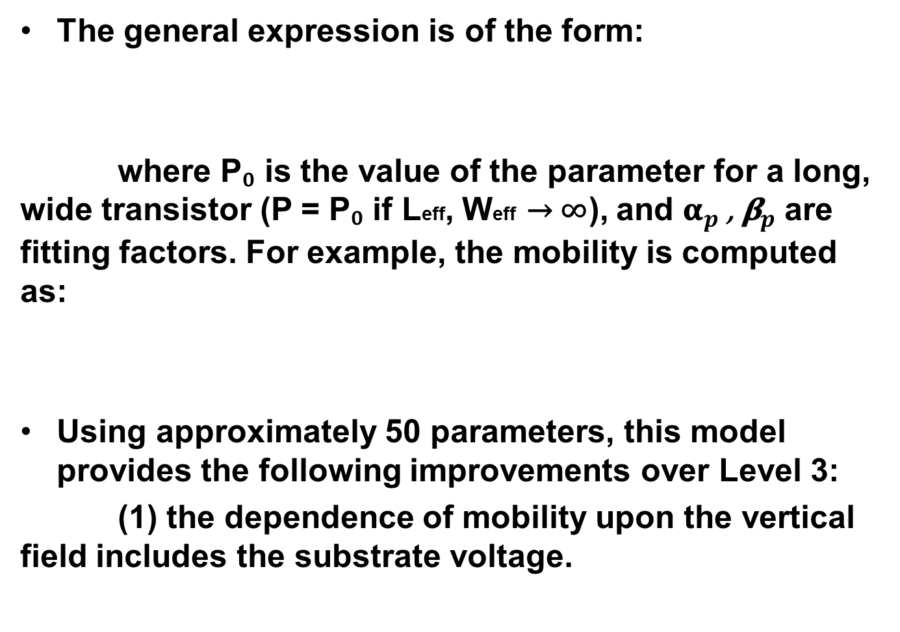


BSIM Series

Slide 47
BSIM Series
(2) the threshold voltage is modified for substrates with nonuniform doping.
(3) the currents in the weak and strong inversion regions are derived such that their values and first derivatives are continuous.
(4) to simplify the drain current equations, new expressions are devised for velocity saturation, dependence of mobility upon the lateral field, and the saturation voltage.

Slide 48
BSIM2
The next model in the BSIM series is BSIM2. Requiring approximately 70 parameters, this version employs new expressions for mobility, drain current, and subthreshold conduction.
It also represents the output impedance more accurately by incorporating both channel-length modulation and drain-induced barrier lowering.
For short, narrow transistors, BSIM2 suffers from large errors in the triode region and even substantial “kinks” in the saturation region.

Slide 49
BSIM3
The trend in BSIM and BSIM2, namely, expressing the device behavior by means of empirical equations that bear little relation to the physical phenomena, eventually created difficulties in modeling short-channel devices.
Consequently, the next generation, BSIM3, has returned to the physical principles of device operation while maintaining many of the useful features of BSIM and BSIM2.
BSIM3 itself has rapidly gone through several versions, requiring approximately 180 parameters in the third one.
BSIM3 provides reasonable accuracy for subthreshold and strong inversion operation while still suffers from large errors in predicting the output impedance

Slide 50
Other Models
In addition to the Level 1-3 models and the four generations of BSIM, a number of other MOS models have been introduced.
Among these, HSPICE Level 28, MOS9, and the EnzKrummenacher-Vittoz (EKV) model are the most notable.
For example, the HSPICE Level 28 model improves the dependence of accuracy upon device dimensions by expressing the parameters as:
Where Lref and Wref denote the dimensions of a “reference” device, i.e., a transistor whose characteristics have been measured.

Slide 51
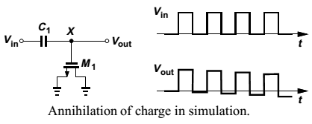
Charge and Capacitance Modeling
The simple gate capacitance model described for the Level 1 model, called the Meyer capacitance model, suffers from many shortcomings even for long-channel devices.
In transient SPICE analyses, such a model does not conserve charge (!), thereby introducing errors in the simulation.
A periodic rectangular waveform applied to a voltage divider consisting of an ideal capacitor and a MOSFET experiences “droop” at the output because in every period some charge at node X is lost.

Slide 52
Charge and Capacitance Modeling
This voltage droop effect arises from the calculation of charge by integrating capacitor voltages with respect to time, an operation that accumulates small errors in the simulation.
To minimize this type of error, the simulation algorithm can be modified such that it first computes the charge in the inversion layer and the depletion region and subsequently partitions the charge among the device capacitances.
Another issue in the Meyer charge model is as follows -
The assumption that in triode region CGS = CGD = (1/2)WLCox + Wcov , and in saturation region CGS = (2/3)WLCox + Wcov and CGD = Wcov is inaccurate for short channel devices, requiring flexible partitioning for ease of curve fitting

Slide 53
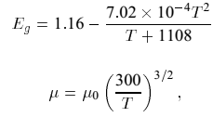
Temperature Dependence
Many parameters of MOS transistors vary with temperature, making it difficult to maintain a reasonable fit between measured and simulated behavior across a wide temperature range.
In the Level 1-3 models as well as BSIM and BSIM2, the following parameters have temperature dependence:
VTH, built-in potential of S/D junctions, the intrinsic carrier concentration of silicon (ni), the bandgap energy (Eg), and the mobility. Most equations are empirical, e.g.,

Slide 54
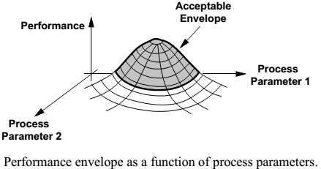
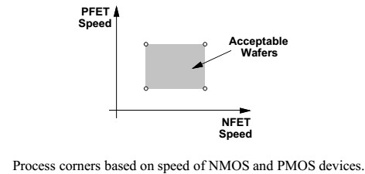
Process Corners
Unlike bipolar transistors, MOSFETs suffer from substantial parameter variations from wafer to wafer.
Process engineers guarantee a performance envelope for the devices.
The idea is to constrain the speed envelope of the NMOS and PMOS transistors to a rectangle defined by four corners – called process corners.

