Slide 1
Chapter 10: Stability and Frequency Compensation
10.1 General Considerations
10.2 Multipole Systems
10.3 Phase Margin
10.4 Basic Frequency Compensation
10.5 Compensation of Two-Stage Op Amps
10.6 Slewing in Two-Stage Op Amps
10.7 Other Compensation Techniques
10.8 Nyquist’s Stability Criterion

Slide 2
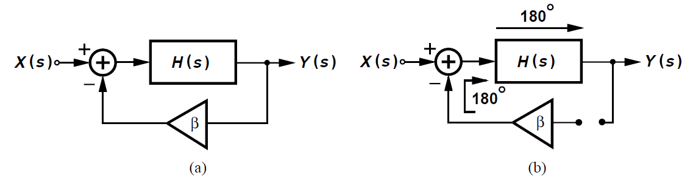
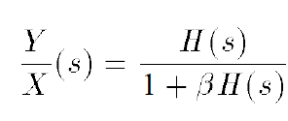
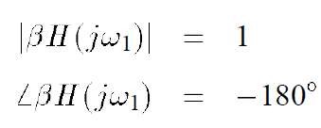
General Considerations
Feedback systems suffer from potential instability and they may oscillate.
Closed-loop transfer function:
What happens if the denominator goes to infinity
“Barkhausen’s criteria”
Negative feedback itself provide 180 phase shift
Loop transmission determines the stability issue

Slide 3
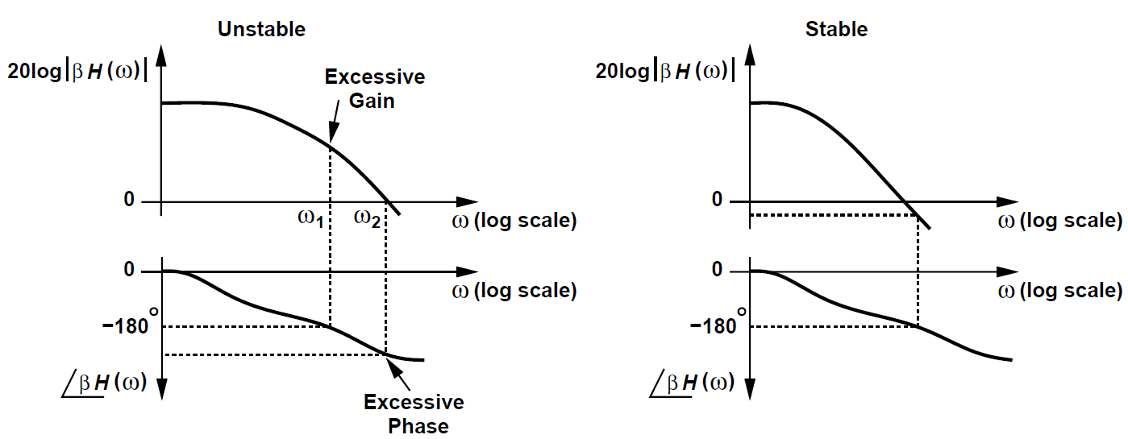
MOSFET as a Switch
Phase shift changes the negative feedback to positive
Gain crossover and phase crossover when gain is unity and phase is – 180 degrees
PX must be behind GX, and GX is equal to unity-gain bandwidth in the open-loop system

Slide 4


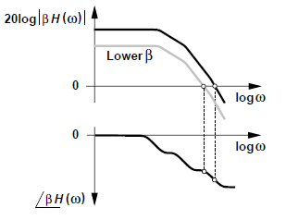
Example 10.1
Explain whether the system depicted before becomes more or less stable if the feedback is weakened.
Solution:
If is reduced, a lower shifts the plot of 20log
down and GX to the left. Since the phase does not change, the system becomes more stable. If there is no feed back, the circuit will not oscillate. The worst case is unity gain feedback, when .

Slide 5
Review of Bode Approximation
The slope of the magnitude plot changes by +20dB/dec at every zero frequency and by -20dB/dec at every pole frequency.
The change begins to change at one-tenth of the pole (left zero)frequency, change by -45 degrees (+45 degrees) at the pole (left zero), and approaches -90 degrees (+90 degrees) at 10 times the pole (left zero)
The key point is that phase changes faster than magnitude.

Slide 6
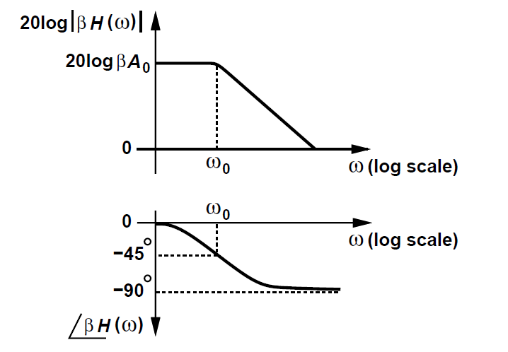

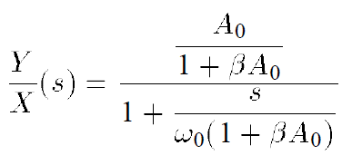
One-Pole System
A phase shift less than 90 degrees
A one-pole system is unconditionally stable

Slide 7

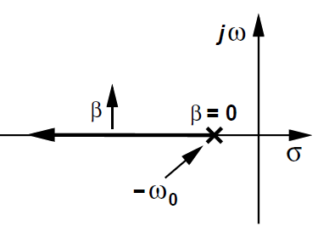
Example 10.2
Construct the root locus for a one-pole system.
Solution:
The closed-loop transfer function implies that the system has a pole . So this is a real-valued pole in the left half plane that moves away from the origin as the loop gain increases.

Slide 8
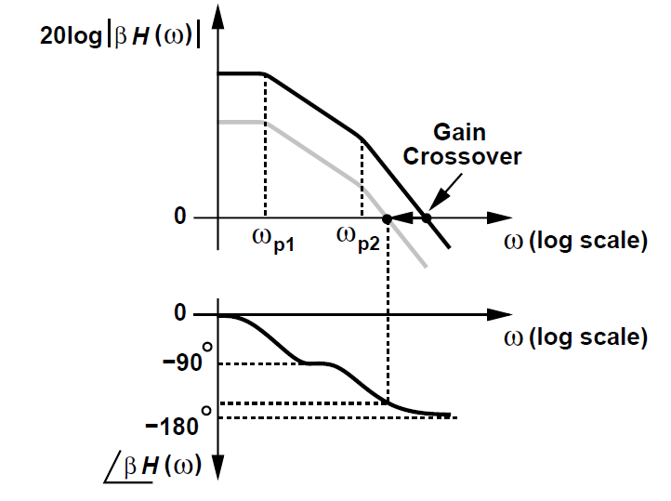
Multipole Systems
The system is stable when below gain crossover, phase is less than -180 degrees
If the feedback becomes weaker, the system is more stable

Slide 9
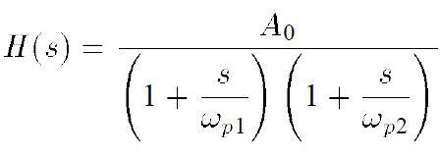
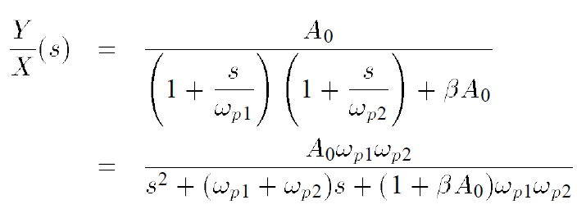
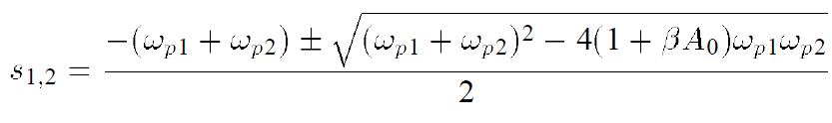
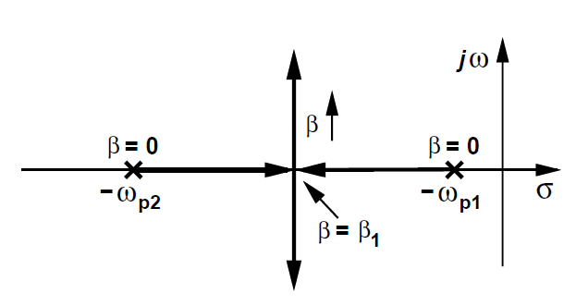

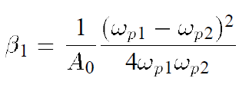
Example 10.3
Construct the root locus for a two-pole system.
Solution:
The closed-loop transfer function implies that the system has a pole . So this is a real-valued pole in the left half plane that moves away from the origin as the loop gain increases.
Open loop gain
Close-loop transfer function
Poles

Slide 10
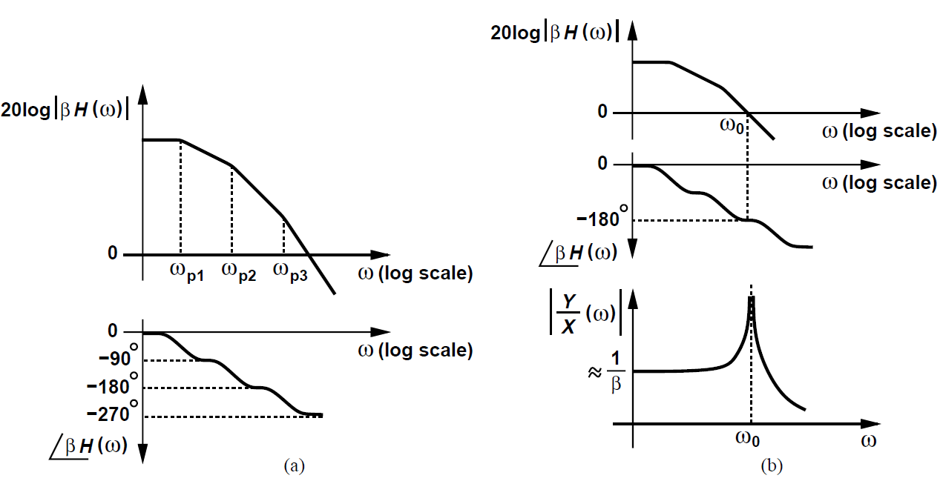
Three poles systems
The system is no long stable
If the feedback becomes weaker, the system is more stable
The close-loop response has infinite gain when gain and phase crossover frequency coincide, which leads to oscillation

Slide 11
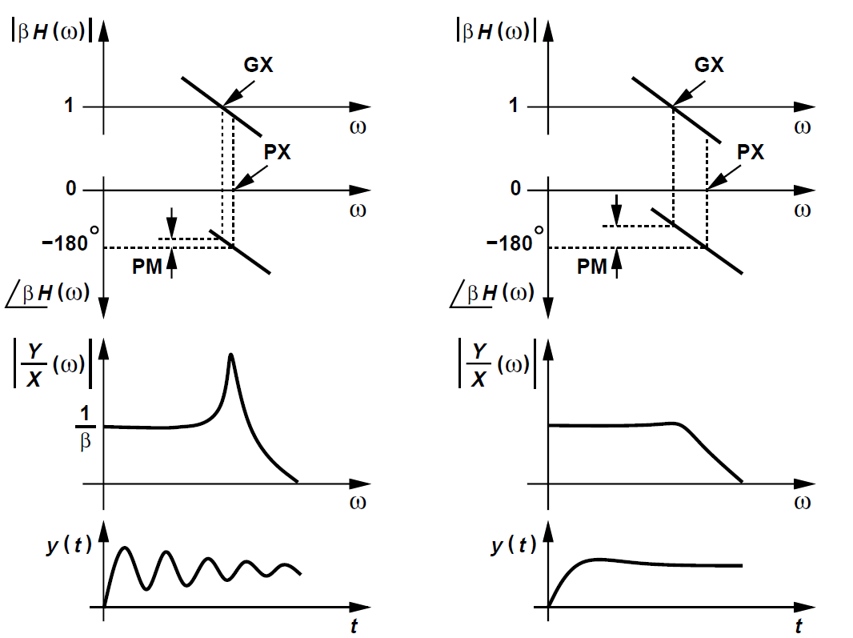
Phase Margin
How far should PX be from GX?

Slide 12

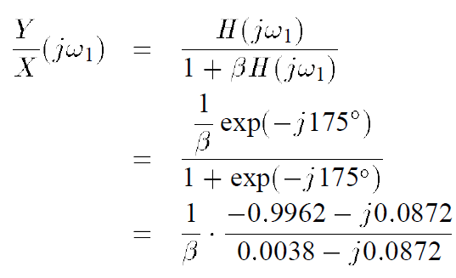
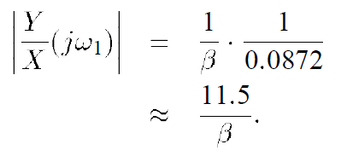
Example : Phase Margin
GX is only slightly below PX. At GX the phase equals -175 degrees.
The closed-loop frequency response exhibits a sharp peak (frequency domain)
The closed-loop system is near oscillation and exhibits a very underdamped behavior.
It would suffer from ringing (time domain)

Slide 13

Definition
Phase Margin(PM), defined as
PM =
A “well-behaved” closed-loop response concludes a greater spacing between GX and PX
The unity-gain bandwidth cannot exceed the second pole frequency
For large-signal application, time-domain simulation of closed-loop system more relevant and useful than small-signal as computations

Slide 14
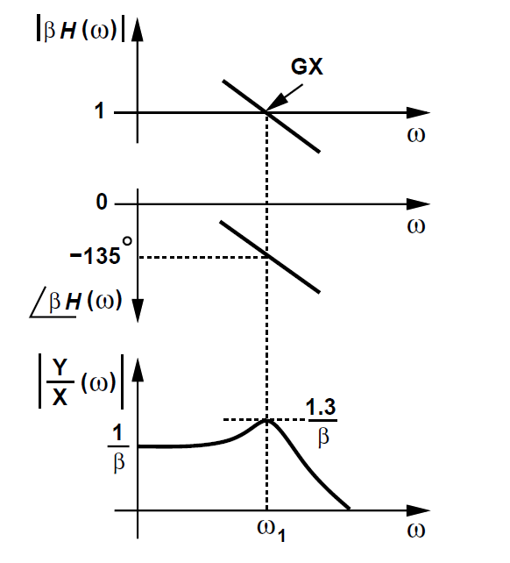
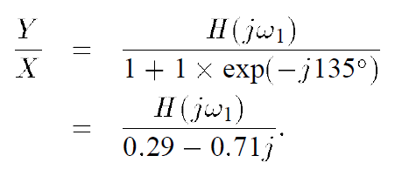


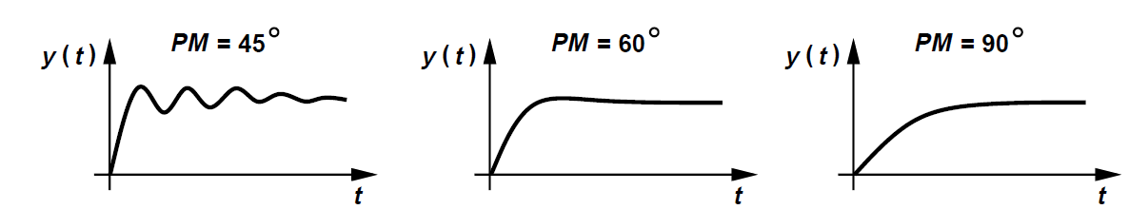
Phase Margin Comparison
How much phase margin is adequate?
PM = 45 degrees
PM = 60 degrees
Well-suited for small signal

Slide 15

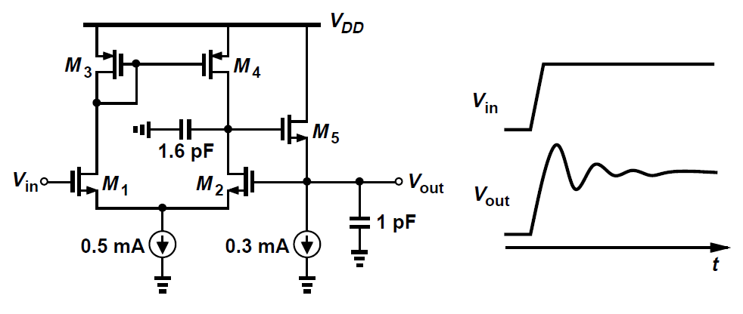
Example: good PM but poor settling
SPICE yields a phase margin of 65 degrees and a unity frequency of 150 MHz
The large-signal step response suffers from ringing

Slide 16
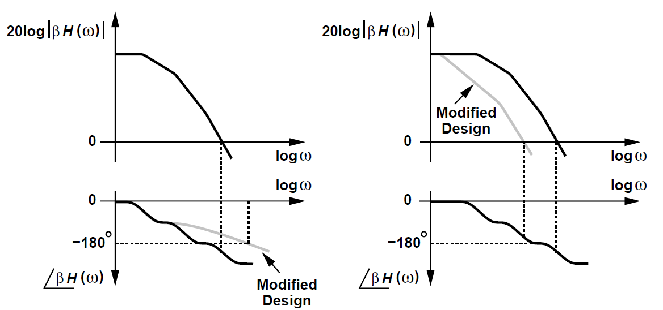
Basic Frequency Compensation
Be “compensated”, the circuit open-loop transfer function must be modified such that closed-loop circuit is stable
- minimizing the overall phase shift (low gain/swing)
- dropping the gain with frequency (low bandwidth)

Slide 17
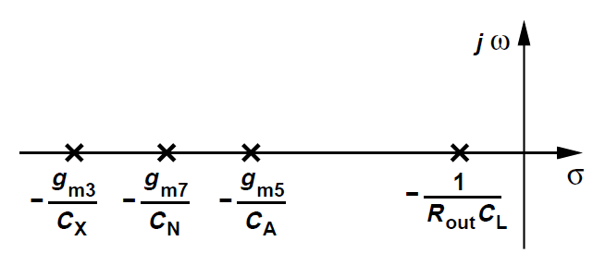
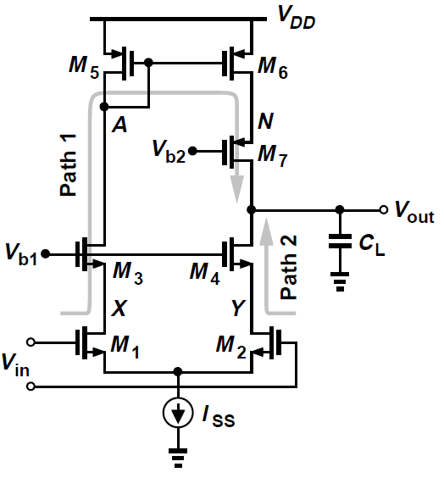
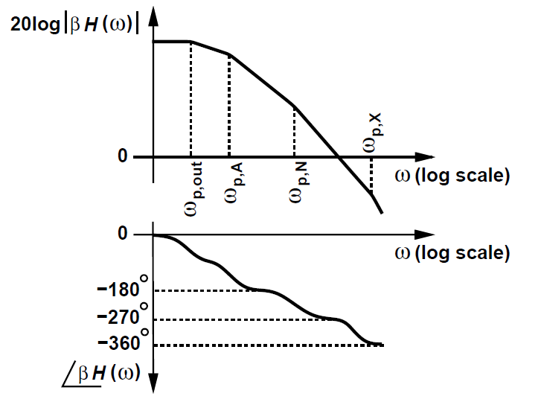
Telescopic Op Amp Stability
Path 1: HF pole at source of M3, a mirror pole at A, and another HF pole at source of M7
Path 2: HF pole at source of M4, shared pole at output
Dominant pole at output due to high output impedance
N is the next dominant pole due to wider device
A zero at the twice of mirror pole

Slide 18
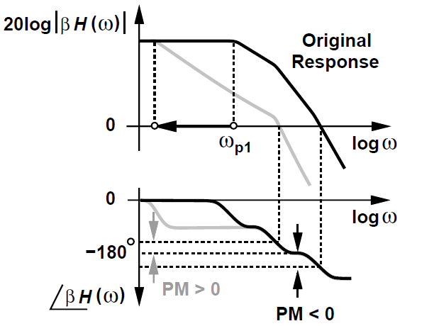
Compensation Procedure
Remember that our mission is to minimize the number of poles while maintaining one dominant pole enough far away from next pole
Lower the dominant pole frequency by a large load capacitance
Phase plot is affected by not the critical part

Slide 19
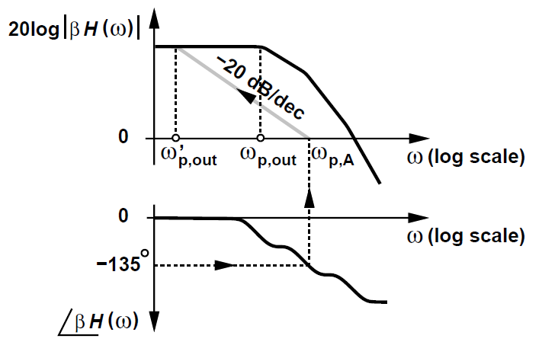
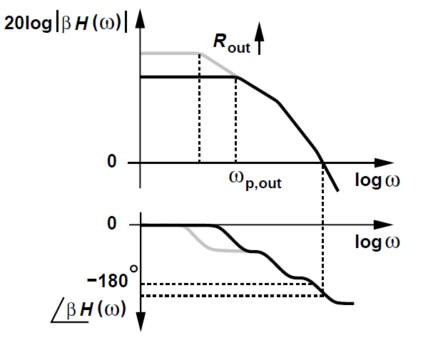

Determine the Dominant Pole
Realize a phase margin with 45 degrees
- draw a 20dB/dec line from gain crossover(A)
- determine the new dominant pole
- load capacitance increased by
Increasing Rout or moving non-dominant pole?
- undesired

Slide 20

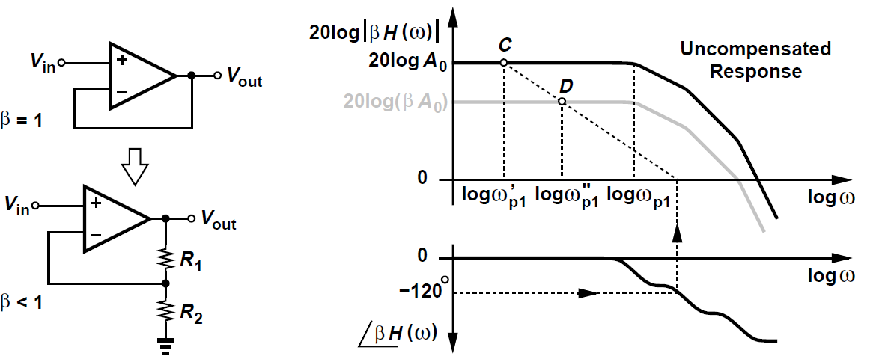


Example 10.5
An Op amp has a phase margin of 60 degrees with unity-gain
feedback. By what factor can the compensation relaxed if the
circuit is to operate with a feedback factor of ?
Solution:
C can scale down by
Notice that the speed is not changed for closed- loop 3dB
bandwidth calc, which means time constant is not changed.
Consider the PM improvement?
Note that unity-gain feedback fastest but worst stability

Slide 21
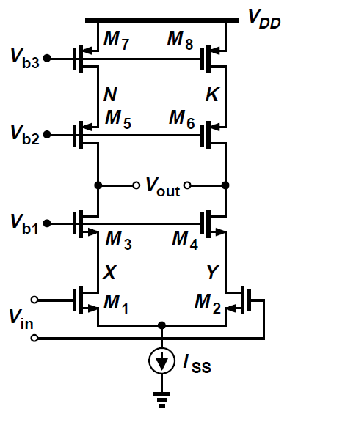
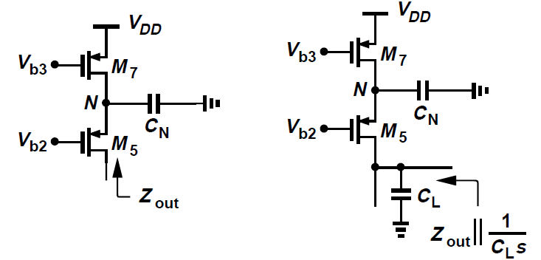
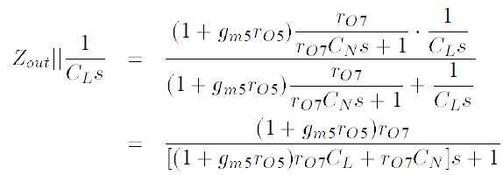

Differential Telescopic Cascode
No mirror pole
Lower the dominant pole by a slight amount as if there is no pole in cascade current source
Low gain but fast path can create zero

Slide 22
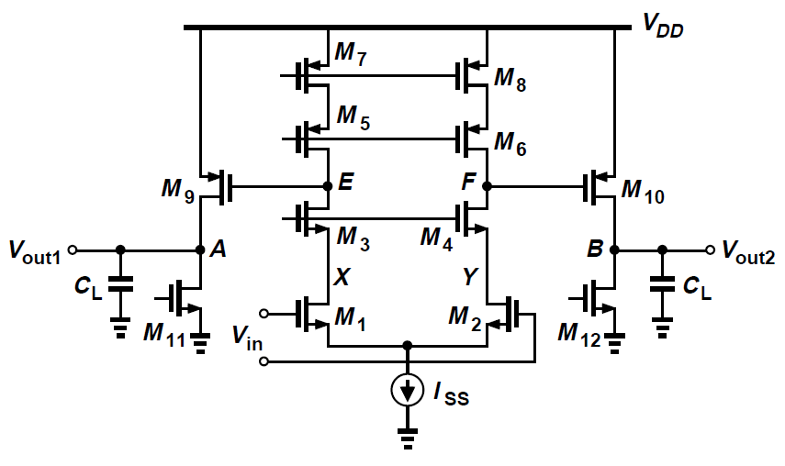
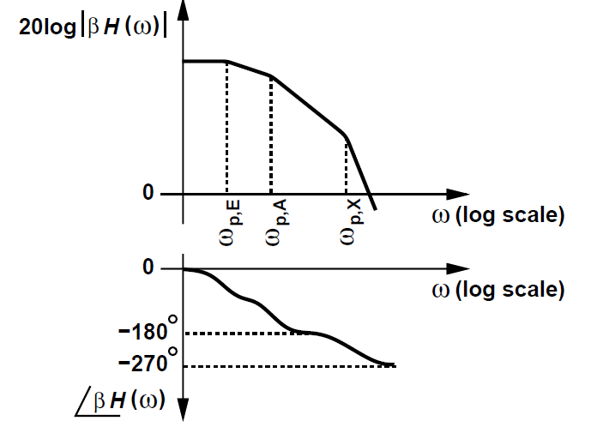
Compensation of Two-Stage Op Amp
Three poles but two dominant at A and E
If only moving one dominant pole,
- limited bandwidth
- a large compensation capacitor

Slide 23
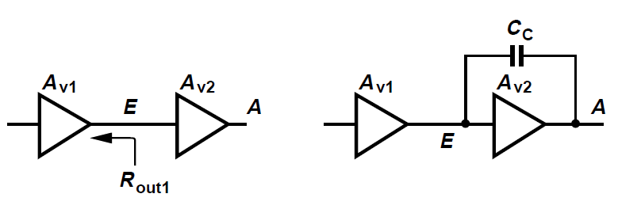

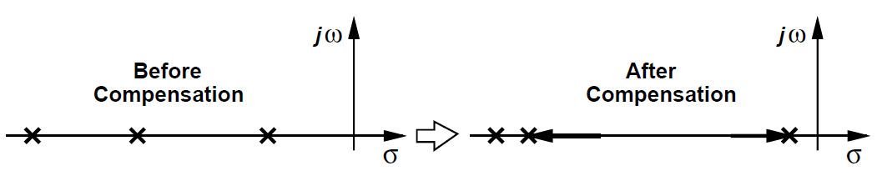
Miller Compensation(1)
A larger C creating a dominating pole
Pole splitting

Slide 24
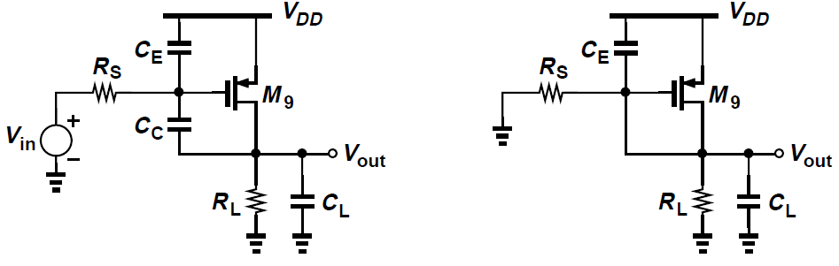
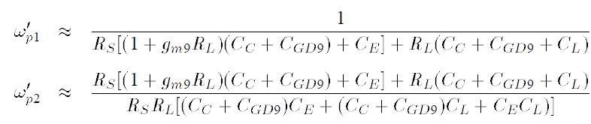


Miller Compensation(2)
Hand calculation. Miller effect provides a low impedance path at high frequency
Require iteration calculation

Slide 25
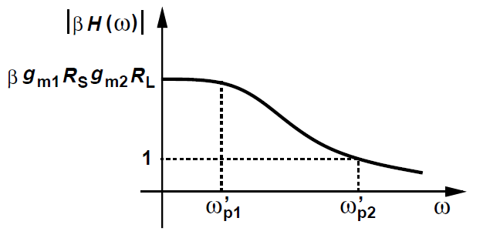




Example 10.6
The two-stage op amp incorporates Miller compensation to reach a phase margin of 45 degrees. Estimate the compensation capacitor value.
Solution:
Dominant pole
Next pole
Loop gain transfer function
C can be smaller for a weaker feedback

Slide 26



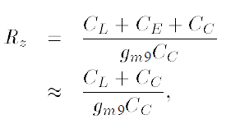
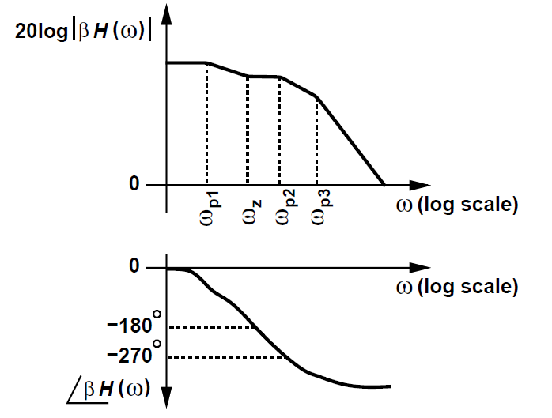
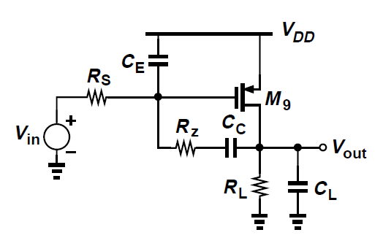
Right-Half-Plane Zero
Zero from a “feedforward” path
Right-half-plane zero yields a negative phase as well as slows down the drop of magnitude
In series with one resistor to move to the left plane

Slide 27
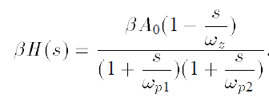
Example 10.7
Noting that the Miller compensation has a right
half plane zero. By making it equals to the non-
dominant pole. Explain what happens.
Solution:
Because of the different sign, both of them still
take effect.

Slide 28
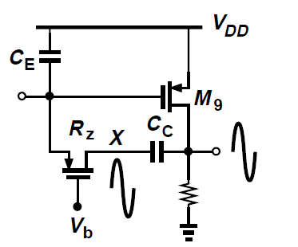
Disadvantage of Canceling Pole
The load capacitance is variable
Actual implementation of Rz due to output voltage excursion is complex

Slide 29
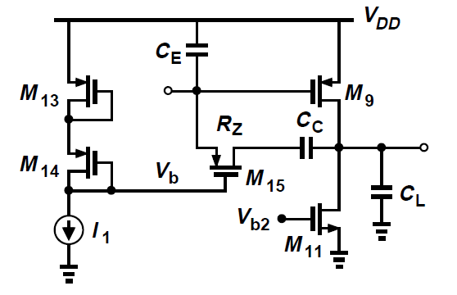
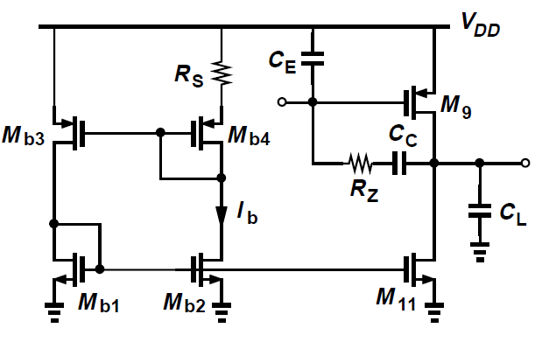


Rz Implementation
VGS13 = VGS9, VGS14 = VGS15
Use constant-gm circuit

Slide 30
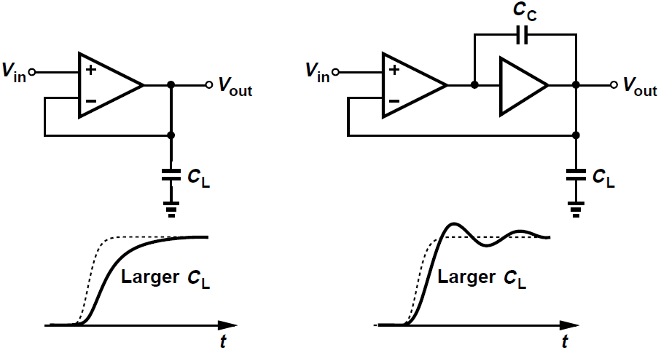
Effect of Load Capacitance
One-stage op amp improves the phase margin
Two-stage op amp degrades the phase margin

Slide 31
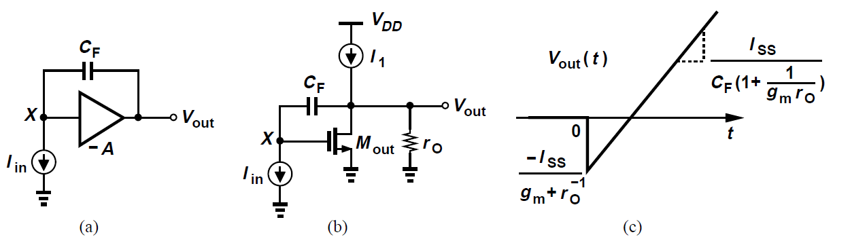

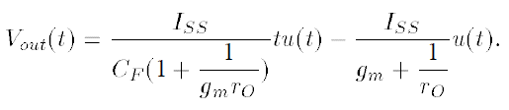
Slewing Study
For large A
For circuit in (b)
- CF acts as a short circuit
- The slope reveals Miller Effect at the output
- I1 only serves as the bias current

Slide 32





Slewing in Two-Stage Op Amp
Positive slew rate
if M5 is not wide enough, M1 goes to triode
Negative slew rate
- Vx rises to turn off M5
- M3 goes to triode

Slide 33





Example 10.8
Op amps typically drive a heavy load capacitance.
Repeat the slew rate analysis.
Solution:
Case(a)
Case(b)

Slide 34



Slewing in Two-Stage Class-AB Op Amp
Recall class-AB op amp incorporate Miller compensation, degrading the phase margin.
Slower than class-A Op Amp
Current mirror yields
Slewing rate

Slide 35




Source Follower to Remove Zero
Expect left-plane-zero at higher frequency

Slide 36




Common-gate to Remove Zero
Source follower limits lower end output
Further splitting provides more bandwidth

Slide 37




Common-gate to Remove Zero Slew Rate
Positive slewing
Negative slewing I3, I2 must as large as Iss

Slide 38




Two-Stage Cascode Op Amp
Zero
Dominant pole
Non-dominant pole
It is plausible to combine two methods and the capacitance at X is quite large, which should also be taken into consideration

Slide 39




Nyquist’s Stability Criterion
Bode plot only consider simple sinusoid waveform
Nyquist’s stability criterion exams RHP poles.
is a growing sinusoid could lead to unstable state
Nyquist stability analysis predicts how many zeros
has in the right half plane(RHP) or on the jw axis.

Slide 40



Basic Concepts
Plot H function in polar coordinates by angle and radius;
With frequencies vary, they create a contour. The horizontal and vertical axes are two projections
and - called H contour

Slide 41



Example: One Pole System
Begin at (A0, 0) for w=0 travels to the left until origin for w=infinite
Falls below the horizontal axis because angle is negative
At the origin the angle is -90 degrees

Slide 42


Calculate Phase from s-Plane
Draw a vector from the pole to s1, measure the angle of this vector with respect to the positive horizontal axis, and multiply by -1
Draw a vector from the zero to s1, repeat the measurement and multiply by 1
The total phase contribution is the algebraically sum
H magnitude is available to analyze by distance calculation, not necessary for Nyquist’s approach

Slide 43



General First-Order System:1 pole, 1 zero

Slide 44


General First-Order System:1 pole, 1zero

Slide 45

Travel on an Arbitrary Path(1)
Abs.
Analyze M and N points
Determine the rotation direction by observing the net angle value

Slide 46

Travel on an Arbitrary Path(2)
S contour encloses pole and zero
H contour does not encloses zero

Slide 47



General First-Order System:1 pole or 1 zero
S contour and H contour has opposite direction for one pole
They are symmetric for one zero

Slide 48

General First-Order System:1 pole and 1 zero
S contour encloses only one pole or one zero
H contour encloses the origin

Slide 49




System with two poles
falls from 0 to infinity
from 0 to -90 degrees and then to -180 degrees
S encloses both poles, H contour encloses origin twice

Slide 50
Cauchy’s Principle
If s contour encircles P poles and Z zeros of H(s) in the clockwise direction, then the polar plot of H(s) encircles the origin Z-P times in the same direction.
If it has a negative number, then H(s) encircles in the counter direction.
- Cauchy’s Principle of Argument
If we manage to draw the polar plot of the transfer function and find it encircles the origin clockwise N times. Thus, in s contour Z = N + P.

Slide 51


Nyquist’s Method
Nyquist’s stability analysis
- A negative-feedback system becomes unstable
if it has any poles on the jw axis or in the RHP
(critical region)
- The same as if has any zeros

Slide 52
Nyquist’s Theorem(1)
How to determine whether has any zeros?
(1)independently determine P
(2)draw the polar plot of as s traverses the contour shown below
(3)determine the number of times N. that encircles the origin clockwise
(4)find P+N as the number of zeros in critical region
Poles of H(s) or are usually none. Since the open-loop system is stable

Slide 53



Nyquist’s Theorem(2)
For a closed-looped system , the polar plot of must not encircle the point (-1,0) clockwise as s traverses a contour around the critical region clockwise.
Choose the s contour to minimize the mathematical labor
- may go through (-1,0) when zeros are on this axis
- the result from M to N is good enough due to symmetry

Slide 54





Example 10.9
Study the closed-loop stability if
Solution:
For the s contour shown in the left. begins at
for s=0. As s=jw moves upwards, the phase becomes
more negative. At , the phase goes to -90 degrees
and the magnitude drops to zero. From M to N, only
the phase of changes. We reflect this plot around
real axis. Since the H contour does not encircle (-1,0),
the closed-loop system is stable.

Slide 55



Example 10.10
Study the closed-loop stability if
Solution:
As s=0, . As s=jw moves upward, the phase
is negative. At , phase is -180 degrees and
magnitude falls to zero. From M to N, H(s) remains at
zero. Since it does not encloses (-1,0), the system is
stable.

Slide 56


Example 10.11
Study the closed-loop stability if
Solution:
As s=0, . As s=jw moves upward, the phase
is negative. At , phase is +90 degrees and
magnitude falls to zero. From M to N, H(s) remains at
zero. It could encircle(-1,0) if at the point of Q
and on
the left of (-1,0). Higher leads to unstable.

Slide 57


Systems with Poles at Origin(1)
Some open-loop system contain one or more poles at the origin. i.e. an integrator
Nyquist stability analysis choose a different s contour that does not go through origin
Travel on an infinitesimally small circle around zero

Slide 58






Systems with Poles at Origin(2)
If and we choose , then
. At and is real and
very large . As rotates to +90 degree , the H
phase towards -90 degree while radius is large.
Then s travels upwards on the jw axis and BH falls.
Then it remains at (0,0). Note that the system is stable since the polar plot does not encircle (-1,0).

Slide 59




Example 10.12
Analyze the closed-loop stability of
The zero can be created, for example, by inserting a
Resistor in series with C1.
Solution:
With , because a small
At , the zero contributes negligible phase. As
we travel upwards to , the function approaches
to . It deflects away from the origin.

Slide 60






Example 10.13
A negative–feedback loop employs two ideal
integrators, i.e., . Study the closed-loop stability
of the system.
Solution:
With , . As goes to
+45 degrees, still at a very large
radius. For , it returns to the real axis. As s travels
at the imagine axis, . The contour passes
(-1,0) at . The closed-loop system therefore
contains two poles on the jw axis

Slide 61



Example 10.14
Repeat the previous example if a zero is added to one of
the integrators , i.e., H(s) =
Solution:
The behavior of BH is similar to that in the previous
example. But as s=+jw travels upward, the zero begins to
contribute appreciable phase and
The zero ensures that BH does not cross or encircle
(-1,0), stabilizing the closed-loop system.

Slide 62




Paradox from Bode Plots
It appears that at frequency , at which is greater than unity and the circuit is capable of oscillation
From Nyquist plot,
owing to zero, the phase of BH never reach 180
degree.

Slide 63



Systems with Multiple 180 degree Crossings
If crosses 180 degree an even(odd) number of times while , then the system is stable(unstable).

