Slide 1

Apache Samza
Introduction
Concepts
Architecture
APIs
Security
Samza vs Storm & Spark
Dacheng Deng 150146955
Guangjian Hu 150193454
Yiwei Jing 150312561

Slide 2
What is Samza?
Apache Samza is a distributed stream processing framework. It uses Apache Kafka for messaging, and Apache Hadoop YARN to provide fault tolerance, processor isolation, security, and resource management.

Slide 3
Features of Samza
Simple API
Managed state
Fault tolerance
Durability
Scalability
Pluggable
Processor isolation

Slide 4
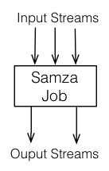
Concepts - Streams

Slide 5
Concepts - Jobs

Slide 6
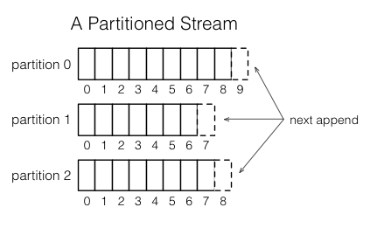
Concepts - Partitions

Slide 7
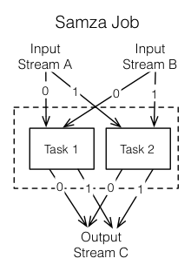
Concepts - Tasks

Slide 8
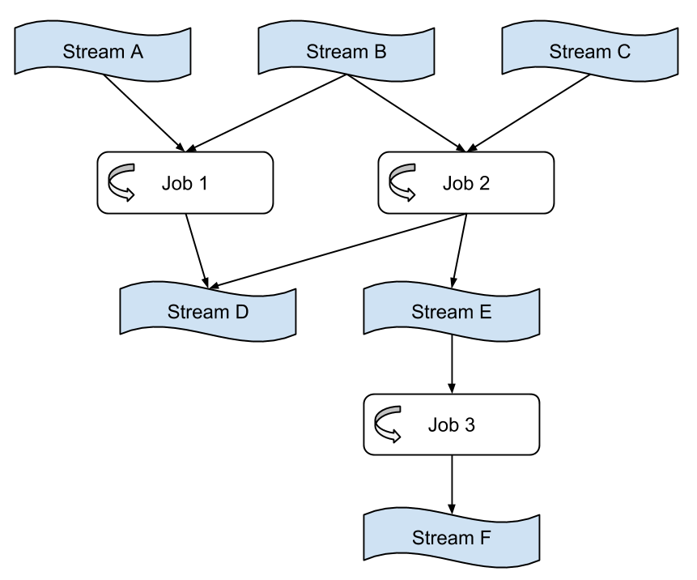
Concepts - Dataflow Graphs

Slide 9
Concepts - Containers

Slide 10
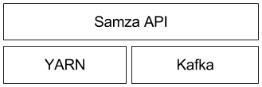
Architecture- Layers
Three layers:
- Streaming: Kafka
- Execution: YARN
- Processing: Samza API

Slide 11
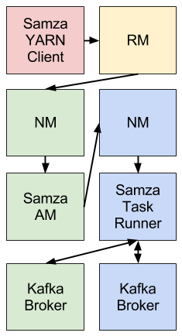
Architecture

Slide 12
APIs - implement the StreamTask interface
package com.example.samza;
public class MyTaskClass implements StreamTask {
public void process(IncomingMessageEnvelope envelope,
MessageCollector collector,
TaskCoordinator coordinator) {
// process message
}
}

Slide 13
APIs - job’s configuration
# This is the class above, which Samza will instantiate when the job is run
task.class=com.example.samza.MyTaskClass
# Define a system called "kafka" (you can give it any name, and you can define
# multiple systems if you want to process messages from different sources)
systems.kafka.samza.factory=org.apache.samza.system.kafka.KafkaSystemFactory
# The job consumes a topic called "PageViewEvent" from the "kafka" system
task.inputs=kafka.PageViewEvent
# Define a serializer/deserializer called "json" which parses JSON messages
serializers.registry.json.class=org.apache.samza.serializers.JsonSerdeFactory
# Use the "json" serializer for messages in the "PageViewEvent" topic
systems.kafka.streams.PageViewEvent.samza.msg.serde=json

Slide 14
APIs - Examples
/** A triple of system name, stream name and partition. */
public class SystemStreamPartition extends SystemStream {
/** The name of the system which provides this stream. It is
defined in the Samza job's configuration. */
public String getSystem() { ... }
/** The name of the stream/topic/queue within the system. */
public String getStream() { ... }
/** The partition within the stream. */
public Partition getPartition() { ... }
}

Slide 15
Security
Securing Streaming Systems | Securing Kafka | Securing Samza’s Environment
Samza does not support any security at the stream system level | Kafka provides no security for its topics, and therefore Samza doesn’t provide any security when using Kafka topics. | Samza containers execute arbitrary user code

Slide 16
THANK YOU.

