Slide 1
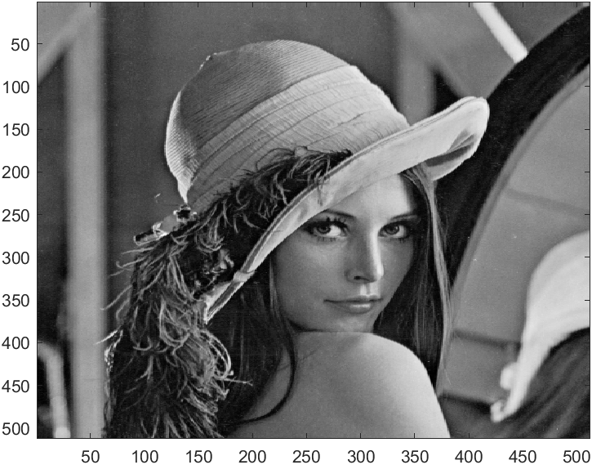
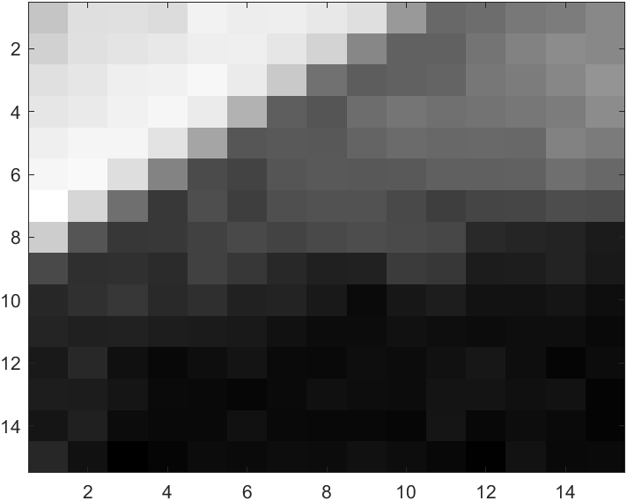
Project: Template matching
목표: Intel MMX/SSE/SSE2/AVX/? 등을 이용하여 32bit 영상에 대해 template matching 함
진행: 3인 1조
평가:
주어진 general C에 대한 parallel processing 결과의 performance improvement 비율 (40%), 코드의 완성도 (30%), 보고서 (20%, 5페이지 이내), 팀원평가 (10%)
제출 (12월 23일 오전 9시): sseMatch.cpp, 보고서

Slide 2

Algorithm - SSD
SSD : Sum of Squared Difference
Subtract all pixel values ​​of a patch(15x15) from the whole image(512x512)
Square the values ​​and then add them.
Do not improve performance by modifying the algorithm.
Operation must be performed on every pixel in the patch

Slide 3
Project Environment Setting
Visual Studio Community 2019
https://docs.Microsoft.com/ko-kr/visualstudio/releases/2019/release-notes
Intel oneAPI Base Toolkit
https://www.intel.com/content/www/us/en/developer/tools/oneapi/base-toolkit-download.html

Slide 4
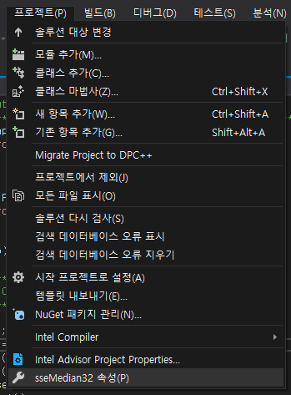
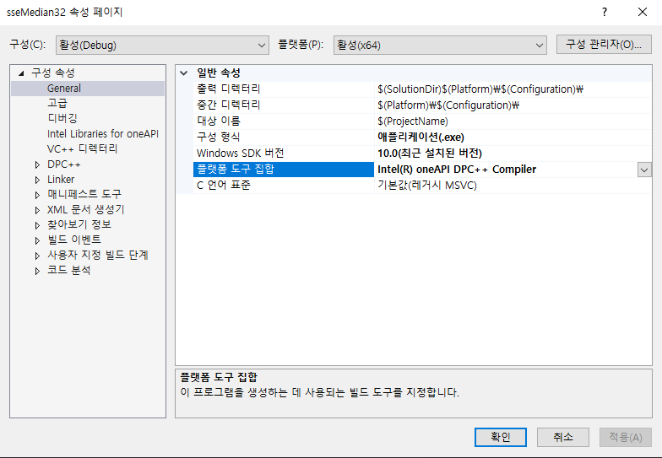
Project Environment Setting
Visual Studio compiler setting
프로젝트 -> 속성 -> Intel® oneAPI DPC++ Compiler 설정

Slide 5
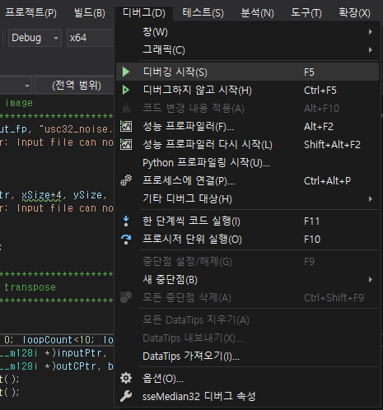
Project Environment Setting
Visual Studio compiler setting
Run project (check x64)

Slide 6
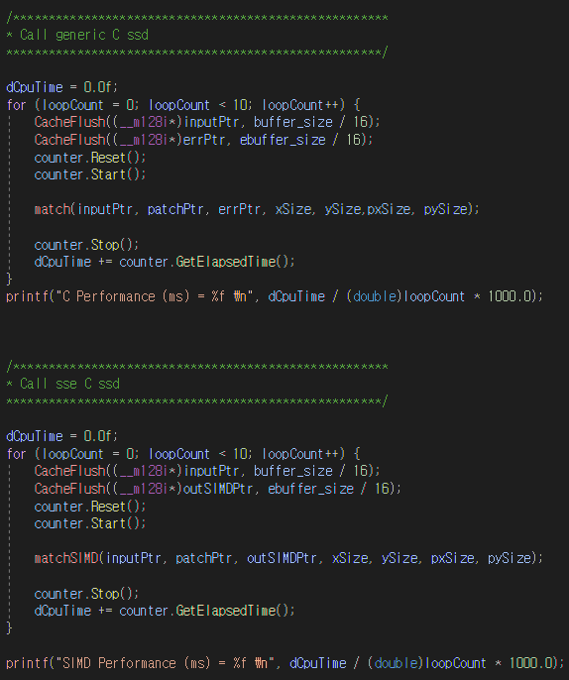
Project Code
Compare the execution time between generic C and SIMD

Slide 7
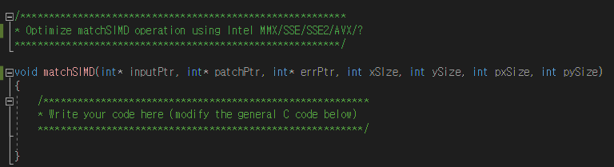
Project Code
Optimize template matching using Intel SIMD
modify matchSIMD ()
Intel Intrinsics Guide
https://www.intel.com/content/www/us/en/docs/intrinsics-guide/index.html

Slide 8
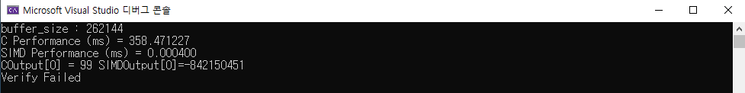
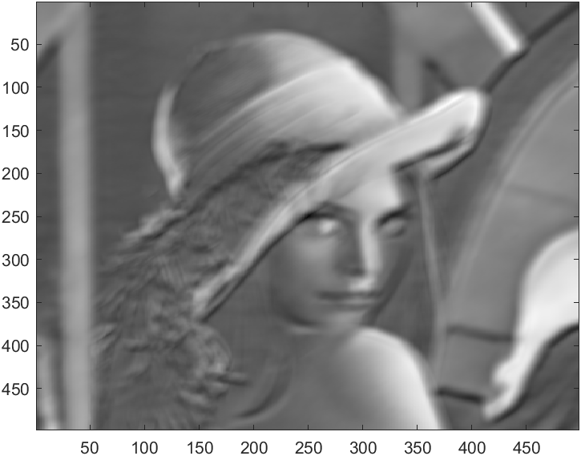
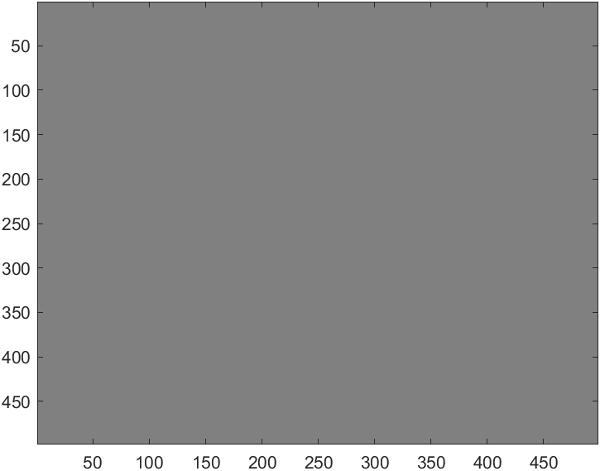
Project Result
If result is same, verification is success.
Using test_Match.m
<Debug message>
<input>
<generic C>
<SIMD>

