Slide 1
STAKEHOLDER BRIEFING · CREDIT RISK MODELING
Two validated probability-of-default models,
ready for pilot
Scenario A scores loan applicants before funding. Scenario B monitors the funded book. Both are CatBoost models evaluated out-of-time, calibrated, thresholded on expected cost, and shipped as reproducible pipelines with drift monitoring.
credit_risk_modeling · reports/scenario_{a,b}_metrics.json · experiments/reports/
Notes:
Frame: results briefing, not a tutorial. Two models, one shared engine, honest limits.

Slide 2
CONTEXT
Lenders need calibrated default probabilities at two decision points — not just a ranking
Decision 1 — Approve or reject (before funding)
Every applicant needs a probability of default before money moves. A score that only ranks well is not enough: pricing, limits, and fair-lending review all need probabilities that mean what they say.
Decision 2 — Monitor the funded book (after origination)
Once funded, pricing and loan-structure fields exist. The book needs re-scoring as vintages age, with drift detection when the world changes.
What this project delivers: two models answering those two questions, evaluated on genuinely unseen future loans, with every claim traceable to a committed report.
Situation
credit_risk_modeling · stakeholder briefing
2 / 28
Notes:
Keep it plain: ranking vs probability. Calibration is the business-critical property.

Slide 3
ARCHITECTURE
Scenario A answers “should we fund this applicant?” Scenario B answers “how risky is this funded loan?”
Scenario A · application-time
Approve / reject
14 features — bureau, demographic, derived (credit age, DTI, LTI)
Uses only what an applicant tells you and the bureau reports
Hard-blocks funding, repayment, and collection fields
OOT AUC 0.644 τ = 0.288
Scenario B · post-origination
Funded-book monitoring
28 features — Scenario A set + grade, int_rate, installment, funded_amnt
Scoring entry point rejects payloads containing repayment/collection fields
Same shared engine (pipeline/core.py), separate feature contract
OOT AUC 0.669 τ = 0.282
Source: reports/scenario_{a,b}_model_card.md · pipeline/scenario_{a,b}/features.py
credit_risk_modeling · stakeholder briefing
3 / 28
Notes:
One engine, two contracts. Leakage prevention is enforced in code, not by convention.

Slide 4
DATA
117,841 mature loans, labeled GOOD/BAD by a 33-month performance window and split forward in time
466k
117,841
3
~15%
raw loan records (2007–2014)
usable after maturity filter
temporal splits, never shuffled
bad (default) rate
Split | Period | Loans | Bad rate | Role
Train | 2007-08 → 2012-11 | 84,764 | 15.3% | fit models
Validation | 2012-11 → 2012-12 | 10,596 | 14.8% | choose calibration & τ
OOT test | 2013Q1 | 22,481 | 13.9% | evaluated once
Source: reports/scenario_a_model_card.md §Data & splits · src/performance_window.py (M=33)
credit_risk_modeling · stakeholder briefing
4 / 28
Notes:
The OOT quarter is genuinely future data — the honest evaluation most projects skip.

Slide 5
WHAT WAS BUILT
A four-stage pipeline turns raw loan tapes into scored, monitored probabilities of default
Raw tape
466k loan records
CSV → interim pickles
prepare
clean · performance
window · temporal split
train
CatBoost / XGB / LGBM
calibration · τ on valid
score
batch scorer
PD + decision + intervals
monitor
PSI drift report
Stable / Moderate / Significant
→
→
→
→
Reproducible
DVC-tracked data & models, manifest.json env+hashes, MLflow runs, 48-test suite.
Unified inference
pipeline/infer.py routes one record through both scenarios.
Explainable
pipeline/explain.py: SHAP importance, cost curves, LR coefficients.
Source: docs/method.md · pipeline/core.py · pipeline/{scenario_a,scenario_b}/
credit_risk_modeling · stakeholder briefing
5 / 28
Notes:
Emphasize: one shared engine, scenario wrappers pass a spec — new scenarios extend, not copy.

Slide 6
TRUST
Forbidden features are blocked in code at scoring time — not by analyst discipline
What never enters a model
Repayment outcomes: recoveries, out_prncp, total_pymnt, last_pymnt_*
Collection fields: collection_recovery_fee, pymnt_plan
Scenario A additionally excludes all funding/pricing fields
How it is enforced
FORBIDDEN_FEATURES lists live in each scenario's features.py
Scenario B scorer hard-rejects payloads containing blocked columns
pipeline/infer.py strips them per scenario when routing one record
Calibration and τ are chosen on validation — the OOT test set is touched once
This is the difference between a notebook that looks good and a model that survives production.
Source: docs/method.md §The two scenarios · pipeline/scenario_b/score.py
credit_risk_modeling · stakeholder briefing
6 / 28
Notes:
Stress: leakage is the #1 way credit models lie. Here it is structural.

Slide 7
MODEL SELECTION
CatBoost won both scenarios — and the alternatives were close enough that ensembles added nothing
Model | A · valid AUC | A · OOT AUC | B · valid AUC | B · OOT AUC
CatBoost | 0.6468 | 0.6442 | 0.6684 | 0.6687
XGBoost | 0.6442 | 0.6433 | 0.6666 | 0.6674
LightGBM | 0.6456 | 0.6436 | 0.6658 | 0.6687
Calibration: raw wins
CatBoost probabilities needed no recalibration — sigmoid/isotonic tested on validation Brier, raw kept.
Threshold: expected cost
τ minimizes expected loss (FN cost ≈ 8.25M vs FP ≈ 2.7M IDR), not accuracy.
Ensembles: tested, rejected
Soft-vote and stacking evaluated — differences within noise, single CatBoost shipped.
Source: reports/scenario_{a,b}_leaderboard.csv · reports/scenario_{a,b}_metrics.json
credit_risk_modeling · stakeholder briefing
7 / 28
Notes:
Key point: differences are ~0.002-0.003 AUC — honest reporting, no overselling.

Slide 8
RESULTS · SCENARIO A
The application-time model holds up out-of-time: AUC 0.644, Gini 0.288, well-calibrated
Metric | Valid | OOT (2013Q1)
ROC AUC | 0.6468 | 0.6442
PR AUC | 0.2375 | 0.2138
Gini | 0.2936 | 0.2885
KS statistic | 0.2149 | 0.2141
Log loss | 0.4024 | 0.3897
Brier score | 0.1217 | 0.1169
Decision threshold τ = 0.2883
Expected-cost optimum on validation. Approved-book bad rate at τ: 13.5% vs 14.8% overall.
Reproduces the notebook baseline
Pipeline output matches nb4/autoresearch CatBoost to six decimals — the .py pipeline is verified against the research code.
Source: reports/scenario_a_metrics.json · reports/scenario_a_model_card.md
credit_risk_modeling · stakeholder briefing
8 / 28
Notes:
Modest AUC is honest — application-time features are limited. Stability valid→OOT is the story.

Slide 9
RESULTS · SCENARIO B
Adding funding and pricing fields lifts OOT AUC to 0.669 — the strongest model in the project
Metric | Valid | OOT (2013Q1)
ROC AUC | 0.6684 | 0.6687
PR AUC | 0.2587 | 0.2364
Gini | 0.3367 | 0.3373
KS statistic | 0.2527 | 0.2483
Log loss | 0.3968 | 0.3841
Brier score | 0.1202 | 0.1155
τ = 0.2823
Expected-cost threshold, same methodology as Scenario A.
OOT AUC higher than validation — the model generalizes, not degrades, on the future quarter.
Source: reports/scenario_b_metrics.json · reports/scenario_b_model_card.md
credit_risk_modeling · stakeholder briefing
9 / 28
Notes:
Grade/int_rate/installment carry signal — that's why B beats A. This is the monitoring model.

Slide 10
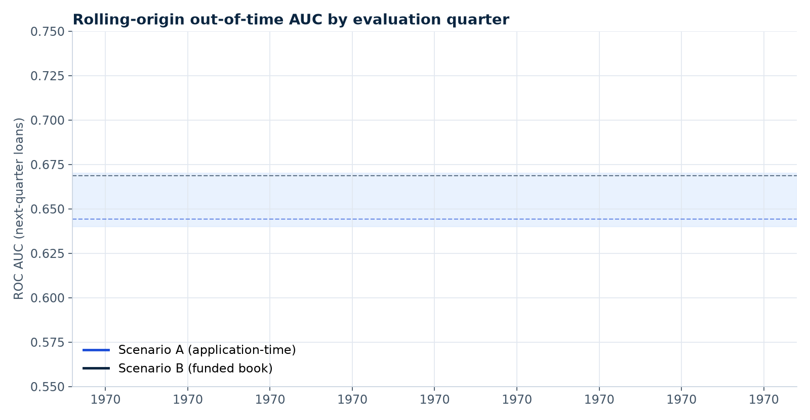
ROBUSTNESS
Rolling-origin evaluation shows gradual drift — a scheduled retraining cadence is sufficient
▪ Method: refit on expanding window, score the next quarter — 16 windows per scenario
▪ Expectation: OOT AUC ~0.64–0.67 on future vintages; the 2010 peak is not recoverable
▪ Drift: bad rates move with Lending Club's book growth — PSI monitoring is designed for this
▪ Cost: full run < 5 min per scenario — cheap gate before promoting any retrained bundle
Source: experiments/reports/rolling_oot_evaluation.md · rolling_oot_{a,b}.csv
credit_risk_modeling · stakeholder briefing
10 / 28
Notes:
This answers 'is 0.644 a lucky quarter?' — no, it's the honest range across many quarters.

Slide 11
CALIBRATION
Raw CatBoost probabilities are already well-calibrated — extra recalibration was tested and rejected
0.897 / 0.881
0.013 / 0.019
raw
calibration slope, valid / OOT (1.0 = perfect)
ECE, valid / OOT (expected calibration error)
winning calibration — sigmoid & isotonic lost on Brier
Per-vintage recalibration hurts. 16 quarterly windows tested: refit calibrators on the adjusted tail worsened ECE and Brier — raw ECE ≈ 0.02 is already good. Recalibrate only at scheduled retraining, not continuously.
Source: experiments/reports/calibration_slope.{csv,md} · recalibration_drift_{a,b}.csv
credit_risk_modeling · stakeholder briefing
11 / 28
Notes:
Business meaning: a predicted PD of 15% corresponds to ~15% observed defaults. That's what pricing needs.

Slide 12
DECISION THRESHOLD
τ is statistically stable (95% CI ±0.05) — but the real uncertainty is population bias, not sampling noise
Scenario | τ deployed | Bootstrap 95% CI | Regret (mean)
A | 0.288 | [0.244, 0.292] | < 0.5% of cost
B | 0.282 | [0.238, 0.302] | < 0.5% of cost
Cost curve is flat near τ
±0.05 deviation changes expected cost by ~2%; p90 regret ~1.2% of minimum.
Governance implication: τ needs policy control, not statistical control. The binding constraint is reject-inference bias (next slide) — an order of magnitude larger effect.
Source: experiments/reports/threshold_ci.md · threshold_ci.csv (500 bootstrap resamples)
credit_risk_modeling · stakeholder briefing
12 / 28
Notes:
500 bootstraps. Deployed τ sits inside the CI — keep it, revisit at retraining cadence.

Slide 13
KNOWN BIAS · SELECTION
Trained only on funded loans, the model likely overstates applicant quality — bounded, not hidden
1.4–1.9×
0.12–0.18
none
plausible true applicant-pool PD vs funded-book PD
oracle τ under plausible assumptions vs deployed 0.288
reject labels exist — strict reject inference is impossible
What this means: absolute PDs are conditional on funding. A predicted 15% means “15% of similar funded loans default” — the true applicant pool defaults more often. Direction and rough magnitude are quantified; exact calibration needs reject-level data.
Source: experiments/reports/reject_inference.md · reject_inference_results.csv
credit_risk_modeling · stakeholder briefing
13 / 28
Notes:
Most important caveat in the deck. Sensitivity analysis, not an estimate — say it plainly.

Slide 14
FAIRNESS
Adverse-impact screening flagged 60-month terms, small_business, and top-LTI borrowers — income is clean
Screen | Flag | Detail | Action
Adverse impact (AIR < 0.80) | 60-mo term · small_business · top LTI tercile | Approval-rate disparity vs reference | Monitor; document
Calibration parity | small_business under-predicts ~5pp | Predicted PD too low vs observed | Segment review
Calibration parity | 60-mo term over-predicts ~6pp OOT | Predicted PD too high vs observed | Segment review
Income | — | No adverse impact detected | None
AIR tests whether the decision treats segments equally; calibration parity tests whether a predicted PD means the same thing inside every segment. 73 segment rows across 9 groupings, valid + OOT.
Source: experiments/reports/adverse_impact.csv · calibration_parity.{csv,md}
credit_risk_modeling · stakeholder briefing
14 / 28
Notes:
Both tests, not just one. Flags are monitoring items, not proven discrimination — be precise.

Slide 15
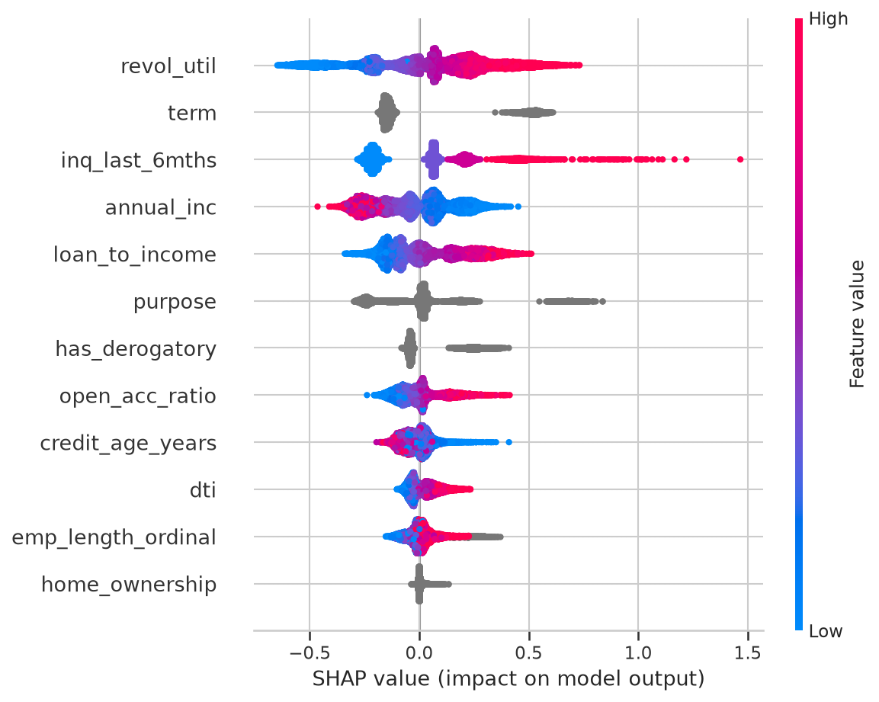
EXPLAINABILITY
SHAP explanations work at portfolio and individual-loan level — decline reasons are defensible
▪ Global: feature importance for the whole book
▪ Per-loan: waterfall plots give each applicant a reason list
▪ Dependence: how revol_util, LTI etc. move PD
▪ Interpretability track preserved: WoE logistic-regression scorecard (nb3) remains for adverse-action explanations
Source: reports/figures/shap_*.png · src/shap_interpretability.py · pipeline/explain.py
credit_risk_modeling · stakeholder briefing
15 / 28
Notes:
Point at the figure: high revol_util and delinquencies push PD up; thin-file and high-DTI too.

Slide 16
UNCERTAINTY
Venn-Abers conformal intervals give each loan a defensible PD range for risk committees
How it works
Isotonic calibration fit twice on the 10,596-loan validation set — label forced 0, then 1
Interval [min(p0,p1), max(p0,p1)] brackets a calibrated probability per loan
Wired into scoring: --intervals on score.py and infer.py
Distribution-free coverage guarantees under exchangeability
Why it matters
Near-threshold loans get visibly wider intervals → manual review queue
Risk committees see uncertainty, not false precision
Complements the bootstrap τ analysis: score-level and threshold-level uncertainty both quantified
Source: experiments/reports/conformal_coverage.md · src/conformal.py
credit_risk_modeling · stakeholder briefing
16 / 28
Notes:
Novel-ish capability most credit shops don't have. Brief — technical audience gets it.

Slide 17
MONITORING
Every scoring batch emits a PSI drift report — per-feature and score-distribution, with a verdict
What is monitored
Characteristic PSI per feature vs reference distribution
Score-distribution PSI — is the book's risk mix shifting?
Overall verdict: Stable / Moderate / Significant
Natural-sort bin ordering (audit fix) so drift localizes correctly
Why it matters now
Rolling evaluation proved drift is gradual — exactly what PSI catches early
Triggers the scheduled retraining cadence before AUC degrades visibly
Regression test: shifted-feature fixture produces material PSI + non-stable verdict
Source: src/population_stability_index.py · pipeline/scenario_{a,b}/score.py --psi · docs/method.md
credit_risk_modeling · stakeholder briefing
17 / 28
Notes:
Monitoring is a feature, not an afterthought — it closes the loop with the drift finding.

Slide 18
ENGINEERING
DVC-tracked artifacts, a manifest of environment and hashes, MLflow runs, and a 48-test suite
DVC
Data, interim frames, and model bundles versioned; local remote pushed.
manifest.json
Environment versions, split config, artifact hashes — any bundle is auditable.
MLflow
Experiment tracking with sqlite backend; runs comparable across retrains.
48 tests
pytest green: pipelines, metrics, PSI, conformal, reject-inference, threshold math.
Scenario A pipeline reproduces the research notebook's CatBoost to six decimals — production code and research code are provably the same model.
Source: README.md · docs/reproduce.md · artifacts/manifest.json · tests/
credit_risk_modeling · stakeholder briefing
18 / 28
Notes:
For the technical half of the audience: this is what 'production-ready' means concretely.

Slide 19
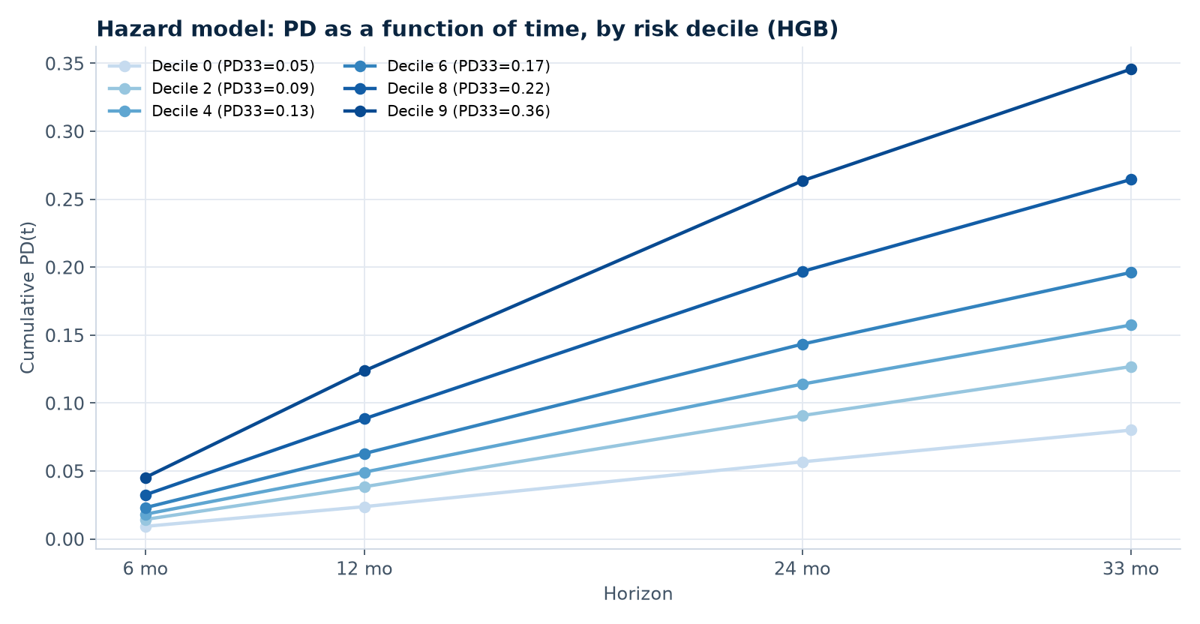
V2 CANDIDATE
The survival model produces PD-as-a-function-of-time — valuable, but it trails on discrimination
▪ Model: discrete-time hazard h(t|x) → survival curve → PD(t) per loan
▪ Performance: OOT AUC 0.637 vs CatBoost 0.644 — documented, not promoted
▪ Outputs: expected-loss term structure peaks around month 11; median time-to-event 17mo
▪ Use case: right tool if the business needs lifetime EL, cross-sell windows, or horizon-specific triggers
Source: experiments/reports/hazard_model.md · hazard_pd_curves.md · hazard_pd_curves_hgb.csv
credit_risk_modeling · stakeholder briefing
19 / 28
Notes:
Show the curve: PD at 6/12/24/33 months per decile. This is what binary models cannot express.

Slide 20
HONESTY
Five known limitations — each with a mitigation already in place or scoped
Single OOT quarter (2013Q1)
Mitigated by rolling-origin evaluation across 16 quarters.
Funded-loan selection bias
Bounded by sensitivity analysis; needs reject-level data to resolve.
Modest application-time AUC (~0.64)
Ceiling of pre-funding features; Scenario B reaches 0.669 with pricing data.
Vintage drift
Gradual, monitored by PSI, handled by retraining cadence.
Synthetic-data tests
Unit tests use fixtures; no live-portfolio shadow validation yet.
Segment exceptions
small_business under-prediction and 60-mo over-prediction flagged for review.
credit_risk_modeling · stakeholder briefing
20 / 28
Notes:
Naming limits builds credibility. Each has a next step — see next-steps slide.

Slide 21
NEGATIVE RESULTS
Class imbalance fixes, alternative representations, and ensembles were all tried — none beat raw CatBoost
Experiment | Result | Decision
SMOTENC oversampling | AUC −0.006 to −0.020, monotonic harm | Rejected
Random undersampling | RUS-30 wrecks log loss; RUS-20 +0.0003 (noise) | Rejected
Count-feature re-expression | +0.0018 valid AUC — within noise margin | Discarded
mths_since_last_* + LR interactions | +0.0014 valid, flat OOT; interactions nil | Rejected
Soft-vote / stacking ensembles | Differences within noise | Single CatBoost
Per-vintage recalibration | Worsens ECE and Brier | Recal only at retrain
Autoresearch loop: ~15s per trial, protocol and keep/discard rule committed in autoresearch/program.md.
Source: experiments/reports/class_imbalance_sampling.md · feature_representation.md · recalibration_drift.md · autoresearch/results/trials.jsonl
credit_risk_modeling · stakeholder briefing
21 / 28
Notes:
Negative results are a feature: the champion survived real competition, documented in trials.jsonl.

Slide 22
RECOMMENDATION
Deploy Scenario A for approve/reject decisions and Scenario B for funded-book monitoring — as a pilot
Scenario A → origination
Score every applicant; τ = 0.288 decision boundary
SHAP waterfall per decline → adverse-action reasons
Venn-Abers interval flags borderline cases for review
Report PDs with the documented funding-conditional caveat
Scenario B → portfolio management
Re-score funded book on each reporting cycle
PSI report per batch → retraining trigger
Segment dashboards watch the three flagged groups
Hazard model available for horizon-specific EL questions
Both bundles reproduce with python -m pipeline.scenario_{a,b}.train; unified scoring via pipeline/infer.py.
credit_risk_modeling · stakeholder briefing
22 / 28
Notes:
Concrete deployment shape. Pilot, not big-bang — shadow mode alongside existing process first.

Slide 23
ASKS
Stakeholders must decide: how to handle reject-data bias, τ governance, and retraining cadence
1 · Reject-level data
Accept funded-conditional PDs with documented bounds (1.4–1.9×, oracle τ 0.12–0.18), or invest in collecting/scoring rejected applicants to close the gap.
2 · τ governance
Approve the expected-cost τ policy (C_FN ≈ 8.25M vs C_FP ≈ 2.7M IDR) and its review cadence — statistical uncertainty is small; policy risk is not.
3 · Retraining cadence
Approve scheduled retraining (~semi-annual, PSI-triggered early) — rolling evaluation shows gradual drift, not abrupt breaks.
credit_risk_modeling · stakeholder briefing
23 / 28
Notes:
Each ask maps to a documented finding. Don't ask for blanket approval — ask for three decisions.

Slide 24
NEXT STEPS
Four scoped next steps: reject data, live shadow validation, dashboard, retraining automation
1 · Reject-level data collection
Highest-value gap: turns bounded bias into measured bias. Reject-inference module already accepts augmented files.
2 · Shadow-mode pilot
Score live applicants without acting; compare model PDs to realized outcomes — the missing live-portfolio validation.
3 · Streamlit decision dashboard
Scaffold exists; wire to pipeline/infer.py + SHAP for a business-facing UI.
4 · Retraining automation
Rolling-OOT harness is the promotion gate; PSI triggers; MLflow tracks each retrain.
Source: README.md §Future directions · dashboard/app.py · autoresearch/program.md
credit_risk_modeling · stakeholder briefing
24 / 28
Notes:
Ordered by value: reject data first — everything else is engineering.

Slide 25
CONCLUSIONS
Two validated models.
Honest about their limits. Ready for pilot.
Scenario A
AUC 0.644 OOT · τ 0.288 · approve/reject
Scenario B
AUC 0.669 OOT · τ 0.282 · book monitoring
Trust layer
Calibration · SHAP · conformal · PSI · fairness · reproducibility
Every number traces to a committed report or test · questions welcome
Notes:
This slide stays on screen during Q&A. If asked for depth: appendix has full metrics + repro commands.

Slide 26
APPENDIX
Details & reproduction
Full metrics tables, experiment log, and exact commands to rebuild every artifact.
Notes:
Skip unless asked. Everything here is committed in the repo.

Slide 27
APPENDIX · METRICS
Full OOT metrics for both production bundles
Scenario A — CatBoost · raw · τ=0.2883 | Valid | OOT
ROC AUC | 0.646804 | 0.644239
PR AUC | 0.237474 | 0.213800
Log loss | 0.402443 | 0.389742
Brier | 0.121717 | 0.116929
Gini | 0.293607 | 0.288478
KS | 0.214866 | 0.214102
Scenario B — CatBoost · raw · τ=0.2823 | Valid | OOT
ROC AUC | 0.668363 | 0.668670
PR AUC | 0.258677 | 0.236444
Log loss | 0.396757 | 0.384100
Brier | 0.120207 | 0.115477
Gini | 0.336726 | 0.337340
KS | 0.252660 | 0.248295
Source: reports/scenario_{a,b}_metrics.json — full precision values
credit_risk_modeling · stakeholder briefing
27 / 28
Notes:
Exact decimals for the technical audience.

Slide 28
APPENDIX · REPRODUCE
Every artifact rebuilds from committed code and DVC-tracked data
# pipelines
python -m pipeline.scenario_a.train
python -m pipeline.scenario_b.train
# scoring + drift
python -m pipeline.scenario_a.score batch.csv -o scores.csv --psi --intervals
# unified inference
python -m pipeline.infer input.csv -o out.csv
# experiments (~15s/trial)
python autoresearch/experiment.py configs/cat_raw.json
Environment
conda env credit-risk_VENV, Python 3.13 · environment.yml · docs/reproduce.md
Reports index
reports/scenario_*_{metrics.json,leaderboard.csv,model_card.md} · experiments/reports/*.md + *.csv
Figures
reports/figures/ (SHAP, KS, cost curves) · presentations/figures/ (rolling OOT, hazard PD(t))
credit_risk_modeling · stakeholder briefing
28 / 28
Notes:
Leave this up if they want to verify anything live.

