Slide 1
Haringey Schools

Slide 2
Schools
The following schools are included in the analysis:
Alexandra Park
Fortismere
Gladesmore
Greig City Academy
Heartlands
Highgate Wood
Hornsey School for Girls
Park View
Skinners
St Thomas More

Slide 3
Performance

Slide 4
Performance 8 Band Definitions
Performance 8 | Confidence Intervals | Band | Percent of Schools
Above 0.5 | All above zero | Well above average | 16%
Above 0.0 | All above zero | Above average | 18%
Above or below 0.0 | Crossing zero | Average | 33%
Below 0.0 | All below zero | Below average | 17%
Below -0.5 | All below zero | Well below average | 16%

Slide 5
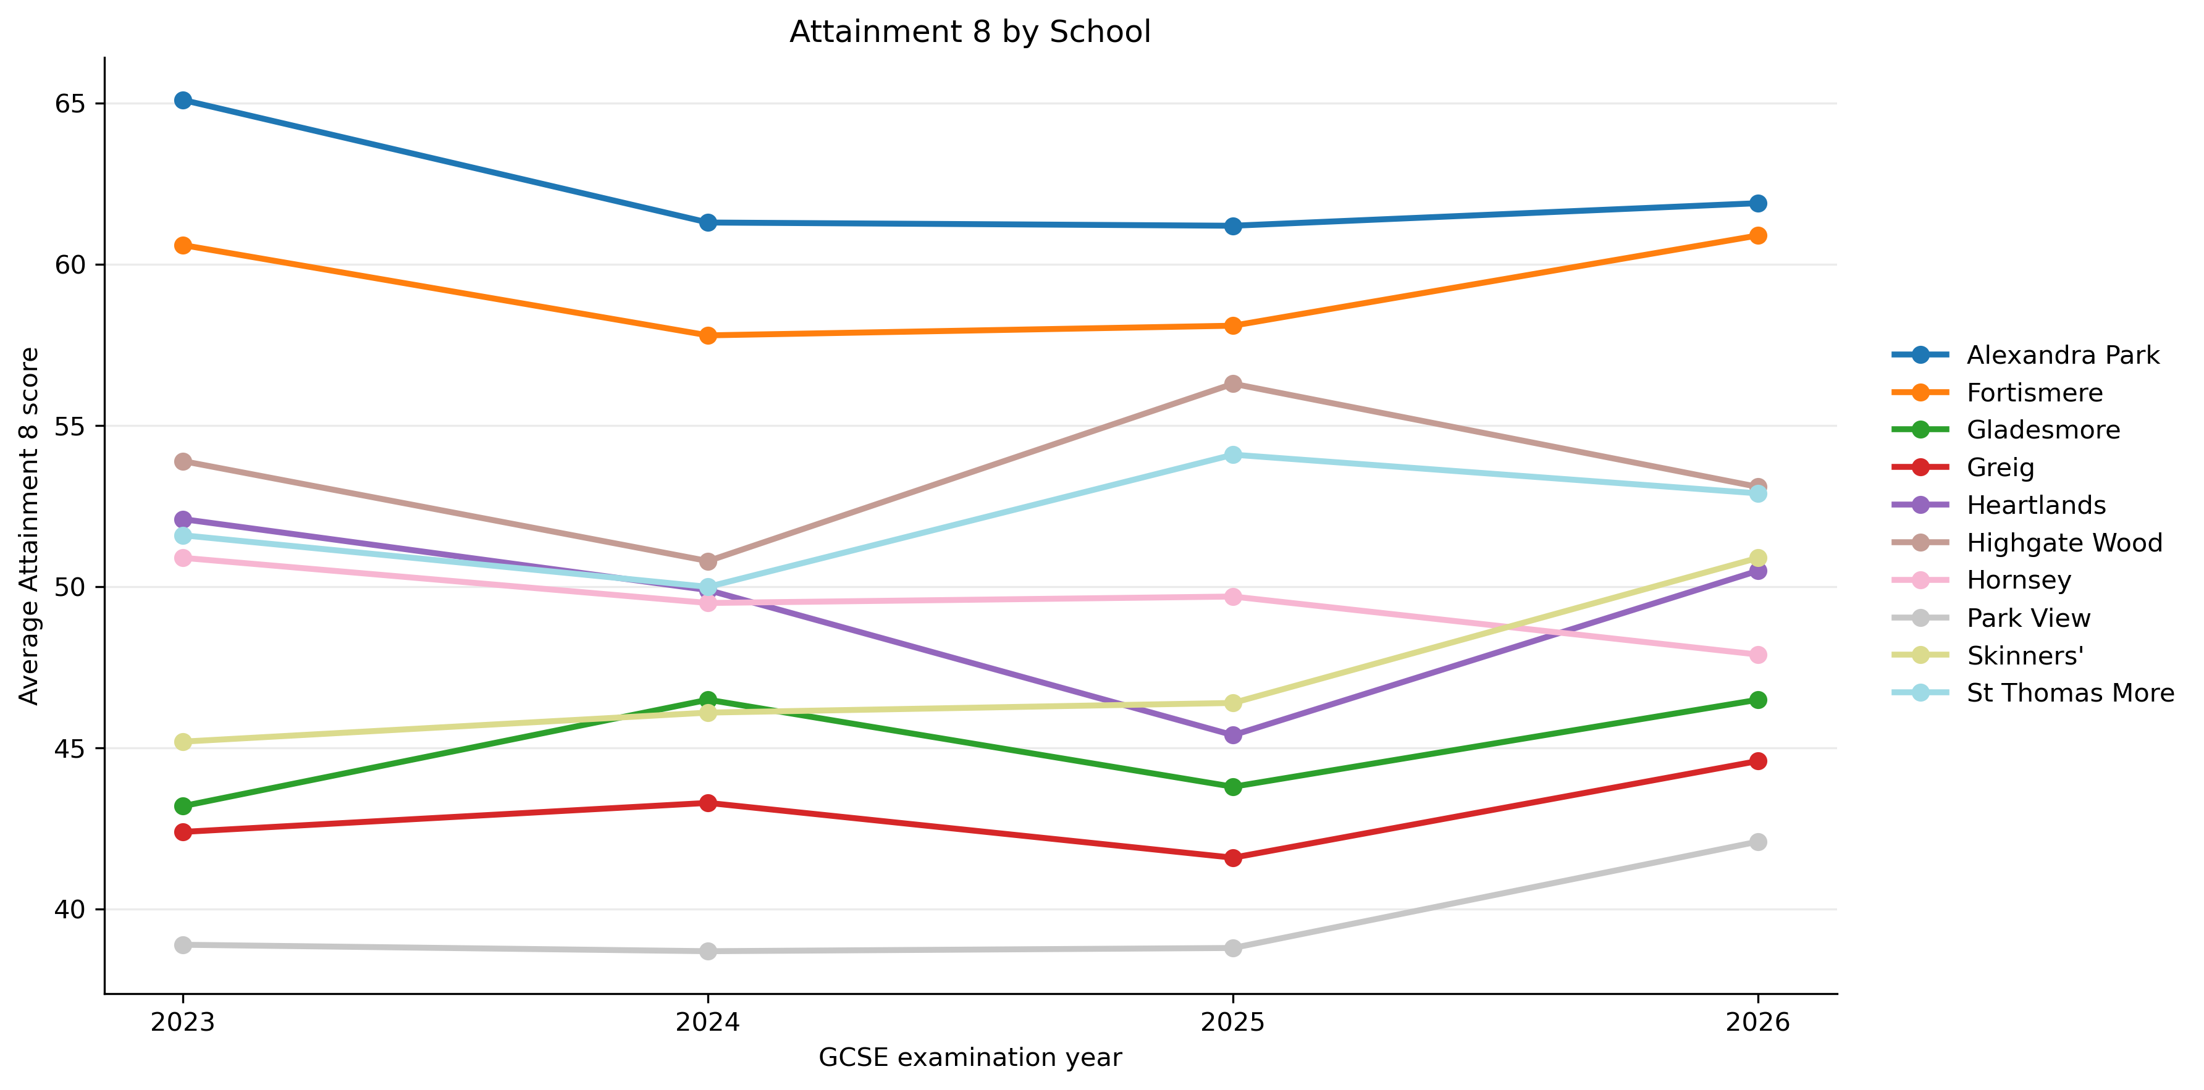
Attainment 8 Trends 2023 - 2026

Slide 6
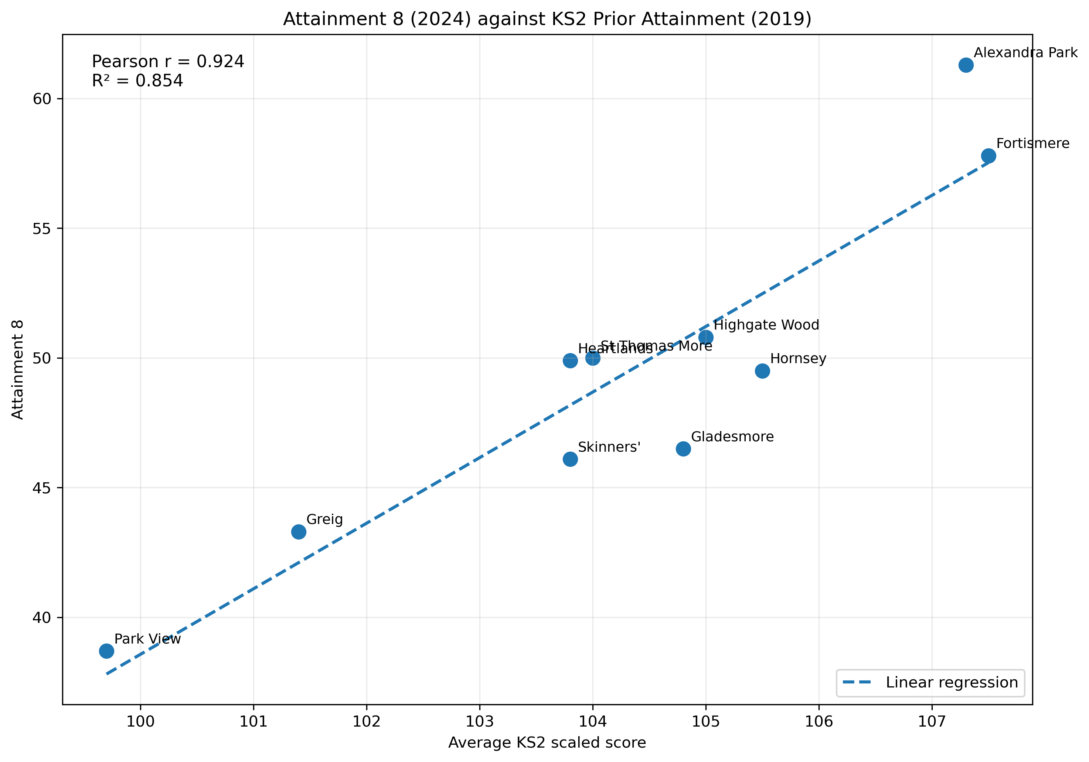
Attainment 8 (2024) strongly correlated with Key Stage 2 (2019) scores

Slide 7
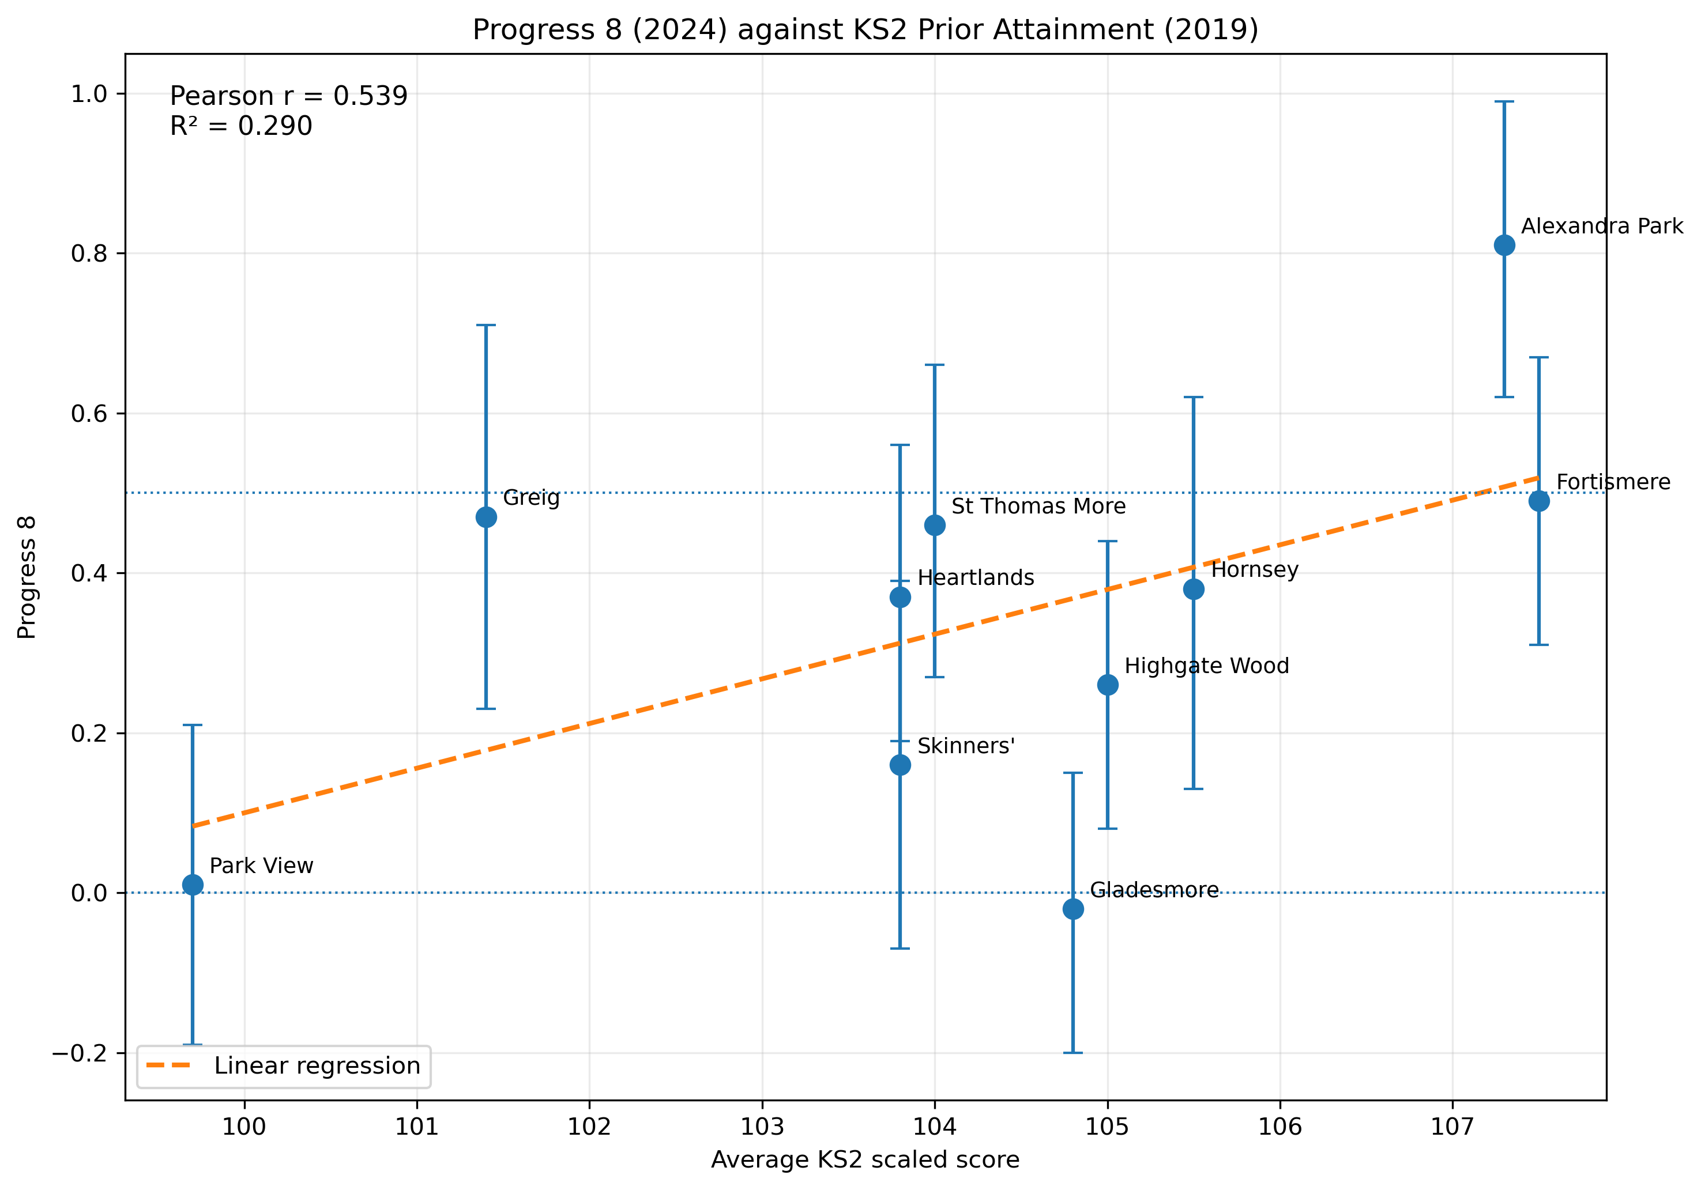
Progress 8 (2024) much less correlated with Key Stage 2 (2019)

Slide 8
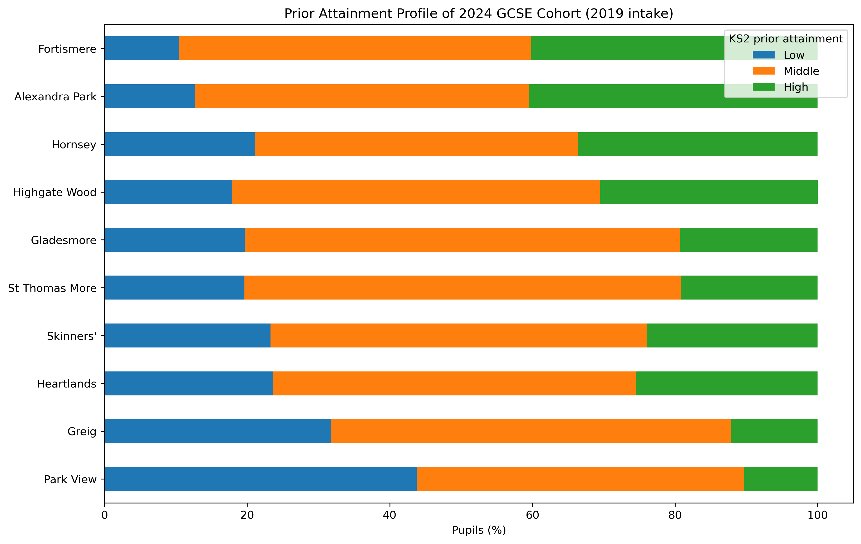
DfE Groups KS2 Scores into Low, Middle and High Bands

Slide 9
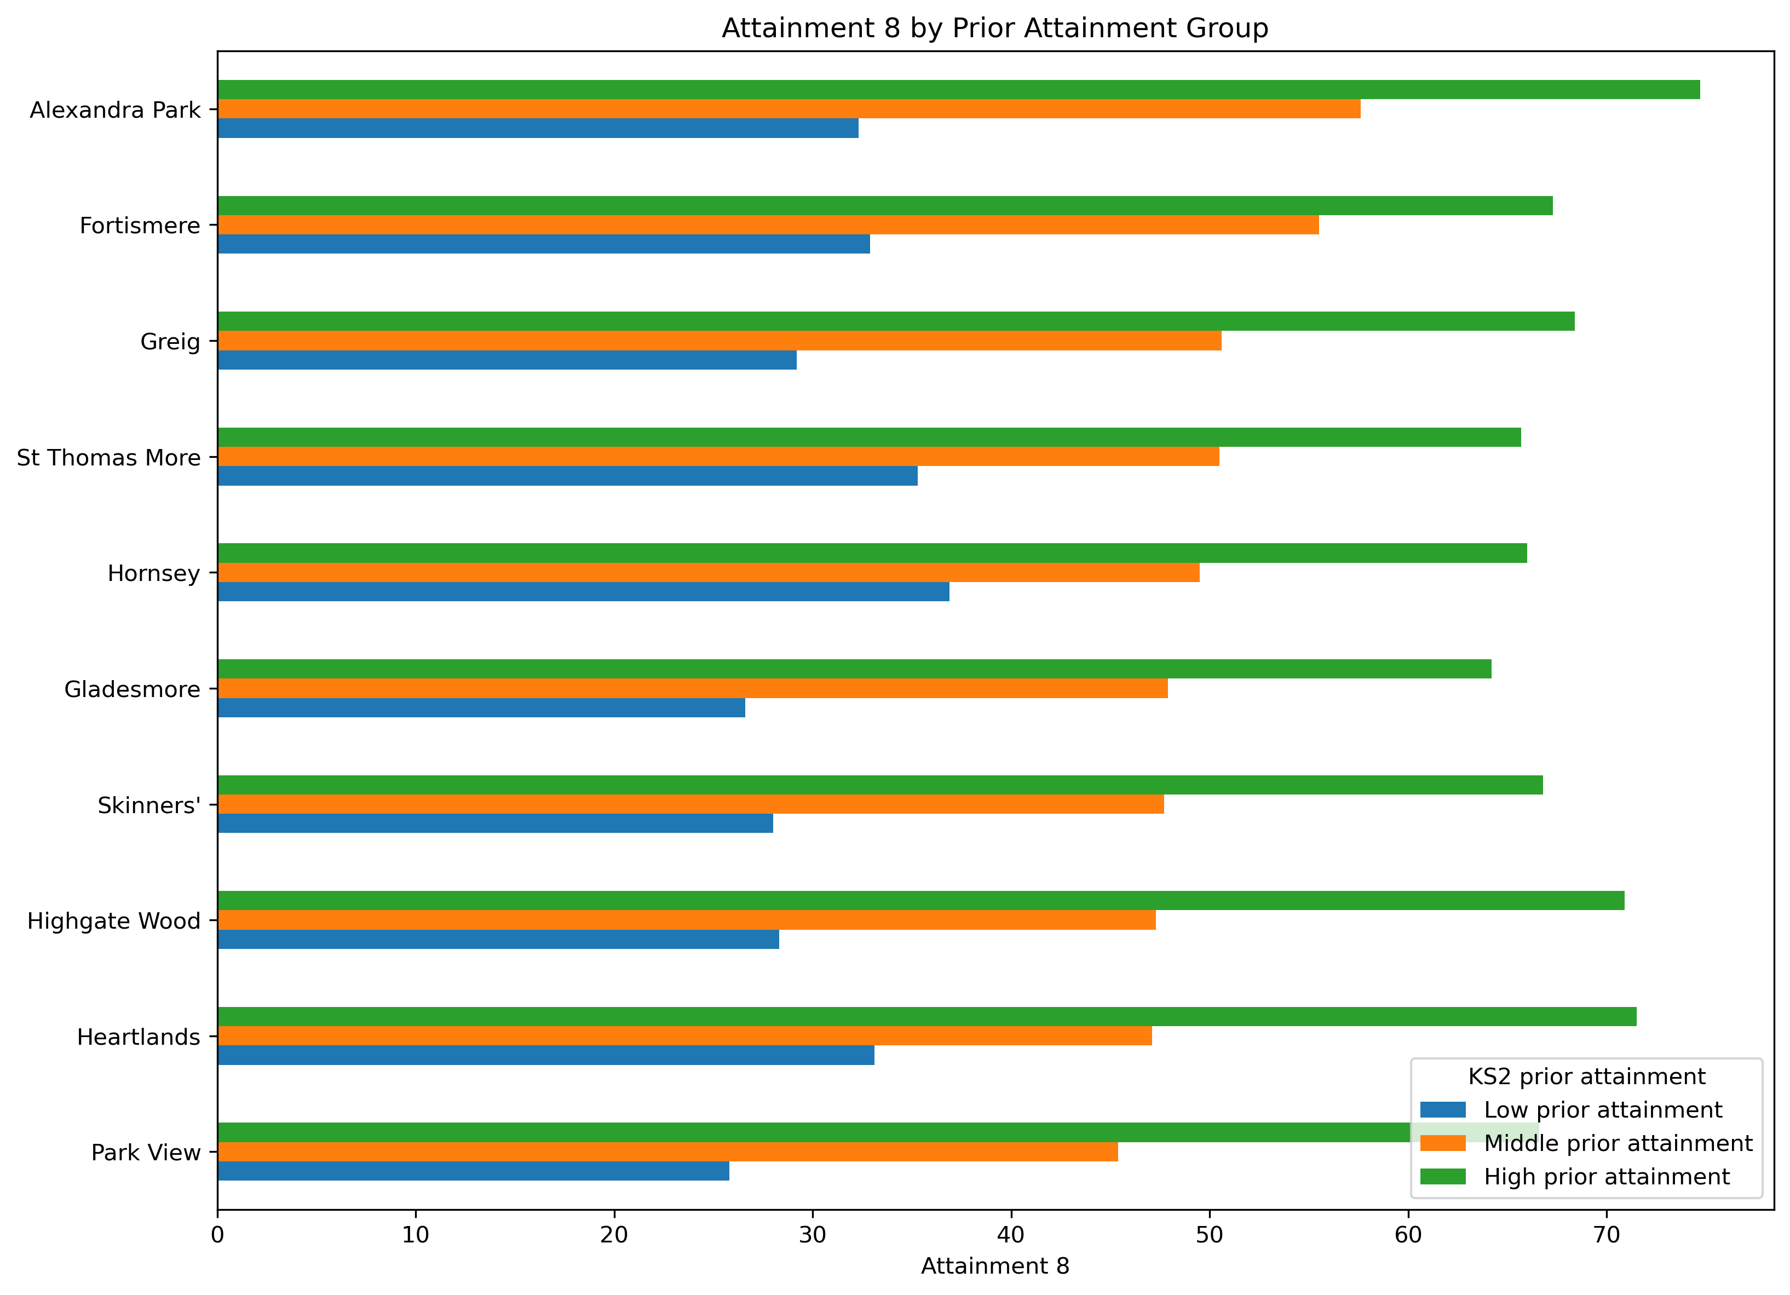
Attainment 8, adjusted for prior KS2, was more aligned

Slide 10
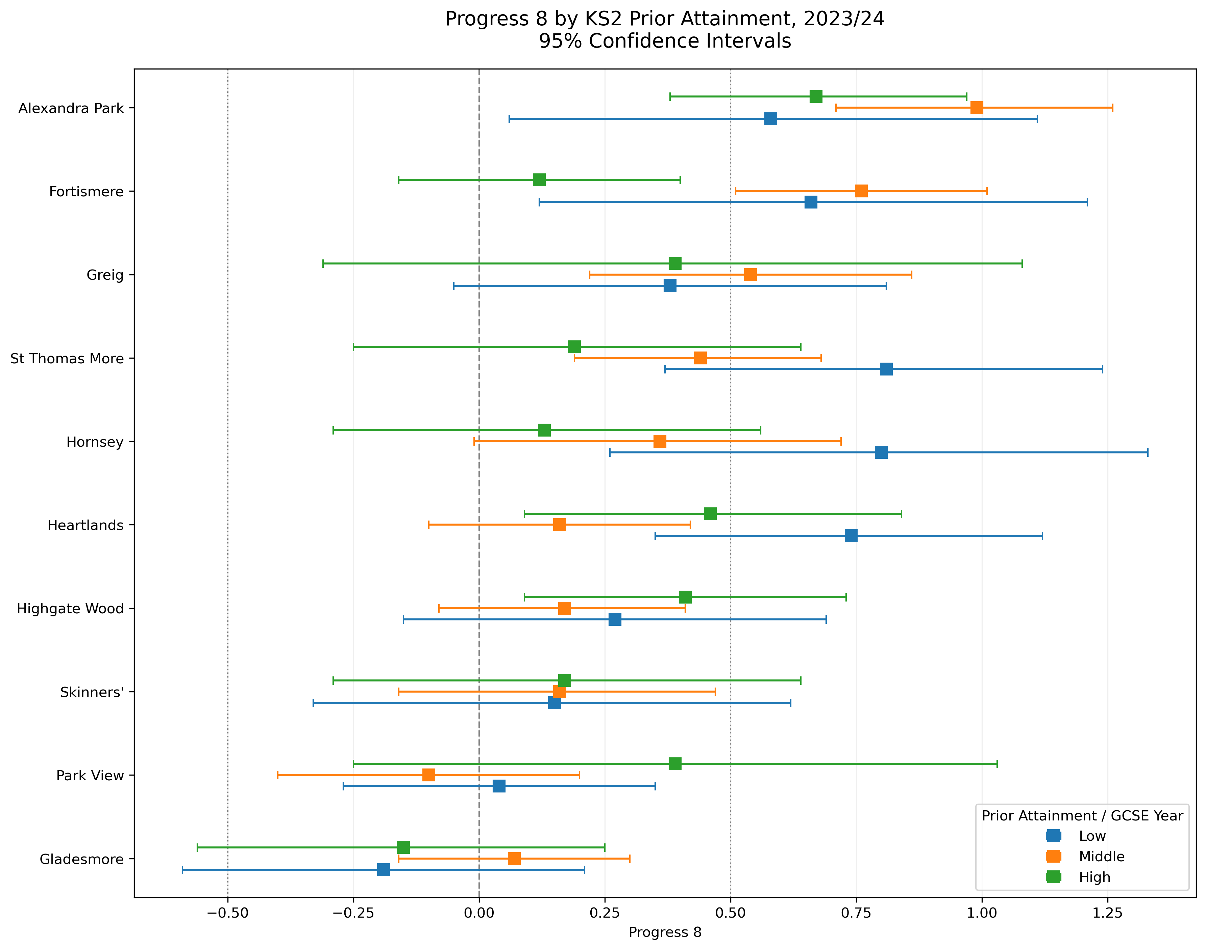
Performance 8, adjusted for prior KS2, with confidence intervals

Slide 11
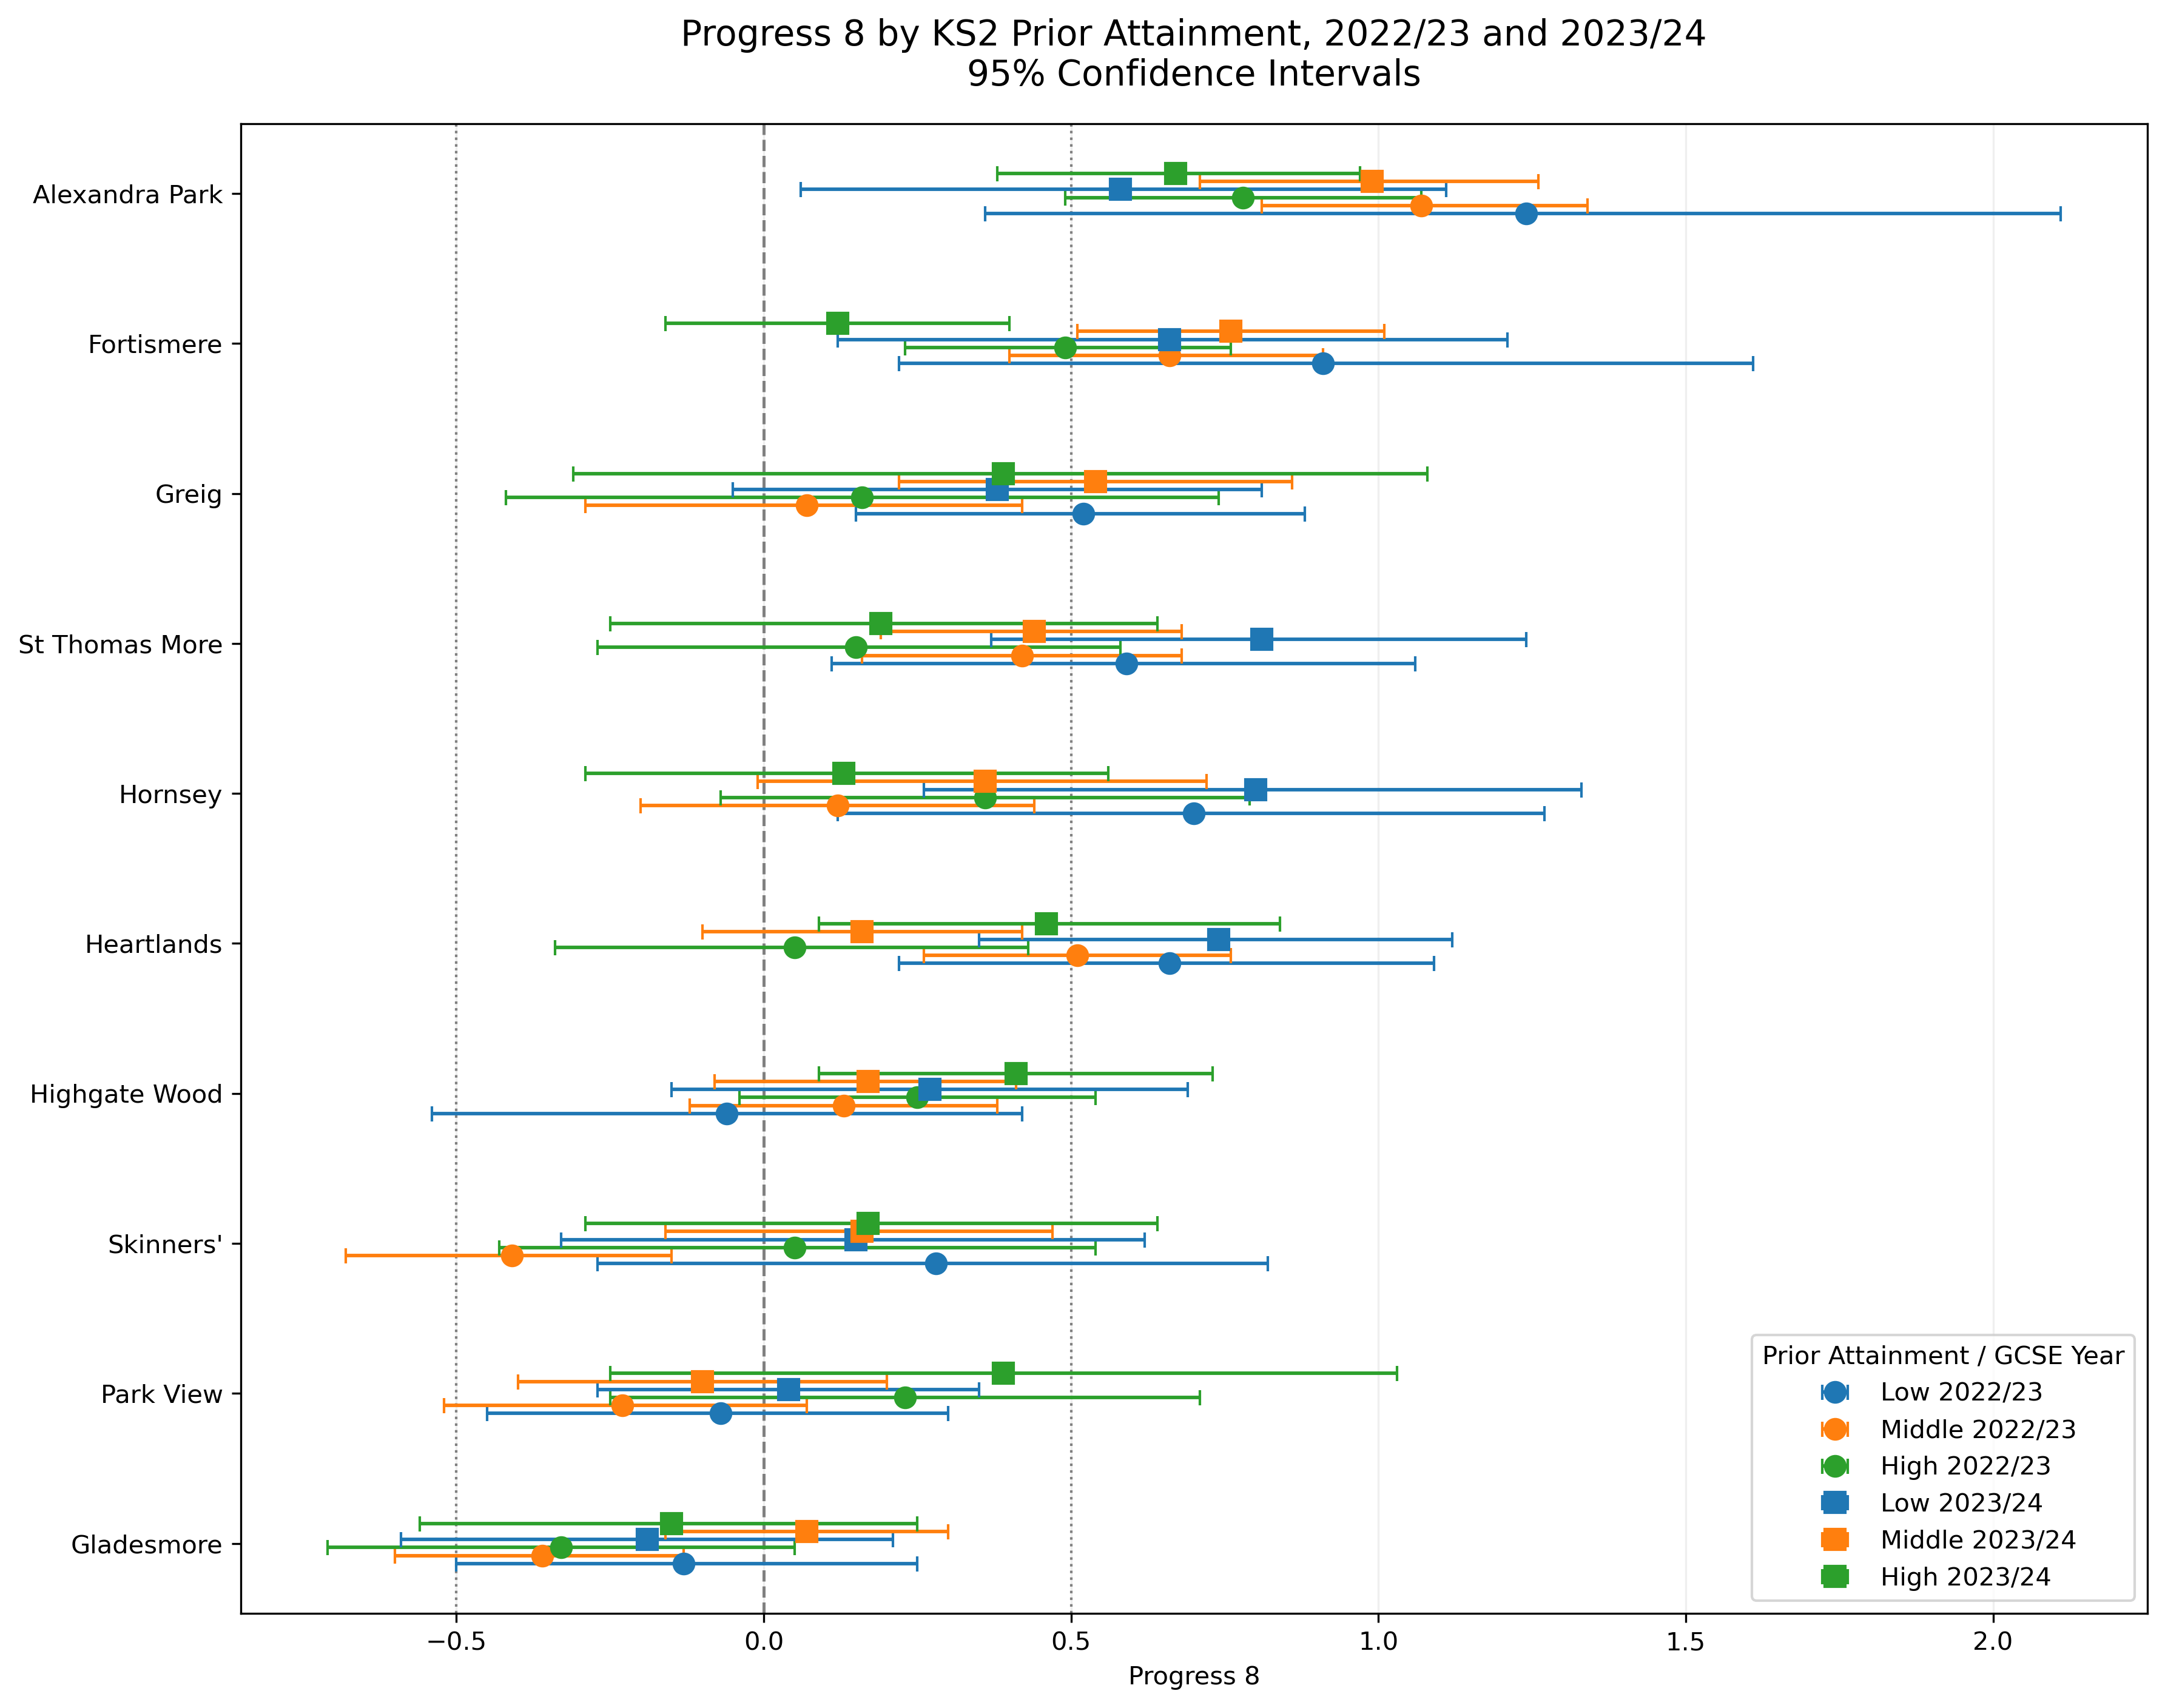
Performance 8, adjusted for prior KS2, with confidence intervals

Slide 12
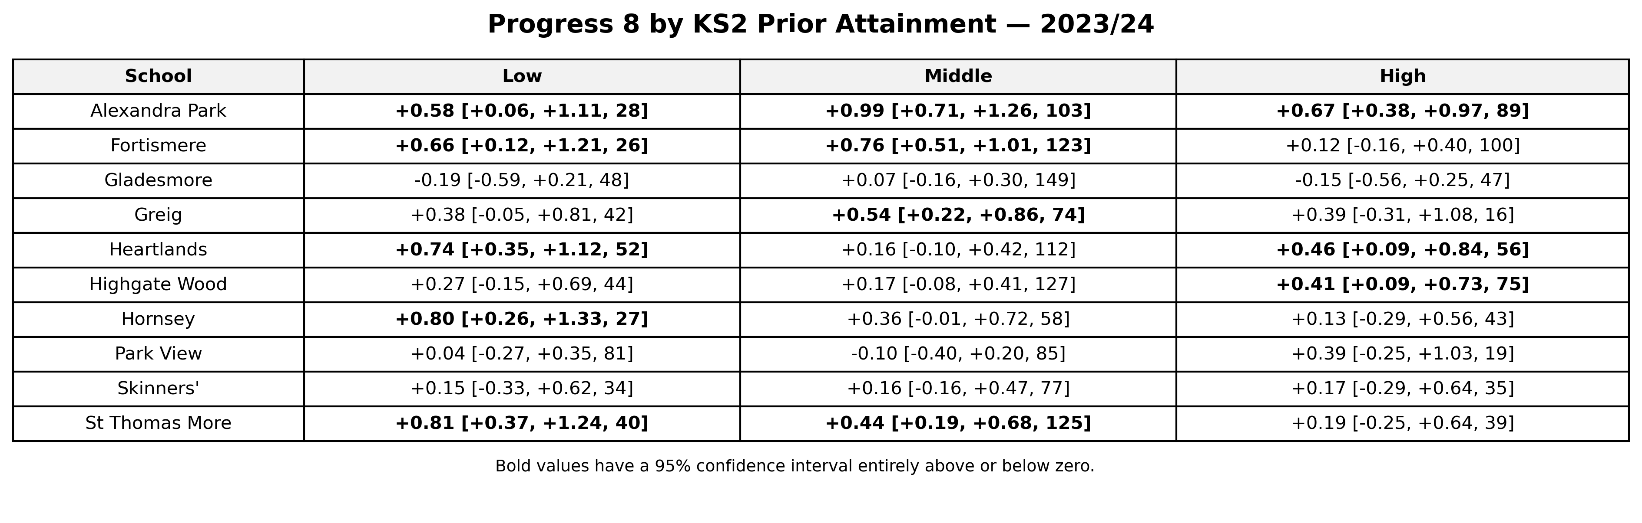
Schools with statistically significant P8 impact (2024)

Slide 13
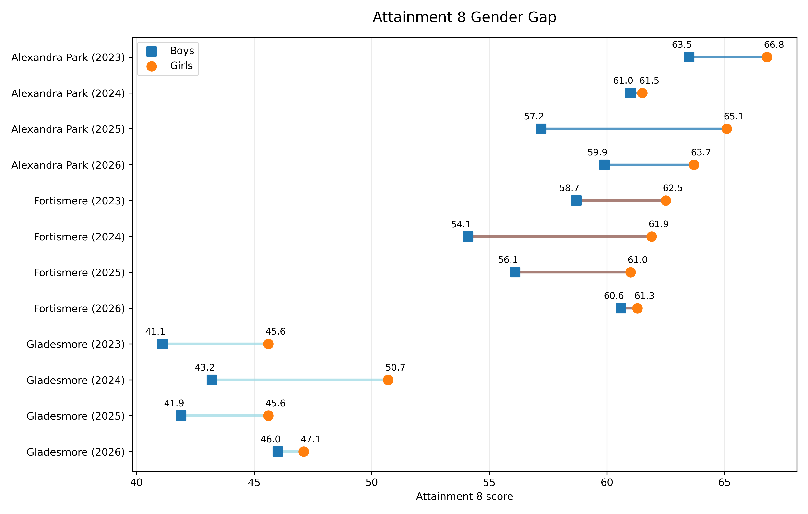
Attainment 8 by sex

Slide 14
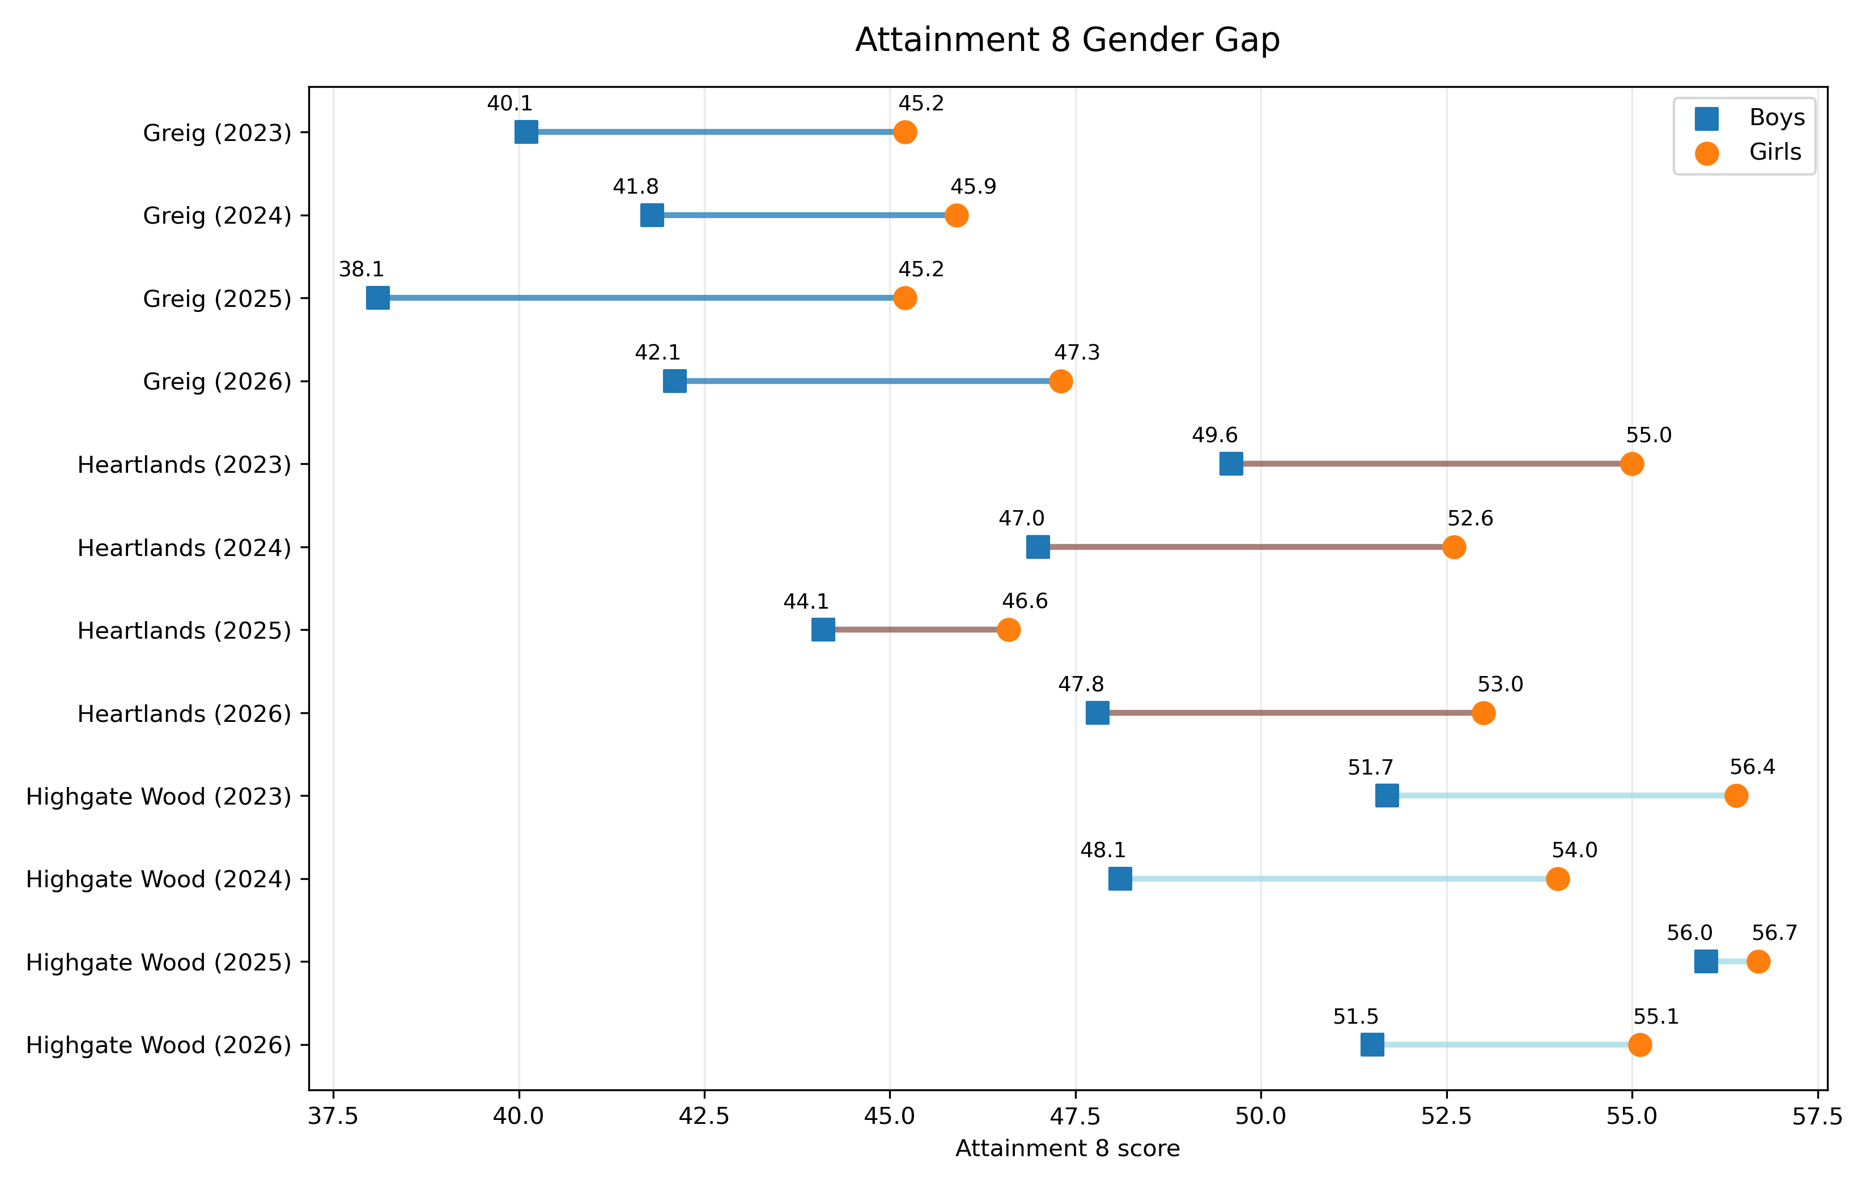
Attainment 8 by sex

Slide 15
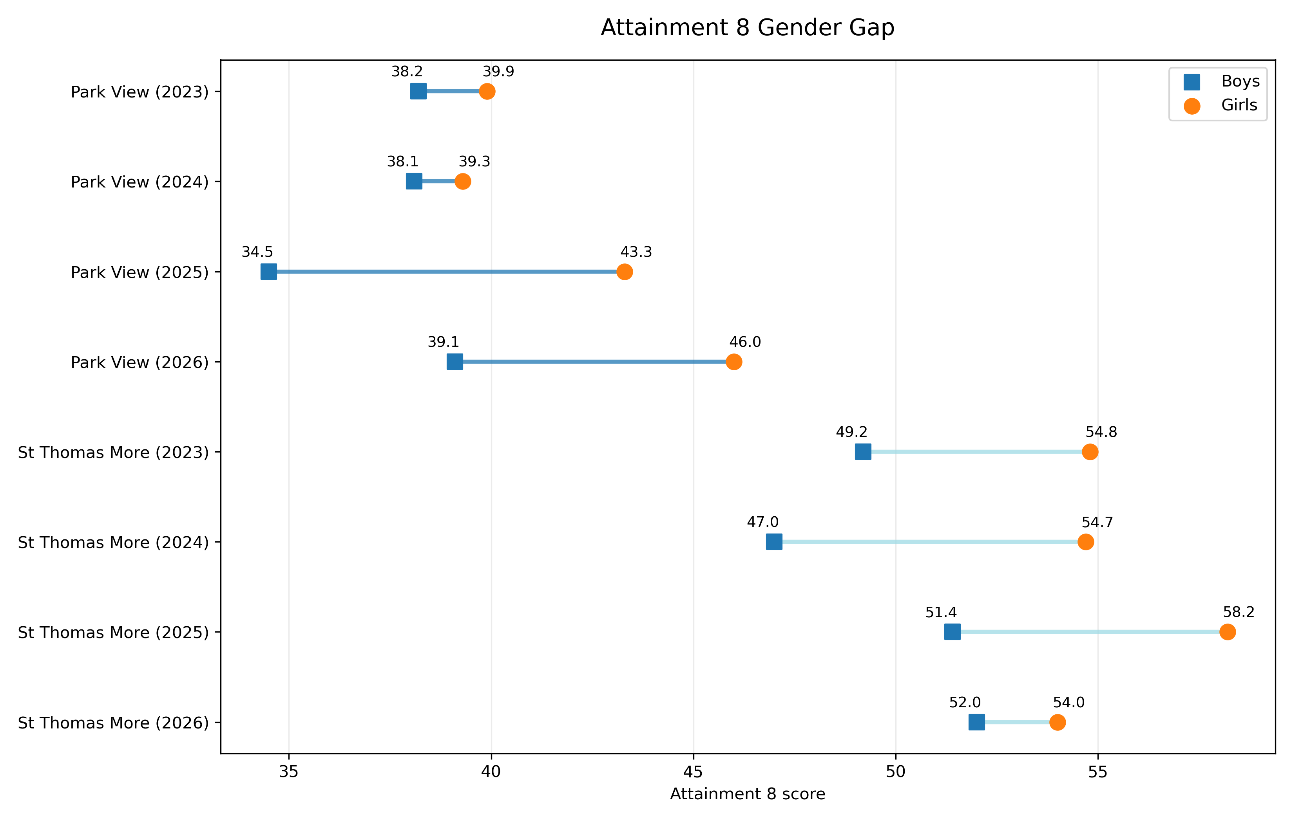
Attainment 8 by sex

Slide 16
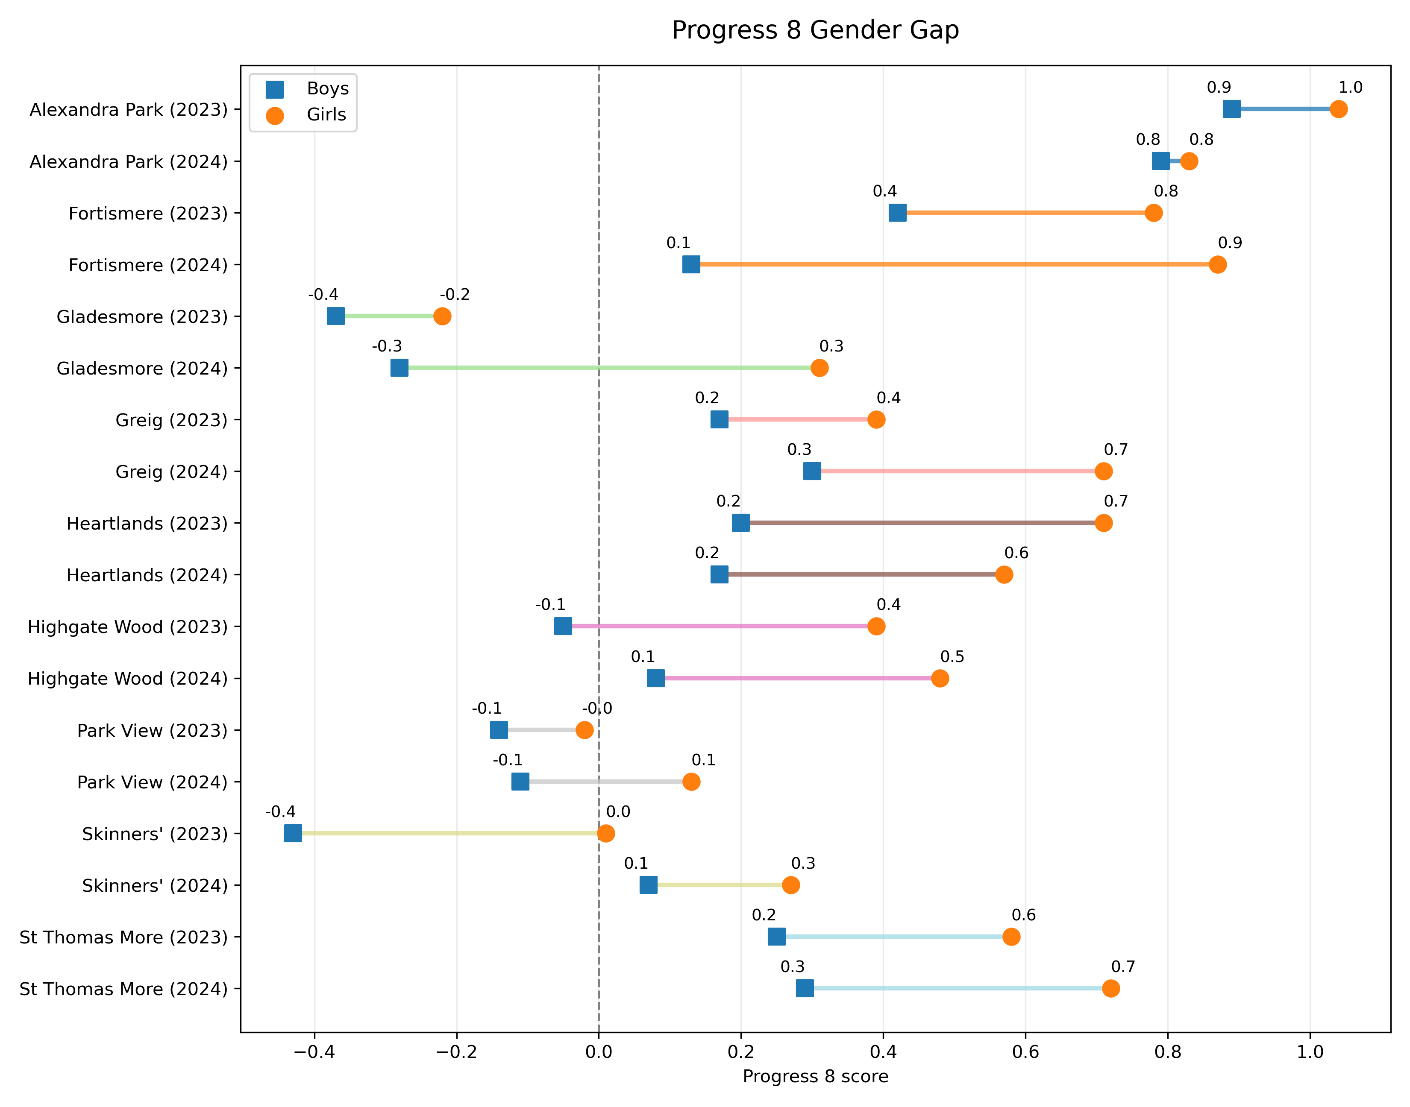
Progress 8 by sex

Slide 17
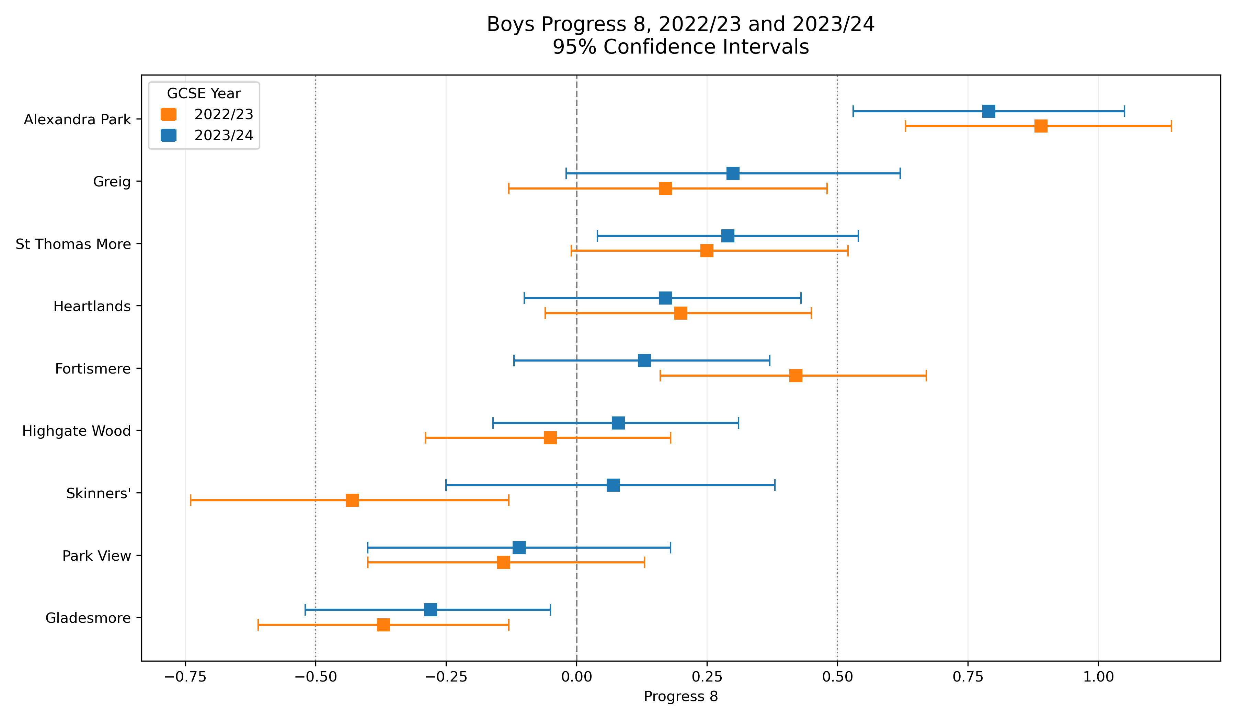
Boys Progress 8 with Confidence Intervals (95%)

Slide 18
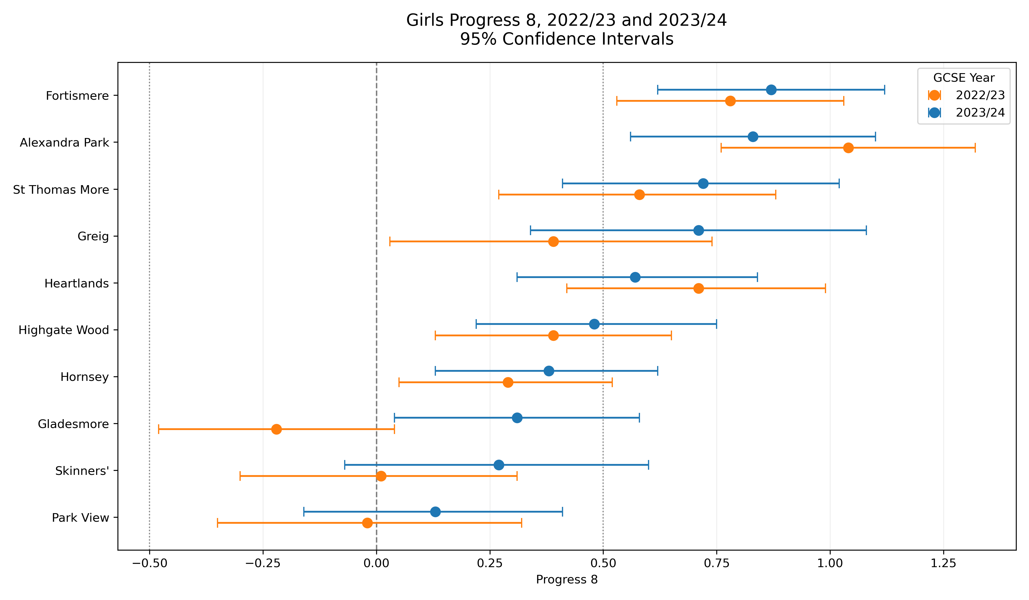
Girls Progress 8 with Confidence Intervals (95%)

Slide 19
Applications

Slide 20
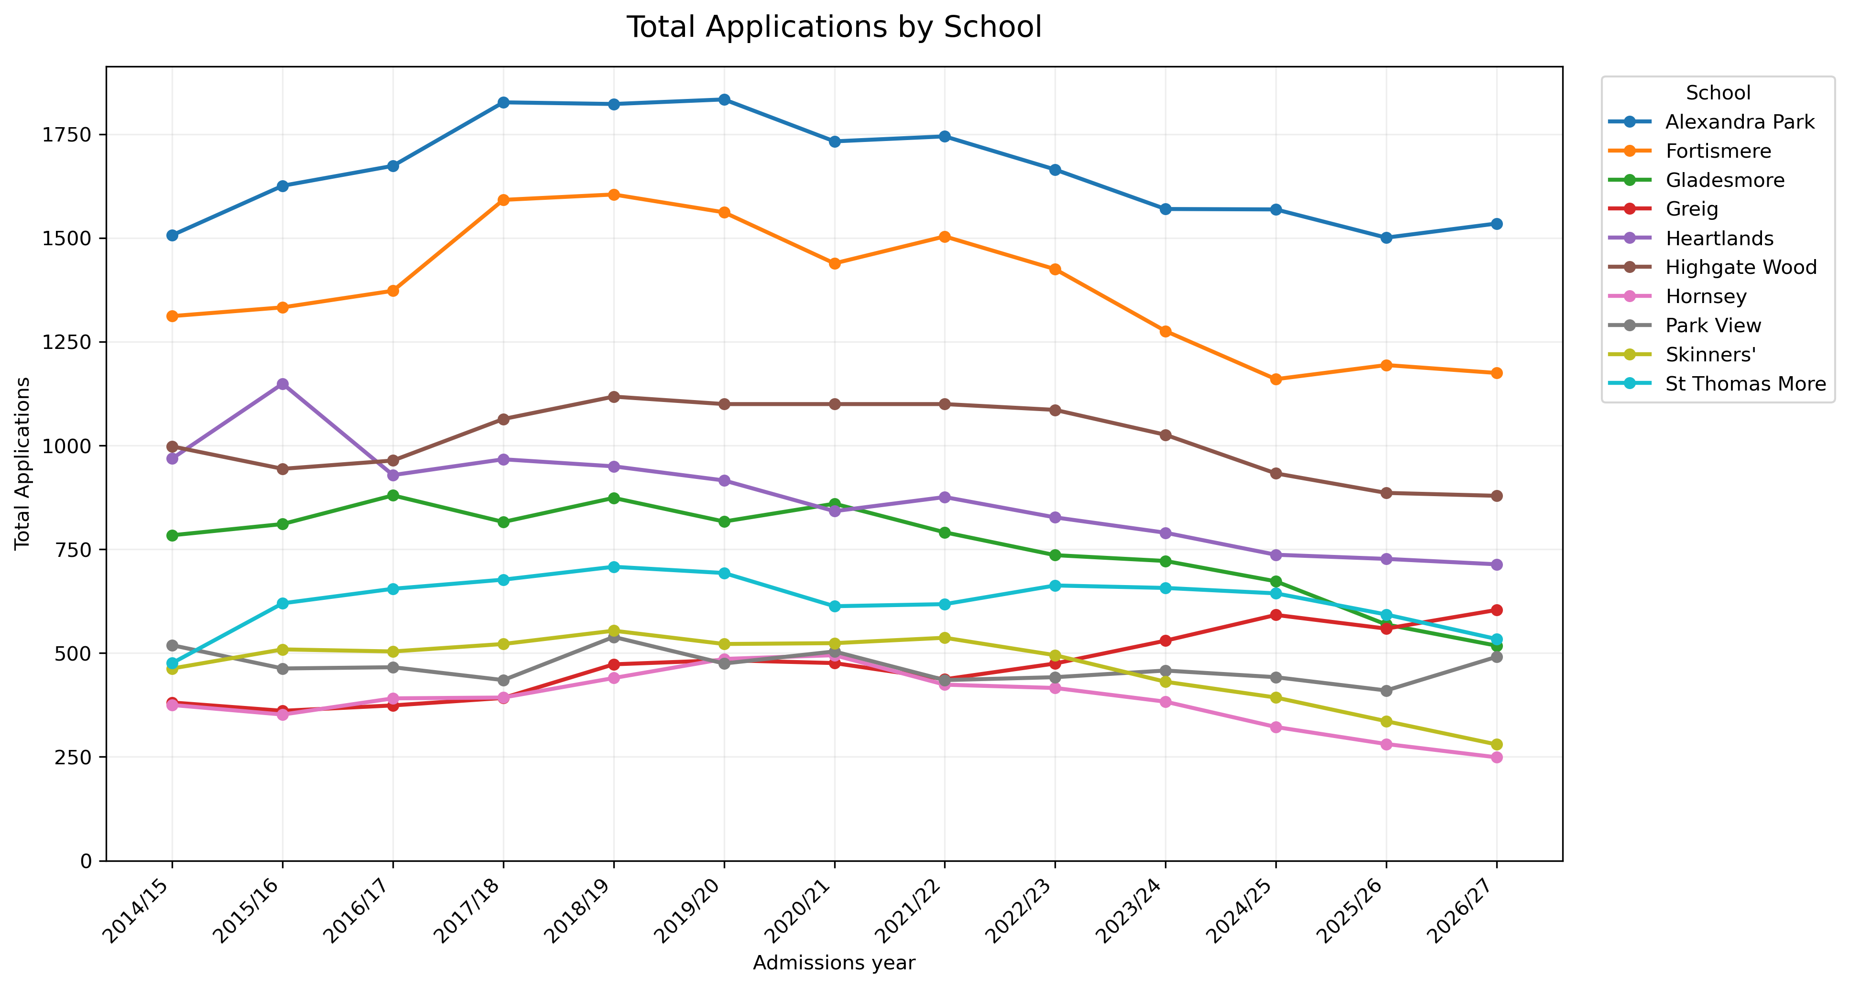
Total Applications Trend

Slide 21
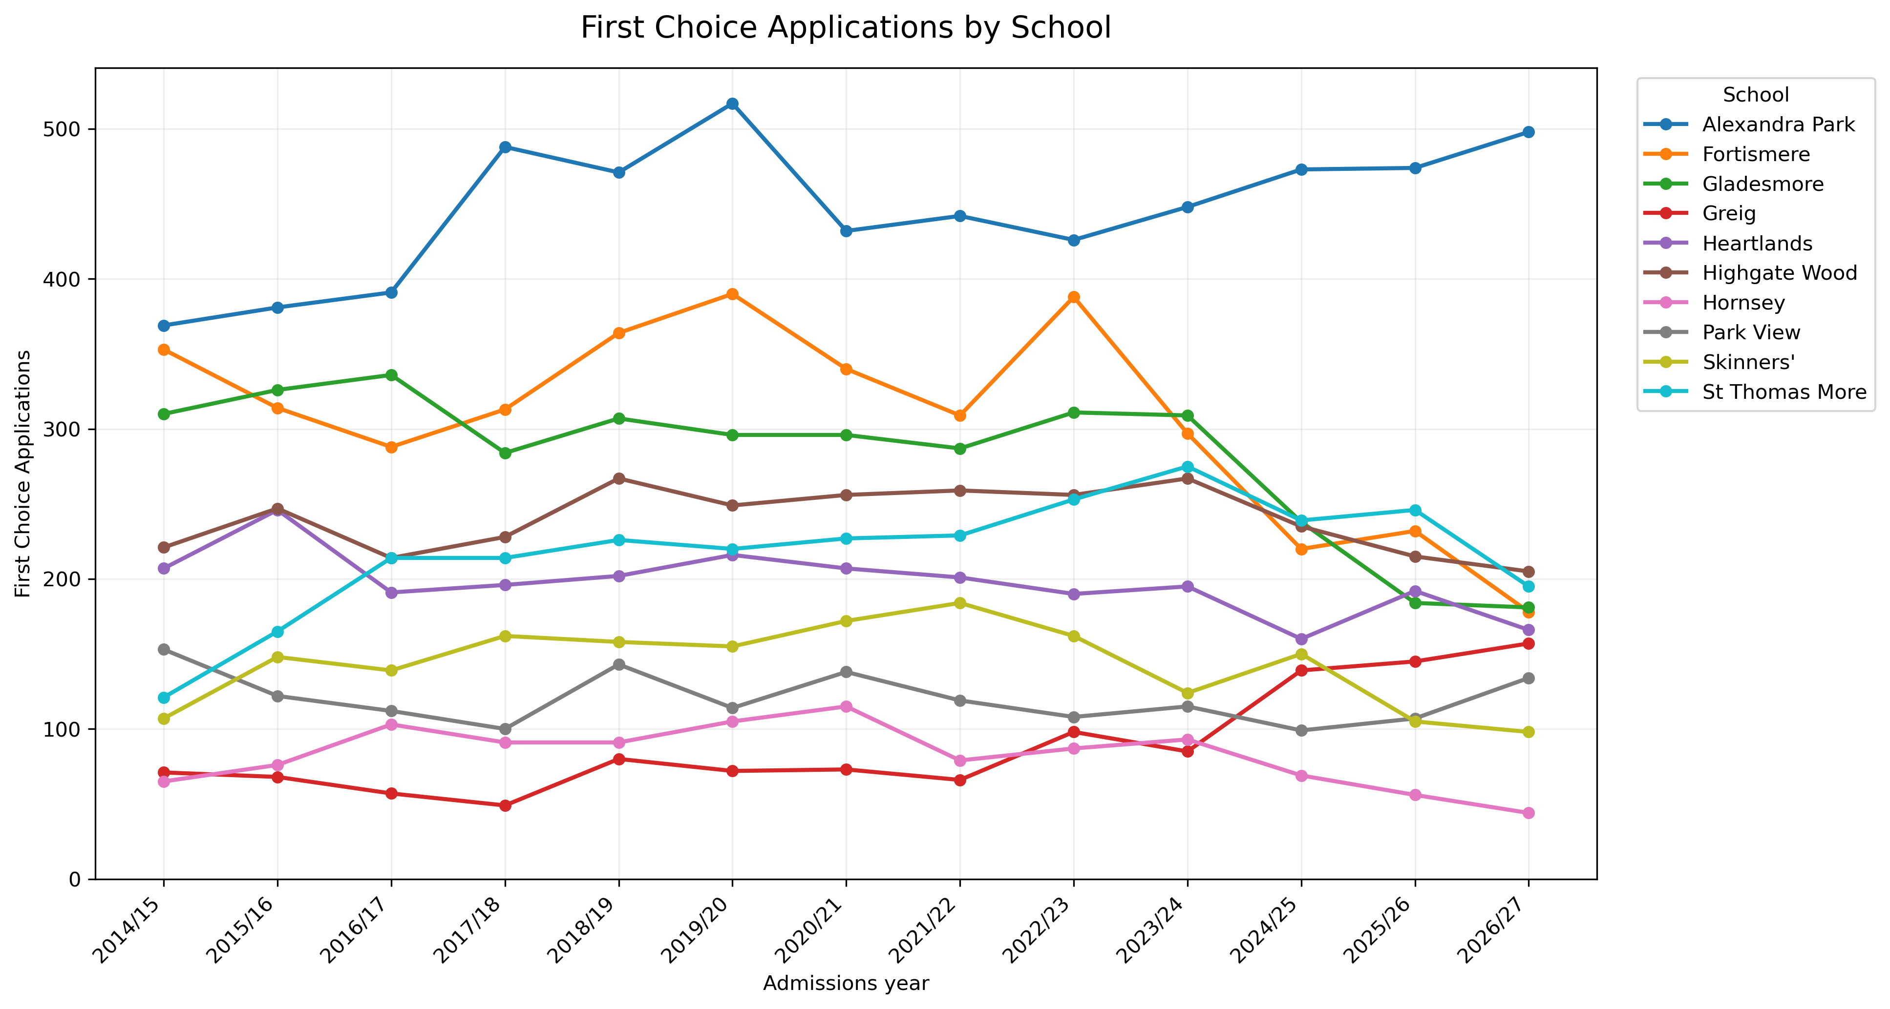
First Choice Applications Trend

Slide 22
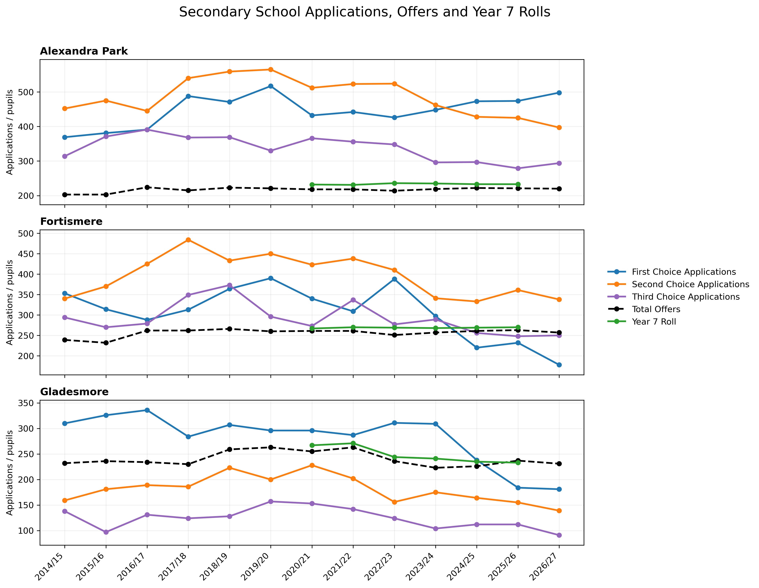
Applications, Offers and Year 7 Rolls

Slide 23
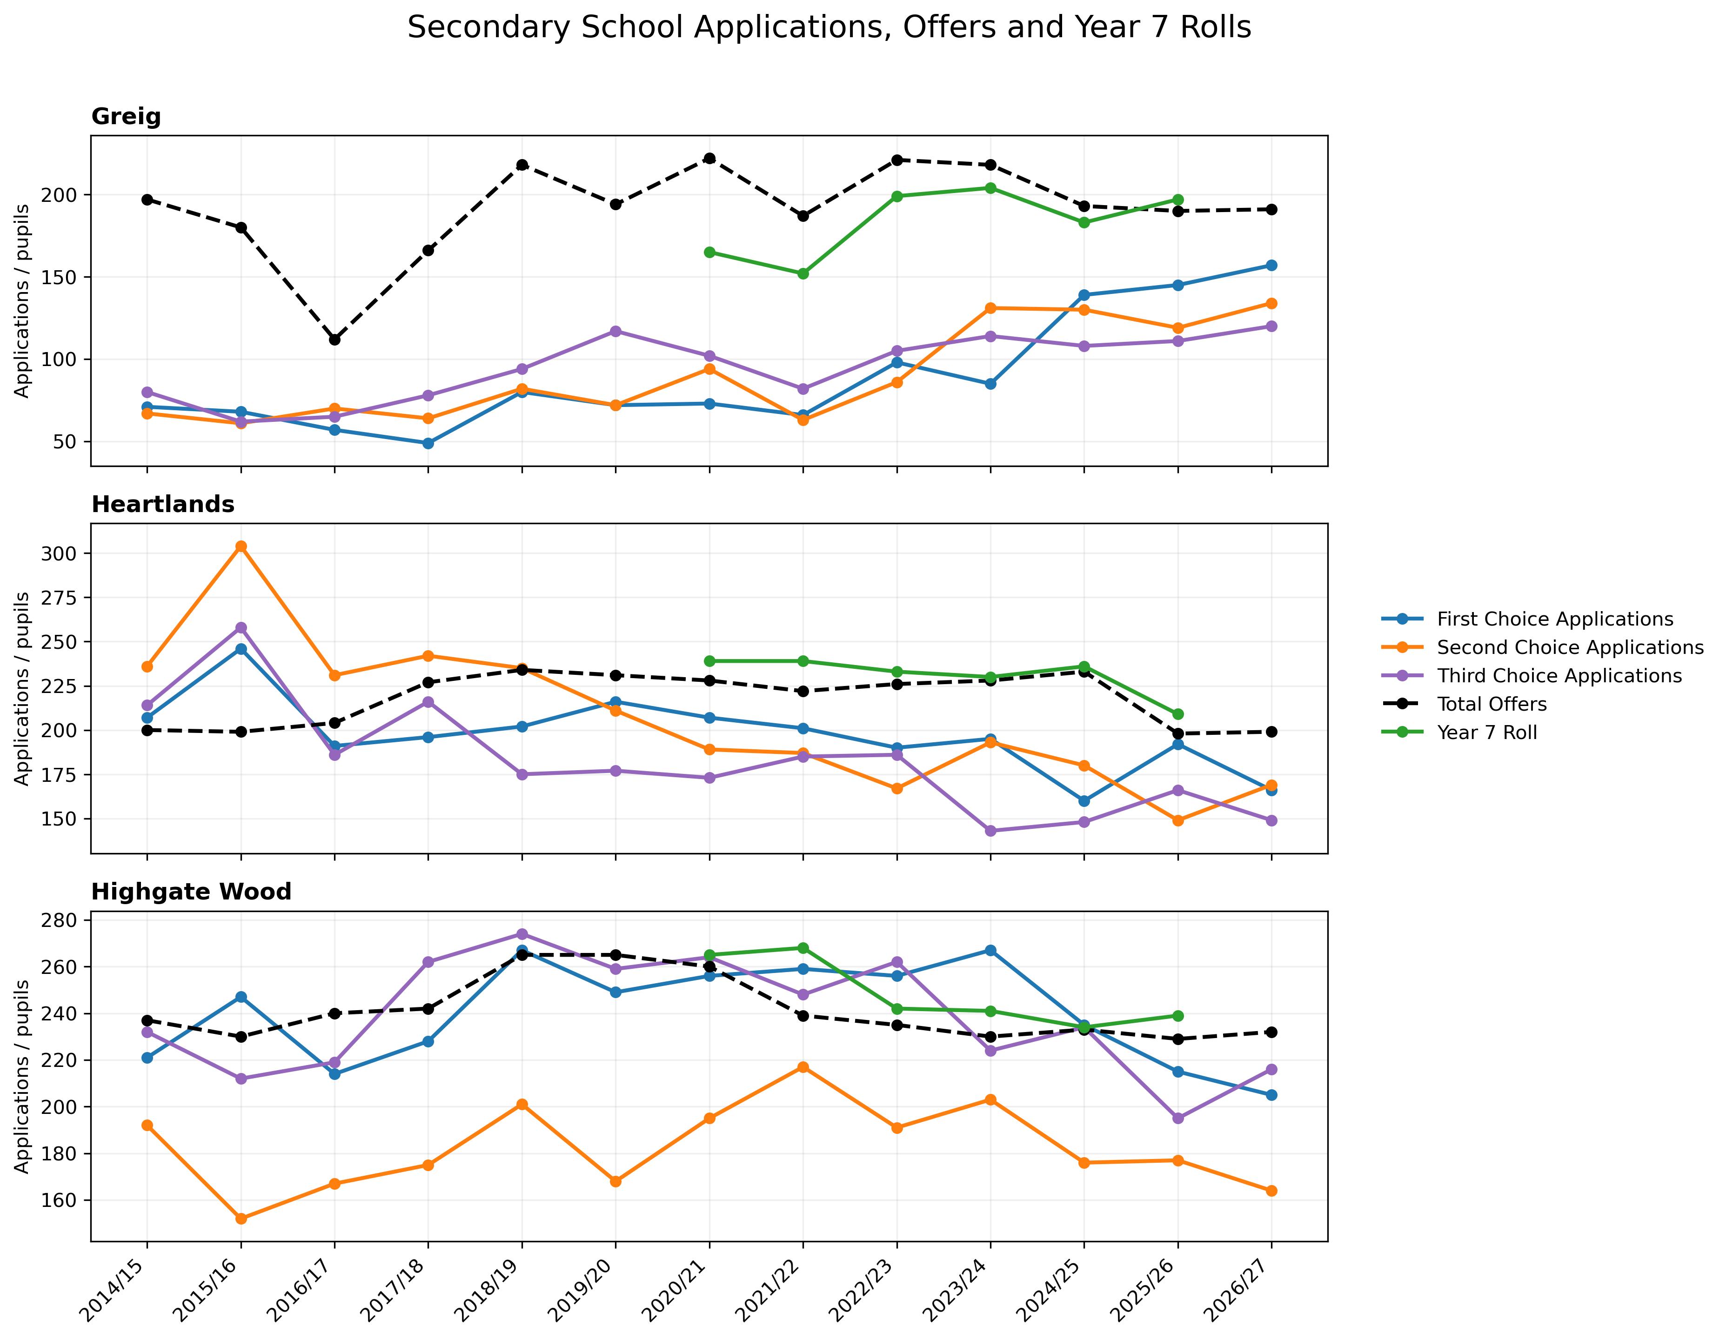
Applications, Offers and Year 7 Rolls

Slide 24
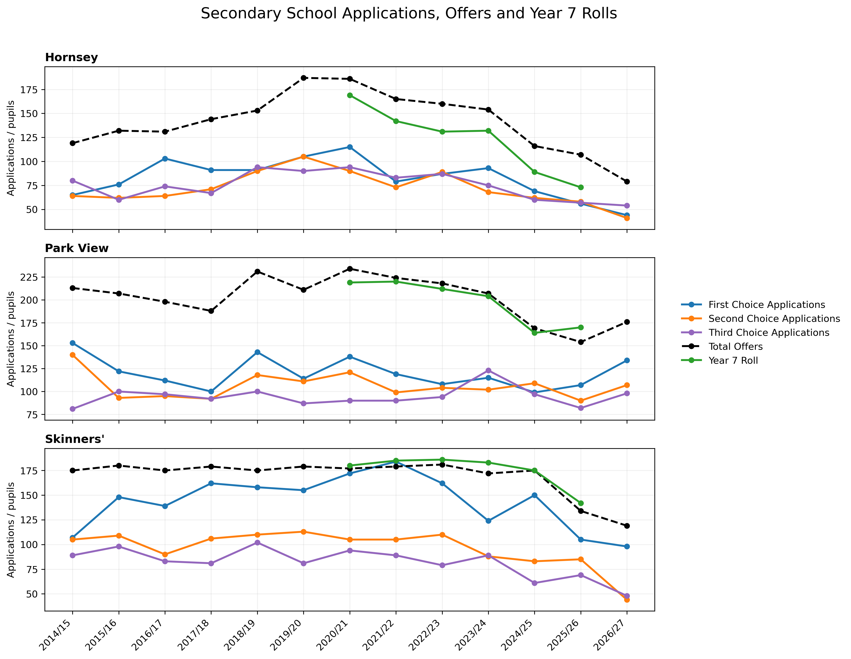
Applications, Offers and Year 7 Rolls'

Slide 25
Catchment Areas

Slide 26
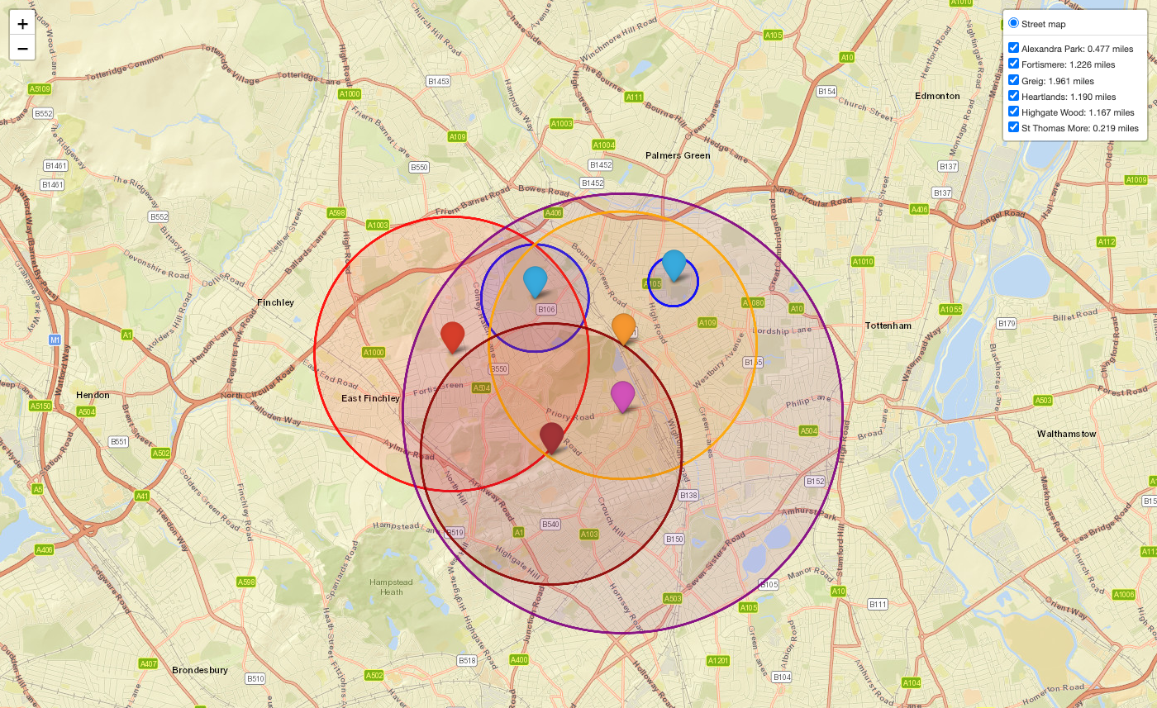
Catchment Areas

Slide 27
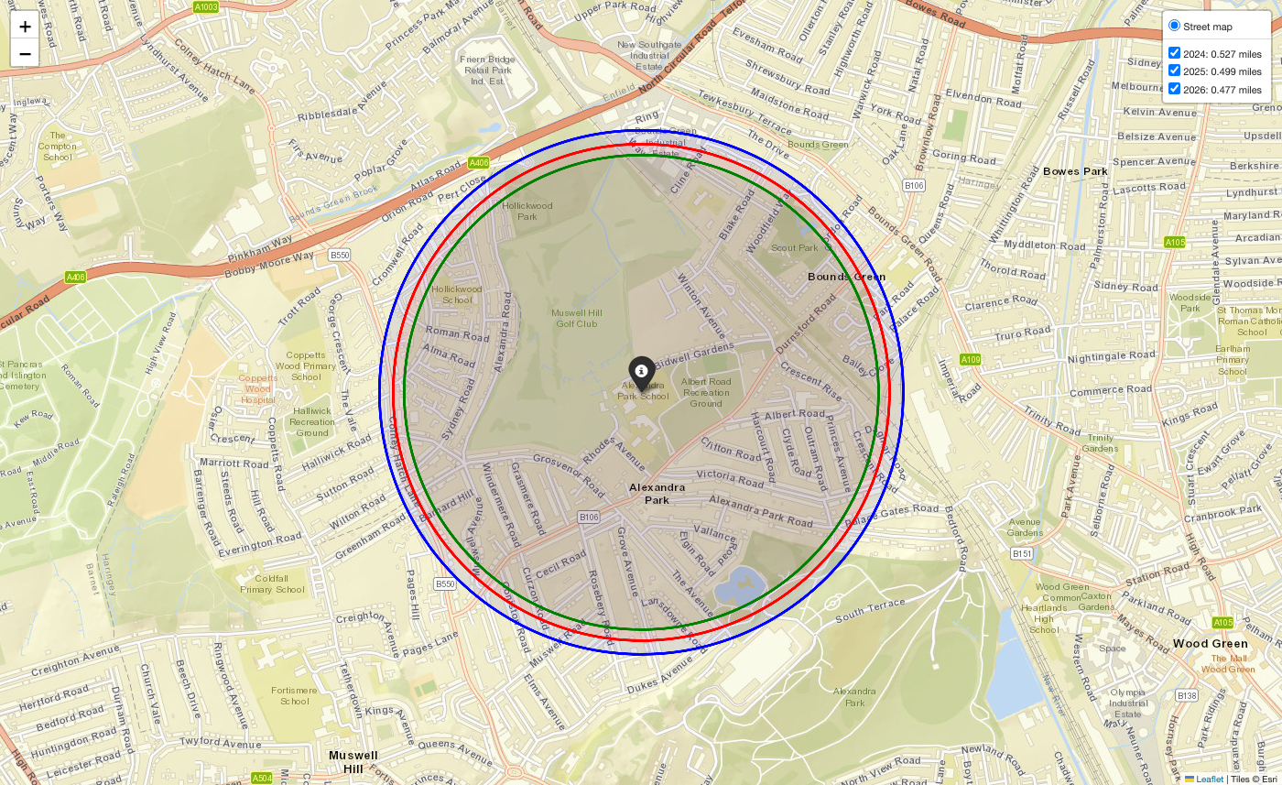
Alexandra Park Catchment

Slide 28
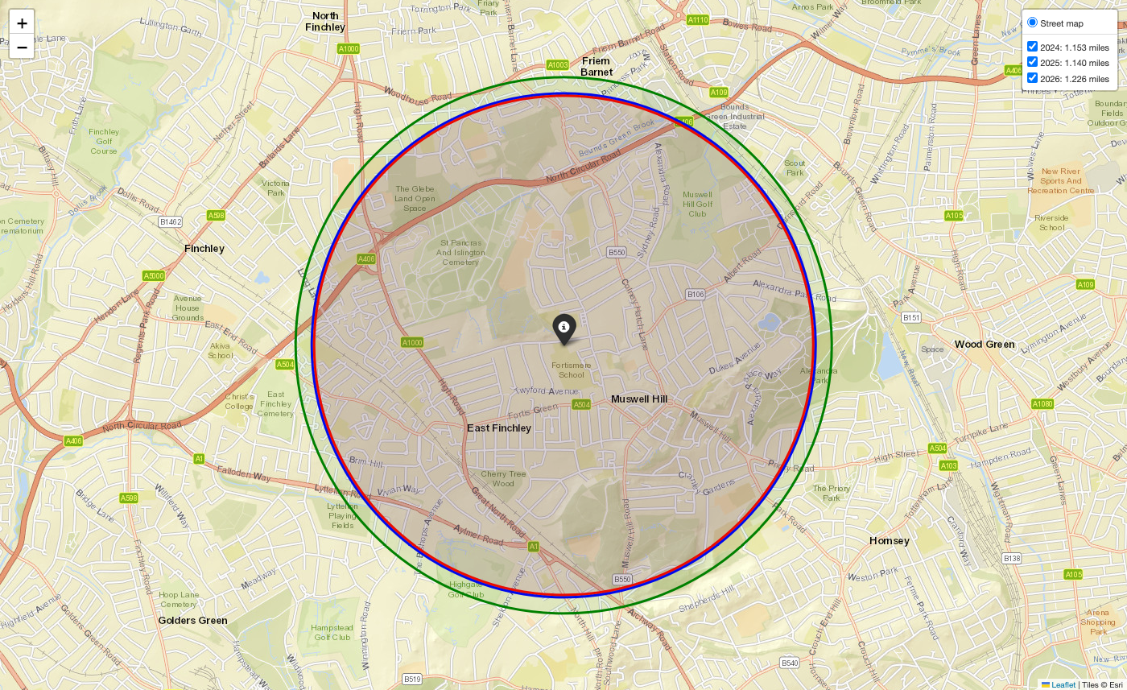
Fortismere Catchment

Slide 29
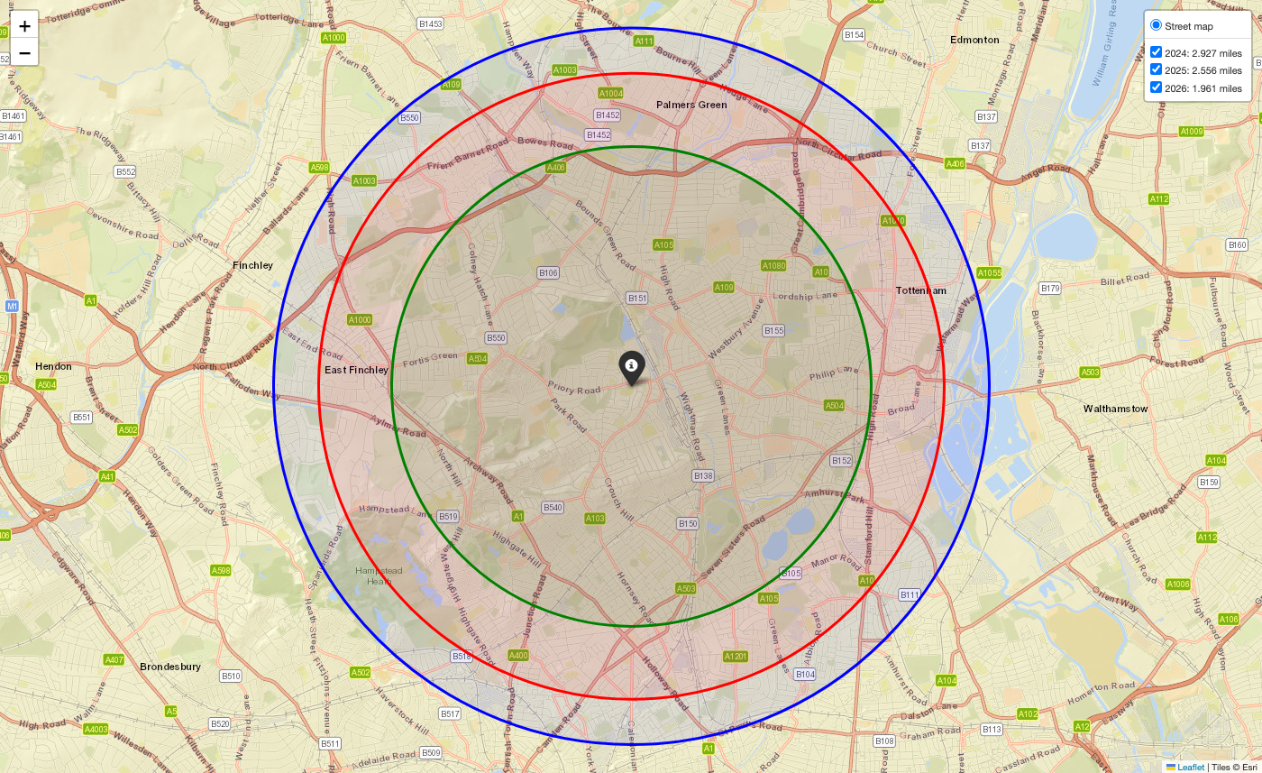
Greig Catchment

Slide 30
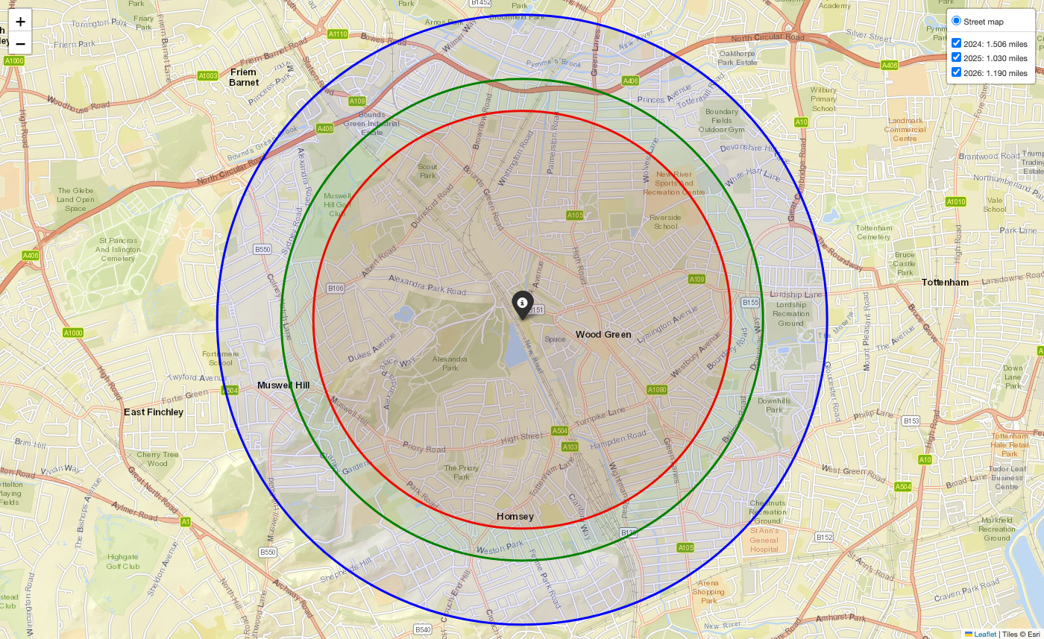
Heartlands Catchment

Slide 31
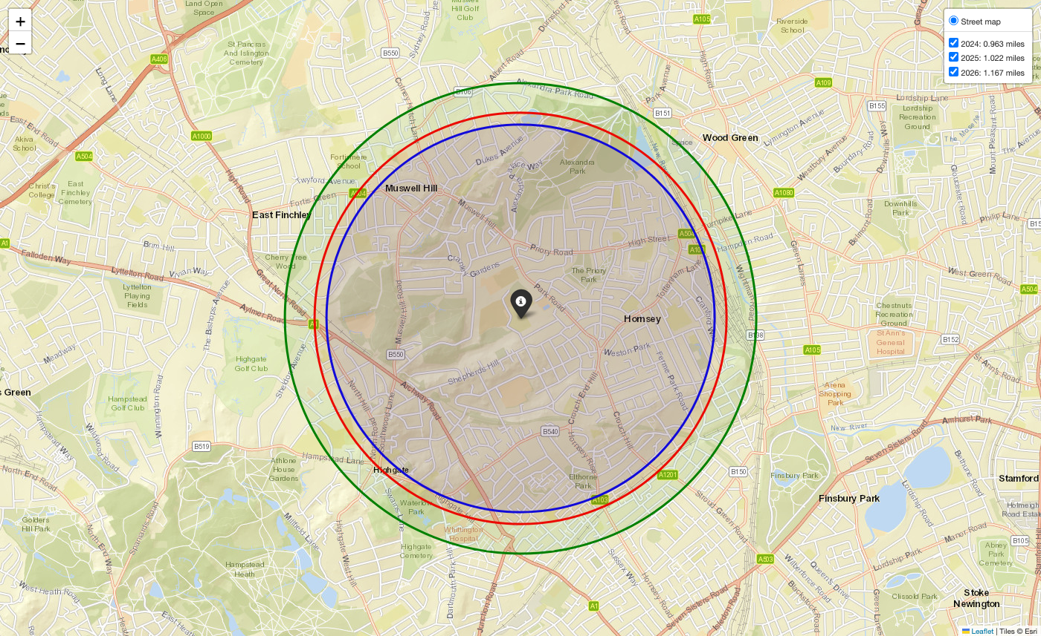
Highgate Wood Catchment

Slide 32
Data Sources
Figures come from published Department for Education statistics, except catchment distances.
GCSE results: Key stage 4 school results: Attainment 8 and Progress 8, overall and by prior attainment and sex (2022/23–2025/26).
Prior attainment: Key stage 2 scores for the same pupils, used as the starting point for Progress 8.
Applications and offers: Applications and offers. Secondary preferences and places offered, including first-choice offers and pupils allocated a school they did not choose.
Year 7 numbers: School census (Schools, pupils and their characteristics): Year 7 roll by sex, 2020/21–2025/26.
Catchment distancesCatchment distances. Last-place cut-offs published by the local authority, mapped from each school’s address.

Slide 33
Project and License
This report is generated by the “highschool-performance” project, available on GitHub: https://github.com/tommyarmstrong/highschool-performance.
The project is licensed under the MIT License.

