Slide 1
Unit 7. Channel Estimation and Equalization
Ece-gy 6023. Wireless communications
Prof. Sundeep rangan

Slide 2
Learning Objectives
Describe role of channel estimation in the receiver steps
Describe role and configuration of reference signals in OFDM
Compute overhead
Qualitatively relate density to the coherence time and bandwidth
Implement and simulate simple kernel-type channel estimators
Compute bias and variance of the kernel estimators
Optimize the kernel to minimize the bias + variance error
Compute the signal to distortion and noise ratio (SNDR) for a given estimator
Measure the SNDR via simulation
Implement a simple channel estimator and equalizer for 5G NR downlink

Slide 3
Outline
Role of Channel Estimation and Equalization
OFDM Channel Estimation via Kernel Regression
Bias-Variance Tradeoff

Slide 4
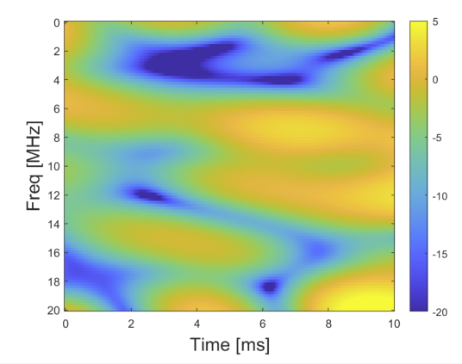


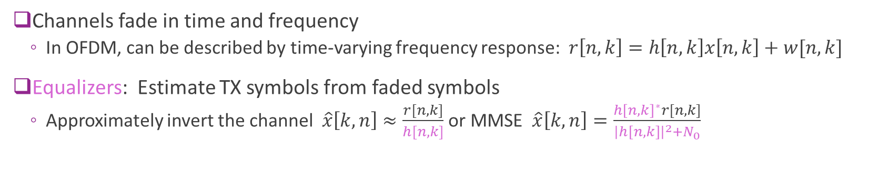



Channel Estimation and Equalization
$$r[n,k]$$
$$x[n,k]$$
h$[k,n]$
$$\hat{x}\left[n,k\right]≈x[n,k]$$
Fading channel $h[n,k]$
Equalization
Channels fade in time and frequency
In OFDM, can be described by time-varying frequency response: $r\left[n,k\right]=h\left[n,k\right]x\left[n,k\right]+w[n,k]$
Equalizers: Estimate TX symbols from faded symbols
Approximately invert the channel $\hat{x}\left[k,n\right]≈\frac{r[n,k]}{h[n,k]}$ or MMSE $\hat{x}\left[k,n\right]=\frac{h{\left[n,k\right]}^{∗}r[n,k]}{{\left|h\left[n,k\right]\right|}^{2}+N_{0}}$
Key challenge: Equalizers need a channel and/or noise estimate

Slide 5

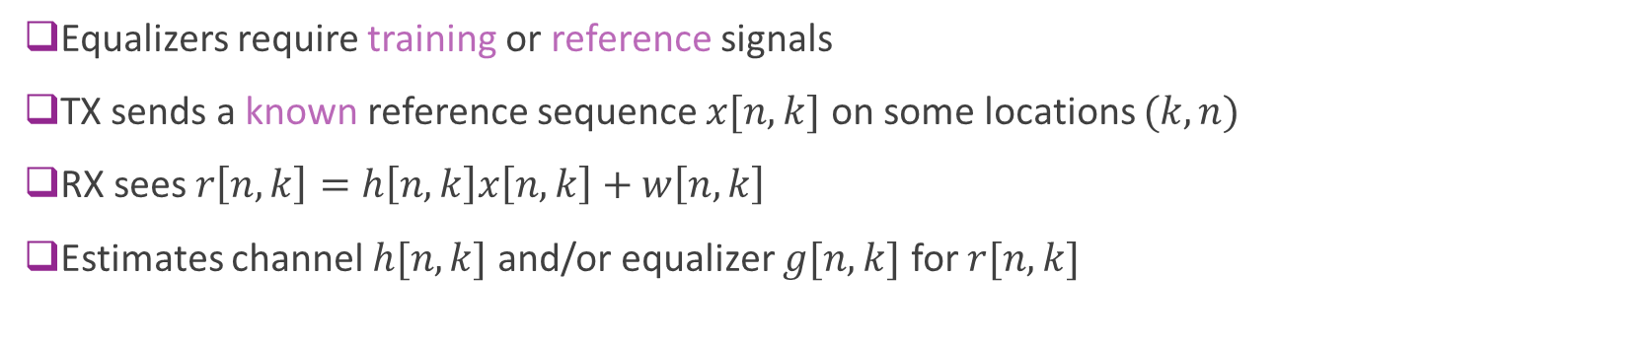
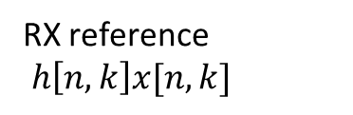
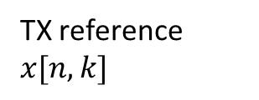

Reference Symbols
TX reference $x[n,k]$
RX reference $h\left[n,k\right]x[n,k]$
h$[n,k]$
$$g[n,k]$$
Fading channel
Equalizer estimator
Equalizers require training or reference signals
TX sends a known reference sequence $x[n,k]$ on some locations $(k,n)$
RX sees $r\left[n,k\right]=h\left[n,k\right]x\left[n,k\right]+w\left[n,k\right]$
Estimates channel $h[n,k]$ and/or equalizer $g[n,k]$ for $r[n,k]$

Slide 6
Receiver Steps in OFDM
Data-Reference demux
Equalization
Equalized symbols
Data symbols
LLRs
Sync & AGC
OFDM FFT
Demodulator
Decoder
Reference symbols
Channel & noise estimate
Today’s unit

Slide 7
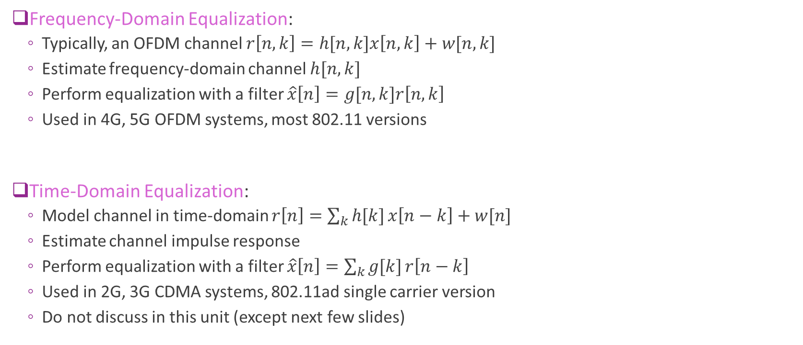
Frequency-Domain and Time-Domain EQ
Frequency-Domain Equalization:
Typically, an OFDM channel $r\left[n,k\right]=h[n,k]x\left[n,k\right]+w[n,k]$
Estimate frequency-domain channel $h[n,k]$
Perform equalization with a filter $\hat{x}\left[n\right]=g[n,k]r\left[n,k\right]$
Used in 4G, 5G OFDM systems, most 802.11 versions
Time-Domain Equalization:
Model channel in time-domain $r\left[n\right]=\sum_{k}{h[k]}x\left[n−k\right]+w[n]$
Estimate channel impulse response
Perform equalization with a filter $\hat{x}\left[n\right]=\sum_{k}{g[k]}r\left[n−k\right]$
Used in 2G, 3G CDMA systems, 802.11ad single carrier version
Do not discuss in this unit (except next few slides)

Slide 8
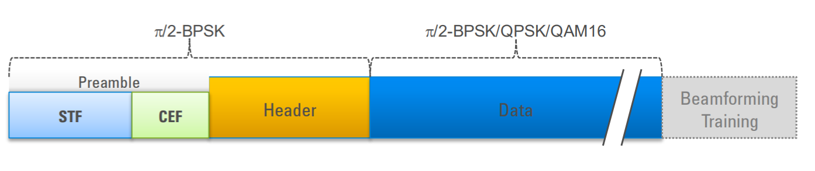
802.11 ad Time-Domain Equalizer
Apply equalizer
802.11ad uses time-domain equalization
STF: Short training field
AGC, detection of packet
coarse estimate of timing
Process as previous lecture
CEF: Channel estimation field
Train equalizer

Slide 9
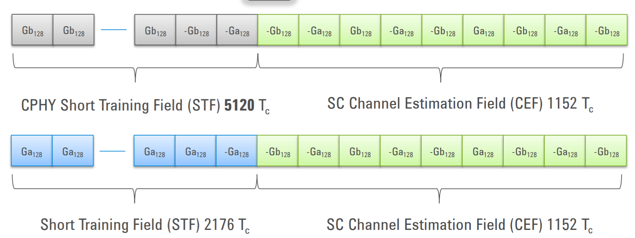
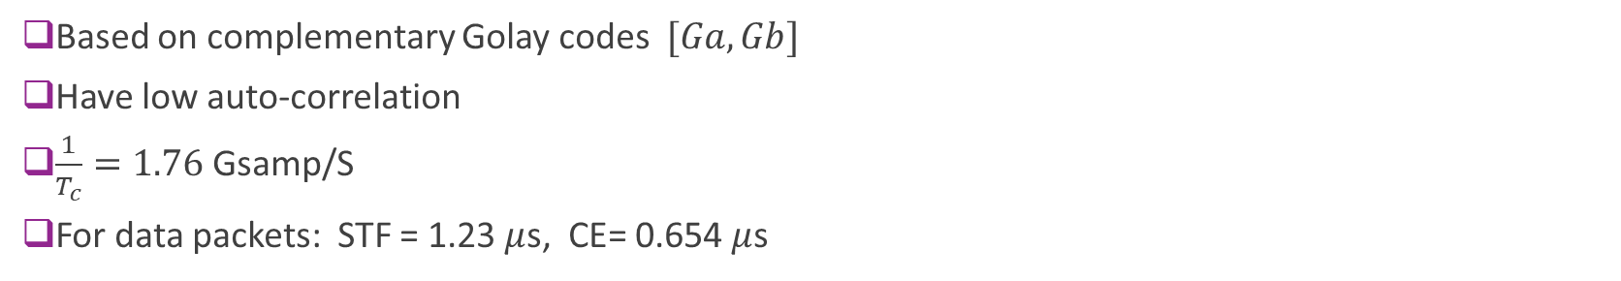
802.11ad Preamble Details
Control packets
Longer STF.
Need to be decoded by all stations. No directional gain
Data packets
Shorter STF
Based on complementary Golay codes $[Ga, Gb]$
Have low auto-correlation
$\frac{1}{T_{c}}=1.76$Gsamp/S
For data packets: STF = 1.23 $μ$s, CE= 0.654 $μ$s

Slide 10
Outline
Role of Channel Estimation and Equalization
OFDM Channel Estimation via Kernel Regression
Bias-Variance Tradeoff

Slide 11
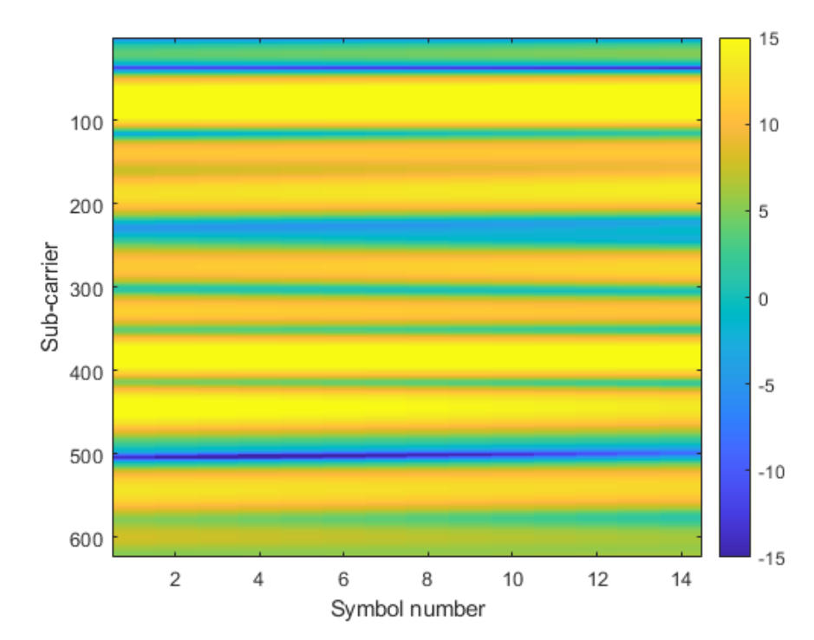
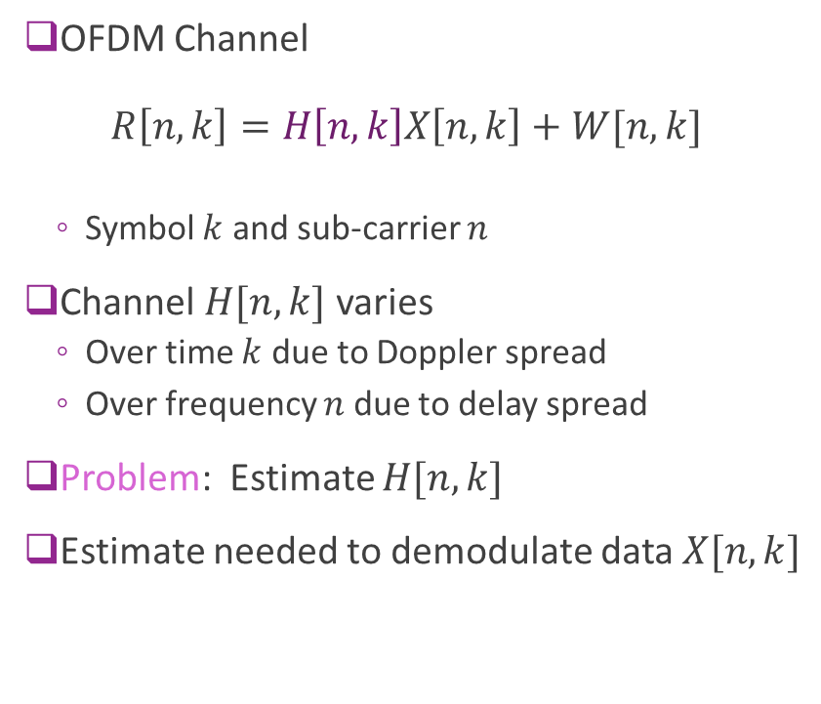
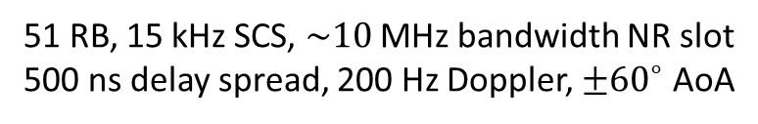
OFDM Channel Estimation
OFDM Channel $R\left[n,k\right]=H\left[n,k\right]X\left[n,k\right]+W[n,k]$
Symbol $k$ and sub-carrier $n$
Channel $H[n,k]$ varies
Over time $k$ due to Doppler spread
Over frequency $n$ due to delay spread
Problem: Estimate $H[n,k]$
Estimate needed to demodulate data $X[n,k]$
51 RB, 15 kHz SCS, $\sim 10$ MHz bandwidth NR slot
500 ns delay spread, 200 Hz Doppler, $±{60}^{∘}$ AoA

Slide 12
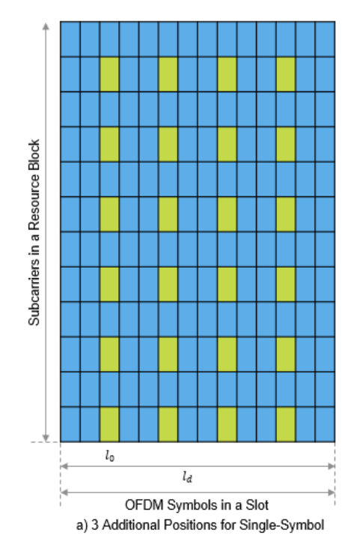
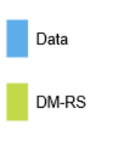
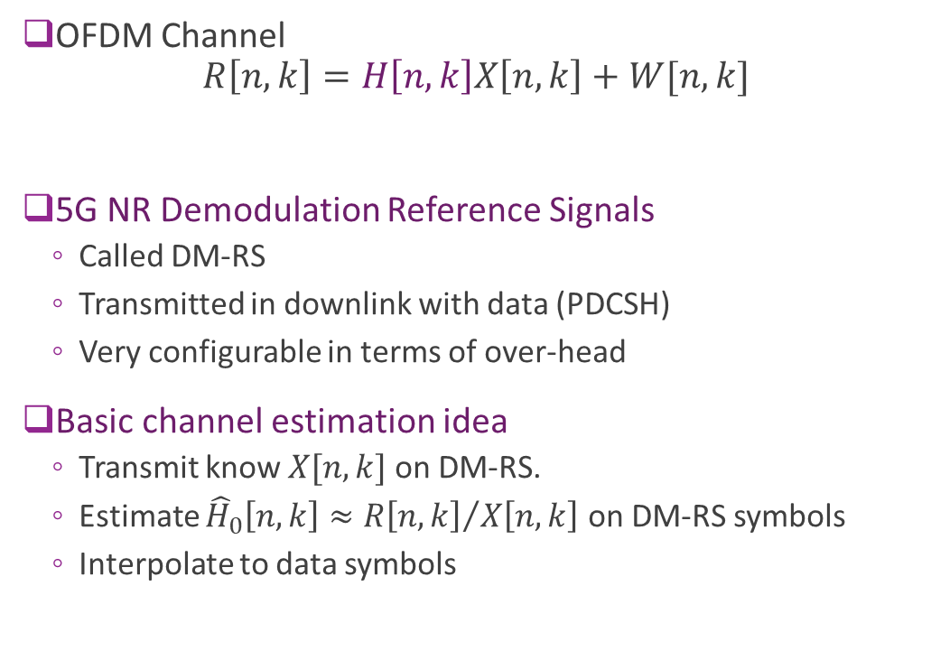
Reference Signals
OFDM Channel $R\left[n,k\right]=H\left[n,k\right]X\left[n,k\right]+W[n,k]$
5G NR Demodulation Reference Signals
Called DM-RS
Transmitted in downlink with data (PDCSH)
Very configurable in terms of over-head
Basic channel estimation idea
Transmit know $X[n,k]$ on DM-RS.
Estimate ${\hat{H}}_{0}\left[n,k\right]≈{R\left[n,k\right]}/{X\left[n,k\right]}$ on DM-RS symbols
Interpolate to data symbols

Slide 13
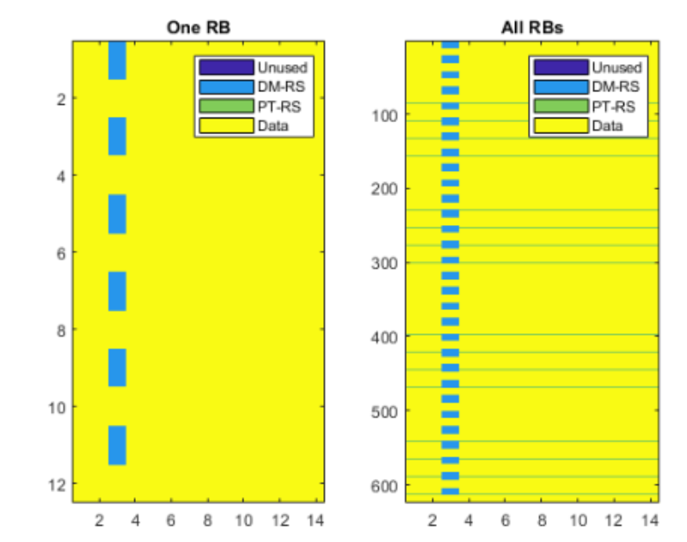
Configuring in DM-RS
Example configuration
DM-RS on one symbol in RB
Occupies 6 out of 12 REs
Also added a phase-tracking reference signal
Tracks phase variations over time
Useful for carrier frequency offset and phase noise (more on this later)
Many configurations possible
See excellent MATLAB 5G tutorial with videos

Slide 14
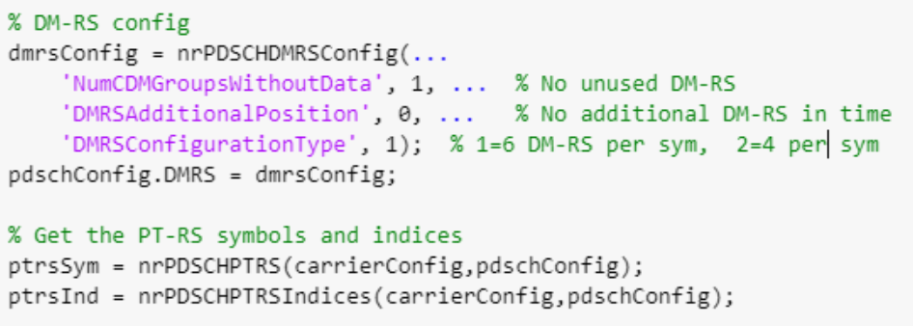
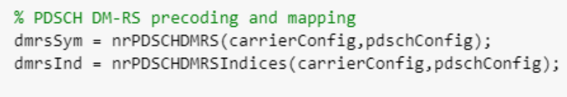
Configuring in MATLAB
MATLAB 5G Toolbox
Provides all config possibilities
Easy to use
See excellent MATLAB 5G tutorial with videos:

Slide 15
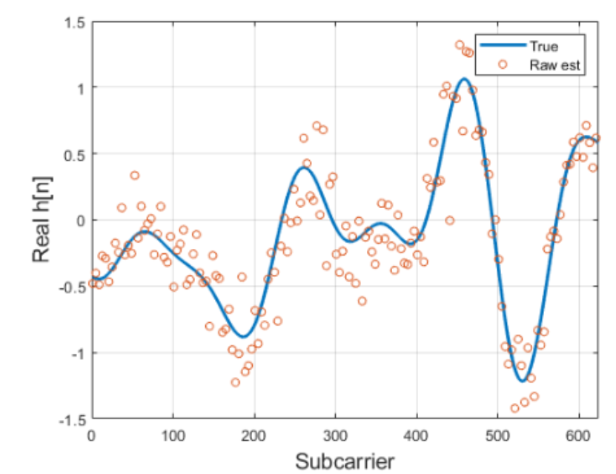
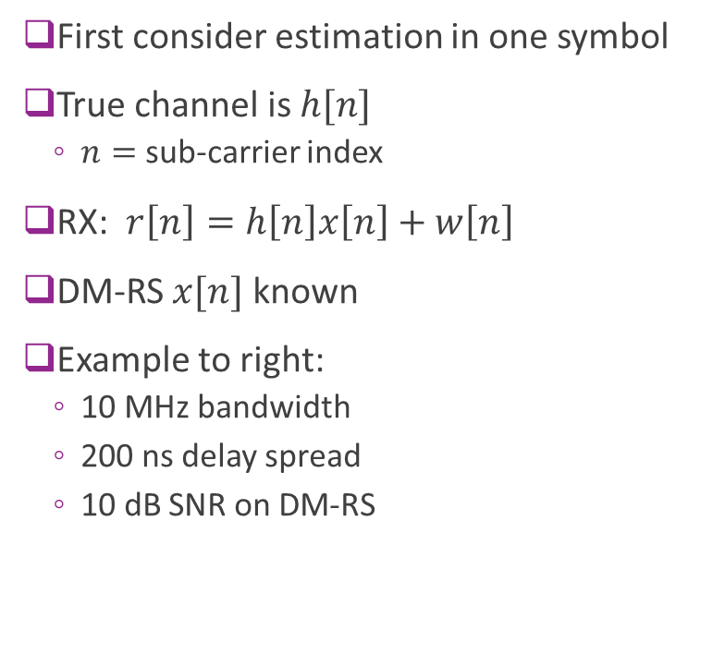
Estimating Channel in a Single Symbol
First consider estimation in one symbol
True channel is $h[n]$
$n=$ sub-carrier index
RX: $r\left[n\right]=h\left[n\right]x\left[n\right]+w\left[n\right]$
DM-RS $x[n]$ known
Example to right:
10 MHz bandwidth
200 ns delay spread
10 dB SNR on DM-RS
Subcarrier

Slide 16
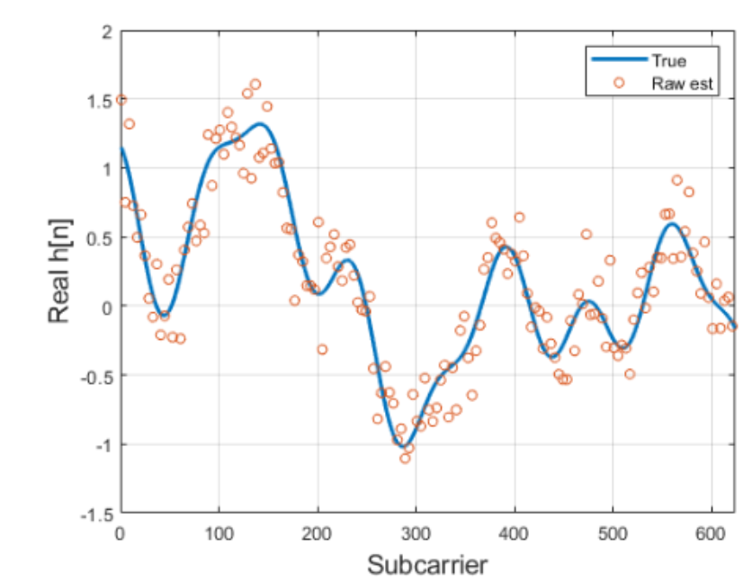
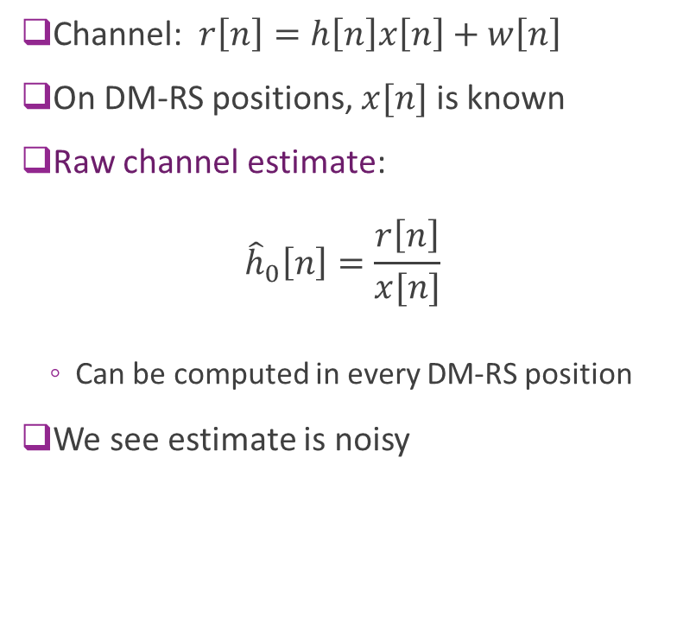
Raw Channel Estimate
Channel: $r\left[n\right]=h\left[n\right]x\left[n\right]+w\left[n\right]$
On DM-RS positions, $x[n]$ is known
Raw channel estimate: ${\hat{h}}_{0}\left[n\right]=\frac{r\left[n\right]}{x[n]}$
Can be computed in every DM-RS position
We see estimate is noisy

Slide 17
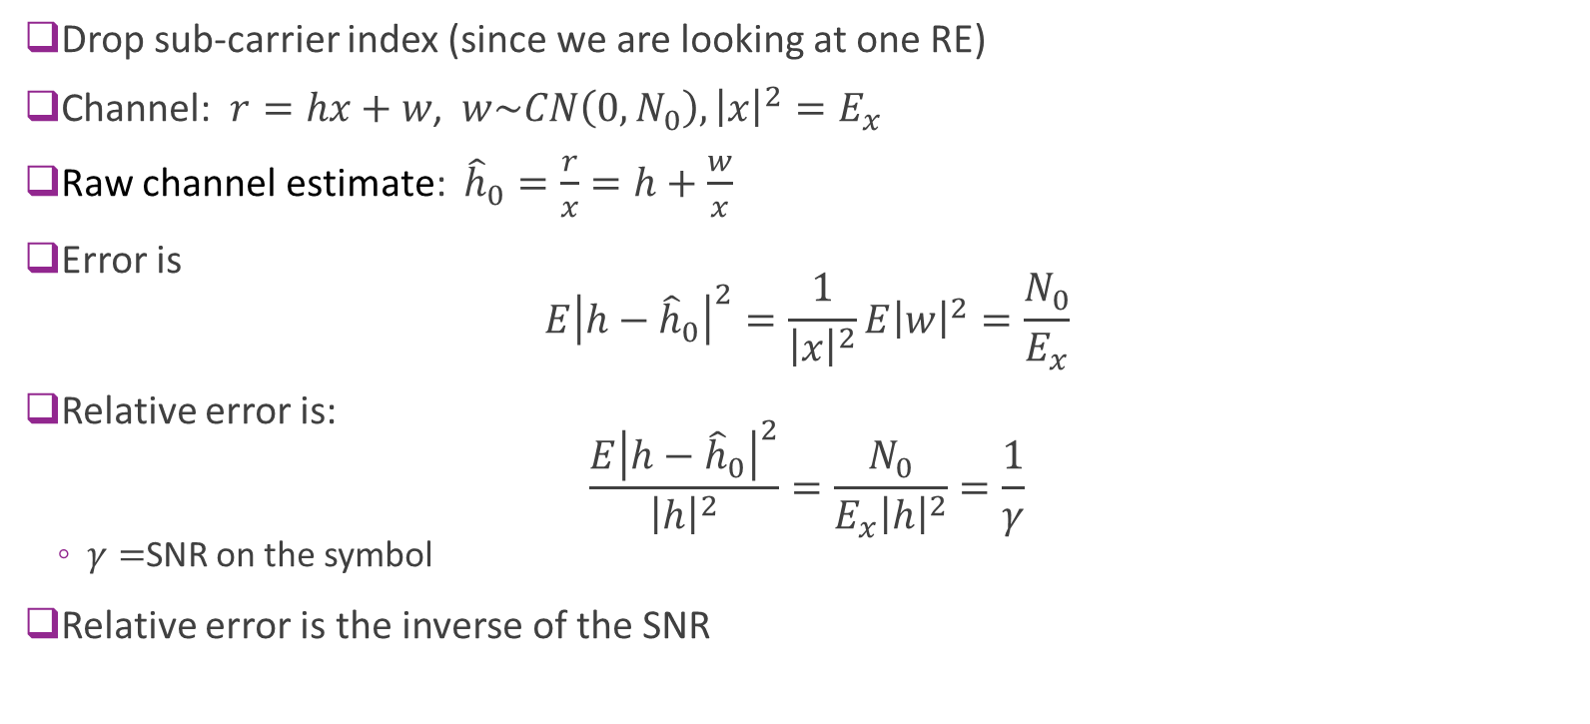
Raw Channel Estimate Error
Drop sub-carrier index (since we are looking at one RE)
Channel: $r=hx+w$, $w\sim CN\left(0,N_{0}\right), {\left|x\right|}^{2}=E_{x}$
Raw channel estimate: ${\hat{h}}_{0}=\frac{r}{x}=h+\frac{w}{x}$
Error is $E{\left|h−{\hat{h}}_{0}\right|}^{2}=\frac{1}{{\left|x\right|}^{2}}E{\left|w\right|}^{2}=\frac{N_{0}}{E_{x}}$
Relative error is: $\frac{E{\left|h−{\hat{h}}_{0}\right|}^{2}}{{\left|h\right|}^{2}}=\frac{N_{0}}{E_{x}{\left|h\right|}^{2}}=\frac{1}{γ}$
$γ=$SNR on the symbol
Relative error is the inverse of the SNR

Slide 18
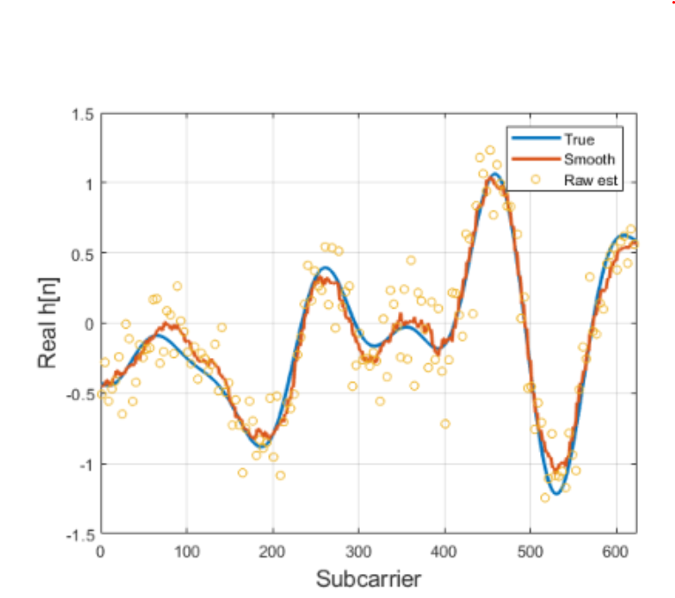
Smoothing the Estimate
Raw channel estimates are:
Noisy
Only available on DM-RS locations
Often smooth the estimate
Fit over all locations
Many options
Linear interpolation, splines
Parametric
We look at Kernel regression
Works well
Easy to implement and analyze

Slide 19
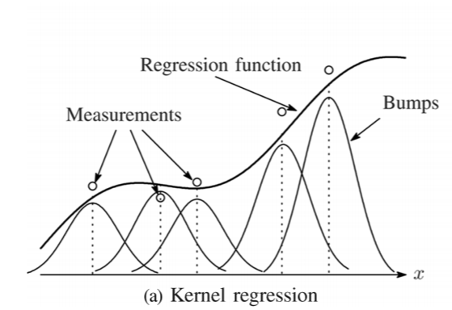

Kernel Regression
Problem: Want to estimate $h\left[n\right], n=1,…,N$
Given noisy values ${\hat{h}}_{0}\left[n\right]=h\left[n\right]+w\left[n\right]$
At locations $n∈I⊂\left\{0,….,N−1\right\}$
Kernel function $w\left[ℓ\right]$
Example radial basis function: $w\left[ℓ\right]=e^{−ℓ^{2}/(2σ^{2})}$
$σ=$ “Bandwidth”
Kernel estimate: $\hat{h}\left[n\right]=\frac{z_{1}[n]}{z_{0}[n]}$
$z_{1}\left[n\right]=\sum_{k∈I}{w\left[n−k\right]{\hat{h}}_{0}\left[k\right]},$
$z_{0}\left[n\right]=\sum_{k∈I}{w\left[n−k\right]}$
Weights raw samples by the distance $w\left[n−k\right]$
Takeda, Farisu, Milanfar, Kernel Regression for Image Processing and Reconstruction, 2007

Slide 20
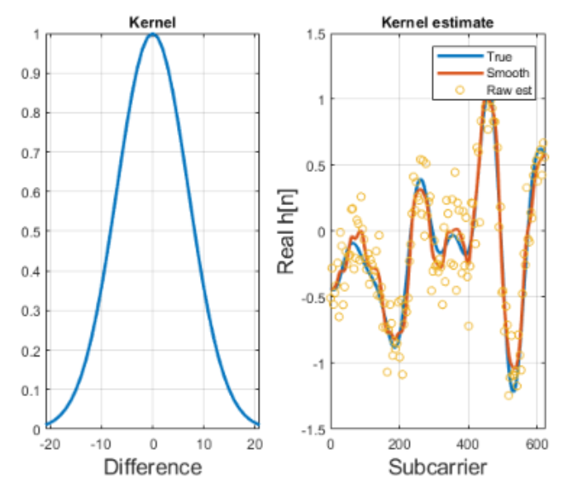

Example
RBF Kernel
Bandwidth $σ=7$
Length $L=3σ$ on each side
Estimate is visibly smoother

Slide 21
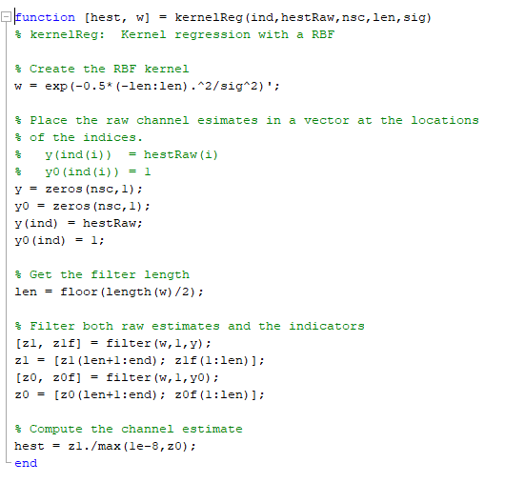
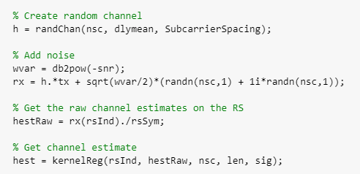
MATLAB Implementation
Easy to implement in software or hardware
See demo

Slide 22
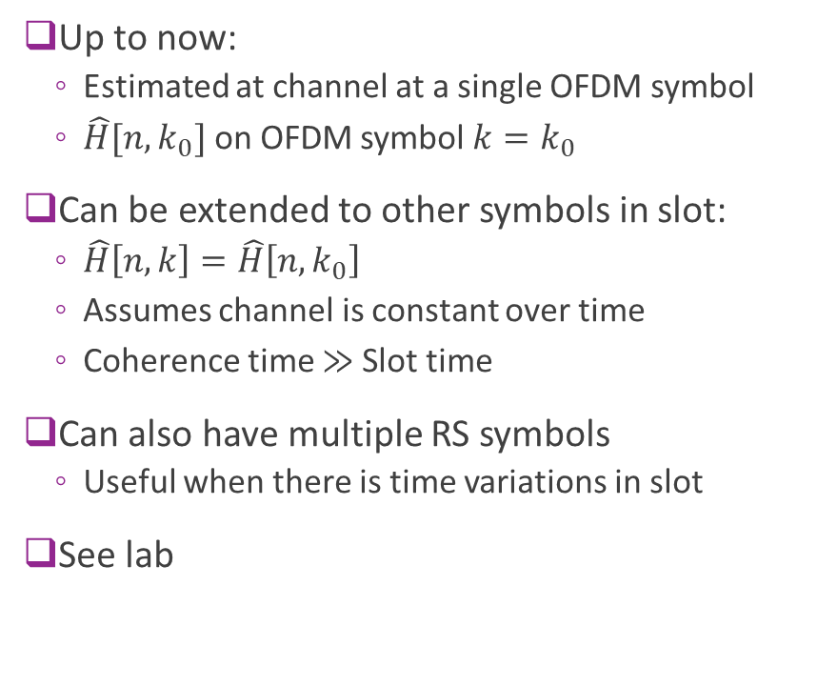
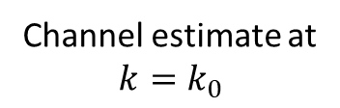
Extending the Estimate to Other Symbols
Up to now:
Estimated at channel at a single OFDM symbol
$\hat{H}[n,k_{0}]$ on OFDM symbol $k=k_{0}$
Can be extended to other symbols in slot:
$\hat{H}\left[n,k\right]=\hat{H}\left[n,k_{0}\right]$
Assumes channel is constant over time
Coherence time $≫$Slot time
Can also have multiple RS symbols
Useful when there is time variations in slot
See lab
Subcarrier
Channel estimate at $$k=k_{0}$$

Slide 23

In-Class Exercise

Slide 24
Outline
Role of Channel Estimation and Equalization
OFDM Channel Estimation via Kernel Regression
Bias-Variance Tradeoff

Slide 25
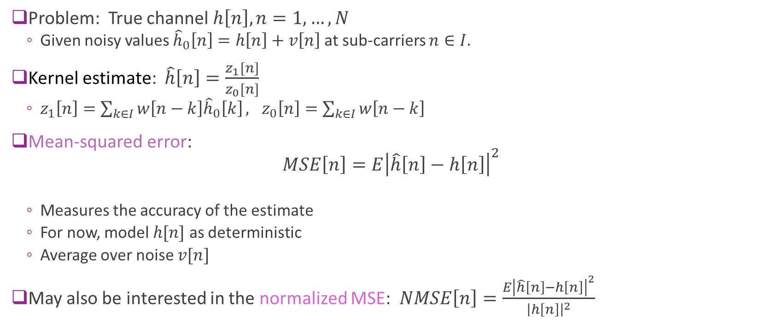
Mean Squared Error with Kernel Regression
Problem: True channel $h\left[n\right], n=1,…,N$
Given noisy values ${\hat{h}}_{0}\left[n\right]=h\left[n\right]+v\left[n\right]$ at sub-carriers $n∈I$.
Kernel estimate: $\hat{h}\left[n\right]=\frac{z_{1}[n]}{z_{0}[n]}$
$z_{1}\left[n\right]=\sum_{k∈I}{w\left[n−k\right]{\hat{h}}_{0}\left[k\right]}, z_{0}\left[n\right]=\sum_{k∈I}{w\left[n−k\right]}$
Mean-squared error: $MSE\left[n\right]=E{\left|\hat{h}\left[n\right]−h\left[n\right]\right|}^{2}$
Measures the accuracy of the estimate
For now, model $h[n]$ as deterministic
Average over noise $v[n]$
May also be interested in the normalized MSE: $NMSE\left[n\right]=\frac{E{\left|\hat{h}\left[n\right]−h\left[n\right]\right|}^{2}}{{\left|h\left[n\right]\right|}^{2}}$

Slide 26
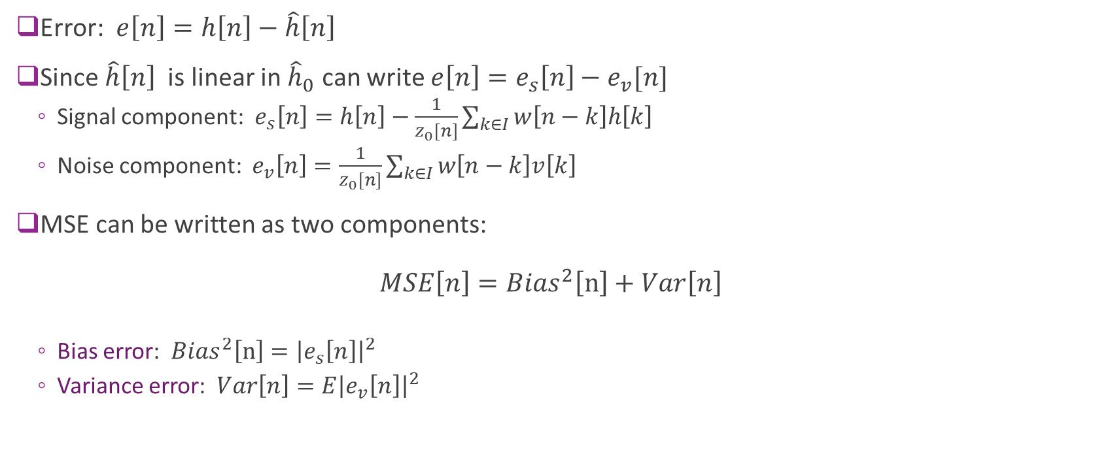
Bias and Variance Error
Error: $e\left[n\right]=h\left[n\right]−\hat{h}\left[n\right]$
Since $\hat{h}\left[n\right]$ is linear in ${\hat{h}}_{0}$ can write $e\left[n\right]=e_{s}\left[n\right]−e_{v}[n]$
Signal component: $e_{s}\left[n\right]=h\left[n\right]−\frac{1}{z_{0}[n]}\sum_{k∈I}{w\left[n−k\right]h\left[k\right]}$
Noise component: $e_{v}\left[n\right]=\frac{1}{z_{0}[n]}\sum_{k∈I}{w\left[n−k\right]v\left[k\right]}$
MSE can be written as two components: $MSE\left[n\right]={Bias}^{2}\left[n\right]+Var\left[n\right]$
Bias error: ${Bias}^{2}\left[n\right]={\left|e_{s}\left[n\right]\right|}^{2}$
Variance error: $Var\left[n\right]=E{\left|e_{v}\left[n\right]\right|}^{2}$

Slide 27
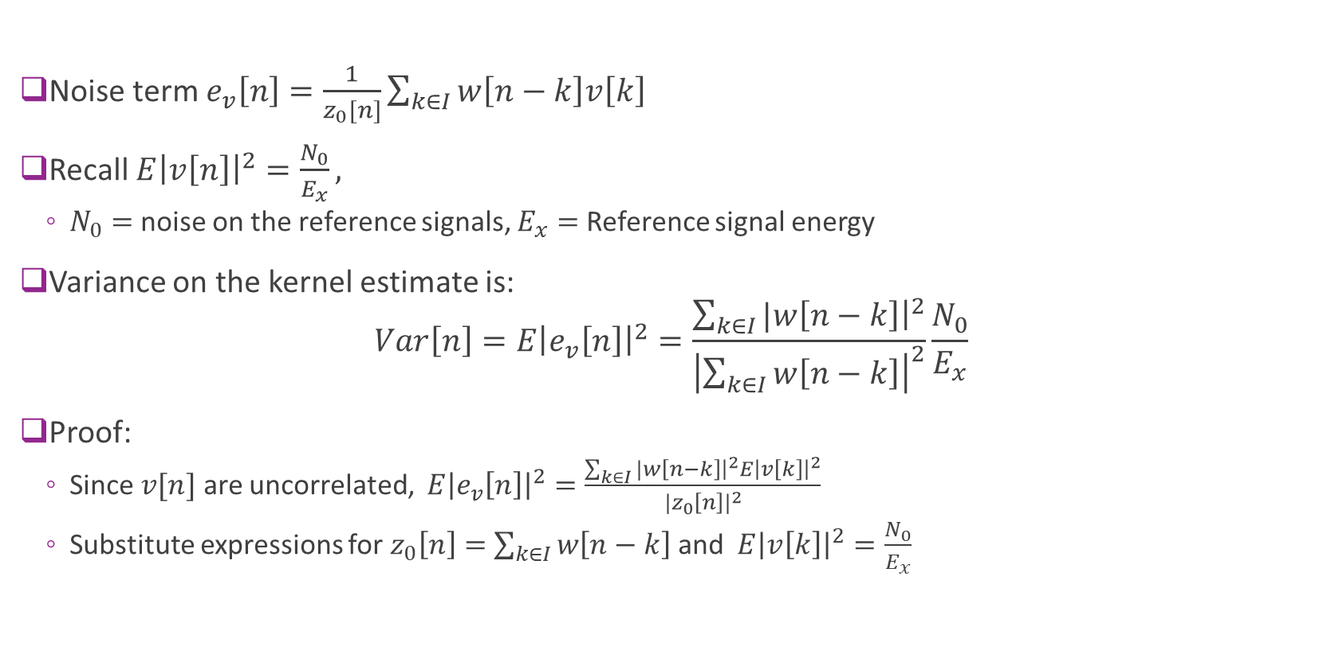
Variance Error
Noise term $e_{v}\left[n\right]=\frac{1}{z_{0}[n]}\sum_{k∈I}{w\left[n−k\right]v\left[k\right]}$
Recall $E{\left|v\left[n\right]\right|}^{2}=\frac{N_{0}}{E_{x}},$
$N_{0}=$ noise on the reference signals, $E_{x}=$ Reference signal energy
Variance on the kernel estimate is: $Var\left[n\right]=E{\left|e_{v}\left[n\right]\right|}^{2}=\frac{\sum_{k∈I}{|w\left[n−k\right]{\left.​\right|}^{2}}}{{\left|\sum_{k∈I}{w\left[n−k\right]}\right|}^{2}}\frac{N_{0}}{E_{x}}$
Proof:
Since $v[n]$ are uncorrelated, $E{\left|e_{v}\left[n\right]\right|}^{2}=\frac{\sum_{k∈I}{|w\left[n−k\right]{\left.​\right|}^{2}}E{\left|v\left[k\right]\right|}^{2}}{|z_{0}{\left[n\right]|}^{2}}$
Substitute expressions for $z_{0}\left[n\right]=$ $\sum_{k∈I}{w\left[n−k\right]}$ and $E{\left|v\left[k\right]\right|}^{2}=\frac{N_{0}}{E_{x}}$

Slide 28

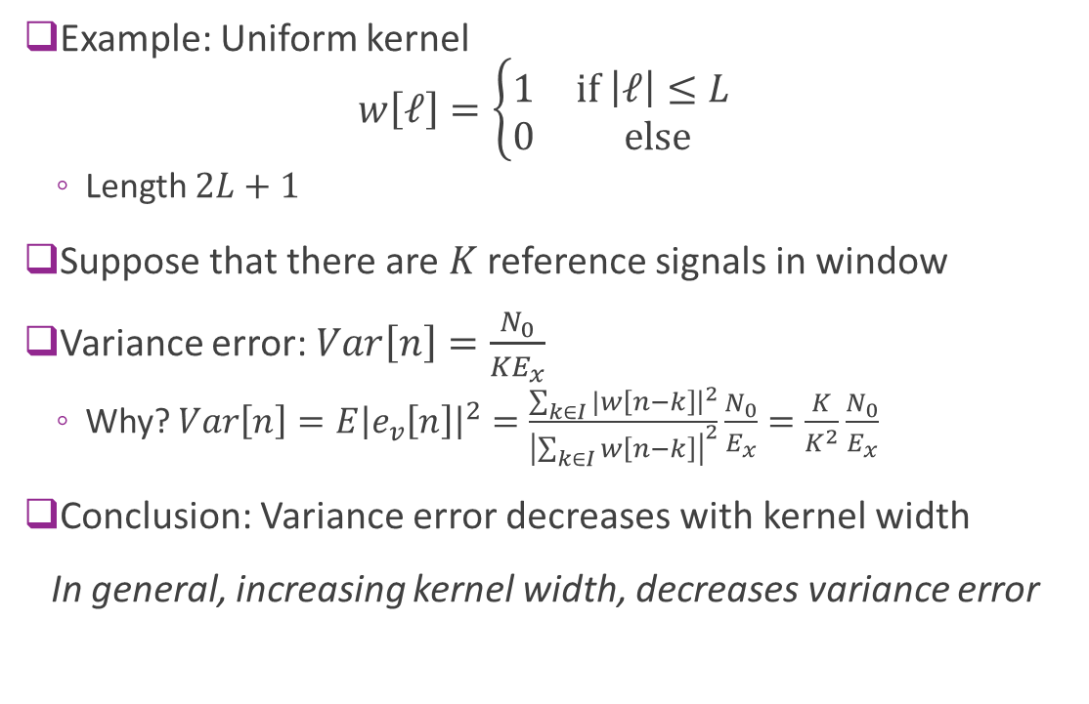
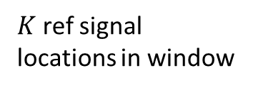

Variance Error for a Uniform Kernel
Example: Uniform kernel $w\left[ℓ\right]=\left\{\begin{matrix}1 & \text{if} \left|ℓ\right|≤L \\ 0 & \text{else}\end{matrix}\right.$
Length $2L+1$
Suppose that there are $K$ reference signals in window
Variance error: $Var\left[n\right]=\frac{N_{0}}{{KE}_{x}}$
Why? $Var\left[n\right]=E{\left|e_{v}\left[n\right]\right|}^{2}=\frac{\sum_{k∈I}{|w\left[n−k\right]{\left.​\right|}^{2}}}{{\left|\sum_{k∈I}{w\left[n−k\right]}\right|}^{2}}\frac{N_{0}}{E_{x}}=\frac{K}{K^{2}}\frac{N_{0}}{E_{x}}$
Conclusion: Variance error decreases with kernel width
In general, increasing kernel width, decreases variance error
$$−L$$
$$L$$
$K$ ref signal locations in window

Slide 29
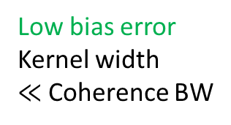

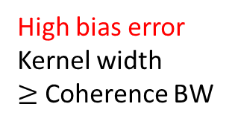
Bias Error
Signal error:
$e_{s}\left[n\right]=h\left[n\right]−\frac{1}{z_{0}\left[n\right]}\sum_{k∈I}{w\left[n−k\right]}h\left[k\right]=h\left[n\right]−\overline{h}\left[n\right]$
$\overline{h}\left[n\right]=$ local average of $h\left[k\right]$
Write as: $\overline{h}\left[n\right]=\sum_{k∈I}{α_{n−k}}h\left[k\right], α_{n−k}=\frac{w\left[n−k\right]}{\sum_{k∈I}{w\left[n−k\right]}}$
Weighted average of values of $h[k]$
Weights $α_{ℓ}$ sum to one
Bias error, ${\left|e_{s}\left[n\right]\right|}^{2},$ is large when:
Average over region where $h[n]$ changes significantly
Window $≥$ Coherence bandwidth / time
In general, increasing kernel increases the bias error
Low bias error
Kernel width $≪$ Coherence BW
High bias error
Kernel width $≥$ Coherence BW

Slide 30
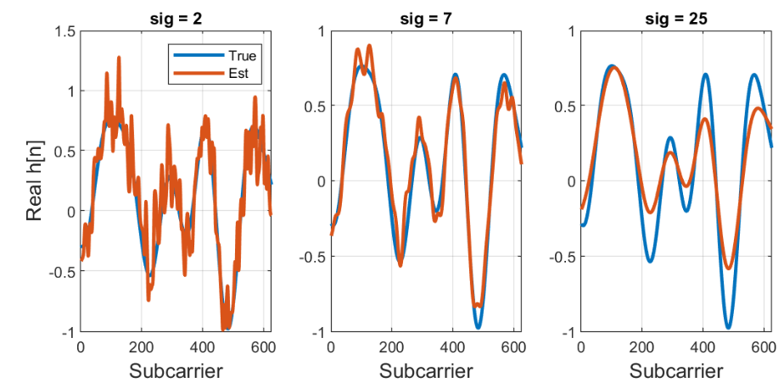
Bias-Variance Tradeoff
Decreasing kernel width
Increasing kernel width
High variance Too low averaging
High bias
Too much averaging

Slide 31
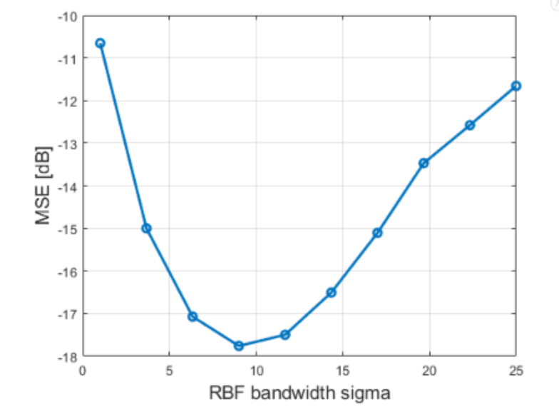
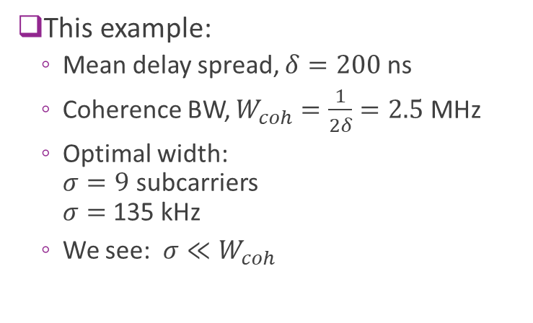
Bias-Variance Tradeoff
High variance
Small kernel width Too low averaging
High bias
High kernel width
Too much averaging
This example:
Mean delay spread, $δ=200$ ns
Coherence BW, $W_{coh}=\frac{1}{2δ}=2.5$ MHz
Optimal width: $σ=9$ subcarriers $σ=$135 kHz
We see: $σ≪W_{coh}$
Optimal

Slide 32
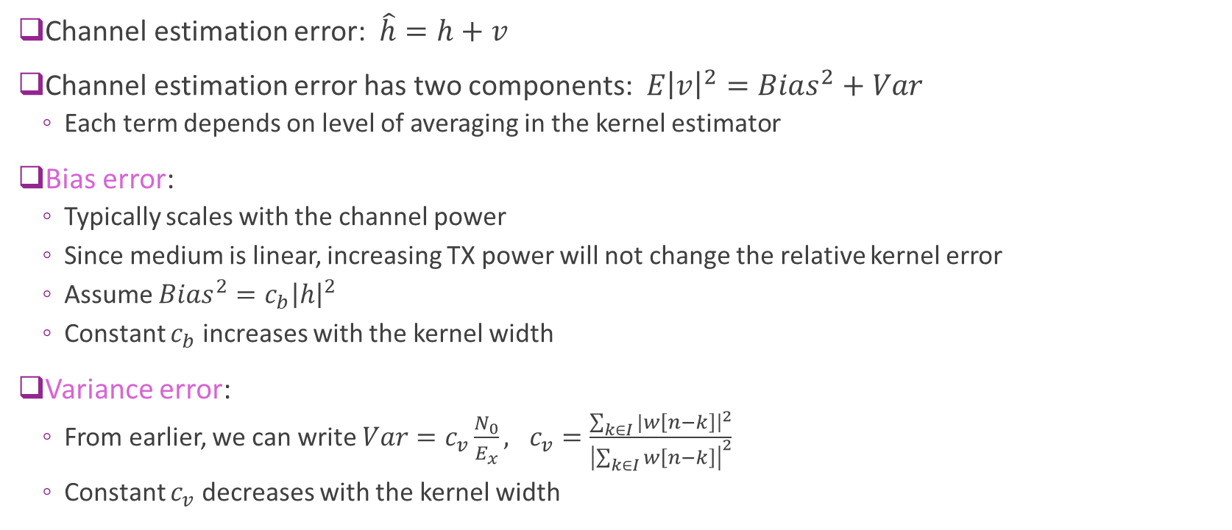
Modeling Channel Estimation Error
Channel estimation error: $\hat{h}=h+v$
Channel estimation error has two components: $E{\left|v\right|}^{2}=Bias^{2}+Var$
Each term depends on level of averaging in the kernel estimator
Bias error:
Typically scales with the channel power
Since medium is linear, increasing TX power will not change the relative kernel error
Assume $Bias^{2}=c_{b}{\left|h\right|}^{2}$
Constant $c_{b}$ increases with the kernel width
Variance error:
From earlier, we can write $Var=c_{v}\frac{N_{0}}{E_{x}}, c_{v}=\frac{\sum_{k∈I}{|w\left[n−k\right]{\left.​\right|}^{2}}}{{\left|\sum_{k∈I}{w\left[n−k\right]}\right|}^{2}}$
Constant $c_{v}$ decreases with the kernel width

Slide 33
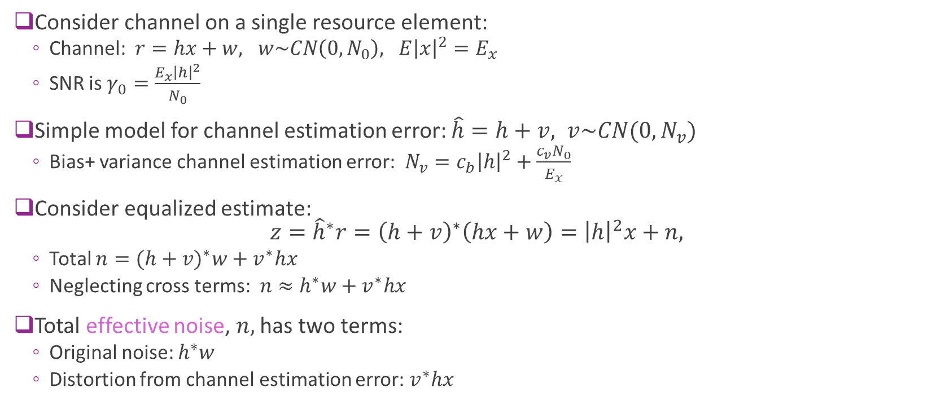
Effective Noise in Equalization
Consider channel on a single resource element:
Channel: $r=hx+w, w\sim CN\left(0,N_{0}\right), E{\left|x\right|}^{2}=E_{x}$
SNR is $γ_{0}=\frac{E_{x}{\left|h\right|}^{2}}{N_{0}}$
Simple model for channel estimation error: $\hat{h}=h+v, v\sim CN(0,N_{v})$
Bias+ variance channel estimation error: $N_{v}=c_{b}{\left|h\right|}^{2}+\frac{c_{v}N_{0}}{E_{x}}$
Consider equalized estimate: $z={\hat{h}}^{∗}r={\left(h+v\right)}^{∗}\left(hx+w\right)={\left|h\right|}^{2}x+n,$
Total $n={(h+v)}^{∗}w+v^{∗}hx$
Neglecting cross terms: $n≈h^{∗}w+v^{∗}hx$
Total effective noise, $n,$ has two terms:
Original noise: $h^{∗}w$
Distortion from channel estimation error: $v^{∗}hx$

Slide 34
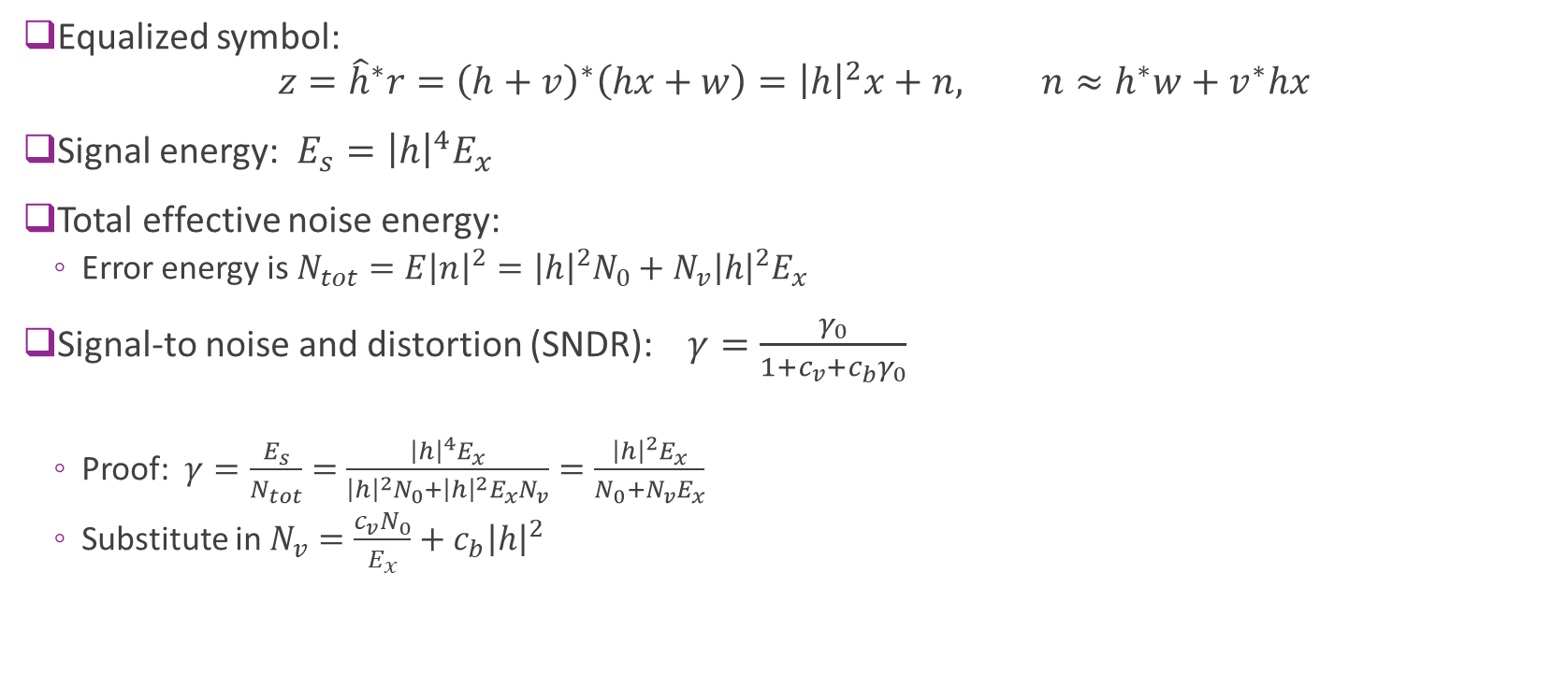
Signal-to-Noise and Distortion (SNDR)
Equalized symbol: $z={\hat{h}}^{∗}r={\left(h+v\right)}^{∗}\left(hx+w\right)={\left|h\right|}^{2}x+n, n≈h^{∗}w+v^{∗}hx$
Signal energy: $E_{s}={\left|h\right|}^{4}E_{x}$
Total effective noise energy:
Error energy is $N_{tot}=E{\left|n\right|}^{2}={\left|h\right|}^{2}N_{0}+N_{v}{\left|h\right|}^{2}E_{x}$
Signal-to noise and distortion (SNDR): $γ=\frac{γ_{0}}{1+c_{v}+c_{b}γ_{0}}$
Proof: $γ=\frac{E_{s}}{N_{tot}}=$ $\frac{{\left|h\right|}^{4}E_{x}}{{\left|h\right|}^{2}N_{0}+{\left|h\right|}^{2}E_{x}N_{v}}=\frac{{\left|h\right|}^{2}E_{x}}{N_{0}+N_{v}E_{x}}$
Substitute in $N_{v}=\frac{c_{v}N_{0}}{E_{x}}+c_{b}{\left|h\right|}^{2}$

Slide 35
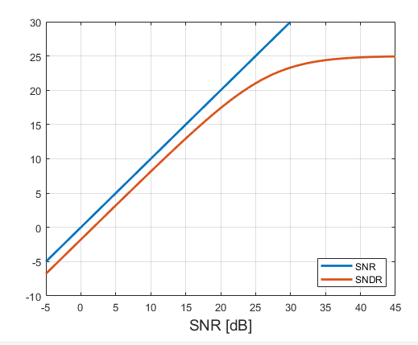
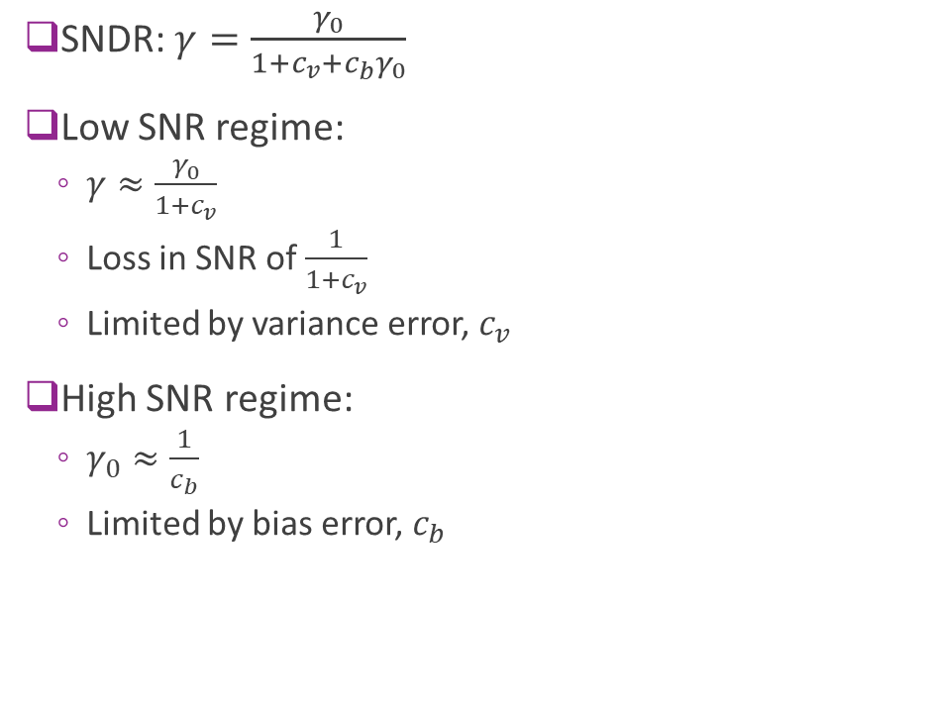
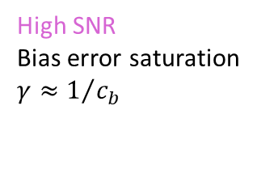
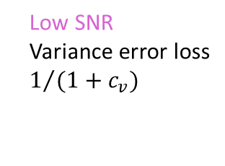
SNDR Regimes
SNDR: $γ=\frac{γ_{0}}{1+c_{v}+c_{b}γ_{0}}$
Low SNR regime:
$γ≈\frac{γ_{0}}{1+c_{v}}$
Loss in SNR of $\frac{1}{1+c_{v}}$
Limited by variance error, $c_{v}$
High SNR regime:
$γ_{0}≈\frac{1}{c_{b}}$
Limited by bias error, $c_{b}$
High SNR Bias error saturation
$γ≈1/{c_{b}}$
Low SNR Variance error loss
$1/{(1+c_{v})}$

Slide 36

Estimating Effective Noise
For equalization and LLR calculations we need to estimate the effective noise
Noise estimation can be performed via residual error:
Reference symbols: $r_{n}=h_{n}x_{n}+w_{n}, n=1,…,N_{RS}$
Obtain channel estimate: ${\hat{h}}_{n}$ (e.g., via kernel regression)
Effective noise estimate: ${\hat{N}}_{RS}=\frac{1}{N_{RS}}\sum_{n}{{\left|r_{n}−{\hat{h}}_{n}x_{n}\right|}^{2}}$
Residual error estimate captures noise and distortion
If ${\hat{h}}_{n}=h_{n}+v_{n},$ then $r_{n}−{\hat{h}}_{n}x_{n}=r_{n}−h_{n}x_{n}+v_{n}x_{n}=w_{n}+v_{n}x_{n}$
But the residual error estimate is biased:
Under-estimates the variance error in the distortion
Measuring error on the symbols used in training
Can compensate by scaling the noise estimate before using in the equalizer or demodulator

Slide 37

Measuring True Effective Noise
From previous slide, residual error noise estimate is biased
Under-estimates the variance error
Uses training symbols for error estimation
To more accurately measure noise, use separate set of test symbols
Get test symbols: $r_{n}=h_{n}x_{n}+w_{n}, n=1,…,N_{test}$
These symbols are distinct from the RS used in training
Error estimate on the test: ${\hat{N}}_{test}=\frac{1}{N_{test}}\sum_{n}{{\left|r_{n}−{\hat{h}}_{n}x_{n}\right|}^{2}}$
Rarely used during actual operation of the receiver
Adding test symbols adds excessive overhead
But, the test symbols can be done in test and simulation
For example, populate data symbols with known symbols

Slide 38


Noise Estimation Simulation
Simulation parameters as before
Mean delay spread, $δ=200$ ns
Coherence bandwidth, $W_{coh}≈\frac{1}{2δ}=2.5$ MHz
One RS per 4 sub-carriers: 60 kHz
“True” noise measured on data symbols
Not used in training
“Estimated” noise measured on RS symbols
We see:
Estimated noise is slightly optimistic at low SNRs
Both true and estimated noise levels off at high SNR
Limited by bias SNR

Slide 39

SNDR in Practice
Estimated the SNDR from effective noise estimate
In this simulation:
About 0.4 dB loss at low SNRs
About 27 dB saturation

Slide 40


In-Class Exercise

