Slide 1
Unit 9. Introduction to MIMO
EL-GY 6023. Wireless Communications
Prof. Sundeep rangan

Slide 2
Learning Objectives
Assuming CSI-R and CSI-T, describe the diagonalization of a MIMO channel
Compute the virtual directions and their SNRs
Compute the capacity for a MIMO channel using diagonalization
Narrowband and wideband
Mathematically formulate the power allocation problem and find optimal power allocations
Describe linear receivers, identify the main blocks and compute their capacity
Zero forcing and LMMSE
Describe reference signals for MIMO channel estimation in 4G and 5G systems
Compute optimal statistical pre-coders and compute the capacity

Slide 3

Excellent Text for This Section
Some material in this section is from this recent text
Provides excellent:
Information theoretic background
Practical guidelines for implementation
Up-to-date examples with issues for mmWave
We only cover a small section
Single user MIMO
Many derivations are left for the text

Slide 4
Outline
Spatial Multiplexing with CSI-T and CSI-R
Power Allocation and Rank Selection
Spatial Multiplexing with CSI-R Only
Channel Estimation and CSI-R
CSI-T Feedback and Statistical Pre-Coding

Slide 5
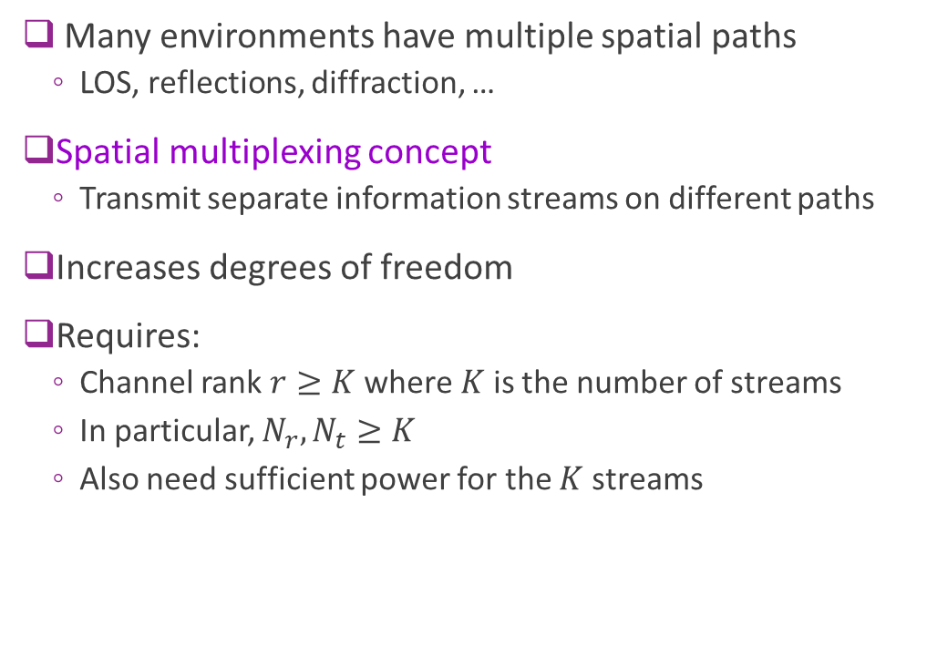
Spatial Multiplexing
Many environments have multiple spatial paths
LOS, reflections, diffraction, …
Spatial multiplexing concept
Transmit separate information streams on different paths
Increases degrees of freedom
Requires:
Channel rank $r≥K$ where $K$ is the number of streams
In particular, $N_{r},N_{t}≥K$
Also need sufficient power for the $K$ streams
RX array
TX array

Slide 6
MIMO History
Early research:
ArrayComm 1991
Paulraj and Kailath, initial patent on SDMA
Foschini and others, initial capacity estimates, 1996
Bell Labs prototype, 1998
Commercialization in LANs
Began study in 2003.
First appeared in 802.11n 2009
Commercialization in cellular:
4G systems, approximately 2004
5G systems: Integral component for support for mmWave

Slide 7

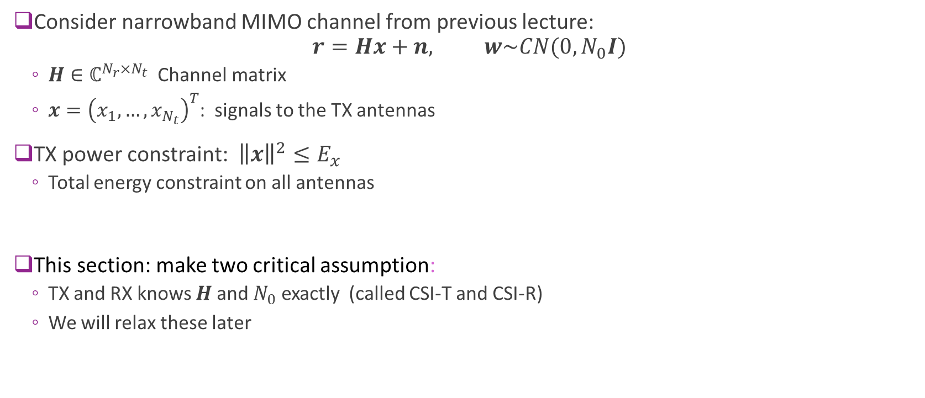



MIMO Narrowband Capacity
Consider narrowband MIMO channel from previous lecture: $r=Hx+n, w\sim CN(0,N_{0}I)$
$H∈ℂ^{N_{r}×N_{t}}$ Channel matrix
$x={\left(x_{1},…,x_{N_{t}}\right)}^{T}$: signals to the TX antennas
TX power constraint: ${\left\|x\right\|}^{2}≤E_{x}$
Total energy constraint on all antennas
This section: make two critical assumption:
TX and RX knows $H$ and $N_{0}$ exactly (called CSI-T and CSI-R)
We will relax these later
$$w$$
$$H$$
$$x$$
$$r$$
TX array
RX array

Slide 8
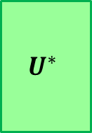

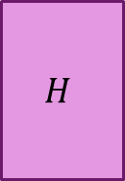
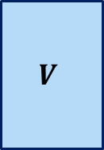
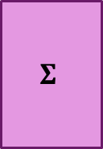
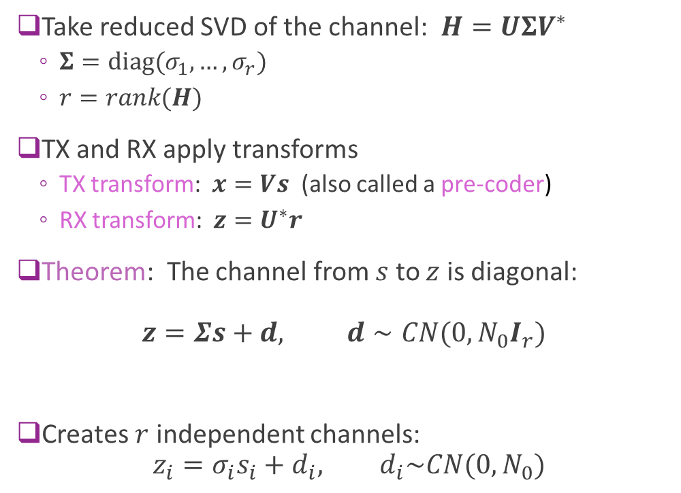







Applying Transforms with the SVD
$$w$$
Take reduced SVD of the channel: $H=UΣV^{∗}$
$Σ=diag(σ_{1},…, σ_{r})$
$r=rank(H)$
TX and RX apply transforms
TX transform: $x=Vs$ (also called a pre-coder)
RX transform: $z=U^{∗}r$
Theorem: The channel from $s$ to $z$ is diagonal: $z=Σs+d, d∼CN(0,N_{0}I_{r})$
Creates $r$ independent channels: $z_{i}=σ_{i}s_{i}+d_{i}, d_{i}\sim CN(0,N_{0})$
$$V$$
$$H$$
$$U^{∗}$$
$$s$$
$$x$$
$$r$$
$$z$$
TX transform
RX transform
=
$$d$$
$$Σ$$
$$s$$
$$z$$

Slide 9



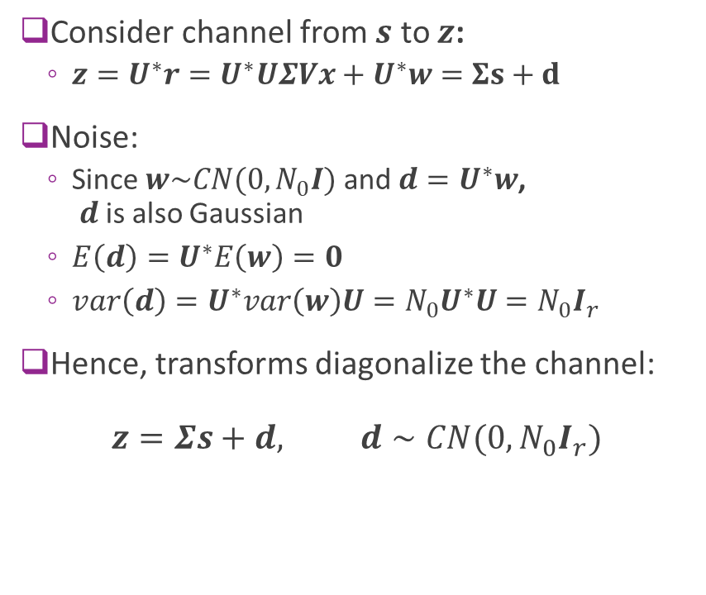
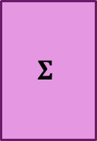
Proof of the Diagonalization
$$w$$
Consider channel from $s$ to $z$:
$z=U^{∗}r=U^{∗}UΣVx+U^{∗}w=Σs+d$
Noise:
Since $w\sim CN(0,N_{0}I)$ and $d=U^{∗}w$, $d$ is also Gaussian
$E\left(d\right)=U^{∗}E\left(w\right)=0$
$var\left(d\right)=U^{∗}var\left(w\right)U=N_{0}U^{∗}U=N_{0}I_{r}$
Hence, transforms diagonalize the channel: $z=Σs+d, d∼CN(0,N_{0}I_{r})$
$$V$$
$$H$$
$$U^{∗}$$
$$s$$
$$x$$
$$r$$
$$z$$
=
$$d$$
$$Σ$$
$$s$$
$$z$$

Slide 10

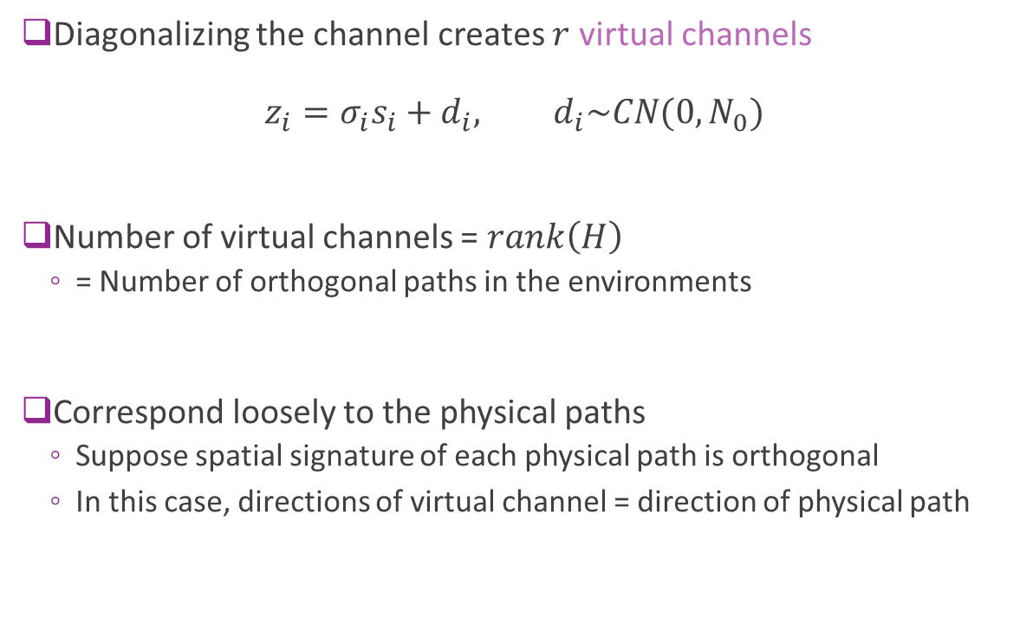


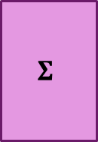
Virtual Channels
Diagonalizing the channel creates $r$ virtual channels $z_{i}=σ_{i}s_{i}+d_{i}, d_{i}\sim CN(0,N_{0})$
Number of virtual channels = $rank\left(H\right)$
= Number of orthogonal paths in the environments
Correspond loosely to the physical paths
Suppose spatial signature of each physical path is orthogonal
In this case, directions of virtual channel = direction of physical path
TX array
RX array
=
$$d$$
$$Σ$$
$$s$$
$$z$$

Slide 11

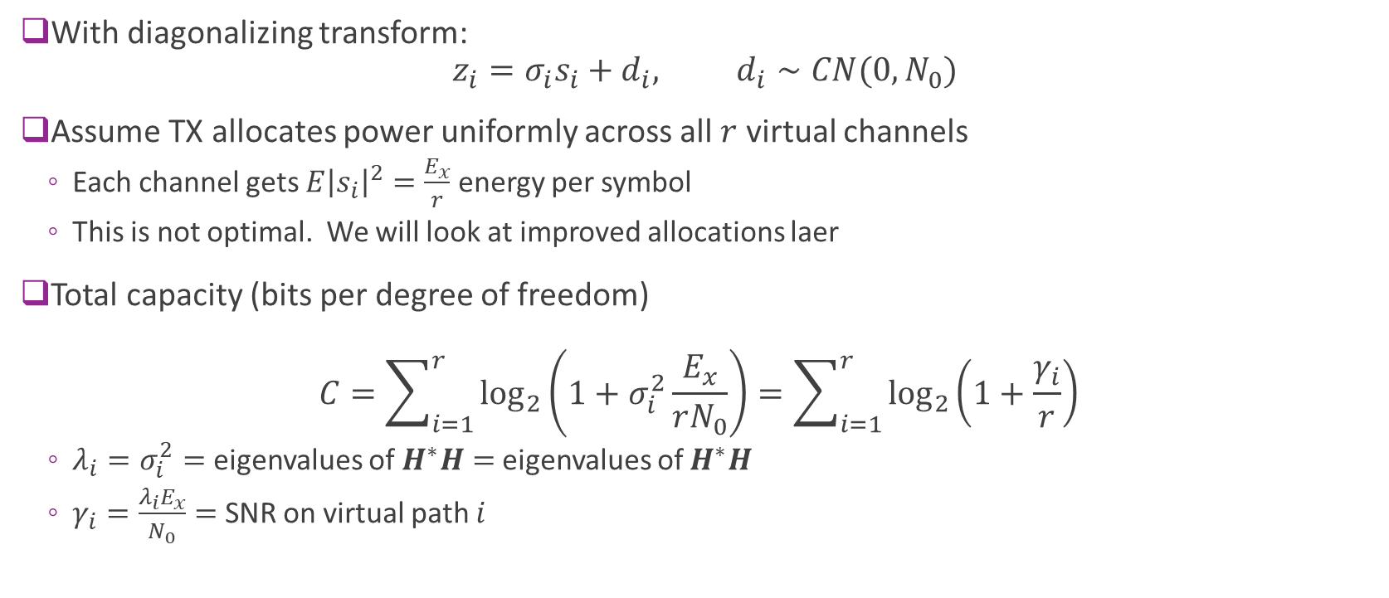



Shannon Capacity
With diagonalizing transform: $z_{i}=σ_{i}s_{i}+d_{i}, d_{i}∼CN(0,N_{0})$
Assume TX allocates power uniformly across all $r$ virtual channels
Each channel gets $E{\left|s_{i}\right|}^{2}=\frac{E_{x}}{r}$ energy per symbol
This is not optimal. We will look at improved allocations laer
Total capacity (bits per degree of freedom) $C=\sum_{i=1}^{r}{\log_{2}\left(1+σ_{i}^{2}\frac{E_{x}}{rN_{0}}\right)}=\sum_{i=1}^{r}{\log_{2}\left(1+\frac{γ_{i}}{r}\right)}$
$λ_{i}=σ_{i}^{2}=$ eigenvalues of $H^{∗}H=$ eigenvalues of $H^{∗}H$
$γ_{i}=\frac{λ_{i}E_{x}}{N_{0}}=$ SNR on virtual path $i$
$$d$$
$$Σ$$
$$s$$
$$z$$

Slide 12
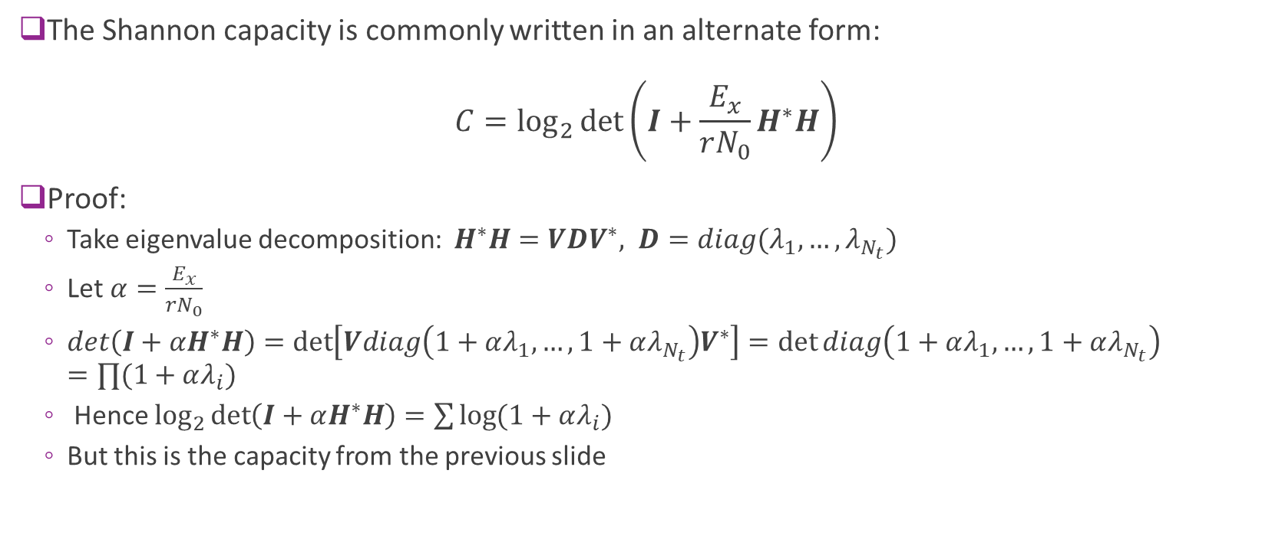
Log-Det Form of the Shannon Capacity
The Shannon capacity is commonly written in an alternate form: $C=\log_{2}{\det\left(I+\frac{E_{x}}{rN_{0}}H^{∗}H\right)}$
Proof:
Take eigenvalue decomposition: $H^{∗}H=VDV^{∗}, D=diag(λ_{1},…,λ_{N_{t}})$
Let $α=\frac{E_{x}}{rN_{0}}$
$det\left(I+αH^{∗}H\right)=\det\left[Vdiag\left(1+αλ_{1},…,1+αλ_{N_{t}}\right)V^{∗}\right]=\det{diag\left(1+αλ_{1},…,1+αλ_{N_{t}}\right)}$ $=∏(1+αλ_{i})$
Hence $\log_{2}{\det\left(I+αH^{∗}H\right)}=\sum{\log{(1+αλ_{i})}}$
But this is the capacity from the previous slide

Slide 13
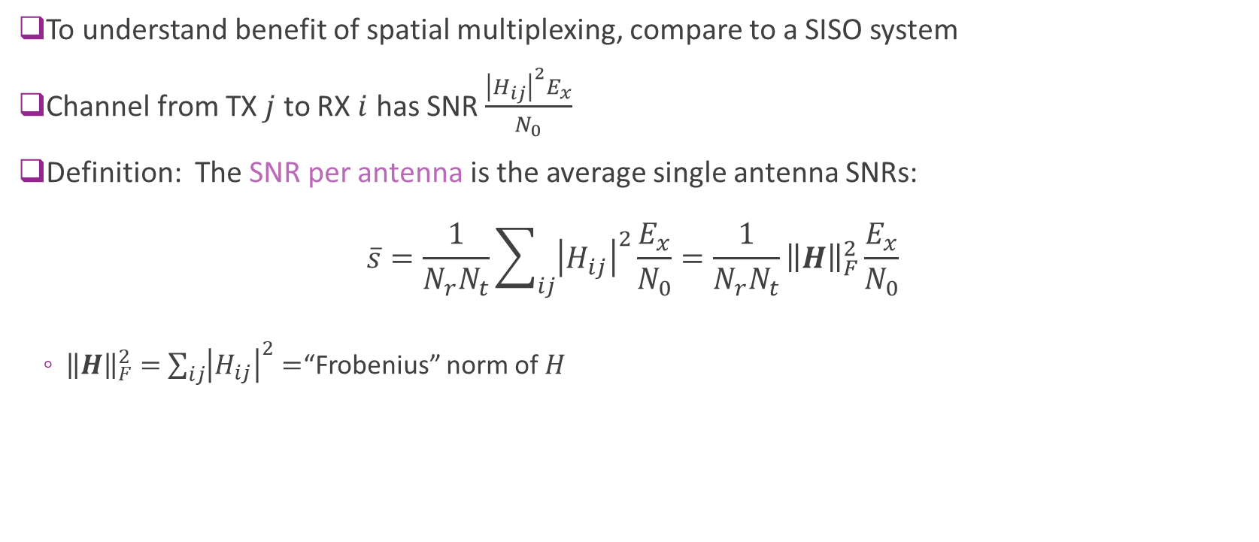
SNR Per Antenna
To understand benefit of spatial multiplexing, compare to a SISO system
Channel from TX $j$ to RX $i$ has SNR $\frac{{\left|H_{ij}\right|}^{2}E_{x}}{N_{0}}$
Definition: The SNR per antenna is the average single antenna SNRs: $\overline{s}=\frac{1}{N_{r}N_{t}}\sum_{ij}{{\left|H_{ij}\right|}^{2}}\frac{E_{x}}{N_{0}}=\frac{1}{N_{r}N_{t}}{\left\|H\right\|}_{F}^{2}\frac{E_{x}}{N_{0}}$
${\left\|H\right\|}_{F}^{2}=$ $\sum_{ij}{{\left|H_{ij}\right|}^{2}}=$“Frobenius” norm of $H$

Slide 14
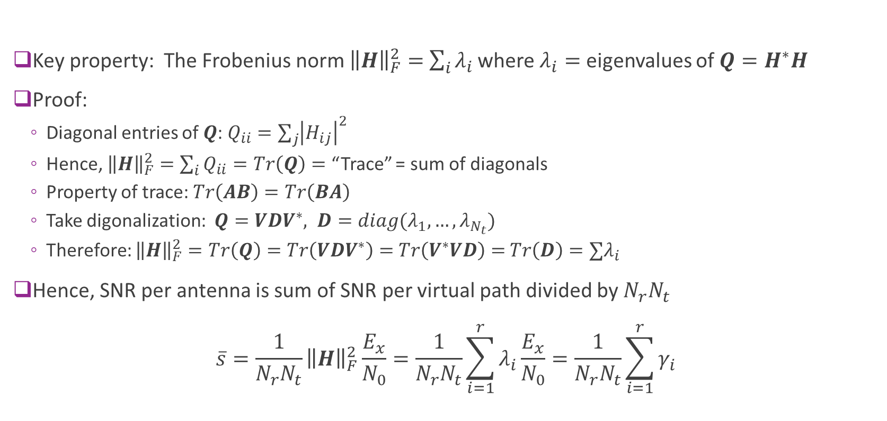
Frobenius Norm=Sum of Eigenvalues
Key property: The Frobenius norm ${\left\|H\right\|}_{F}^{2}=$ $\sum_{i}{λ_{i}}$ where $λ_{i}=$ eigenvalues of $Q=H^{∗}H$
Proof:
Diagonal entries of $Q$: $Q_{ii}=\sum_{j}{{\left|H_{ij}\right|}^{2}}$
Hence, ${\left\|H\right\|}_{F}^{2}=\sum_{i}{Q_{ii}}=Tr\left(Q\right)=$ “Trace” = sum of diagonals
Property of trace: $Tr\left(AB\right)=Tr\left(BA\right)$
Take digonalization: $Q=VDV^{∗}, D=diag(λ_{1},…,λ_{N_{t}})$
Therefore: ${\left\|H\right\|}_{F}^{2}=Tr\left(Q\right)=Tr\left(VDV^{∗}\right)=$ $Tr\left(V^{∗}VD\right)=$ $Tr\left(D\right)=∑λ_{i}$
Hence, SNR per antenna is sum of SNR per virtual path divided by $N_{r}N_{t}$ $\overline{s}=\frac{1}{N_{r}N_{t}}{\left\|H\right\|}_{F}^{2}\frac{E_{x}}{N_{0}}=\frac{1}{N_{r}N_{t}}\sum_{i=1}^{r}{λ_{i}}\frac{E_{x}}{N_{0}}=\frac{1}{N_{r}N_{t}}\sum_{i=1}^{r}{γ_{i}}$

Slide 15
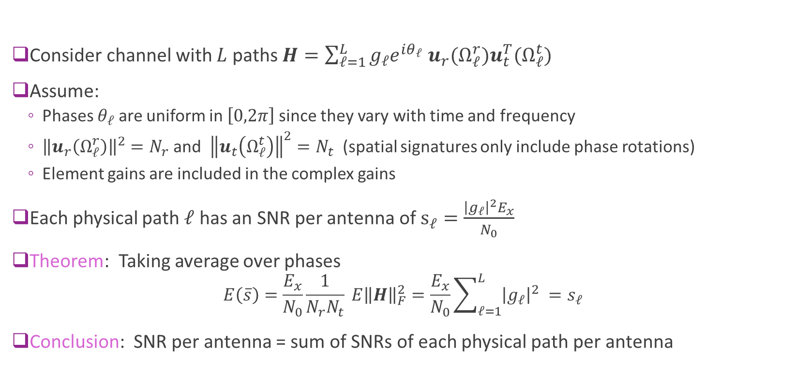
SNR Per Antenna and Physical Path SNRs
Consider channel with $L$ paths $H=\sum_{ℓ=1}^{L}{g_{ℓ}e^{iθ_{ℓ}} u_{r}(Ω_{ℓ}^{r})u_{t }^{T}(Ω_{ℓ}^{t})}$
Assume:
Phases $θ_{ℓ}$ are uniform in $\left[0,2π\right]$since they vary with time and frequency
${\left\|u_{r}\left(Ω_{ℓ}^{r}\right)\right\|}^{2}=N_{r}$ and ${\left\|u_{t}\left(Ω_{ℓ}^{t}\right)\right\|}^{2}=N_{t}$ (spatial signatures only include phase rotations)
Element gains are included in the complex gains
Each physical path $ℓ$ has an SNR per antenna of $s_{ℓ}=\frac{{\left|g_{ℓ}\right|}^{2}E_{x}}{N_{0}}$
Theorem: Taking average over phases
$$E\left(\overline{s}\right)=\frac{E_{x}}{N_{0}}\frac{1}{N_{r}N_{t}} E{\left\|H\right\|}_{F}^{2}=\frac{E_{x}}{N_{0}}\sum_{ℓ=1}^{L}{{\left|g_{ℓ}\right|}^{2} }=s_{ℓ}$$
Conclusion: SNR per antenna = sum of SNRs of each physical path per antenna

Slide 16
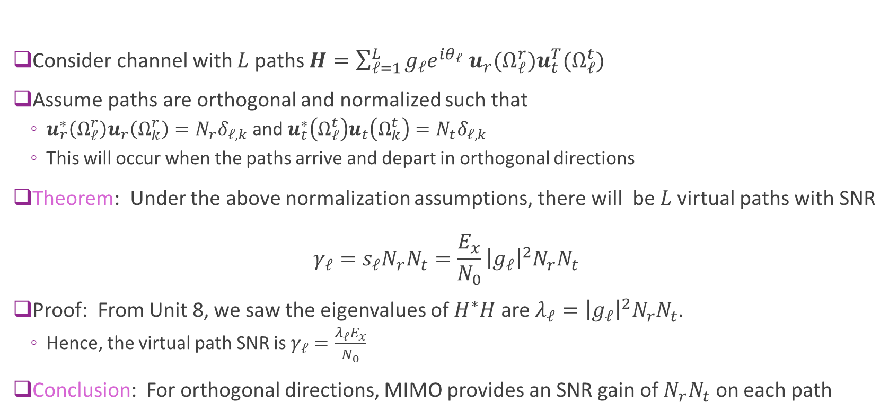
Virtual Path SNRs and Path SNRs
Consider channel with $L$ paths $H=\sum_{ℓ=1}^{L}{g_{ℓ}e^{iθ_{ℓ}} u_{r}(Ω_{ℓ}^{r})u_{t }^{T}(Ω_{ℓ}^{t})}$
Assume paths are orthogonal and normalized such that
$u_{r}^{∗}\left(Ω_{ℓ}^{r}\right)u_{r}\left(Ω_{k}^{r}\right)=N_{r}δ_{ℓ,k}$ and $u_{t}^{∗}\left(Ω_{ℓ}^{t}\right)u_{t}\left(Ω_{k}^{t}\right)=N_{t}δ_{ℓ,k}$
This will occur when the paths arrive and depart in orthogonal directions
Theorem: Under the above normalization assumptions, there will be $L$ virtual paths with SNR $γ_{ℓ}=s_{ℓ}N_{r}N_{t}=\frac{E_{x}}{N_{0}}{\left|g_{ℓ}\right|}^{2}N_{r}N_{t}$
Proof: From Unit 8, we saw the eigenvalues of $H^{∗}H$ are $λ_{ℓ}={\left|g_{ℓ}\right|}^{2}N_{r}N_{t}$.
Hence, the virtual path SNR is $γ_{ℓ}=\frac{λ_{ℓ}E_{x}}{N_{0}}$
Conclusion: For orthogonal directions, MIMO provides an SNR gain of $N_{r}N_{t}$ on each path

Slide 17



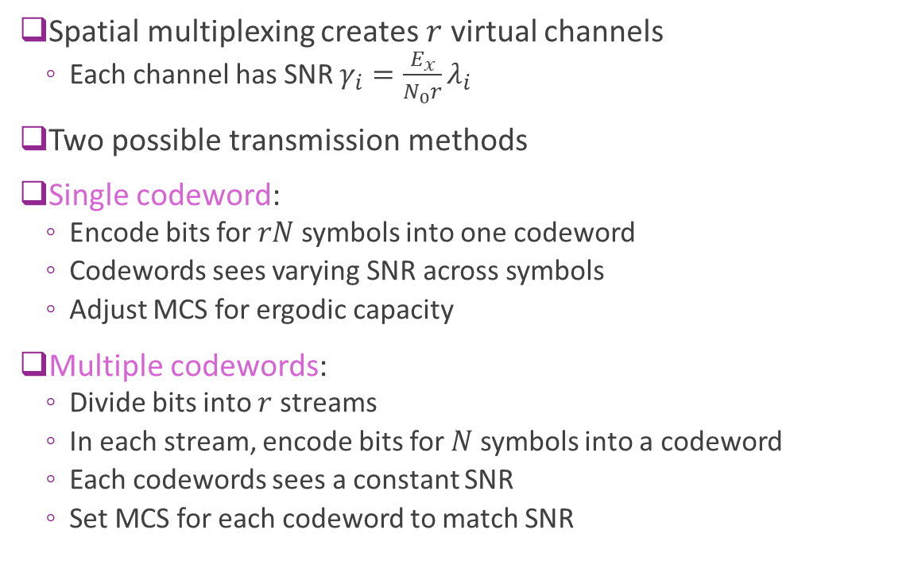



Coding Architectures
Spatial multiplexing creates $r$ virtual channels
Each channel has SNR $γ_{i}=\frac{E_{x}}{N_{0}r}λ_{i}$
Two possible transmission methods
Single codeword:
Encode bits for $rN$ symbols into one codeword
Codewords sees varying SNR across symbols
Adjust MCS for ergodic capacity
Multiple codewords:
Divide bits into $r$ streams
In each stream, encode bits for $N$ symbols into a codeword
Each codewords sees a constant SNR
Set MCS for each codeword to match SNR
Single Codeword
Encoder
SNR $γ_{1}$
Decoder
$$⋮$$
SNR $γ_{r}$
Multiple codewords
Encoder
SNR $γ_{1}$
Decoder
$$⋮$$
SNR $γ_{r}$

Slide 18

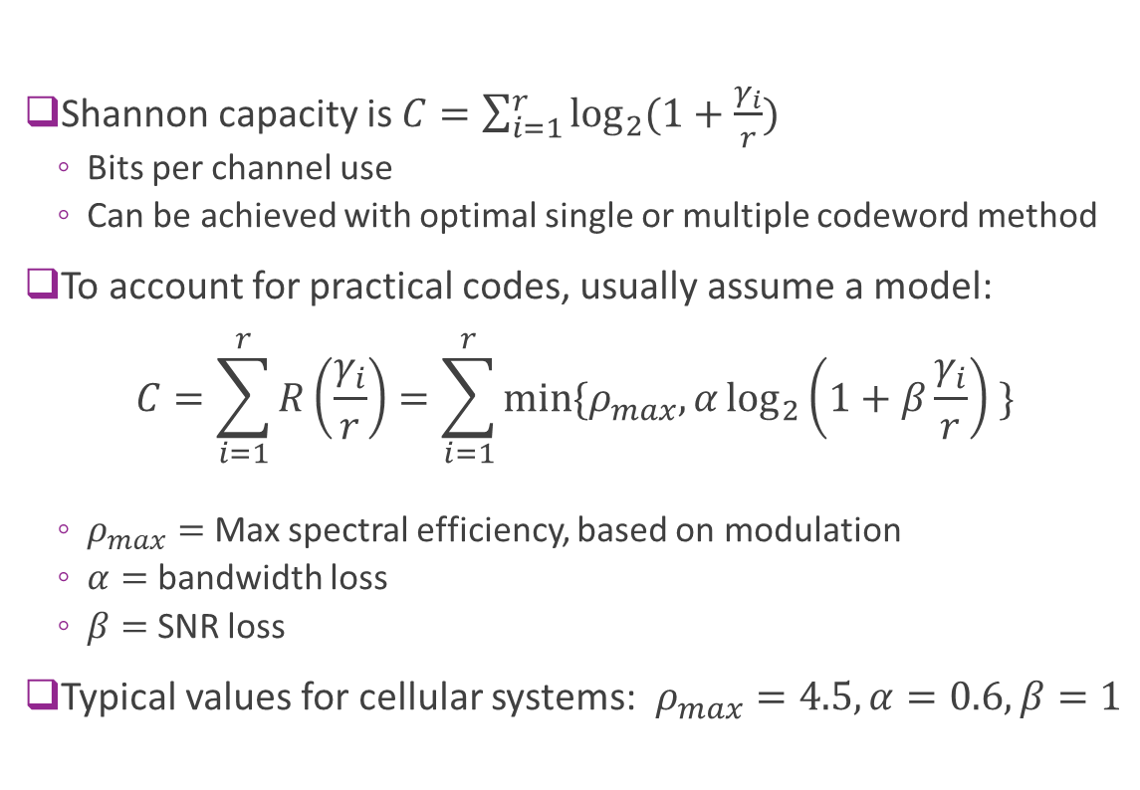


Capacity with Practical Codes
Shannon capacity is $C=\sum_{i=1}^{r}{\log_{2}{(1+\frac{γ_{i}}{r})}}$
Bits per channel use
Can be achieved with optimal single or multiple codeword method
To account for practical codes, usually assume a model: $C=\sum_{i=1}^{r}{R\left(\frac{γ_{i}}{r}\right)}=\sum_{i=1}^{r}{\min{\{ρ_{max},α\log_{2}\left(1+β\frac{γ_{i}}{r}\right) \}}}$
$ρ_{max}=$Max spectral efficiency, based on modulation
$α=$ bandwidth loss
$β=$ SNR loss
Typical values for cellular systems: $ρ_{max}=4.5, α=0.6, β=1$
SNR $γ_{1}$
$$⋮$$
SNR $γ_{r}$

Slide 19
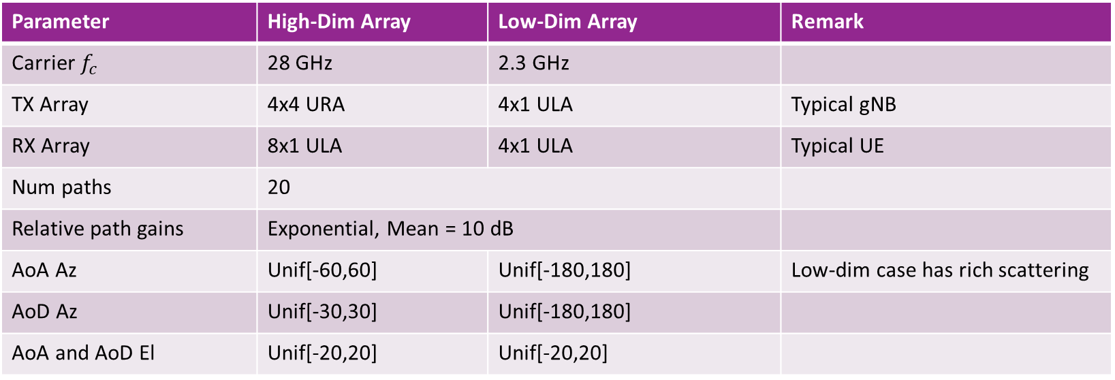
Examples
We will illustrate the calculations in this unit in two cases
Parameter | High-Dim Array | Low-Dim Array | Remark
Carrier $f_{c}$ | 28 GHz | 2.3 GHz
TX Array | 4x4 URA | 4x1 ULA | Typical gNB
RX Array | 8x1 ULA | 4x1 ULA | Typical UE
Num paths | 20
Relative path gains | Exponential, Mean = 10 dB
AoA Az | Unif[-60,60] | Unif[-180,180] | Low-dim case has rich scattering
AoD Az | Unif[-30,30] | Unif[-180,180]
AoA and AoD El | Unif[-20,20] | Unif[-20,20]

Slide 20
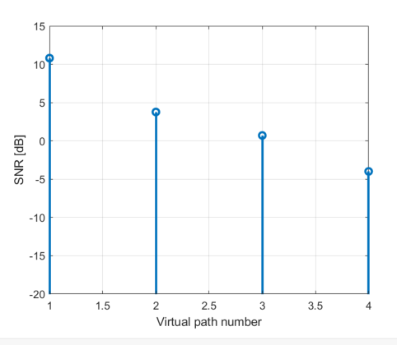
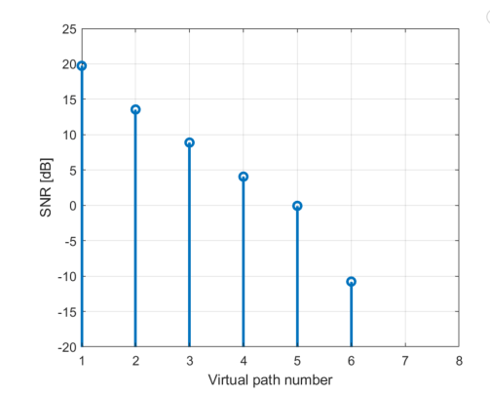
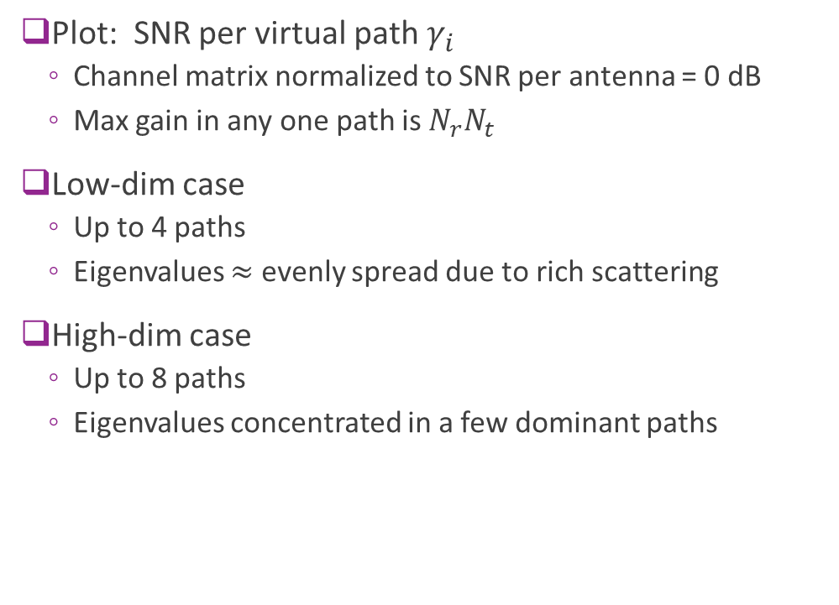
Eigenvalue Distribution
Low-dim array
Plot: SNR per virtual path $γ_{i}$
Channel matrix normalized to SNR per antenna = 0 dB
Max gain in any one path is $N_{r}N_{t}$
Low-dim case
Up to 4 paths
Eigenvalues $≈$ evenly spread due to rich scattering
High-dim case
Up to 8 paths
Eigenvalues concentrated in a few dominant paths
High-dim array

Slide 21
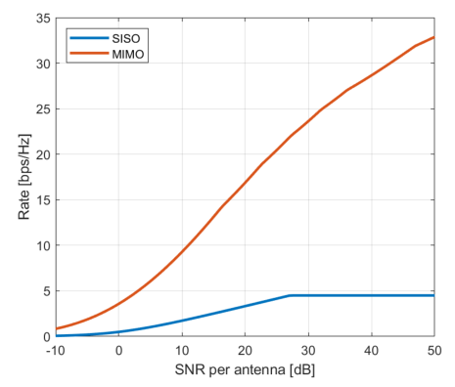
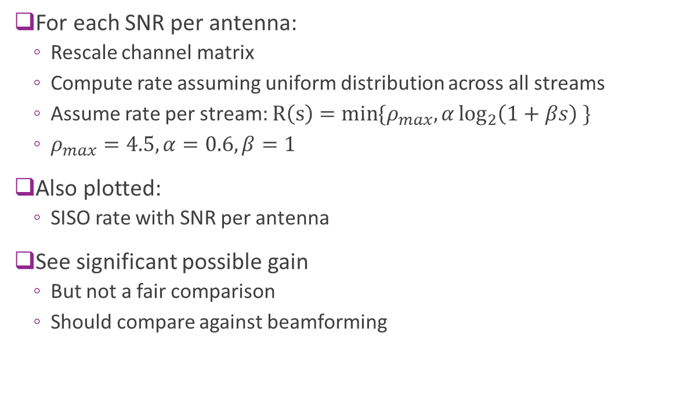
Rate vs SNR
For each SNR per antenna:
Rescale channel matrix
Compute rate assuming uniform distribution across all streams
Assume rate per stream: $R\left(s\right)=\min{\{ρ_{max},α\log_{2}\left(1+βs\right) \}}$
$ρ_{max}=4.5, α=0.6, β=1$
Also plotted:
SISO rate with SNR per antenna
See significant possible gain
But not a fair comparison
Should compare against beamforming
High-dim array

Slide 22
Outline
Spatial Multiplexing with CSI-T and CSI-R
Power Allocation and Rank Selection
Spatial Multiplexing with CSI-R Only
Channel Estimation and CSI-R
CSI-T Feedback and Statistical Pre-Coding

Slide 23








Spatial Multiplexing vs Beamforming
Beamforming:
Places all energy on virtual path with strongest SNR
Achieves rate $R_{BF}=R\left(γ_{1}\right)$
If codes achieve capacity, $R_{BF}=\log_{2}{(1+γ_{1})}$
Spatial multiplexing:
Transmit energy evenly on $r$ virtual paths
$R_{SM}=\sum_{i}{R(\frac{γ_{i}}{r})}= \sum_{i}{\log_{2}{(1+\frac{γ_{i}}{r})}}$
To compare, consider two extreme cases:
Equal SNRs $γ_{i}=γ$ for all $i$
Single dominant SNR $γ_{1}$
SNR $γ_{1}$
$$1$$
SNR $\frac{γ_{1}}{r}$
$$\frac{1}{r}$$
$$⋮$$
$$\frac{1}{r}$$
SNR $\frac{γ_{r}}{r}$

Slide 24
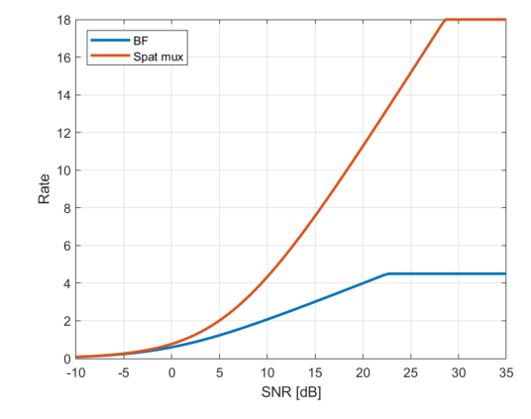
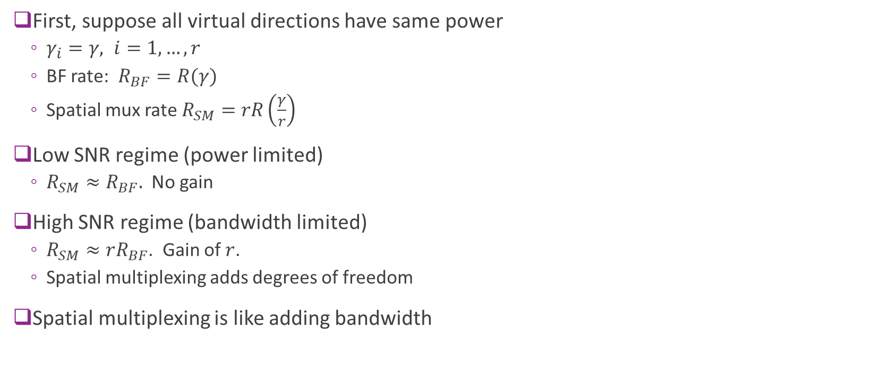

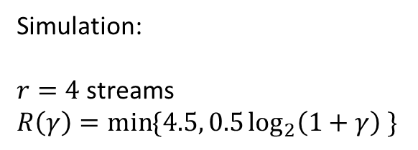
Spatial Multiplexing vs Beamforming Equal SNR streams
First, suppose all virtual directions have same power
$γ_{i}=γ, i=1,…,r$
BF rate: $R_{BF}=R(γ)$
Spatial mux rate $R_{SM}=rR\left(\frac{γ}{r}\right)$
Low SNR regime (power limited)
$R_{SM}≈R_{BF}.$ No gain
High SNR regime (bandwidth limited)
$R_{SM}≈rR_{BF}$. Gain of $r$.
Spatial multiplexing adds degrees of freedom
Spatial multiplexing is like adding bandwidth
$4×$4.5 bps/Hz
4.5 bps/Hz
Simulation:
$r=4$ streams
$R\left(γ\right)=\min{\{4.5, 0.5\log_{2}\left(1+γ\right) }\}$

Slide 25
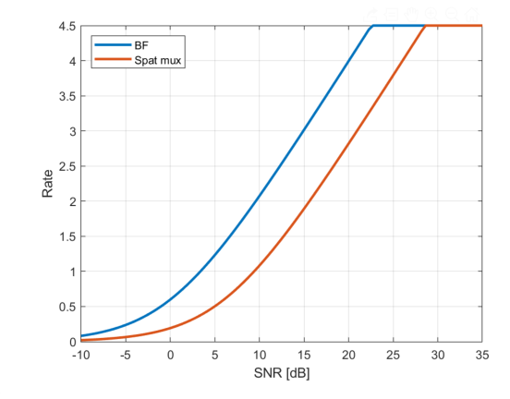
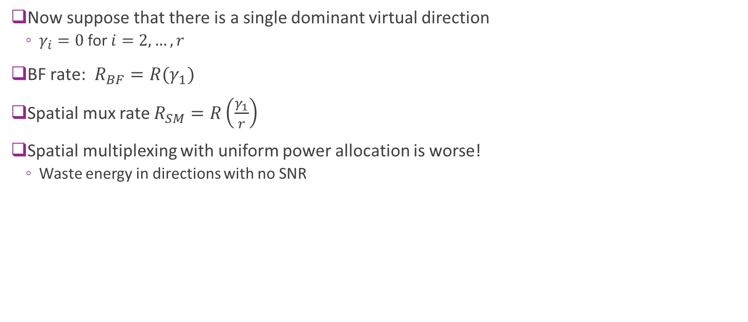
Spatial Multiplexing vs Beamforming Single Dominant Stream
Now suppose that there is a single dominant virtual direction
$γ_{i}=0$ for $i=2,…,r$
BF rate: $R_{BF}=R(γ_{1})$
Spatial mux rate $R_{SM}=R\left(\frac{γ_{1}}{r}\right)$
Spatial multiplexing with uniform power allocation is worse!
Waste energy in directions with no SNR

Slide 26
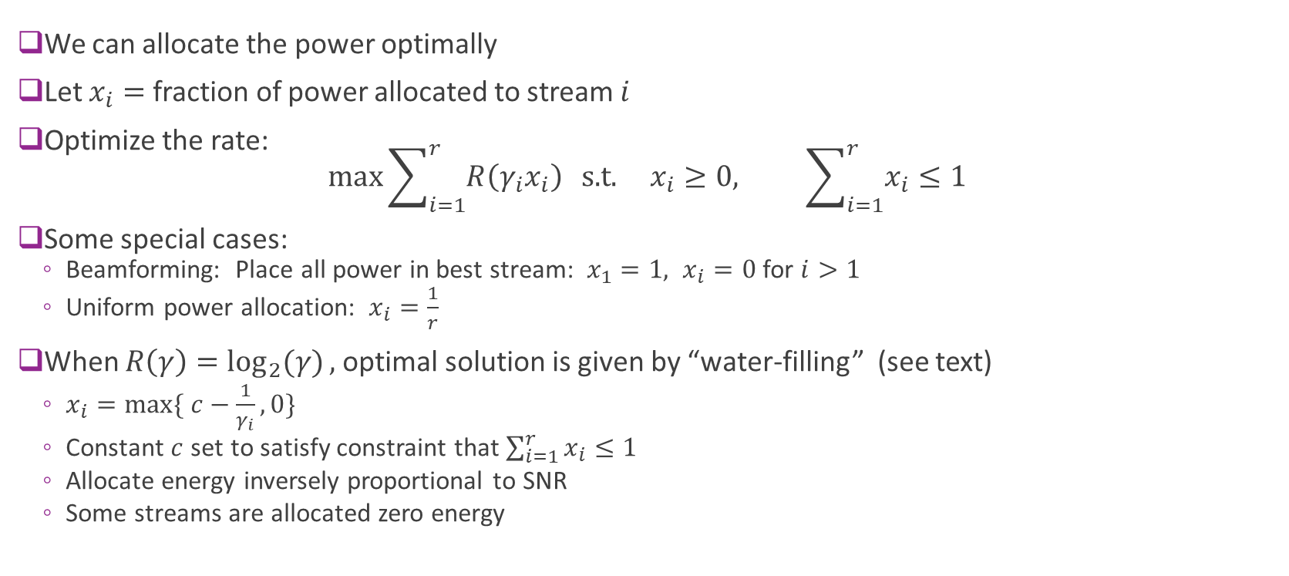
Power Optimization and Water-Filling
We can allocate the power optimally
Let $x_{i}=$ fraction of power allocated to stream $i$
Optimize the rate: $\max{\sum_{i=1}^{r}{R\left(γ_{i}x_{i}\right)}} \text{s}\text{.}\text{t}\text{.} x_{i}≥0, \sum_{i=1}^{r}{x_{i}}≤1$
Some special cases:
Beamforming: Place all power in best stream: $x_{1}=1, x_{i}=0$ for $i>1$
Uniform power allocation: $x_{i}=\frac{1}{r}$
When $R\left(γ\right)=\log_{2}{(γ)},$ optimal solution is given by “water-filling” (see text)
$x_{i}=max⁡\{ c−\frac{1}{γ_{i}}, 0\}$
Constant $c$ set to satisfy constraint that $\sum_{i=1}^{r}{x_{i}}≤1$
Allocate energy inversely proportional to SNR
Some streams are allocated zero energy

Slide 27
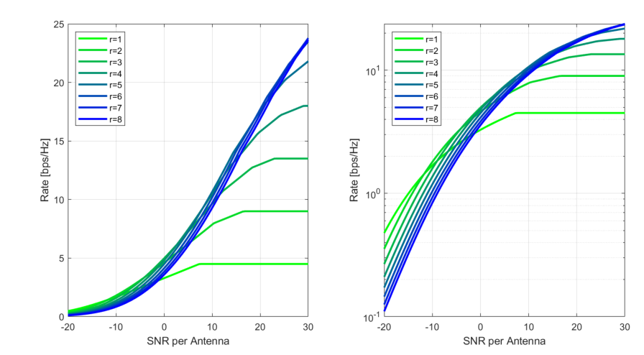

Power Allocation
Consider sub-optimal strategy
Uniformly allocate to top $r$ streams
Plot to the right:
Synthetic channel from before
We see that $r=1$ (BF) optimal at lower SNRs
At higher SNRs, multi-streams become useful

Slide 28
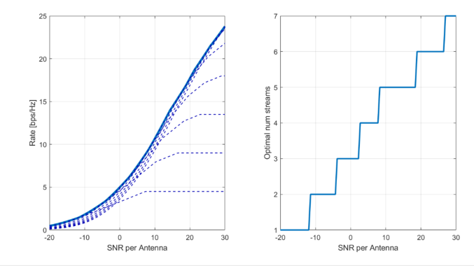

Optimal Rank Selection
Water Filling is difficult for a general rate function
Consider sub-optimal strategy
Uniformly allocate to top $r$ streams
Left plot:
Best rate among all possible ranks
Right plot:
Best rank
We see rank increases with SNR
Optimal rate
Optimal rank

Slide 29
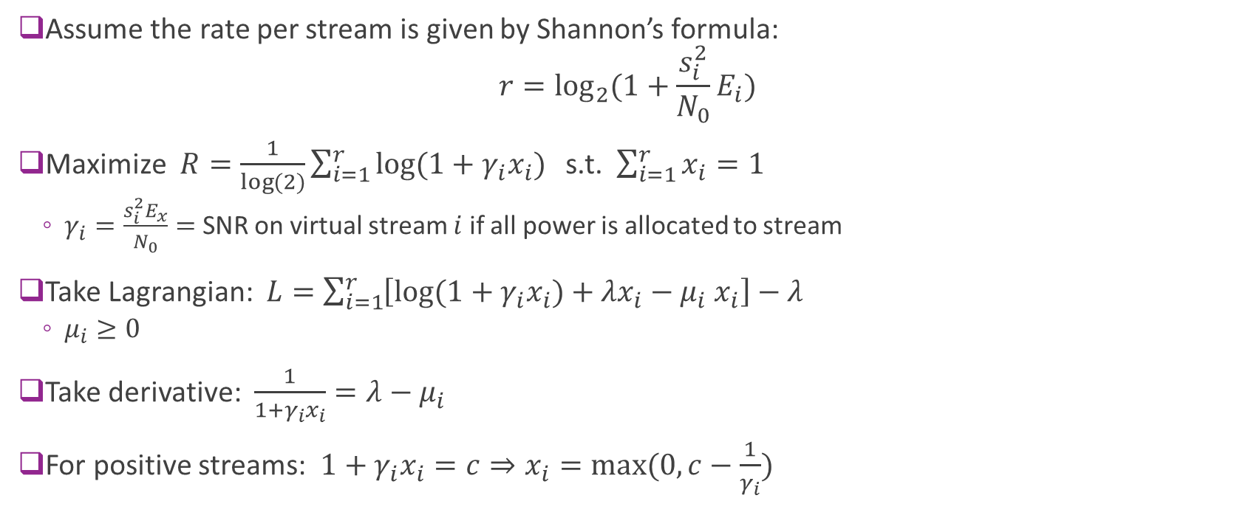
Water-Filling
Assume the rate per stream is given by Shannon’s formula: $r=\log_{2}{(1+\frac{s_{i}^{2}}{N_{0}}E_{i})}$
Maximize $R=\frac{1}{\log{(2)}}\sum_{i=1}^{r}{\log{(1+γ_{i}x_{i})}}$ s.t. $\sum_{i=1}^{r}{x_{i}}=1$
$γ_{i}=\frac{s_{i}^{2}E_{x}}{N_{0}}=$ SNR on virtual stream $i$ if all power is allocated to stream
Take Lagrangian: $L=\sum_{i=1}^{r}{\left[\log{(1+γ_{i}x_{i})}+λx_{i}−μ_{i} x_{i}\right]}−λ$
$μ_{i}≥0$
Take derivative: $\frac{1}{1+γ_{i}x_{i}}=λ−μ_{i}$
For positive streams: $1+γ_{i}x_{i}=c⇒x_{i}=max⁡(0, c−\frac{1}{γ_{i}})$

Slide 30
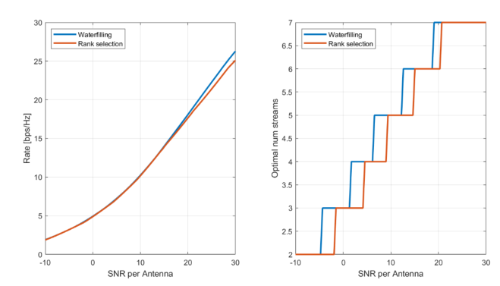
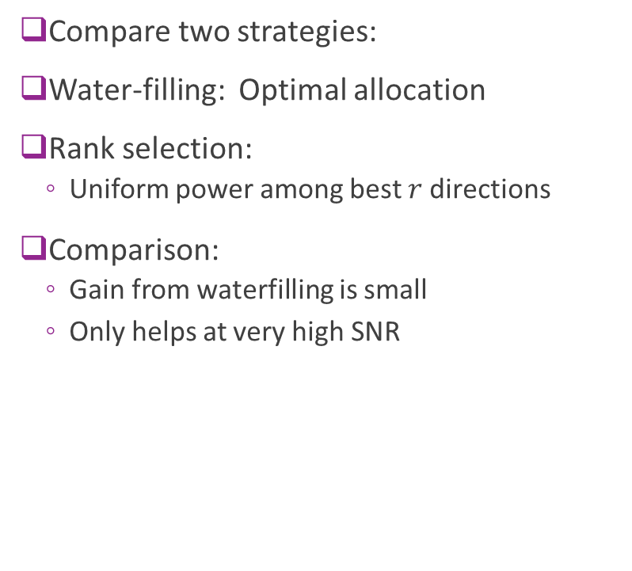
Example: Water-Filling vs Rank Selection
Compare two strategies:
Water-filling: Optimal allocation
Rank selection:
Uniform power among best $r$directions
Comparison:
Gain from waterfilling is small
Only helps at very high SNR

Slide 31
Outline
Spatial Multiplexing with CSI-T and CSI-R
Power Allocation and Rank Selection
Spatial Multiplexing with CSI-R Only
Channel Estimation and CSI-R
CSI-T Feedback and Statistical Pre-Coding

Slide 32
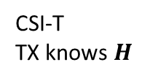


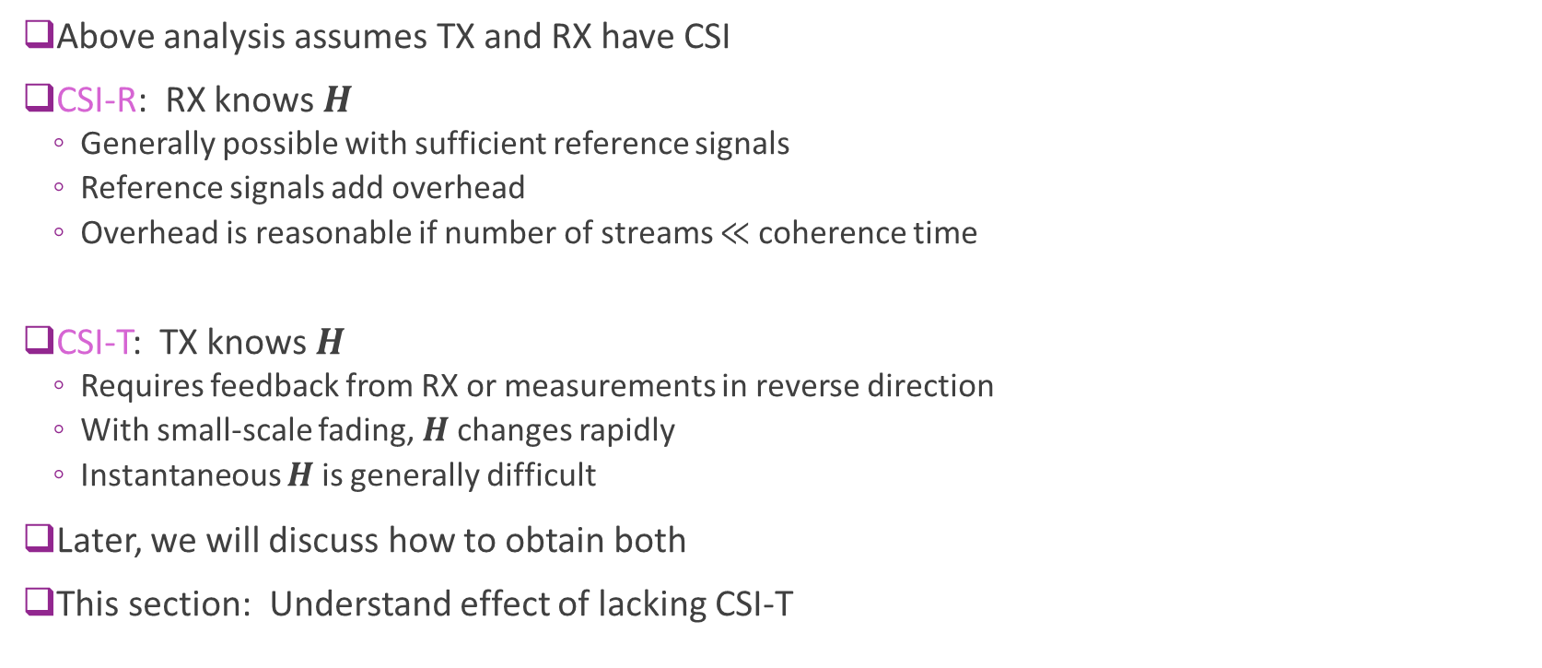


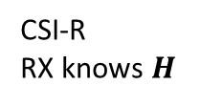
Challenges in Obtaining CSI
Above analysis assumes TX and RX have CSI
CSI-R: RX knows $H$
Generally possible with sufficient reference signals
Reference signals add overhead
Overhead is reasonable if number of streams $≪$coherence time
CSI-T: TX knows $H$
Requires feedback from RX or measurements in reverse direction
With small-scale fading, $H$ changes rapidly
Instantaneous $H$ is generally difficult
Later, we will discuss how to obtain both
This section: Understand effect of lacking CSI-T
$$w$$
$$H$$
$$x$$
$$r$$
CSI-T
TX knows $H$
CSI-R
RX knows $H$

Slide 33
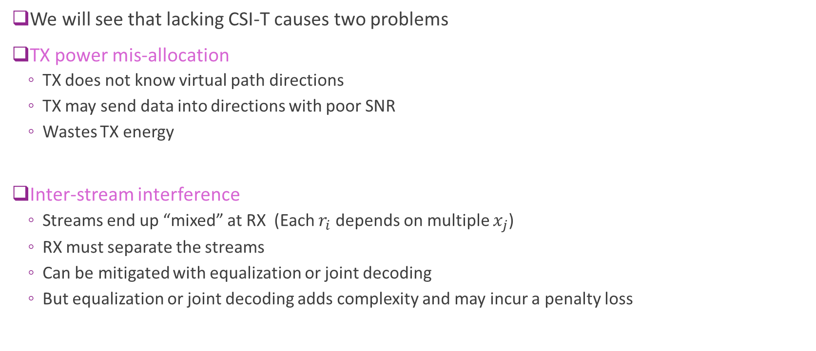
Problems in Lacking CSI-T
We will see that lacking CSI-T causes two problems
TX power mis-allocation
TX does not know virtual path directions
TX may send data into directions with poor SNR
Wastes TX energy
Inter-stream interference
Streams end up “mixed” at RX (Each $r_{i}$ depends on multiple $x_{j}$)
RX must separate the streams
Can be mitigated with equalization or joint decoding
But equalization or joint decoding adds complexity and may incur a penalty loss
$$w$$
$$H$$
$$x$$
$$r$$
CSI-T
TX knows $H$
CSI-R
RX knows $H$

Slide 34
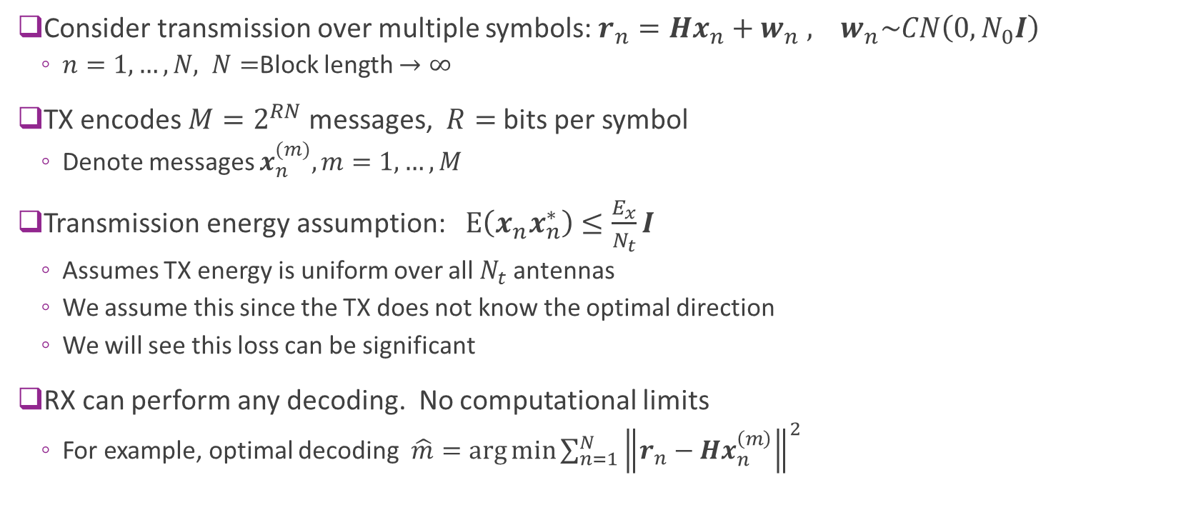
Information Theoretic Formulation
Consider transmission over multiple symbols: $r_{n}=Hx_{n}+w_{n} , w_{n}\sim CN\left(0,N_{0}I\right)$
$n=1,…,N, N=$Block length $→∞$
TX encodes $M=2^{RN}$ messages, $R=$ bits per symbol
Denote messages $x_{n}^{(m)}, m=1,…,M$
Transmission energy assumption: $E\left(x_{n}x_{n}^{∗}\right)≤\frac{E_{x}}{N_{t}}I$
Assumes TX energy is uniform over all $N_{t}$ antennas
We assume this since the TX does not know the optimal direction
We will see this loss can be significant
RX can perform any decoding. No computational limits
For example, optimal decoding $\hat{m}=\arg{\min{\sum_{n=1}^{N}{{\left\|r_{n}−Hx_{n}^{\left(m\right)}\right\|}^{2}}}}$

Slide 35
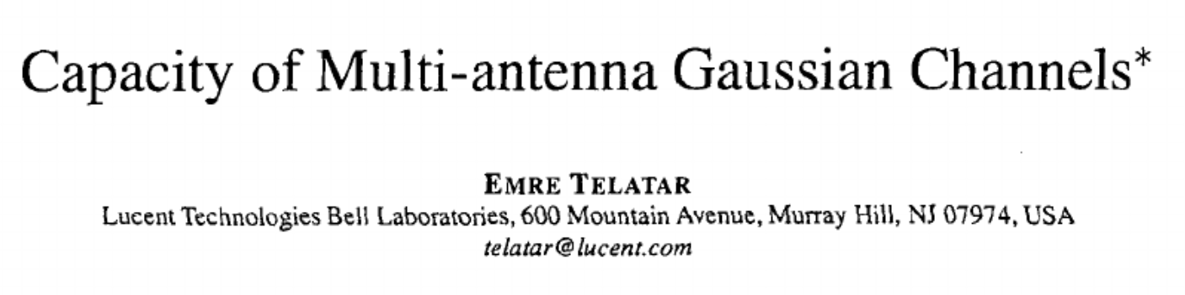
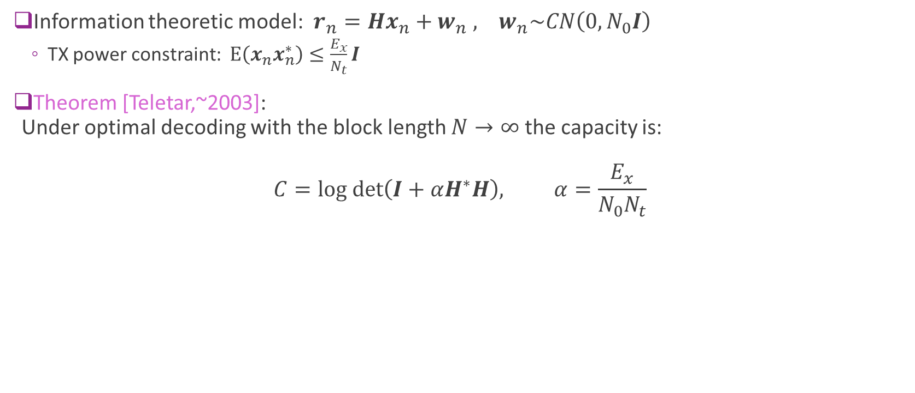
Information Theoretic Capacity
Information theoretic model: $r_{n}=Hx_{n}+w_{n} , w_{n}\sim CN\left(0,N_{0}I\right)$
TX power constraint: $E\left(x_{n}x_{n}^{∗}\right)≤\frac{E_{x}}{N_{t}}I$
Theorem [Teletar,~2003]: Under optimal decoding with the block length $N→∞$ the capacity is: $C=log det\left(I+αH^{∗}H\right), α=\frac{E_{x}}{N_{0}N_{t}}$

Slide 36
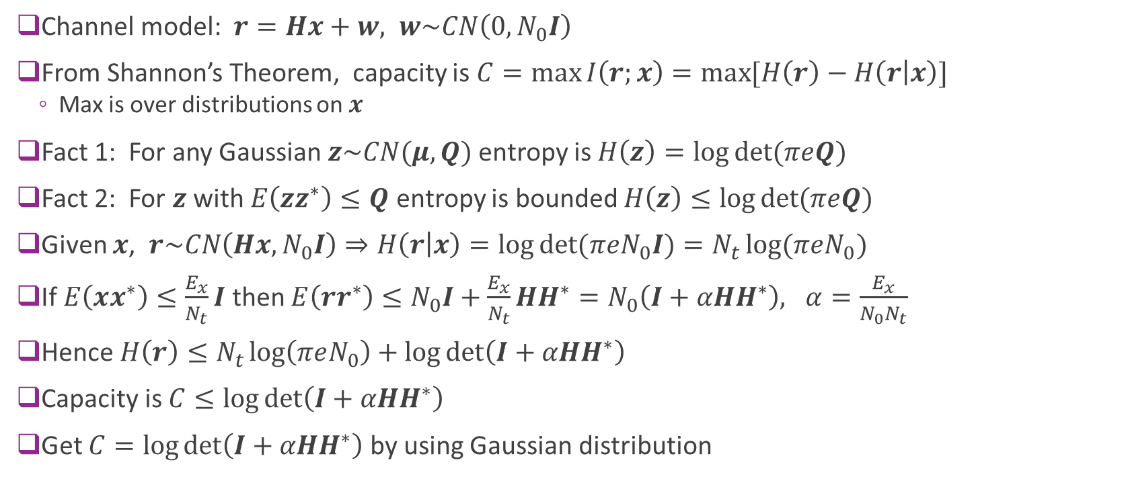
Proof of the Teletar’s Result
Channel model: $r=Hx+w, w\sim CN\left(0,N_{0}I\right)$
From Shannon’s Theorem, capacity is $C=\max{I\left(r;x\right)}=\max{[H\left(r\right)−H\left(r | x\right)]}$
Max is over distributions on $x$
Fact 1: For any Gaussian $z\sim CN(μ,Q)$ entropy is $H\left(z\right)=\log{\det{(πeQ)}}$
Fact 2: For $z$ with $E\left(zz^{∗}\right)≤Q$ entropy is bounded $H\left(z\right)≤\log{\det{(πeQ)}}$
Given $x$, $r\sim CN\left(Hx, N_{0}I\right)⇒H\left(r | x\right)=\log{\det{(πeN_{0}I)}}=N_{t}\log{(πeN_{0})}$
If $E\left(xx^{∗}\right)≤\frac{E_{x}}{N_{t}}I$ then $E\left(rr^{∗}\right)≤N_{0}I+\frac{E_{x}}{N_{t}}HH^{∗}=N_{0}\left(I+αHH^{∗}\right), α=\frac{E_{x}}{N_{0}N_{t}}$
Hence $H\left(r\right)≤N_{t}\log\left(πeN_{0}\right)+\log{\det\left(I+αHH^{∗}\right)}$
Capacity is $C≤\log{\det\left(I+αHH^{∗}\right)}$
Get $C=\log{\det\left(I+αHH^{∗}\right)}$ by using Gaussian distribution

Slide 37

Comparison to CSI-T Case
We saw that if TX allocates energy TX power uniformly on all $r$ virtual directions, capacity is $C=log det\left(I+\frac{γ_{x}}{r}H^{∗}H\right), γ_{x}=\frac{E_{x}}{N_{0}}$
Capacity with TX uniformly on all $N_{t}$ TX antennas is: $C=log det\left(I+\frac{γ_{x}}{N_{t}}H^{∗}H\right)$
Conclusion: With optimal decoding:
Can obtain capacity identical to TX uniformly on $N_{t}$ directions
There is a TX power mis-allocation loss:
Loss of $\frac{r}{N_{t}}$ in SNR when $N_{t}>r$. This is especially large when $N_{t}>N_{r}$
No water-filling. Hence, within the rank $r$ virtual streams, power is not allocated optimally

Slide 38


TX Mis-Allocation Loss Example Low Dimensional Array Case
Simulation:
$N_{t}=4, N_{r}=4$
Random channel with rich scattering
AoA and AoD uniform on $[0,2π]$
TX mis-allocation loss is minimal
With rich scattering and small num antennas:
All directions have good SNR
Uniform power allocation is optimal

Slide 39


TX Mis-Allocation Loss Example High Dimensional Array Case
Simulation from before:
$N_{t}=16, N_{r}=8$
Random channel
Max rank is $r=\min\left(N_{r},N_{t}\right)=8$
At high SNR, the loss is $\frac{r}{N_{t}}=\frac{1}{2}$
At lower SNRs, the loss is larger
Wastes significant energy on poor rank directions

Slide 40

Loss from Inter-Stream Interference
Prior capacity result required optimal decoding:
Search over all possible codewords $\hat{m}=\arg{\min{\sum_{n=1}^{N}{{\left\|r_{n}−Hx_{n}^{\left(m\right)}\right\|}^{2}}}}$
Computationally impossible for even moderate block size
We consider a simple linear equalization scheme:
Linear equalization followed by symbol demodulation and channel decoding
This method introduces a second loss due to inter-stream interference

Slide 41







Linear Equalization Concept
Symbol demod
Channel decoder
$$w$$
Spatial EQ
$$H$$
$$F$$
$$x$$
$$r$$
$$z$$
LLRs
Most practical systems use linear spatial equalization
Perform linear transform $z=Fr$ to approximately invert $H$ and recover $x$
Followed by symbol demodulation on the symbols $z$ to create LLRs
LLRs then used by the channel decoder
In contrast, we call the optimal decoder the joint decoding
Since it jointly performs the symbol demodulation and channel decoding

Slide 42







Linear Zero-Forcing Equalizer
Estimate $x$ via a least-squares optimization $z=\arg{\min_{x}{{\left\|r−Hx\right\|}^{2}}}$
Solution is called the zero-forcing equalizer: $z=F_{ZF}r, F_{ZF}={\left(H^{∗}H\right)}^{−1}H^{∗}$
The reason for the name will be clear later
Note for the inverse to exist we need $N_{r}≥N_{t}$
More specifically, we need $rank\left(H\right)≥N_{t}$
$$w$$
$$H$$
$$F$$
$$x$$
$$r$$
$$z$$

Slide 43

Zero-Forcing Equalizer Analysis
Suppose we use ZF equalizer $z=F_{ZF}r, F_{ZF}={\left(H^{∗}H\right)}^{−1}H^{∗}$
Then channel from $x$ to $z$ is
$z=Fr={\left(H^{∗}H\right)}^{−1}H^{∗}\left(Hx+w\right)=x+d, d={\left(H^{∗}H\right)}^{−1}H^{∗}w$
Creates $N_{t}$ parallel channels
$z_{i}=x_{i}+d_{i}, i=1,…,N_{t}$
Noise covariance matrix is:
$var\left(d\right)={\left(H^{∗}H\right)}^{−1}H^{∗}var\left(w\right)H{\left(H^{∗}H\right)}^{−1}=N_{0}{\left(H^{∗}H\right)}^{−1}H^{∗}H{\left(H^{∗}H\right)}^{−1}=N_{0}{\left(H^{∗}H\right)}^{−1}$
SNR on each channel: Since $E{\left|x_{i}\right|}^{2}=\frac{E_{x}}{N_{t}}$ $γ_{i}^{ZF}=\frac{E_{x}}{N_{t}N_{0}} \frac{1}{Q_{ii}}, Q={\left(H^{∗}H\right)}^{−1}$
$$w$$
$$H$$
$$F$$
$$x$$
$$r$$
$$z$$

Slide 44

Problems with Zero Forcing
SNR on each stream with zero forcing is: $γ_{i}^{ZF}=\frac{E_{x}}{N_{t}N_{0}} \frac{1}{Q_{ii}}, Q={\left(H^{∗}H\right)}^{−1}$
For inverse to exist, requires that $N_{r}≥N_{t}$
Also, when eigenvalues of $H^{∗}H$ are small, $Q$ will blow up
What is the optimal linear transform?

Slide 45

Linear MMSE Equalization
Narrowband channel $r=Hx+w, w\sim CN\left(0,N_{0}I\right),$
Assume
Assume $E\left(xx^{∗}\right)=\frac{E_{x}}{N_{t}}I$ and $E\left(x\right)=0$
TX energy is $\frac{E_{x}}{N_{t}}$ in each antenna
Select $F$ to minimize average error: $E{\left\|x−Fr\right\|}^{2}=E{\left\|x−F(Hx+w)\right\|}^{2}$
Optimal linear estimator from probability theory is $z=Fr, F_{LMMSE}=α{\left(αH^{∗}H+I\right)}^{−1}H^{∗}, α=\frac{E_{x}}{N_{t}N_{0}}$
$$w$$
$$H$$
$$F$$
$$x$$
$$r$$
$$z$$

Slide 46

Linear Equalizer: Interference + Noise
Narrowband channel $r=Hx+w, w\sim CN\left(0,N_{0}I\right),$
Equalized symbols: $z=Fr$
For now, consider general linear equalizer $F$
Hence: $z=FHx+Fw$ and hence, per component $z_{i}={[FH]}_{ii}x_{i}+\sum_{j≠i}{{\left[FH\right]}_{ij}x_{j}}+{\left[Fw\right]}_{i}$
LMMSE receiver: Decode $x_{i}$ from $z_{i}$ treating inter-stream interference as noise
$$w$$
$$H$$
$$F$$
$$x$$
$$r$$
$$z$$
Desired signal
Inter-stream interference
Noise

Slide 47

LMMSE: SINR
From previous slide: $z_{i}={[FH]}_{ii}x_{i}+\sum_{j≠i}{{\left[FH\right]}_{ij}x_{j}}+{\left[Fw\right]}_{i}$
On channel $i$:
Signal energy $E_{sig}={\left|[FH\right]}_{ii}{\left.​\right|}^{2} \frac{E_{x}}{N_{t}}$
Interference energy: $E_{int}=\frac{E_{x}}{N_{t}}\sum_{j≠i}{{|\left[FH\right]}_{ij}{\left.​\right|}^{2}}$
Noise energy: $E_{noise}=N_{0} {\left[F^{∗}F\right]}_{ii}$
SINR on channel $i:$
$γ_{i}^{LMMSE}=\frac{E_{sig}}{E_{noise}+E_{int}}$
$$w$$
$$H$$
$$F$$
$$x$$
$$r$$
$$z$$

Slide 48

LMMSE SINR
Channel $r=Hx+w, w\sim CN\left(0,N_{0}I\right)$ , $E\left(xx^{∗}\right)=\frac{E_{x}}{N_{t}}I$
Consider linear equalizer $z=Fr$
Theorem:
With the LMMSE equalizer, $F=F_{LMMSE}$, SINR per channel is: $γ_{i}^{LMMSE}=\frac{1}{Q_{ii}}−1, Q={\left(αH^{∗}H+I\right)}^{−1}, α=\frac{E_{x}}{N_{0}N_{t}}$
For any other linear transform $F$, $γ_{i}≤\frac{1}{Q_{ii}}−1$
Proof: Follows from long linear algebra.
See text
$$w$$
$$H$$
$$F$$
$$x$$
$$r$$
$$z$$

Slide 49

LMMSE vs. ZF
At high SNR, LMMSE $→$ZF:
Recall $F_{LMMSE}=α{\left(αH^{∗}H+I\right)}^{−1}H^{∗}, α=\frac{E_{x}}{N_{0}N_{t}}$
If $H^{∗}H$ is invertible, as $α→∞, F_{LMMSE}=α{\left(αH^{∗}H+I\right)}^{−1}H^{∗}→{\left(H^{∗}H\right)}^{−1}H^{∗}=F_{ZF}$
For ZF, there is no inter-stream interference:
Recall $z_{i}={[FH]}_{ii}x_{i}+\sum_{j≠i}{{\left[FH\right]}_{ij}x_{j}}+{\left[Fw\right]}_{i}$
With $F_{ZF}H={\left(H^{∗}H\right)}^{−1}H^{∗}H=I$
Thus, ${\left[FH\right]}_{ij}=0$ for $i≠j$
Hence, ZF forces the inter-stream interference to zero. Hence, the name
But ZF amplifies the noise term $Fw$
Linear MMSE optimally trades off noise and inter-stream interference

Slide 50

LMMSE vs. Joint Decoding
We saw that with optimal joint decoding capacity is: $C_{joint}=\log_{2}{\det{(I+αH^{∗}H)}}=−\log_{2}{\det\left(Q\right)}, Q={\left(αH^{∗}H+I\right)}^{−1}$
With LMMSE, capacity is: $C_{LMMSE}=\sum_{i=1}^{N_{t}}{\log_{2}{(1+γ_{i}^{LMMSE})}}=\sum_{i=1}^{N_{t}}{\log_{2}\left(\frac{1}{Q_{ii}}\right)}=−\sum_{i=1}^{N_{t}}{\log_{2}\left(Q_{ii}\right)}$
Fact: $C_{LMMSE}≤C_{joint}$
Proof:
Linear algebra fact: for any matrix $Q≥0$, $\det\left(Q\right)≤\prod_{i}{Q_{ii}}$
This fact follows from a Cholesky factorization $Q=LL^{∗}$
Therefore, $C_{joint}=−\log_{2}{\det\left(Q\right)}≥−\log_{2}{\prod_{i}{Q_{ii}}}=−\sum_{i=1}^{N_{t}}{\log_{2}\left(Q_{ii}\right)}=C_{LMMSE}$

Slide 51

LMMSE Loss: Low-Dim Case
Consider the low-dimensional example
4 x 4 MIMO with rich scattering
See parameters above
At low SNRs:
LMMSE performs close to Joint decoding
LMMSE performs much better than ZF
At high SNRs:
Joint decoding provides a small advantage
Gain of ~2 dB
ZF performs close to LMMSE

Slide 52







LMMSE Loss: High-Dim Case
Next consider the low-dimensional example
$N_{t}=16$ and $N_{r}=8$
See parameters above
Linear equalization requires that $N_{t}>r$
$r=$ channel rank = number of virtual directions with significant SNR
Otherwise, cannot recover $x$
When $N_{t}>r$, we need to perform pre-coding:
Estimate the number, $r,$ of TX streams to use (somehow)
Pre-code $x=Fs$ where $s$ is $r−$dimensional
At the receiver perform decoding on pre-coded channel $G=HF$
$$w$$
$$F$$
$$H$$
$$s$$
$$x$$
$$r$$
Pre-coder

Slide 53


LMMSE Loss: High-Dim Case
We have $N_{t}=16$ and $N_{r}=8$
Hence, some pre-coding is needed to use LMMSE
As an example, suppose we use random pre-coding
Select $r=6$ streams (num of significant evals)
Take a $r$= random orthogonal methods
After random pre-coding:
There is a significant loss.
Even with optimal joint decoding
LMMSE and ZF have further losses
For high-dim arrays, some CSI-T is needed
This is particularly important in mmWave
Need to intelligently select directions

Slide 54
Improving over LMMSE
We see that LMMSE decoding is not optimal
Incurs a penalty due to inter-stream interference
Several possible advanced receivers can be used to reduce inter-stream interference:
LMMSE + SIC:
Successively decode each stream and cancel it out
We describe this next
Turbo / joint decoding methods:
Iteratively perform iterations of the decoder with the LMMSE
Take the soft information of decoder to improve the LMMSE
See text

Slide 55








LMMSE + SIC: Transmitter
Encoders
TX:
Divide data into $N=N_{t}$ streams
Get information bits $b_{1},…,b_{N}$
Encode $N$ codewords
Modulate to create $N$ symbols $x_{1},…,x_{N}$
TX $x_{i}$ on TX antenna $i$
Channel: $r=Hx+w$
Can be written: $r=h_{1}x_{1}+…+h_{N}x_{N}+w$
$$b_{1}$$
$$x_{1}$$
$$⋮$$
$$b_{2}$$
$$x_{2}$$
$$b_{N}$$
$$x_{N}$$

Slide 56





LMMSE + SIC: First Stream
Encoders
LMMSE estimators
Decoders
Decode stream 1:
Perform LMMSE estimate of $x_{1}$ from $r$ to get $z_{1}$
Signal $z_{1}$ will have interference from $x_{2},…, x_{N}$
Treat signals from $x_{2},…,x_{N}$ as noise
Decode bits $b_{1}$ from LMMSE signal $z_{1}$ (symbol demod + decoder)
Cancellation phase
Re-encode estimated bits ${\hat{b}}_{1}$
Subtract out ${\hat{x}}_{1}$ to give $r←r−h_{1}{\hat{x}}_{1}$
If $x_{1}={\hat{x}}_{1},$ $r=h_{2}x_{2}+…+h_{N}x_{N}+w$
Residual signal $r$ has no contribution from $x_{1}!$
$$b_{1}$$
$$x_{1}$$
$$z_{1}$$
$${\hat{b}}_{1}$$
$${\hat{x}}_{1}$$
$$⋮$$
$$−$$
$$b_{2}$$
$$x_{2}$$
$$b_{N}$$
$$x_{N}$$

Slide 57





LMMSE + SIC: Subsequent Streams
Encoders
LMMSE estimators
Decoders
For stream 2:
As stream 1, get LMMSE estimate of $x_{2}$
LMMSE uses residual
Residual $r$ has no contribution from $x_{1}$
Interference is only $x_{3},…, x_{N}$
Treat signals from $x_{3},…,x_{N}$ as noise
Decode bits $b_{2}$, re-encode and subtract
Continue for all $N$ streams
$$b_{1}$$
$$x_{1}$$
$${\hat{b}}_{1}$$
$${\hat{x}}_{1}$$
$$⋮$$
$$−$$
$$b_{2}$$
$$x_{2}$$
$${\hat{b}}_{2}$$
$${\hat{x}}_{2}$$
$$−$$
Re-encoders
$$b_{N}$$
$$x_{N}$$
$${\hat{b}}_{N}$$

Slide 58
LMMSE + SIC Performance
Theorem: The capacity of the LMMSE SIC scheme is equal to optimal joint decoding
Proof: Use linear algebra to estimate SINR in each stream.
With some linear algebra manipulations, you can show you end up at the same capacity
Conclusions: LMMSE + SIC is a practical method to get optimal joint decoding
Computational issues:
Error propagation: If one stream is in error, you cannot subtract
Difficult to merge with H-ARQ.
Need large buffer for symbols. This buffer is the main bottleneck in practical systems
Commercial systems:
Have generally only used LMMSE+SIC on small numbers of antennas
LMMSE without SIC is overwhelmingly dominant implementation method

Slide 59
Outline
Spatial Multiplexing with CSI-T and CSI-R
Power Allocation and Rank Selection
Spatial Multiplexing with CSI-R Only
Channel Estimation and CSI-R
CSI-T Feedback and Statistical Pre-Coding

Slide 60

Obtaining CSI-R
Assume TX has selected a pre-coder $x=Vs$
RX sees channel $r[n]=Hx[n]+w[n]=HVs[n]+w[n]=Gs[n]+w[n]$
Results in a channel matrix $G∈ℂ^{N_{r}×N_{s}}$
$N_{s}$= number of streams
$N_{r}$= number of RX antennas
For CSI-R, RX needs to estimate $G$
RX does not need to know the pre-coder or the true channel!

Slide 61


Reference Signals
Most systems use some form of reference signals
One set of reference signals for each TX stream
Typically allocated on orthogonal resources
Example to right: One sub-frame in LTE
Configuration for 4 TX “ports”
Resource elements $R_{1}$ to $R_{4}$ are the RS for each port
Each port has 2 to 4 REs per resource block
In a RS for stream $k$, we get a measurement: $r=g_{k}x_{k}+w$
Estimate $g_{k}=$ $k−$th column of $G$

Slide 62


Example: 5G NR DM-RS
DM-RS: Demodulation reference signals
Reference signals contained in downlink data
Shown in yellow squares
Multiple layers in 5G:
Each spatial layer is modulated to a “port”
One set of reference signal for each port
Reference signals are different ports are orthogonal
Bottom right: RS for 8 port transmission
Each RS allocated on 12 REs
Each RE shared with 4 other ports
Uses an orthogonal covering code (OCC)

Slide 63

Overhead Issues
Suppose channel is constant over $L=W_{coh}T_{coh}$ symbols
$W_{coh}=$ coherence bandwidth, $T_{coh}=$coherence bandwidth
We need at least one reference symbol per transmitted stream in each coherence block
Overhead is $\frac{N_{RS}}{L}$, $N_{RS}=$ number of RS $≥N_{S}$ = number of streams
Rate will be: $R=(1−\frac{N_{RS}}{L})\sum_{i=1}^{N_{s}}{\log_{2}{(1+\frac{γ_{i}}{N_{S}})}}$
Training loss: $1−\frac{N_{RS}}{L}$
Power loss per stream: $\frac{γ_{i}}{N_{S}}$
Bandwidth increase: Sum over $i$
In general, there is a tradeoff

Slide 64


Information Theoretic Calculation
Hochwald and Hassibi, 2003
Simplified block fading model
Channel is constant over $T$ uses
Allocates RS in each block
With known channel
Increasing num TX streams helps
Without non-coherent channel
Eventually hurts
Spend more energy on training
Less energy on data

Slide 65
Outline
Spatial Multiplexing with CSI-T and CSI-R
Power Allocation and Rank Selection
Spatial Multiplexing with CSI-R Only
Channel Estimation and CSI-R
CSI-T Feedback and Statistical Pre-Coding

Slide 66






Problems in Obtaining CSI-T
Channel state information is asymmetric
Receiver:
Can directly measure the channel
Transmitter:
No direct measurement
We discuss two possible methods:
Precoding matrix feedback
Reverse link reference signal with reciprocity
$$w$$
$$H$$
$$x$$
$$r$$
TX
RX

Slide 67






Pre-coding Feedback
TX
CSI-RS
RX
Feedback method
TX sends CSI reference signals from each antenna
RX measures complex channel matrix
RX computes optimal TX pre-coding matrix $F$
Also determines optimal rank
RX sends TX pre-coder back to TX
Pre-coder Matrix Indicator (PMI)
TX uses pre-coder in transmission
Problem:
Must feedback within time coherence
Many need to send freq-dependent pre-coders
Potentially high overhead for fast varying channels
Estimate $H$
Compute TX pre-coder and rank
PMI $F$
TX pre-codes with $F$
Pre-coded data
RX processing

Slide 68

Statistical Pre-Coding
Consider channel: $H=\sum_{ℓ=1}^{L}{g_{ℓ}e^{iθ_{ℓ}} u_{r}(Ω_{ℓ}^{r})u_{t }^{T}(Ω_{ℓ}^{t})}$
Parameters vary in two different time scales:
Small-scale variations: $θ_{ℓ}$ vary with time and frequency. Difficult to track
Large-scale variations: ${|g}_{ℓ}|$ and $Ω_{ℓ}^{r}$ and $Ω_{ℓ}^{t}$ vary with path gains. Slower varying. Easier to track
Statistical pre-coding concept:
Measure $H$ on many different time and frequencies
Assume $θ$ varies but large-scale parameters are constant
Based TX pre-coding on statistics of $H$
Also called long-term pre-coding
RX array
TX array

Slide 69

TX and RX Spatial Covariance Matrices
Statistical pre-coding is typically based on the spatial covariance matrices
Consider channel: $H(θ)=\sum_{ℓ=1}^{L}{g_{ℓ}e^{iθ_{ℓ}} u_{r}(Ω_{ℓ}^{r})u_{t }^{T}(Ω_{ℓ}^{t})}$
Define TX and RX spatial covariance matrices
$$Q_{tx}=E\left[H{\left(θ\right)}^{∗}H\left(θ\right)\right]∈ℂ^{N_{t}×N_{t}}, Q_{rx}=E\left[H\left(θ\right)H{\left(θ\right)}^{∗}\right]∈ℂ^{N_{r}×N_{r}}$$
Average is over small-scale parameters
If phases are i.i.d. $θ_{ℓ}\sim \text{Unif}[0,2π]$:
$$Q_{tx}=N_{r}\sum_{ℓ=1}^{L}{{\left|g_{ℓ}\right|}^{2}u_{t}(Ω_{ℓ}^{t})u_{t }^{∗}(Ω_{ℓ}^{t})}, Q_{rx}=N_{t}\sum_{ℓ=1}^{L}{{\left|g_{ℓ}\right|}^{2}u_{r}(Ω_{ℓ}^{r})u_{r }^{∗}(Ω_{ℓ}^{r})}$$

Slide 70


Statistical Pre-Coding with $Q_{tx}$
Estimate $Q_{tx}=E\left[H{\left(θ\right)}^{∗}H\left(θ\right)\right]$
Measured over many time and frequency instances
Take eigenvalue decomposition: $Q_{tx}=VΛV^{∗},$ $Λ=diag(λ_{1},…,λ_{N_{t}})$
Assume sorted $λ_{1}≥⋯≥λ_{N_{t}}$
To transmit on $r$ streams:
Take TX pre-coder: $F_{stat}=V[:,1:r]$ corresponding to $r$largest eigenvalues
Use pre-coding $x=V\left[:,1:r\right]s$

Slide 71

Instantaneous vs. Statistical Pre-Coding
Statistical pre-coding:
Select one $F_{stat}∈ℂ^{N_{t}×r}$: Maps $r$ streams to $N_{t}$ antennas
On each channel realization, see channel matrix: $H\left(θ\right)F_{stat}$
Obtain ergodic capacity: $C=E_{θ}\left[\log_{2}{\det{(I+\frac{E_{x}}{N_{0}}}}F_{stat}^{∗}H^{∗}(θ)H\left(θ\right)F_{stat})\right]$
Instantaneous pre-coding:
Can select pre-coder $F(θ)$ for each channel realization
Get ergodic capacity: $C=E_{θ}\left[ \log_{2}{\det{(I+\frac{E_{x}}{N_{0}}}}F^{∗}(θ)H^{∗}(θ)H\left(θ\right)F(θ)\right]$

Slide 72



Example
High-dim array case: $N_{t}=16, N_{r}=8$
Transmission rank $r=4$ and $8$
Instantaneous selects best $r$ directions in each realization. Statistical select $r$ directions from $Q_{tx}$
Uniform power allocation across all $r$
Rank=4
Rank=8

