Slide 1
Summary of Projects
By Tommy Godfrey

Slide 2
C++ Meta Assembler
Brief description: This program takes in 2 text files, one which lets the user define their own Assembly language commands with corresponding machine code, and another which lets them write Assembly programs in their assembler. When the program is executed it produces a third text file, in cedar logic format, containing machine code.
It was designed with a specific virtual CPU in mind, one I made in CEDAR logic, so that I could write working assembly programs for it. It makes use of directives such as EQU, ORG and has working labels and offsets.
Skills learned:
-Object oriented programming -Source control
-File handling -Assembly
-Debugging

Slide 3
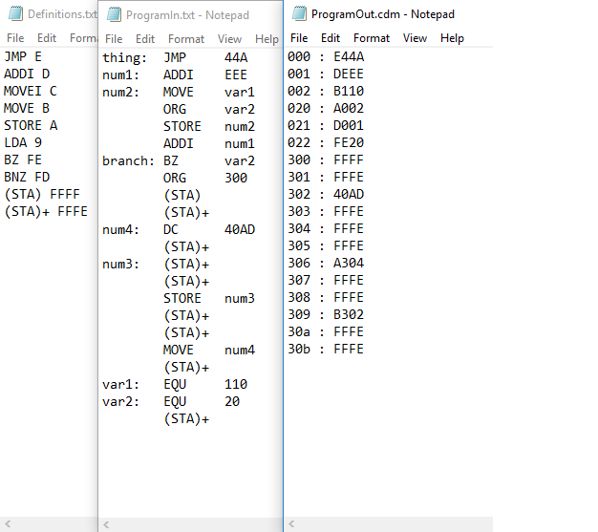
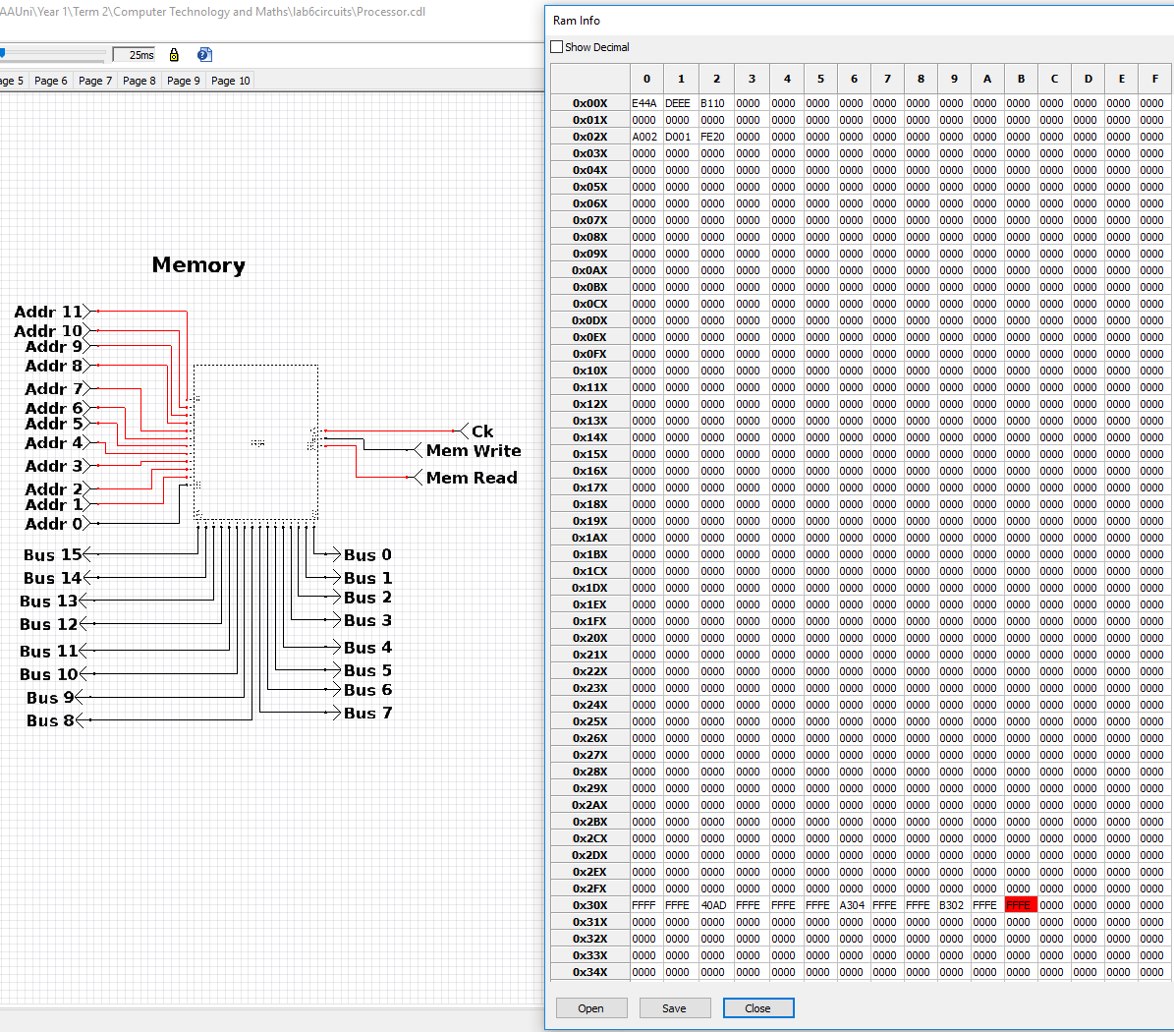
C++ Meta Assembler

Slide 4
Python Hacking minigame
Brief description: My first major programming project of the year was a small hacking minigame that was intended to resemble the Fallout franchise’s hacking minigame. It was made in Python and would output the game to the console, which is where it took user input. The word pool was in the form of a word document that could be edited, it handles user error, and the game would keep a record of the user’s win streak.
Skills learned:
-User input -Error handling
-Basic game systems
-File handling
-Functions

Slide 5
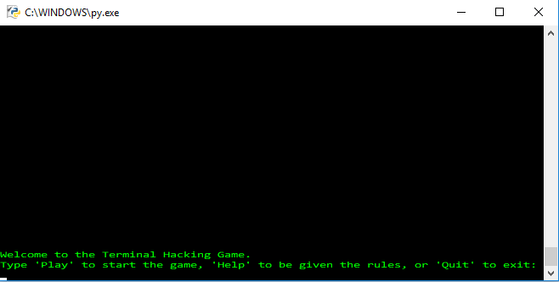
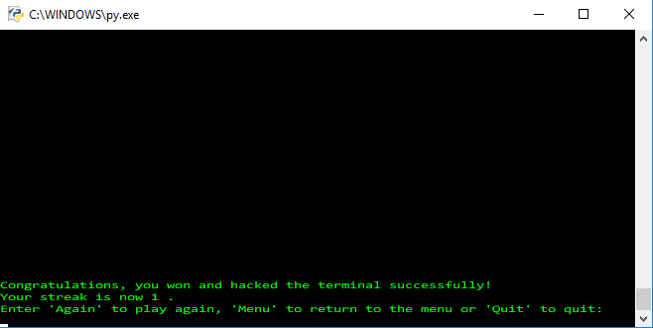
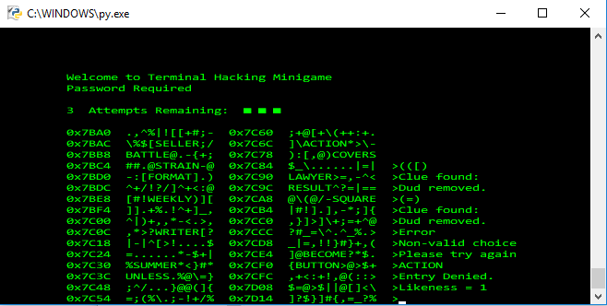
Python Hacking minigame

