Slide 1
CPU-GPU Programming: Performance Portability on Modern HPC Platforms
Thomas Gorham
Computer Science & Engineering Department
University of Tennessee at Chattanooga
Spring 2022
Notes:
Hello and welcome.
My name is Thomas Gorham and this is my final research project for advanced computer networks a hybrid programming model for exascale called mpi + x

Slide 2
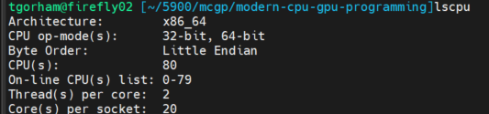
Why we are here today
The Purpose of this work was to create a useful code base and wiki page of programming expertise on heterogeneous (CPU+GPU) architectures by utilizing Kokkos on a manycore node with attached GPU accelerators.
Built on Firefly 02 with Cuda 11.3, GCC 10.2, and CMake 3.19.4
Have also built on TS and locally
Firefly02 Specs

Slide 3
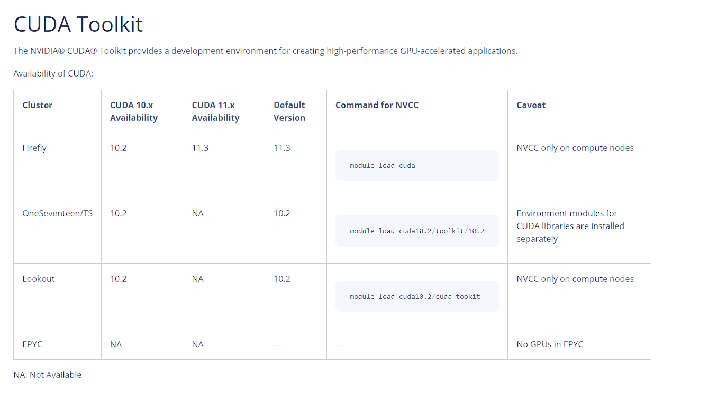
*Quick Aside: No GPUs on Epyc

Slide 4
Why we are here today
The Goal is to show you how Kokkos simplifies the challenges of programming heterogeneous architectures with abstractions that optimize data storage and parallel execution, and how different programming model backends can be set at compile time for maximum portability
Controlling Kokkos Execution Spaces and Memory Spaces at Compile Time vs in the Code
An execution space is the place and way to run the code
Kokkos::Serial, Kokkos::OpenMP, Kokkos::Threads, Kokkos::Cuda, Kokkos::Hip, etc...
A memory space is where the data is stored
Kokkos::HostSpace, Kokkos::CudaSpace, Kokkos::CudaUVMSpace, Kokkos::HIPSpace, etc...

Slide 5
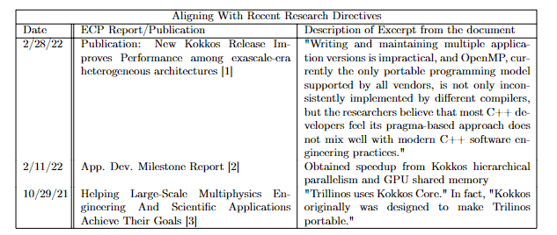
Why we are here today
The Significance of this work is rooted in its alignment with current research regarding heterogeneous computing for performance portability.

Slide 6
HPC Background
"High Performance Computing" (HPC) most generally refers to the practice of aggregating computing power in a way that delivers much higher performance in order to efficiently solve massive computational problems
"if one computer can solve a problem, 5000 computers can solve it even faster"
-Tim Carrol Director, HPC & AI for Research at Microsoft
more compute resources = more computational power = the ability to solve problems faster
HPC enables us to solve difficult problems across many scientific fields that were once considered
"out of reach".
One example of a problem that we have solved thanks to developments in HPC was decoding the Human Genome [5]

Slide 7
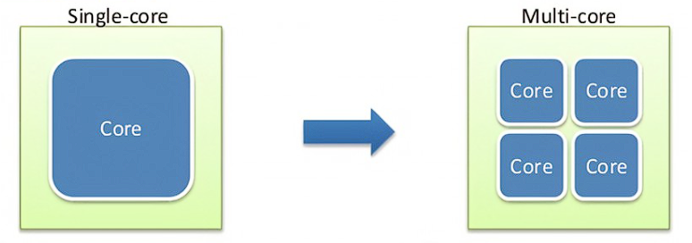
How are these Problems solved?
Up until the early 2000s:
smaller transistors = faster processors = increased power consumption = solve problems faster
Around 2005:
MultiCore Processors
core = a distinct execution unit of a CPU with its own instruction stream

Slide 8
How are these Problems solved?
Caveat: adding more CPU processors did not magically improve the performance of the vast majority of serial programs. For instance,
Instead, exploiting the increased power of multiple processors on a single chip for increased performance required parallelism.

Slide 9
How are these Problems solved?
parallel computing is the simultaneous use of multiple compute resources to solve a computational problem.
1) Break the computational problem into discrete parts that can be solved concurrently
2) Reduce each part of the problem further into a series of instructions
3) Execute the instructions from each part simultaneously on multiple cores/CPUs

Slide 10
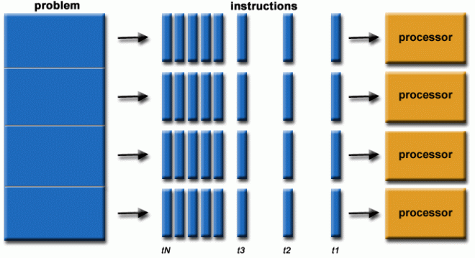
How are these Problems solved?
Example: C:\Users\TM\pi.c
Example2: C:\Users\TM\pipar.c
Wiki link

Slide 11
How are these Problems solved?
In previous example, we used OpenMP, an API for writing multithreaded applications.
1 -> 2 threads
Kokkos is a shared memory programming model
Shared memory machines are computers that are composed of multiple processing elements that share an address space. These are further divided into two classes
The class that is relevant today is:
Non Uniform address space multiprocessor (NUMA): different memory regions have different access costs … think of memory segmented into “Near” and “Far” memory

Slide 12
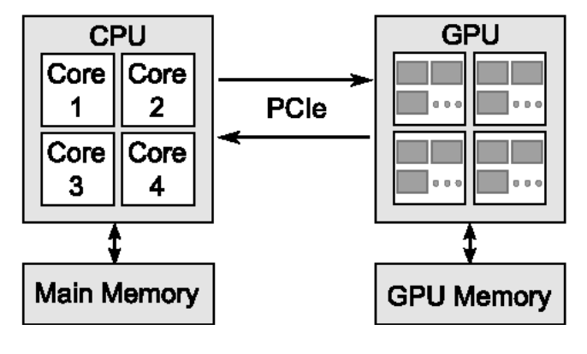
Heterogeneous Architectures
Machines that contain at least one accelerator, such as Sierra or Summit are considered to have heterogenous (CPU-GPU) architectures, in that they contain different types of computational units. Heterogeneous memory systems provide the potential benefit of significantly increasing system performance and reducing power consumption at the cost of complexity in their architectures.

Slide 13
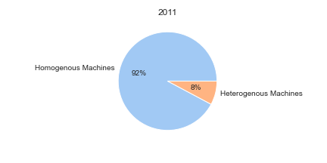
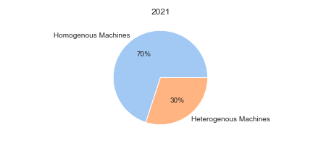
The number of these machines is increasing rapidly

Slide 14
Heterogeneity
Hardware: CPUs, GPUs, FPGA
Increasing complexity of modern machines such as multiple GPU accelerators
Software: Compilers, Operating Systems, Libraries
How can we get applications to target underlying hardware given the reality of diverse complexity in modern systems?

Slide 15
Heterogeneity Challenges
Challenge 1: optimizing data access patterns in CPU-GPU environments.
This is because these devices store data quite differently, and the data structure layouts in GPU memory often lead to sub-optimal performance for programs designed with a CPU memory interface. In other words, application performance is highly sensitive to irregularity in memory access pattern

Slide 16
Heterogeneity Challenges
Challenge 2: Portability
This derives from lack of uniformity
its not quite clear how performance portable a program written for an AMD-based machine will be to another (e.g., an Intel-based machine).
What is clear is that if you are use the standard programming model for a heterogenous NVIDIA-based machine and you want to run on an AMD-based machine, you will need to change to AMD's supported programming model

Slide 17
Challenge 2 cont
Changing programming models to run on different machines requires code to be rewritten per the specifications of the machine's respective programming model. Ultimately, this becomes a particular problem for large-scale HPC applications that on average consist of 300,000 - 600,000 lines of code. In other words, rewriting code is expensive.

Slide 18
Existing Solutions
Programming models for shared/distributed memory
Make programmers learn openmp, OpenACC, OpenCV, pthreads, TBB, Cilk++, MPI, UPC, Fortran,
What if instead we could just write one solution in C++ and change our target at compile time?

Slide 19
Solving These Challenges With Kokkos
Programming two execution targets (the CPU and the GPU) require a set of mechanisms for performance portability across the range of potential and final system designs. Kokkos is a shared memory programming model that emphasizes performance portability accross all modern HPC architectures. The Kokkos API allows developers to express parallelism that is able to compile and execute
In Serial on the CPU
In Parallel on the CPU
In Parallel on the CPU and GPU
regardless of the manufacturer of either chip. Thus, this removes the need to refactor the source code itself, and enables HPC applications to run on theoretically any HPC machine.
tommygorham/modern-cpu-gpu-programming: Wiki page and code base to support my final project and paper with regards to a MS in Computer Science at the University of Tennessee at Chattanooga. (github.com)
Architecture Specific Optimizaitons · tommygorham/modern-cpu-gpu-programming Wiki (github.com)

Slide 20
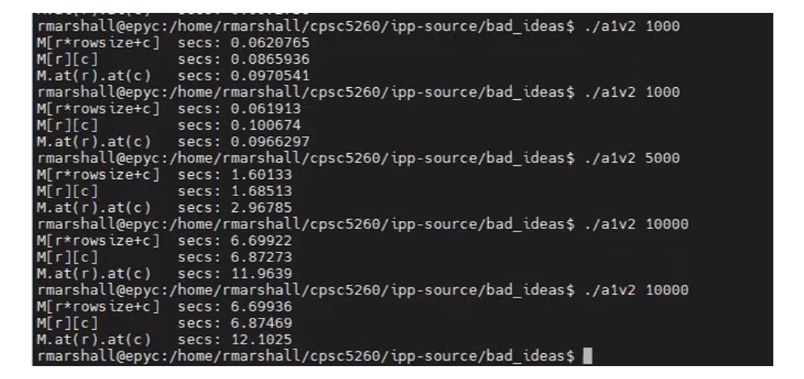
Optimize memory Access in C
From a parallel computing class I took under Mr. Ryan Marshall, we had experimented with matrices access time in C, and we found that one-dimensional row-major access was the fastest. Below is an image from his in-class experimentation.

Slide 21
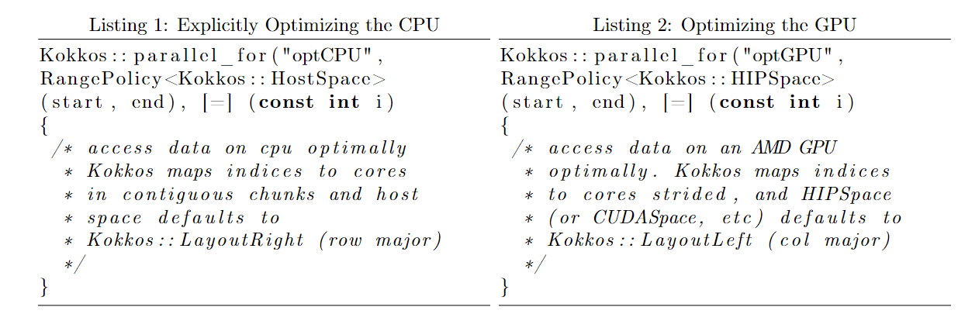
Optimize memory access in Kokkos
Can control where memory lives and executes 1 of 2 ways
1) Compile time parameters and which set the default execution/memory spaces
2) Hard set in the Code as shown below in the code, beginning with Program 1. The code snippet below shows how these spaces can be explicitly controlled to set optimal access for the CPU or the GPU from within the source code

Slide 22
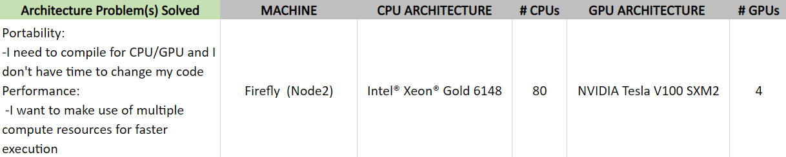
HPC Program One: Matrix-Vector Multiplication
Algorithm: Matrix-Vector Multiplication
Formal Equation: y_{m} = A_{mn} x_{n}
Initial m,n: 10,000
Solution Size of y: 100,000
Link to results Program 1,2,4 here
Link to results for Program 3 here

Slide 23
Question: How can I reproduce this on my cluster?
Write one solution and make compile time changes for the compute resource you want to leverage
Compile and run for CPU
Compile and run for GPU
Cmake Build Commands
-DCMAKE_INSTALL_PREFIX = <path-to-kokkos-install>
-DCMAKE_CXX_COMPILER = <path-to-c++_compiler>
Cmake Build Commands
-DCMAKE_INSTALL_PREFIX = <path-to-kokkos-install>
-DCMAKE_CXX_COMPILER = <path-to-nvcc_compiler>
-DKokkos_ENABLE_HIP=ON

Slide 24
Most Notable Takeaways
Link to page 6

Slide 25
References
[1] ECP "New Kokkos Release Improves Performance Portability Among Exascale-era Heterogeneous Architectures
[2] ECP "2021 Application Development Milestone Report"
[3] ECP "Helping Large-scale Multiphysics Engineering and Scientific Applications Achieve Their Goals
[4] ECP "ECP Software Technology Capability Assessment Report Public"
[5] National Library of Medicine "Deconding the Human Genome"
[6] BIOWULF High Performance Computing At The NIH "Scientific Applications on NIH HPC Systems"
[7] Science Direct "Programming languages for data-Intensive HPC applications: A systematic mapping study”
[8] International Journal of Innovative Science and Research Technology "Programming Language for Data Intensive HPC Applications: Applications and its Relevance"

