Slide 1
Text summarizer Natural language processing
By: Tommy Granström

Slide 2

Introduction
Every day there is a lot of articles are published
Time consuming to read all of them
Inspired by the app ”Inshort news” and an article by Joshi Prateek
Develop a text summarizer
Flexible, different types of texts and languages

Slide 3

Data collection
Dataset with texts and corresponding summaries from ”inshort news”
Ability to create summary in other languages
Two Swedish texts from Wikipedia
Three German Articles
Stop words dataset from Nltk library

Slide 4

Modeling - Approach
Abstract and Extractive
Abstract
“Predict” the summary
Complex and limited
Extractive
Extracts parts from text to summarize
Not so complex and more flexible

Slide 5
Modeling – Extractive approach
Implemented using python
Divide the given text by sentences
Preprocessing of the data
Create a numerical vector representation for all sentences

Slide 6
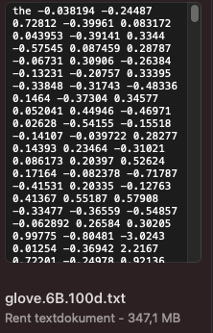
Modeling – Numerical vector representation
Example uses dictionary with predefined numerical vector representation for English words
I Used the TFIDF score to create numerical vector representation
Not limited to English
Don't need to load 400000 rows of data

Slide 7
Modeling – Extractive approach
Rank the sentences
Cosine similarity
Similarity matrix
Dense graph
Create the summary, based on the top ranked sentences

Slide 8

Evaluation
User evaluation
Three articles from dataset to compare with Inshort news
Two Swedish texts from Wikipedia
Grade each summary with a score 1-5
Three articles in German

Slide 9
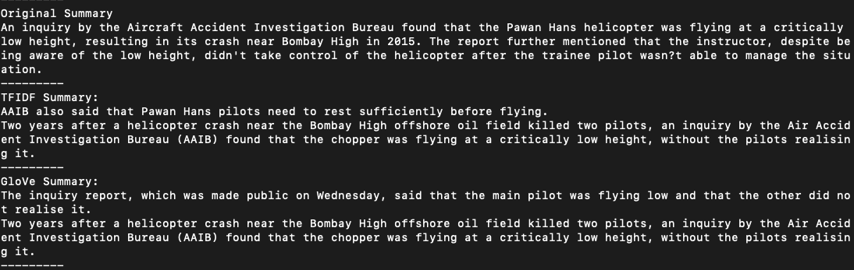
Evaluation Results

Slide 10
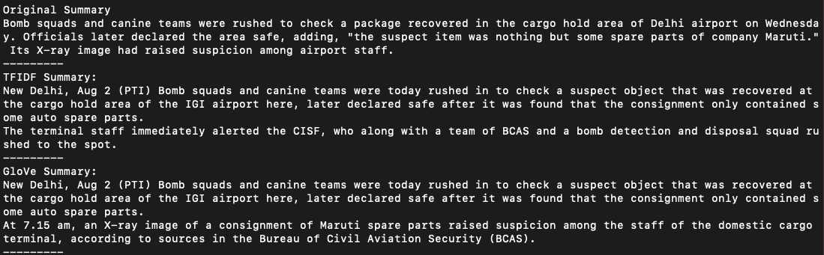
Evaluation Results

Slide 11
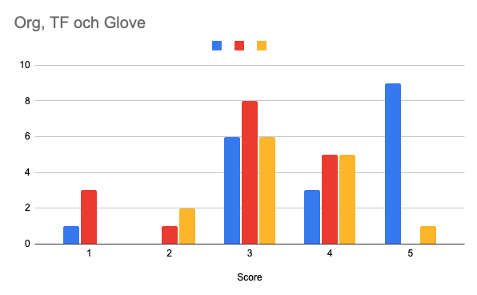
Evaluation Results
Score for Swedish texts: 3.1428… = ~3
German articles, contained fundamental information but incorrect grammar.

Slide 12
Conclusion
The text summarizer does work
Can result in odd sentences, grammar will not always be correct (50/50)
Information in the summary, corresponds to the fundamental information in the text

Slide 13
Thank you for listening!
Any questions?

