Slide 1
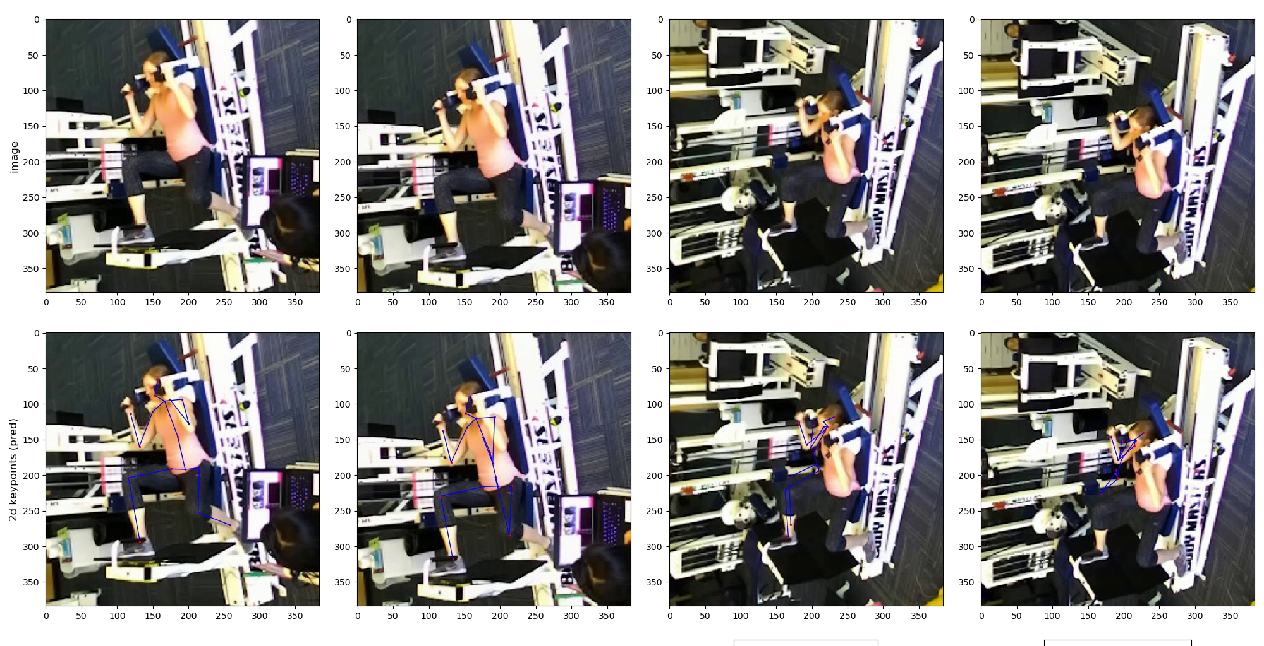
0_Original

Slide 2
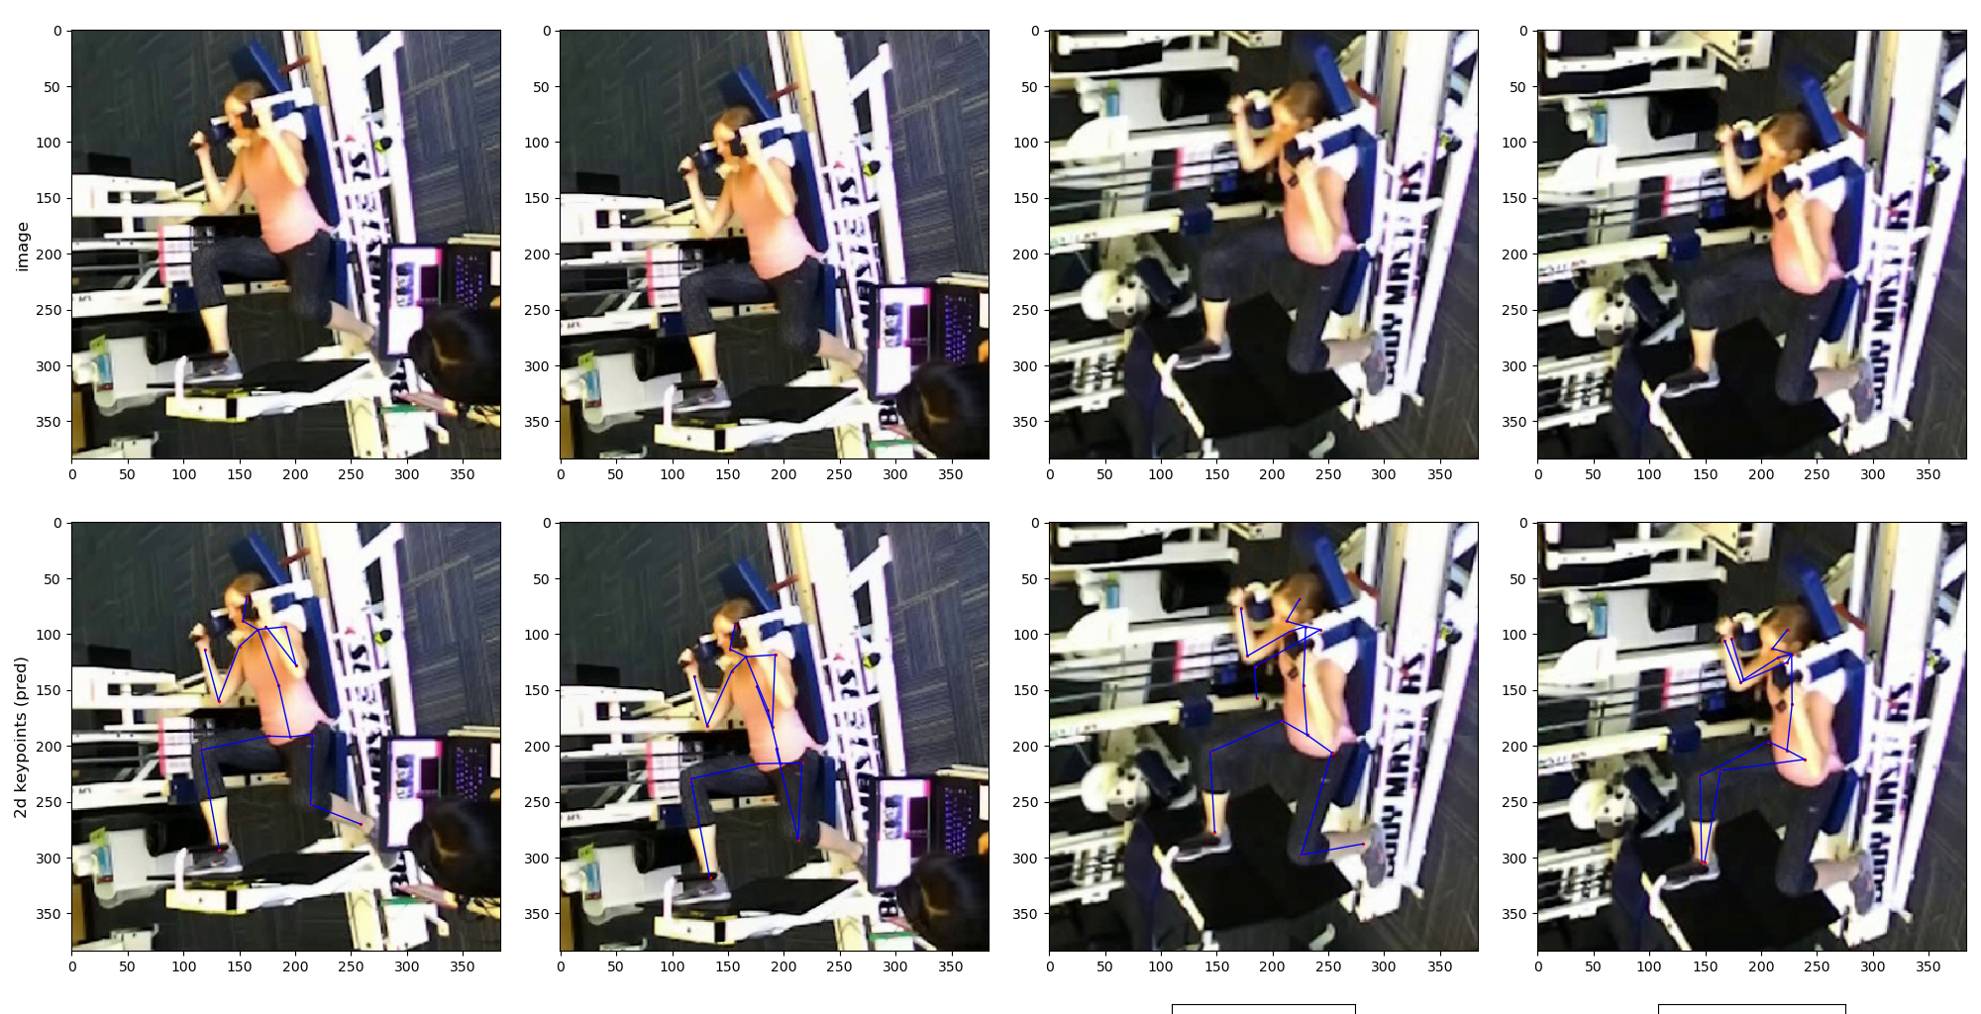
1_fixed_bounding_box
Original cam1_bbox [[475 150 859 534]]
Original cam2_bbox [[475 150 859 534]]
Original cam3_bbox [[475 150 859 534]]
Original cam4_bbox [[475 150 859 534]]
New cam1_bbox [[475 150 859 534]]
New cam2_bbox [[475 150 859 534]]
New cam3_bbox [[575 200 809 504]]
New cam4_bbox [[575 200 809 504]]

Slide 3
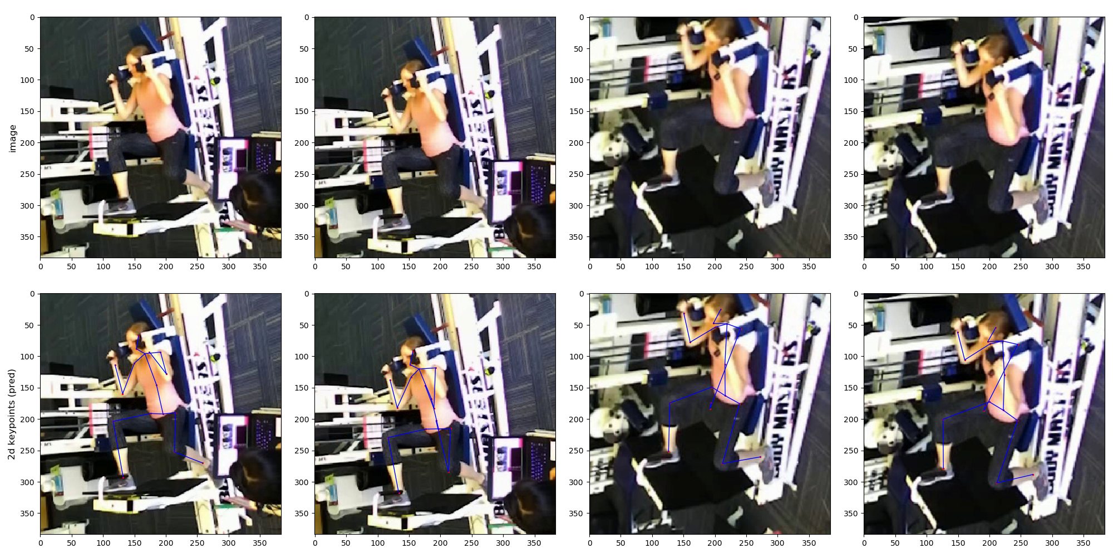
2_fixed_bounding_box
Original cam1_bbox [[475 150 859 534]]
Original cam2_bbox [[475 150 859 534]]
Original cam3_bbox [[475 150 859 534]]
Original cam4_bbox [[475 150 859 534]]
New cam1_bbox [[475 150 859 534]]
New cam2_bbox [[475 150 859 534]]
New cam3_bbox [[625 225 809 504]]
New cam4_bbox [[625 225 809 504]]

