Slide 1
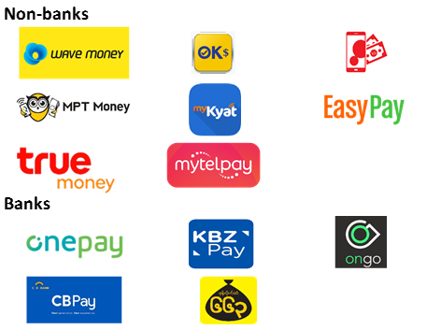

Proposal to promote Ewallet payment among Myanmar supermarket customers

Slide 2
Contents
Introduction
Business Scenario
Insights and Findings
Proposals
Q & A
References

Slide 3
Introduction
Target audience:
Bosses and stakeholders of the supermarket.
Data Source:
Downloaded from Kaggle.
Myanmar Supermarket sales data of 1000 records over a 3 month period.
Data Preparation:
The dataset was relatively clean, some of the dates were not in the correct format and had to be adjusted.

Slide 4
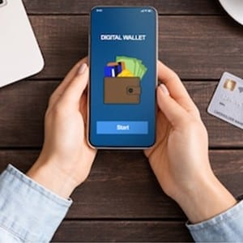
Business Scenario
There are 3 types of payment used by customers:
Cash, Credit Card, and Ewallet
Proposal to increase Ewallet digital payment among supermarket customers.
Benefits of using Ewallet payment:
Less handling of physical cash – savings in manpower
More accuracy and security, also faster accounting
Credit card payment is less desired
- Need to pay bank charge, possible credit card fraud
We will look at the dataset to understand the trends of Ewallet and from them suggest proposals.

Slide 6

Insights and Findings
The proportion of cash, credit card, and Ewallet payment is almost equal at nearly one-third for each.
There is a higher adoption rate of Ewallet payment in Yangon compared to Mandalay and Naypyitaw.
Ewallet is more actually popular among normal customers compared with member customers.
Ewallet is less popular among female customers.
Ewallet is the payment of choice for fashion accessories, health & beauty, and home & lifestyle. Less so for electronics, food & beverages, and sports & travel.

Slide 7

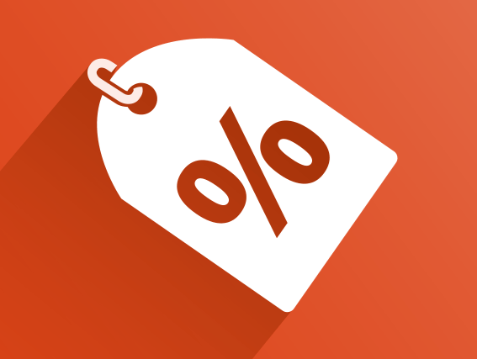
Proposals to promote Ewallet payment
Introduction of promotions for payment by Ewallet.
Discounts, special offers and/or lucky draw participation.
Introduce further incentives for Ewallet payment for customers who sign up for membership.
Members can accumulate more points per purchase if they pay by Ewallet, points which can be redeemed for further discounts or free gifts.
Special outreach program towards female customers to encourage them to use Ewallet payment.
Additional attention to be paid to the implementation of such promotions in Mandalay and Naypyitaw as Ewallet is not as popular in these two cities compared with Yangon.

Slide 8
Q & A

Slide 9
Reference
https://www.kaggle.com/aungpyaeap/supermarket-sales

