Slide 1
Suicide rates and trends in Singapore

Slide 2
Contents
CONTENTS
Introduction
Scenario
Terminology
Dashboard
Insights and findings
Further Comments
References

Slide 3



Introduction
Target audience
Schools, hospitals, government agencies, community support groups (eg. SOS, Please Stay, Caring for Life)

Slide 4
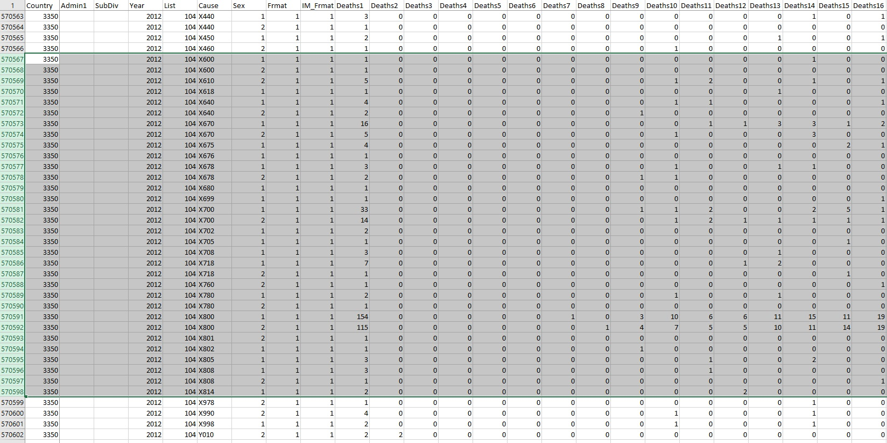
Data Source
Suicide figures from WHO
In some csv files, some of the zero values were empty spaces (NULL values).
Specific codes for suicides
Code for Singapore

Slide 5
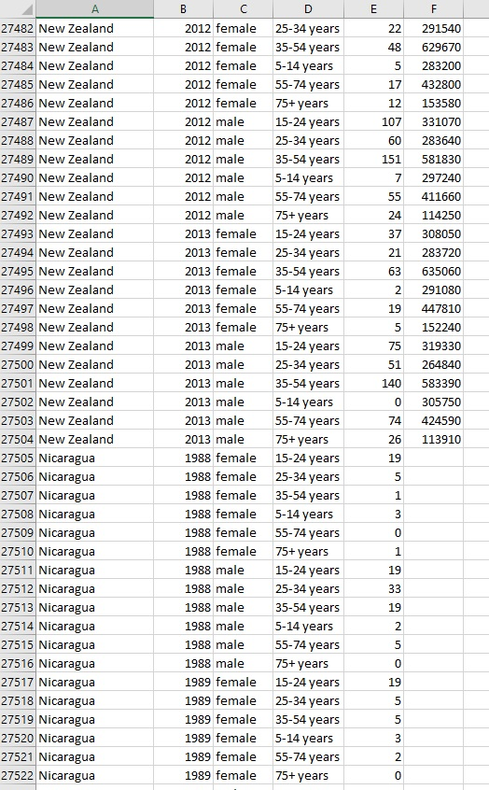
Data Source
Suicide figures from WHO (with population figures)
In some csv files, some of the population values were empty spaces (NULL values).

Slide 6
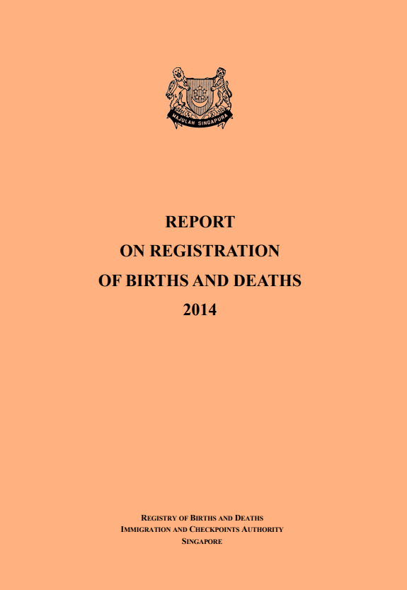
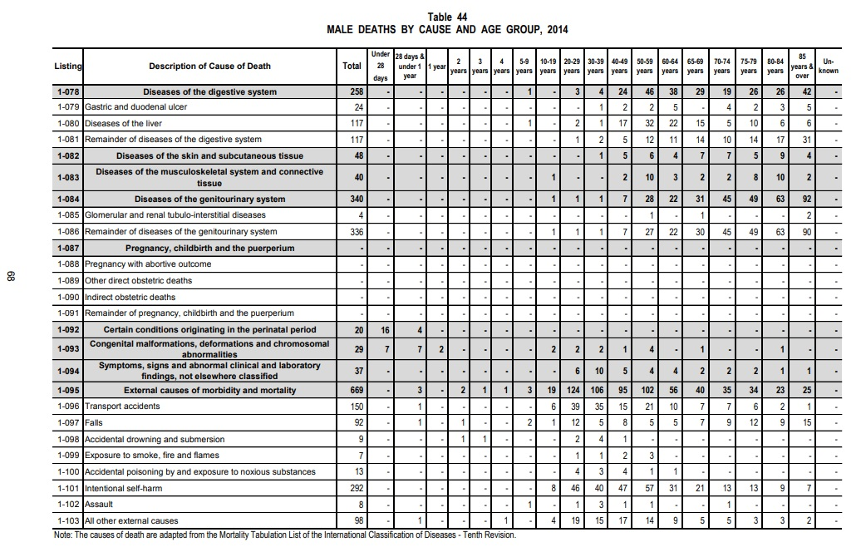
Data Source
Suicide figures from ICA Reports from 2014 to 2019

Slide 7
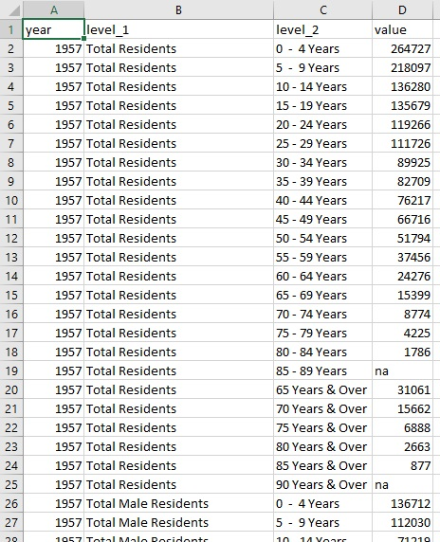
Data Source
Population figures from data.gov.sg
Duplicated values
NA values

Slide 8
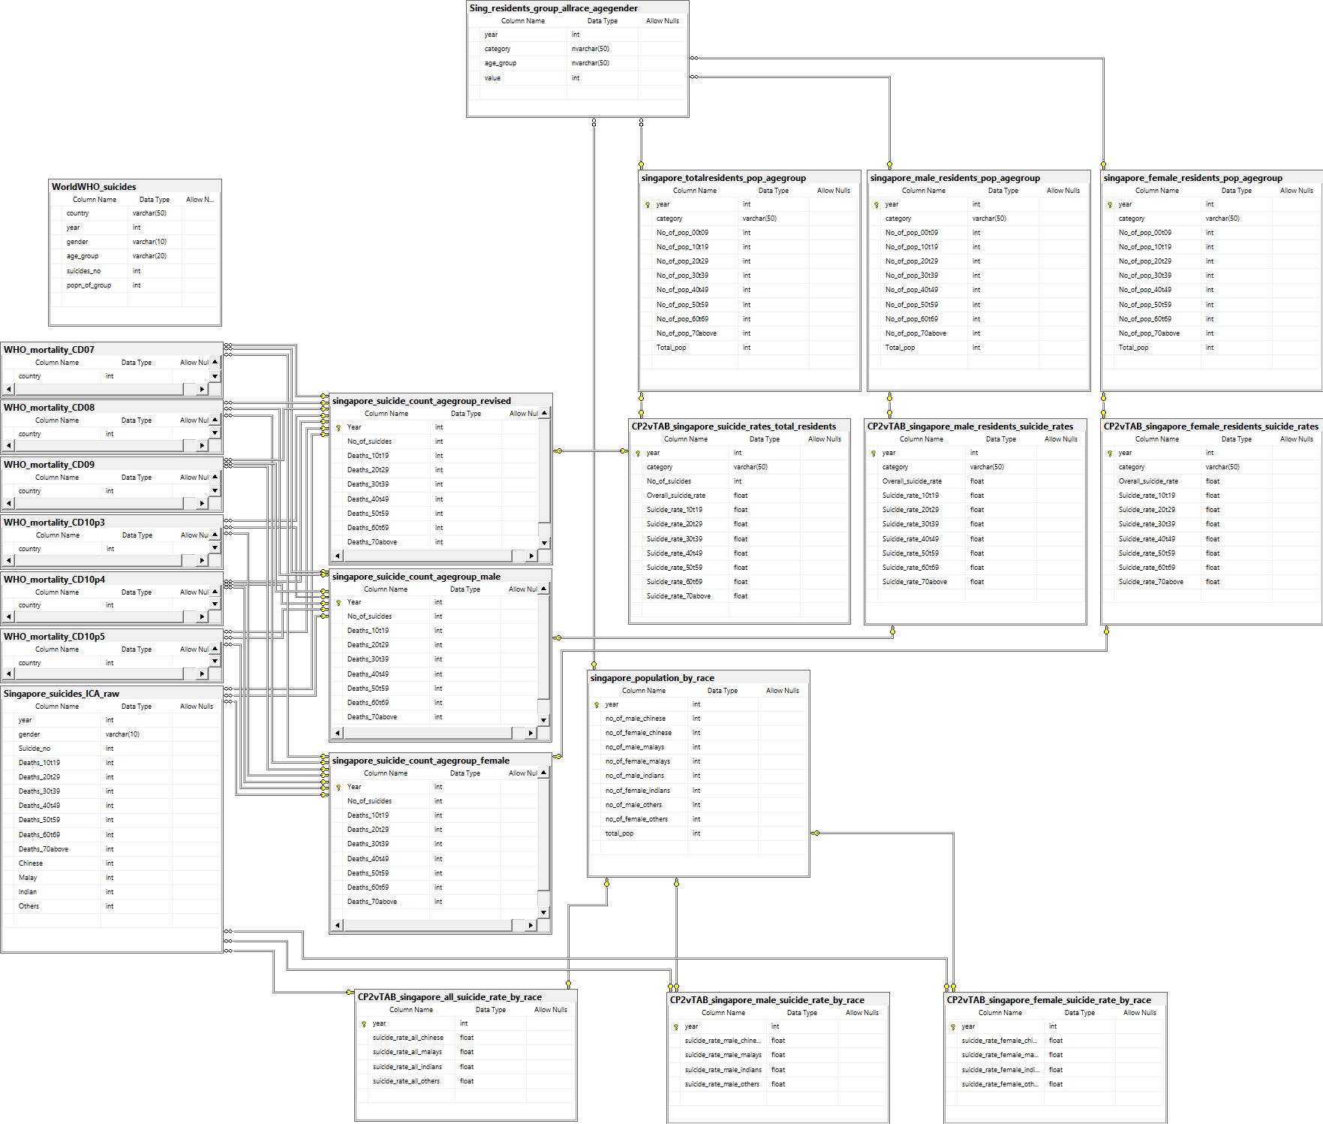
Data for Singapore population
Data Preparation
Population sorted by year and age groups
Data for suicide counts in other countries
Suicide counts sorted by year and age groups
Calculated suicide rates for different age groups
Data for suicide
counts
Population sorted by year and race
Calculated suicide rates for race

Slide 9
SCENARIO
The Singapore government regards every suicide as one death too many, and that every life matters.
Youth suicides is of particular concern – As of 2019, suicide is the leading cause of death in the 10-19 and 20-29 age group.
It is important to recognize the trends of suicide in Singapore in order to develop a comprehensive suicide prevention strategy.
Eg. Identify at-risk groups and recognizing the suicide risks each group face
The visualization of the collected data will allow us to recognize any trends if present.

Slide 10
Terminology
For meaningful comparisons of suicide data between countries or population groups, WHO uses a suicide rate defined as:
Suicide rate – Number of suicides per 100k of population at risk
For this project, the suicide data for Singapore in the last 20 years is presented as they will still be relevant in the current political socio-economic climate.

Slide 11
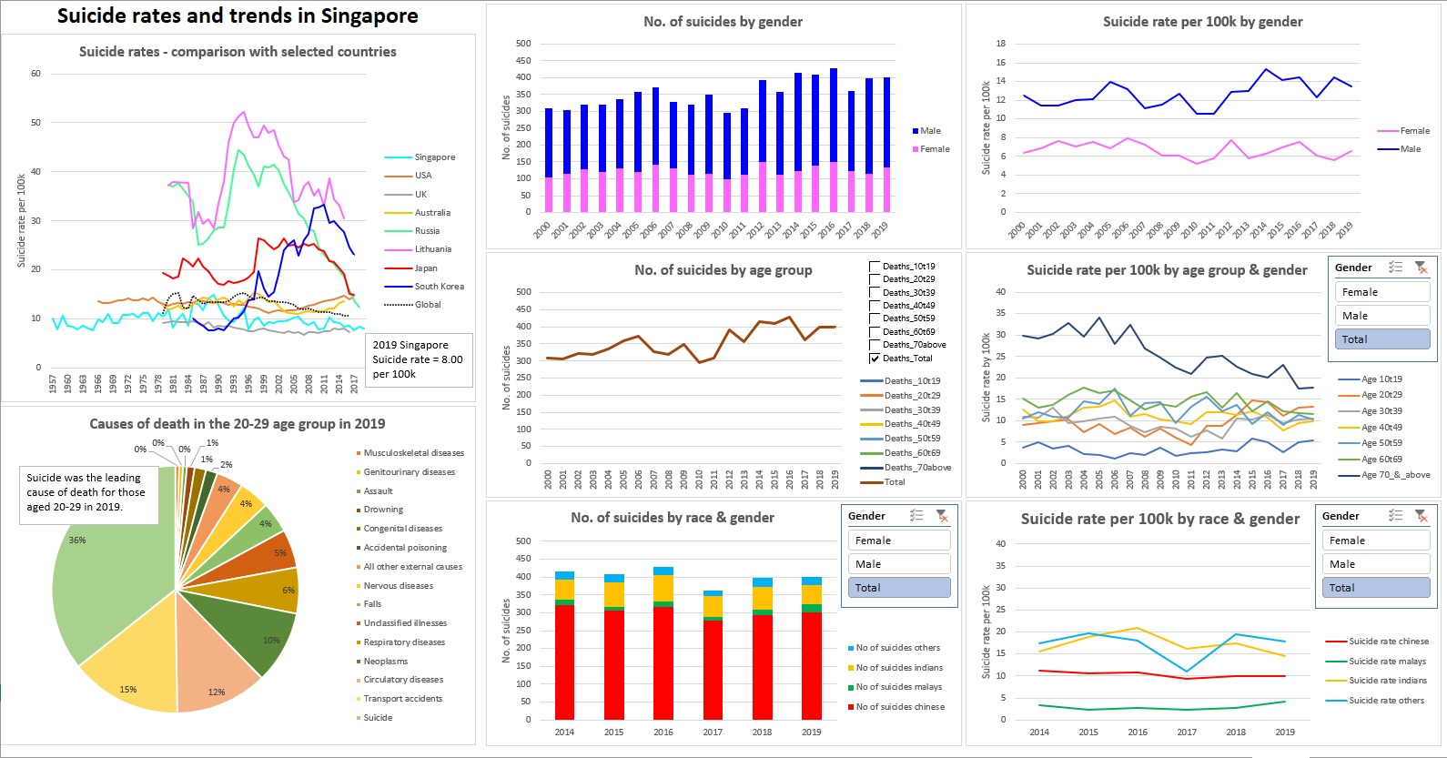

Slide 12
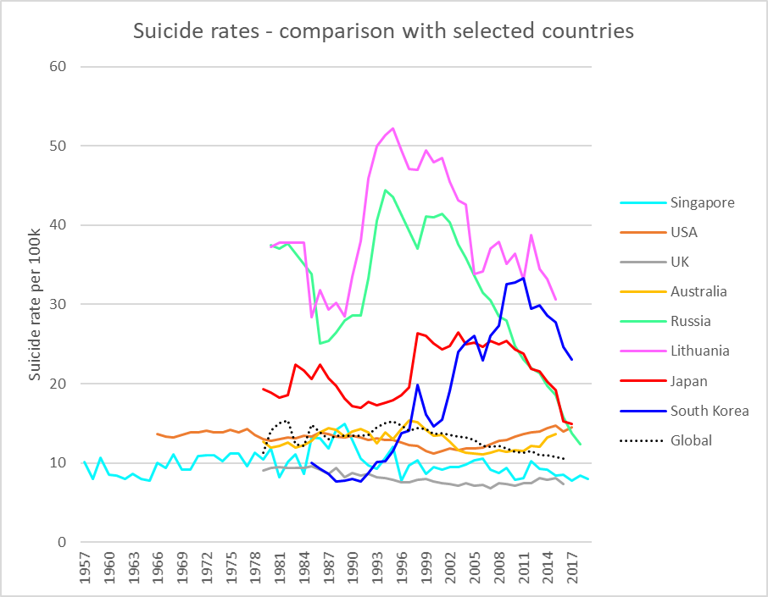
Insights and findings
Singapore’s overall suicide rate has been relatively stable at near or around 10 per 100k, with a peak during the 1980s. It is currently at about 8 per 100k.

Slide 13

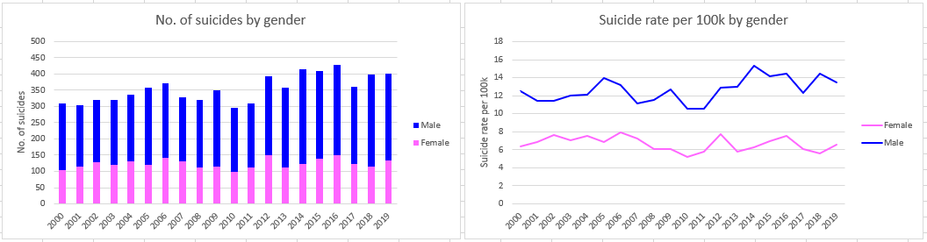
Insights and findings
The number of suicides in Singapore ranged around 300 to 400 in the last 20 years.
In general, more males committed suicide than females, with a ratio of about 2:1.

Slide 14
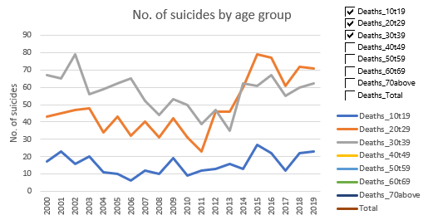
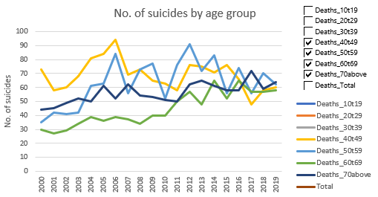
Insights and findings
Since 2010, apart from age group 40-49 which had a slight decline, the number of suicides in each age group has increased. The increase is more significant in the 10-19 and 20-29 age group.

Slide 15
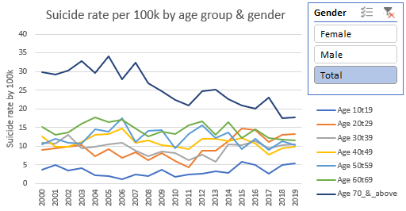
Insights and findings
A more meaningful metric for comparison between each age groups is the suicide rate – number of suicides per 100k persons.
The suicide rates increased for the 10-19, 20-29, 30-39 age groups, remained somewhat constant for the 40-49 and 50-59 groups, and have decreased for 60-69 and 70 and above groups.

Slide 16
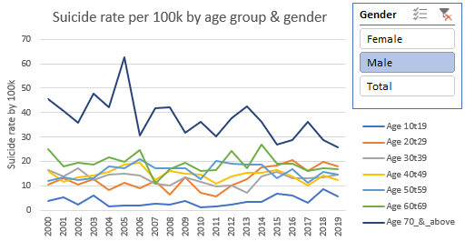
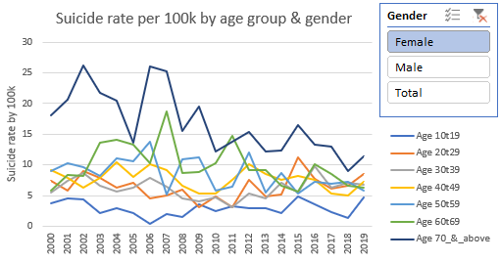
Insights and findings
Similar trend was observed in both males and females.
Data unequivocally shows an increase in suicide rates for youths, which is a serious cause for concern by the Singapore government.
Nevertheless, all age groups remains at-risk of suicide.

Slide 17
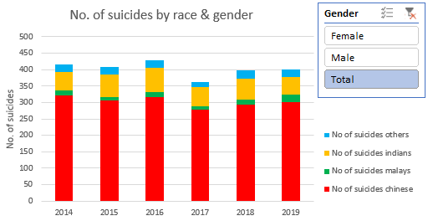
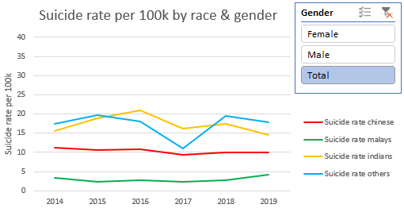
Insights and findings
Majority of those who committed suicide are Chinese, followed by Indians.
Malays have the least number of suicides.
Suicide rate comparison between races shows a slight decline for suicide rates for Chinese between 2014 and 2019.
Suicide rate for Indians and others fluctuated during the same period.
There is a slight increase in the suicide rate for Malays.

Slide 18


FURTHER COMMENT
Increase in youth suicides could be due to:
Stress from expectations in terms of academic and job achievement, leading to mental illness such as depression, anorexia or others.
Social media exposure in the forms of cyberbullying.
Likewise, different age groups also have their respective suicide risks:
Adults, who may be facing job/financial difficulties or relationship problems.
Seniors/elderly, who may have health issues or those who live alone.
Those with mental health conditions.

Slide 19

FURTHER COMMENT
The Singapore government adopts a multi-pronged approach in suicide prevention:
Building mental resilience
Early identification and encourage help seeking
Supporting at-risk groups
Providing funding for crisis support (eg. SOS).
Every life matters.
A whole of society approach is required to work
towards a zero-suicide Singapore.

Slide 20
REFERENCES
WHO mortality rates
https://www.who.int/data/data-collection-tools/who-mortality-database
World suicide rates with population data
https://www.kaggle.com/szamil/who-suicide-statistics
Singapore ICA Annual Reports
https://www.ica.gov.sg/news-and-publications/statistics
Singapore population data
https://data.gov.sg/dataset/resident-population-by-ethnicity-gender-and-age-group
Ministry of Health News Highlight
https://www.moh.gov.sg/news-highlights/details/multi-pronged-approach-to-suicide-prevention-and-intervention-in-singapore
SOS Samaritans of Singapore
https://www.sos.org.sg/

