Slide 1
Capstone Project 4
Machine Learning for Prediction of Prostate Cancer Diagnosis
Lin Yong Jia
2 July 2021

Slide 2
Agenda
Defining objective
General Process and Workflow
Data Analysis
Results

Slide 3
Objectives
A prostate cancer specialist is trying to determine whether machine learning can be used to quickly and accurately predict the diagnosis of patients.
Therefore more early attention can be paid to the patients predicted by ML to have prostate cancer.
In total, the data consist of 100 observations with 10 variables (9 numeric variables and one categorical variable)

Slide 4
General Process and Workflow
Task 1
Task 2
Task 3
Task 4
Problem
Definition
Data Analysis
Split Data (Train and Test)
Define Model
Train Model
Visualization
Model Evaluation
Results
Visualization of Confusion matrix
Model Prediction Comparison
Conclusions & Recommendations
Data Preparation
Feature Engineering
Data Cleaning
Data Transformation
Dataset
EDA

Slide 5
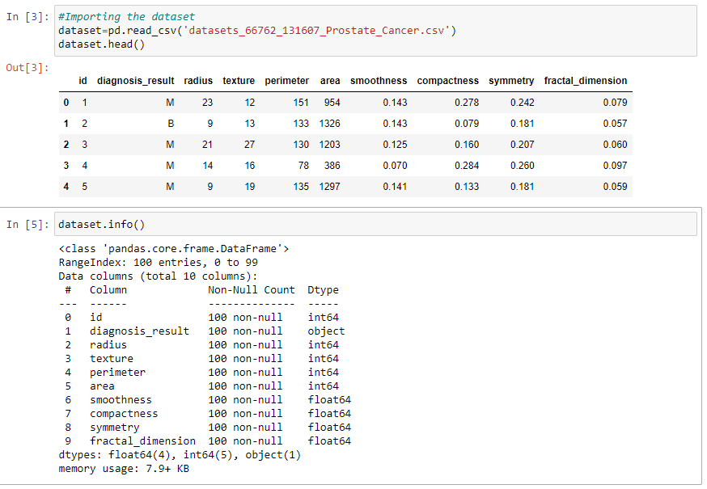
Task 1
Perform an Exploratory Data Analysis (EDA) to understand the dataset and gain insights.
Get a clear picture of the features and the relationships between them.
Identify any missing values, errors, outliers – no null values / outliers found.

Slide 6
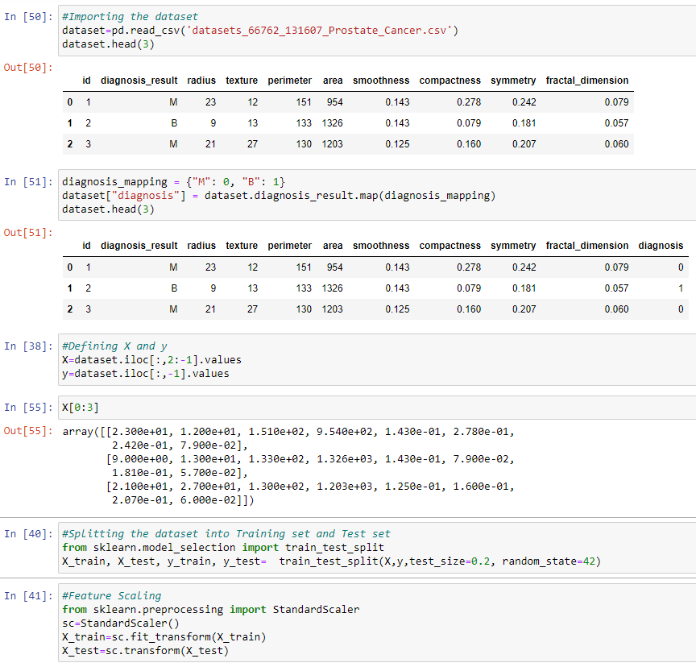
Task 2
Data preparation
Data transformation
Feature Engineering
Select required columns for X, y
Split the data into train set (80%) and test set (20%)
Scaling applied so that data is normalized.

Slide 7
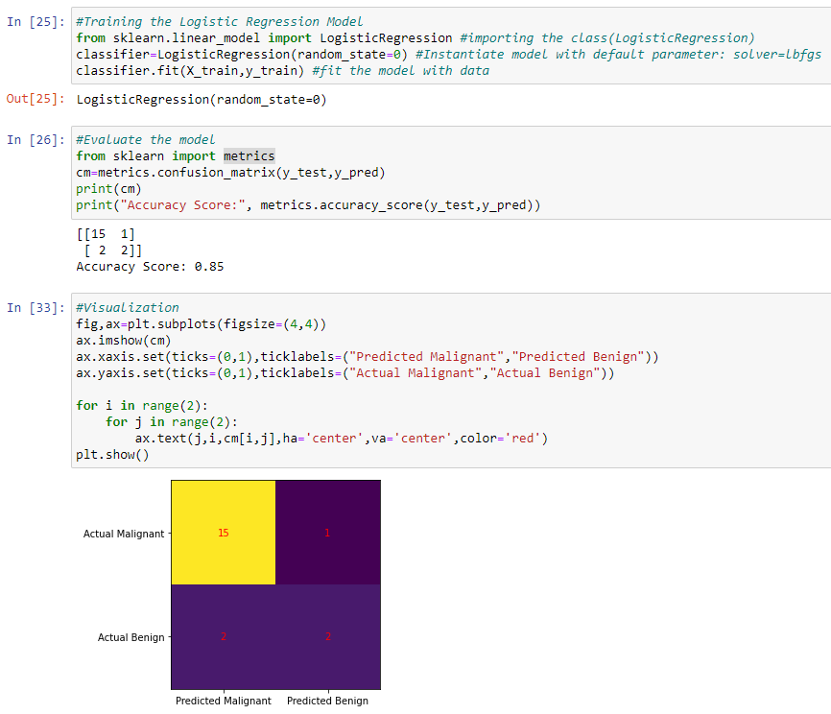
Task 3
Selected 5 models to test accuracy
Logistic Regression
Support Vector
K Nearest Neighbor
Random Forest
Naive Bayes
Performed the following for prediction analysis:
Confusion Matrix
Visualization
Classification Report
Cross Validation
Grid Search

Slide 8
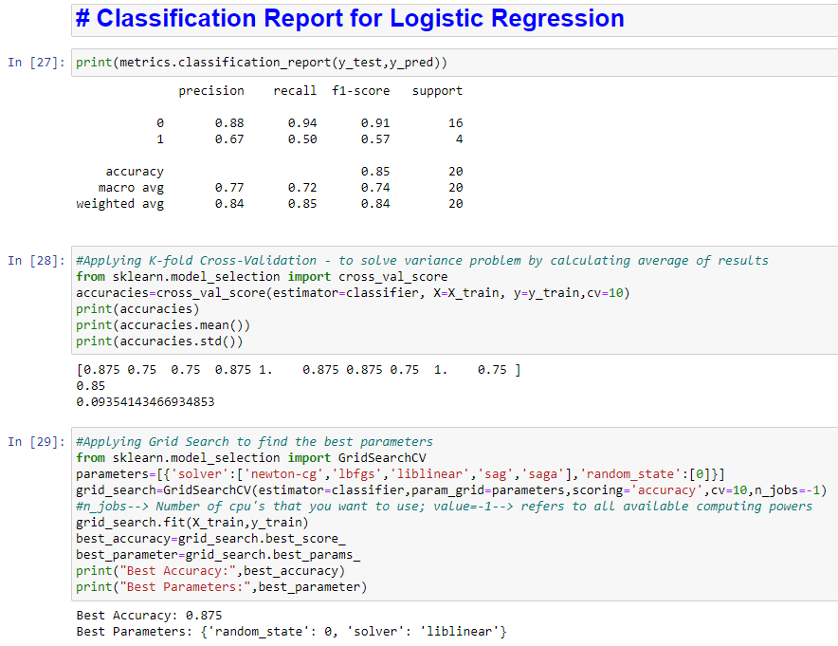
Test: Logistic Regression Model
Classification Report (default parameters: solver=‘lbfgs’) achieved accuracy of 85%
Applying K-fold cross validation, returned accuracy of 85% and standard deviation of 0.0935.
Grid search for best parameters (solver=‘liblinear’) achieved accuracy of 87.5%

Slide 9
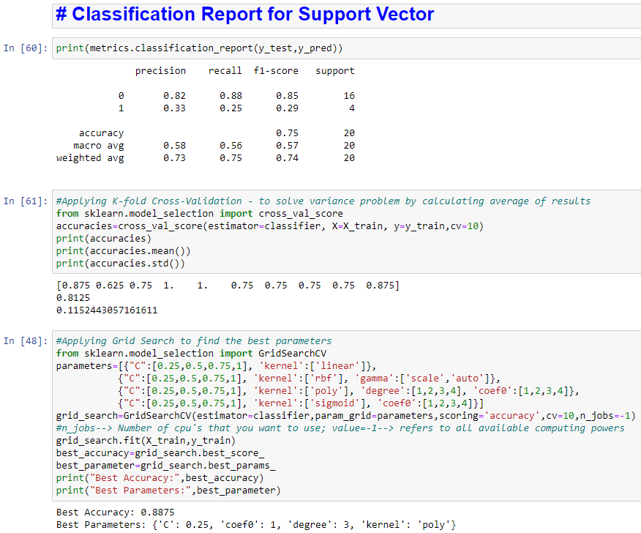
Test: Support Vector Model
Classification Report (default parameters: C=1, kernel=‘rbf’, gamma=‘scale’) achieved accuracy of 75%
Applying K-fold cross validation, returned accuracy of 81.25% and standard deviation of 0.115.
Grid search for best parameters (C=0.25, kernel=‘poly’, coef0=1, degree=3) achieved accuracy of 88.75%

Slide 10
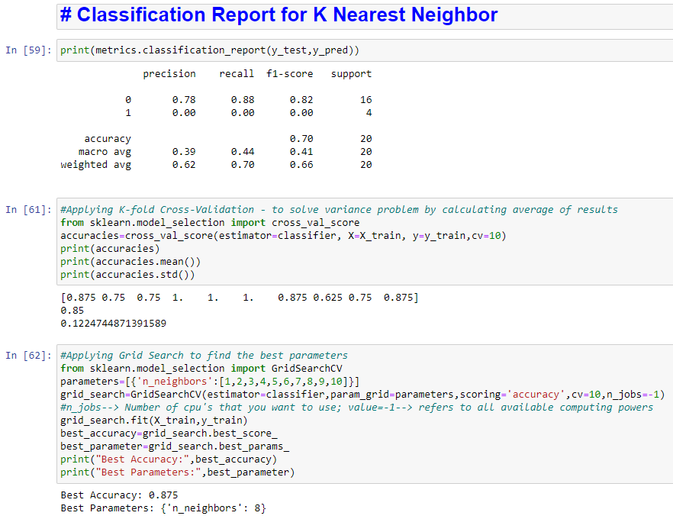
Test: K Nearest Neighbor Model
Classification Report (default parameters: n-neighbor=5) achieved accuracy of 70%
Applying K-fold cross validation, returned accuracy of 85% and standard deviation of 0.122.
Grid search for best parameters (n-neighbor=8) achieved accuracy of 87.5%

Slide 11
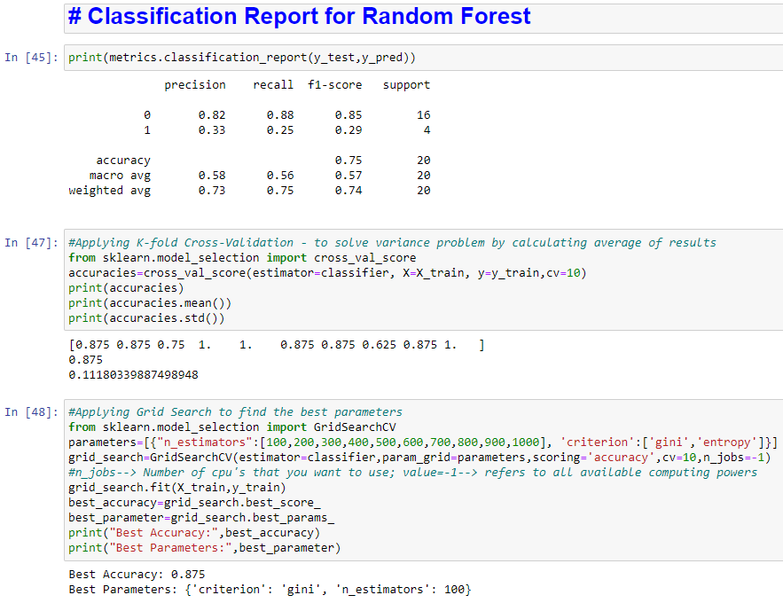
Test: Random Forest Model
Classification Report (default parameters: n-estimators=100, criterion=‘gini’) achieved accuracy of 75%
Applying K-fold cross validation, returned accuracy of 87.5% and standard deviation of 0.112.
Grid search for best parameters (n-estimators=100, criterion=‘gini’) achieved accuracy of 87.5%

Slide 12
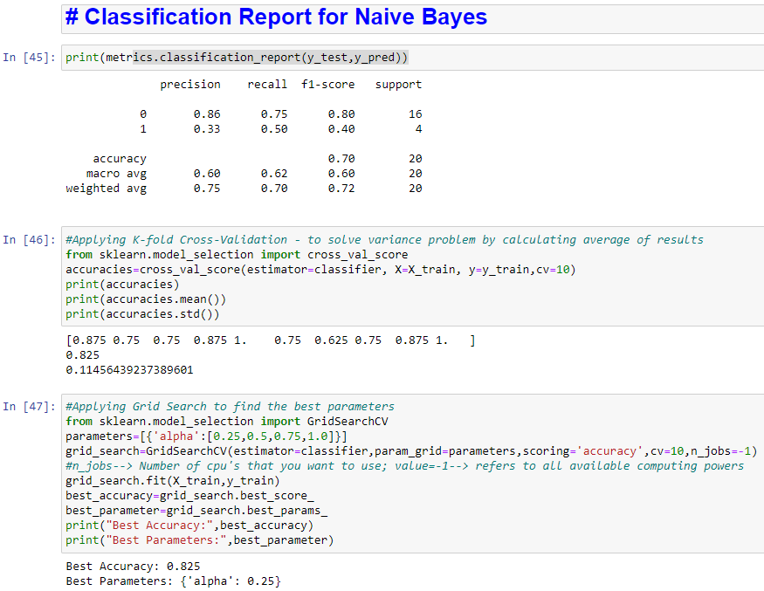
Test: Naïve Bayes Model
Classification Report (default parameters: alpha=1) achieved accuracy of 70%
Applying K-fold cross validation, returned accuracy of 82.5% and standard deviation of 0.115.
Grid search for best parameters (alpha=0.25) achieved accuracy of 82.5%

Slide 13
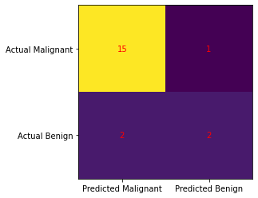
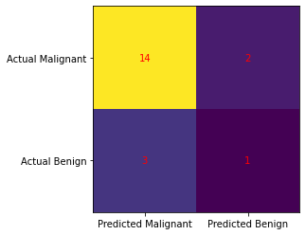
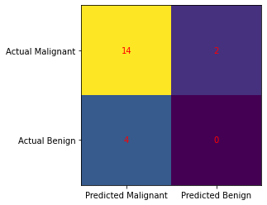
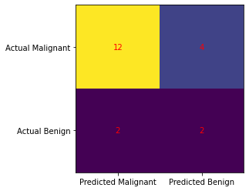
Logistic Regression
Support Vector
K Nearest Neighbor
Random Forest
Task 4
Naïve Bayes
Visualization of confusion matrix
For prediction of medical diagnosis, it is desired to have more True Positives and less False Negatives predictions.
In this context, logistic regression model is more favorable.

Slide 14
Task 4
Model Prediction Validation
Of the 5 models, logistic regression model had the highest test accuracy at 85%.
With cross-validation, and grid search for best parameters, overall accuracy of all models had improved to around 80-plus %
Based on the results, and given the context of making the best prediction, the logistic regression model provided the best prediction for diagnosis of prostate cancer.

Slide 15
Task 4
Conclusions
The prostate cancer specialist can use machine learning (in particular using logistic regression model) to reliably give an early preliminary diagnosis on whether a patient has prostate cancer, based on the measured variables collected during initial examination.
This will allow for early special attention to be paid to patients who are preliminary-identified to be positive for prostate cancer, instead of them having to pass time in uncertainty while undergoing biopsy and waiting for the results.
Again, there is a possibility that the ML prediction can be wrong, and a more definitive diagnosis will come from the biopsy results.
Recommendations
With a larger dataset the ML can potentially be trained to give more accurate predictions.

